Slide 1
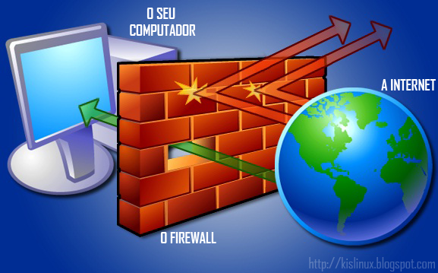
FIREWALL
-CREATED AND PRESENTED BY:
SHAWNI DUTTA
This Photo by Unknown author is licensed under CC BY-SA-NC.

Slide 2
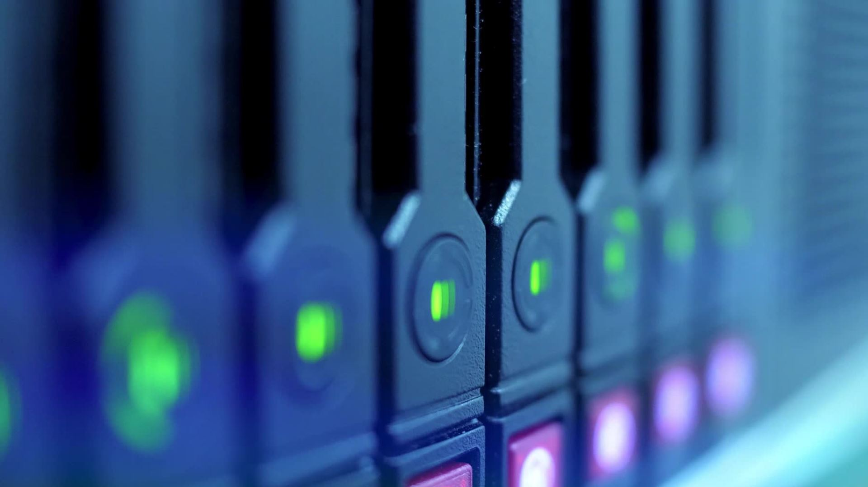
WHAT IS A FIREWALL?
A firewall is a device (usually a router or a computer) installed between the internal network of an organization and the rest of the Internet.
It is designed to forward some packets and filter (not forward) others.
It monitors all incoming and outgoing traffic and based on a defined set of security rules it accepts, rejects or drops that specific traffic.
Accept : allow the traffic
Reject : block the traffic but reply with an “unreachable error”
Drop : block the traffic with no reply

Slide 3
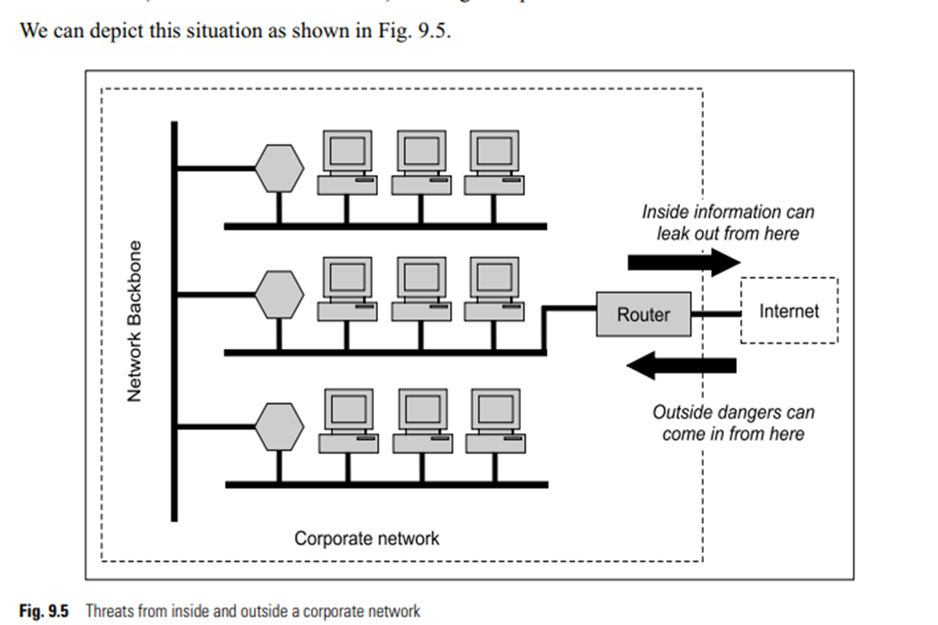
WHY FIREWALL?
At a broad level, there are two kinds of attacks:
Most corporations have large amounts of valuable and confidential data in their networks. Leaking of this critical information to competitors can be a great setback.
Apart from the danger of the insider information leaking out, there is a great danger of the outside elements (such as viruses and worms) entering a corporate network to create havoc.
As a result of these dangers, we must have mechanisms which can ensure that the inside information remains inside and also prevent the outsider attackers from entering inside a corporate network. As we know, encryption of information (if implemented properly) renders its transmission to the outside world redundant. That is, even if confidential information flows out of a corporate network, if it is in encrypted form, outsiders cannot make any sense of it. However, encryption does not work in the other direction. Outside attackers can still try to break inside a corporate network. Consequently, better schemes are desired to achieve protection from outside attacks. This is where a firewall comes into picture.

Slide 4
CHARACTERISTICS OF A GOOD FIREWALL
All traffic from inside to outside and vice versa, must pass through the firewall. To achieve this, all the access to the local network must first be physically blocked and access only via the firewall should be permitted.
Only the traffic authorized as per the local security policy should be allowed to pass through.
The firewall itself must be strong enough, so as to render attacks on it useless.

Slide 5
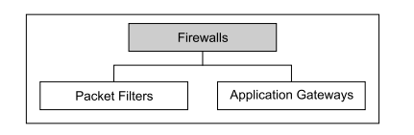
Types of Firewalls

Slide 6
PACKET FILTER
As the name suggests, a packet filter applies a set of rules to each packet and based on the outcome, decides to either forward or discard the packet. It is also called as screening router or screening filter.
It can forward or block packets based on the information in the network layer and transport layer headers: source and destination IP addresses, source and destination port addresses, and type of protocol (TCP or UDP).
A packet-filter firewall is a router that uses a filtering table to decide which packets must be discarded.
A packet filter firewall filters at the network or transport layer.

Slide 7
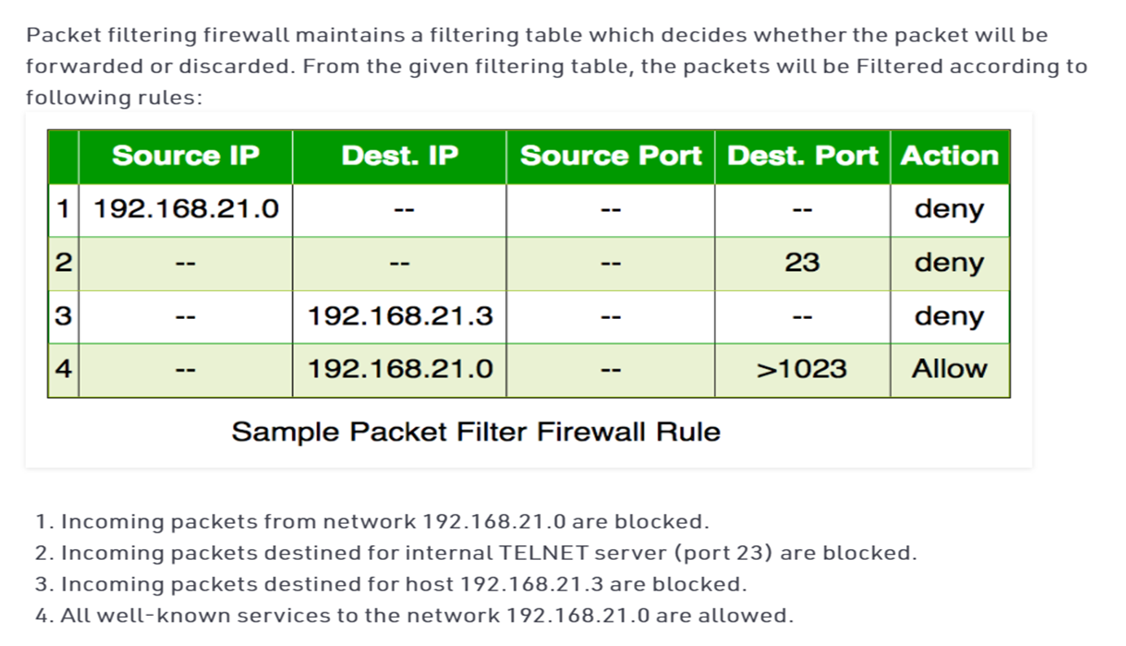
PACKET FILTERING FIREWALL

Slide 8
What does stateful firewall mean?
A stateful firewall is a firewall that monitors the full state of active network connections.
This means that stateful firewalls are constantly analyzing the complete context of traffic and data packets, seeking entry to a network rather than discrete traffic and data packets in isolation.
Once a certain kind of traffic has been approved by a stateful firewall, it is added to a state table and can travel more freely into the protected network.
Traffic and data packets that don’t successfully complete the required handshake will be blocked.
By taking multiple factors into consideration before adding a type of connection to an approved list, such as TCP stages, stateful firewalls are able to observe traffic streams in their entirety.

Slide 9
STATEFUL VS STATELESS FIREWALL
Stateless firewalls are designed to protect networks based on static information such as source and destination. Whereas stateful firewalls filter packets based on the full context of a given network connection, stateless firewalls filter packets based on the individual packets themselves.
To do so, stateless firewalls use packet filtering rules that specify certain match conditions. If match conditions are met, stateless firewall filters will then use a set of preapproved actions to guide packets into the network. If match conditions are not met, unidentified or malicious packets will be blocked.

Slide 10
PACKET FILTER
The chief advantage of the packet filter is its simplicity. The users need not be aware of a packet filter at all.
Packet filters are very fast in their operating speed.
However, the two disadvantages of a packet filter are-
the difficulties in setting up the packet filter rules correctly and
lack of support for authentication.

Slide 11
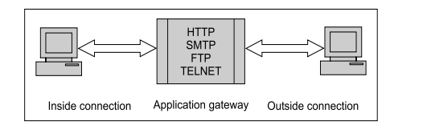
Application Gateways
An application gateway is also called a proxy server.
This is because it acts like a proxy (i.e. deputy or substitute) and decides about the flow of application level traffic.

Slide 12
WORKING OF APPLICATION GATEWAY
An internal user contacts the application gateway using a TCP/IP application, such as HTTP or TELNET.
The application gateway asks the user about the remote host with which the user wants to set up a connection for actual communication (i.e. its domain name or IP address, etc.). The application gateway also asks for the user id and the password required to access the services of the application gateway.
The user provides this information to the application gateway.
The application gateway now accesses the remote host on behalf of the user and passes the packets of the user to the remote host.
From here onwards, the application gateway acts like a proxy of the actual end user and delivers packets from the user to the remote host and vice versa.

Slide 13
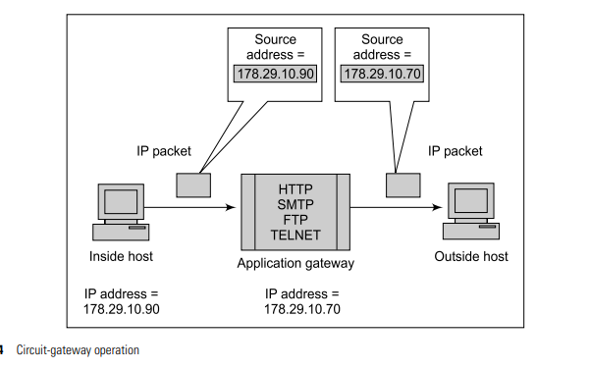
Circuit gateway
There is a variation of the application gateway, called as circuit gateway, which performs some additional functions as compared to those performed by an application gateway.
A circuit gateway, in fact, creates a new connection between itself and the remote host. The user is not aware of this and thinks that there is a direct connection between itself and the remote host. Also, the circuit gateway changes the source IP address in the packets from the end user’s IP address to its own.
This way, the IP addresses of the computers of the internal users are hidden from the outside world. Of course, both the connections are shown with a single arrow to stress on the concept, in reality, both the connections are two-ways.

Slide 14
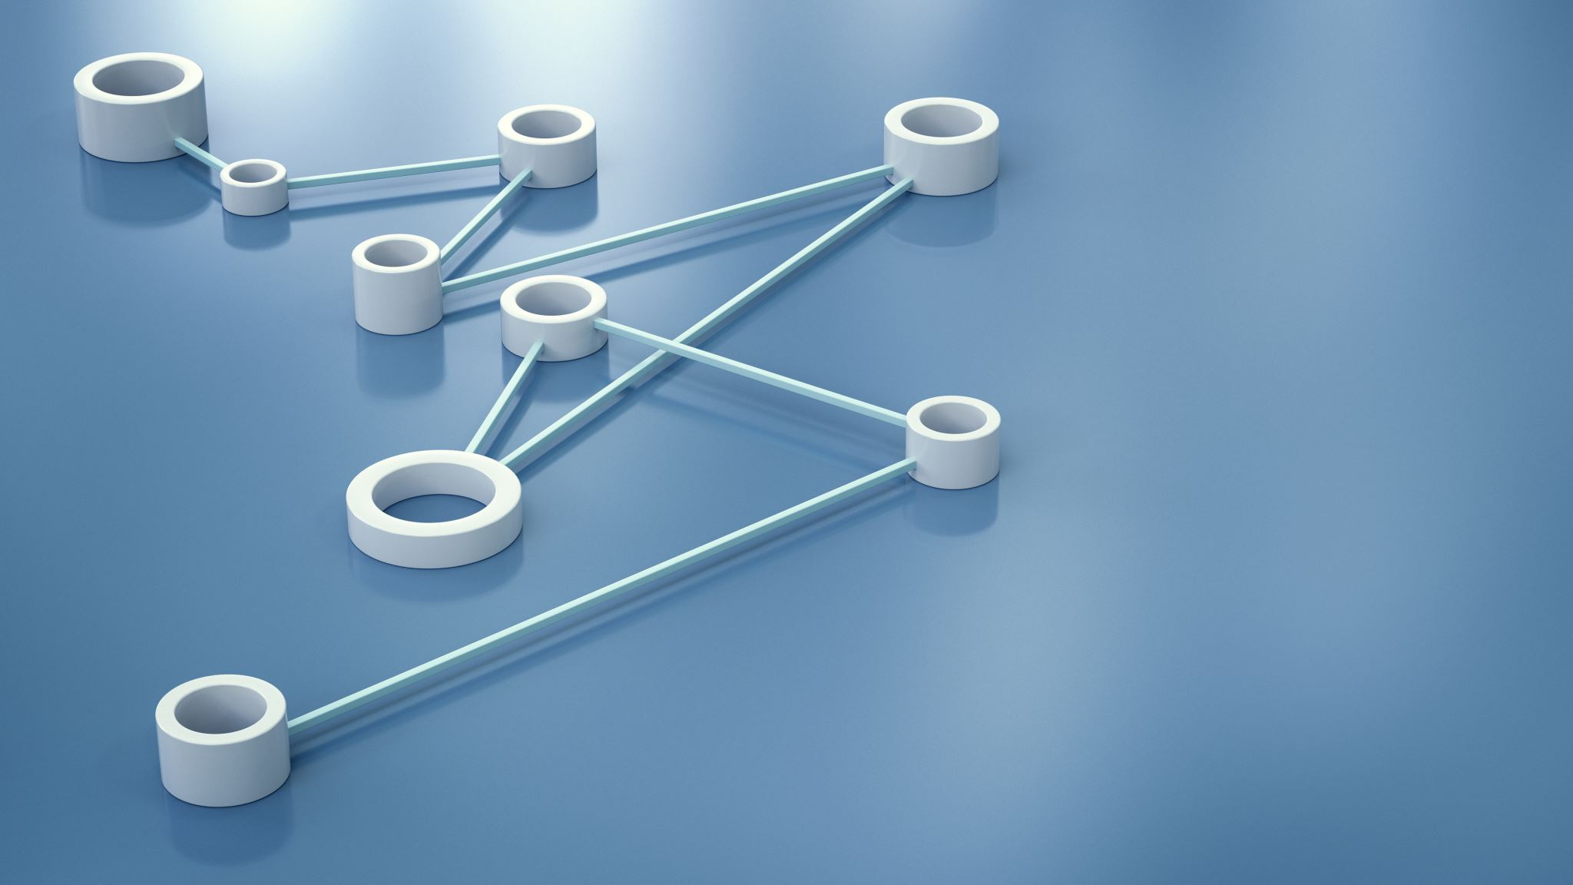
LIMITATION OF APPLICATION GATEWAY
The disadvantage of application gateways is the overhead in terms of connections.
As we noticed, there are actually two sets of connections now:
one between the end user and the application gateway and
another between the application gateway and the remote host.
The application gateway has to manage these two sets of connections and the traffic going between them.

Slide 15
WHICH ONE IS MORE SECURE ? PACKET FILTER OR APPLICATION GATEWAY?
Application gateways are generally more secure than packet filters, because rather than examining every packet against a number of rules, here we simply detect whether a user is allowed to work with a TCP/IP application or not.

Slide 16
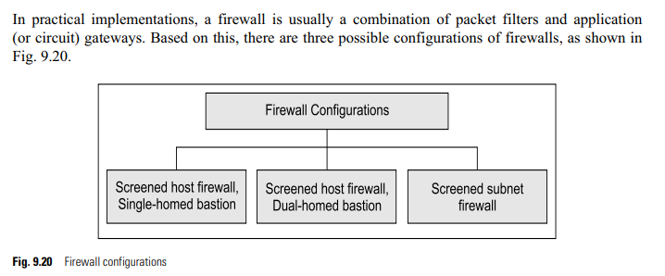
Firewall Configurations

Slide 17
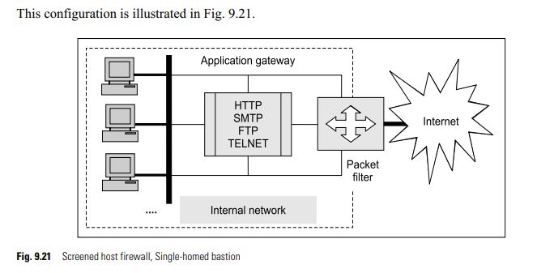
Screened Host Firewall, Single-Homed Bastion
In the Screened host firewall, Single-homed bastion configuration, a firewall set up consists of two parts: a packet-filtering router and an application gateway. Their purposes are as follows.
The packet filter ensures that the incoming traffic (i.e. from the Internet to the corporate network) is allowed only if it is destined for the application gateway, by examining the destination address field of every incoming IP packet. Similarly, it also ensures that the outgoing traffic (i.e. from the corporate network to the Internet) is allowed only if it is originating from the application gateway, by examining the source address field of every outgoing IP packet.
The application gateway performs authentication and proxy functions.

Slide 18
Screened Host Firewall, Single-Homed Bastion
This configuration increases the security of the network by performing checks at both packet and application levels.
This also gives more flexibility to the network administrators to define more granular security policies.
However, as we can see, one big disadvantage here is that the internal users are connected to the application gateway, as well as to the packet filter.
Therefore, if the packet filter is somehow successfully attacked and its security compromised, then the whole internal network is exposed to the attacker.

Slide 19
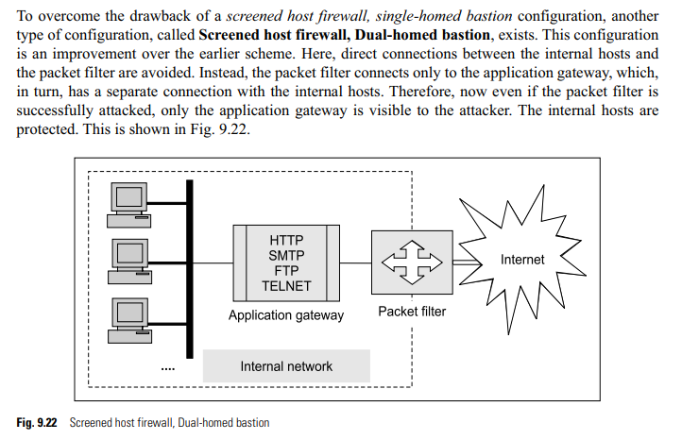
Screened Host Firewall, Dual-Homed Bastion

Slide 20
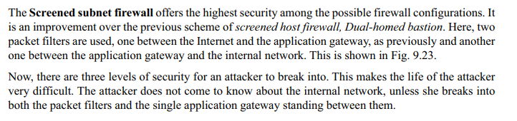
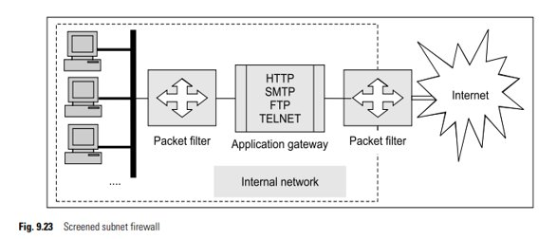
Screened Subnet Firewall

Slide 21
Personal Firewall
A personal firewall controls the traffic between a personal computer or workstation on one side and the Internet or enterprise network on the other side. Personal firewall functionality can be used in the home environment and on corporate intranets.
Typically, the personal firewall is a software module on the personal computer. In a home environment with multiple computers connected to the Internet, firewall functionality can also be housed in a router that connects all of the home computers to a DSL, cable modem, or other Internet interface.

Slide 22
Demilitarized Zone (DMZ) Networks
The concept of a Demilitarized Zone (DMZ) networks is quite popular in firewall architectures.
Firewalls can be arranged to form a DMZ. DMZ is required only if an organization has servers that it needs to make available to the outside world (e.g. Web servers or FTP servers).
For this, a firewall has at least three network interfaces. One interface connects to the internal private network; the second connects to the external public network (i.e. the Internet) and the third connects to the public servers (which form the DMZ network).

Slide 23
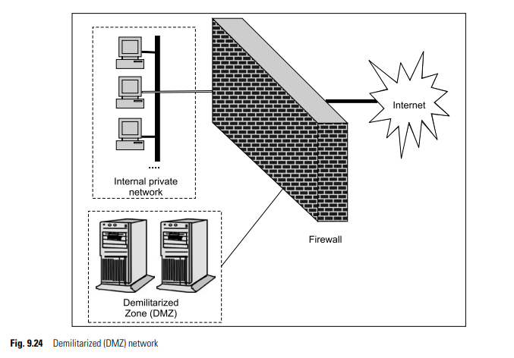
Demilitarized Zone (DMZ) Networks
The chief advantage of such a scheme is that the access to any service on the DMZ can be restricted. For instance, if the Web server is the only required service, we can limit the traffic in/out of the DMZ network to the HTTP and HTTPS protocols (i.e. ports 80 and 443, respectively). All other traffic can be filtered. More significantly, the internal private network is no way directly connected to the DMZ. So, even if an attacker can somehow manage to hack into the DMZ, the internal private network is safe and out of the reach of the attacker.

Slide 24
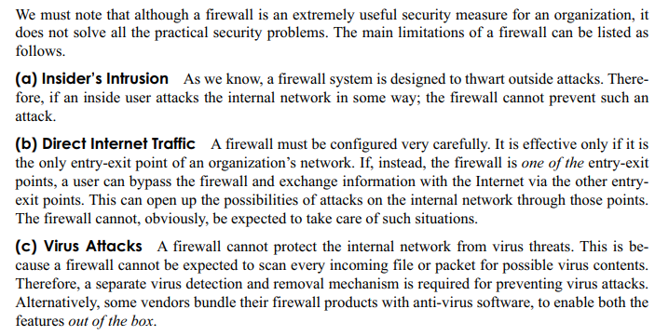
LIMITATIONS OF A FIREWALL

