Slide 1
Digital Signal Processing: 1
Dr. Amlan Chakrabarti

Slide 2
WHAT IS DSP ?
DSP OR DIGITAL SIGNAL PROCESSING IS THE PROCESSING OF THE SIGNALS DIGITALLY OR BY DIGITAL MEANS.
THE SIGNALS ARE ANALOG (CONTINUOUS) SUCH AS HUMAN VOICE, ELECTRICAL SIGNAL(VOLTAGE OR CURRENT), RADIO WAVE, OPTICAL, AUDIO, AND SO ON WHICH CONTAINS A STREAM OF INFORMATION OR DATA.

Slide 3
Analog vs. Digital
i) Signal
Analog : voice, audio, video, ….
Digital : digitized analog signal, data
ii) Processing
Analog : passive/active filtering
AM, FM, PM modulation
Fourier, Laplace transform
Digital : FIR/IIR filtering
AM, windowing
Discrete Fourier transform, z-transform

Slide 4
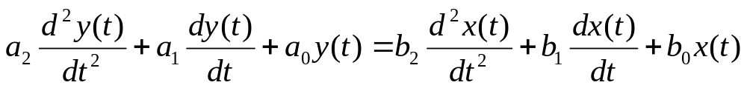
iii) System
Analog : R, L, C, Op-amp, switch, …
differential equation
Digital : adder, multiplier, memory, …
difference equation
iv) Theory
Circuit theory
DSP theory

Slide 5
Difference of Analog & Digital Signal
Analog signal must be converted into Digital form (Discrete) before DSP techniques can be applied. The analog signal is basically denoted as x[t] or x_{a}[t] because it varied by time. The analog signal comes in form of sinusoid (sine or cosine wave).
The Analog signal is digitized by using Integrated Electronic Circuit device called an Analog-to-Digital Converter (ADC). The output of ADC will be in the form of binary number that represents the analog signal such as electrical voltage.

Slide 6
Why Digital?
- Environmental change!
Global communication - noise immunity
Multimedia communication - integration
Networking - encryption, packetizing
Wireless, mobile - encryption, compression

Slide 7
The analog signal are always come with noise. Thus the noise filtering is needed before the signal goes to ADC. The filtering can be done by using DSP techniques.
The special purpose microprocessors are designed to carry out application of DSP. It is named as Digital Signal Processors (DSPs) and used in real time application.

Slide 8
DIGITAL SIGNAL PROCESSING
DSPs are programmable devices and capable of carrying out millions of instruction per second.
It is vital to know how Digital Signal Processing work before we go to DSPs (The diagram of the process is shown in Figure 1 and 2).
The signals and systems must come together. The systems are needed to operate the signals. For example, we need to use Thermometer to measure Temperature, Microphone to carry out analog signal (human voice) and convert it to electrical signal, Charge-Couple Device (CCD) used in in Camera or Digital Camera to convert image to picture and so on. In general, the system is characterized by the type of operation that it performs on the signal.

Slide 9
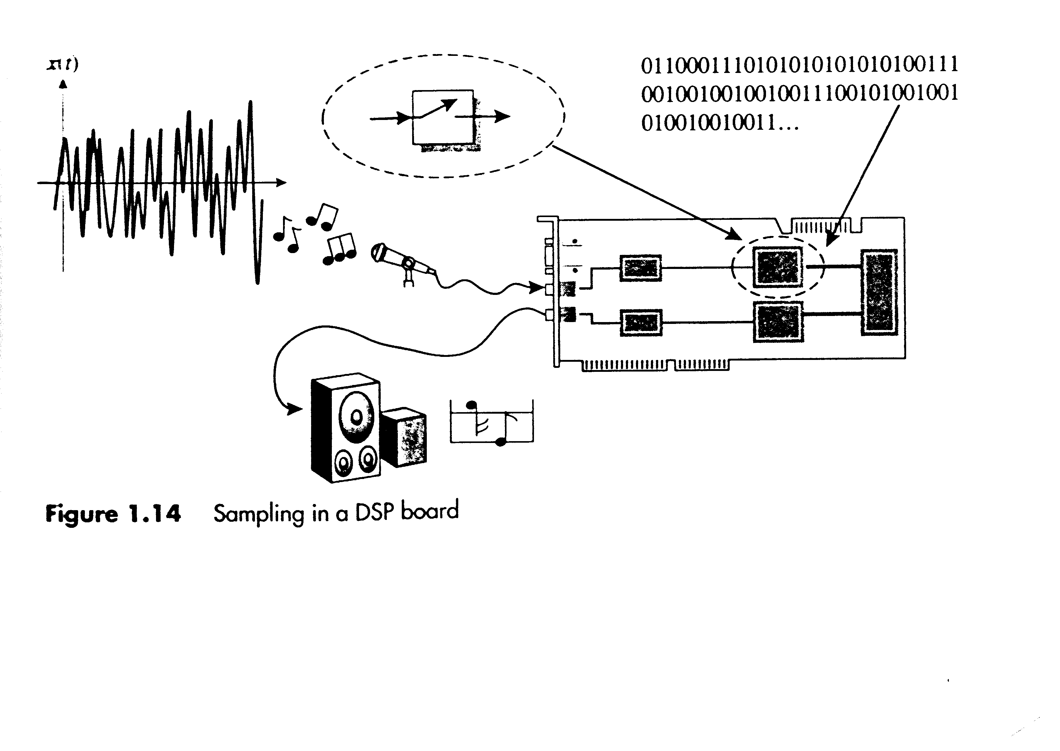
Figure 1 : Digitized process of signal

Slide 10
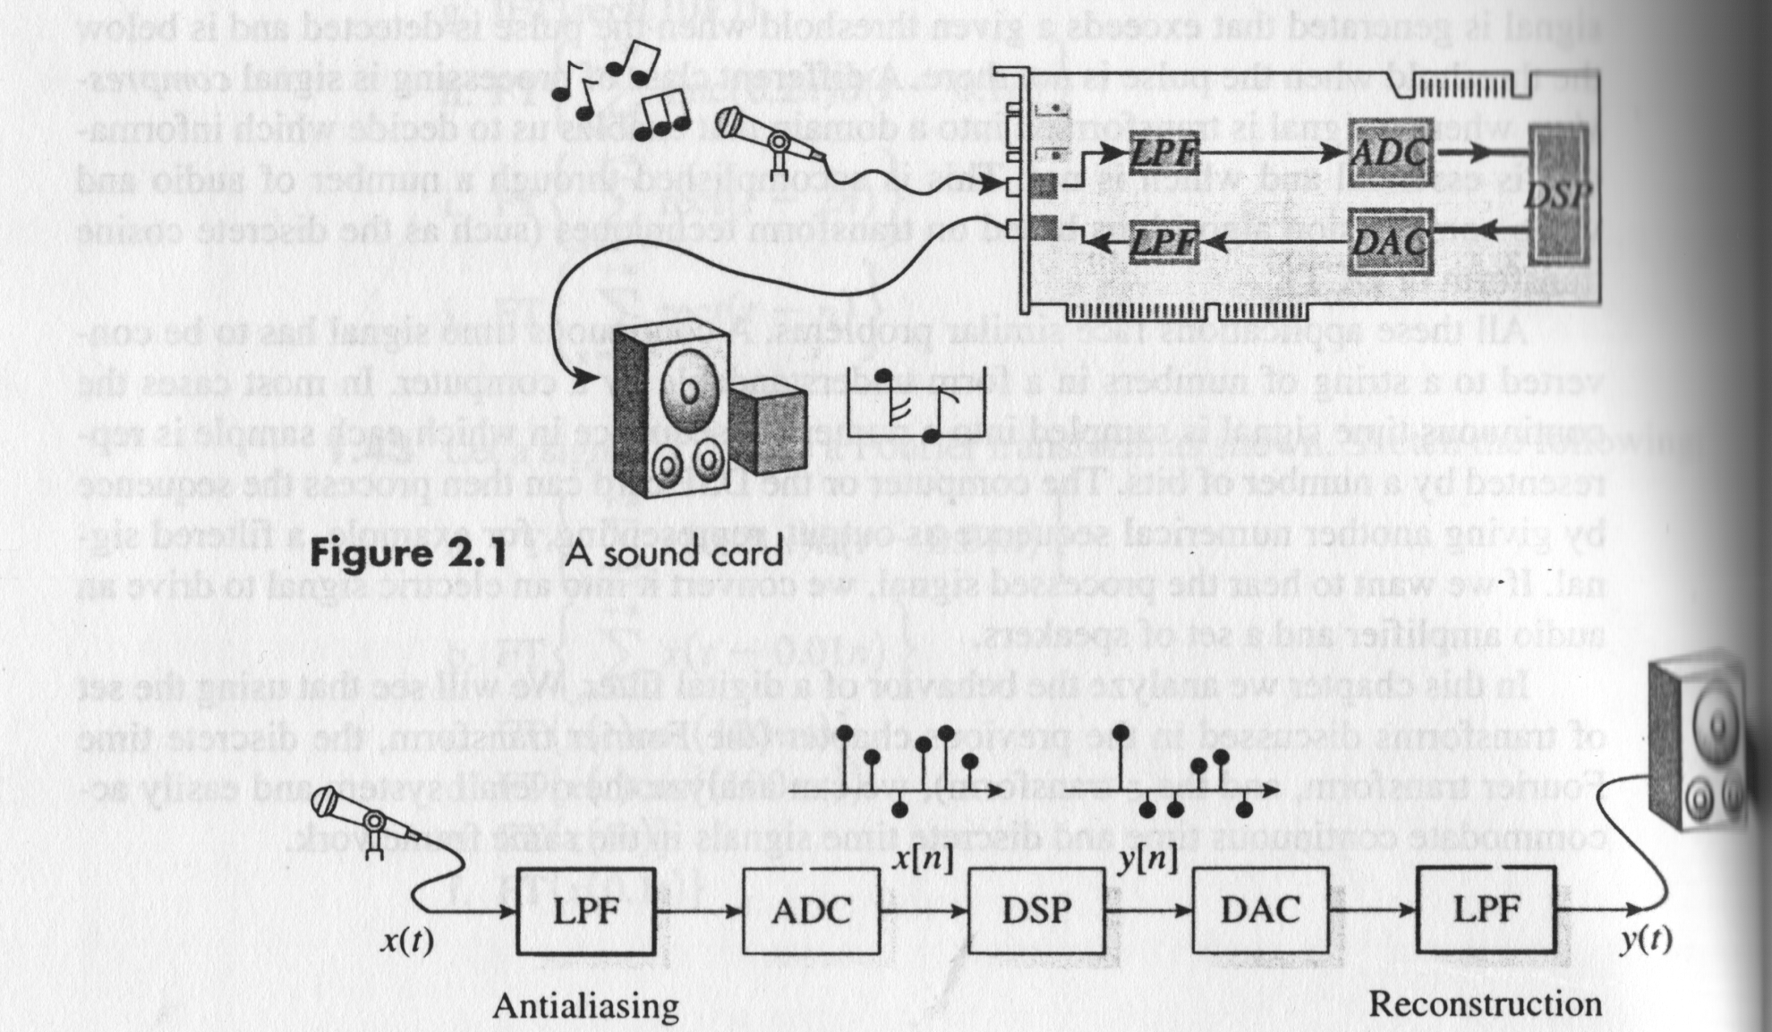
Figure 2 : Complete Process of Digital Signal

Slide 11
From the diagram, it can be seen that ADC and DAC are 2 vital devices used in signal processing to convert the signal from analog to discrete (digital) and vice versa.
ADC is basically consists of Sampler, Quantizer and Coder. All this elements are built up by CMOS Switched-Capacitor (for Sampling), Op-Amp (Signal Amplification) & Comparator (Quantizer).

Slide 12
Quantization is the conversion of discrete-time continuous-valued to discrete-time discrete- valued (digital) signal. The difference of this is called Quantization Error.
The coder in ADC will convert the output of the Quantizer to b-bit binary sequence that can be read by DSPs (Digital Signal Processors).
The DAC, will perform a reverse operation of ADC in order to generate back analog signal.

Slide 13
APPLICATION AREAS
DSP CAN BE APPLIED IN THE FOLLOWING FIELDS :
=> COMMUNICATION SYSTEMS
(MOBILE PHONE, SATELLITE, RADAR, SONAR,
INTERNET)
=> ENTERTAINMENT ELECTRONICS
(RADIO, TV, Hi-Fi, CD/VCD/DVD PLAYER,MP3),
=> MULTIMEDIA
(ACOUSTICS, IMAGE, SPEECH RECOGNIZATION &
VIDEO CODING, DIGITAL CAMERA),

Slide 14
=> MEDICAL INSTRUMENT
(ECG – Electrocardiogram – provides
information about the condition of patient’s heart),
=> GEOPHYSICS (Seismology)
(Apparatus used to measure earth movement)
=> INSTRUMENTATION
(ELECTRONIC TESTER Such as Digital Multimeter,
Oscilloscope)
=> IC TECHNOLOGY
=> DATA COMPRESSION

Slide 15
Discrete-Time Signals and Systems
Introduction

Slide 16
The Taxonomy of Signals
Signal: A function that conveys information
Amplitude
Continuous
Discrete
Continuous
analog signals
continuous-time
signals
Time
discrete-time
signals
digital signals
Discrete

Slide 17
Signal Process Systems
Facilitate the extraction of desired information e.g.,
Filters
Parameter estimation
Signal
Processing
System
signal
output

Slide 18
Signal Process Systems
continuous-time signal
analog
system
continuous-time signal
signal
output
discrete-time signal
discrete-
time
system
discrete-time signal
signal
output
digital signal
digital
system
digital signal
signal
output

Slide 19
Signal Process Systems
A important class of systems
Linear Shift-Invariant Systems.
In particular, we’ll discuss
Linear Shift-Invariant Discrete-Time Systems.

Slide 20
Discrete-Time Signals and Systems
Discrete-Time Signals---Sequences

Slide 21
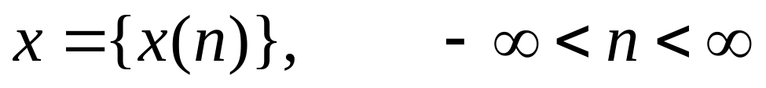
Representation by a Sequence
Discrete-time system theory
  Concerned with processing signals that are represented by sequences.
x(n)
3
4
5
6
7
n
-8
-7
-6
-5
-4
-3
-2
-1
1
2
8
9
10

Slide 22
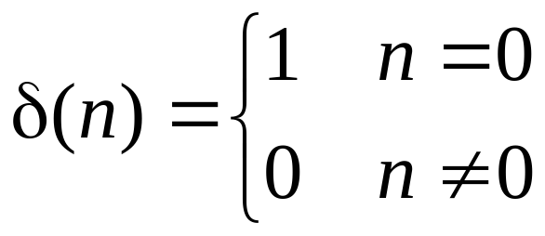
Important Sequences
Unit-sample sequence δ(n)
Sometime call δ(n)
  a discrete-time impulse; or
  an impulse
δ(n)
n
-8
-7
-6
-5
-4
-3
-2
-1
1
2
3
4
5
6
7
8
9
10

Slide 23
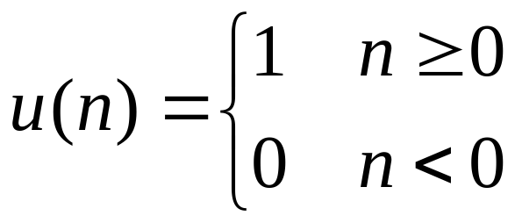
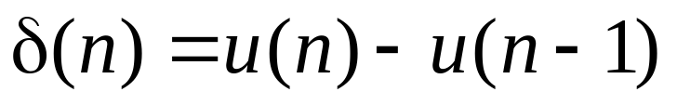
Important Sequences
Unit-step sequence u(n)
Fact:
u(n)
n
-8
-7
-6
-5
-4
-3
-2
-1
1
2
3
4
5
6
7
8
9
10

Slide 24
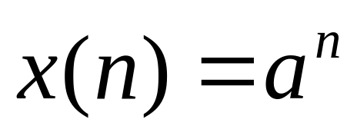
Important Sequences
Real exponential sequence
x(n)
. . .
. . .
n
-8
-7
-6
-5
-4
-3
-2
-1
1
2
3
4
5
6
7
8
9
10

Slide 25
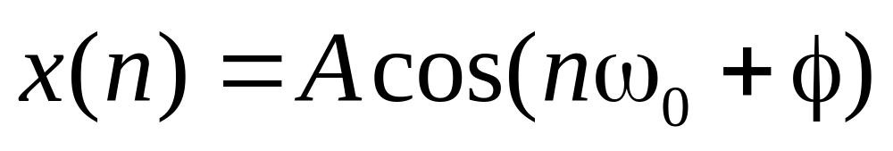
Important Sequences
Sinusoidal sequence
x(n)
n

Slide 26
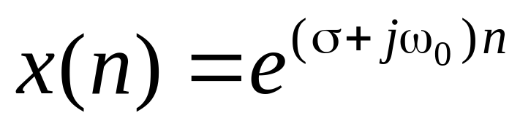
Important Sequences
Complex exponential sequence

Slide 27
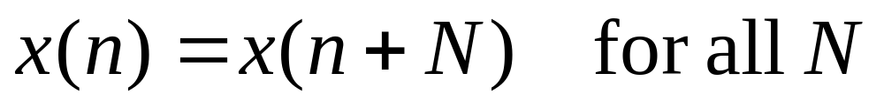
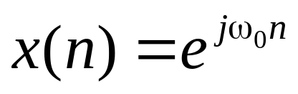
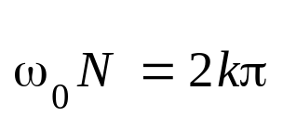
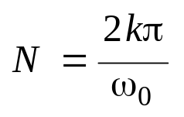
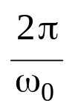
Important Sequences
A sequence x(n) is defined to be periodic with period N if
Example: consider
must be a rational number

Slide 28
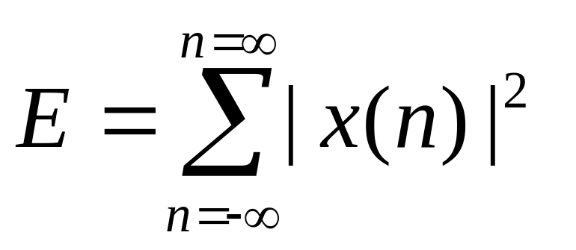
Energy of a Sequence
Energy of a sequence is defined by

Slide 29
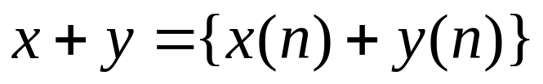
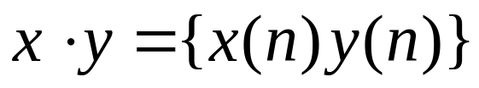
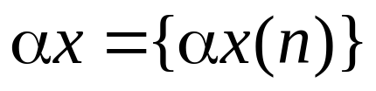
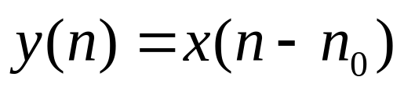
Operations on Sequences
Sum
Product
Multiplication
Shift

Slide 30
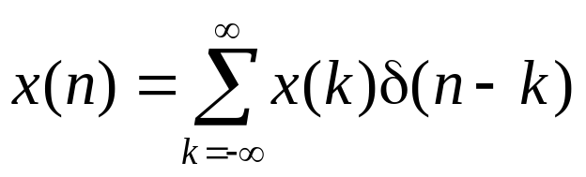
Sequence Representation
Using delay unit
x(n)
a₋₃
a₁
n
2
7
-8
-7
-6
-5
-4
-3
-2
-1
1
3
4
5
6
8
9
10
a₂
a₇

Slide 31
Discrete-Time Signals and Systems
Linear Shift-Invariant Systems

Slide 32
Systems
T [ ]
x(n)
y(n)=T[x(n)]
Mathematically modeled as a unique transformation or operator.

Slide 33
Linear Systems
T [ ]
x(n)
y(n)=T[x(n)]

Slide 34
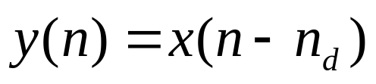
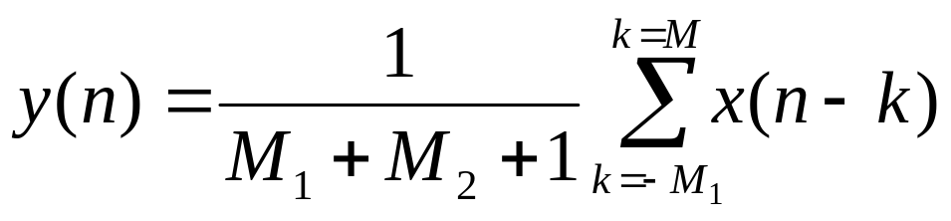
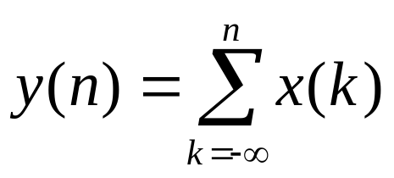
Examples:
T [ ]
x(n)
y(n)=T[x(n)]
Ideal Delay System
Moving Average
Accumulator

Slide 35
Examples:
T [ ]
Are these system linear?
y(n)=T[x(n)]
x(n)
Ideal Delay System
Moving Average
Accumulator

Slide 36
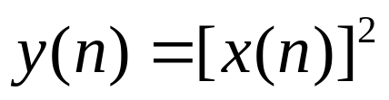
Examples:
T [ ]
x(n)
y(n)=T[x(n)]
A Memoryless System
Is this system linear?

Slide 37
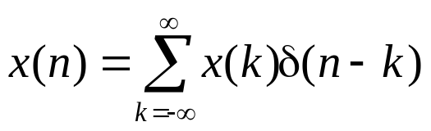
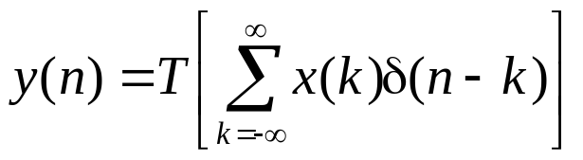
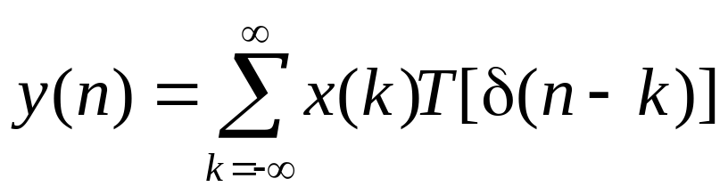
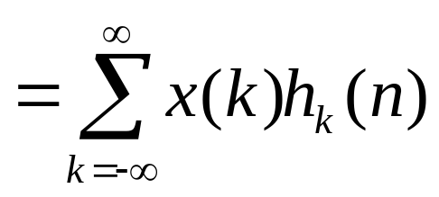
Linear Systems
T [ ]
x(n)
y(n)=T[x(n)]

Slide 38
Shift-Invariant Systems
x(n)
y(n)=T[x(n)]
T [ ]
x(n-k)
y(n-k)
x(n)
y(n)
x(n-1)
y(n-1)
x(n-2)
y(n-2)

Slide 39
Shift-Invariant Systems
x(n)
y(n)=T[x(n)]
T [ ]
x(n-k)
y(n-k)
x(n)
y(n)
x(n-1)
y(n-1)
x(n-2)
y(n-2)

Slide 40
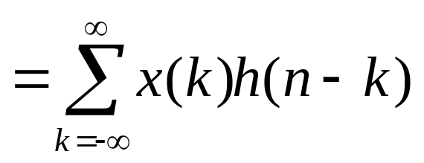
Linear Shift-Invariant Systems
T [ ]
x(n)
y(n)=T[x(n)]

Slide 41
Linear Shift-Invariant Systems
T [ ]
x(n)
y(n)=T[x(n)]

Slide 42
Impulse Response
x(n)=δ(n)
h(n)=T[δ(n)]
T [ ]
0
0
0
0

Slide 43
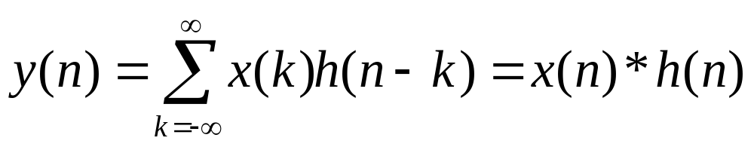
Convolution Sum
δ(n)
h(n)
T [ ]
x(n)
y(n)
convolution
A linear shift-invariant system is completely characterized by its impulse response.

Slide 44
Characterize a System
h(n)
x(n)
x(n)*h(n)

Slide 45
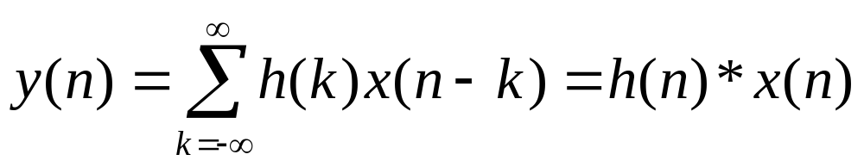
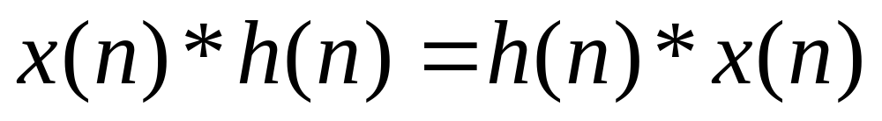
Properties of Convolution Math

Slide 46
Properties of Convolution Math
x(n)
h₁(n)
h₂(n)
y(n)
x(n)
h₂(n)
h₁(n)
y(n)
x(n)
h₁(n)*h₂(n)
y(n)
These systems are identical.

Slide 47
Properties of Convolution Math
h₁(n)
x(n)
+
y(n)
h₂(n)
x(n)
h₁(n)+h₂(n)
y(n)
These two systems are identical.

Slide 48
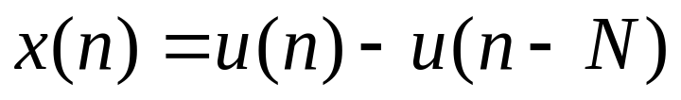
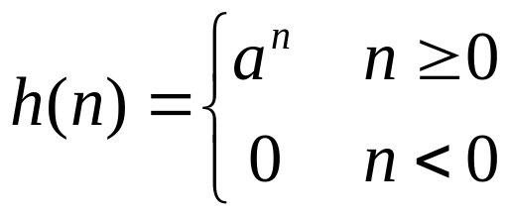
Example
y(n)=?
0
1
2
3
4
5
6
0
1
2
3
4
5
6

Slide 49
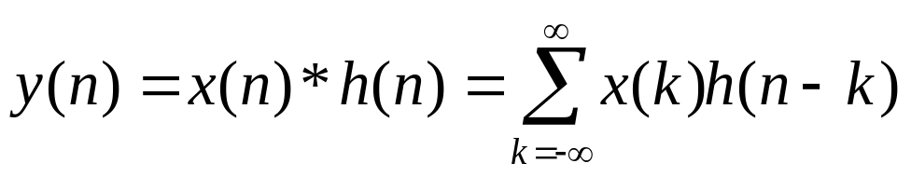
Example
x(k)
k
0
1
2
3
4
5
6
h(k)
k
0
1
2
3
4
5
6
h(0−k)
k
0
1
2
3
4
5
6

Slide 50
Example
x(k)
k
0
1
2
3
4
5
6
compute y(0)
h(0−k)
k
0
1
2
3
4
5
6
compute y(1)
h(1−k)
k
0
1
2
3
4
5
6
How to computer y(n)?

Slide 51
Example
Two conditions have to be considered.
n<N and n≥N.
x(k)
k
0
1
2
3
4
5
6
compute y(0)
h(0−k)
k
0
1
2
3
4
5
6
compute y(1)
h(1−k)
k
0
1
2
3
4
5
6
How to computer y(n)?

Slide 52
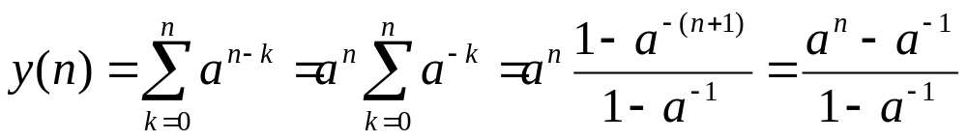
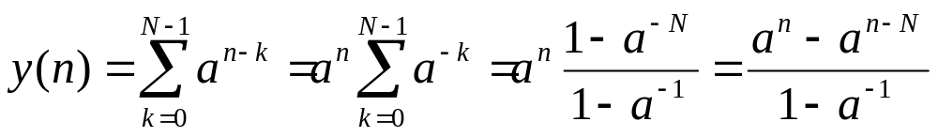
Example
n < N
n ≥ N

Slide 53
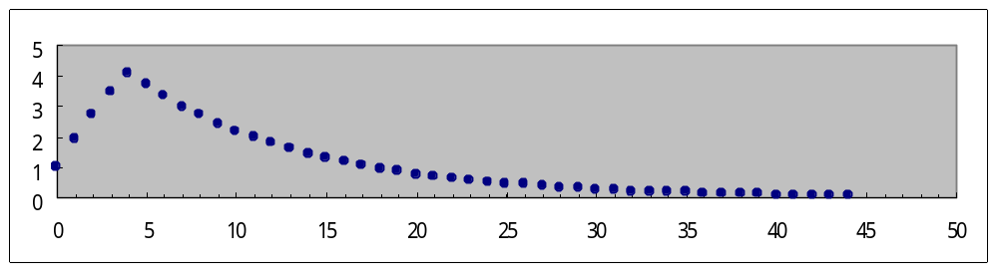
Example
n < N
n ≥ N

