Slide 1
Bottom up parsing
Construct a parse tree for an input string beginning at leaves and going towards root OR
Reduce a string w of input to start symbol of grammar Consider a grammar
S → aABe
A → Abc | b
B → d
The sentential forms happen to be a right most derivation in the reverse order.
S ➔ a A B e
➔ a A d e
➔ a A b c d e
➔ a b b c d e
1
And reduction of a string a b b c d e
a A b c d e a A d e
a A B e S

Slide 2
Shift reduce parsing
Split string being parsed into two parts
Two parts are separated by a special character “.”
Left part is a string of terminals and non terminals
Right part is a string of terminals
Initially the input is .w

Slide 3
Shift reduce parsing …
Bottom up parsing has two actions
Shift: move terminal symbol from right string to left string
if string before shift is then string after shift is
α.pqr αp.qr

Slide 4
Shift reduce parsing …
Reduce: immediately on the left of “.” identify a string same as RHS of a production and replace it by LHS
if string before reduce action is αβ.pqr and A→β is a production
then string after reduction is αA.pqr

Slide 5
Example
Assume grammar is E → E+E | E*E | id Parse id*id+id
Assume an oracle tells you when to shift / when to reduce
String
1 .id*id+id 2 id.*id+id 3 E.*id+id 4 E*.id+id 5 E*id.+id 6 E*E.+id
7 E.+
8 E+.id
9 E+id.
10 E+E.
11 E.
action (by oracle)
shift
reduce E→id shift
shift
reduce E→id reduce E→E*E shift
shift
Reduce E→id Reduce E→E+E ACCEPT
5

Slide 6
Shift reduce parsing …
Symbols on the left of “.” are kept on a stack
Top of the stack is at “.”
Shift pushes a terminal on the stack
Reduce pops symbols (rhs of production) and pushes a non terminal (lhs of production) onto the stack
The most important issue: when to shift and when to reduce
Reduce action should be taken only if the result can be reduced to the start symbol

Slide 7
Issues in bottom up parsing
How do we know which action to take
whether to shift or reduce
Which production to use for reduction?
Sometimes parser can reduce but it should not:
X→Є can always be used for reduction!

Slide 8
Issues in bottom up parsing
Sometimes parser can reduce in different ways!
Given stack δ and input symbol a, should the parser
Shift a onto stack (making it δa)
Reduce by some production A→β assuming that stack has form αβ (making it αA)
Stack can have many combinations of αβ
How to keep track of length of β?

Slide 9
Handles
The basic steps of a bottom-up parser are
to identify a substring within a rightmost sentential form which matches the RHS of a rule.
when this substring is replaced by the LHS of the matching rule, it must produce the previous rightmost-sentential form.
Such a substring is called a handle

Slide 10
Handle
A handle of a right sentential form γ is
a production rule A→ β, and
an occurrence of a sub-string β in γ
such that
when the occurrence of β is replaced by A in γ, we get the previous right sentential form in a rightmost derivation of γ.

Slide 11
Handle
Formally, if
S ➔^{rm*} αAw ➔^{rm} αβw,
then
β in the position following α,
and the corresponding production A→ β is a handle of αβw.
The string w consists of only terminal symbols

Slide 12
Handle
We only want to reduce handle and not any RHS
Handle pruning: If β is a handle and A → β is a production then replace β by A
A right most derivation in reverse can be obtained by handle pruning.
12

Slide 13
Handle: Observation
Only terminal symbols can appear to the right of a handle in a rightmost sentential form.
Why?

Slide 14
Handle: Observation
Is this scenario possible:
𝛼𝛽𝛾 is the content of the stack
𝐴 → 𝛾 is a handle
The stack content reduces to 𝛼𝛽𝐴
Now B → 𝛽 is the handle
In other words, handle is not on top, but buried inside stack

Slide 15
Handles …
Consider two cases of right most derivation to understand the fact that handle appears on the top of the stack
𝑆 → 𝛼𝐴𝑧 → 𝛼𝛽𝐵𝑦𝑧 → 𝛼𝛽𝛾𝑦𝑧
𝑆 → 𝛼𝐵𝑥𝐴𝑧 → 𝛼𝐵𝑥𝑦𝑧 → 𝛼𝛾𝑥𝑦𝑧

Slide 16
Handle always appears on the top Case I: 𝑆 → 𝛼𝐴𝑧 → 𝛼𝛽𝐵𝑦𝑧 → 𝛼𝛽𝛾𝑦𝑧
stack | input | action
αβγ | yz | reduce by B→γ
αβB | yz | shift y
αβBy | z | reduce by A→ βBy
αA | z
Case II: 𝑆 → 𝛼𝐵𝑥𝐴𝑧 → 𝛼𝐵𝑥𝑦𝑧 → 𝛼𝛾𝑥𝑦𝑧
stack | input | action
αγ | xyz | reduce by B→γ
αB | xyz | shift x
αBx | yz | shift y
αBxy | z | reduce A→y
αBxA | z | 16

Slide 17
Shift Reduce Parsers
The general shift-reduce technique is:
if there is no handle on the stack then shift
If there is a handle then reduce
Bottom up parsing is essentially the process of detecting handles and reducing them.
Different bottom-up parsers differ in the way they detect handles.

Slide 18
Conflicts
What happens when there is a choice
What action to take in case both shift and reduce are valid?
shift-reduce conflict
Which rule to use for reduction if reduction is possible by more than one rule?
reduce-reduce conflict

Slide 19
Conflicts
Conflicts come either because of ambiguous grammars or parsing method is not powerful enough

Slide 20
Shift reduce conflict
Consider the grammar E → E+E | E*E | id and the input id+id*id
stack | input | action |  | stack | input | action
E+E | *id | reduce by E→E+E |  | E+E | *id | shift
E E* E*id E*E | *id id | shift shift reduce by E→id reduce byE→E*E |  | E+E* E+E*id E+E*E E+E | id | shift reduce by E→id reduce by E→E*E reduce by E→E+E
E |  |  |  | E

Slide 21
Reduce reduce conflict
Consider the grammar M → R+R | R+c | R
R → c
and the input c+c
Stack | input | action |  | Stack | input | action
c | c+c +c | shift reduce by R→c |  | c | c+c +c | shift reduce by R→c
R | +c | shift |  | R | +c | shift
R+ R+c R+R | c | shift reduce by R→c reduce by M→R+R |  | R+ R+c M | c | shift reduce by M→R+c
M

Slide 22

LR parsing
Input buffer contains the input string.
Stack contains a string of the form S₀X₁S₁X₂……X_{n}S_{n}
input
where each X_{i} is a grammar symbol and each S_{i} is a state.
Table contains action and goto parts.
action table is indexed by state and terminal symbols.
goto table is indexed by state
stack
parser
driver
output
action
goto
Parse table
and non terminal symbols.
22

Slide 23


E → E + T | T
T → T * F | F F → ( E ) | id
Example
Consider a grammar
and its parse table
State | id | + | * | ( | ) | $ |  | E | T | F
0 | s5 |  |  | s4 |  |  |  | 1 | 2 | 3
1 |  | s6 |  |  |  | acc
2 |  | r2 | s7 |  | r2 | r2
3 |  | r4 | r4 |  | r4 | r4
4 | s5 |  |  | s4 |  |  |  | 8 | 2 | 3
5 |  | r6 | r6 |  | r6 | r6
6 | s5 |  |  | s4 |  |  |  |  | 9 | 3
7 | s5 |  |  | s4 |  |  |  |  |  | 10
8 |  | s6 |  |  | s11
9 |  | r1 | s7 |  | r1 | r1
10 |  | r3 | r3 |  | r3
 |  |  |  |  |  | r3
11 |  | r5 | r5 |  | r5 | r5
action
goto
23

Slide 24
Actions in an LR (shift reduce) parser
Assume S_{i} is top of stack and a_{i} is current input symbol
Action [S_{i},a_{i}] can have four values
sj: shift a_{i} to the stack, goto state S_{j}
rk: reduce by rule number k
acc: Accept
err: Error (empty cells in the table)

Slide 25
Driving the LR parser
Stack: S₀X₁S₁X₂…X_{m}S_{m} Input: a_{i}a_{i+1}…a_{n}$
If action[S_{m},a_{i}] = shift S
Then the configuration becomes
Stack: S₀X₁S₁……X_{m}S_{m}a_{i}S Input: a_{i+1}…a_{n}$
If action[S_{m},a_{i}] = reduce A→β Then the configuration becomes
Stack: S₀X₁S₁…X_{m-r}S_{m-r} AS Input: a_{i}a_{i+1}…a_{n}$ Where r = |β| and S = goto[S_{m-r},A]

Slide 26
Driving the LR parser
Stack: S₀X₁S₁X₂…X_{m}S_{m} Input: a_{i}a_{i+1}…a_{n}$
If action[S_{m},a_{i}] = accept
Then parsing is completed. HALT
If action[S_{m},a_{i}] = error (or empty cell) Then invoke error recovery routine.

Slide 27
Parse id + id * id
Stack |  | Input | Action
0 0 id 5 0 F 3 0 T 2 |  | id+id*id$ +id*id$ +id*id$ +id*id$ | shift 5 reduce by F→id reduce by T→F reduce by E→T
0 E 1 |  | +id*id$ | shift 6
0 E 1 + 6 0 E 1 + 6 id 5 | id*id$ | shift 5 *id$ | reduce by F→id
0 E 1 + 6 F 3 |  | *id$ | reduce by T→F
0 E 1 + 6 T 9 |  | *id$ | shift 7
0 E 1 + 6 T 9 * 7 | id$ | shift 5
0 E 1 + 6 T 9 * 7 id 5 |  | $ | reduce by F→id
0 E 1 + 6 T 9 * 7 F 10 |  | $ | reduce by T→T*F
0 E 1 + 6 T 9 |  | $ | reduce by E→E+T
0 E 1 |  | $ | ACCEPT

Slide 28
Configuration of a LR parser
The tuple
<Stack Contents, Remaining Input> defines a configuration of a LR parser
Initially the configuration is
<S₀ , a₀a₁…a_{n}$ >
Typical final configuration on a successful parse is
< S₀X₁S_{i} , $>

Slide 29
LR parsing Algorithm
Initial state: Stack: S₀ Input: w$
while (1) {
if (action[S,a] = shift S’) { push(a); push(S’); ip++
} else if (action[S,a] = reduce A→β) { pop (2*|β|) symbols;
push(A); push (goto*S’’,A+)
(S’’ is the state at stack top after popping symbols)
} else if (action[S,a] = accept) { exit
} else { error }

Slide 30
Constructing parse table
Augment the grammar
G is a grammar with start symbol S
The augmented grammar G’ for G has a new start symbol S’ and an additional production S’ → S
When the parser reduces by this rule it will stop with accept

Slide 31
Production to Use for Reduction
How do we know which production to apply in a given configuration
We can guess!
May require backtracking
Keep track of “ALL” possible rules that can apply at a given point in the input string
But in general, there is no upper bound on the length of the input string
Is there a bound on number of applicable rules?

Slide 32
Some hands on!
𝐸′ → 𝐸
𝐸 → 𝐸 + 𝑇
𝐸 → 𝑇
𝑇 → 𝑇 ∗ 𝐹
𝑇 → 𝐹
𝐹 → (𝐸)
𝐹 → 𝑖𝑑
Strings to Parse
id + id + id + id
id * id * id * id
id * id + id * id
id * (id + id) * id

Slide 33
Parser states
Goal is to know the valid reductions at any given point
Summarize all possible stack prefixes α as a parser state
Parser state is defined by a DFA state that reads in the stack α
Accept states of DFA are unique reductions

Slide 34
Viable prefixes
α is a viable prefix of the grammar if
∃w such that αw is a right sentential form
<α,w> is a configuration of the parser
As long as the parser has viable prefixes on the stack no parser error has been seen
The set of viable prefixes is a regular language
We can construct an automaton that accepts viable prefixes

Slide 35
LR(0) items
An LR(0) item of a grammar G is a
production of G with a special symbol “.” at some position of the right side
Thus production A→XYZ gives four LR(0) items
A → .XYZ A → X.YZ A → XY.Z A → XYZ.

Slide 36
LR(0) items
An item indicates how much of a production has been seen at a point in the process of parsing
Symbols on the left of “.” are already on the stacks
Symbols on the right of “.” are expected in the input

Slide 37
Start state
Start state of DFA is an empty
stack corresponding to S’→.S item
This means no input has been seen
The parser expects to see a string derived from S

Slide 38
Closure of a state
Closure of a state adds items for all productions whose LHS occurs in an item in the state, just after “.”
Set of possible productions to be reduced next
Added items have “.” located at the beginning
No symbol of these items is on the stack as yet

Slide 39
Closure operation
Let I be a set of items for a grammar G
closure(I) is a set constructed as follows:
Every item in I is in closure (I)
If A → α.Bβ is in closure(I) and B → γ is a production then B → .γ is in closure(I)
Intuitively A →α.Bβ indicates that we expect a string derivable from Bβ in input
If B → γ is a production then we might see a string derivable from γ at this point

Slide 40
Example
For the grammar
E’ → E
E → E + T | T
T → T * F | F F → ( E ) | id
If I is , E’ → .E } then closure(I) is
E’ → .E
E → .E + T E → .T
T → .T * F T → .F
F → .id F → .(E)

Slide 41
Goto operation
Goto(I,X) , where I is a set of items and X is a grammar symbol,
is closure of set of item A →αX.β
such that A → α.Xβ is in I
Intuitively if I is a set of items for some valid prefix α then goto(I,X) is set of valid items for prefix αX

Slide 42
Goto operation
If I is , E’→E. , E→E. + T } then goto(I,+) is
E → E + .T
T → .T * F T → .F
F → .(E)
F → .id

Slide 43
Sets of items
C : Collection of sets of LR(0) items for grammar G’
C = , closure ( , S’ → .S } ) } repeat
for each set of items I in C
for each grammar symbol X
if goto (I,X) is not empty and not in C ADD goto(I,X) to C
until no more additions to C

Slide 44
Example
Grammar:
E’ → E
E → E+T | T
T → T*F | F
F → (E) | id
I₀: closure(E’→.E) E′ → .E
E → .E + T
E → .T
T → .T * F T → .F
F → .(E)
F → .id
I₁: goto(I₀,E) E′ → E.
E → E. + T
I₂: goto(I₀,T) E → T.
T → T. *F
I₃: goto(I₀,F) T → F.
I₄: goto( I₀,( )
F → (.E)
E → .E + T E → .T
T → .T * F
T → .F
F → .(E)
F → .id
I₅: goto(I₀,id)
F → id.

Slide 45
I₆: goto(I₁,+)
E → E + .T
I₉: goto(I₆,T)
E → E + T.
T → T. * F
T → .T * F T → .F
F → .(E)
F → .id
goto(I₆,F) is I₃ goto(I₆,( ) is I₄ goto(I₆,id) is I₅
I₇: goto(I₂,*) T → T * .F F →.(E)
F → .id
I : goto(I ,F)
10 7
T → T * F.
goto(I₇,( ) is I₄ goto(I₇,id) is I₅
I₈: goto(I₄,E)
F → (E.)
E → E. + T
I₁₁: goto(I₈,) )
F → (E).
goto(I₄,T) is I₂ goto(I₄,F) is I₃ goto(I₄,( ) is I₄ goto(I₄,id) is I₅
goto(I₈,+) is I₆ goto(I₉,*) is I₇
45

Slide 46
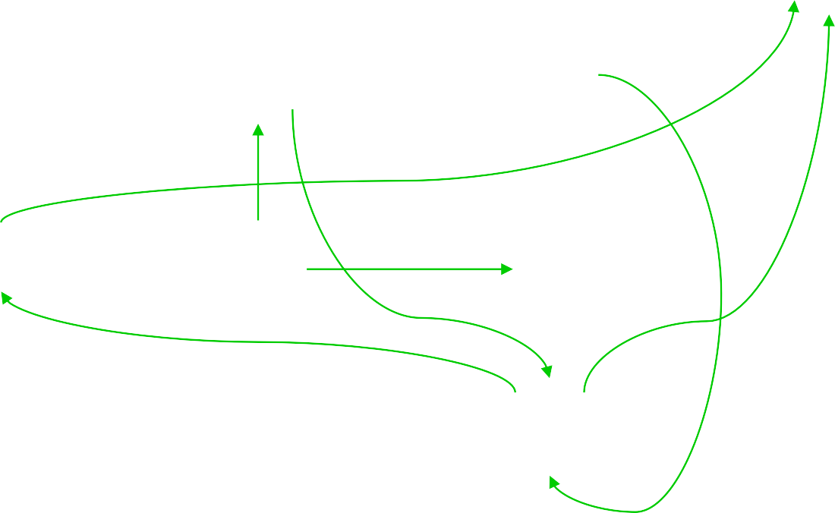
id
id
I5
I1
+
I6
+
I9
id
(
(
*
(
I0
I4
I8
)
I11
id
(
I2
*
I7
I10
I3

Slide 47
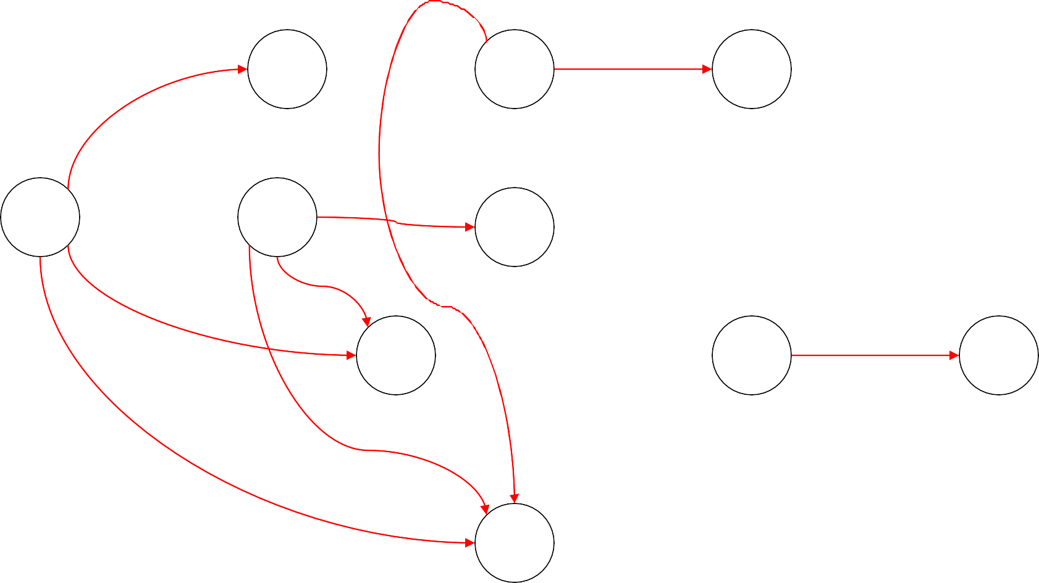
I5
F
E
I1
I6
T
I9
I0
I4
E
I8
I11
T
F
T
I2
I7
F
I10
F
I3

Slide 48
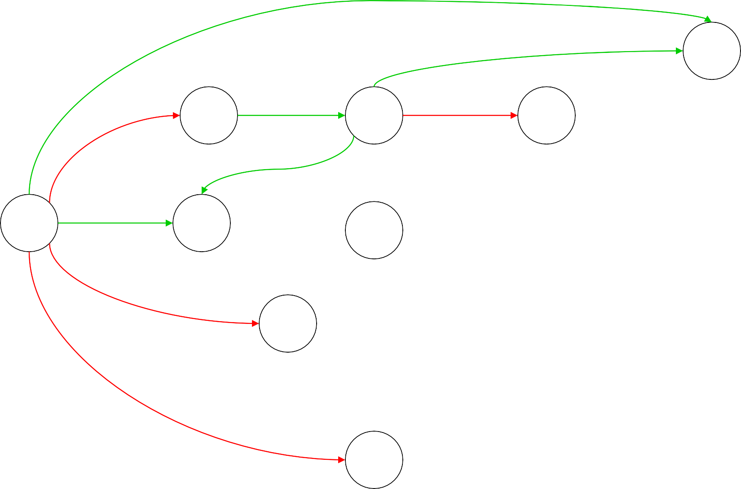
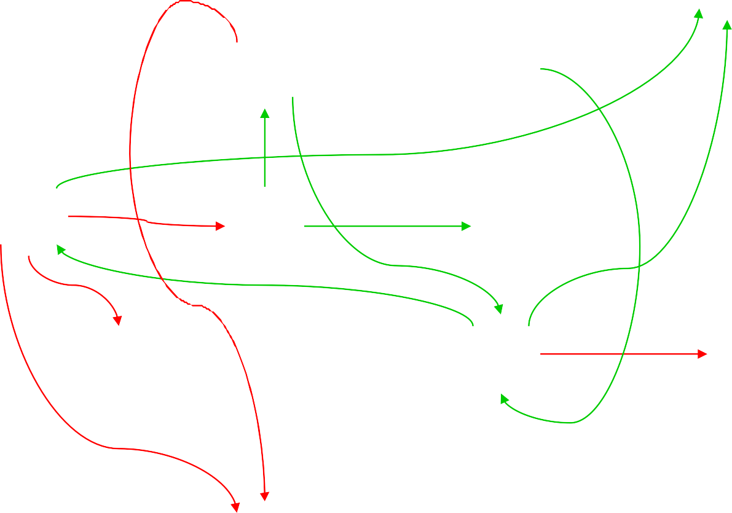
id
id
I5
F
E
I1
+
I6
+
T
I9
id
(
(
*
(
I0
I4
E
I8
)
I11
T
F
T
id
(
I2
*
I7
F
I10
F
I3

Slide 49
LR(0) (?) Parse Table
The information is still not sufficient to help us resolve shift-reduce conflict. For example the state:
I₁: E′ → E.
E → E. + T
We need some more information to make decisions.

Slide 50
Constructing parse table
First(α) for a string of terminals and non terminals α is
Set of symbols that might begin the fully expanded (made of only tokens) version of α
Follow(X) for a non terminal X is
set of symbols that might follow the derivation of X in the input stream
X
first
follow

Slide 51
Compute first sets
If X is a terminal symbol then first(X) = {X}
If X → Є is a production then Є is in first(X)
If X is a non terminal and X → Y_{l}Y₂ … Y_{k} is a production, then
if for some i, a is in first(Y_{i})
and Є is in all of first(Y_{j}) (such that j<i) then a is in first(X)
If Є is in first (Y₁) … first(Y_{k}) then Є is in first(X)
Now generalize to a string 𝛼 of terminals and non-terminals

Slide 52
Example
For the expression grammar
E → T E‘ T → F T'
F → ( E ) | id
E' → +T E' | Є
T' → * F T' | Є
First(E) = First(T) = First(F)
= { (, id }
First(E')
= {+, Є}
First(T')
= { *, Є}

Slide 53
Compute follow sets
Place $ in follow(S) // S is the start symbol
If there is a production A → αBβ
then everything in first(β) (except ε) is in follow(B)
If there is a production A → αBβ and first(β) contains ε
then everything in follow(A) is in follow(B)
If there is a production A → αB
then everything in follow(A) is in follow(B) Last two steps have to be repeated until the follow sets converge.

Slide 54
Example
For the expression grammar E → T E’
E' → + T E' | Є T → F T'
T' → * F T' | Є F → ( E ) | id
follow(E) = follow(E’) = , $, ) -
follow(T) = follow(T’) = , $, ), + -
follow(F) = { $, ), +, *}

Slide 55
Construct SLR parse table
Construct C={I₀, …, I_{n}} the collection of sets of LR(0) items
If A→α.aβ is in I_{i} and goto(I_{i,}a) = I_{j} then action[i,a] = shift j
If A→α. is in I_{i}
then action[i,a] = reduce A→α for all a in follow(A)
If S'→S. is in I_{i} then action[i,$] = accept
If goto(I_{i},A) = I_{j}
then goto[i,A]=j for all non terminals A
All entries not defined are errors

Slide 56
Notes
This method of parsing is called SLR (Simple LR)
LR parsers accept LR(k) languages
L stands for left to right scan of input
R stands for rightmost derivation
k stands for number of lookahead token
SLR is the simplest of the LR parsing methods. SLR is too weak to handle most languages!
If an SLR parse table for a grammar does not have multiple entries in any cell then the grammar is unambiguous
All SLR grammars are unambiguous
Are all unambiguous grammars in SLR?

Slide 57
Practice Assignment
Construct SLR parse table for following grammar
E → E + E | E - E | E * E | E / E | ( E ) | digit Show steps in parsing of string
9*5+(2+3*7)
Steps to be followed
Augment the grammar
Construct set of LR(0) items
Construct the parse table
Show states of parser as the given string is parsed

Slide 58
Example
Consider following grammar and its SLR parse table: S’ → S
S → L = R
S → R L → *R L → id R → L
I₁: goto(I₀, S) S’ → S.
I₂: goto(I₀, L) S → L.=R R → L.
I₀: S’ → .S
S → .L=R S → .R
L → .*R L → .id R → .L
Assignment (not to be submitted): Construct rest of the items and the parse table.

Slide 59
SLR parse table for the grammar
 | = | * | id | $ |  | S | L | R
0 |  | s4 | s5 |  |  | 1 | 2 | 3
1 |  |  |  | acc
2 | s6,r6 |  |  | r6
3 |  |  |  | r3
4 |  | s4 | s5 |  |  |  | 8 | 7
5 | r5 |  |  | r5
6 |  | s4 | s5 |  |  |  | 8 | 9
7 | r4 |  |  | r4
8 | r6 |  |  | r6
9 |  |  |  | r2
The table has multiple entries in action[2,=]
59

Slide 60
There is both a shift and a reduce entry in action[2,=]. Therefore state 2 has a shift- reduce conflict on symbol “=“, However, the grammar is not ambiguous.
Parse id=id assuming reduce action is taken in [2,=]
Stack | input | action
0 | id=id | shift 5
0 id 5 | =id | reduce by L→id
0 L 2 | =id | reduce by R→L
0 R 3 | =id | error

Slide 61
if shift action is taken in [2,=]
Stack | input | action
0 | id=id$ | shift 5
0 id 5 | =id$ | reduce by L→id
0 L 2 | =id$ | shift 6
0 L 2 = 6 | id$ | shift 5
0 L 2 = 6 id 5 | $ | reduce by L→id
0 L 2 = 6 L 8 | $ | reduce by R→L
0 L 2 = 6 R 9 | $ | reduce by S→L=R
0 S 1 | $ | ACCEPT

Slide 62
Problems in SLR parsing
No sentential form of this grammar can start with R=…
However, the reduce action in action[2,=] generates a sentential form starting with R=
Therefore, the reduce action is incorrect
In SLR parsing method state i calls for reduction on
symbol “a”, by rule A→α if I_{i} contains [A→α.+ and “a” is in follow(A)
However, when state I appears on the top of the stack, the viable prefix βα on the stack may be such that βA can not be followed by symbol “a” in any right sentential form
Thus, the reduction by the rule A→α on symbol “a” is invalid
SLR parsers cannot remember the left context

Slide 63
Canonical LR Parsing
Carry extra information in the state so that wrong reductions by A → α will be ruled out
Redefine LR items to include a terminal symbol as a second component (look ahead symbol)
The general form of the item becomes [A →
α.β, a] which is called LR(1) item.
Item [A → α., a] calls for reduction only if
next input is a. The set of symbols “a”s will be a subset of Follow(A).

Slide 64
Closure(I)
repeat
for each item [A → α.Bβ, a] in I
for each production B → γ in G' and for each terminal b in First(βa)
add item [B → .γ, b] to I until no more additions to I

Slide 65
Example
Consider the following grammar
S‘→ S S → CC
C → cC | d
Compute closure(I) where I=,*S’ → .S, $]}
S‘→ .S, S → .CC,
C → .cC,
C → .cC,
C → .d,
C → .d,
$
$ c d c d

Slide 66
Example
Construct sets of LR(1) items for the grammar on previous slide
I₀: S′ → .S,
$
$ c/d c/d
I₄: goto(I₀,d)
S → .CC,
C → .cC,
C → .d,
C → d.,
c/d
I₅: goto(I₂,C)
S → CC.,
$
I₁: goto(I₀,S)
S′ → S.,
$
I₆: goto(I₂,c)
C → c.C,
C → .cC,
C → .d,
$
$
$
I₂: goto(I₀,C)
S → C.C,
C → .cC,
C → .d,
$
$
$
I₇: goto(I₂,d)
C → d.,
$
I₃: goto(I₀,c)
C → c.C,
C → .cC,
C → .d,
c/d c/d c/d
I₈: goto(I₃,C)
C → cC.,
c/d
I₉: goto(I₆,C)
C → cC.,
$

Slide 67
Construction of Canonical LR parse table
Construct C={I_{0, …,}I_{n}} the sets of LR(1) items.
If [A → α.aβ, b] is in I_{i} and goto(I_{i}, a)=I_{j} then action[i,a]=shift j
If [A → α., a] is in I_{i}
then action[i,a] reduce A → α
If [S′ → S., $] is in I_{i}
then action[i,$] = accept
If goto(I_{i}, A) = I_{j} then goto[i,A] = j for all non terminals A

Slide 68
Parse table
State | c | d | $ |  | S | C
0 | s3 | s4 |  |  | 1 | 2
1 |  |  | acc
2 | s6 | s7 |  |  |  | 5
3 | s3 | s4 |  |  |  | 8
4 | r3 | r3
5 |  |  | r1
6 | s6 | s7 |  |  |  | 9
7 |  |  | r3
8 | r2 | r2
9 |  |  | r2

Slide 69
Notes on Canonical LR Parser
Consider the grammar discussed in the previous two slides. The
language specified by the grammar is c*dc*d.
When reading input cc…dcc…d the parser shifts cs into stack and then goes into state 4 after reading d. It then calls for reduction by C→d if following symbol is c or d.
IF $ follows the first d then input string is c*d which is not in the language; parser declares an error
On an error canonical LR parser never makes a wrong shift/reduce
move. It immediately declares an error
Problem: Canonical LR parse table has a large number of states

Slide 70
LALR Parse table
Look Ahead LR parsers
Consider a pair of similar looking states (same kernel and
different lookaheads) in the set of LR(1) items
I₄: C → d. , c/d I₇: C → d., $
Replace I₄ and I₇ by a new state I₄₇ consisting of
(C → d., c/d/$)
Similarly I₃ & I₆ and I₈ & I₉ form pairs
Merge LR(1) items having the same core

Slide 71
Construct LALR parse table
Construct C={I₀,……,I_{n}} set of LR(1) items
For each core present in LR(1) items find all sets having the same
core and replace these sets by their union
Let C' = {J₀,…….,J_{m}} be the resulting set of items
Construct action table as was done earlier
Let J = I₁ U I₂…….U I_{k}
since I₁ , I₂……., I_{k} have same core, goto(J,X) will have he same
core
Let K=goto(I₁,X) U goto(I₂,X)……goto(I_{k},X) the goto(J,X)=K

Slide 72
LALR parse table …
State | c | d | $ | S | C
0 | s36 | s47 |  | 1 | 2
1 |  |  | acc
2 | s36 | s47 |  |  | 5
36 | s36 | s47 |  |  | 89
47 | r3 | r3 | r3
5 |  |  | r1
89 | r2 | r2 | r2

Slide 73
Notes on LALR parse table
Modified parser behaves as original except that it will reduce C→d on inputs like ccd. The error will eventually be caught before any more symbols are shifted.
In general core is a set of LR(0) items and LR(1) grammar may produce more than one set of items with the same core.
Merging items never produces shift/reduce conflicts but may produce reduce/reduce conflicts.
SLR and LALR parse tables have same number of states.

Slide 74
Notes on LALR parse table…
Merging items may result into conflicts in LALR parsers which did not exist in LR parsers
New conflicts can not be of shift reduce kind:
Assume there is a shift reduce conflict in some state of LALR parser with items
{[X→α.,a],[Y→γ.aβ,b]}
Then there must have been a state in the LR parser with the same core
Contradiction; because LR parser did not have conflicts
LALR parser can have new reduce-reduce conflicts
Assume states
{[X→α., a], [Y→β., b]} and {[X→α., b], [Y→β., a]}
Merging the two states produces
{[X→α., a/b], [Y→β., a/b]}

Slide 75
Notes on LALR parse table…
LALR parsers are not built by first making canonical LR parse tables
There are direct, complicated but efficient algorithms to develop LALR parsers
Relative power of various classes
– SLR(1) ≤ LALR(1) ≤ LR(1)
SLR(k) ≤ LALR(k) ≤ LR(k)
LL(k) ≤ LR(k)

Slide 76
Error Recovery
An error is detected when an entry in the action table is found to be empty.
Panic mode error recovery can be implemented as follows:
scan down the stack until a state S with a goto on a particular nonterminal A is found.
discard zero or more input symbols until a symbol a is found that can legitimately follow A.
stack the state goto[S,A] and resume parsing.
Choice of A: Normally these are non terminals representing major program pieces such as an expression, statement or a block. For example if A is the nonterminal stmt, a might be semicolon or end.

Slide 77
Parser Generator
Some common parser generators
YACC: Yet Another Compiler Compiler
Bison: GNU Software
ANTLR: ANother Tool for Language Recognition
Yacc/Bison source program specification (accept LALR grammars)
declaration
%%
translation rules
%%
supporting C routines

Slide 78
Yacc and Lex schema
C code for lexical analyzer
Token
specifications
Lex
Lex.yy.c
Grammar
specifications
Yacc
C code for
parser
y.tab.c
C
Compiler
Object code
Input program
Parser
Abstract Syntax tree
Refer to YACC Manual

Slide 79
Bottom up parsing …
A more powerful parsing technique
LR grammars – more expensive than LL
Can handle left recursive grammars
Can handle virtually all the programming languages
Natural expression of programming language syntax
Automatic generation of parsers (Yacc, Bison etc.)
Detects errors as soon as possible
Allows better error recovery

