Slide 1
LR Parsing

Slide 2
Creating an LR parsing table is a systematic process that involves constructing the canonical collection of LR(0) items, determining the ACTION and GOTO entries, and using those to drive the parsing decisions.
Algorithm to Construct an LR(0) Parsing Table
Inputs:
A context-free grammar G=(V,T,P,S)
An augmented grammar G′ with a new start symbol S′→S

Slide 3
Step 1: Augment the Grammar
Add a new start production:
S' → S
This helps detect when parsing is complete.
Step 2: Compute the Canonical Collection of LR(0) Items
2.1 Define the closure operation:
Given a set of items I, compute CLOSURE as:
Start with the initial item set I
Repeat until no more items can be added:
If A→α⋅Bβ ∈ I and B→γ ∈ P, then add B→⋅γB to I

Slide 4
2.2 Define the GOTO function:
For an item set I and Grammar symbol X, GOTO(I,X) is the closure of the set of items:
{ A → αX·β | A → α·Xβ ∈ I }
2.3 Construct all states:
Start from the initial state: I₀=CLOSURE({S′→⋅S})
For each item set I_{i} ​ and each grammar symbol X, compute GOTO(I_{i},X)=I_{j}
Add I_{j}​ to the collection of item sets if not already present.

Slide 5
Step 3: Construct the LR(0) Parsing Table
Let the set of item sets be I₀, I₁,…, I_{n}​.
3.1 ACTION Table
For each item A→α⋅aβA in state Ii​:
If a is a terminal and GOTO(I_{i},a)=I_{j} ​, set:
ACTION[i, a] = shift j
If A→α⋅A in Ii​ and A≠S′
Set:
ACTION[i, a] = reduce A → α for all a ∈ FOLLOW(A)
If S′→S⋅ is in Ii​, then:
Set:
ACTION[i, $] = accept

Slide 6
3.2 GOTO Table
For each non-terminal A, if GOTO(I_{i},A)=I_{j} ​, then:
GOTO[i, A] = j
Step 4: Report Conflicts (if any)
If multiple actions are assigned to the same cell, it indicates a conflict (shift/reduce or reduce/reduce), meaning the Grammar is not LR(0).

Slide 7
Example: LR(0) Parsing Table for a Simple Grammar
Grammar:
1. S' → S
2. S → A A
3. A → a
4. A → b

Slide 8
Step 1: Augment the Grammar
S' → ·S
Step 2: Canonical Collection of LR(0) Items
I₀: closure({ S' → ·S })
S' → ·S
S → ·A A
A → ·a
A → ·b
GOTO(I₀, S) = I₁
S' → S·
GOTO(I₀, A) = I₂
S → A·A
A → ·a
A → ·b
GOTO(I₂, A) = I₃
S → A A·
GOTO(I₀, a) = I₄
A → a·
GOTO(I₀, b) = I₅
A → b·
GOTO(I₂, a) = I₄ (already exists) GOTO(I₂, b) = I₅ (already exists)

Slide 9
So, the canonical collection of items is:
I₀: S' → ·S S → ·A A A → ·a A → ·b
I₁: S' → S·
I₂: S → A·A A → ·a A → ·b
I₃: S → A A·
I₄: A → a·
I₅: A → b·

Slide 10
Step 3: Build the Parsing Table
Legend:
s4: shift and go to state 4
r2: reduce using rule 2: S → A A
acc: accept
blank: error or undefined
Summary
This process can be generalized for SLR(1), LR(1), and LALR(1) parsers with additional lookahead mechanisms. However, no lookahead symbols are used for pure LR(0) parsing, which restricts it to a small class of grammars.
State | a | b | $ | S | A
0 | s4 | s5 |  | 1 | 2
1 |  |  | acc
2 | s4 | s5 |  |  | 3
3 | r2 | r2 | r2
4 | r3 | r3 | r3
5 | r4 | r4 | r4

Slide 11
What is SLR(1)?
SLR(1) (Simple LR with 1-symbol lookahead) improves upon LR(0) by resolving reduce conflicts using FOLLOW sets.

Slide 12
Algorithm to Construct an SLR(1) Parsing Table
Input
A context-free grammar G=(V,T,P,S)
Step 1: Augment the Grammar
Add a new start symbol:
S' → S

Slide 13
Step 2: Compute the Canonical Collection of LR(0) Items
a. Closure Function
Given a set of items I, CLOSURE(I) is computed as:
Start with I
If A→α⋅Bβ ∈ I and B→γ∈P, then add B→⋅γB to I
Repeat until no new items can be added
b. Goto Function
Given I and Grammar symbol X:
GOTO(I, X) = CLOSURE({ A → αX·β | A → α·Xβ ∈ I })
c. Start from Initial Item
I₀ = CLOSURE({ S' → ·S })
Build states I₀,I₁,...,I_{n} using GOTO over terminals and nonterminals.

Slide 14
Step 3: Compute FIRST and FOLLOW sets
FIRST(X): Terminals that begin strings derived from X
FOLLOW(X): Terminals that can appear after X in sentential forms
FOLLOW is used to place reduce actions in the ACTION table.

Slide 15
Step 4: Construct ACTION and GOTO Tables
Let I0,I1,...,In ​ be the LR(0) item sets.
a. ACTION Table
For each state iii:
If A→α⋅aβ ∈ I_{i} ​, where a is a terminal, and GOTO(I_{i},a)=I_{j}
ACTION[i, a] = shift j
If A→α⋅∈I_{i} and A≠S′
ACTION[i, a] = reduce A → α for each a ∈ FOLLOW(A)
If S′→S⋅∈ I_{i}
ACTION[i, $] = accept
b. GOTO Table
For a non-terminal A, if GOTO(I_{i},A)= I_{j}
GOTO[i, A] = j

Slide 16
Step 5: Report Conflicts
A conflict exists if a cell has multiple entries (shift-reduce or reduce-reduce). Such a grammar is not SLR(1).

Slide 17
Example Grammar
1. S' → S
2. S → A A
3. A → a
4. A → b
Step 1: Augment the Grammar
S' → S

Slide 18
Step 2: Canonical LR(0) Item Sets
I₀:
S' → ·S
S → ·A A
A → ·a
A → ·b
GOTO(I₀, S) = I₁:
S' → S·
GOTO(I₀, A) = I₂:
S → A·A
A → ·a
A → ·b
GOTO(I₂, A) = I₃:
S → A A·
GOTO(I₀, a) = I₄:
A → a·
GOTO(I₀, b) = I₅:
A → b·

Slide 19
So, item sets:
State | Items
I₀ | S' → ·S S → ·A A A → ·a A → ·b
I₁ | S' → S·
I₂ | S → A·A A → ·a A → ·b
I₃ | S → A A·
I₄ | A → a·
I₅ | A → b·

Slide 20
Step 3: Compute FOLLOW sets
FOLLOW(S') = { $ }
FOLLOW(S) = { $ }
FOLLOW(A) = { a, b, $ }
Explanation:
From S → A A, FOLLOW of first A includes FIRST(A) → {a, b}
From S → A A, FOLLOW of second A includes FOLLOW(S) → {$}

Slide 21
Step 4: Construct Parsing Table
Notes:
State 3: S → A A· → reduce by Rule 2 on FOLLOW(S) = { $ } → r2 in column $
State 4: A → a· → reduce by Rule 3 on FOLLOW(A) = {a, b, $}
State 5: A → b· → reduce by Rule 4 on FOLLOW(A) = {a, b, $}
State | a | b | $ | S | A
0 | s4 | s5 |  | 1 | 2
1 |  |  | acc
2 | s4 | s5 |  |  | 3
3 | r2 | r2 | r2
4 | r3 | r3 | r3
5 | r4 | r4 | r4

Slide 22
Final SLR(1) Parsing Table
State | a | b | $ | S | A
0 | s4 | s5 |  | 1 | 2
1 |  |  | acc
2 | s4 | s5 |  |  | 3
3 |  |  | r2
4 | r3 | r3 | r3
5 | r4 | r4 | r4
Summary
SLR(1) parsing resolves reduce conflicts using FOLLOW sets.
It is more powerful than LR(0), but less powerful than LR(1) and LALR(1).
Still simple enough for many practical grammars.

Slide 23
LALR(1) (Lookahead LR) parsing combines the power of LR(1) with the size efficiency of SLR(1).
It merges LR(1) item sets with identical cores (ignoring lookaheads).
It usually results in smaller tables than LR(1) but more precise than SLR(1).

Slide 24
Algorithm for LALR(1) Table Construction
Step 1: Augment the Grammar
Add a new start rule:
S' → S
Step 2: Compute LR(1) Items
LR(1) Item:
An item is of the form:
[A → α·β, a]
It means we are at a point in the production A→αβ, having seen α, and the lookahead is a.
Closure(I):
For each item [A→α⋅Bβ, in I, and each production B→γ and for each terminal b∈FIRST(βa), add:
[B → ·γ, b]
Repeat until no new items are added.
GOTO(I, X):
Advance the dot over symbol X and take the closure of the resulting items.

Slide 25
Step 3: Construct a Canonical Collection of LR(1) Item Sets
Start with:
I₀ = CLOSURE({ [S' → ·S, $] })
Build all item sets I0,I1,...,In ​ using GOTO.
Step 4: Merge States with Same LR(0) Core
If two LR(1) states have same LR(0) items (core) but different lookaheads, merge them by combining lookaheads.
For example:
[A → α·, a] in state I₁
[A → α·, b] in state I₂
If core is same: A → α·, then they’re merged into:
[A → α·, {a, b}]
This gives LALR(1) item sets.

Slide 26
Step 5: Construct ACTION and GOTO Tables
ACTION:
If [A→α⋅aβ,b]∈Ii ​ and GOTO(Ii,a)=Ij ​:
ACTION[i, a] = shift j
If [A→α⋅,a]∈Ii
ACTION[i, a] = reduce A → α
If [S' → S·, $]
ACTION[i, $] = accept
GOTO:
For a non-terminal A, if GOTO(Ii,A)=Ij ​:
GOTO[i, A] = j
Step 6: Report Conflicts
If a table cell contains multiple actions (e.g., shift and reduce), it’s a conflict. If no conflicts exist, the Grammar is LALR(1).

Slide 27
Example: Grammar
1. S' → S
2. S → Aa
3. S → bAc
4. S → dc
5. S → bda
6. A → d

Slide 28
Full LR(1) construction):
Start with:
[S' → ·S, $]
Build closure and GOTO to generate full LR(1) item sets with lookahead symbols.

Slide 29
Merging States (LALR Step):
States with same core (ignoring lookahead) are merged.
For example:
I₅ = { [A → d·, a] }
I₆ = { [A → d·, c] }
Core: A → d·
Merge to:
[A → d·, {a, c}]

Slide 30
Final Table Entries (Example Rows):
State | a | b | c | d | $ | S | A
0 |  | s2 |  | s4 |  | 1 | 3
1 | acc
2 |  |  |  | s4 |  |  | 5
3 | s6
4 |  |  | r6 |  | r6
5 | r2 |  | s7
6 |  |  | r5 |  | r5
7 | r3 |  |  |  | r3
Here:
s2: shift to state 2
r6: reduce by A → d
acc: accept

Slide 31
Summary: Key Differences Between SLR(1), LR(1), and LALR(1)
Feature | SLR(1) | LR(1) | LALR(1)
Items | LR(0) + FOLLOW | LR(1) items (with lookahead) | Merged LR(1) items with same core
Table Size | Small | Large | Moderate
Power | Less | More | Close to LR(1)
Conflicts | More (approximate) | Fewer (accurate) | Few (merged lookaheads)
Use in Yacc | ❌ | ❌ | ✅ (default parser type)

Slide 32
The LR(0) items are the core building blocks for constructing an LR(0) parsing table used in bottom-up parsing. An LR(0) item is a production rule where a dot (.) is placed at any position in the right-hand side of the production, indicating how far the parser has processed that production. In LR(0) parsing, the goal is to decide how to move through the input by maintaining a set of such items.
LR(0) Items Definition:
An LR(0) item is a production of the form A→α⋅βA where α and β are strings of grammar symbols (terminals or non-terminals), and the dot (.) is at any position in the production’s right-hand side.
If the dot is at the beginning of the production, it means that no part of the production has been processed yet.
If the dot is at the end, it indicates that the entire production has been processed.

Slide 33
Algorithm for Computing LR(0) Items
Start with the Augmented Grammar:
Augment the grammar by adding a new start symbol S′→S, where S is the original start symbol.
Initial Item Set (I0):
The initial item set I0​ contains the item S′→⋅S' (i.e., the dot before the start symbol).
The set I0​ is the closure of the initial item.

Slide 34
3. Closure Operation:
The closure of a set of items includes all items that can be derived from non-terminals in the production's right-hand side.
To compute the closure of an item set, for each item A→α⋅Bβ in the set:
For each production B→γB add B→⋅γ to the item set, if not already present.
Repeat this process until no new items can be added to the set.

Slide 35
4. Goto Operation:
The GOTO of a set of items is a new set of items obtained by shifting the dot over a symbol from the right-hand side of the items.
For each item in the current set, if the dot is before a symbol X, create a new item by shifting the dot over X, i.e., A→αX⋅β.
Perform the closure on this new item set.

Slide 36
5. Repeat the Process:
Apply the closure and GOTO operations iteratively to generate all the item sets. Each item set corresponds to a state in the parsing automaton.
6. Transition Table:
After generating all the item sets, create a state transition table where the states represent the item sets, and the transitions are based on the GOTO operation with terminal and non-terminal symbols.

Slide 37
Example
Grammar:
E’ → E
E → E+T | T
T → T*F | F
F → (E) | id
I₀: closure(E’→.E) E′ → .E
E → .E + T
E → .T
T → .T * F T → .F
F → .(E)
F → .id
I₁: goto(I₀,E) E′ → E.
E → E. + T
I₂: goto(I₀,T) E → T.
T → T. *F
I₃: goto(I₀,F) T → F.
I₄: goto( I₀,( )
F → (.E)
E → .E + T E → .T
T → .T * F
T → .F
F → .(E)
F → .id
I₅: goto(I₀,id)
F → id.

Slide 38
I₆: goto(I₁,+)
E → E + .T
I₉: goto(I₆,T)
E → E + T.
T → T. * F
T → .T * F T → .F
F → .(E)
F → .id
goto(I₆,F) is I₃ goto(I₆,( ) is I₄ goto(I₆,id) is I₅
I₇: goto(I₂,*) T → T * .F F →.(E)
F → .id
I : goto(I ,F)
10 7
T → T * F.
goto(I₇,( ) is I₄ goto(I₇,id) is I₅
I₈: goto(I₄,E)
F → (E.)
E → E. + T
I₁₁: goto(I₈,) )
F → (E).
goto(I₄,T) is I₂ goto(I₄,F) is I₃ goto(I₄,( ) is I₄ goto(I₄,id) is I₅
goto(I₈,+) is I₆ goto(I₉,*) is I₇

Slide 39
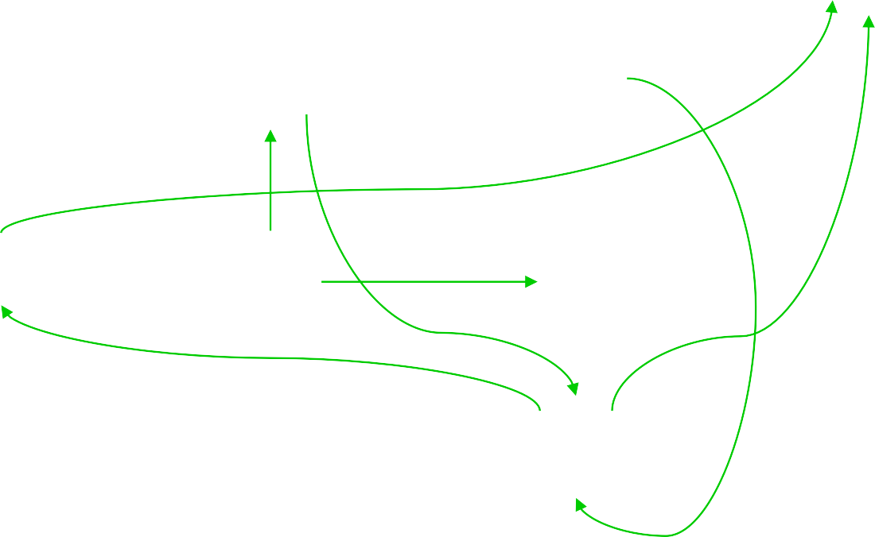
id
id
I5
I1
+
I6
+
I9
id
(
(
*
(
I0
I4
I8
)
I11
id
(
I2
*
I7
I10
I3

Slide 40
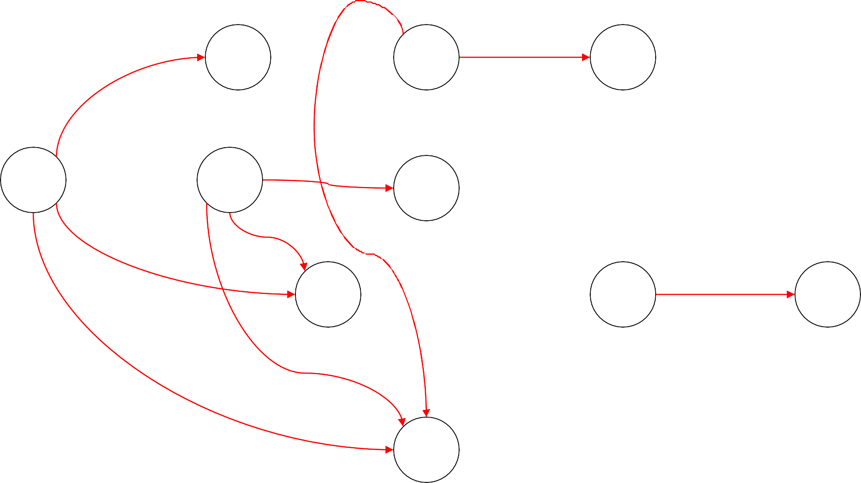
I5
F
E
I1
I6
T
I9
I0
I4
E
I8
I11
T
F
T
I2
I7
F
I10
F
I3

Slide 41
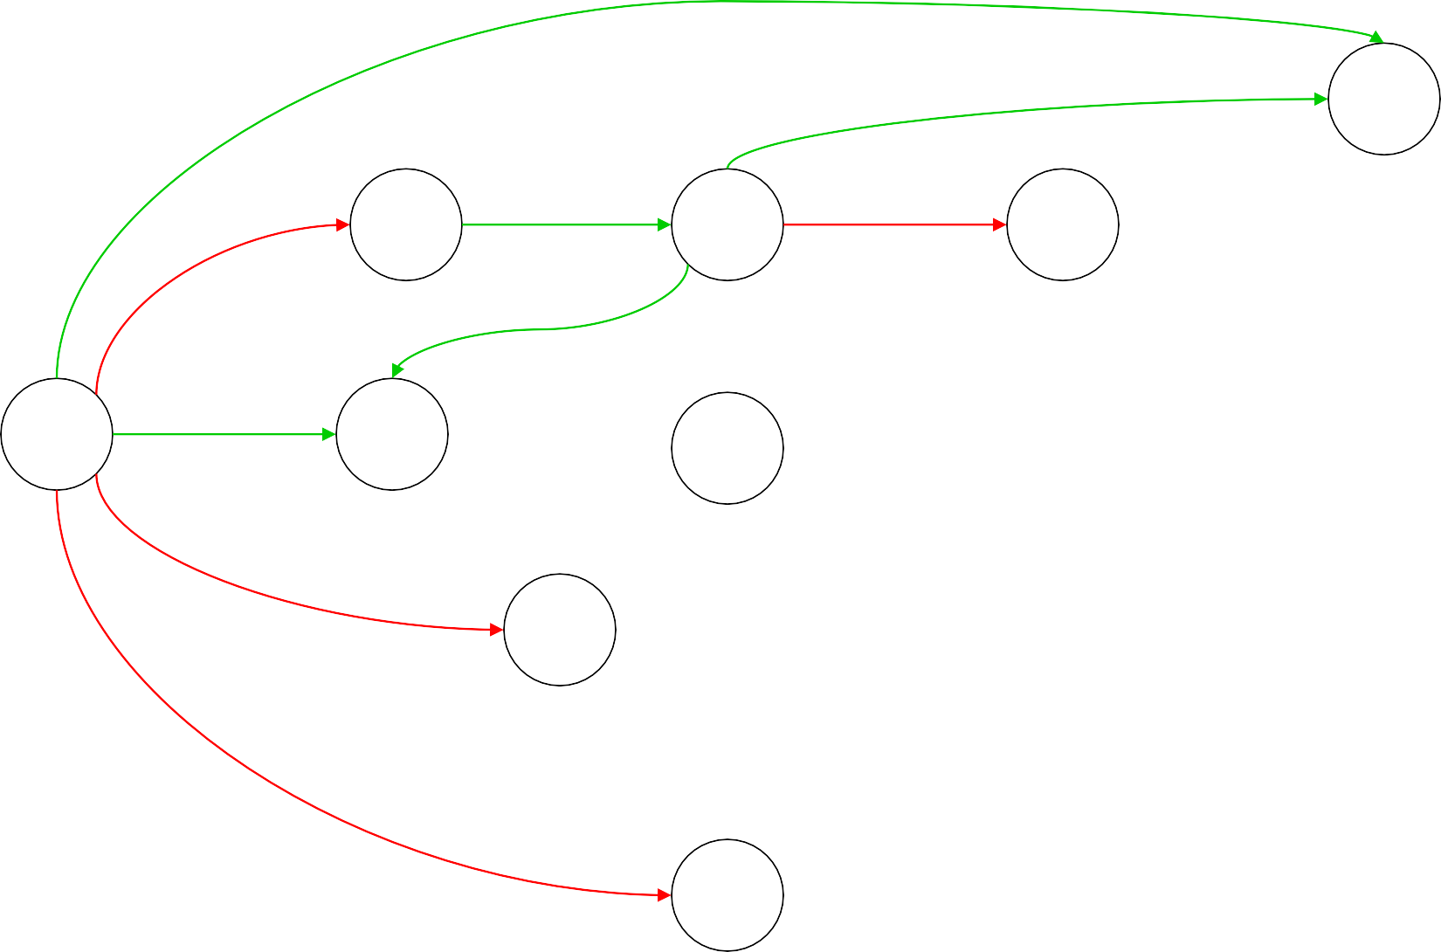
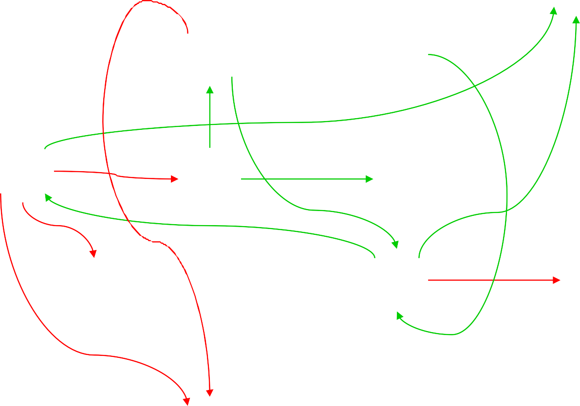
id
id
I5
F
E
I1
+
I6
+
T
I9
id
(
(
*
(
I0
I4
E
I8
)
I11
T
F
T
id
(
I2
*
I7
F
I10
F
I3

