Slide 1
NoSQL

Slide 2
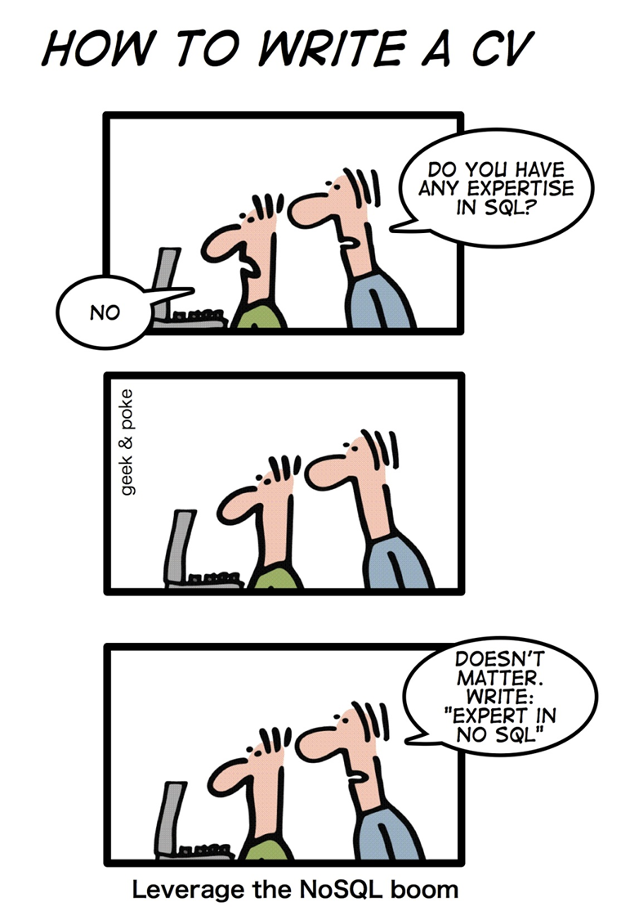
NoSQL!
NoSQL databases are currently a important topic in some parts of computing, with over a hundred different NoSQL databases.
NoSQL is a type of database management system (DBMS) that is designed to handle and store large volumes of unstructured and semi-structured data.
Unlike traditional relational databases that use tables with pre-defined schemas to store data.

Slide 3
RDBMS Characteristics
Data stored in columns and tables
Relationships represented by data
Data Manipulation Language
Data Definition Language
Transactions
Abstraction from physical layer
Applications specify what, not how
Physical layer can change without modifying applications
Create indexes to support queries
In Memory databases

Slide 4
Transactions – ACID Properties
Atomic – All of the work in a transaction completes (commit) or none of it completes
Consistent – A transaction transforms the database from one consistent state to another consistent state. Consistency is defined in terms of constraints.
Isolated – The results of any changes made during a transaction are not visible until the transaction has committed.
Durable – The results of a committed transaction survive failures

Slide 5
No SQL?
NoSQL stands for:
No Relational
No RDBMS
Not Only SQL
NoSQL is an umbrella term for all databases and data stores that don’t follow the RDBMS principles
A class of products
A collection of several (related) concepts about data storage and manipulation
Often related to large data sets

Slide 6
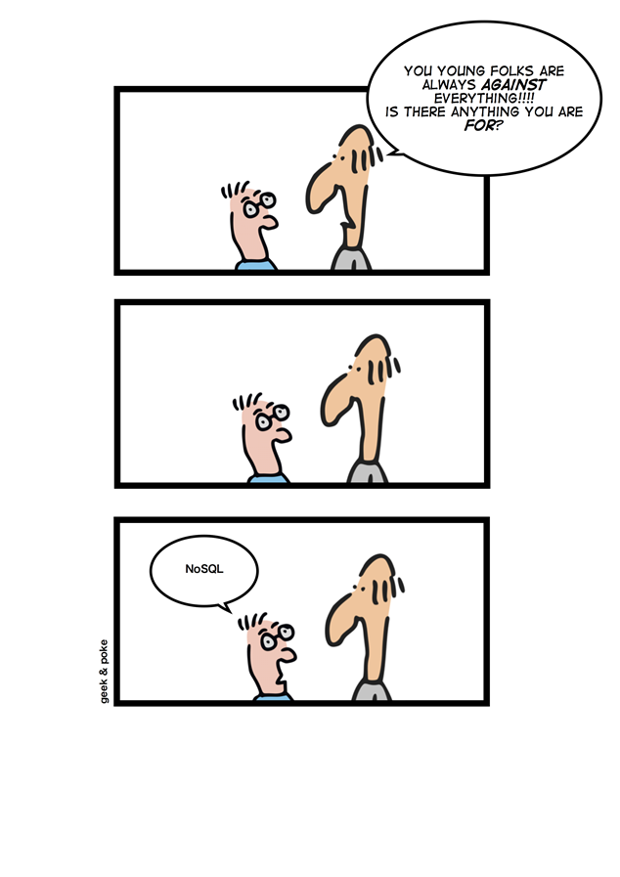
NoSQL Definition
From www.nosql-database.org:
Next Generation Databases mostly addressing some of the points: being non-relational, distributed, open-source and horizontal scalable. The original intention has been modern web-scale databases. The movement began early 2009 and is growing rapidly. Often more characteristics apply as: schema-free, easy replication support, simple API, eventually consistent / BASE (not ACID), a huge data amount, and more.

Slide 7
Where does NoSQL come from?
Non-relational DBMSs are not new
But NoSQL represents a new incarnation
Due to massively scalable Internet applications
Based on distributed and parallel computing
Development
Starts with Google
First research paper published in 2003
Continues also thanks to Lucene's developers/Apache (Hadoop) and Amazon (Dynamo)

Slide 8
Why are RDBMS not suitable for Big Data
The context is Internet
RDBMSs assume that data are
Dense
Largely uniform (structured data)
Data coming from Internet are
Massive and sparse
Semi-structured or unstructured
With massive sparse data sets, the typical storage mechanisms and access methods get stretched

Slide 9
NoSQL Distinguishing Characteristics
Large data volumes
Google’s “big data”
Scalable replication and distribution
Potentially thousands of machines
Potentially distributed around the world
Queries need to return answers quickly
Mostly query, few updates
Asynchronous Inserts & Updates
Schema-less
ACID transaction properties are not needed – BASE
CAP Theorem
Open source development

Slide 10
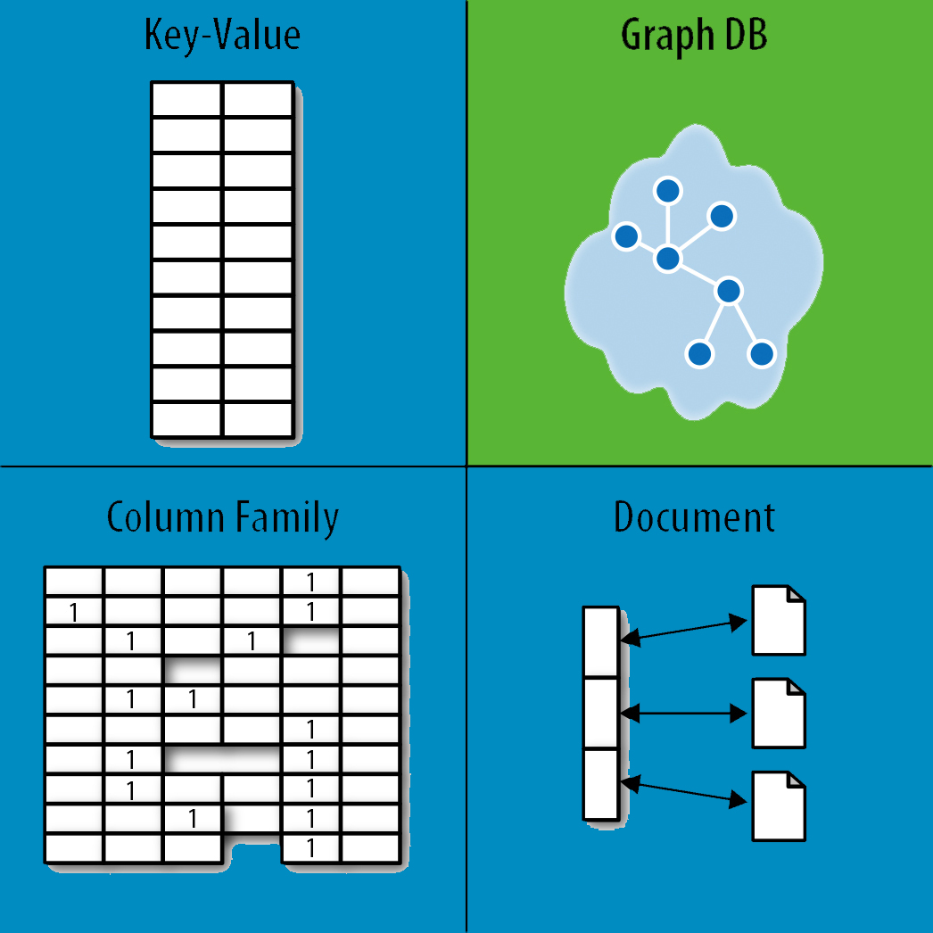
NoSQL Database Types
Discussing NoSQL databases is complicated because there are a variety of types:
Sorted ordered Column Store
Optimized for queries over large datasets, and store columns of data together, instead of rows
Document databases:
pair each key with a complex data structure known as a document.
Key-Value Store :
are the simplest NoSQL databases. Every single item in the database is stored as an attribute name (or 'key'), together with its value.
Graph Databases :
are used to store information about networks of data, such as social connections

Slide 11
Document Databases (Document Store)
Documents
Loosely structured sets of key/value pairs in documents, e.g., XML, JSON, BSON
Encapsulate and encode data in some standard formats or encodings
Are addressed in the database via a unique key
Documents are treated as a whole, avoiding splitting a document into its constituent name/value pairs
Allow documents retrieving by keys or contents
Notable for:
MongoDB (used in FourSquare, Github, and more)
CouchDB (used in Apple, BBC, Canonical, Cern, and more)

Slide 12
Document Databases (Document Store)
The central concept is the notion of a "document“ which corresponds to a row in RDBMS.
A document comes in some standard formats like JSON (BSON).
Documents are addressed in the database via a unique key that represents that document.
The database offers an API or query language that retrieves documents based on their contents.
Documents are schema free, i.e., different documents can have structures and schema that differ from one another. (An RDBMS requires that each row contain the same columns.)

Slide 13
Features of document database:
Document Type Model: As we all know data is stored in documents rather than tables or graphs, so it becomes easy to map things in many programming languages.
Flexible Schema: Overall schema is very much flexible to support this statement one must know that not all documents in a collection need to have the same fields.
Distributed and Resilient: Document data models are very much dispersed which is the reason behind horizontal scaling and distribution of data.
Manageable Query Language: These data models are the ones in which query language allows the developers to perform CRUD (Create Read Update Destroy) operations on the data model.

Slide 14
Document Databases, JSON
{
_id: ObjectId("51156a1e056d6f966f268f81"),
type: "Article",
author: "Derick Rethans",
title: "Introduction to Document Databases with MongoDB",
date: ISODate("2013-04-24T16:26:31.911Z"),
body: "This arti…"
},
{
_id: ObjectId("51156a1e056d6f966f268f82"),
type: "Book",
author: "Derick Rethans",
title: "php|architect's Guide to Date and Time Programming with PHP",
isbn: "978-0-9738621-5-7"
}

Slide 15
Advantages of Document Database
Schema-less: These are very good in retaining existing data at massive volumes because there are absolutely no restrictions in the format and the structure of data storage.
Faster creation of document and maintenance: It is very simple to create a document and apart from this maintenance requires is almost nothing.
Open formats: It has a very simple build process that uses XML, JSON, and its other forms.
Built-in versioning: It has built-in versioning which means as the documents grow in size there might be a chance they can grow in complexity. Versioning decreases conflicts.

Slide 16
Disadvantages of Document Database
Weak Atomicity: It lacks in supporting multi-document ACID transactions. A change in the document data model involving two collections will require us to run two separate queries i.e. one for each collection. This is where it breaks atomicity requirements.
Consistency Check Limitations: One can search the collections and documents that are not connected to an author collection but doing this might create a problem in the performance of database performance.
Security: Nowadays many web applications lack security which in turn results in the leakage of sensitive data. So it becomes a point of concern, one must pay attention to web app vulnerabilities.

Slide 17
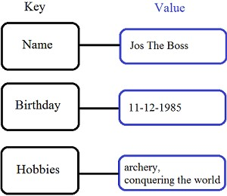
Key/Value stores
A key-value data model or database is also referred to as a key-value store.
It is a non-relational type of database.
In this, an associative array is used as a basic database in which an individual key is linked with just one value in a collection.
For the values, keys are special identifiers.
Any kind of entity can be valued. The collection of key-value pairs stored on separate records is called key-value databases and they do not have an already defined structure.

Slide 18
When to use a key-value database:
db.transport.find()
User session attributes in an online app like finance or gaming, which is referred to as real-time random data access.
Caching mechanism for repeatedly accessing data or key-based design.
The application is developed on queries that are based on keys.

Slide 19
Advantages:
It is very easy to use. Due to the simplicity of the database, data can accept any kind, or even different kinds when required.
Its response time is fast due to its simplicity, given that the remaining environment near it is very much constructed and improved.
Key-value store databases are scalable vertically as well as horizontally.
Built-in redundancy makes this database more reliable.

Slide 20
Disadvantage
As querying language is not present in key-value databases, transportation of queries from one database to a different database cannot be done.
The key-value store database is not refined. You cannot query the database without a key.

Slide 21
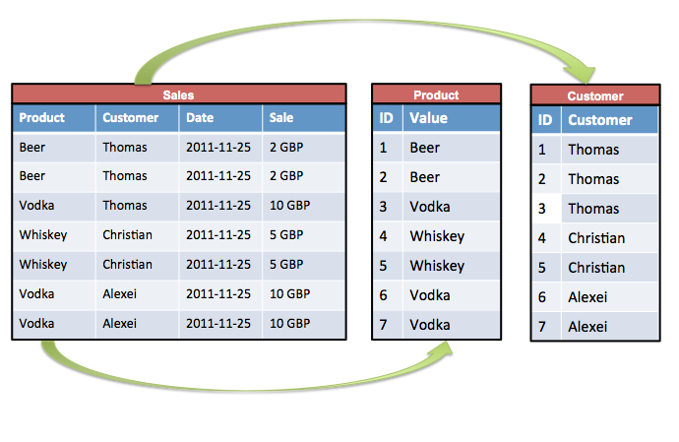
Sorted Ordered Column-Oriented Stores
Data are stored in a column-oriented way
Data efficiently stored
Avoids consuming space for storing nulls
Columns are grouped in column-families
Data isn’t stored as a single table but is stored by column families
Unit of data is a set of key/value pairs
Identified by “row-key”
Ordered and sorted based on row-key
Notable for:
Google's Bigtable (used in all Google's services)
HBase (Facebook, StumbleUpon, Hulu, Yahoo!, ...)

Slide 22
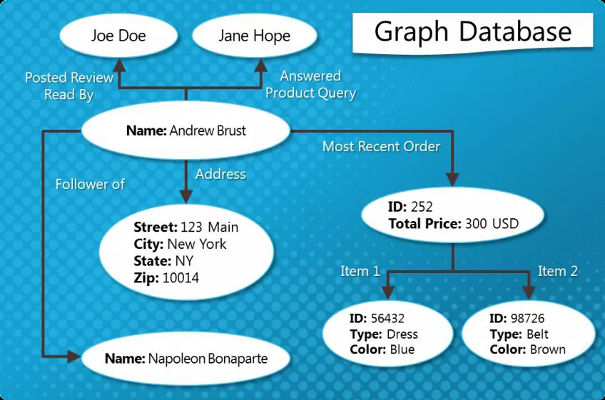
Graph Databases
Graph-oriented
Everything is stored as an edge, a node or an attribute.
Each node and edge can have any number of attributes.
Both the nodes and edges can be labelled.
Labels can be used to narrow searches.

Slide 23
NoSQL, No ACID
RDBMSs are based on ACID (Atomicity, Consistency, Isolation, and Durability) properties
NoSQL
Does not give importance to ACID properties
In some cases completely ignores them
In distributed parallel systems it is difficult/impossible to ensure ACID properties
Long-running transactions don't work because keeping resources blocked for a long time is not practical

Slide 24
BASE Transactions
Acronym contrived to be the opposite of ACID
Basically Available,
Soft state,
Eventually Consistent
Characteristics
Weak consistency – stale data OK
Availability first
Best effort
Approximate answers OK
Aggressive (optimistic)
Simpler and faster

Slide 25
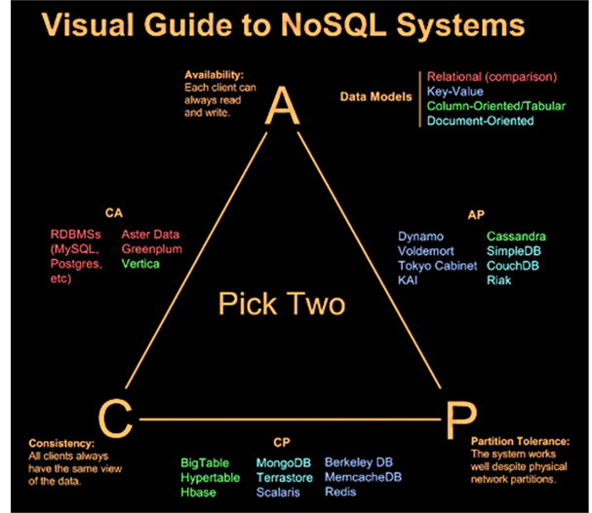
CAP Theorem
A congruent and logical way for assessing the problems involved in assuring ACID-like guarantees in distributed systems is provided by the CAP theorem
At most two of the following three can be maximized at one time
Consistency
Each client has the same view of the data
Availability
Each client can always read and write
Partition tolerance
System works well across distributed physical networks

Slide 26
CAP Theorem: Two out of Three
CAP theorem – At most two properties on three can be addressed
The choices could be as follows:
Availability is compromised but consistency and partition tolerance are preferred over it
The system has little or no partition tolerance. Consistency and availability are preferred
Consistency is compromised but systems are always available and can work when parts of it are partitioned

Slide 27
Consistency or Availability
Consistency and Availability is not “binary” decision
AP systems relax consistency in favor of availability – but are not inconsistent
CP systems sacrifice availability for consistency- but are not unavailable
This suggests both AP and CP systems can offer a degree of consistency, and availability, as well as partition tolerance
C
A
P

Slide 28
Performance
There is no perfect NoSQL database
Every database has its advantages and disadvantages
Depending on the type of tasks (and preferences) to accomplish
NoSQL is a set of concepts, ideas, technologies, and software dealing with
Big data
Sparse un/semi-structured data
High horizontal scalability
Massive parallel processing
Different applications, goals, targets, approaches need different NoSQL solutions

Slide 29
Where would I use it?
Where would I use a NoSQL database?
Do you have somewhere a large set of uncontrolled, unstructured, data that you are trying to fit into a RDBMS?
Log Analysis
Social Networking Feeds (many firms hooked in through Facebook or Twitter)
External feeds from partners
Data that is not easily analyzed in a RDBMS such as time-based data
Large data feeds that need to be massaged before entry into an RDBMS

Slide 30
Summary
Most likely, 10 years from now, the majority of data is still stored in RDBMS.
Leading users of NoSQL datastores are social networking sites such as Twitter, Facebook, LinkedIn, and Digg.
Not every problem is a nail and not every solution is a hammer.
NoSQL has taken a field that was "dead" (database development) and suddenly brought it back to life.

