Slide 1
Classification of Signals & Systems

Slide 2
Introduction to Signals
A Signal is the function of one or more independent variables that carries some information to represent a physical phenomenon.
  e.g. ECG, EEG
Two Types of Signals
Continuous-time signals
Discrete-time signals

Slide 3
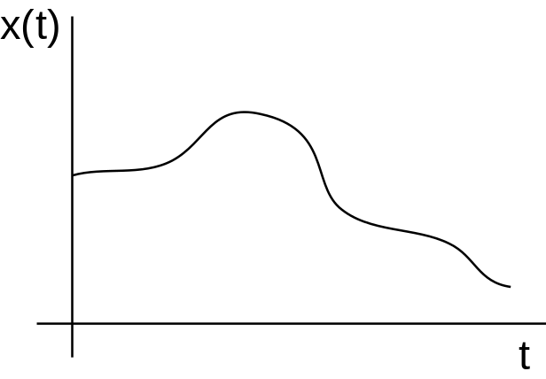
1. Continuous-Time Signals
Signal that has a value for all points in time
Function of time
  Written as x(t) because the signal “x” is a function of time
Commonly found in the physical world
  ex. Human speech
Displayed graphically as a line

Slide 4
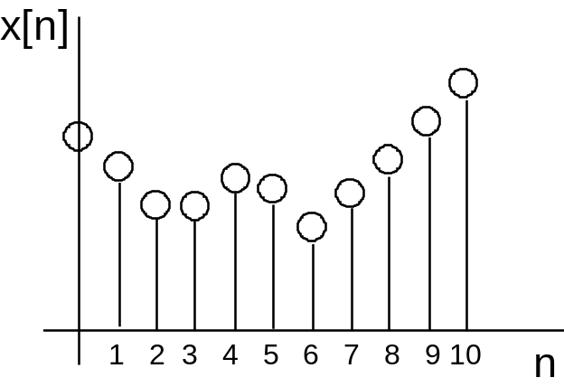
2. Discrete-Time Signals
Signal that has a value for only specific points in time
Typically formed by “sampling” a continuous-time signal
  Taking the value of the original waveform at specific intervals in time
Function of the sample value, n
  Write as x[n]
  Often called a sequence
Commonly found in the digital world
  ex. wav file or mp3
Displayed graphically as individual values
  Called a “stem” plot
Sample number

Slide 5
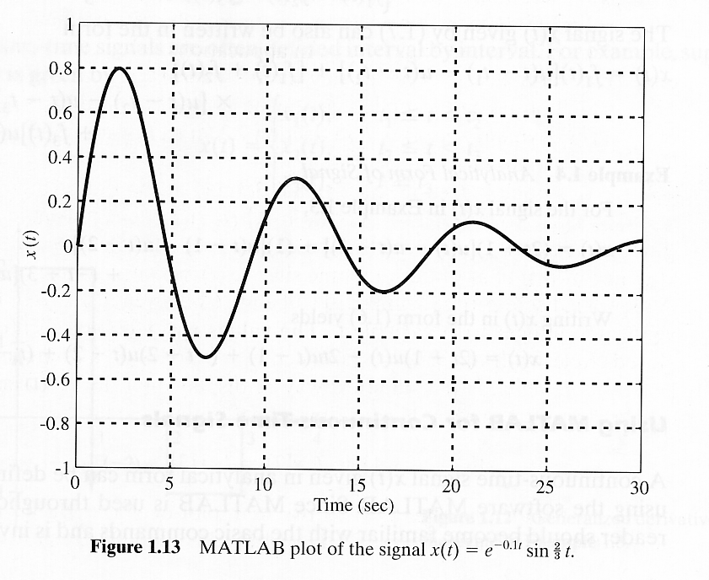
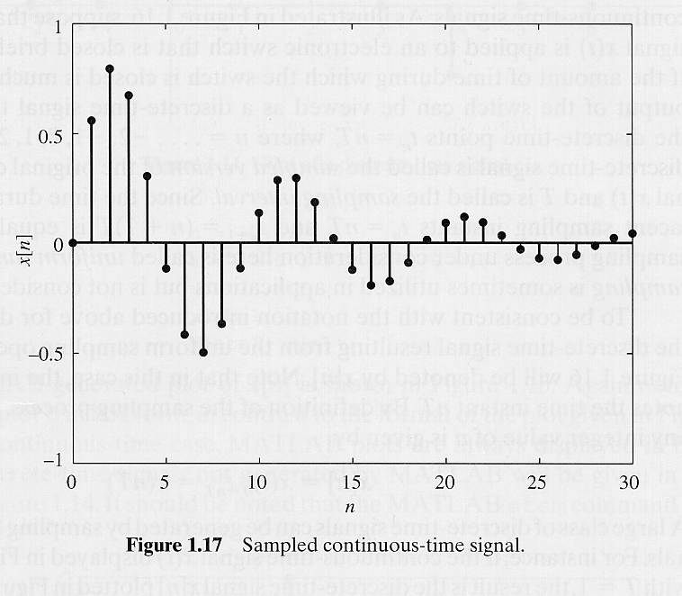




Examples: CT vs. DT Signals

Slide 6

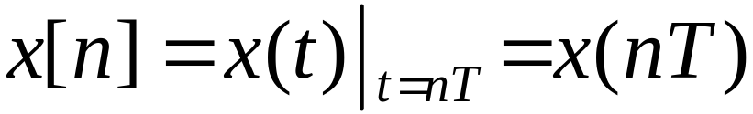
Sampling
Discrete-time signals are often obtained by sampling continuous-time signals
.
.

Slide 7
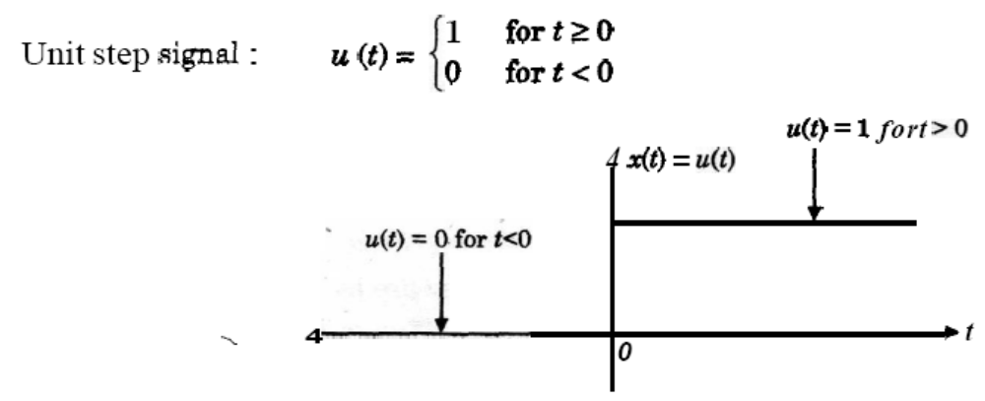
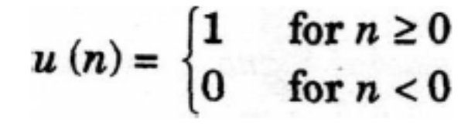
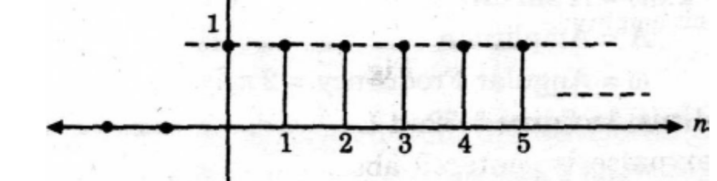
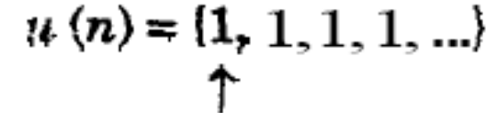
Elementary Signals

Slide 8
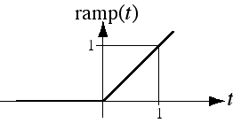
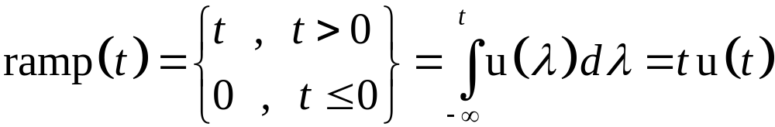
Unit Ramp Function
The unit ramp function is the integral of the unit step function.
It is called the unit ramp function because for positive t, its
slope is one amplitude unit per time.

Slide 9
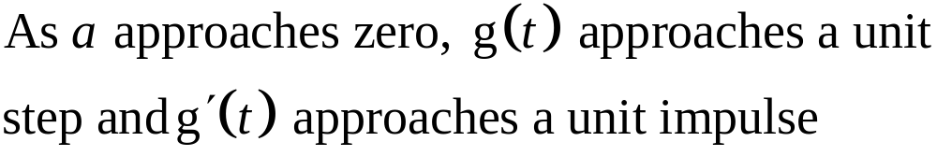
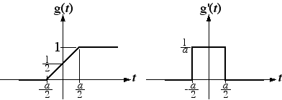
Unit Impulse Function
Functions that approach unit step and unit impulse
So unit impulse function is the derivative of the unit step
function or unit step is the integral of the unit impulse function

Slide 10
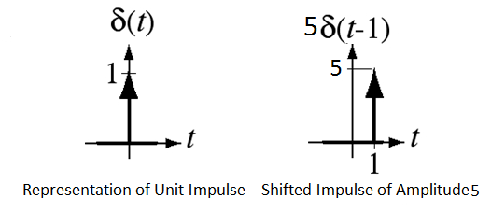
Representation of Impulse Function
The area under an impulse is called its strength or weight. It is
represented graphically by a vertical arrow. An impulse with a
strength of one is called a unit impulse.

Slide 11
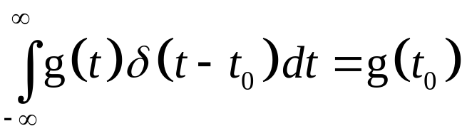
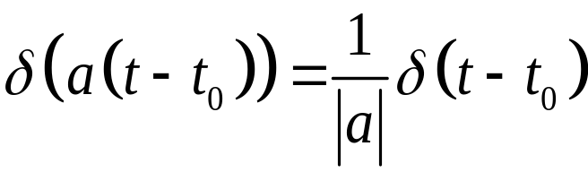
Properties of the Impulse Function
The Sampling Property
The Scaling Property
The Replication Property
g(t)⊗ δ(t) = g (t)

Slide 12
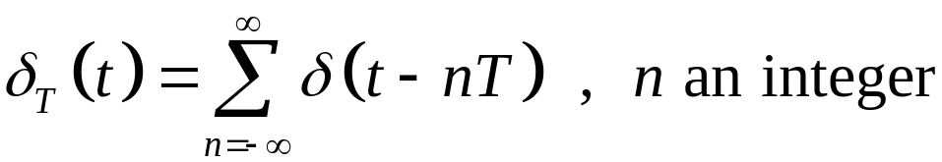
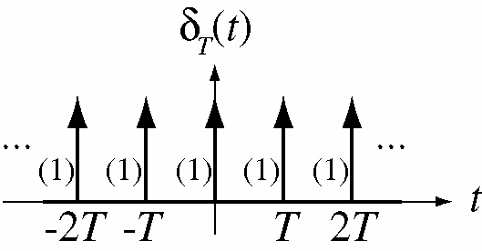
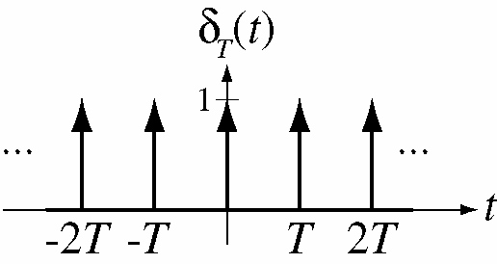
Unit Impulse Train
The unit impulse train is a sum of infinitely uniformly-
spaced impulses and is given by

Slide 13
Sinusoidal & Exponential Signals
Sinusoids and exponentials are important in signal and system analysis because they arise naturally in the solutions of the differential equations.
Sinusoidal Signals can expressed in either of two ways :
cyclic frequency form- A sin 2Пf_{o}t = A sin(2П/T_{o})t
radian frequency form- A sin ω_{o}t
ω_{o} = 2Пf_{o} = 2П/T_{o}
T_{o} = Time Period of the Sinusoidal Wave

Slide 14
Sinusoidal & Exponential Signals Contd.
x(t) = A sin (2Пf_{o}t+ θ)
= A sin (ω_{o}t+ θ)
x(t) = Ae^{at Real Exponential}
= Ae^{jω̥t =} A[cos (ω_{o}t) +j sin (ω_{o}t)] ^{Complex Exponential}
θ = Phase of sinusoidal wave
A = amplitude of a sinusoidal or exponential signal
f_{o} = fundamental cyclic frequency of sinusoidal signal
ω_{o} = radian frequency
Sinusoidal signal

Slide 15
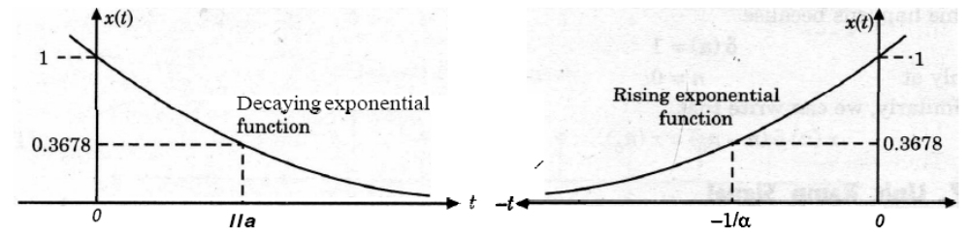
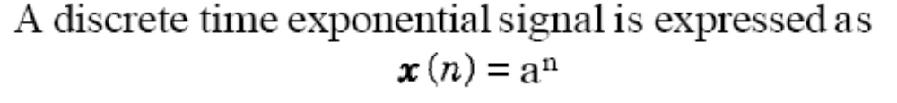
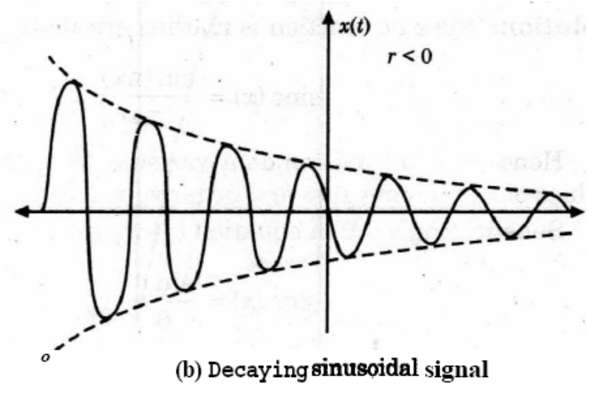
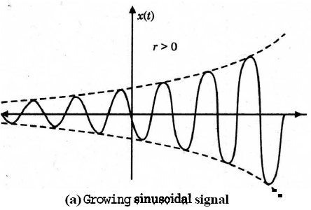
Real Exponential Signals and damped Sinusoidal
x(t) = e^{-at}
x(t) = e^{αt}

Slide 16
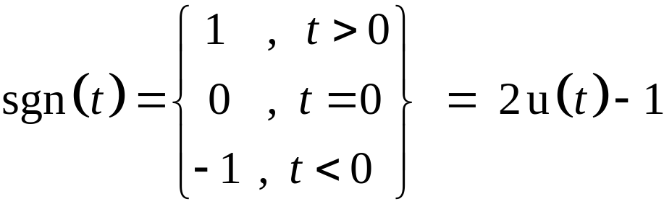
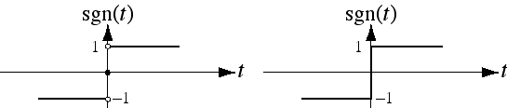
Signum Function
Precise Graph
Commonly-Used Graph
The signum function, is closely related to the unit-step
function.

Slide 17
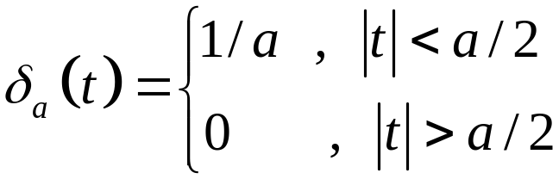
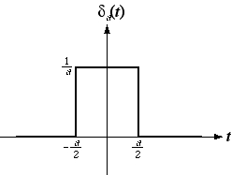
Rectangular Pulse or Gate Function
Rectangular pulse,

Slide 18
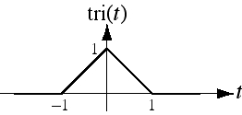
The Unit Triangle Function
A triangular pulse whose height and area are both one but its base width is not, is called unit triangle function. The unit triangle is related to the unit rectangle through an operation called convolution.

Slide 19
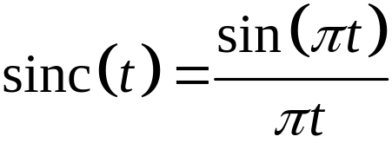
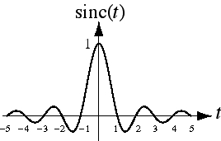
Sinc Function

Slide 20
Discrete-Time Signals
Sampling is the acquisition of the values of a continuous-time signal at discrete points in time
x(t) is a continuous-time signal, x[n] is a discrete-time signal

Slide 21
Discrete Time Exponential and Sinusoidal Signals
DT signals can be defined in a manner analogous to their continuous-time counter part
x[n] = A sin (2Пn/N_{o}+θ)
= A sin (2ПF_{o}n+ θ)
x[n] = a^{n}
n = the discrete time
A = amplitude
θ = phase shifting radians,
N_{o} = Discrete Period of the wave
1/N₀ = F_{o} = Ω_{o}/2 П = Discrete Frequency
Discrete Time Sinusoidal Signal
Discrete Time Exponential Signal

Slide 22
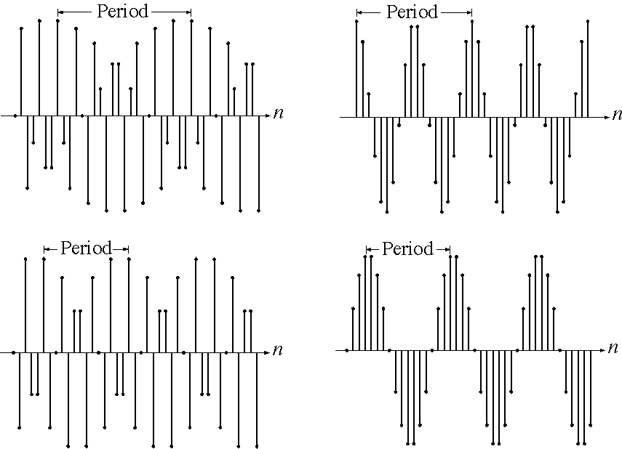
Discrete Time Sinusoidal Signals

Slide 23
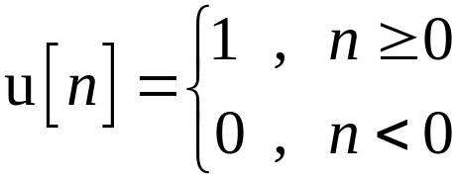
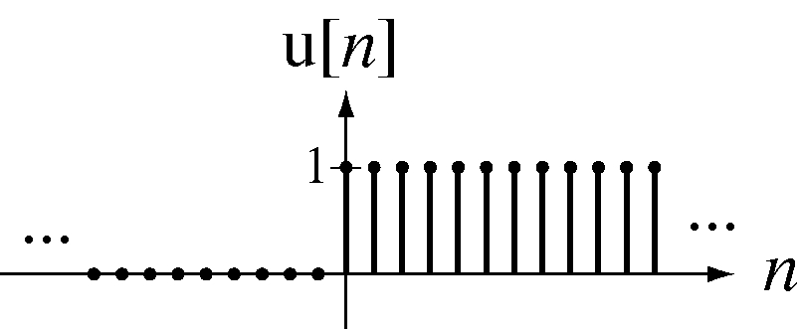
Discrete Time Unit Step Function or Unit Sequence Function

Slide 24
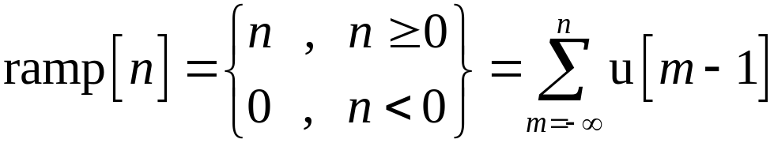
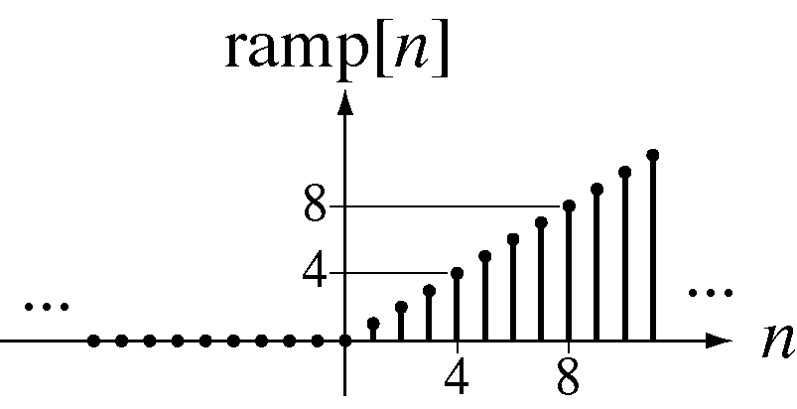
Discrete Time Unit Ramp Function

Slide 25
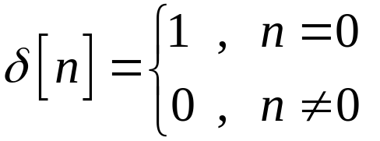
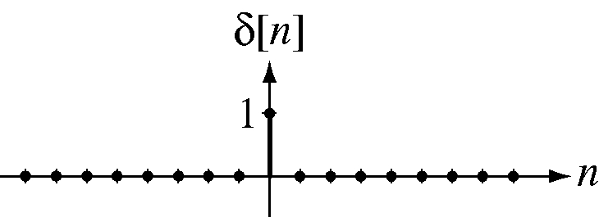
Discrete Time Unit Impulse Function or Unit Pulse Sequence

Slide 26
Unit Pulse Sequence Contd.
The discrete-time unit impulse is a function in the ordinary sense in contrast with the continuous-time unit impulse.
It has a sampling property.
It has no scaling property i.e.
δ[n]= δ[an] for any non-zero finite integer ‘a’

Slide 27
Operations of Signals
Sometime a given mathematical function may completely describe a signal .
Different operations are required for different purposes of arbitrary signals.
The operations on signals can be
Time Shifting
Time Scaling
Time Inversion or Time Folding

Slide 28
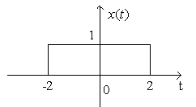
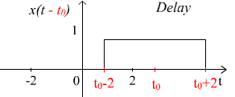
Time Shifting
The original signal x(t) is shifted by an amount tₒ.
X(t)→X(t-to) →Signal Delayed→ Shift to the right

Slide 29
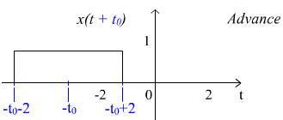
Time Shifting Contd.
X(t)→X(t+to) →Signal Advanced→ Shift to the left

Slide 30
Time Scaling
For the given function x(t), x(at) is the time scaled version of x(t)
For a ˃ 1,period of function x(t) reduces and function speeds up. Graph of the function shrinks.
For a ˂ 1, the period of the x(t) increases and the function slows down. Graph of the function expands.

Slide 31
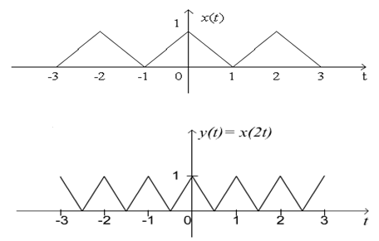
Time scaling Contd.
Example: Given x(t) and we are to find y(t) = x(2t).
The period of x(t) is 2 and the period of y(t) is 1,
Notes:
Example: fast forwarding / slow playing

Slide 32
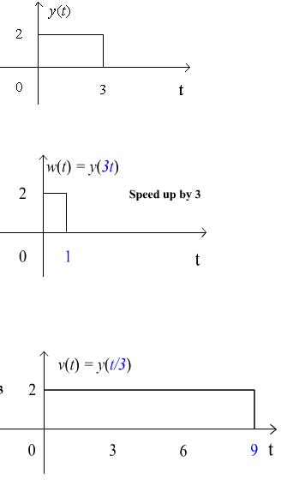
Time scaling Contd.
Given y(t),
  find w(t) = y(3t)
  and v(t) = y(t/3).

Slide 33
Time Reversal
Time reversal is also called time folding
In Time reversal signal is reversed with respect to time i.e.
y(t) = x(-t) is obtained for the given function

Slide 34
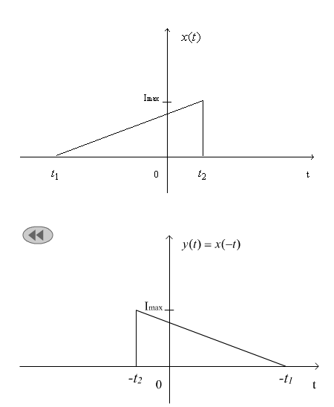
Time reversal Contd.
Notes:
Example: Playing a tape recorder backward
Beatle Revolution 9 is said be played backward!

Slide 35
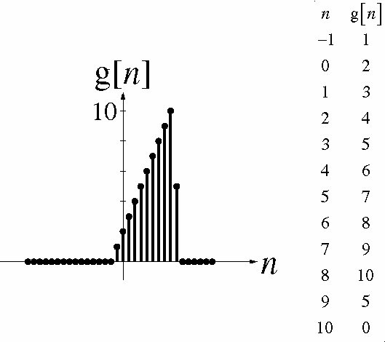
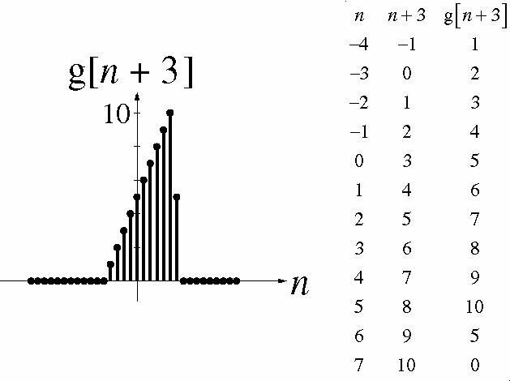
Operations of Discrete Time Functions

Slide 36

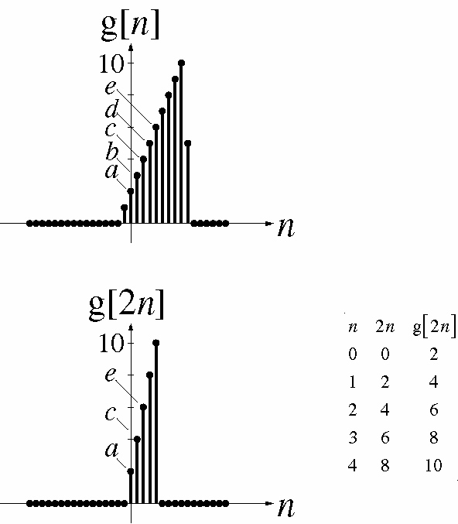
Operations of Discrete Functions Contd.
Scaling; Signal Compression
K an integer > 1

Slide 37
Classification of Signals
Deterministic & Non Deterministic Signals
Periodic & A periodic Signals
Even & Odd Signals
Energy & Power Signals

Slide 38
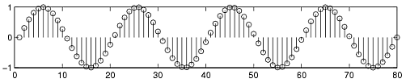
Deterministic & Non Deterministic Signals
Deterministic signals
Behavior of these signals is predictable w.r.t time
There is no uncertainty with respect to its value at any time.
These signals can be expressed mathematically.
For example x(t) = sin(3t) is deterministic signal.

Slide 39

Deterministic & Non Deterministic Signals Contd.
Non Deterministic or Random signals
Behavior of these signals is random i.e. not predictable w.r.t time.
There is an uncertainty with respect to its value at any time.
These signals can’t be expressed mathematically.
For example Thermal Noise generated is non deterministic signal.

Slide 40
Periodic and Non-periodic Signals
Given x(t) is a continuous-time signal
x (t) is periodic iff x(t) = x(t+Tₒ) for any T and any integer n
Example
  x(t) = A cos(ωt)
  x(t+Tₒ) = A cos[ω(t+Tₒ)] = A cos(ωt+ωTₒ)= A cos(ωt+2π) = A cos(ωt)
  Note: Tₒ =1/fₒ ; ω=2πfₒ

Slide 41
Periodic and Non-periodic Signals Contd.
For non-periodic signals
x(t) ≠ x(t+Tₒ)
A non-periodic signal is assumed to have a period T = ∞
Example of non periodic signal is an exponential signal

Slide 42
Important Condition of Periodicity for Discrete Time Signals
A discrete time signal is periodic if
x(n) = x(n+N)
For satisfying the above condition the frequency of the discrete time signal should be ratio of two integers
i.e. fₒ = k/N

Slide 43
Sum of periodic Signals
X(t) = x1(t) + X2(t)
X(t+T) = x1(t+m₁T₁) + X2(t+m₂T₂)
m₁T₁=m₂T₂ = Tₒ = Fundamental period
Example: cos(tπ/3)+sin(tπ/4)
  T1=(2π)/(π/3)=6; T2 =(2π)/(π/4)=8;
  T1/T2=6/8 = ¾ = (rational number) = m2/m1
  m₁T₁=m₂T₂ → Find m1 and m2→
  6.4 = 3.8 = 24 = Tₒ

Slide 44
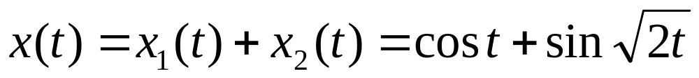
Sum of periodic Signals – may not always be periodic!
  T1=(2π)/(1)= 2π; T2 =(2π)/(sqrt(2));
  T1/T2= sqrt(2);
  Note: T1/T2 = sqrt(2) is an irrational number
  X(t) is aperiodic

Slide 45
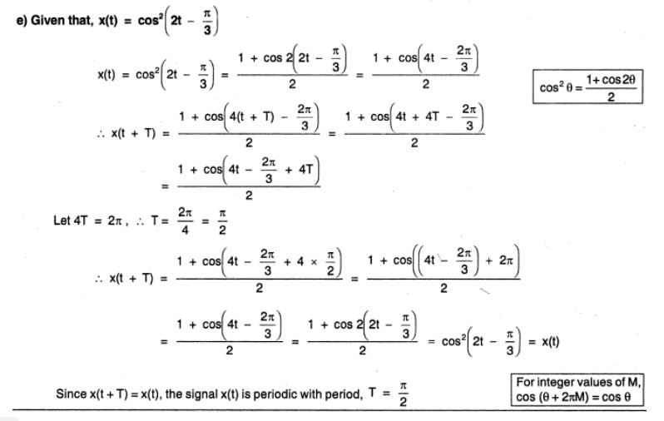

Slide 46


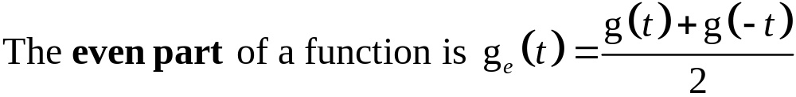

Even and Odd Signals
Even Functions
Odd Functions
A function whose even part is zero, is odd and a function
whose odd part is zero, is even.

Slide 47
Various Combinations of even and odd functions
Function type | Sum | Difference | Product | Quotient
Both even | Even | Even | Even | Even
Both odd | Odd | Odd | Even | Even
Even and odd | Neither | Neither | Odd | Odd

Slide 48
Derivatives and Integrals of Functions
Function type | Derivative | Integral
Even | Odd | Odd + constant
Odd | Even | Even

Slide 49





Discrete Time Even and Odd Signals

Slide 50
Combination of even and odd function for DT Signals
Function type | Sum | Difference | Product | Quotient
Both even | Even | Even | Even | Even
Both odd | Odd | Odd | Even | Even
Even and odd | Even or Odd | Even or odd | Odd | Odd

Slide 51

Products of DT Even and Odd Functions
Two Even Functions

Slide 52

Products of DT Even and Odd Functions Contd.
An Even Function and an Odd Function

Slide 53


Proof Examples
Change t→ -t
Prove that product of two even signals is even.
Prove that product of two odd signals is odd.
What is the product of an even signal and an odd signal? Prove it!

Slide 54

Products of DT Even and Odd Functions Contd.
Two Odd Functions

Slide 55

Energy and Power Signals
Energy Signal
A signal with finite energy and zero power is called Energy Signal i.e.for energy signal
0<E<∞ and P =0
Signal energy of a signal is defined as the area under the square of the magnitude of the signal.
The units of signal energy depends on the unit of the signal.

Slide 56

Energy and Power Signals Contd.
Power Signal
Some signals have infinite signal energy. In that caseit is more convenient to deal with average signal power.
For power signals
0<P<∞ and E = ∞
Average power of the signal is given by

Slide 57

Energy and Power Signals Contd.
For a periodic signal x(t) the average signal power is
T is any period of the signal.
Periodic signals are generally power signals.

Slide 58

Signal Energy and Power for DT Signal
A discrtet time signal with finite energy and zero power is called Energy Signal i.e.for energy signal
0<E<∞ and P =0
The signal energy of a for a discrete time signal x[n] is

Slide 59



Signal Energy and Power for DT Signal Contd.
The average signal power of a discrete time power signal
x[n] is
For a periodic signal x[n] the average signal power is

Slide 60


Slide 61
What is System?
Systems process input signals to produce output signals
A system is combination of elements that manipulates one or more signals to accomplish a function and produces some output.
input signal
output signal
system

Slide 62
Types of Systems
Causal & Anticausal
Linear & Non Linear
Time Variant &Time-invariant
Stable & Unstable
Static & Dynamic
Invertible & Inverse Systems

Slide 63
Causal & Anticausal Systems
Causal system : A system is said to be causal if the present value of the output signal depends only on the present and/or past values of the input signal.
Example: y[n]=x[n]+1/2x[n-1]

Slide 64

Causal & Anticausal Systems Contd.
Anticausal system : A system is said to be anticausal if the present value of the output signal depends only on the future values of the input signal.

Slide 65

Linear & Non Linear Systems

Slide 66


Slide 67


Time Invariant and Time Variant Systems
A system is said to be time invariant if a time delay or time advance of the input signal leads to a identical time shift in the output signal.

Slide 68


Slide 69

Stable & Unstable Systems
A system is said to be bounded-input bounded-output stable (BIBO stable) iff every bounded input results in a bounded output.
i.e.

Slide 70

Stable & Unstable Systems Contd.
Example
- y[n]=1/3(x[n]+x[n-1]+x[n-2])

Slide 71
Stable & Unstable Systems Contd.
Example: The system represented by
y(t) = A x(t) is unstable ; A˃1
Reason: let us assume x(t) = u(t), then at every instant u(t) will keep on multiplying with A and hence it will not be bonded.

Slide 72

Static & Dynamic Systems
A static system is memoryless system
It has no storage devices
its output signal depends on present values of the input signal
For example

Slide 73

Static & Dynamic Systems Contd.
A dynamic system possesses memory
It has the storage devices
A system is said to possess memory if its output signal depends on past values and future values of the input signal

Slide 74
Invertible & Inverse Systems
If a system is invertible it has an Inverse System
Example: y(t)=2x(t)
  System is invertible→ must have inverse, that is:
  For any x(t) we get a distinct output y(t)
  Thus, the system must have an Inverse
    x(t)=1/2 y(t)=z(t)
x(t)
System
y(t)
Inverse
System
x(t)
System
(multiplier)
Inverse
System
(divider)
x(t)
y(t)=2x(t)
x(t)

Slide 75



Discrete-Time Systems
A Discrete-Time System is a mathematical operation that maps a given input sequence x[n] into an output sequence y[n]
  Example:
  Moving (Running) Average
  Maximum
  Ideal Delay System

Slide 76


Memoryless System
  A system is memoryless if the output y[n] at every value of n depends only on the input x[n] at the same value of n
  Example :
  Square
  Sign
  counter example:
  Ideal Delay System

Slide 77


Linear Systems
Linear System: A system is linear if and only if
  Example: Ideal Delay System

Slide 78



Time-Invariant Systems
  Time-Invariant (shift-invariant) Systems
  A time shift at the input causes corresponding time-shift at output
  Example: Square
  Counter Example: Compressor System

Slide 79


Causal System
  A system is causal iff it’s output is a function of only the current and previous samples
  Examples: Backward Difference
  Counter Example: Forward Difference

Slide 80




Stable System
  Stability (in the sense of bounded-input bounded-output BIBO). A system is stable iff every bounded input produces a bounded output
  Example: Square
  Counter Example: Log

Slide 81
THANKS

