Slide 1
The Concept of ‘System’
(oppenheim et al. 1999)
Discrete-time Systems
  A transformation or operator that maps an input sequence with values x[n] into an output sequence with value y[n] .
y[n] = T{x[n]}
x[n]
T{⋅}
y[n]

Slide 2
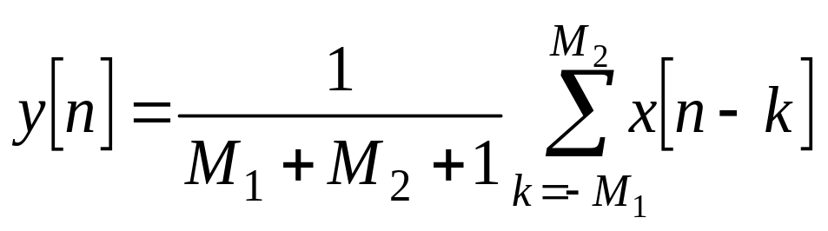
System Examples
Ideal Delay
  y[n] = x[n−n_{d}], where n_{d} is a fixed positive integer called the delay of the system.
Moving Average
Memoryless Systems
  The output y[n] at every value of n depends only on the input x[n], at the same value of n.
  Eg. y[n] = (x[n])², for each value of n.

Slide 3
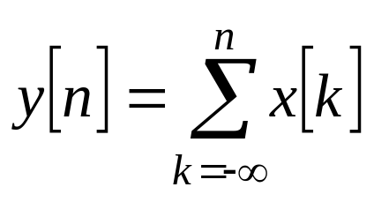
System Examples (continue)
Linear System: If y₁[n] and y₂[n] are the responses of a system when x₁[n] and x₂[n] are the respective inputs. The system is linear if and only if
  T{x₁[n] + x₂[n]} = T{x₁[n] }+ T{x₂[n]} = y₁[n] + y₂[n] .
  T{ax[n] } = aT{x[n]} = ay[n], for arbitrary constant a.
  So, if x[n] = Σ_{k} a_{k}x_{k}[n], y[n] = Σ_{k} a_{k}y_{k}[n] (superposition principle)
For example
Accumulator System
(is a linear system)

Slide 4
System Examples (continue)
Nonlinear System.
  Eg. w[n] = log₁₀(|x[n]|) is not linear.
Time-invariant System:
  If y[n] = T{x[n]}, then y[n−n₀] = T{x[n −n₀]}
  The accumulator is a time-invariant system.

Slide 5
System Examples (continue)
Causality
  A system is causal if, for every choice of n₀, the output sequence value at the index n = n₀ depends only the input sequence values for n ≤ n₀.
  That is, if x₁[n] = x₂[n] for n ≤ n₀, then y₁[n] = y₂[n] for n ≤ n₀.
Eg. Forward-difference system (non causal)
  y[n] = x[n+1] − x[n] (The current value of the output depends on a future value of the input)
Eg. Background-difference (causal)
  y[n] = x[n] − x[n−1]

Slide 6
System Examples (continue)
Stability
  Bounded input, bounded output (BIBO): If the input is bounded, |x[n]| ≤ B_{x} < ∞ for all n, then the output is also bounded, i.e., there exists a positive value B_{y} s.t. |y[n]| ≤ B_{y} < ∞ for all n.
Eg., the system y[n] = (x[n])² is stable.

Slide 7
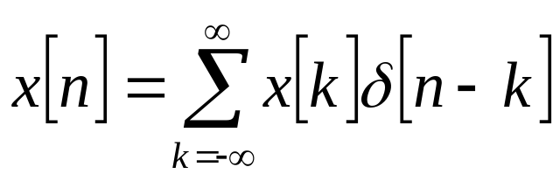
Linear Time Invariant Systems
A system that is both linear and time invariant is called a linear time invariant (LTI) system.
By setting the input x[n] as δ[n], the impulse function, the output h[n] of an LTI system is called the impulse response of this system.
  Time invariant: when the input is δ[n-k], the output is h[n-k].
  Remember that the x[n] can be represented as a linear combination of delayed impulses

Slide 8
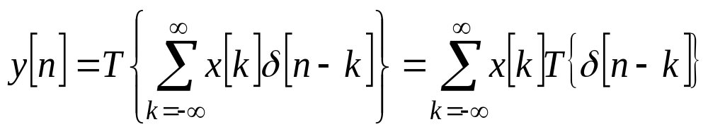
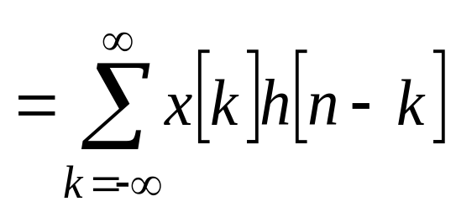
Linear Time Invariant Systems (continue)
Hence
Therefore, a LTI system is completely characterized by its impulse response h[n].

Slide 9
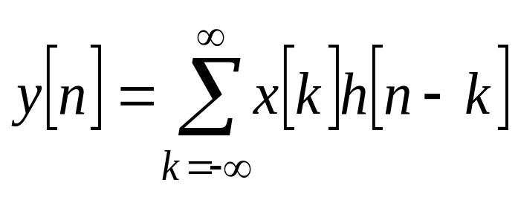
Linear Time Invariant Systems (continue)
  Note that the above operation is convolution, and can be written in short by y[n] = x[n] ∗ h[n].
  The output of an LTI system is equivalent to the convolution of the input and the impulse response.
In a LTI system, the input sample at n = k, represented as x[k]δ[n-k], is transformed by the system into an output sequence x[k]h[n-k] for −∞ < n < ∞.

Slide 10
Property of LTI System and Convolution
Communitive
  x[n] ∗ h[n] = h[n] ∗ x[n].
Distributive over addition
  x[n] ∗ (h₁[n] + h₂[n]) = x[n] ∗ h₁[n] + x[n] ∗ h₂[n].
Cascade connection
h₁[n]
h₂[n]
x[n]
y[n]
h₁[n] ∗ h₂[n]
x[n]
y[n]
h₂[n]
h₁[n]
x[n]
y[n]

Slide 11
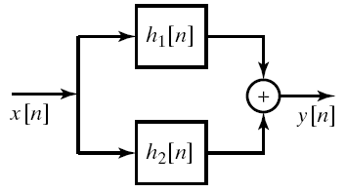

Property of LTI System and Convolution (continue)
Parallel combination of LTI systems and its equivalent system.

Slide 12
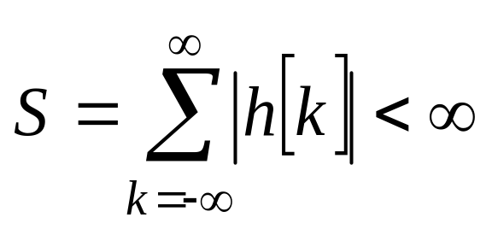
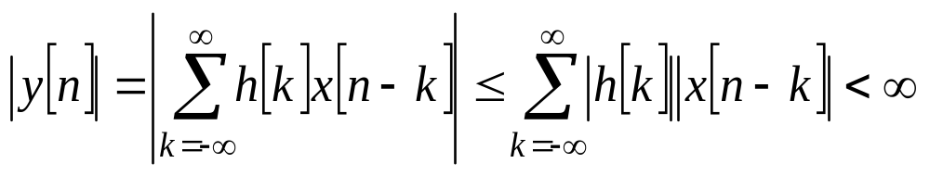
Property of LTI System and Convolution (continue)
Stability: A LTI system is stable if and only if
Since
when |x[n]| ≤ B_{x}.
This is a sufficient condition proof.

Slide 13
Property of LTI System and Convolution (continue)
Causality
  those systems for which the output depends only on the input samples y[n₀] depends only the input sequence values for n ≤ n₀.
  Follow this property, an LTI system is causal iff
  h[n] = 0 for all n < 0.
  Causal sequence: a sequence that is zero for n<0. A causal sequence could be the impulse response of a causal system.

Slide 14
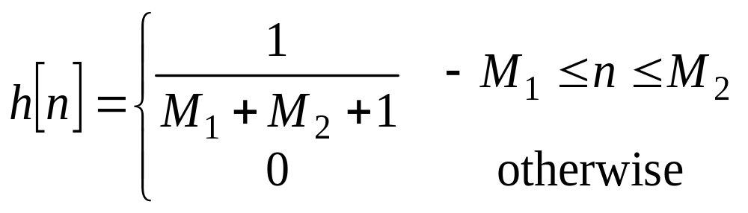
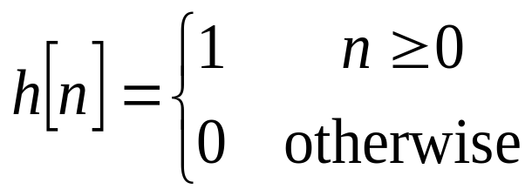
Impulse Responses of Some LTI Systems
Ideal delay: h[n] = δ[n-n_{d}]
Moving average
Accumulator
Forward difference: h[n] = δ[n+1]−δ[n]
Backward difference: h[n] = δ[n]−δ[n−1]

Slide 15
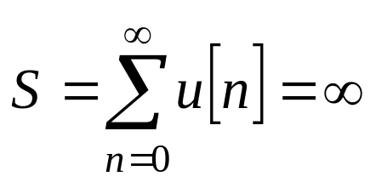
Examples of Stable/Unstable Systems
In the above, moving average, forward difference and backward difference are stable systems, since the impulse response has only a finite number of terms.
  Such systems are called finite-duration impulse response (FIR) systems.
  FIR is equivalent to a weighted average of a sliding window.
  FIR systems will always be stable.
The accumulator is unstable since

Slide 16
Examples of Stable/Unstable Systems (continue)
When the impulse response is infinite in duration, the system is referred to as an infinite-duration impulse response (IIR) system.
  The accumulator is an IIR system.
Another example of IIR system: h[n] = a^{n}u[n]
  When |a|<1, this system is stable since
  S = 1 +|a| +|a|² +…+ |a|^{n} +…… = 1/(1−|a|) is bounded.
  When |a|≥ 1, this system is unstable

Slide 17
Examples of Causal Systems
The ideal delay, accumulator, and backward difference systems are causal.
The forward difference system is noncausal.
The moving average system is causal requires −M₁≥0 and M₂≥0.

Slide 18

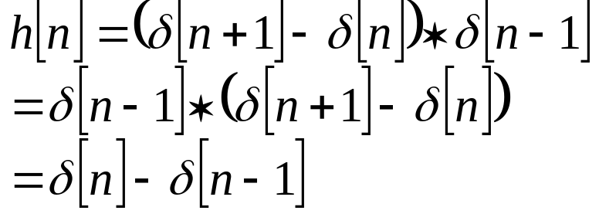


Equivalent Systems
A LTI system can be realized in different ways by separating it into different subsystems.

Slide 19
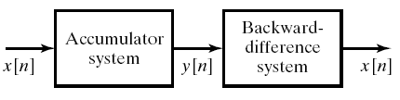
Equivalent Systems (continue)
Another example of cascade systems – inverse system.

Slide 20
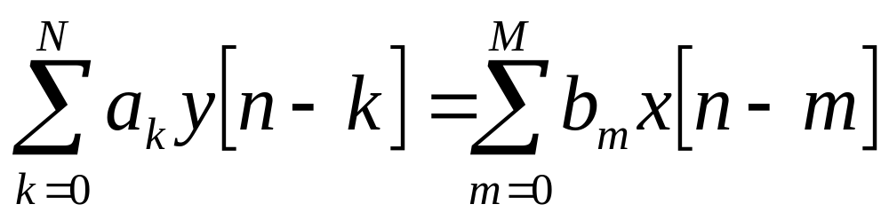
Linear Constant-coefficient Difference Equations
for all n
An important subclass of LTI systems consist of those system for which the input x[n] and output y[n] satisfy an Nth-order linear constant-coefficient difference equation.
A general form is shown above.
Not-all LTI systems can be represented into this form, but it specifies a wide class of LTI systems.

Slide 21
Block Diagram of the Difference Equation
Assume that a₀ = 1. Let TD denote one-sample delay.
x[n]
b₀
+
+
y[n]
TD
TD
x[n-1]
b₁
+
+
− a₁
y[n-1]
TD
TD
x[n-2]
b₂
+
+
− a₂
y[n-2]
TD
TD
+
− a_{N}
y[n-N]
x[n-M]
b_{M}
+

