Slide 1
Introduction to
Fast Fourier Transform (FFT)
Algorithms

Slide 2
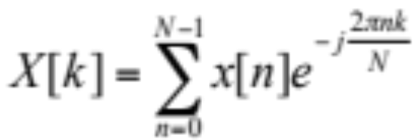
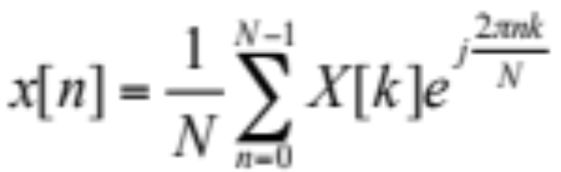
Discrete Fourier Transform (DFT)
The DFT provides uniformly spaced samples of the Discrete-Time Fourier Transform (DTFT)
DFT definition:
Requires N² complex multiplies and N(N-1) complex additions

Slide 3


Faster DFT computation?
Take advantage of the symmetry and periodicity of the complex exponential (let W_{N}=e^{-j2π/N})
  symmetry:
  periodicity:
Note that two length N/2 DFTs take less computation than one length N DFT: 2(N/2)²<N²
Algorithms that exploit computational savings are collectively called Fast Fourier Transforms

Slide 4
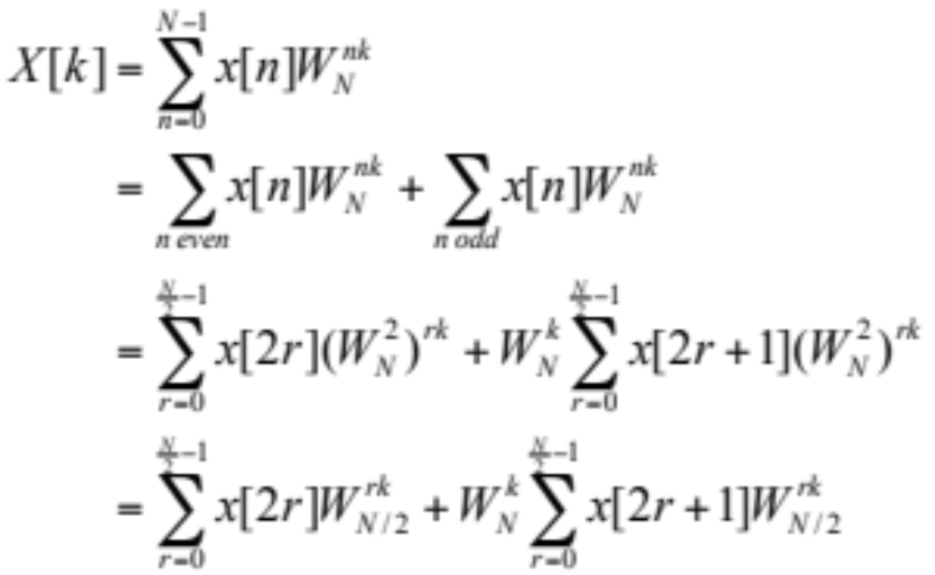
Decimation-in-Time Algorithm
Consider expressing DFT with even and odd input samples:

Slide 5
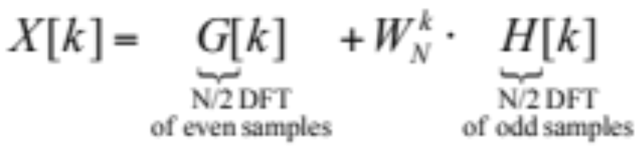

DIT Algorithm (cont.)
Result is the sum of two N/2 length DFTs
Then repeat decomposition of N/2 to N/4 DFTs, etc.
x[0,2,4,6]
N/2
DFT
X[0…7]
x[1,3,5,7]
N/2
DFT

Slide 6

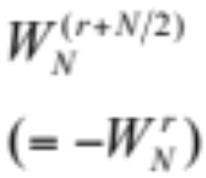
Detail of “Butterfly”
Cross feed of G[k] and H[k] in flow diagram is called a “butterfly”, due to shape
or simplify:
-1

Slide 7





8-point DFT Diagram
x[0,4,2,6,1,5,3,7]
X[0…7]

Slide 8
Computation on DSP
Input and Output data
  Real data in X memory
  Imaginary data in Y memory
Coefficients (“twiddle” factors)
  cos (real) values in X memory
  sin (imag) values in Y memory
Inverse computed with exponent sign change and 1/N scaling

