Slide 1
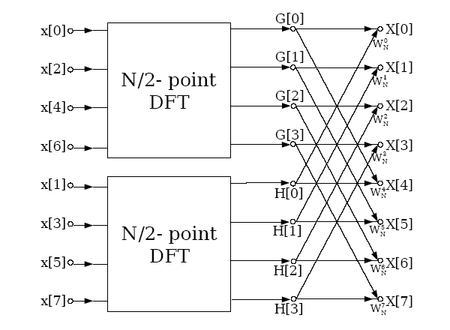
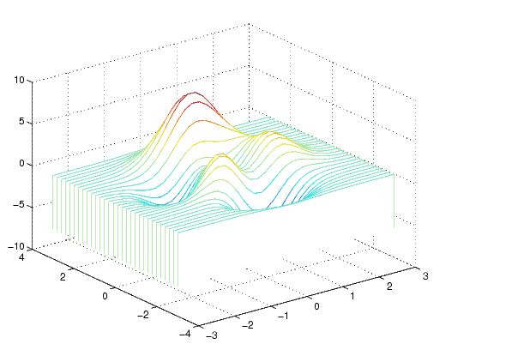
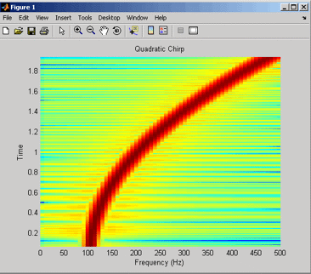
FAST FOURIER TRANSFORM
Objectives:
Discrete Fourier Transform
Computational Complexity
Decimation in Time
Butterfly Diagrams
Convolution Application
Waterfall Plots
Spectrograms
Notes:
MS Equation 3.0 was used with settings of: 18, 12, 8, 18, 12.

Slide 2
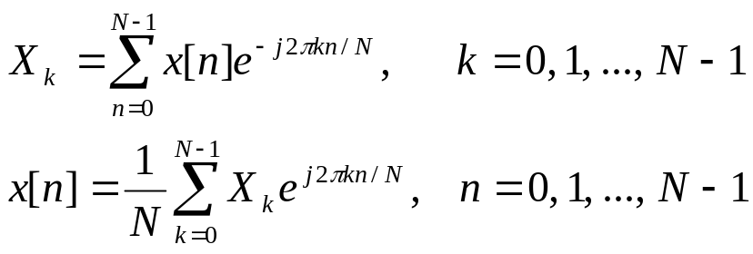
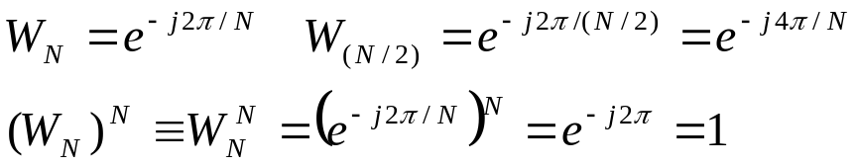
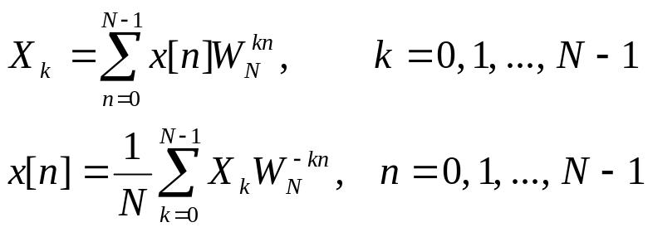
The Discrete Fourier Transform
Recall our definition for the Discrete Fourier Transform (DFT):
The computation for X_{k} requires N² complex multiplications that require four multiplications of real numbers per complex multiplication.
The Fast Fourier Transform (FFT) is an approach to reduce the computational complexity that produces the same result as a DFT (same result, significantly fewer multiplications).
To simplify notation, define:
We can rewrite the DFT equations:
Notes:
]i=k,

Slide 3
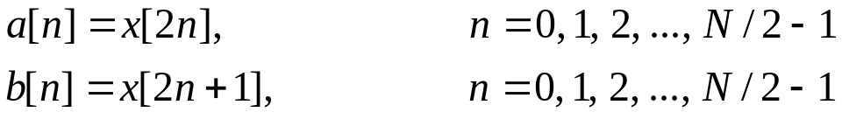
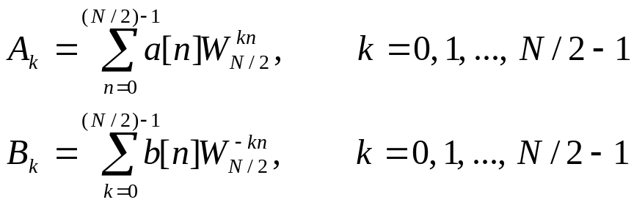
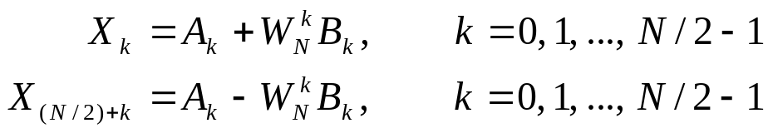

Decimation in Time (Radix 2)
Let’s explore an approach that subdivides time interval into successively smaller intervals. Assume N, the size of the DFT, is an even integer so that N/2 is also an integer. Define two auxiliary signals:
Let A_{k} and B_{k} denote two (N/2)-point DFTs of a[n] and b[n]:
We can show that these are related to the DFT by the following equations:
The computation of A_{k} and B_{k} each requires (N/2)² = N²/4 multiplications. The scaling by requires N/2 additional multiplications. The total computation is N²/2+N/2 multiplications, which represents N²/2-N/2 fewer multiplications than the N² multiplications required by the DFT.
For N = 128, this is a savings of 8,128 multiplications (16,384 vs. 8,256).

Slide 4
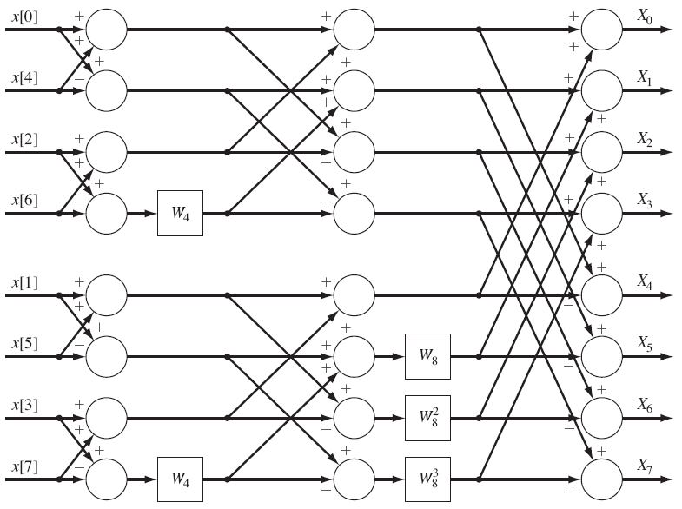
Block Diagram of an FFT Algorithm
If N is a power of 2 (e.g., N = 2^{q}), we can repeat this process to further reduce the computations. The overall complexity reduces from N² to (Nlog₂N)/2.

Slide 5
Bit Reversing
Note that the inputs have been shuffled so that the outputs are produced in the correct order.
This can be represented as a bit-reversing process:
Time Point (n) | Binary Word | Reversed-Bit Word | Order
0 | 000 | 000 | x[0]
1 | 001 | 100 | x[4]
2 | 010 | 010 | x[2]
3 | 011 | 110 | x[6]
4 | 100 | 001 | x[1]
5 | 101 | 101 | x[5]
6 | 110 | 011 | x[3]
7 | 111 | 111 | x[7]

Slide 6
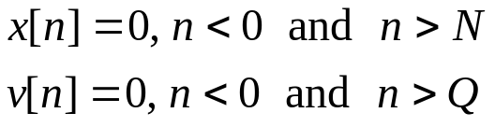
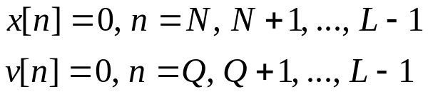
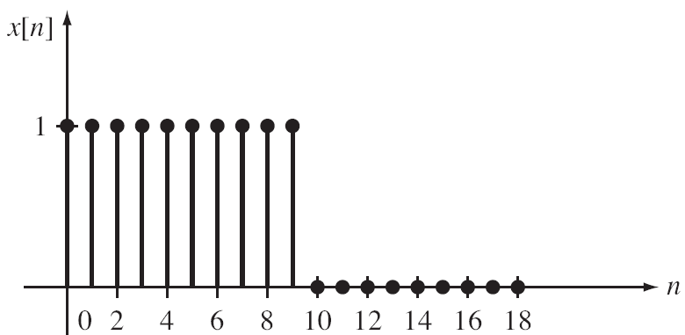

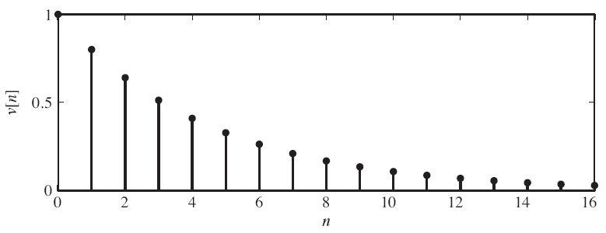

Application – Convolution
Given two time-limited signals:
let r equal the smallest possible integer such that N + Q < 2r. Let L = 2r.
We can pad these signals with zeros to make them the same length so that we can apply an FFT:
The convolution of these two (zero-padded) signals computed using a convolution sum requires L² /2 + 3L/2 multiplications. Computing the convolution using the FFT requires (3L/2)log₂L + L multiplications.
Example: Consider the convolution of a pulse and a truncated exponential.
What is the effect of truncating the exponential in the frequency domain?

Slide 7
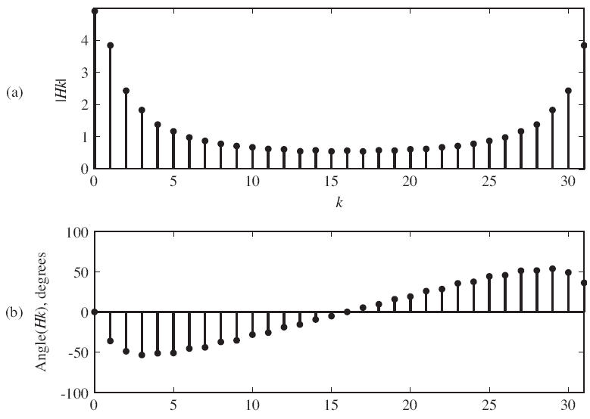
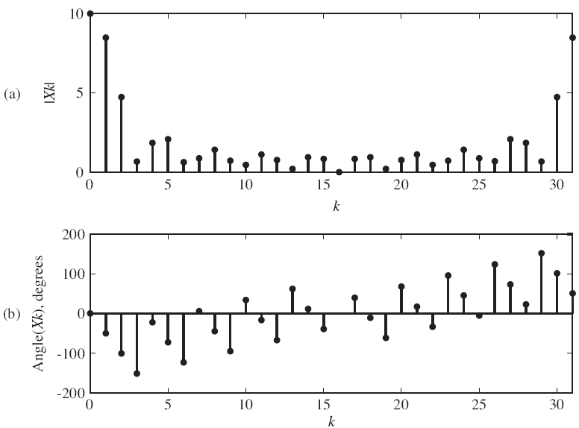
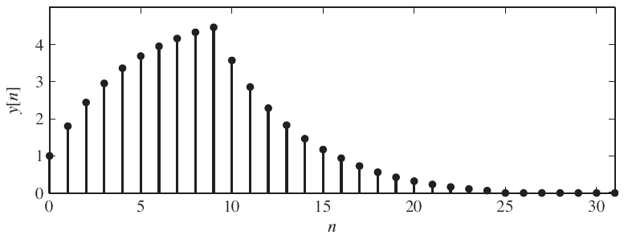
Application – Convolution (Cont.)
We can select an FFT Order as follows:
N = 16
Q = 16 (an approximation)
N + Q = 32 =2**5 ⇒ L = 5
The MATLAB code to generate the
L-point DFT using the function fft() is:
N = 0:16; L = 32;
v = (0.8).^n;
Vk = fft(v, L);
x = [ones(1, 10)]
Xk = fft(x, L);
The output can be generated by
multiplying the frequency responses,
and taking the inverse FFT:
Yk = Vk.*Xk;
y = ifft(Yk, L);
This can be validated by using the time-domain
convolution function from Chapter 2.

Slide 8
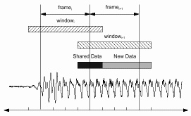
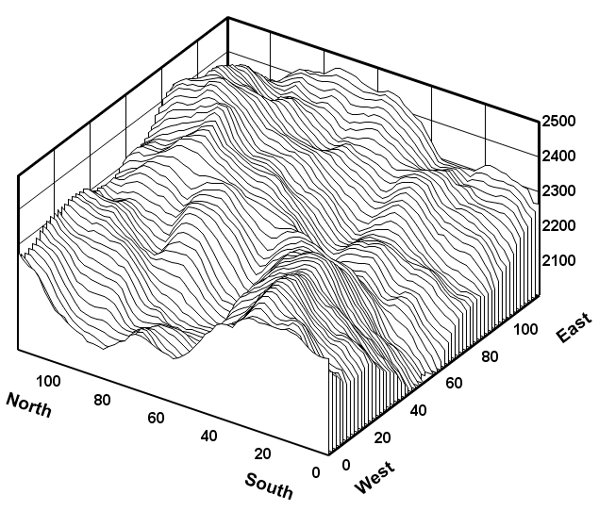
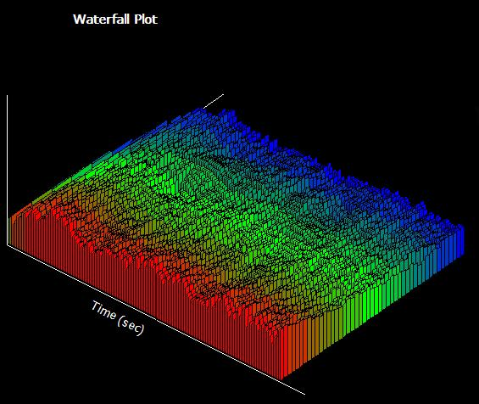
Application – Waterfall Plots
Often we will used an overlapping frame-based analysis to compute the spectrum as a function of time.
This approach is used in many disciplines (e.g., graphic equalizer in audio systems).
One popular visualization is referred to as a waterfall plot.

Slide 9
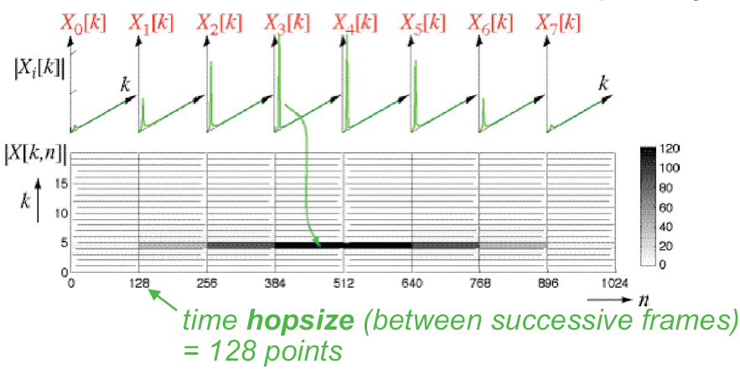
Applications of the FFT – The Spectrogram
Another very important visualization tool is the spectrogram, a time-frequency plot of the spectrum in which the spectral magnitude is plotted as a grayscale value or color.

Slide 10
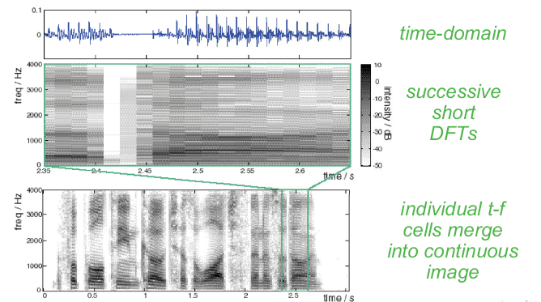
Spectrograms As Continuous Images

Slide 11
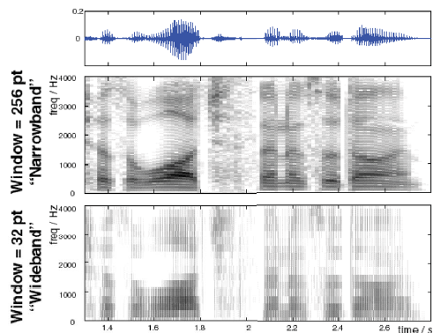
Narrowband vs. Wideband Spectrograms

Slide 12
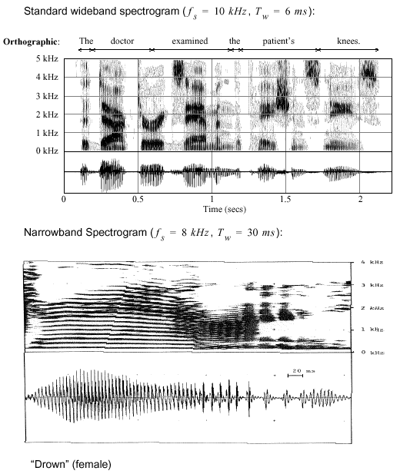
Applications to Speech Processing
The choice of the length of the FFT can produce dramatically different views of your signal.
For speech signals, a 6 ms window (48 samples at 8 kHz) allows visualization of individual speech sounds (phonemes).
A longer FFT length (240 samples – 30 ms at 8 kHz) allows visualization of the fundamental frequency and its harmonics, which is related to the vibration of the vocal chords.
Such time-frequency displays need not be limited to the Fourier transform. For example, wavelets are a popular alternative.

Slide 13
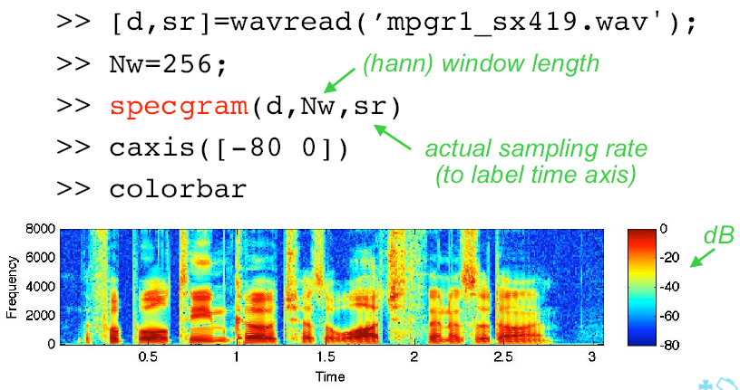
Spectrograms in MATLAB
MATLAB contains a wide variety of visualization tools including a spectrogram function.
MATLAB can read several file formats directly, including .wav files.
Several aspects of the spectrogram can be programmed, including the color map and the analysis window.

Slide 14
Summary
Introduced a decimation-in-time approach to fast computation of the DFT known as the Fast Fourier Transform.
Discussed the computational efficiency.
Demonstrated application of this to convolution.
Introduced applications of the convolution known as the waterfall plot and the spectrogram.

