Slide 1

Fog Computing
Bringing Cloud and Edge for Real-Time Processing

Slide 2
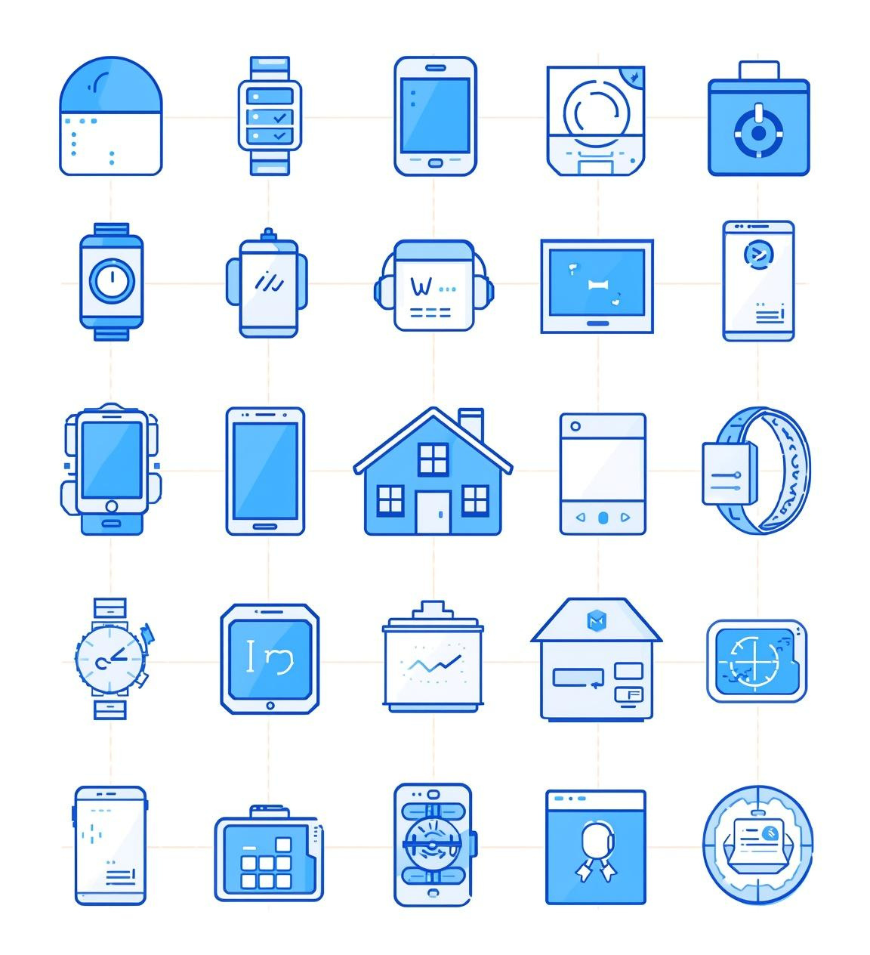
Introduction to Fog Computing
The rapid growth of IoT devices generates massive data at the edge, leading to cloud latency and bandwidth issues.
Fog computing offers a viable solution for enabling real-time processing of this data.

Slide 3
Understanding Fog Computing
Proposed by CISCO SYSTEMS In 2014.
Fog computing is a distributed computing paradigm that extends cloud capabilities to the edge.
It allows for data processing closer to the source, thereby reducing dependence on the cloud.

Slide 4
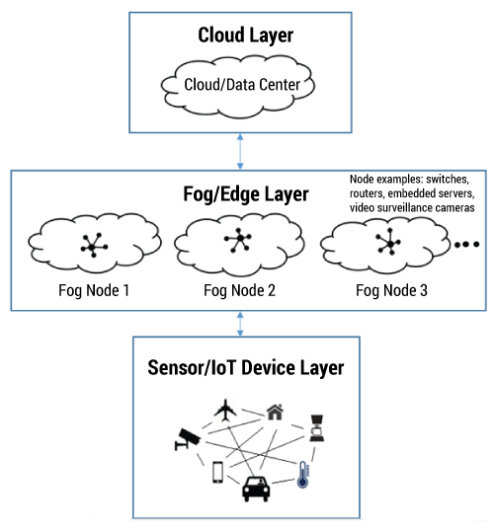
Architecture of Fog Computing
The architecture consists of three layers: Edge, Fog, and Cloud. This distributed model reduces latency and optimizes bandwidth, enabling efficient data processing close to the source of data generation.

Slide 5
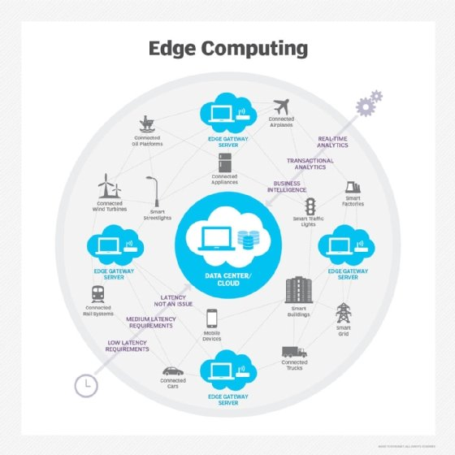
Edge Layer Functions
Collects data from various IoT devices like sensors
Performs basic preprocessing before sending to fog layer
Example systems include smart sensors in homes and industries

Slide 6
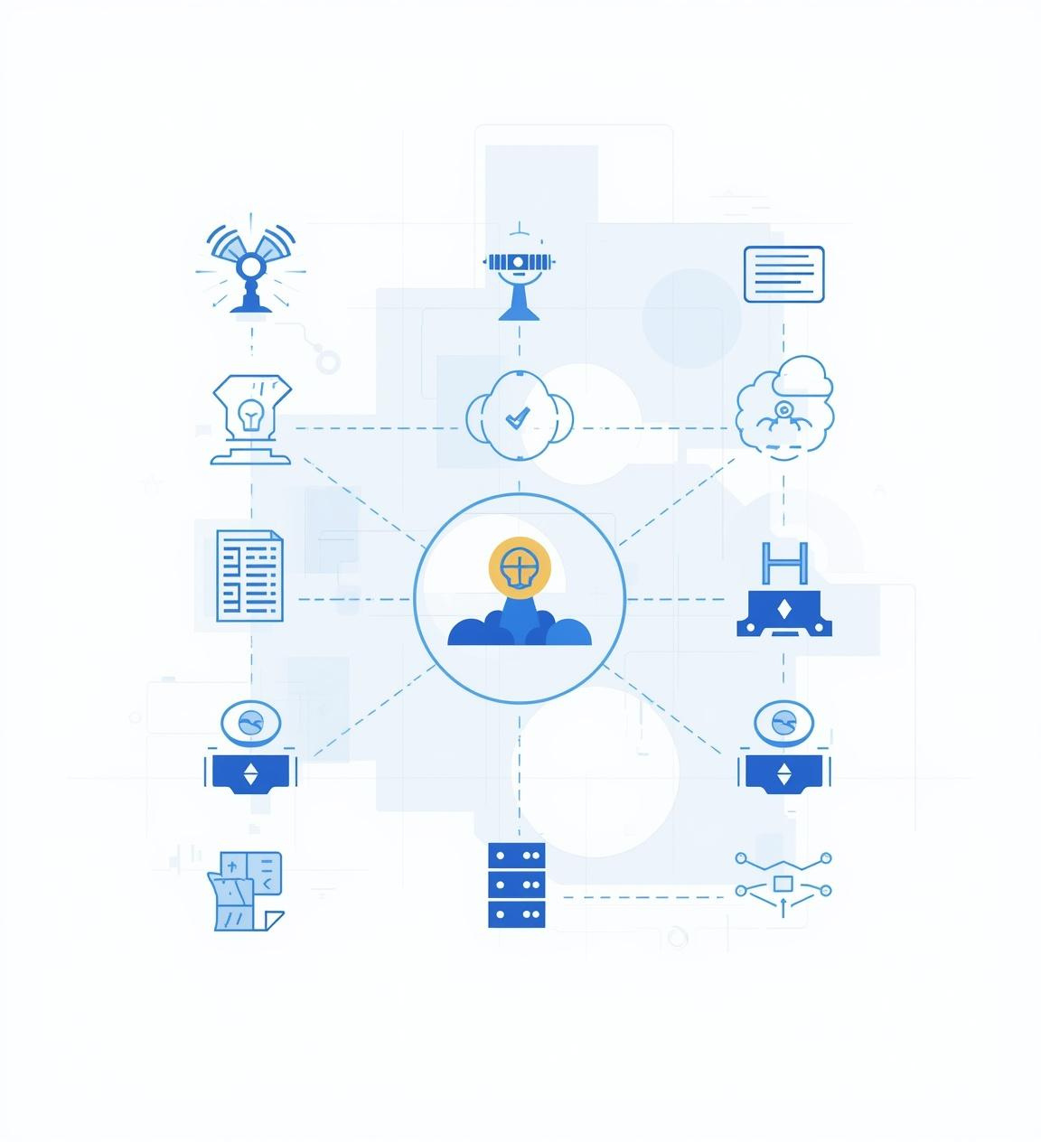
Fog Layer Functionality
Supports real-time processing of incoming data streams
Facilitates filtering and aggregation for actionable insights
Enables immediate decision-making with low latency responses

Slide 7
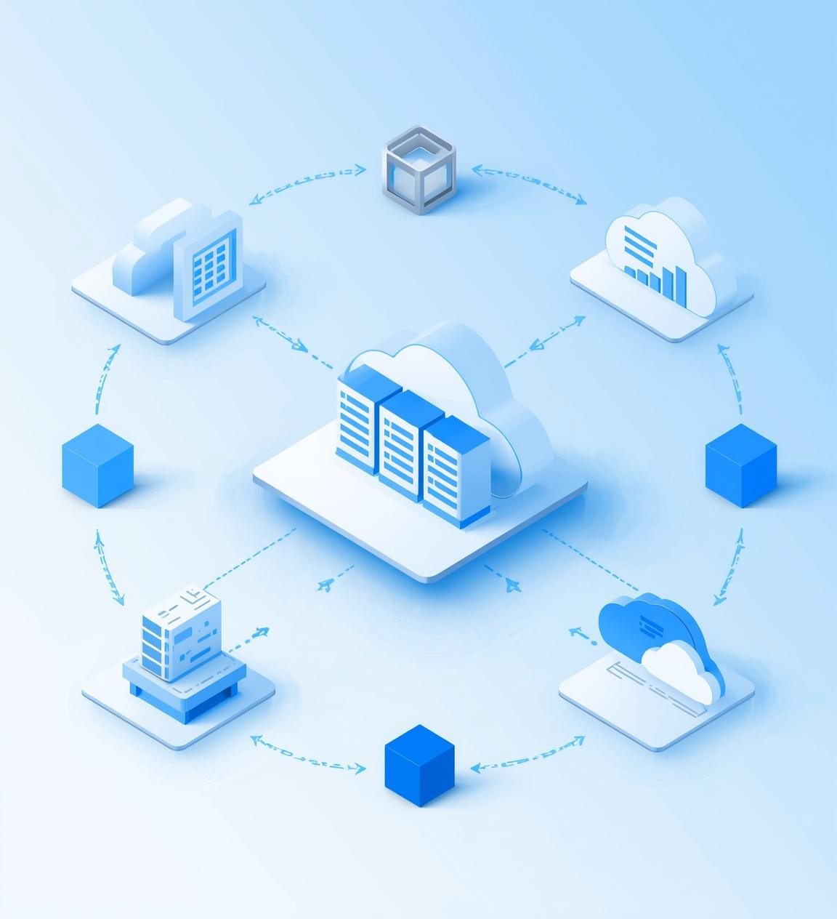
Cloud Layer Overview
Facilitates big data analytics for informed decisions
Supports AI and ML processing for predictive insights
Provides long-term storage for data retention and backup

Slide 8
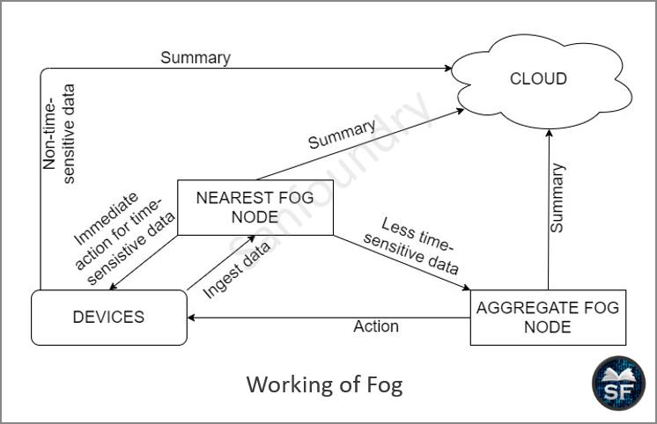
Working Principle of Fog Computing
The data fl ow process starts at the Edge, where sensors generate real-time data, which is then processed by the Fog layer. Finally, the Cloud handles complex tasks, ensuring efficiency and speed.

Slide 9
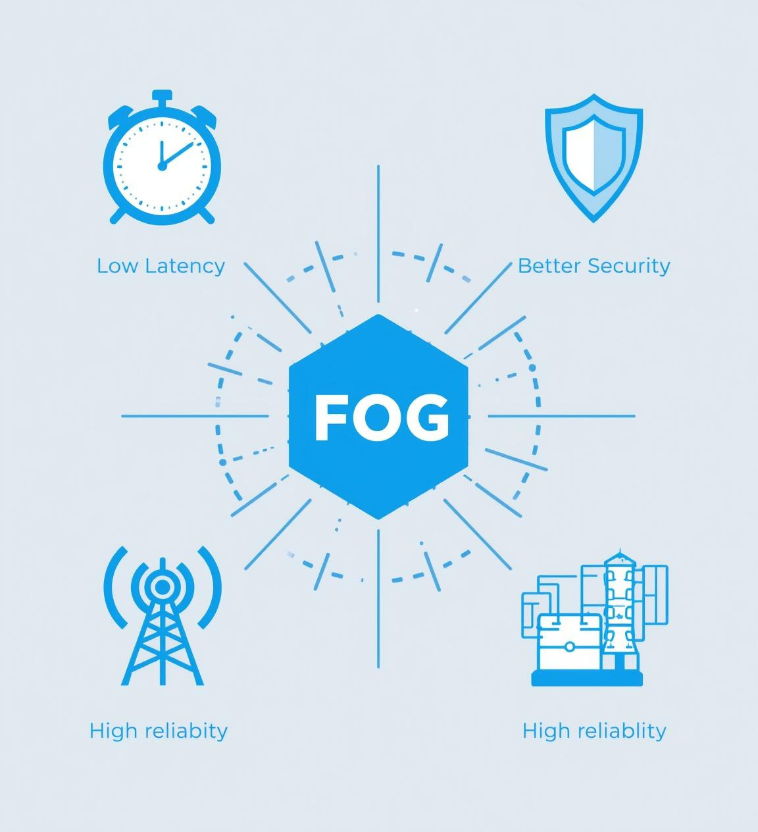
Advantages of Fog Computing
Fog computing offers signif icant benefts, including low latency for real-time processing, reduced network congestion, enhanced security measures, high reliability, and support for critical applications, making it essential for modern infrastructure.

Slide 10
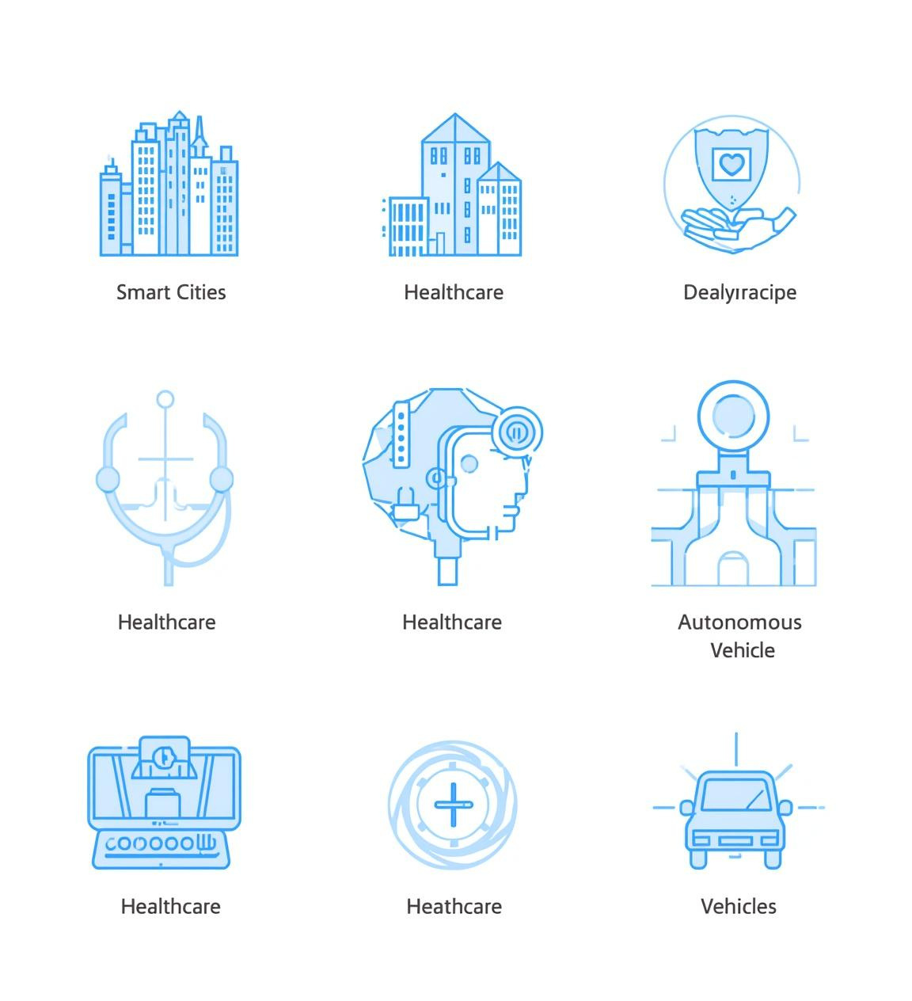
Applications of Fog Computing
Smart Cities: Enhance urban living through connected services and infrastructure
Healthcare: Real-time patient monitoring for improved medical outcomes
Autonomous Vehicles: Enable safer navigation through immediate data processing
Agriculture: Precison farming and Resource Optimization enabling Smart-agriculture.

Slide 11
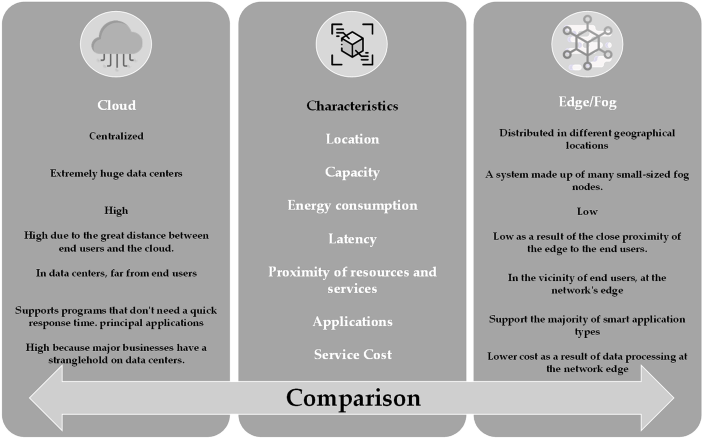
Comparison of Computing Models
This table highlights the key differences between Cloud, Fog, and Edge computing, focusing on location, latency, processing capabilities, and bandwidth, providing a clear understanding of each model's strengths and weaknesses.

Slide 12
Conclusion: Fog Computing Essentials
Fog computing effectively bridges the gap between cloud and edge, enabling low latency and enhancing IoT effciency.
It is crucial for developing future smart infrastructure and improving real-time processing capabilities.
Improves effcency and performance by distributing computing resources
Closing Statement: Fog Computing is a key technology for Future-Smart infrastructure.

Slide 13
THANK YOU!
Your attention is appreciated!

