Slide 1
EDGE
COMPUTING

Slide 2
AGENDA
01
What is Edge Computing?
05
Key Technologies
02
Why Do We Need It?
06
Security & Privacy
03
Architecture & Layers
07
Real-World Applications
04
How It Works
08
Challenges & Future

Slide 3



WHAT IS EDGE COMPUTING?
"A distributed computing paradigm that enables data processing to occur closer to the source of data generation rather than relying entirely on centralized cloud data centers.
EVOLUTION:
CORE IDEA:
IMPACT:
Not a new concept but evolution of distributed computing integrating cloud, networking, and embedded systems.
Move computation and storage closer to where data is created. Less travel = less latency.
By 2020: 50B+ connected devices, 40 ZB total global data. 45% processed at the edge

Slide 4








WHY DO WE NEED EDGE COMPUTING?
Cloud Computing Shortcomings
Goals of Edge Computing
High Latency
Lower Latency
Reduce Cost
50–200ms round-trip; fails real-time needs like autonomous driving
Compute at or near the data source
Filter & aggregate locally before transmission
Privacy Risk
Sensitive data uploaded to centralized cloud is vulnerable to breach
Bridge Networks
Enhance Reliability
Connect sensors to IP-capable networks
Resilient computing for remote & mobile devices
Energy Drain
Massive data center consumption cannot meet growing demands
Enhance Security
Extend the Cloud
Bandwidth Saturation
HD video & 4K surge overwhelms WAN backhaul
Anonymize & scrub data locally before cloud
Autonomous edge nodes as cloud extensions

Slide 5
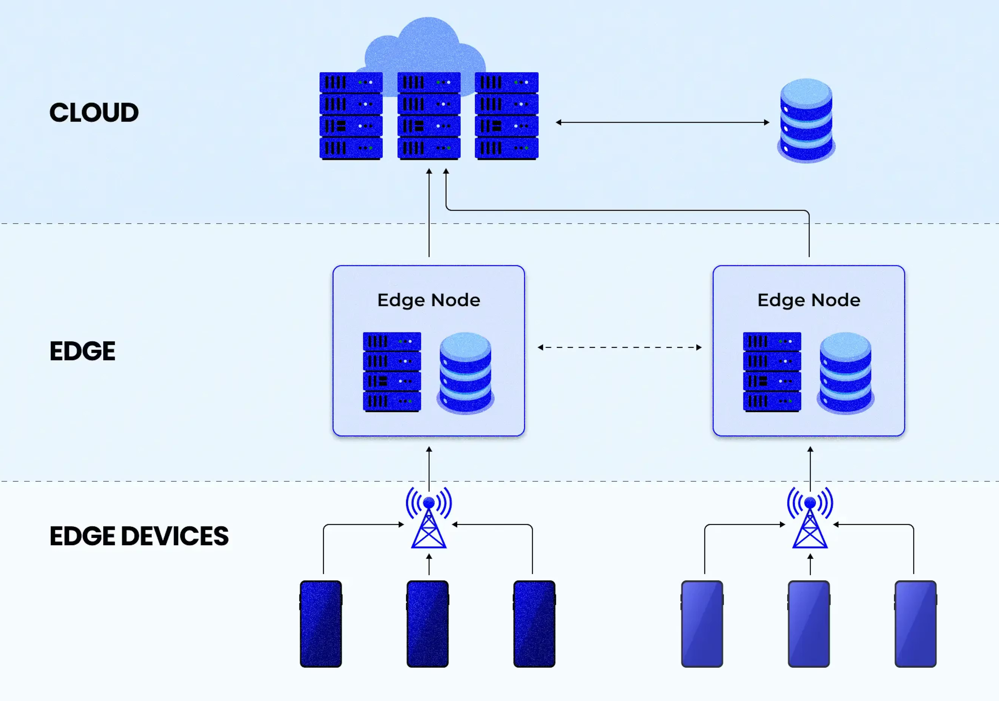
THREE-TIER ARCHITECTURE
▸ Large-scale data storage & analytics
CLOUD LAYER
▸ Long-term processing
▸ Global system coordination
▸ Model retraining & deep analytics
EDGE LAYER
▸ Edge servers, micro data centers, IoT gateways
▸ Real-time data filtering & aggregation
▸ AI inference with GPUs/FPGAs/NPUs
▸ 5G / 4G / Fiber local networks
DEVICE LAYER
▸ Smartphones, sensors, cameras, vehicles
▸ Continuous raw data generation
▸ Both data consumer and data provider
▸ Communication via BT / RF / NFC

Slide 6




HOW EDGE COMPUTING WORKS
Stage 1
Stage 2
Stage 3
Stage 4
Stage 5
Data Generation
Local Preprocessing
Edge Processing
Decision Making
Cloud Sync
IoT devices: sensors, cameras, vehicles generate raw data continuously
Filter, compress & aggregate data; protocol translation (MQTT/OPC-UA)
AI inference, anomaly detection, object recognition at edge servers in milliseconds
Autonomous local actions: alarms, braking, routing—no cloud round-trip needed
Selective async upload for long-term storage, model retraining & global analytics

Slide 7

REAL-WORLD EXAMPLE: AUTONOMOUS VEHICLE
Autonomous vehicles generate up to 40 TB of raw data per hour, thus cloud latency is physically impossible for safety-critical decisions
LiDAR + Cameras
3D point clouds at 10–20 Hz; 30 fps video streams across multiple angles
1
2
Sensor Fusion
Synchronizes data, constructs unified environmental model (occupancy grid)
3
Onboard AI (NVIDIA Drive)
Deep neural networks for object detection, lane & pedestrian recognition in real time
4
Planning Module
Steering, braking & lane changes decided in 10–50ms onboard. Emergency braking < 10ms
5
Cloud Sync (Wi-Fi/OTA)
Anonymized driving logs uploaded for fleet-wide model retraining after trips

Slide 8
EDGE vs CLOUD COMPUTING
Feature | Cloud Computing | Edge Computing
Application | Global & large-scale | Local or proximate
Bandwidth Load | High — all data traverses WAN | Low — most data processed locally
Latency | 50–200 ms (high) | 1–10 ms (ultra-low)
Processing Mode | Centralized, large-scale | Distributed, small-scale AI
Security Model | Centralized — perimeter based | Distributed — data stays local
Energy Use | High — large data centers | Lower — distributed micro-nodes
Best Use Case | ML training, BI, archival | Autonomous vehicles, IoT, CCTV

Slide 9





KEY TECHNOLOGIES
Computing Offloading
5G Integration
Caching Acceleration
Migrates intensive tasks from resource-constrained devices to nearby MEC servers. Outcomes: local execution, full offload, or partial offload.
Ultra-low latency (1ms), high bandwidth, and massive device connectivity creating new real-time application categories.
Edge-cached content (base station, CDN) is served locally — Netflix Open Connect serves 95% of traffic from edge appliances.
Mobility Management
Traffic Offloading
Containers & K3s
Seamless VM migration across edge nodes to maintain service continuity as mobile users traverse geographic zones.
Offloads data to mobile edge networks, reducing backhaul bandwidth. Saves up to 34% energy in heterogeneous wireless networks.
Docker containers + lightweight Kubernetes (512 MB footprint) enable portable, orchestrated edge application deployments.

Slide 10
SECURITY & PRIVACY
Distributed architecture increases attack vectors vs. centralized cloud — each edge node is a potential attack surface
Data Security
Identity Authentication
Attribute-Based Encryption (ABE)
Proxy Re-Encryption (PRE)
Fully Homomorphic Encryption (FHE)
Searchable Encryption on edge servers
Single-domain & cross-domain auth
SAML, OpenID, SSO standards
Handover authentication for mobile devices
Multi trust-domain coexistence
Privacy Protection
Access Control
Location privacy for LBS applications
Federated learning — no raw data sharing
Differential privacy techniques
Fine-grained identity & behavior schemes
Attribute-Based Access Control (ABAC)
Role-Based Access Control (RBAC)
Fine-grained data sharing
Zero-trust architecture research

Slide 11
REAL-WORLD APPLICATIONS
Video Streaming
Predictive Maintenance
Smart Cities
Netflix Open Connect
Industry 4.0
Traffic & Infra
Edge appliances at ISPs cache top titles. 95% global traffic served from edge — 65%+ backbone reduction
Edge sensors monitor machine vibration and predict failures in real time using intelligent gateways
Intersection-level edge nodes adjust traffic signals locally, reducing avg wait times by 25–40%
Healthcare
Security Monitoring
Autonomous Vehicles
ICU Monitoring
Smart Surveillance
5G + V2X
Smart gateways detect atrial fibrillation in real time and trigger bedside alarms within seconds, no cloud needed
Lightweight neural networks (MobileNet/SqueezeNet) detect loitering and anomalous behavior at the edge
Sub-10ms safety decisions, V2X communication, high-res map updates — all via edge computing platform

Slide 12
CHALLENGES & FUTURE DIRECTIONS
Current Challenges
Future Directions
Resource Management
5G Convergence
Heterogeneous, constrained hardware — dynamic CPU/memory allocation
Ultra-low latency and massive device connectivity in unified end-to-edge-to-cloud continuum
Interoperability
Blockchain Integration
Fragmented vendors & protocols; ETSI MEC and OpenFog efforts ongoing
Decentralized trust and data provenance for distributed edge environments
Security at Scale
Cognitive Edge Systems
Thousands of physically accessible nodes — each an attack surface
Autonomously learning and adapting edge AI agents (reinforcement learning)
Energy Efficiency
Continuum Computing
Battery-constrained devices; ASICs/NPUs offer promising gains
IoT to Edge to Cloud is treated as one unified fabric with new orchestration frameworks
AI at the Edge
Federated Learning
Model compression, pruning & quantization for constrained hardware
Privacy-preserving AI training across distributed devices without sharing raw data

Slide 13
CONCLUSION
Paradigm Shift
Edge computing is not an extension of cloud it’s instead a transformative redefinition of how data is processed and utilized
Real-Time Intelligence
Low-latency, distributed processing enables autonomous vehicles, smart cities, healthcare, and industrial IoT
Layered Architecture
The three-layer architecture optimizes resource utilization and minimizes network congestion
Security & Privacy
Keeping data local inherently improves privacy; but distributed nodes require new lightweight security models
The Road Ahead
5G/6G, federated learning, cognitive edge AI, and continuum computing will define the next generation of infrastructure

Slide 14
THANK YOU

