Slide 1
College Of Software
Android
《SlimDiary》
School Name：Chongqing University
Instructor：Feno
Reporter：Debra He

Slide 2
1
Purpose
Why I decided to work on this application?
2
Overview
Components I have used
CONTENTS
3
Challenge
Technical challenges
4
Show
A video demo
5
Summary
Limitations and improvements

Slide 3
PART
1
Purpose

Slide 4
Purpose
Patience and Encouragement
To lose weight is not an easy issue. For the sake of being patient , I would like to build an application named Slim Diary. This app can record your process to lose weight and send it to the Internet. Many people can see this process and encourage you to continue your efforts. Meanwhile, you can also see how others lose weight, and to encourage them to continue to work hard. For example, your food that eats daily, as well as what kind of exercise you take can be seen by every person. It is an app that encourage not only yourself but also others to lose weight.

Slide 5
PART
2
Overview

Slide 6
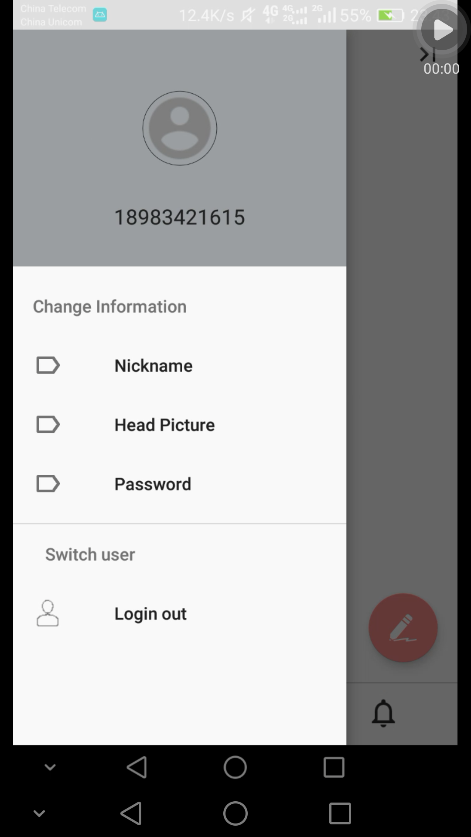
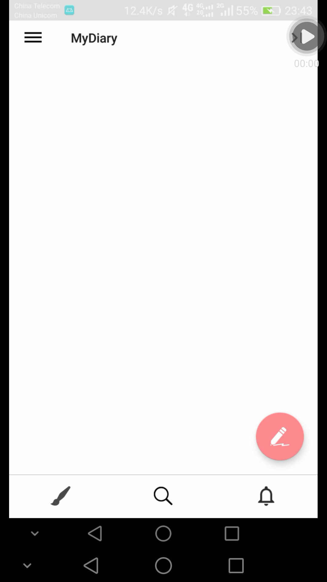

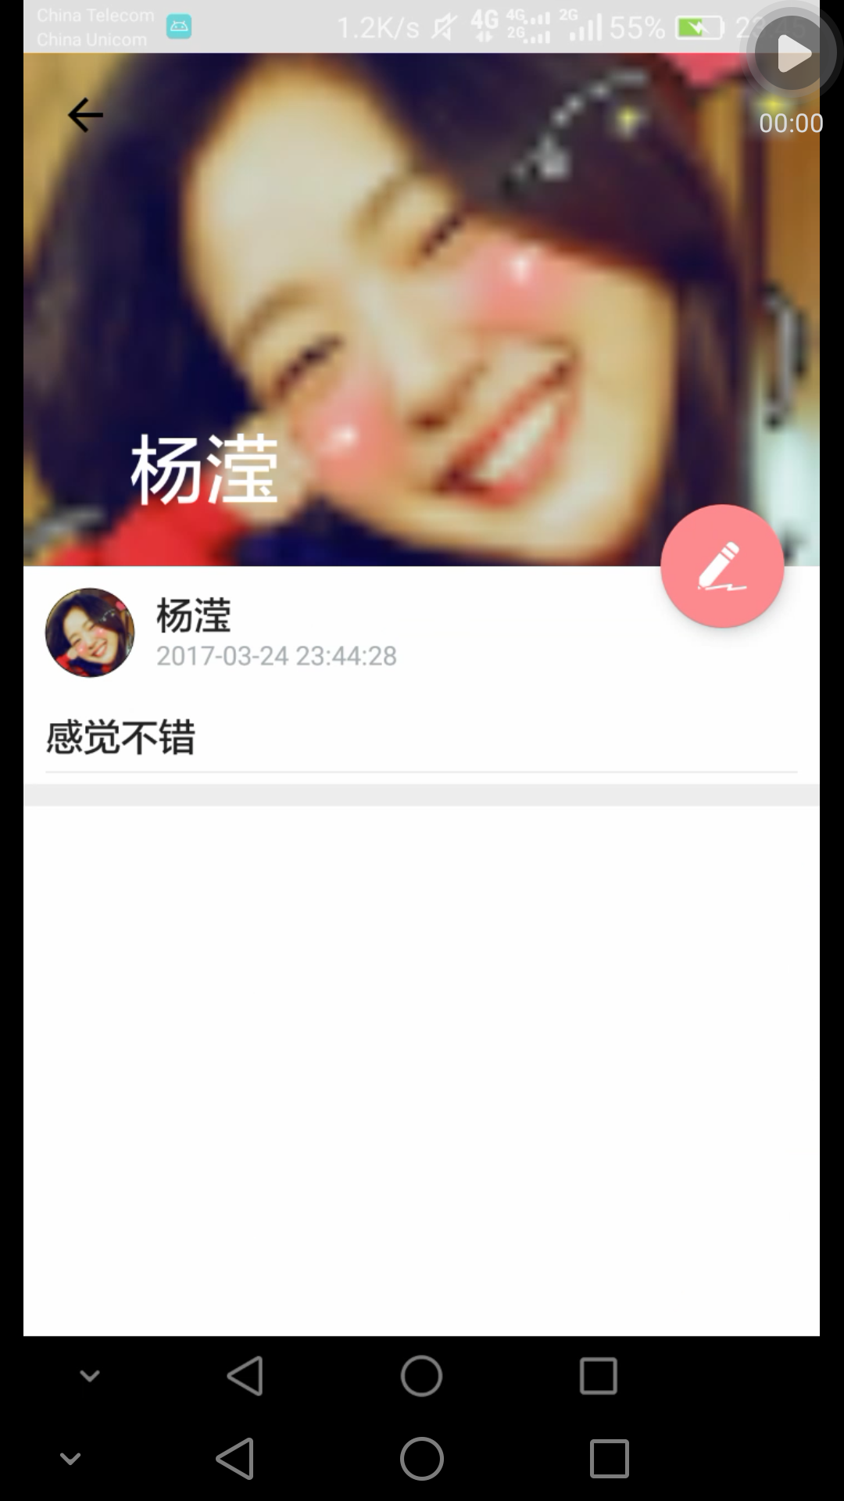
Components
Toolbar
CollapsingTool
barLayout
DrawerLayout
FloatingActionButton
Navigation
View
ViewPager

Slide 7
PART
3
Challenge

Slide 8
Technical challenges
SMS verification
Data service
Used MOB to solve it.
Used BMOB to solve it.
A
B
Image loader
Asynchronous loading
Used Volley to solve it.
Handler handler;
Message message = handler.obtainMessage();
message.what = 0;
message.obj = 1; handler.sendMessage(message);
C
D

Slide 9
PART
4
Show

Slide 10
PART
5
Summary

Slide 11
Limitations and improvements
Multi language
IM
Time class e.g. today ,yesterday
Add picture and video

Slide 12
THANK YOU!
For listening
《SlimDiary》
School Name ：Chongqing University
Instructor ：Feno
Reporter ：Debra He

