Slide 1
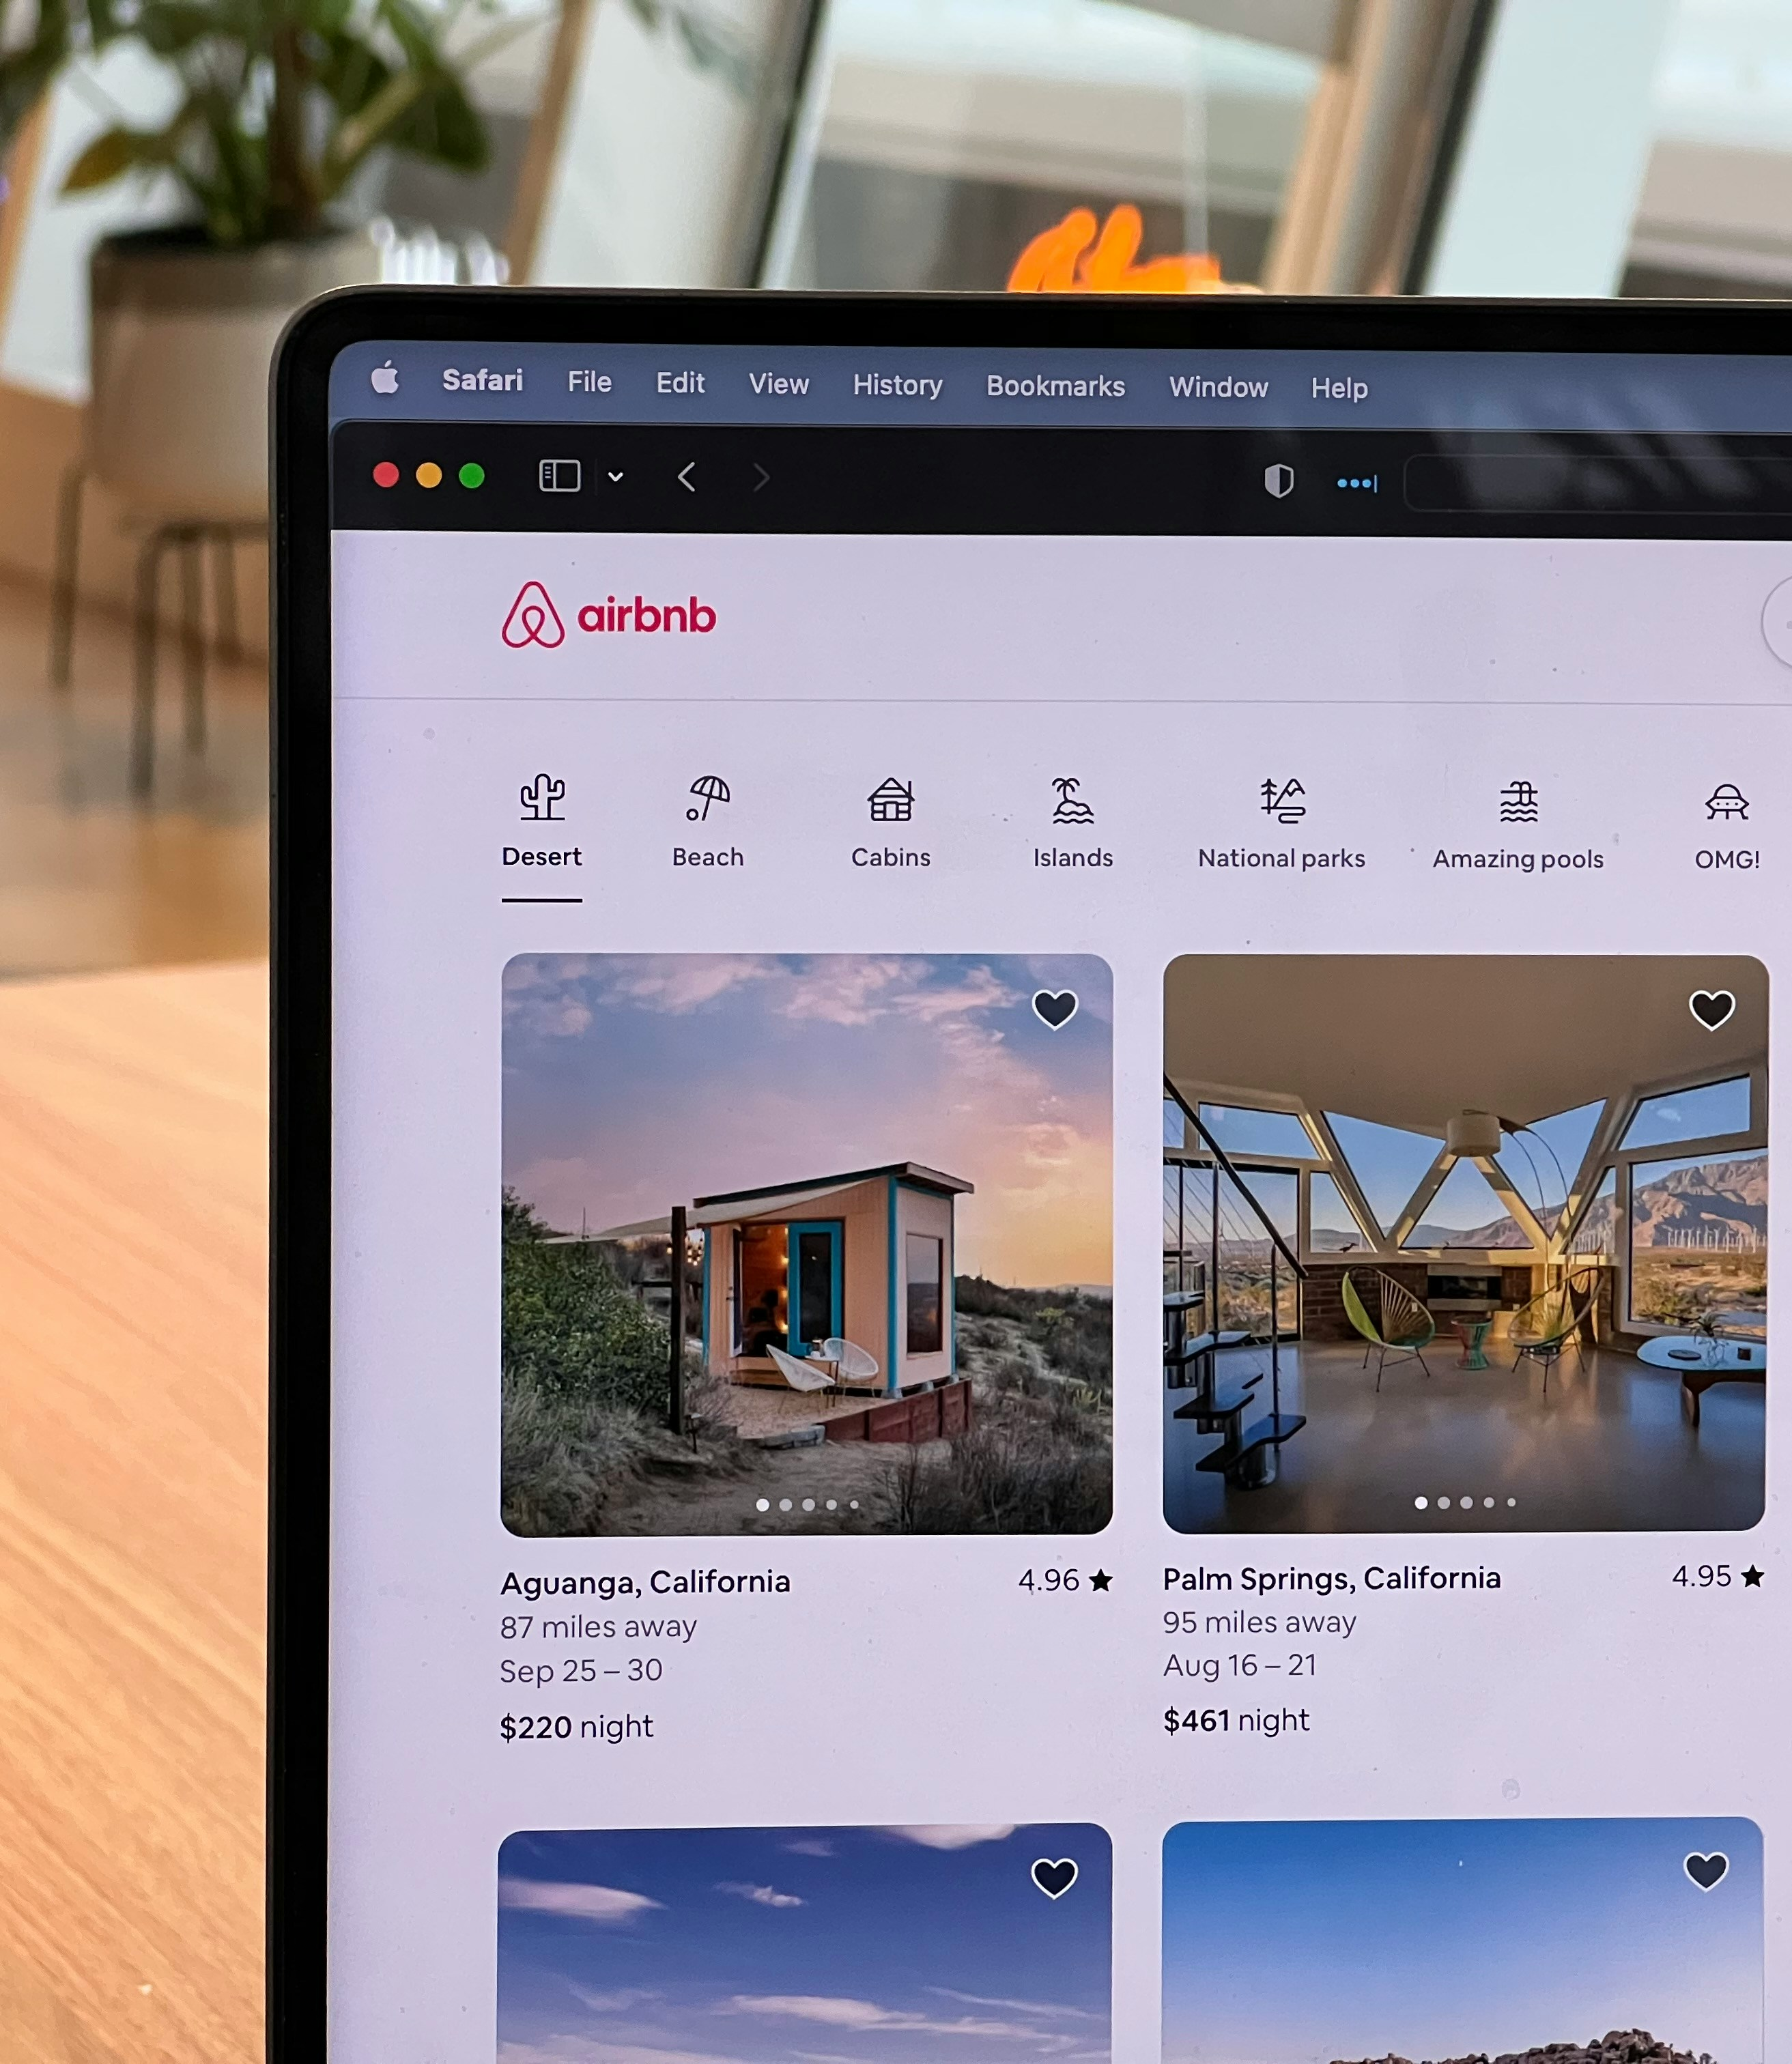

Airbnb
Global Performance
Dashboard
Presented By-
Debraj Paul
Id – AF05266178

Slide 2

Airbnb
Business Model
Airbnb operates as a two-sided digital marketplace that connects Hosts (individuals looking to rent out their spare space) with Guests (travelers seeking unique, affordable accommodations). Instead of owning any physical real estate, Airbnb provides the platform that facilitates trust, matching, and secure transactions between both parties.

Slide 3
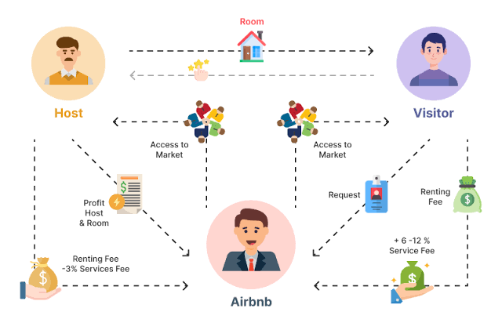

Slide 4


Slide 5

Datasets
Listing.xlsx contains standard short-term rental market data (similar to Airbnb). The 33 fields can be logically grouped into five core themes for your presentation slides:
Host Profile & Credibility
Host Identity: Tracks basic operational metrics (host_id, host_since, host_location, host_total_listings_count).
Trust & Verification: Indicators for safety and reliability (host_is_superhost, host_has_profile_pic, host_identity_verified).
Responsiveness: Evaluates how reliably a host communicates with guests (host_response_time, host_response_rate, host_acceptance_rate).
Property & Listing Details
Core Identification: Unique descriptors for each ad (listing_id, name).
Property Character: Classifies the style and setup of the space (property_type, room_type).
Capacity: Specifies the size and layout (accommodates, bedrooms).
Features: List of physical items or perks included in the stay (amenities).
Geographic Distribution
Macro Location: Broader regional context (city, district).
Micro Location: Local area context (neighbourhood).
Spatial Coordinates: Precise mapping vectors (latitude, longitude).
Financials & Booking Rules
Pricing: The nightly base cost of renting the property (price).
Stay Restrictions: Minimum and maximum boundaries for a single stay (minimum_nights, maximum_nights).
Logistics: Shows if a guest can book immediately without host approval (instant_bookable).
Review & Quality Scores
Overall Rating: Summary guest satisfaction metric (review_scores_rating).
Granular Performance Categories: Breakdown of specific operational elements:
Accuracy: Listing truthfulness (review_scores_accuracy)
Hygiene: Cleanliness level (review_scores_cleanliness)
Arrival: Check-in process seamlessness (review_scores_checkin)
Interaction: Host communication standard (review_scores_communication)
Setting: Real-world location satisfaction (review_scores_location)
ROI: Value for money spent (review_scores_value)
Reviews.xlsx serves as a transactional relational table that connects to the previous dataset. It contains four core tracking metrics, which can be presented on a single slide detailing user interaction data:
Slide Breakdown: Guest Engagement & Reviews
Listing Connection: The primary connector field (listing_id) that links each review back to the specific property from the Listing.xlsx database.
Unique Indicators: Unique system keys assigned to organize the reviews and individuals (review_id, reviewer_id).
Temporal Tracking: The specific timestamp documenting exactly when the review was posted by the guest (date).

Slide 6

Questions
Based on the provided presentation slides and dashboard pages, here are the business questions that the dashboard answers, grouped by analytical category.
📊 Big Picture / Overview
How big is Airbnb's presence across major global cities?
How has Airbnb grown over time and where did it peak?
Which cities contribute most to Airbnb's overall business?
Are listings concentrated or evenly spread across cities?
📈 Market Share by City
Which cities dominate Airbnb listings globally?
Are a few cities driving most of the supply?
How much of the total market do top cities control?
What is the cumulative contribution of cities like Paris, NYC, and Sydney?
Is Airbnb supply fragmented or highly concentrated?
🏠 Property Type & Pricing
Which property types are most commonly listed?
Are hotel rooms more expensive than Airbnb stays?
Why might travelers prefer Airbnb over hotels in certain cities?
Does pricing explain higher adoption in cities like Paris?
⭐ Ratings & Customer Satisfaction
Which cities deliver the best overall guest experience?
Which cities are underperforming on ratings?
Are low ratings driven by cleanliness, value for money, or communication?
Is high supply always equal to high quality?

Slide 7
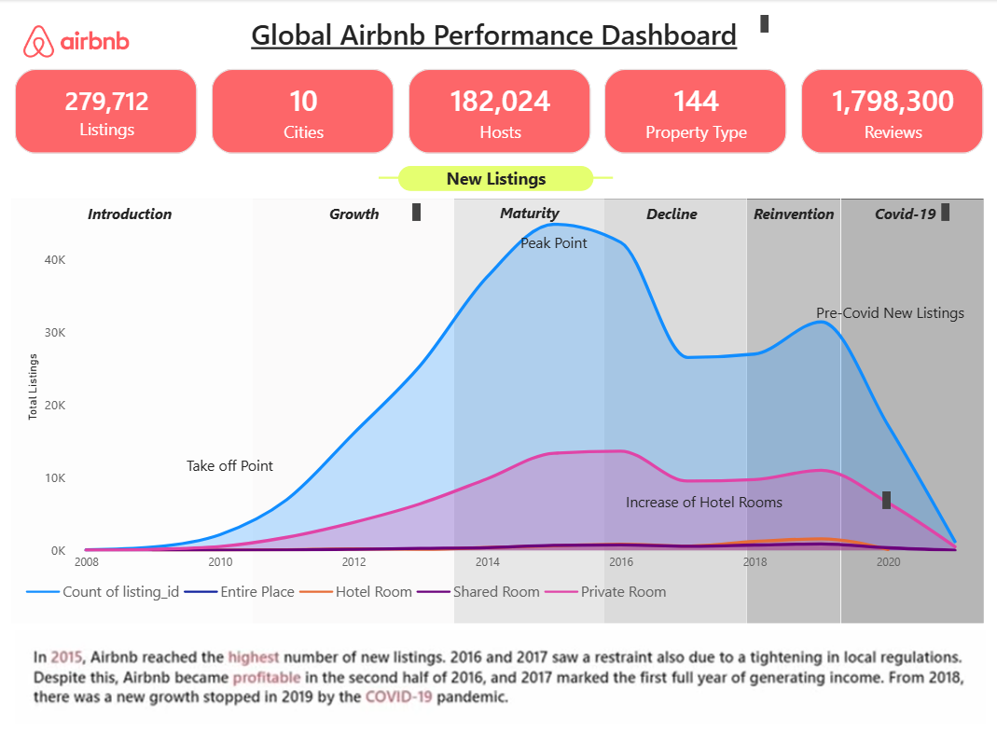
Dashboard
Overview Page

Slide 8
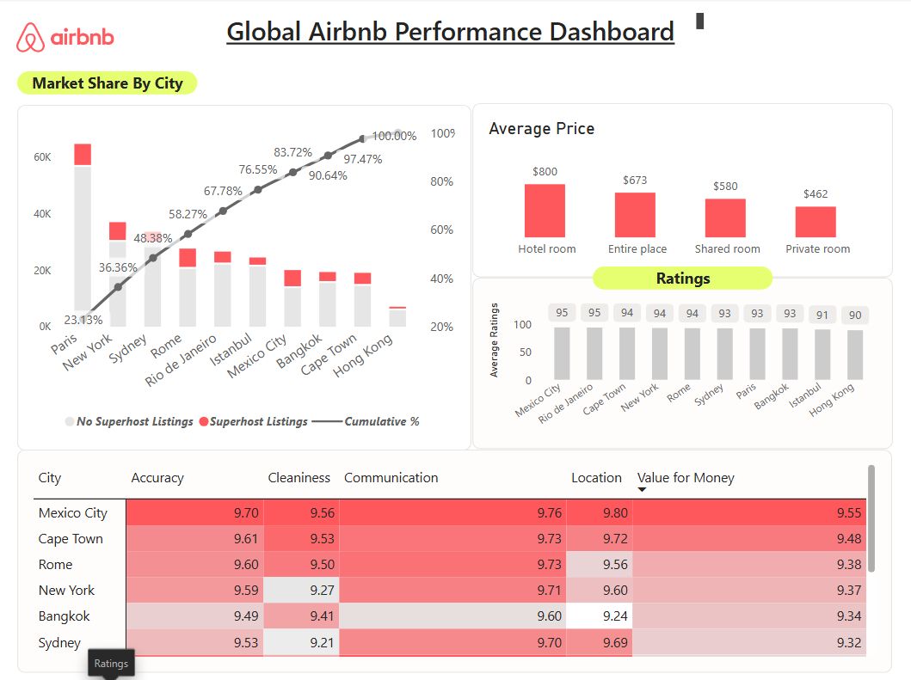
Dashboard
Rating Page

Slide 9
Key Performance Indicators
Platform footprint overview: The dashboard currently tracks 279,712 active property listings, serving as the foundation for our booking and revenue metrics.
Geographic breakdown: Data in this view covers 10 unique cities, allowing for direct cross-market performance and revenue comparisons.
Total host engagement: The platform currently supports 182,024 individual hosts, forming the core network behind our booking inventory.
Portfolio diversity overview: The active inventory spans 144 distinct property types, supporting our strategy to capture niche and non-traditional travel segments.
Total feedback volume: The dashboard tracks 1,798,300 traveler reviews, reflecting the cumulative historical engagement and guest satisfaction metrics on the platform.

Slide 10
Insights
In 2015, Airbnb reached the highest number of new listings. 2016 and 2017 saw a restraint also due to a tightening in local regulations. Despite this, Airbnb became profitable in the second half of 2016, and 2017 marked the first full year of generating income. From 2018, there was a new growth stopped in 2019 by the COVID-19 pandemic.
This product lifecycle chart illustrates the trajectory of new Airbnb listings from 2008 to 2021, mapping their evolution across six distinct phases: Introduction (2008–2010) establishing a take-off point, Growth (2010–2013) showing rapid acceleration, and Maturity (2013–2016) where listings hit an all-time "Peak Point" of roughly 45,000. This is followed by a sharp Decline (2016–2018) due to tightening local regulations, a brief Reinvention recovery phase (2018–2019) that establishes a secondary "Pre-Covid" peak, and a final Covid-19 phase (2019–2021) showing a near-vertical collapse in listings down to near zero.
Throughout the timeline, the macro volume is driven entirely by the overall Count of listing_id (light blue line) and Private Rooms (pink line), while Entire Places, Hotel Rooms, and Shared Rooms remain flat at the baseline.

Slide 11
Insights
here is a clear mismatch between supply and pricing power on the platform. The previous lifecycles showed that the platform's supply is heavily driven by Private Rooms, yet this data reveals they yield the lowest average price ($462). Conversely, Hotel Rooms demand the highest premium ($800), validating Airbnb's operational shift during its "Maturity" phase to actively push for an "Increase of Hotel Rooms" to capture higher-margin revenue despite lower total listing volumes. Paris, NYC, and Sydney account for almost half of the total listings and 59% of total reviews. Paris is the city with the most listings and reviews. A possible driver is the prices for hotel rooms being twice as much as Airbnb!
These two charts provide a breakdown of Airbnb's global footprint, highlighting Market Share By City and the Average Price by accommodation type.
Market Share By City (Pareto Chart): This chart ranks cities by total listings, tracking the proportion of standard listings vs. Superhost listings (red bars) along with a Cumulative % line. Paris dominates as the top market with a 23.13% individual market share, followed by New York; together with Sydney, the top three cities account for nearly half (48.38%) of the entire dataset's total volume.
Average Price (Bar Chart): This chart displays the average nightly rate per room type, revealing that Hotel Rooms are the most expensive at $800, followed by Entire Places ($673) and Shared Rooms ($580), while Private Rooms are the most affordable at $462.

Slide 12
Insights
A city’s market volume does not dictate its quality of user experience. While the previous chart proved Paris is Airbnb's undisputed volume leader with over 23% market share, this data reveals it sits near the bottom tier for guest satisfaction (93 overall rating). In contrast, emerging or secondary volume markets like Mexico City and Cape Town deliver far superior experiences and value for money, presenting a strategic opportunity for Airbnb to shift promotional focus toward these high-satisfaction regions to improve brand loyalty and avoid user fatigue in saturated, lower-rated mega-markets.
This visualization presents user satisfaction metrics across top destinations, consisting of a top bar chart showing overall average ratings out of 100 and a bottom heat map breaking down specific performance sub-categories on a 10-point scale. Mexico City leads global satisfaction with both the highest overall average score of 95 and near-perfect marks across the board, notably dominating in Location (9.80) and Value for Money (9.55), while major hubs like Paris and Bangkok lag behind with lower overall scores (93) and lower sub-scores across categories like Cleanliness and Value.

Slide 13
Thank You

