Slide 1


Hotel Booking
Cancellations Prediction Study
Outcomes

Slide 2


Background
Aqui vamos escrever:
business goals
nosso challenge
overview do business
Hotel chain C
Business Goals
To Implement predictive models to forecast net demand based on reservations on-the-books.
To implement better price and overbooking policies.
To identify high cancellation likelihood bookings.
To implement actions to prevent cancellation.
To reduce cancellations to a rate of 20%.
H2
H1
Notes:
Primary objective
Our analysis will focus on Lisbon’s resort since that was the data provided

Slide 3
Key Findings
Aqui vamos escrever:
o que encontramos (in terms of data)
importancia do que encontramos
Confusion matrix
Resultados

Slide 4
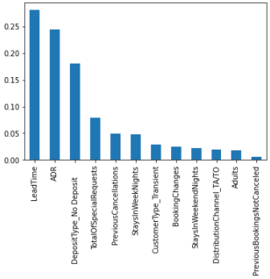
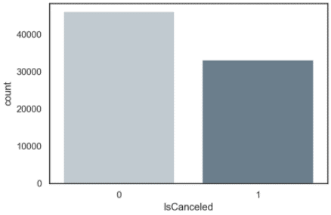
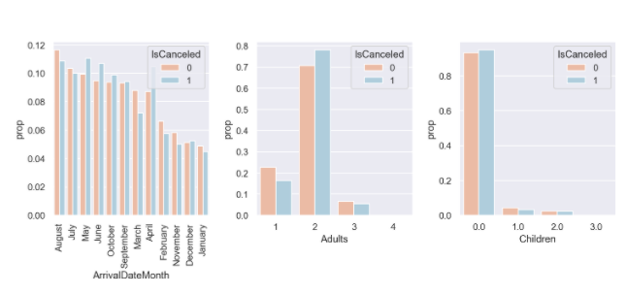
Key Findings
Aqui vamos escrever:
Mostrar um pouco dos dados (visualizacoes)
Grafico RFE / Main variables
Implement better price and overbooking policies.
42% Cancelled

Slide 5
Project Plan
Aqui vamos escrever:
algoritmos utilizados
main variables
Dataset challenges:
Limited dataset – 79330 observations
Data quality: ~30% of what seemed to be duplicated entries
Overfitting

Slide 6
Key Take aways
Aqui vamos escrever:
4 or so main conclusions

Slide 7
Thank you!

Slide 8


