Slide 1


Hotel Booking
Cancellations Prediction Study
Outcomes

Slide 2


Background
Hotel chain C
Business Goals
Implement predictive models to forecast net demand based on reservations on-the-books.
Implement better price and overbooking policies.
Identify high cancellation likelihood bookings.
Implement actions to prevent cancellation.
Reduce cancellations to a rate of 20%.
H2
H1
Notes:
Primary objective
Our analysis will focus on Lisbon’s resort since that was the data provided

Slide 3
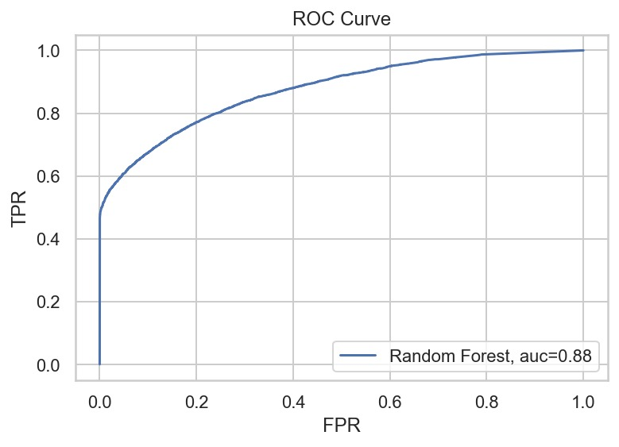
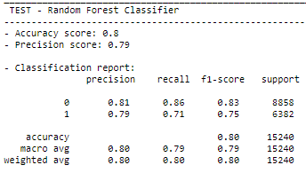
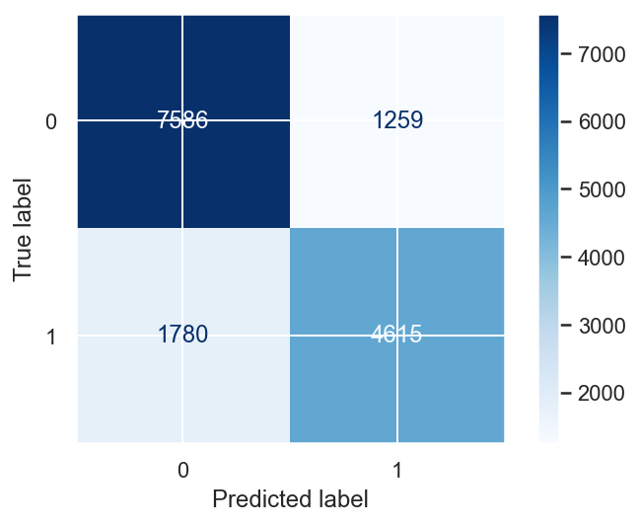
Key Findings
Algorithm:
Random Forest Classifier
Notes:
Models quality: Accuracy, Precision, F1-score
Accuracy: overall performance of the model – 80%
Precision: how good the model is predicting the cancellations – 79%
F1-score: balance between the false positive (precision) and false negative (recall) – 80% - especially relevant for the present analysis

Slide 4
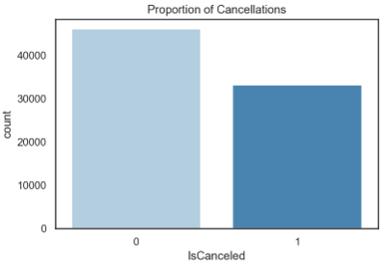
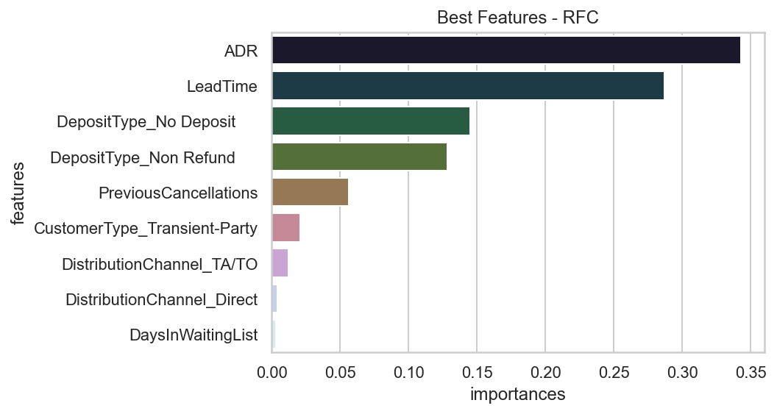
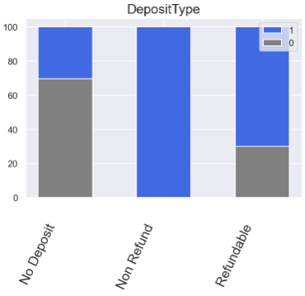
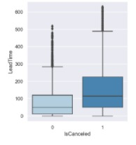
Key Findings
More willing to cancel:
Arrival months: April to June
Bookings with no children and/or babies
Meals: Bed & Breakfast
Distribution channel: TA or TO
Higher lead time
Less willing to cancel:
Customer type: Groups and transient-party
Repeated guests
Notes:
TA – Travel Agent
TO – Travel Operator

Slide 5
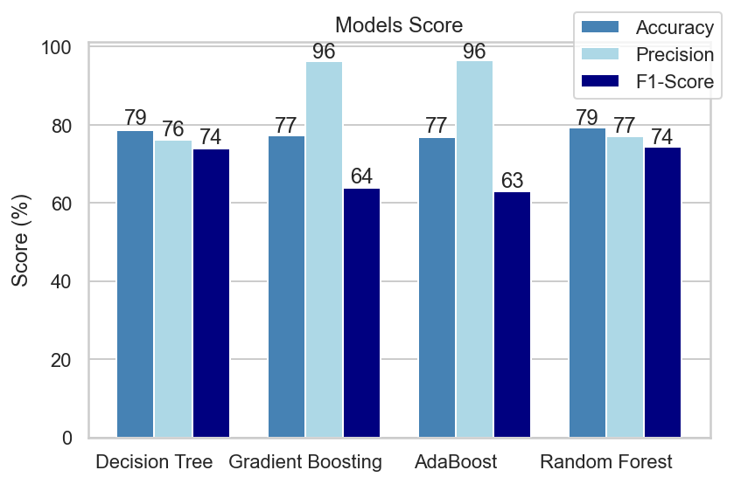
Project Plan
Data preparation: Analysis and removal of irrelevant information (missing values, inconsistent data and outliers)
Generate test design: Keep the duplicates and better distribute them between the training and testing datasets. Cross validation on training dataset.
Feature selection: Mutual Information Coefficient
Modelling: Decision Tree, Gradient Boosting, AdaBoost, Random Forest
Evaluation: Accuracy, Precision, F1-Score

Slide 6
Key Takeaways
Main variables to the predictive model: ADR, LeadTime, DepositType, PreviousCancellations
Bookings made far in advance are more likely to be cancelled
Repeated guests are more reliable (<3% of the current number of bookings)
The model presents good accuracy, precision and F1-Score, that will help C to implement actions to prevent cancellation

Slide 7
Thank you!

