Slide 1


Hotel Booking
Cancellations Prediction Study
Outcomes

Slide 2


Background
Aqui vamos escrever:
business goals
nosso challenge
overview do business
Hotel chain C
Business Goals
Implement predictive models to forecast net demand based on reservations on-the-books.
Implement better price and overbooking policies.
Identify high cancellation likelihood bookings.
Implement actions to prevent cancellation.
Reduce cancellations to a rate of 20%.
Create a prediction app
H2
H1
Notes:
Primary objective
Our analysis will focus on Lisbon’s resort since that was the data provided

Slide 3
Key Findings
Aqui vamos escrever:
o que encontramos (in terms of data)
importancia do que encontramos
Confusion matrix
Resultados

Slide 4
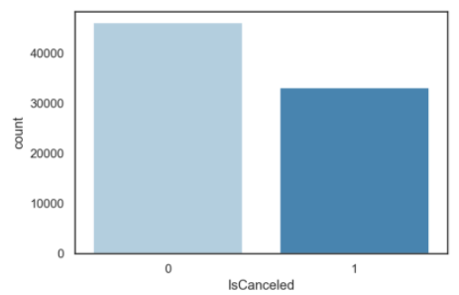
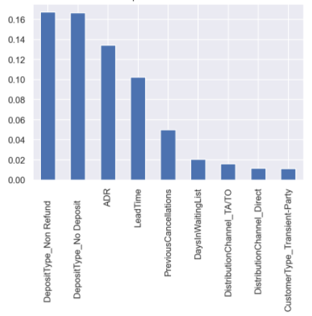
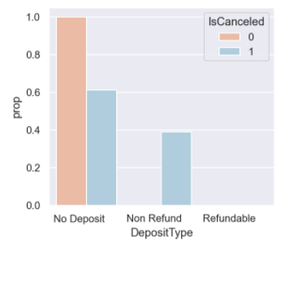
Key Findings
Aqui vamos escrever:
Mostrar um pouco dos dados (visualizacoes)
Grafico Mutual/ Main variables
Cancellation proportion in the dataset (42%)
Best features
c
Cancellation proportion according to the most important feature

Slide 5
Project Plan
Aqui vamos escrever:
algoritmos utilizados
main variables
Dataset challenges:
Limited dataset – 79330 observations
Data quality: ~30% of what seemed to be duplicated entries
Select best features
Identify best prediction model
Dataset solutions:
Analysis and removal useless information (missing values, inconsistent data and outliers)
Keep the duplicates and better distribute them between train and test dataset
Mutual Information Classifier
Algorithms considered: Decision Tree, Gradient Boosting, AdaBoost, Random Forest

Slide 6
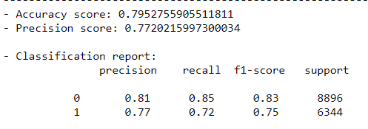
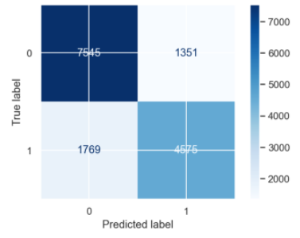
Key Take aways
Aqui vamos escrever:
4 or so main conclusions
Best model: Random Forest
Predictive App
Confusion Matrix

Slide 7
Thank you!

