Slide 1
Getting Started with
Vector Searches in
SQL Server 2025
Deborah Melkin
DebtheDBA.wordpress.com
youtube.com/@debthedba

Slide 2

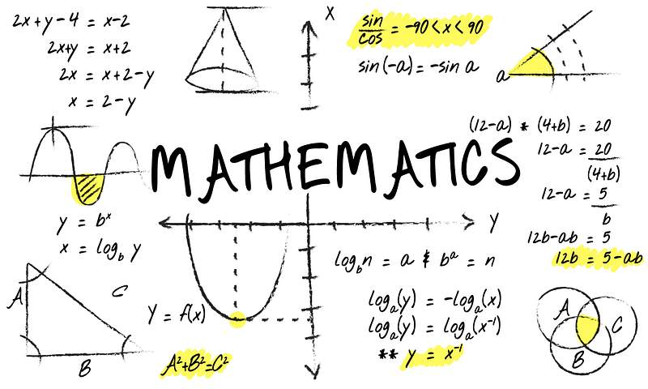

This Photo by Unknown Author is licensed under CC BY-SA

Slide 3
What are Vectors?

Slide 4
LLMs = type of model
Vector/Vector Embedding
= numeric representation of something
= a location in dimensional space
1234567.25496
I’m a green star icon.
This is the vector embedding

Slide 5
How does Vector Search work?

Slide 6
PROMPT:
Find me all icons that are similar to my green star…
2536748.2165
0385739.2135879
1234566.5461
3873948.2
3483745.75
1234567.25496
1234577.21
1234560.21658
3746593.8987
343939.9879
Reminder: These numbers are not really embedding numbers but examples only

Slide 7
Ok, show me some real examples of this…
aka Demo Time

Slide 8
Resources

Slide 9
Resources
https://github.com/Azure-Samples/azure-sql-db-vector-search
https://devblogs.microsoft.com/azure-sql/category/vectors/
https://github.com/yorek/azure-sql-db-ai-samples-search
https://devblogs.microsoft.com/azure-sql/storing-querying-and-keeping-embeddings-updated-options-and-best-practices/
https://devblogs.microsoft.com/azure-sql/efficiently-and-elegantly-modeling-embeddings-in-azure-sql-and-sql-server/

Slide 10
Resources
What’s New in SQL Server 2025
  https://aka.ms/sqlserver2025docs
SQL Server Launch Blog
  https://aka.ms/sqlserver2025
Download SQL Server 2025
  https://aka.ms/getsqlserver2025

Slide 11
Resources - Community
https://www.nocentino.com/posts/2025-05-19-ollama-sql-faststart
https://sqlbek.wordpress.com/2025/05/19/ollama-quick-start/
Getting Started with Vector Searches (Video)

