Slide 1

Project Report:
Mapping Brain Networks
Neuromatch Academy, July 2020
Les Souris Grises
063-Gay-Ladybug

Slide 2
Introduction
We are Les Souris Grises from the pod 063-Gay-Ladybug. And today we are here to present our project on the Steinmetz dataset.
Decision making in the brain is a result of a cascade of activity within different brain regions in the brain. We’re aware of the anatomical organisation of these regions but the dynamical interactions among them, is not well established.
Our initial goal was to identify this cascade of activity from the dataset. A discussion with our mentor made us realize that our goals were too ambitious, and we settled on trying to manually identify the regions, and try to make a regressive classifier for the model.

Slide 3
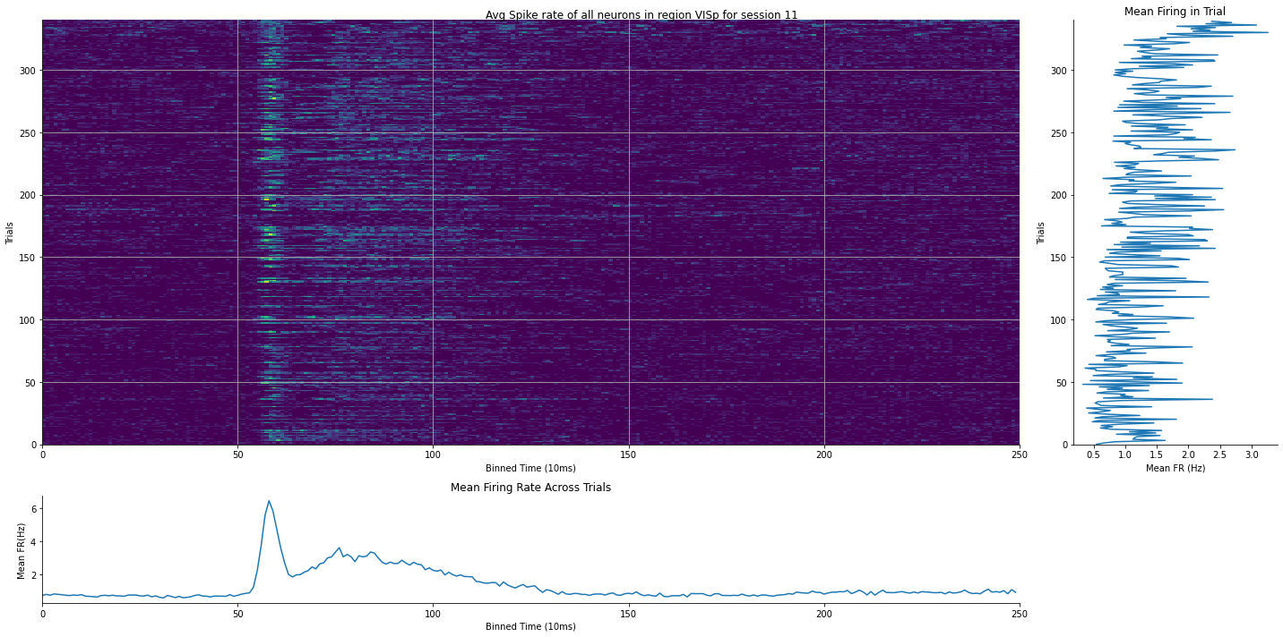
Results

Slide 4
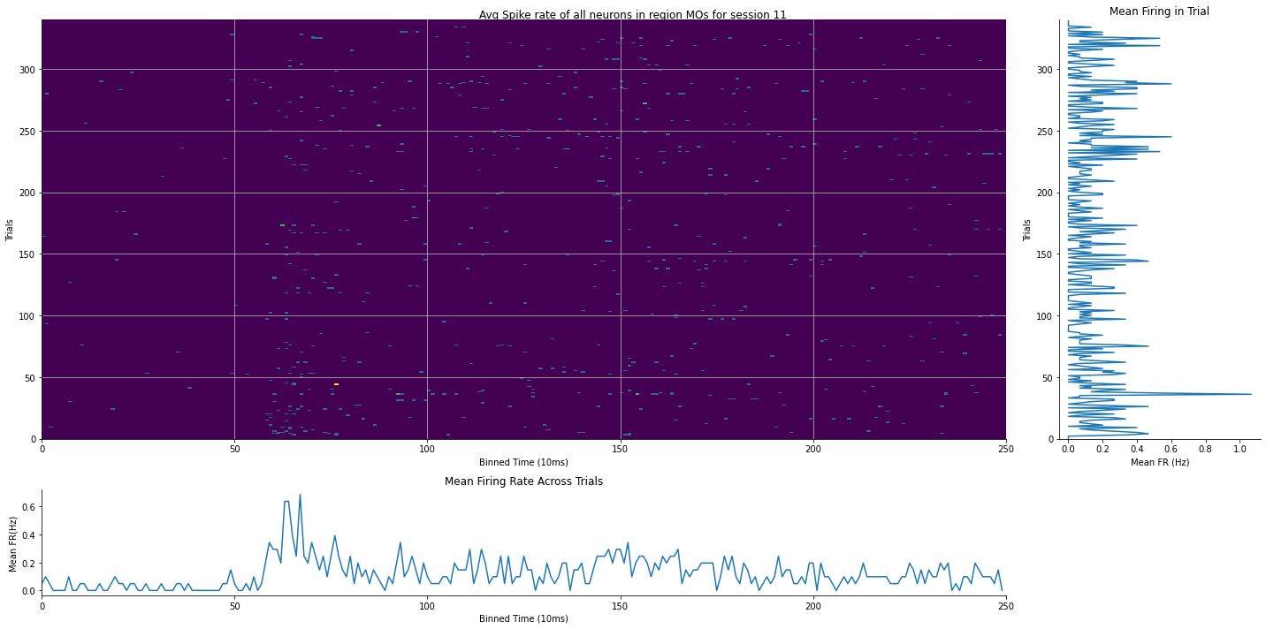
Results

Slide 5
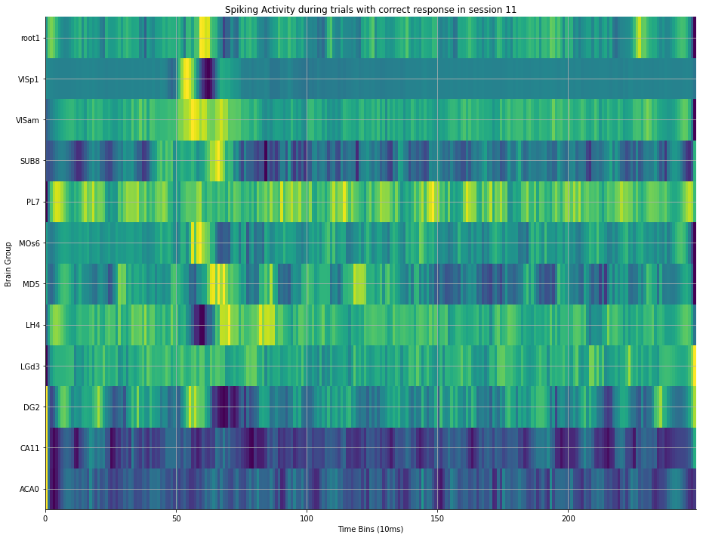
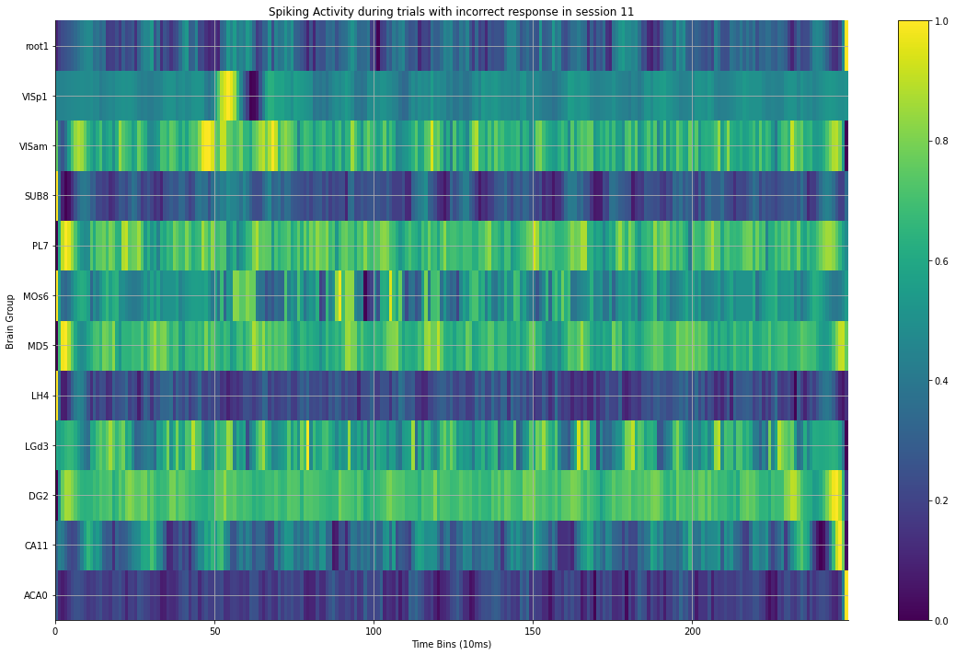
Results

Slide 6
Next steps:
At our present stage, we have been visually able to identify the areas that have different points of activation in time.
Our further tasks would be to first try to develop a classification model that could organize the raw data into these different trials. This will allows us to verify the data.
After which, we can proceed to use cross-correlation, RDMs or CCA to compare areas.

Slide 7
Experience
Anwesha What did you like best? 1. Learning a lot of new stuff. 2. Getting to know and learning from new folks from various fields. 3. Working on a real experimental dataset.
Anna What did you like best? 1. Learning from my teammates. 2. Discovering information from the data.
Debaditya What did you like best? 1. Interacting with my peers 2. Exploring a new domain 3. Working with raw data
Difficulties Faced: 1. Understanding concepts of brain connectivity. 2. Choosing the right model to fit the data 3. Coding to create specific graphs
Difficulties Faced: 1. Things got a bit icky, felt like quitting sometimes. 2. Making the data useable and interpretable.
Difficulties Faced: 1. The highly intensive course + project schedule. 2. Struggled to decide which tools would best serve our aims.
Things Learnt: 1.Tools for graphs. 2.Extracting appropriate information from data. 3. Structure of the brain.
Things Learnt: 1. Practical intuition to ask good questions from a given dataset. 2. An overall idea about carrying out a project from analysis to representation of results to drawing meaningful inferences.
Things Learnt: 1. Even basic data analysis needs a lot of cleaning. 2. How to interpret electrophysiology data and understand time dependence.

Slide 8
People
Resources
John S. Butler - Mentor
Arun H. Garamila - TA
Anna Marinou - Team Member
Anwesha Das - Team Member
Debaditya Bhattacharya - Team Member
Documentation
GitHub Repository
Google Drive

Slide 9
Thank you Neuromatch Academy!

