Slide 1
Predicting Consumption patterns with Repeated and novel events
Jingyuan Liu Chi Zhang
(jl4926) (cz2465)

Slide 2
Introduction
Consumption Patterns
Dataset: Repeat Consumption Matrices Data Set (UCI,2018)
Reference Paper: Predicting Consumption Patterns with Repeated and Novel Events. Dimitrios Kotzias, Moshe Lichman, and Padhraic Smyth.
Main Method: NMF, Mixture Model.
Repeated
Novel
tw_oc (13k x 11k)
go_sf (2k x 7k)
reddit_top (113k x 21k)
lastfm (992 x 15k)
tw_ny (30k x 11k)
go_ny (1k x 7k)
reddit_sample (20k x 21k)

Slide 3
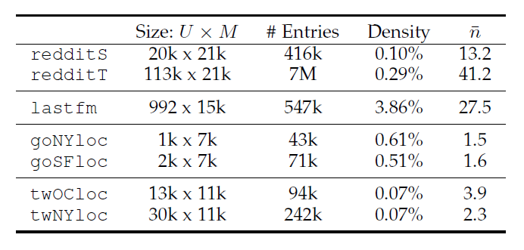
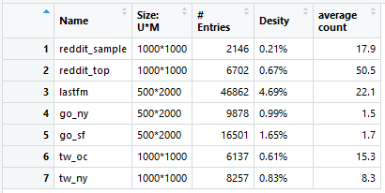
Data preprocessing
The original data sets are too large to
use NMF.
(Can’t get any result of the smallest data set
in 30 min)
Cut off data set

Slide 4
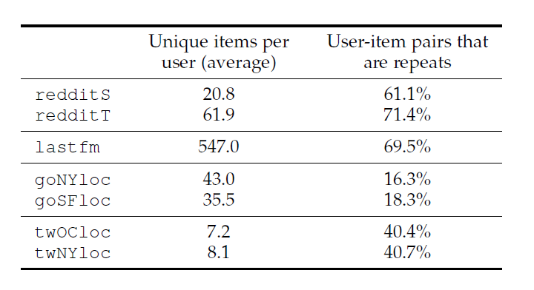
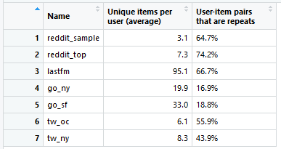
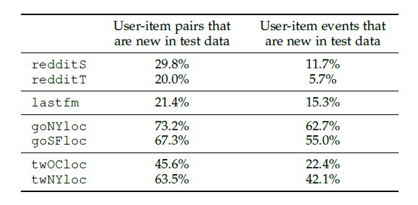
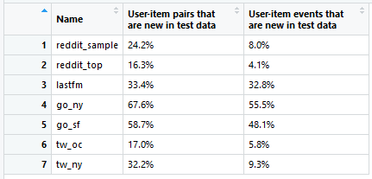
Characteristics of Data
Mean consumption and repeat consumption characteristics across
datasets
Exploration rates: percentages of new items and events per user, in the
test data, across data sets

Slide 5
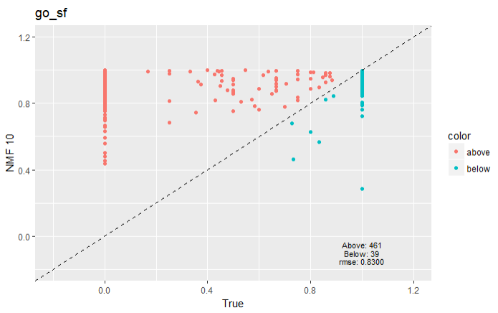
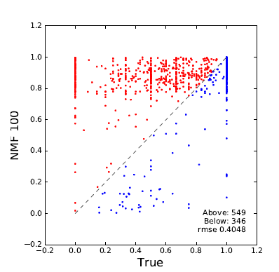
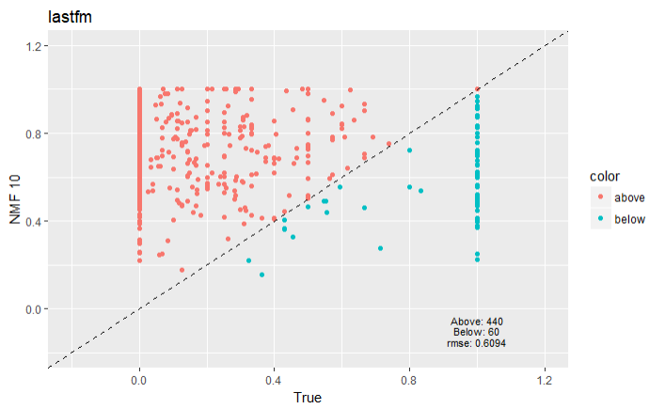
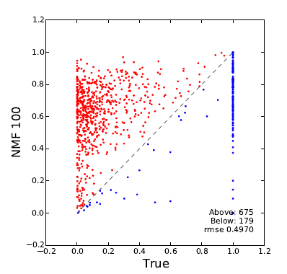
NMF: Oversmooth!!

Slide 6
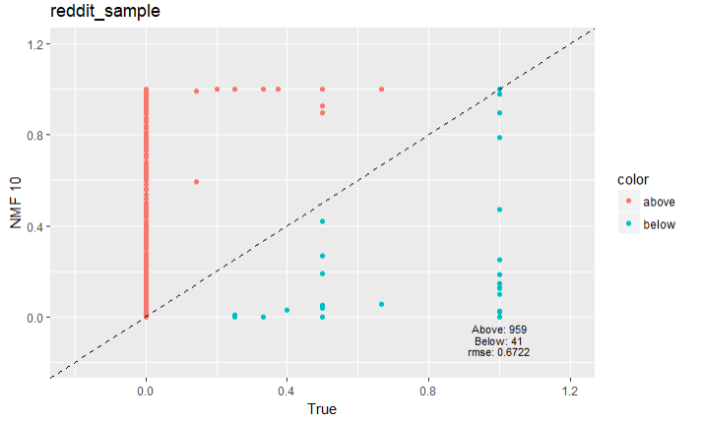
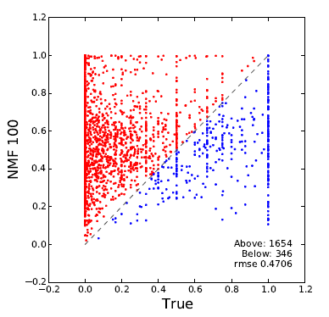
NMF: Oversmooth!!

Slide 7
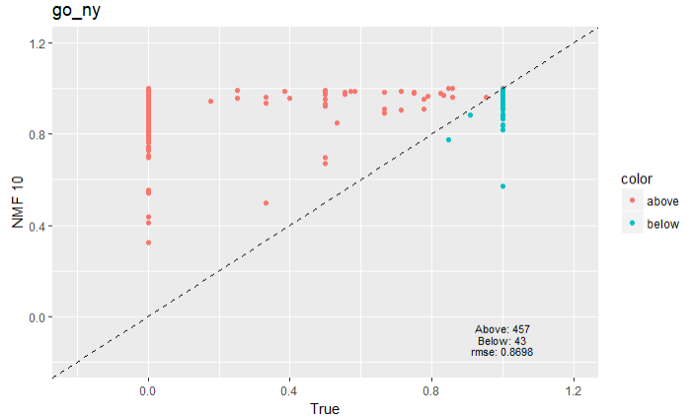
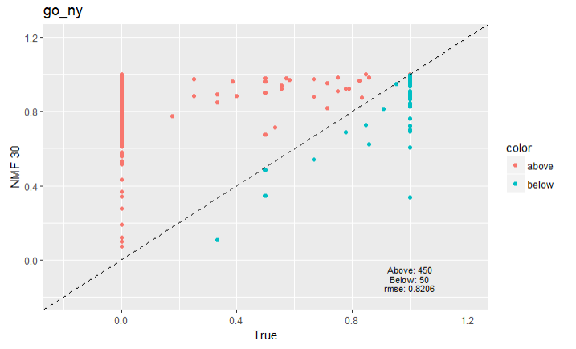
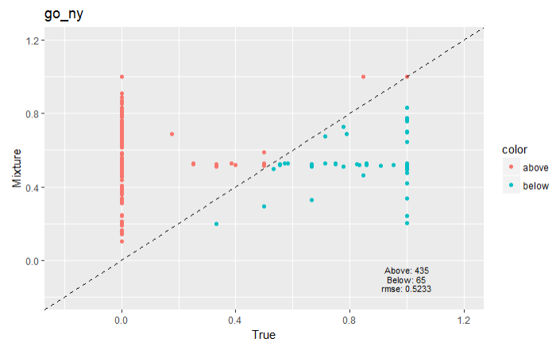
NMF: Oversmooth can be solved with large rank
NMF 10: Oversmooth)
NMF 30: Reduce oversmooth
Mixture Model: Ideal

Slide 8
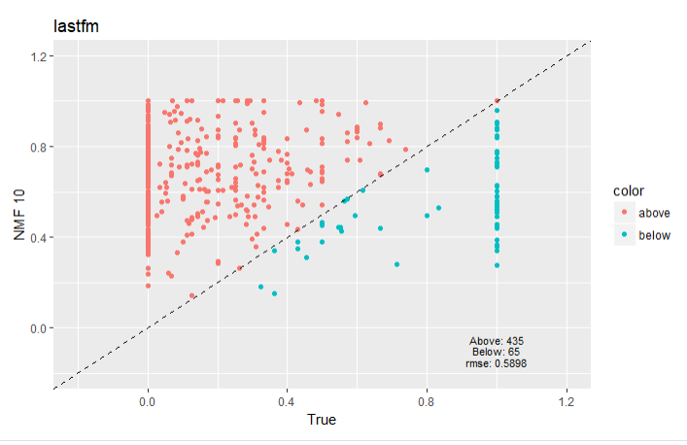

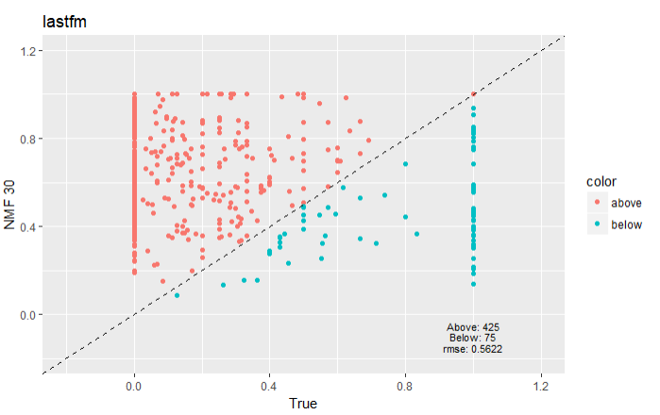
NMF: Oversmooth can be solved with large rank
NMF 10: rmse:0.5898
NMF 20: rmse:0.5788
NMF 30: rmse:0.5622

Slide 9
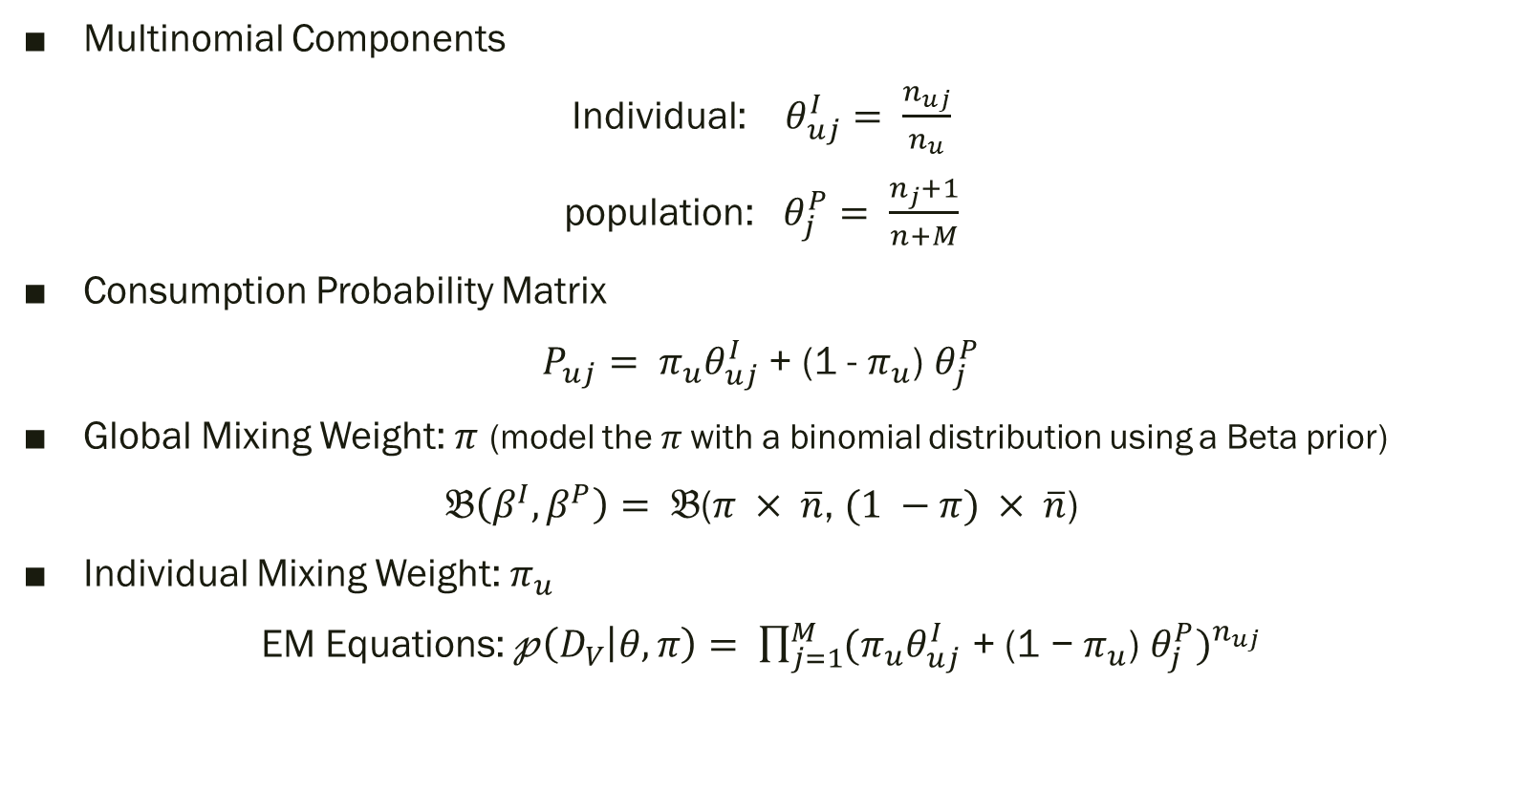
Mixture Model
Multinomial Components
Individual: $θ_{uj}^{I}= \frac{n_{uj}}{n_{u}}$
population: $θ_{j}^{P}= \frac{n_{j}+1}{n+M}$
Consumption Probability Matrix
$P_{uj}= π_{u}θ_{uj}^{I}$ + (1 - $π_{u}$) $θ_{j}^{P}$
Global Mixing Weight: $π$ (model the $π$with a binomial distribution using a Beta prior)
$𝔅\left(β^{I},β^{P}\right)= 𝔅$($π × \overline{n}$, $(1 −π) × \overline{n}$)
Individual Mixing Weight: $π_{u}$
EM Equations: $𝓅\left(D_{V} | θ,π\right)= \prod_{j=1}^{M}{{{(π}_{u}θ_{uj}^{I}\text{ + (1 − }π_{u}\text{) }θ_{j}^{P})}^{n_{uj}}}$

Slide 10
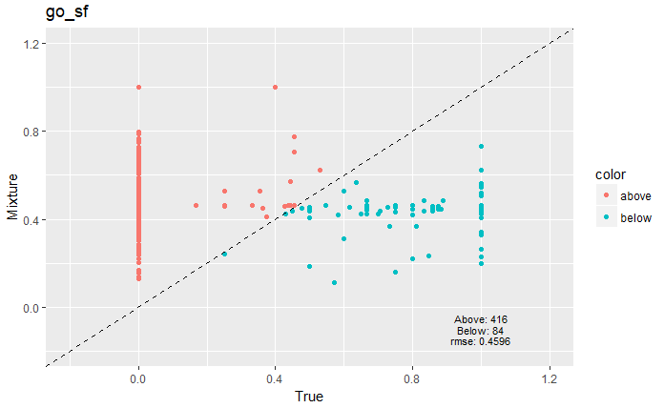
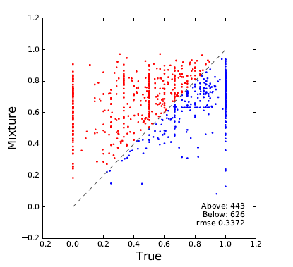
Mixture Model

Slide 11
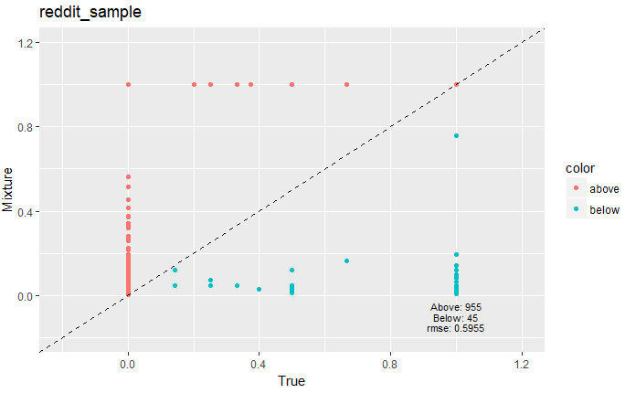
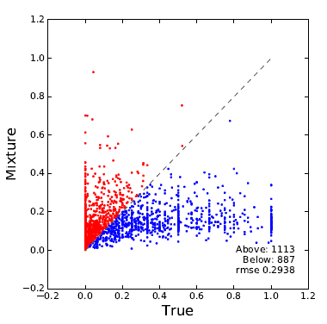
Mixture Model

Slide 12
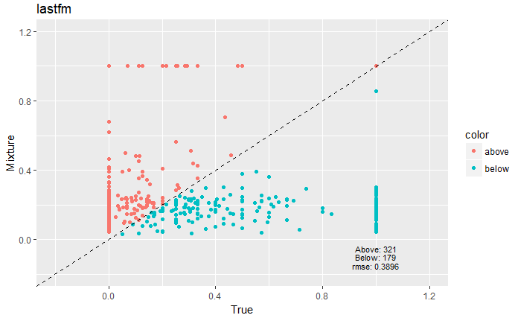
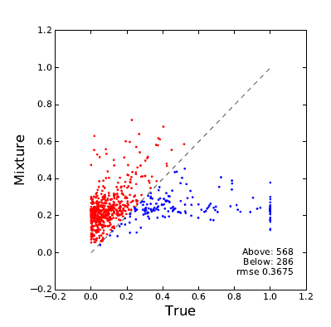
Mixture Model

Slide 13
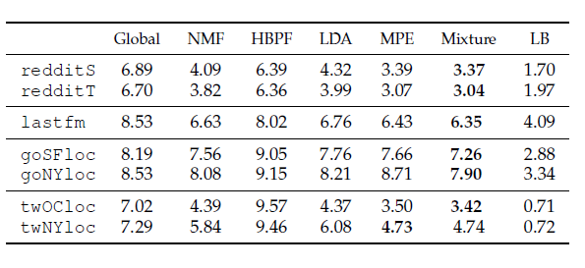
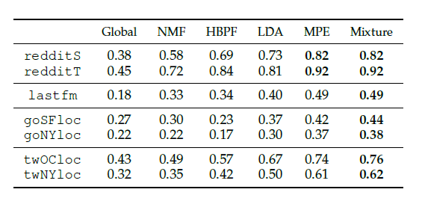

Evaluation Metrics
log-loss: $−logP=−\frac{1}{N_{te}}\sum_{u}{\sum_{j}{n_{uj}logP(j|u)}}$ (Lower scores are better)
Recall@k: $Recall@k= \frac{1}{N_{te}}\sum_{u}{\sum_{j}{\frac{n_{uj}1\{rank\left(u,j\right)≤k\}}{\sum_{j′}{n_{uj′}}}}}$ (Higher scores are better)
log loss | NMF 10 | NMF ns 10 | Mixture
redditS | 2.276 | inf | 0.881
redditT | 1.694 | inf | 0.815
lastfm | 6.814 | inf | 5.262
goSFloc | 8.85 | inf | 5.766
goNYloc | 12.1 | inf | 5.702
twOCloc | 3.265 | inf | 1.442
twNYloc | 2.386 | inf | 1.278
Recall@k | NMF 10 | NMF ns 10 | Mixture
redditS | 0.0713 | 0.0647 | 0.073
redditT | 0.0183 | 0.0139 | 0.0187
lastfm | 0.0054 | 0.0049 | 0.007
goSFloc | 0.0675 | 0.0624 | 0.074
goNYloc | 0.114 | 0.108 | 0.143
twOCloc | 0.2 | 0.199 | 0.208
twNYloc | 0.16 | 0.156 | 0.17

Slide 14
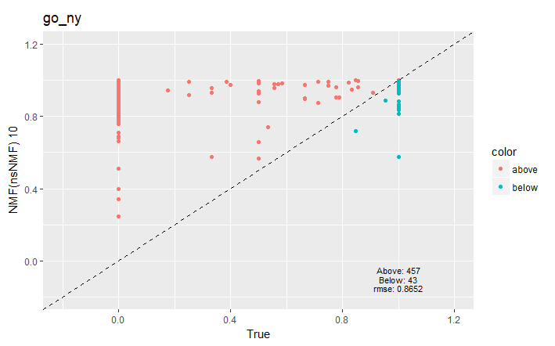
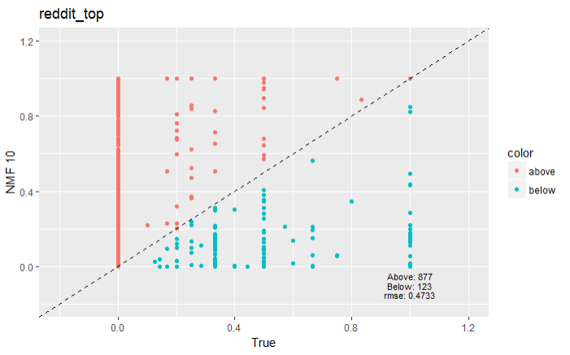
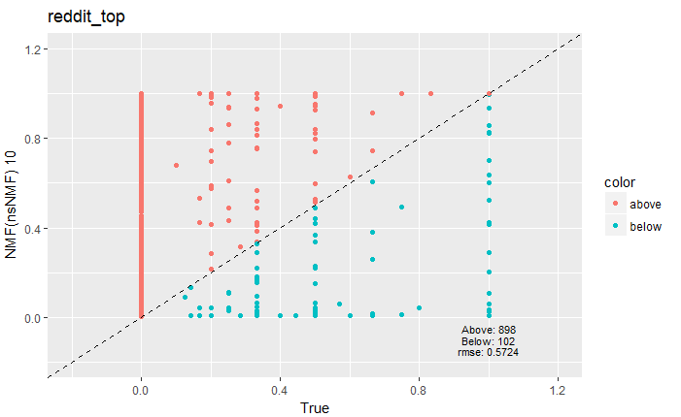
No smooth NMF algorithm
Rsme: 0.8698
Rsme: 0.8652
Rsme: 0.4733
Rsme: 0.5724

Slide 15
No smooth NMF algorithm
No smooth NMF algorithm does not improve the performance significantly
No smooth NMF gets worst scores in two evaluation than NMF
No smooth NMF reduce the time cost of NMF significantly:
NMF with default brunet algorithm cost 15 mins to compute a rank 10 matrix
NMF with nsNMF algorithm cost 6 mins to compute a rank 10 matrix

Slide 16
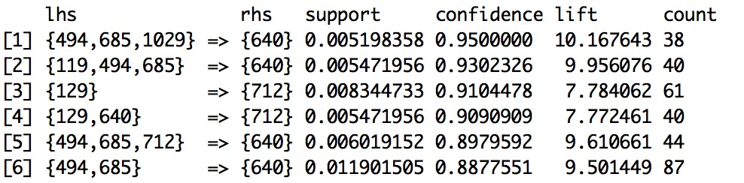
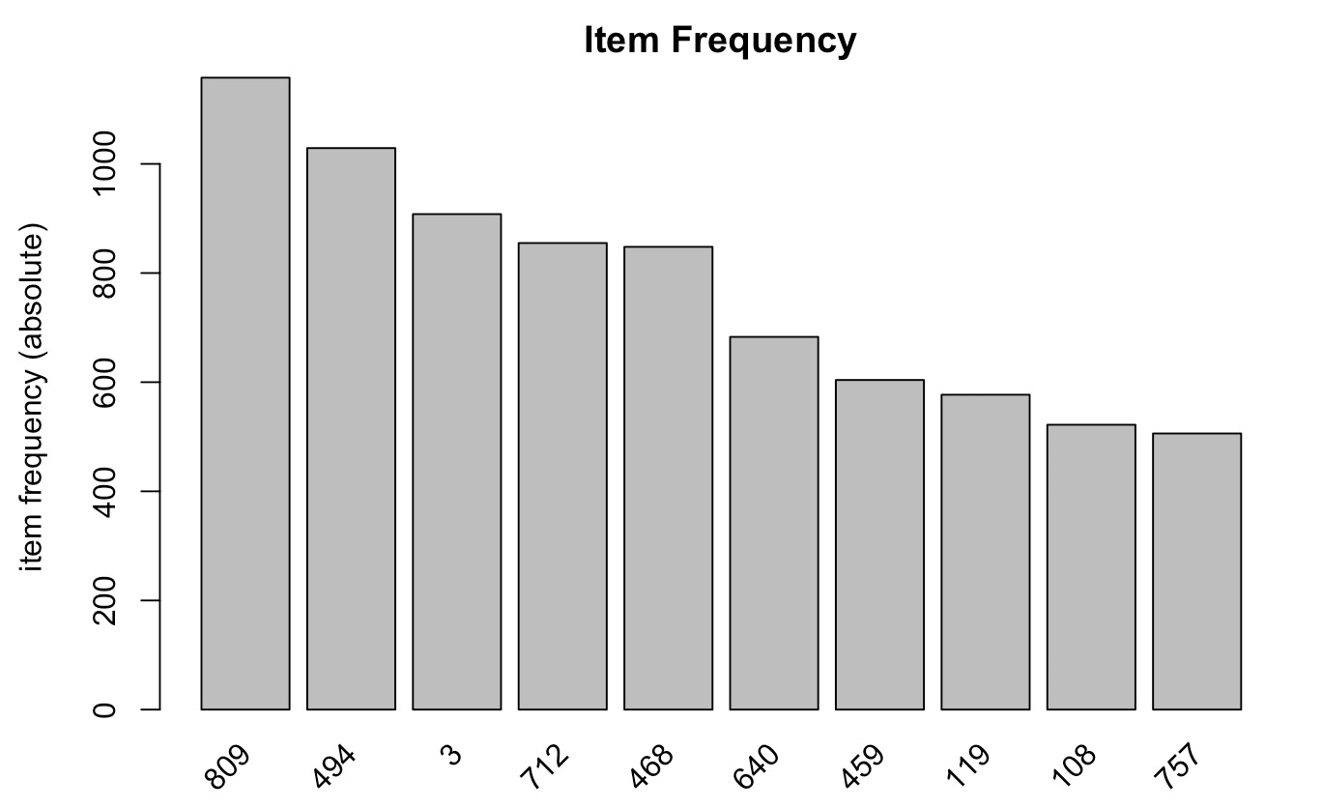
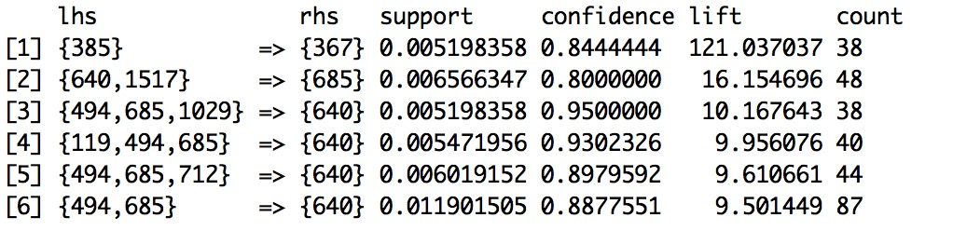
Besides, We also did
Association Analysis

Slide 17
Conclusion
Log-loss is still a lot larger than the lower bound => improvement needed.

