Slide 1


Slide 2
Download
Anaconda: https://www.anaconda.com/products/individual
Visual studio code: https://code.visualstudio.com/

Slide 3
Open Source Hong Kong 開源香港
開源香港（英文：Open Source Hong Kong，簡稱 OSHK）是一個根據香港社團條例 Cap.151 登記的香港開源協會。OSHK 旨於促進開放源碼軟件的發展，我們是一個聯繫一眾開源開發者、貢獻者和用家的技術社群。我們會員開發及支持多個不同開放源碼專案。
開源香港是 Open Source Initiative (OSI) 的聯盟成員 Affiliate Member。
OSHK 透過舉行香港和亞洲會議和活動，來鼓勵國際開源社群共同協作。
英語、廣東話和國語是 OSHK 主要溝通語言。
https://opensource.hk/join/

Slide 4

自我介紹 Calvin Tsang calvin@opensource.hk
Solution Architect, Cloud & Data (Insurance) Technical Consultant, Marketing App in APAC (Publication) Mobile App Team Lead (Banking) Full stack developer (Aviation)
Vice President of Open Source Hong Kong President of Hong Kong Open Source Conference 2020 & 2021
Podcaster, Certified Scrum Master
Projects: Hang Seng Bank Commercial Bank App, AML App, Jumpseat Booking System, Game, Video Call, Home Automation, CMS etc.
Now? Focus on Machine Learning Project.

Slide 5
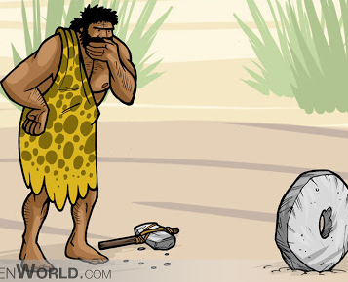

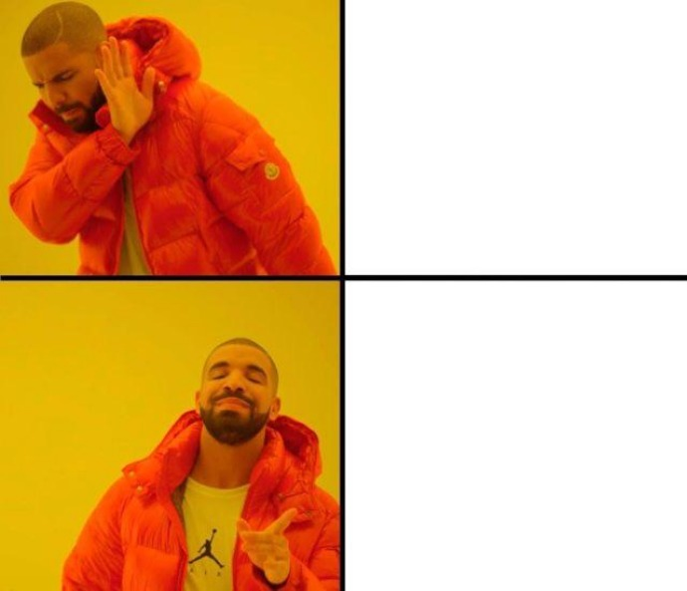

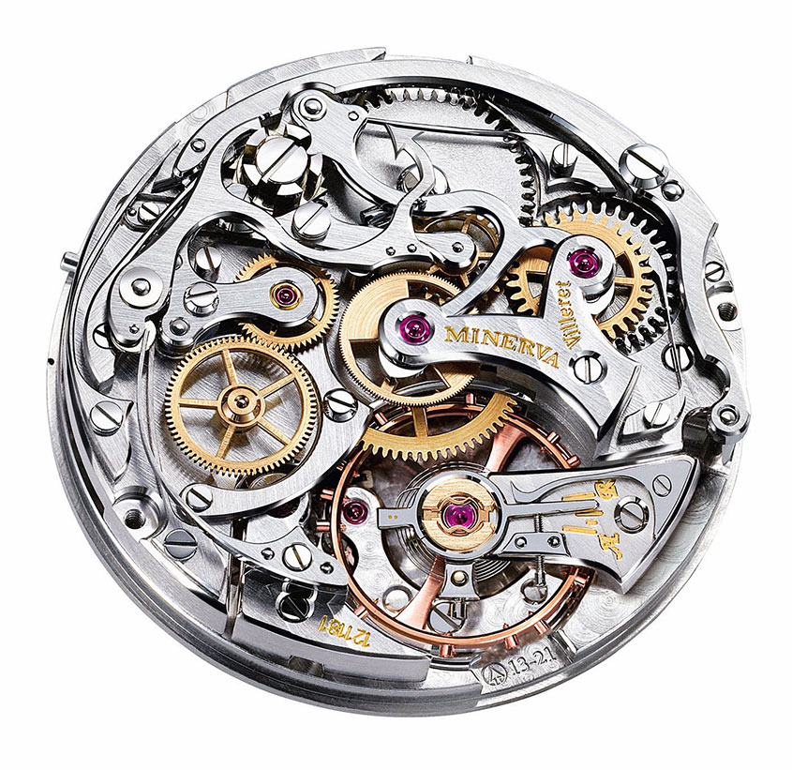








Notes:
We sometime want to avoid re-inventing the wheel, as in avoid useless duplicated effort. But in this workshop, we have this punch line to represent how we would like all of us to learn from basics together. And of coz, pun intended, Wheel is a standard of Python distribution you will know later
By learning the fundamentals and working principles of wheels from basic to advanced, we will know how to choose to use the right ones, assemble them together and fix existing ones in various situations, and to create new ones to fit missing gaps and ones of better designs.

Slide 6
Reinvent the wheel重造輪子
2021 新企劃！
本活動希望利用現時的應用程式去學習程式開發, 從重造人家的程式, 去理解運作過程。
當他日學有所成，不要浪費青春。

Slide 7
流程
30 分鐘 基礎講解，小程式學習
1小時 落手做題目，小組研究

Slide 8

Binary二進制

Slide 9
1,2,4,8,16,64,128… 2^0 … 2^(n-1)
在數學和數碼電路中指以2為基數的記數系統，以2為基數代表系統是二進位制的。
這一系統中，通常用兩個不同的數字0和1來表示。

Slide 10
Example (binary->decimal)
0010 2 = 2^1 = 2 10
0011 2 = 2^0 + 2^1 = 3 10
0100 2 = 2^2 = 4 10
0101 2 = 2^0 + 2^2 = 5 10
1010 2 = 2^2 + 2^3 = 10 10

Slide 11
Example (dec > bin)
2 10 = {2/2 = 1..0} = 0010 2
3 10 = {3/2 = 1..1, 1/2 = 0..1} = 0011 2
4 10 = { ... } = 0100 2
5 10 = { ... } = 0101 2
10 10 = { ... } = 1010 2

Slide 12
Warm up
710 → (bin)
1110 → (bin)
1001 2→ (dec)
1111 2 → (dec)
Advance ~
12710→ (bin)
10101010 2 → (dec)

Slide 13
Oct, Hex
3 digit Oct, 000 (0) – 111(7)
4 digit 0000 (0) – 1111 (15)

Slide 14

Coding

Slide 15
Python
Python is an easy to learn, powerful programming language. It has efficient high-level data structures and a simple but effective approach to object-oriented programming. Python’s elegant syntax and dynamic typing, together with its interpreted nature, make it an ideal language for scripting and rapid application development in many areas on most platforms.
Free and Open Source

Slide 16
Python (more)
Use Python3

Slide 17
Hello World
print("Hello, World!")
# comment
Run >> `python myfile.py`

Slide 18
Python Indentation
if 5 > 2: print("Five is greater than two!")
Syntax Error:
if 5 > 2: print("Five is greater than two!")

Slide 19
Looping -1
for x in range(6):
_ _ print(x)
not the values of 0 to 6, but the values 0 to 5 [6]

Slide 20
Looping -2
for x in range(2, 30, 3):
print(x)
Increment the sequence with 3
{2, 5, 8, 11, 14…29}

Slide 21
Looping when finished
for x in range(6): print(x) else: print("Finally finished!")
0 1 2 3 4 5 Finally finished!

Slide 22
Exercise
Print a list from 0 to 10
Print a list from 4 to 55
Print a list from 0 to 201 with increment 10, print “DONE” when finished

Slide 23
---

Slide 24
Python Variables
x = 5 y = "John" print(x) print(y)
-
x = str(3) # x will be '3' y = int(3) # y will be 3 z = float(3) # z will be 3.0

Slide 25
Conditions
Equals: a == b
Not Equals: a != b
Less than: a < b
Less than or equal to: a <= b
Greater than: a > b
Greater than or equal to: a >= b

Slide 26
If statements
Decision Making
a = 33 b = 200 if b > a: _ _print("b is greater than a")

