Slide 1

20210413-2

Slide 2
Download
Anaconda: https://www.anaconda.com/products/individual
Visual studio code: https://code.visualstudio.com/
AOB
Contact Information
Slide: `1 http://bit.ly/reinvent_ch2

Slide 3

Logic

Slide 4
Logic
True
False
Logical Operator: AND (&& / .) , OR (|| / + ), NOT (~)

Slide 5
Truth Table
condition 1 (e.g., X) | condition 2 (e.g., Y) | NOT X ( ~ X ) | X AND Y ( X && Y ) | X OR Y ( X || Y )
false | false
false | true
true | false
true | true

Slide 6
Truth Table
condition 1 (e.g., X) | condition 2 (e.g., Y) | NOT X ( ~ X ) | X AND Y ( X && Y ) | X OR Y ( X || Y )
false | false | true | false | false
false | true | true | false | true
true | false | false | false | true
true | true | false | true | true

Slide 7
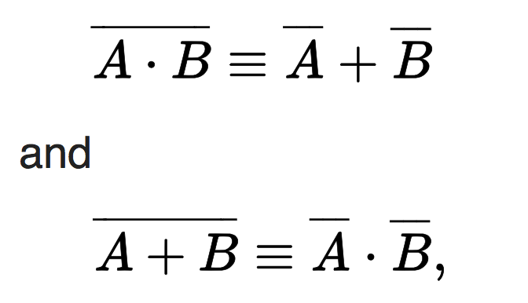
DeMorgan's Laws
NOT(A || B) is Equivalent to (NOT(A) AND NOT(B))
NOT(A || B) is Equivalent to (NOT(A) AND NOT(B))

Slide 8
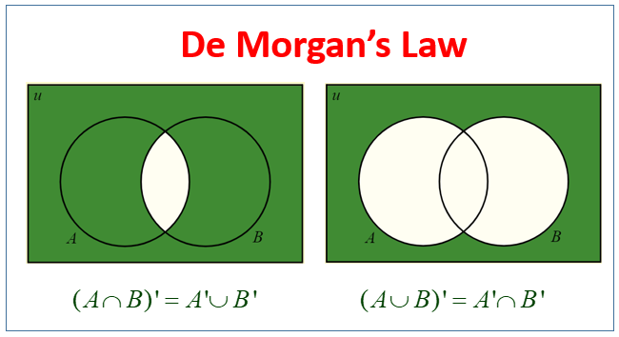

Slide 9
Exercise
Truth table

Slide 10

Coding

Slide 11
Last Month
Looping
Python Env Setup

Slide 12
Variable
Variables are containers for storing data values.
Python has no command for declaring a variable.
Variable names are case-sensitive.
x = 5 y = "John" print(x) print(y)

Slide 13
Variable Names
A variable can have a short name (like x and y) or a more descriptive name (age, carname, total_volume). Rules for Python variables:A variable name must start with a letter or the underscore character
A variable name cannot start with a number
A variable name can only contain alpha-numeric characters and underscores (A-z, 0-9, and _ )
Variable names are case-sensitive (age, Age and AGE are three different variables)

Slide 14
Variable - Casting
x = str(3) # x will be '3' y = int(3) # y will be 3 z = float(3) # z will be 3.0

Slide 15
Variable Get Type
x = 5 y = "John" print(type(x)) print(type(y))

Slide 16
Python Data Types
Text Type: | str
Numeric Types: | int, float, complex
Sequence Types: | list, tuple, range
Mapping Type: | dict
Set Types: | set, frozenset
Boolean Type: | bool
Binary Types: | bytes, bytearray, memoryview

Slide 17
Common use data type example
x = "Hello World" | str
x = 20 | int
x = 20.5 | float
x = 1j | complex
x = ["apple", "banana", "cherry"] | list
x = ("apple", "banana", "cherry") | tuple
x = range(6) | range
x = {"name" : "John", "age" : 36} | dict
x = {"apple", "banana", "cherry"} | set
x = True | bool

Slide 18
Data Type: Number
x = 1 # int y = 2.8 # float z = 1j # complex

Slide 19
Strings
Strings in python are surrounded by either single quotation marks, or double quotation marks.
'hello' is the same as "hello".
print("Hello") print('Hello')

Slide 20
String functions (1)
for x in "banana": print(x)
a = "Hello, World!" print(len(a))

Slide 21
String functions (2)
txt = "The best things in life are free!" print("free" in txt)
txt = "The best things in life are free!" print(expensive" not in txt)
b = "Hello, World!" print(b[2:5])

Slide 22
String functions (3)
a = "Hello, World!" print(a.replace("H", "J"))
a = "Hello, World!" print(a.split(",")) # returns ['Hello', ' World!']

Slide 23
String function(4)
a = "Hello" b = "World" c = a + " " + b print(c)
quantity = 3 itemno = 567 price = 49.95 myorder = "I want {} pieces of item {} for {} dollars." print(myorder.format(quantity, itemno, price))

Slide 24
Exercise
1) Given Apple $5, Banana $14, Orange $6 Calculate the summation for 12 pc Apple, 15 pc Banana, 21 pc Orange Print the price with 1 line
2) Apple discounted 5%, Banana discounted 15% but Orange increased 10%, please renew the reasonable price in 1 line
3) If I have budget $400, I want to buy 14 pc Apple, 20 pc Banana, 52 pc Orange, how much is owed?

Slide 25
Exercise (cont.)
4) If I have $200 and want to buy and share the fruits to 3 children *FAIRLY. How many Apple, Banana and Orange that I should buy and how much dollar remaining.
5) How about I have $333 budget? (Change the input from $200 to $333)
Given “print('Enter your budget:’) budget = input()”

Slide 26
Python Arithmetic Operator
Operator | Name | Example
+ | Addition | x + y
- | Subtraction | x - y
* | Multiplication | x * y
/ | Division | x / y
% | Modulus | x % y
** | Exponentiation | x ** y
// | Floor division | x // y

Slide 27
Python Assignment Operators
Operator | Example | Same As
= | x = 5 | x = 5
+= | x += 3 | x = x + 3
-= | x -= 3 | x = x - 3
*= | x *= 3 | x = x * 3
/= | x /= 3 | x = x / 3
%= | x %= 3 | x = x % 3
//= | x //= 3 | x = x // 3
**= | x **= 3 | x = x ** 3
&= | x &= 3 | x = x & 3
|= | x |= 3 | x = x | 3
^= | x ^= 3 | x = x ^ 3
>>= | x >>= 3 | x = x >> 3
<<= | x <<= 3 | x = x << 3

Slide 28
Data Type: Boolean
Booleans represent one of two values: True or False.
a = 200 b = 33 if b > a: print("b is greater than a") else: print("b is not greater than a")

Slide 29
Data Type: List, Tuples, Set, Dictionary
List is a collection which is ordered and changeable. Allows duplicate members.
Tuple is a collection which is ordered and unchangeable. Allows duplicate members.
Set is a collection which is unordered and unindexed. No duplicate members.
Dictionary is a collection which is ordered* and changeable. No duplicate members.
As of Python version 3.7, dictionaries are ordered. In Python 3.6 and earlier, dictionaries are unordered.

Slide 30
List function
thislist = ["apple", "banana", "cherry"] print(thislist[1]) #banana
thislist = ["apple", "banana", "cherry"] print(thislist[-1]) #cherry
thislist = ["apple", "banana", "cherry", "orange", "kiwi", "melon", "mango"]
print(thislist[2:5]) # ['cherry', 'orange', 'kiwi']

Slide 31
List Function (2)
thislist = ["apple", "banana", "cherry"] thislist[1] = "blackcurrant" print(thislist)
thislist = ["apple", "banana", "cherry"] thislist.append("orange") print(thislist)

Slide 32
List function (3)
thislist = ["apple", "banana", "cherry"] thislist.remove("banana") print(thislist)
thislist = ["apple", "banana", "cherry"] for x in thislist: print(x)

Slide 33
List function (4)
thislist = ["apple", "banana", "cherry"] for i in range(len(thislist)): print(thislist[i])
thislist = ["orange", "mango", "kiwi", "pineapple", "banana"] thislist.sort() print(thislist)

Slide 34
Data Type: Tuple
mytuple = ("apple", "banana", "cherry")

Slide 35
Change item for Unchangeable Tuple
x = ("apple", "banana", "cherry") y = list(x) y[1] = "kiwi" x = tuple(y) print(x)

Slide 36
Data Type: Set (unordered, unchangeable)
myset = {"apple", "banana", "cherry"}
Once a set is created, you cannot change its items, but you can add new items.
thisset = {"apple", "banana", "cherry"} thisset.add("orange") print(thisset)

Slide 37
Data Type: Dictionaries
Dictionaries are used to store data values in key:value pairs.
A dictionary is a collection which is ordered*, changeable and does not allow duplicates.
thisdict = { "brand": "Ford", "model": "Mustang", "year": 1964 }

Slide 38
Exercise
Store ”Apple”, “Banana”, “Orange”, “Avocado”, “Durian”, “Kiwi” to List, Tuple and Set Type
Assign the price for above fruit with $5, $12, $6, $22, $85, $13 as Dictionary Type
List all the fruit
Sorting the fruit
Remove “Avocado” in the list
Add “Watermelon” to the list
Update a list show only the fruit price is under $15.

Slide 39
Exercise / Homework
Create Tic Tac Toe Game with 2 users input
Input Players’ name
Print the game space
Create the game space to store game state.
Request x,y coordinate as input (e.g. “0,0”, “2,2”, “1,2” etc)
Verify the input
Print the updated game space
Check the game is over and announce player name

Slide 40
Next Class
28/4 Wed 19:30

