Slide 1

20210511 / Slide 3

Slide 2
Python Function
關鍵字 (keyword) 用在函數 (function) 或方法 (method) 中回傳數值，這是說如果函數或方法需要回傳值 (return value) 的話，就要加上 return 陳述，基本上函數或方法只會回傳一個數值。

Slide 3
Example 1, define and return
def get_10():
return 10
print(get_10())

Slide 4
Example 2, parameter
def get_p(p):
return p
print(get_p(5))

Slide 5
Example 3, local variable
def get_a():
a = 0
return a
print(get_a())

Slide 6
Variable Scope
Local Variable
Global Variable

Slide 7
Global Variable -1
x = "global"
def foo():
print("x inside:", x)
foo()
print("x outside:", x)
--
x inside: global
x outside: global

Slide 8
Global Variable - 2
x = "global"
def foo():
x = x * 2
print(x)
foo()

Slide 9
Local Variable -1
def foo():
y = "local"
foo()
print(y)

Slide 10
Local variable 2
def foo():
y = "local"
print(y)
foo()

Slide 11
Global & Local var
x = "global "
def foo():
global x
y = "local"
x = x * 2
print(x)
print(y)
foo()

Slide 12
Answer
global global
local

Slide 13
Global & Local var - 2
x = 5
def foo():
x = 10
print("local x:", x)
foo()
print("global x:", x)

Slide 14
Answer
local x: 10
global x: 5

Slide 15
Exercise
Create a function getPriceA() and return 12
Create a function setPriceA with 1 parameter
Update getPriceA function to support variable ‘a’ from setPriceA a
Create getPriceB and setPriceB for var b as well
Create one more function sum() with getPriceA & getPriceB and return the value
Request for input A and B 1 by 1 and set PriceA & PriceB
Print out the sum value to user

Slide 16

Tic Tac Toe
Show me the code

Slide 17
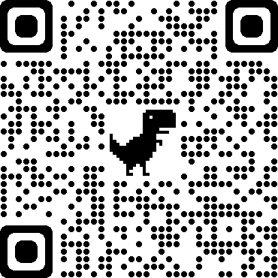
Download
https://drive.google.com/drive/folders/11QGE8QIh6F-b2iU7HInZHmOWrEOdqeMO

Slide 18
Exercise / Homework
Create Tic Tac Toe Game with 2 users input
Input Players’ name
Print the game space
Create the game space to store game state.
Request x,y coordinate as input (e.g. “0,0”, “2,2”, “1,2” etc)
Verify the input
Print the updated game space
Check the game is over and announce player name

