Slide 1

Project 1
Eddie Smith

Slide 2
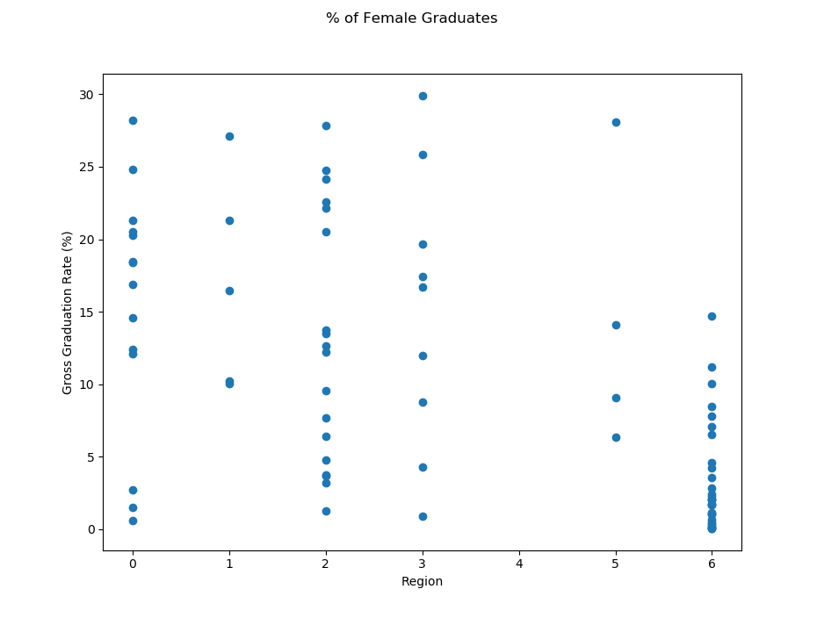
% of Female Graduates < 30%
Regions:
0 – EAP 1 – ECA 2 – LAC
3 – ME 4 – NA 5 – SA
6 – SSA
Country | Region | GGR
Lebanon | ME | 29.88909
China | EAP | 28.21447
India | SA | 28.09594
Ecuador | LAC | 27.83287
Serbia | ECA | 27.13499
----- | ----- | -----
Mozambique | SSA | 0.19817
Angola | SSA | 0.09530
Chad | SSA | 0.07506
Tanzania | SSA | 0.05823
Gambia | SSA | 0.05636

Slide 3
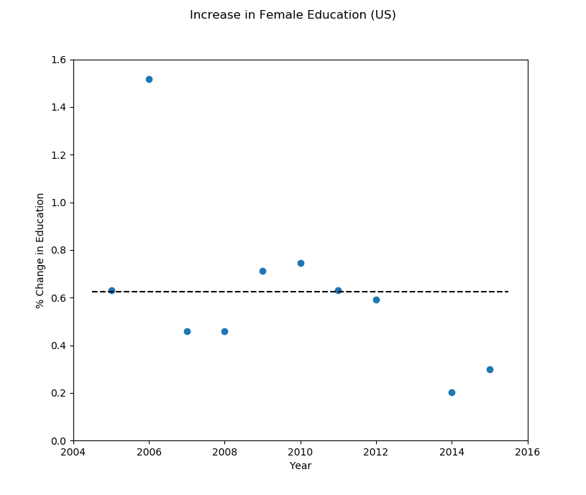
Increase in US Female Education
Year | Change from Previous
2005 | 0.6305
2006 | 1.5176
2007 | (0.4590)
2008 | 0.4590
2009 | 0.7123
2010 | 0.7462
2011 | 0.6321
2012 | 0.5910
2013 | N/A
2014 | 0.2020
2015 | 0.3005
Average | 0.6250

Slide 4
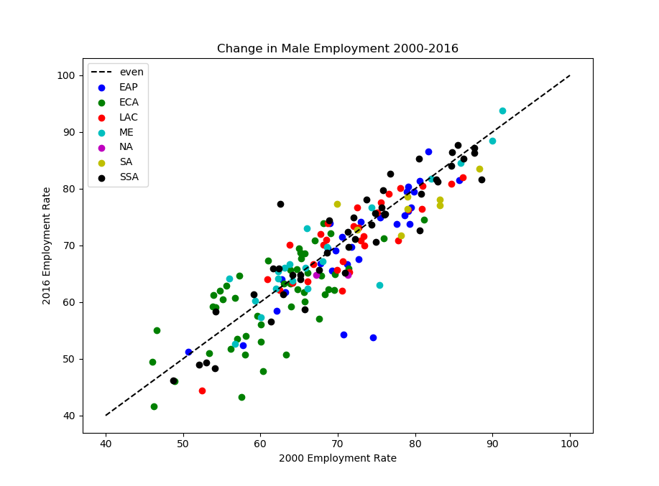
Change in Male Employment
$\frac{\left(2016−2000\right)}{2000}$
Country | % Change
Mali | 23.5262
Bulgaria | 18.1143
Algeria | 14.5049
Poland | 13.4110
Slovak Republic | 13.2269
----- | -----
Albania | -19.7950
Greece | -20.7475
Samoa | -23.2529
Moldova | -24.8342
Timor-Leste | -27.9058

Slide 5
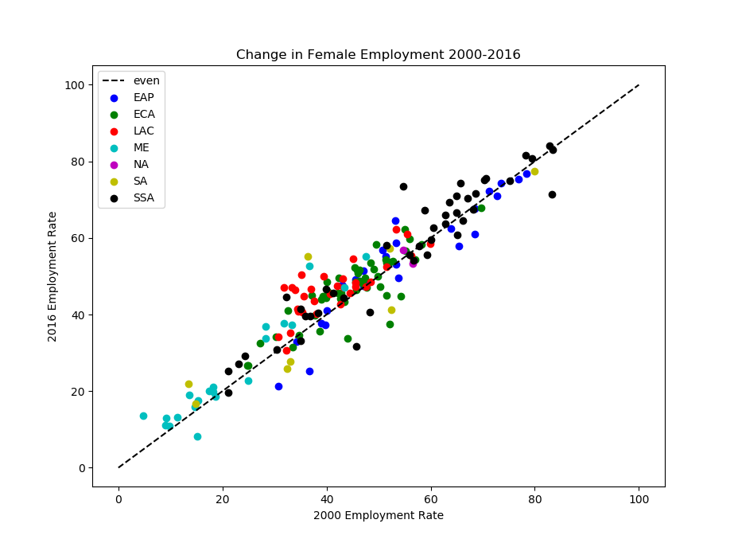
Change in Female Employment
$\frac{\left(2016−2000\right)}{2000}$
Country | % Change
Algeria | 189.4165
Pakistan | 62.9663
Maldives | 51.1760
Chile | 47.8173
Qatar | 43.6988
----- | -----
Moldova | -28.1658
Samoa | -30.8016
Gabon | -30.8389
Timor-Leste | -30.9175
Syria | -45.8078

Slide 6
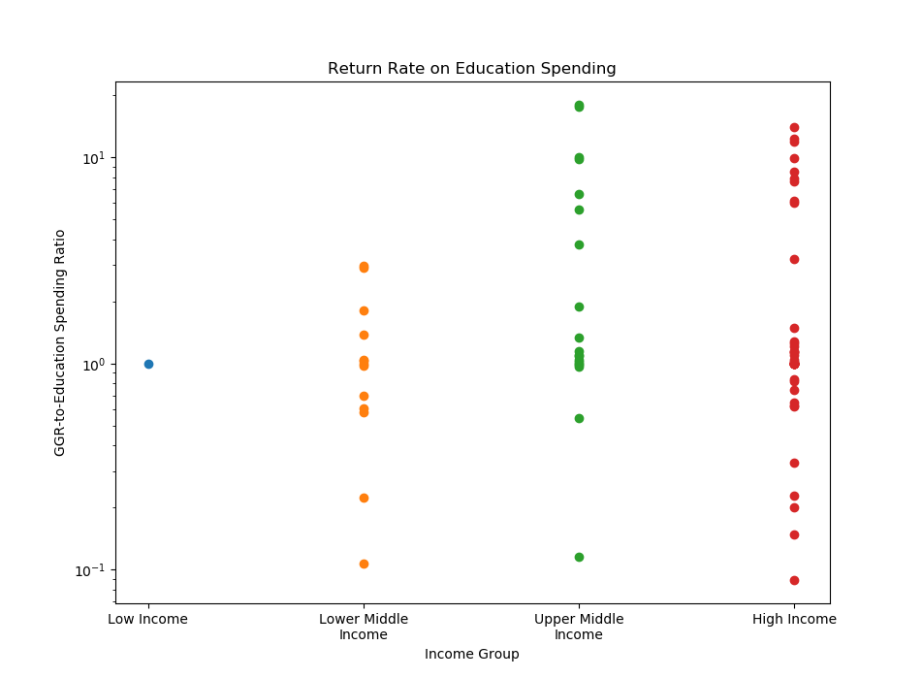
Rate of Return on Education Spending
$\frac{\left(GrossGraduationRate\right)}{\left(GDPEducationSpending\right)}$
Country | Income Group | Ratio
Ethiopia | LI | 1.0
Sri Lanka | LMI | 2.9763
Vietnam | LMI | 2.9160
Uzbekistan | LMI | 0.2236
Laos | LMI | 0.1077
Romania | UMI | 17.8480
Lebanon | UMI | 17.5721
Georgia | UMI | 0.5420
Namibia | UMI | 0.1151
Czech Rep. | HI | 13.9134
Poland | HI | 12.2654
Qatar | HI | 0.1483
Trinidad & Tobago | HI | 0.0891

