Slide 1
Gender Statistic Analysis
Leon Wilson

Slide 2
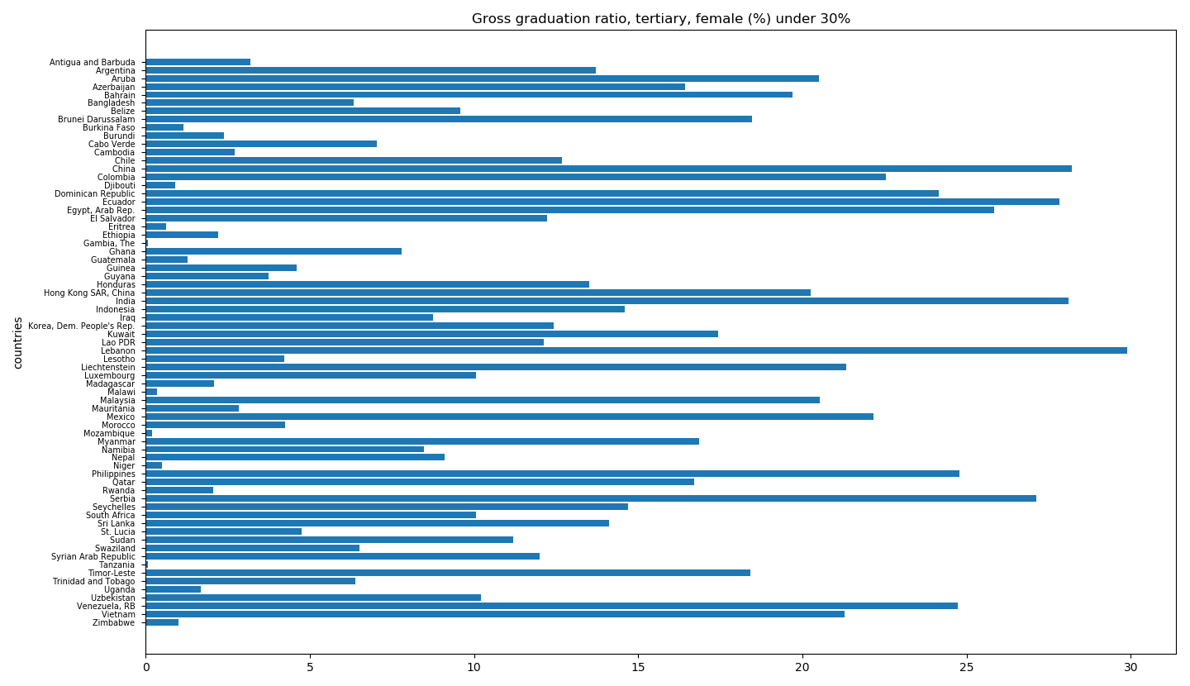
Identify the countries where % of female graduates is less than 30%

Slide 3
Country | Graduation Rate
Gambia | 0.056
Tanzania | 0.058
Mozambique | 0.198
Malawi | 0.340
Niger | 0.492
Country | Graduation Rate
Lebanon | 29.889
China | 28.214
India | 28.095
Ecuador | 27.832
Serbia | 27.134

Slide 4
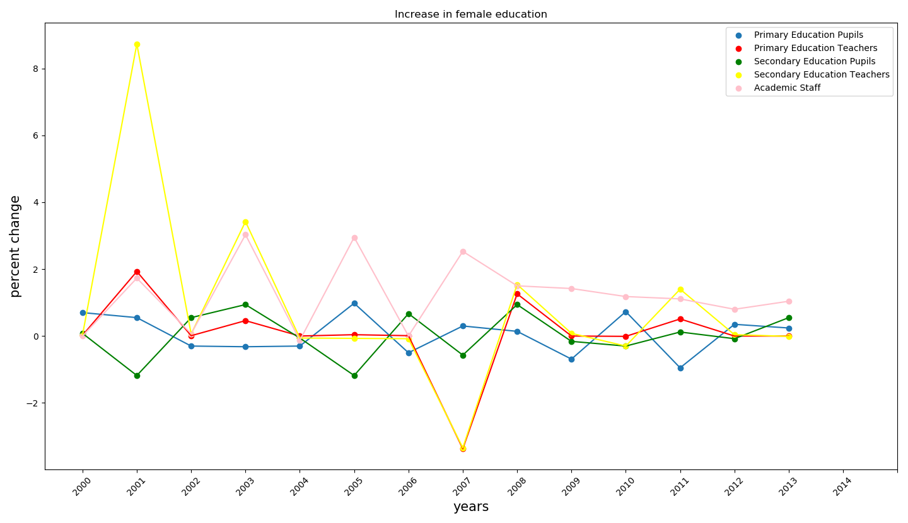
List the average increase in female education in the U.S from the year 2000

Slide 5
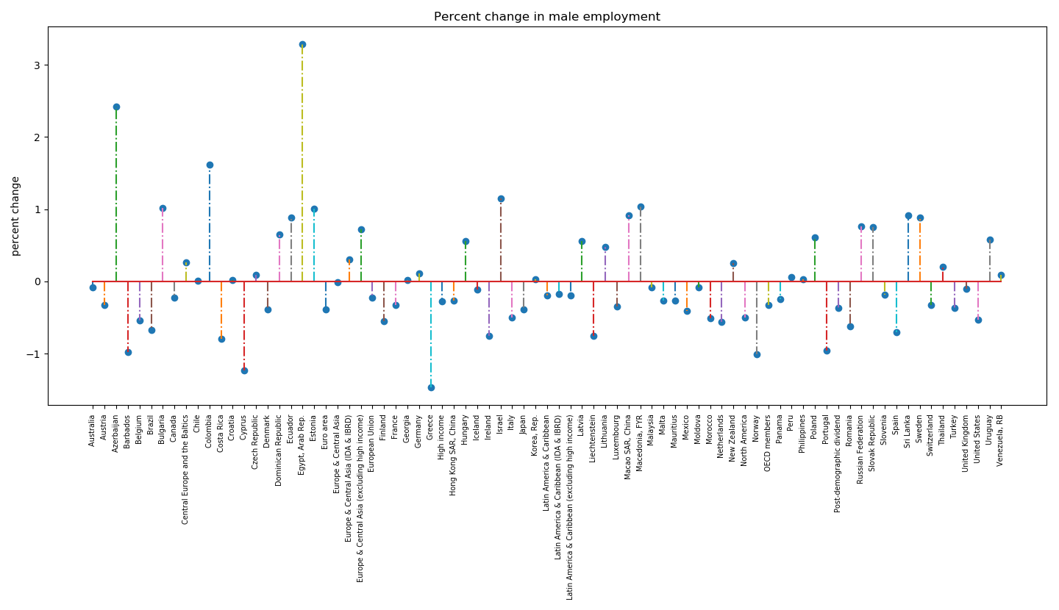
List the % of change in male employment from the year 2000
Highest increase in male employment : Egypt, Arab Rep. : 3.29%
Lowest decrease in male employment : Greece : -1.47%

Slide 6
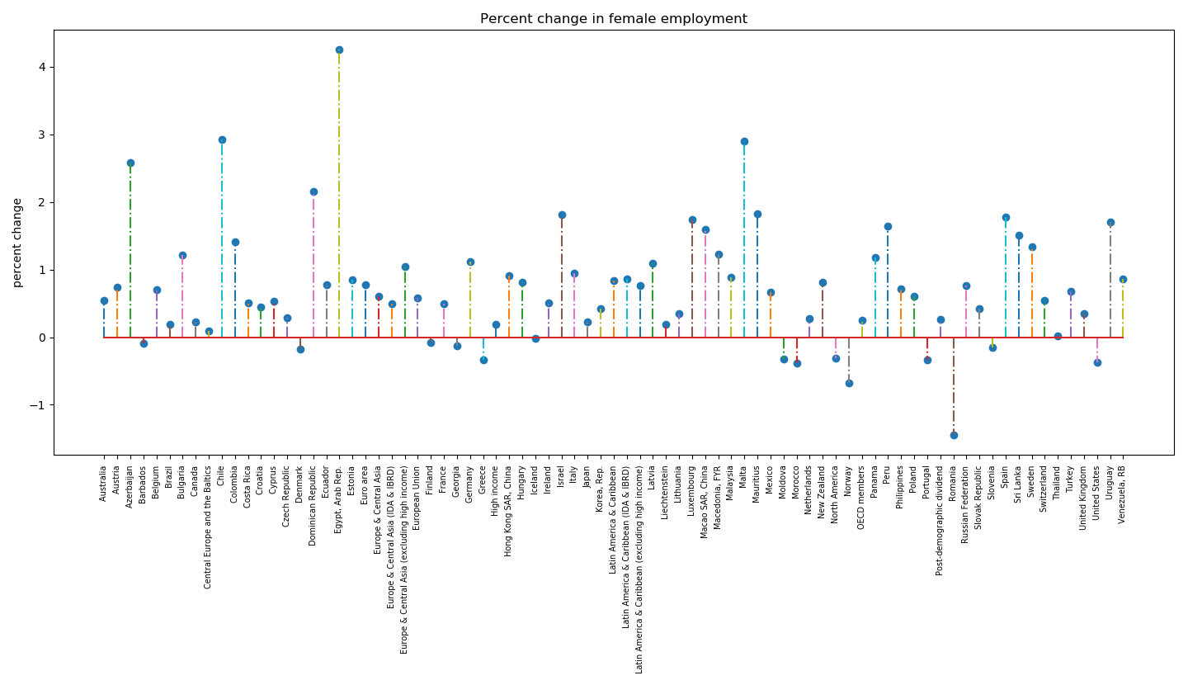
List the % of change in female employment from the year 2000
Highest increase in male employment : Egypt, Arab Rep. : 4.26%
Lowest decrease in female employment : Romania : -1.45%

Slide 7
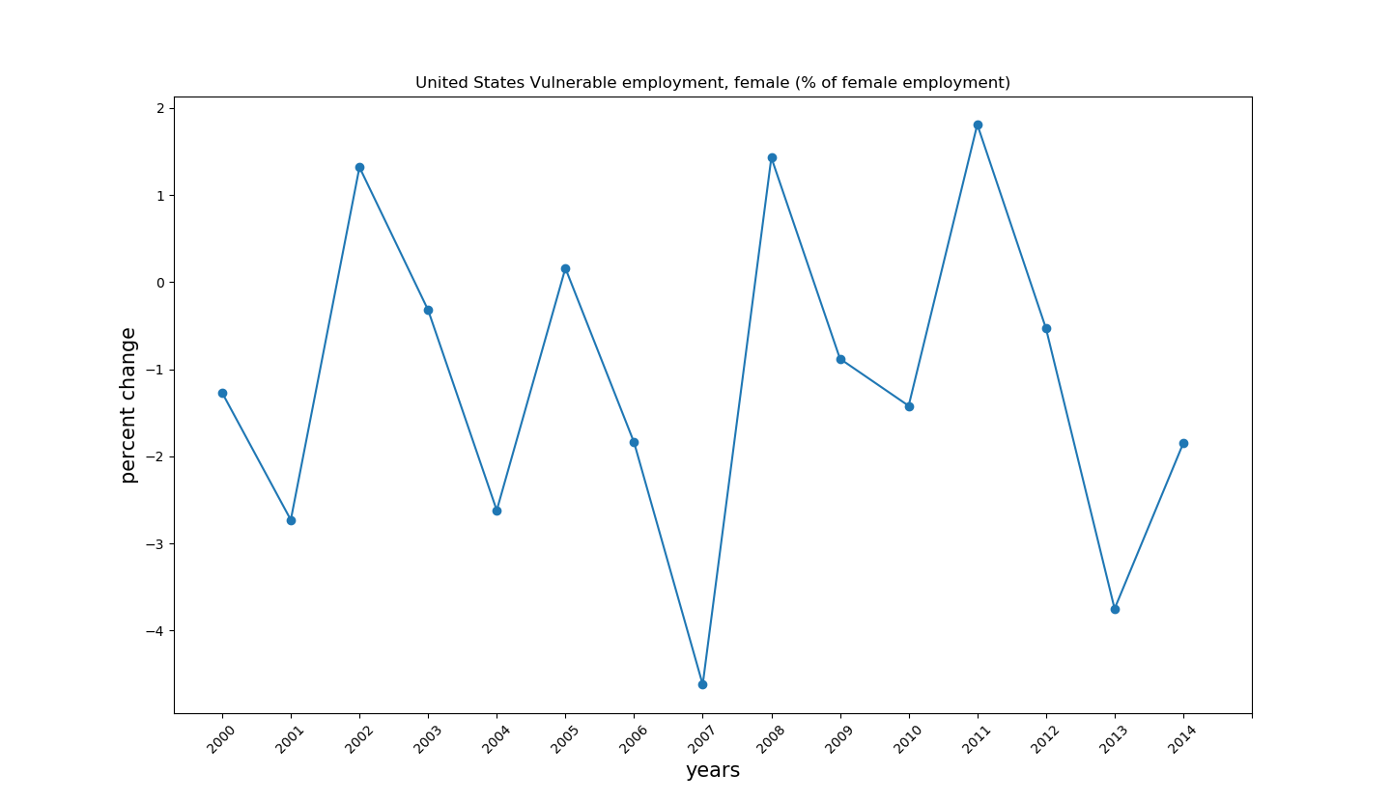
What was the percent increase in female vulnerable employment from the year 2000

