Slide 1
Project 1: Gender Statistics Analysis With Map-Reduce
By: Ben Keeper

Slide 2
Business Questions
Identify the countries where % of female graduates is less than 30%.
List the average increase in female education in the U.S. from the year 2000.
List the % of change in male employment from the year 2000.
List the % of change in female employment from the year 2000.
Evaluate one additional business factor

Slide 3
Question 1 Condensed Results
Average Gross Graduation Ratio, Female
(Tertiary Education) by Region
NOTE: See the slide backups section
for the full hadoop results

Slide 4
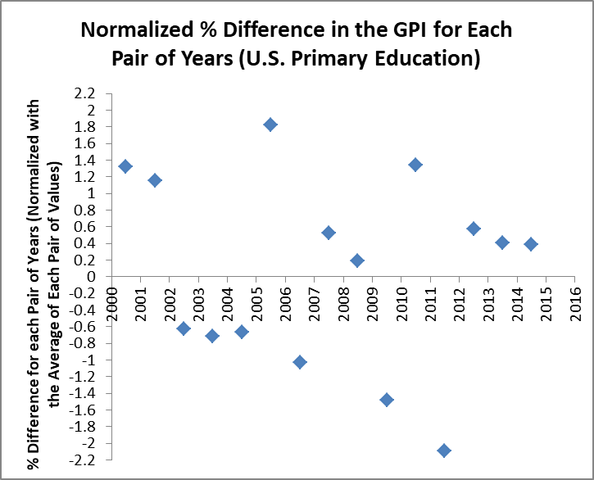
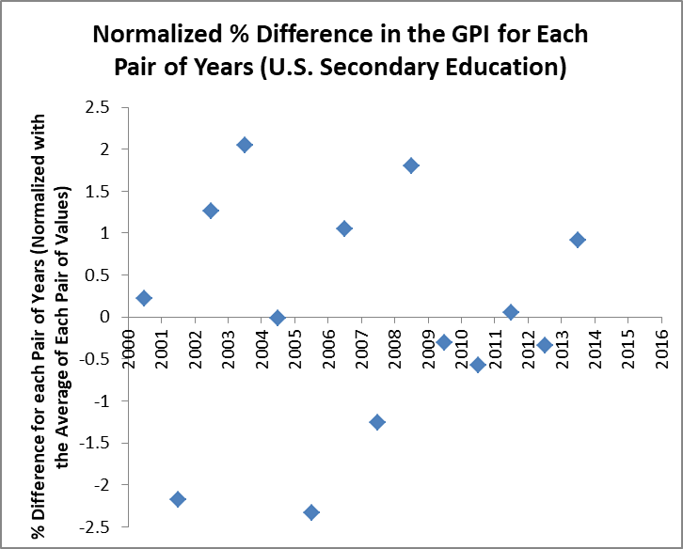
Question 2 Condensed Results
Education Group
Primary Education | Primary + Secondary Education | Secondary Education | Tertiary Education
0.956% | 0.516% | 1.025% | 0.790%
Average Absolute % Difference
NOTE: See the appendix for scatter plots for the other two education groups
Notes:
Each pairwise percent difference was normalized individually by using the average of the two GPI values within each pair of years

Slide 5
Question 3 Results
NOTE: See accompanying Excel document for the table of results

Slide 6
Question 4 Results
Twenty of the Highest
Overall % Changes in
Female Employment
To Population Ratio
As Measured Over
the Year Interval 2000
To 2016
NOTE: See accompanying Excel document for the table of results

Slide 7
Question 5
Considered the founding of Revature back in 2003 (source: “Glassdoor”)
Assume that Revature was founded in the United States in the year 2003
The provided csv file contained the following data:
The time in days required to do start up a business
The number of procedures necessary to register a business
Custom business question:
Find those country(s) where Revature would have started up in the quickest amount of time and where Revature would have encountered the least amount of red tape
Follow-up: Compare the optimal choice to choosing the United States

Slide 8
Solution to this Question and Running an Example Hadoop Job
Map-Reduce routine for this request:
Find all countries/regions with a 2003 data point for the time required to start a business and the number of procedures needed to start a business
After all of the data points are obtained, return only those countries/regions where the time needed for start-up is < 45 days and the number of registration procedures is <= 10
Based on these metrics alone, the optimal country for the founding of Revature would have been Australia with a start-up time of only 3 days and only 3 required registration procedures
The United States as compared to the optimal choice:
Startup in the U.S. was 3 days longer
The U.S. had 3 more registration procedures
Notes:
The full results of this analysis are in “Project-1-Post-Processing-of-Hadoop Results.xlsx”

Slide 9
Questions?

Slide 10
Appendix

Slide 11
First Business Question Thought Process
Original Question:
Identify the countries where % of female graduates is less than 30%.
Interpretation:
Identify the countries whose most current measure of the female gross graduation ratio is less than 30%
Assumptions:
The gross graduation ratio is a valid measure of the % of female graduates
The only female graduates being considered are graduates from tertiary education programs
The requester desires the most current information on each country
Regions will never contain any data of business value to the requestor; regions were skipped as there was no data

Slide 12
Full Results for the First Question

Slide 13
Second Business Question Thought Process
Original Question:
List the average increase in female education in the U.S. from the year 2000.
Interpretation:
Determine the average absolute % change in the gender parity index (GPI) as measured on each of the three major levels of education in the U.S. within the years 2000 and 2016.
Assumptions and Definitions:
The GPI, as established by UNESCO, is the ratio of female enrollment to male enrollment within a given level of education. The dataset provides a GPI for primary, secondary, primary + secondary, and tertiary education
Confounding variable with this metric is when the number of males decreases
Assumed that the requestor accepts the GPI as a valid metric for tracking trends in female education

Slide 14
Second Question Hadoop Output and Post-Processing
Results of the map-reduce job:
Produced normalized pairwise % differences in the GPI for each consecutive year of data
The total output of values was grouped into four buckets, with each bucket representing the four education groups that the GPI was recorded for
Post-processing in Excel:
Taking the absolute value of each pairwise % difference
Computing an average for each education group

Slide 15
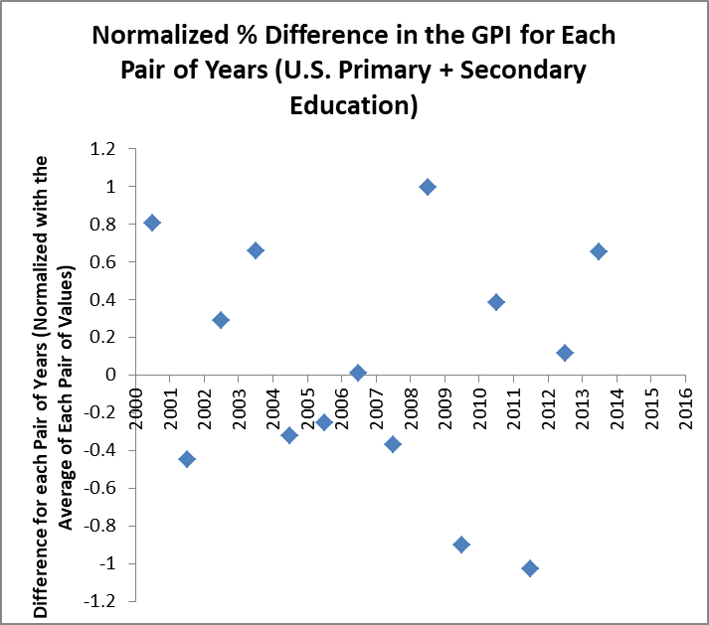
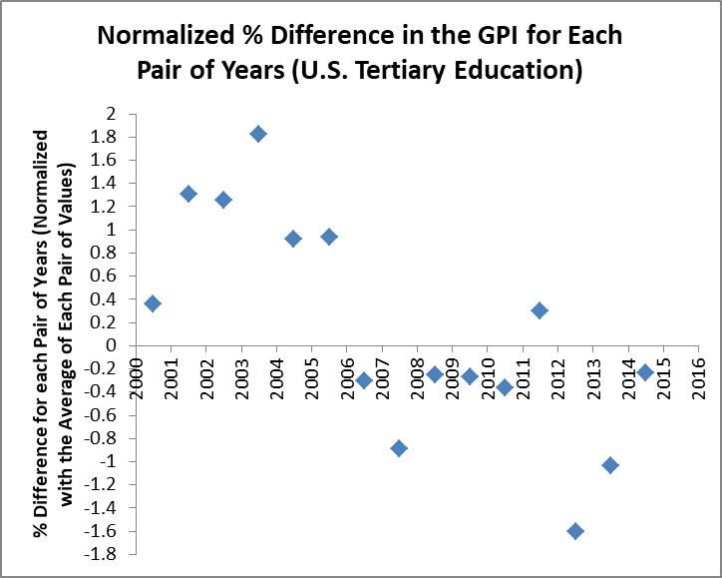
Remaining Charts Summarizing the Results of the Second Question
Notes:
Each pairwise percent difference was normalized individually by using the average of the two GPI values within each pair of years

Slide 16
Third Business Question Thought Process
Original Question:
List the % of change in male employment from the year 2000
Interpretation:
For all countries with this data, find the overall % change in the male employment to population ratio from the year closest to or equal to 2000 up to the year closest to or equal to 2016
Assumptions:
The requestor accepts the male employment to population ratio as a valid metric for tracking male employment trends

Slide 17
Fourth Business Question Thought Process
Original Question:
List the % of change in female employment from the year 2000
Interpretation:
For all countries with this data, find the overall % change in the female employment to population ratio from the year closest to or equal to 2000 up to the year closest to or equal to 2016
Assumptions:
The requestor accepts the male employment to population ratio as a valid metric for tracking female employment trends

