Slide 1

Project 1 (Using Map Reduce, HDFS & Hadoop)
By: Tenzing Bajracharya

Slide 2

Interpretations & Approach for Project 1
Majority of the questions were focused on gender issues like women education, women employment and many others.
My approach for the towards answering the answers were based on personal perception of the questions. Almost all the questions had the possibility of being solved only by a mapper but I did incorporate reducers in 2 on my questions as well.

Slide 3
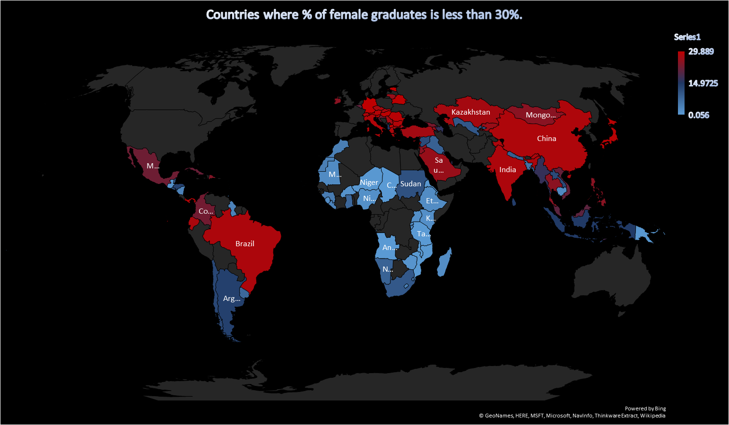

Slide 4
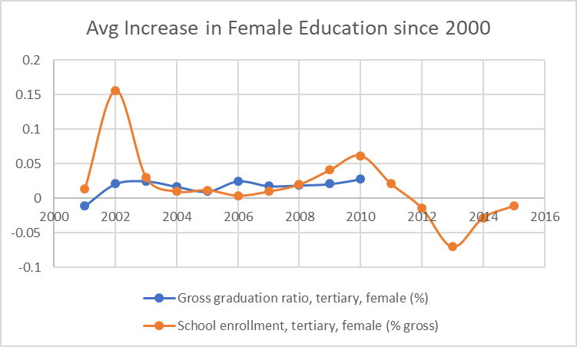

Slide 5
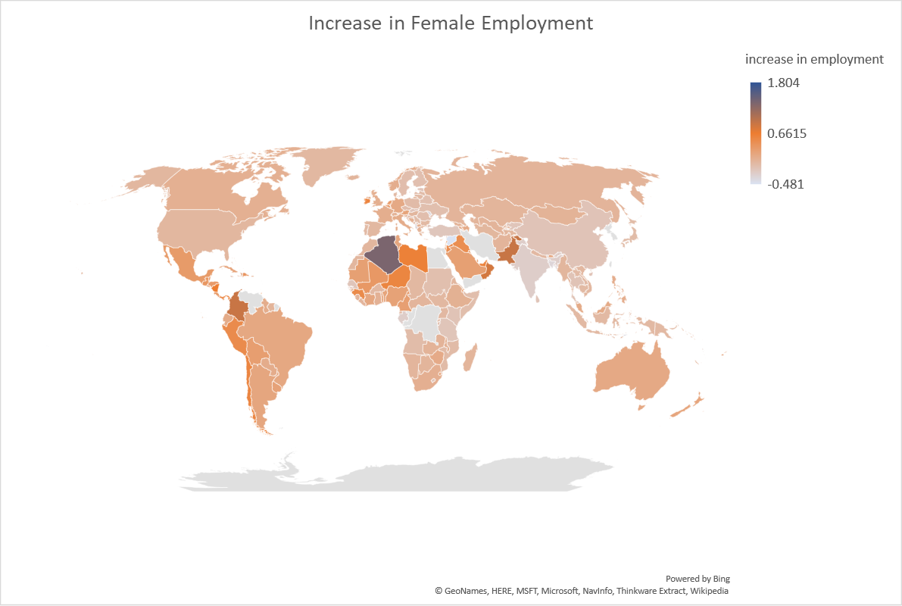

Slide 6
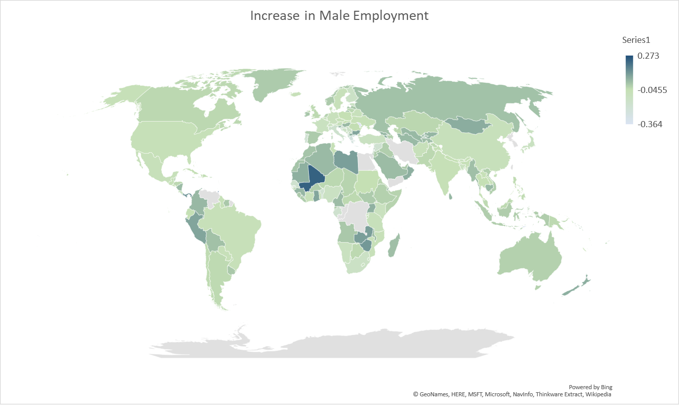

Slide 7
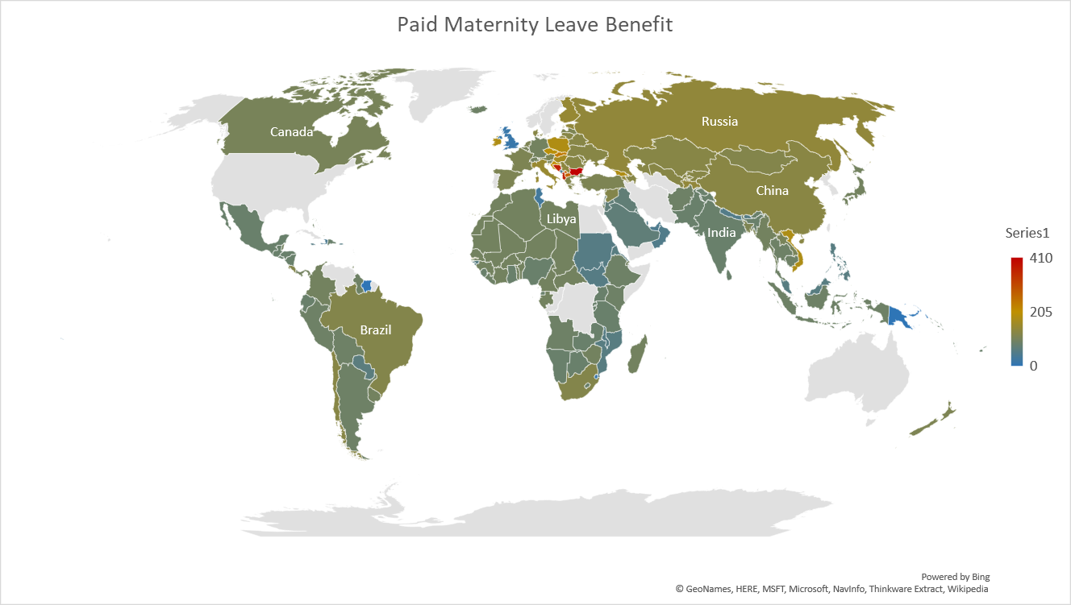
Countries | Paid Maternity Leave
Bulgaria | 410 days
Albania | 365 days
Bosnia and Herzegovina | 365 days
Iran, Islamic Rep. | 270 days
Kosovo | 270 days

