Slide 1
MapReduce on Gender Stats Data
Zachariah Turner

Slide 2
Question 1
Aim: List all countries that had less than 30% of females graduate
Records used: Gross Tertiary Graduation Ratio for Females for all countries
Countries without data were not included

Slide 3
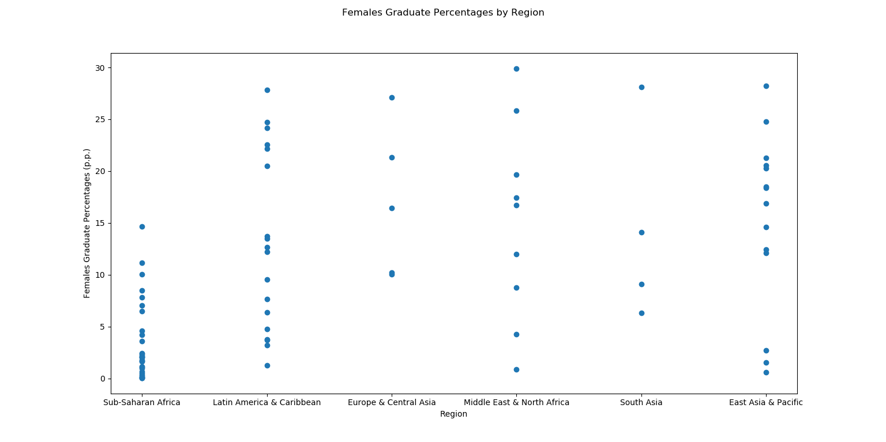
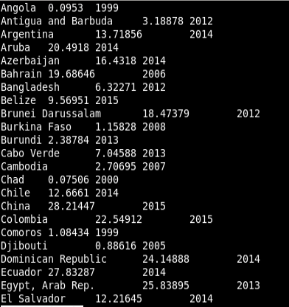
Question 1 Data
Country (Region) | Percentage(%)
China (EA&P) | 28.21447%
Ecuador (LA&C) | 27.83287%
India (SA) | 28.09594%
Lebanon (ME&NA) | 29.88909%
Serbia (E&CA) | 27.13499%

Slide 4
Question 2
Approach: Find the records for United States Bachelor’s, Master’s, and Doctoral percentages and find the average percent point change between all percentages after and including the year 2000 .
2012-to-2013 change not included due to ISCED definition change

Slide 5
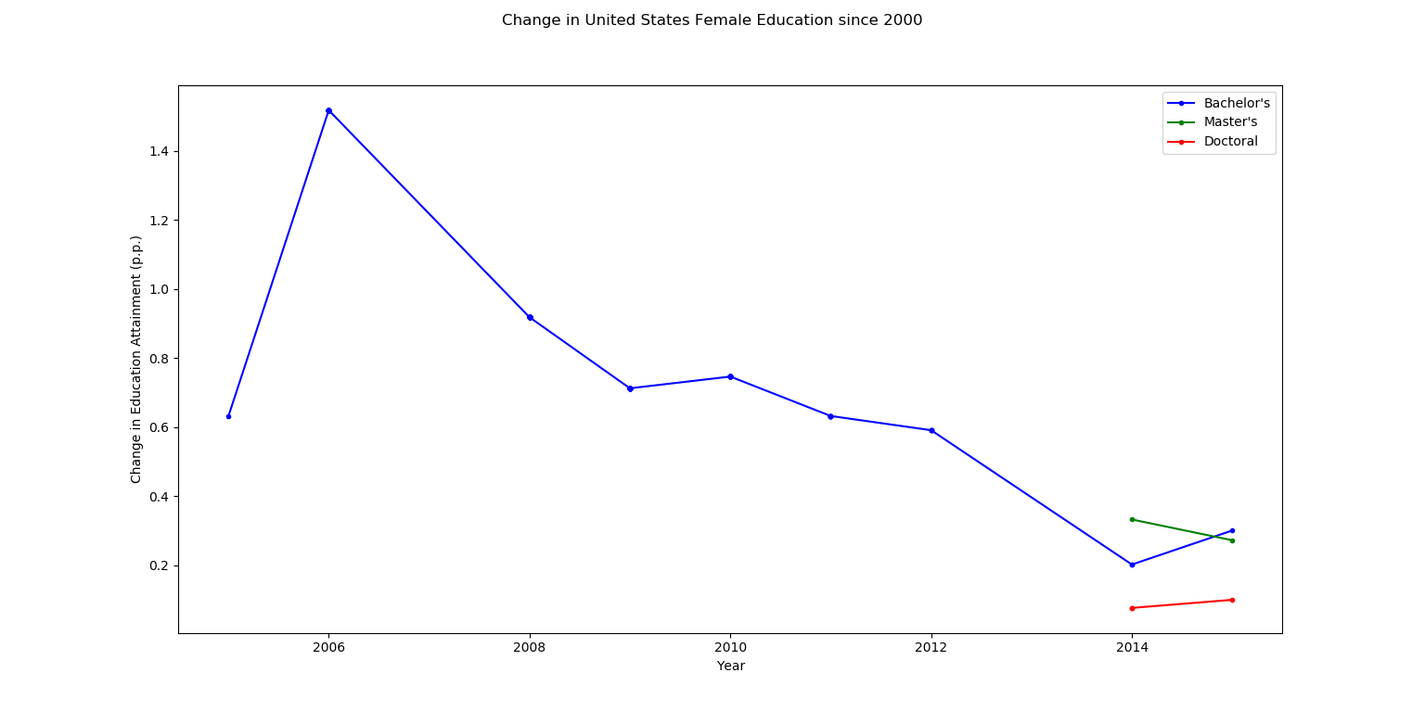

Question 2 Data

Slide 6
Question 3 & 4
Approach: Find the Employment to population ratio for females and males 15+ and subtract the latest percentage and the percentage in 2000 to get percent point change.
Countries without year 2000 data point or additional data points after 2000 are not included

Slide 7
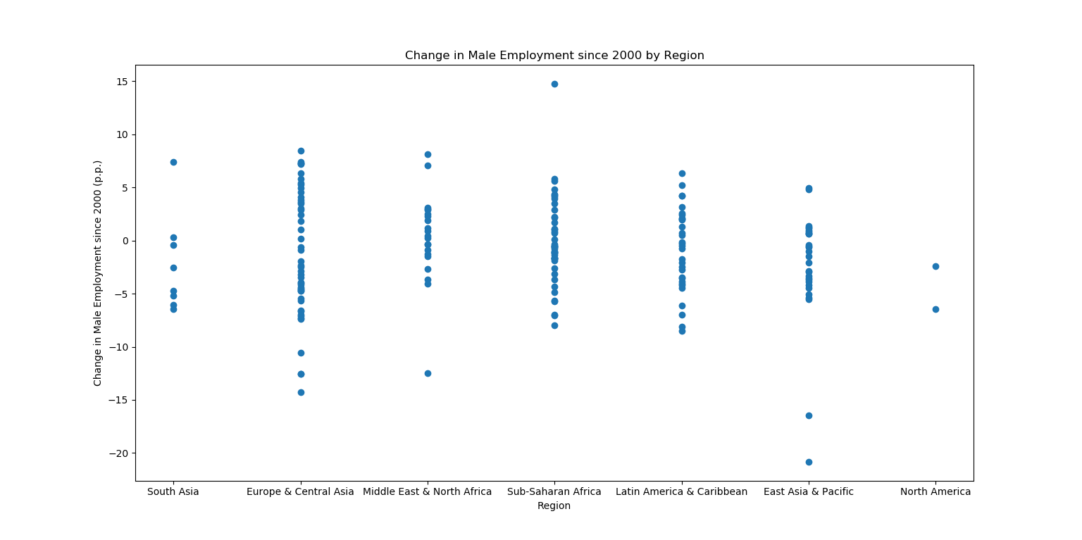
Question 3 Data
Country (Region) | Change (p.p.)
Mali (S-SA) | 14.737%
Maldives (SA) | 7.405998%
Samoa (EA&P) | -16.447002%
Syria (ME&NA) | -12.464001%
Timor-Leste (EA&P) | -20.806%

Slide 8
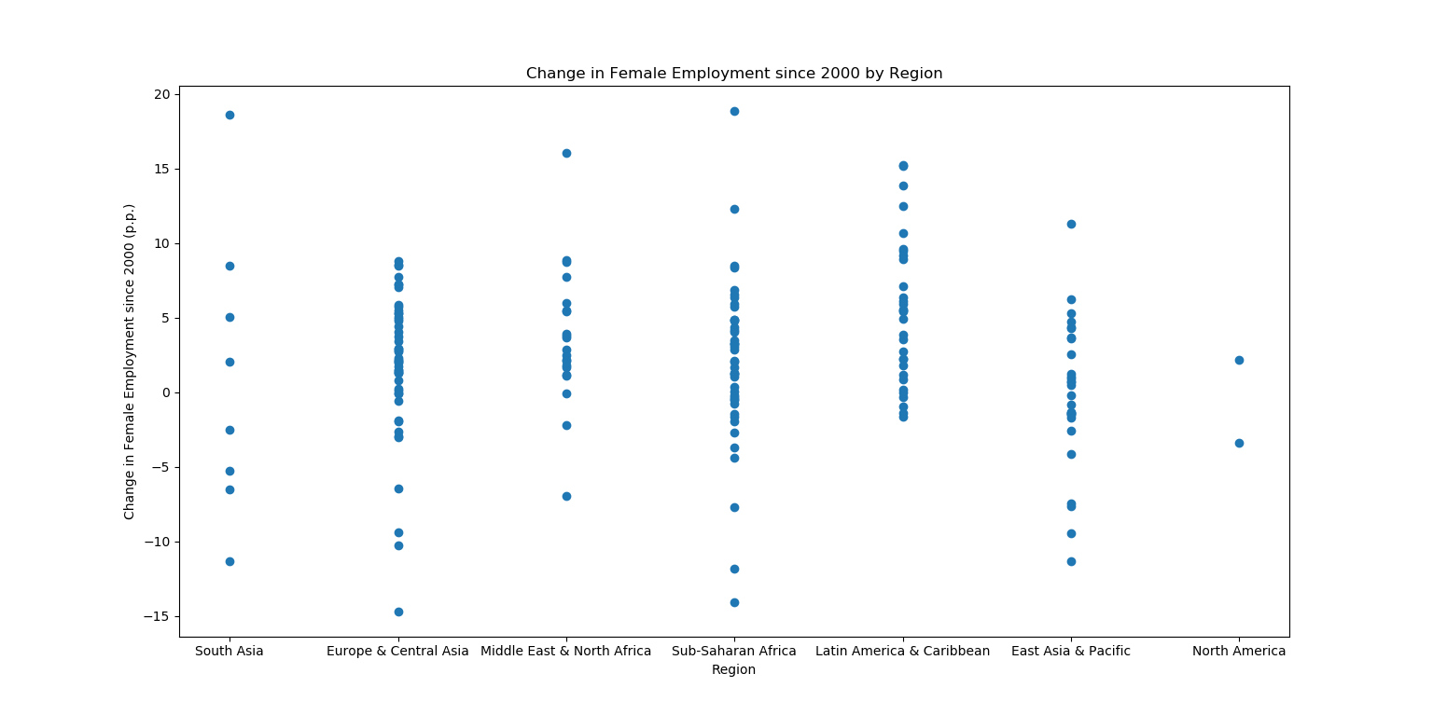
Question 4 Data
Country (Region) | Change (p.p.)
Guinea (S-SA) | 18.868999%
Maldives (SA) | 18.646999%
Qatar (ME&NA) | 16.051003%
Bangladesh (SA) | -11.321999%
Gabon (S-SA) | -14.098%
Moldova (E&CA) | -14.691002%

Slide 9
Question 5
Question: Find the ratio of the percentage of females who have at least a Bachelor’s to the percentage of females in the rural population for every country
Countries without education data between 2000 and 2015 are not included

Slide 10
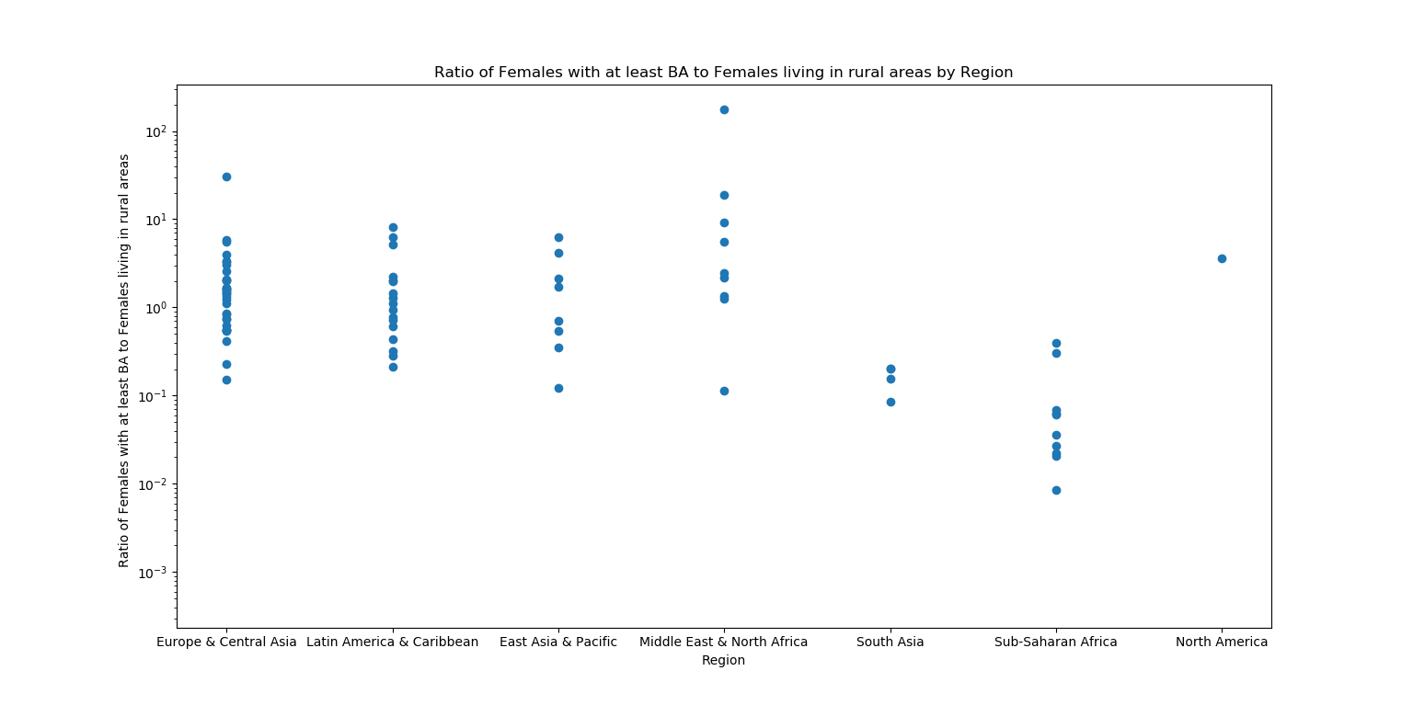
Question 5 Data
Country (Region) | Ratio of Education to rural population
Qatar (ME&NA) | 176.358928
Belgium (E&CA) | 30.509808
Kuwait (ME&NA) | 18.765294
Israel (ME&NA) | 9.230975

Slide 11
Questions?

