Slide 1

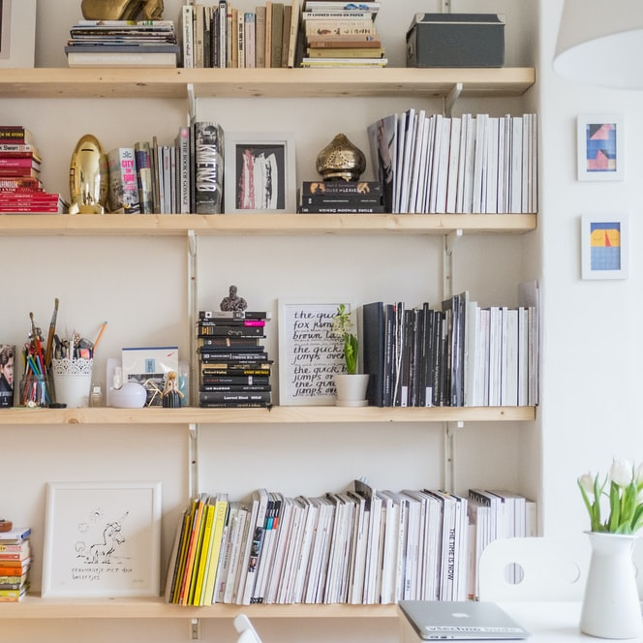
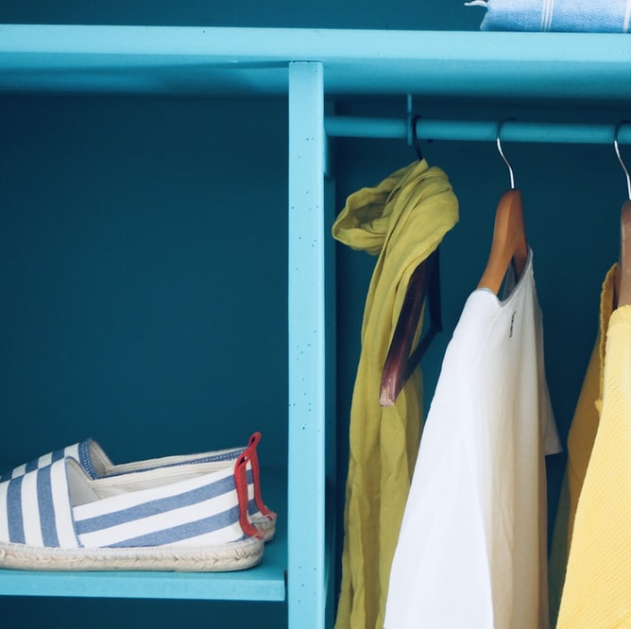
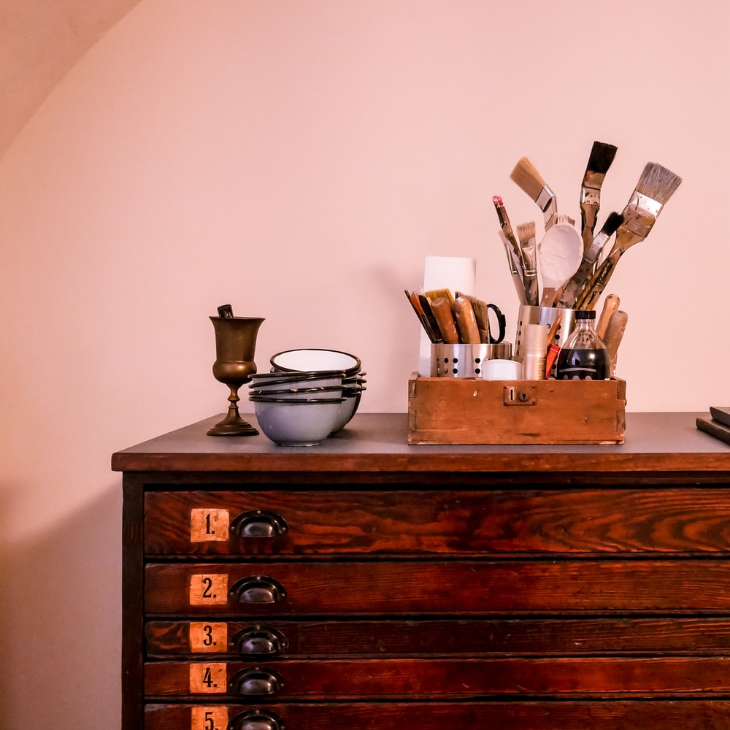
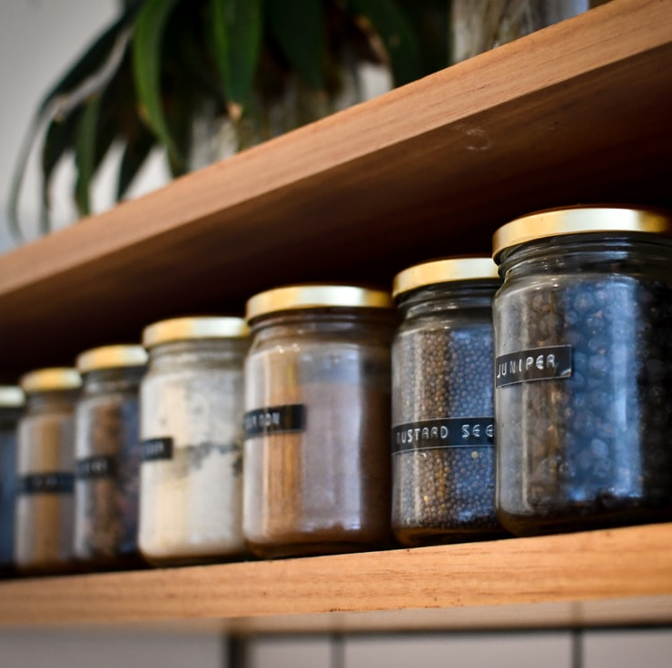
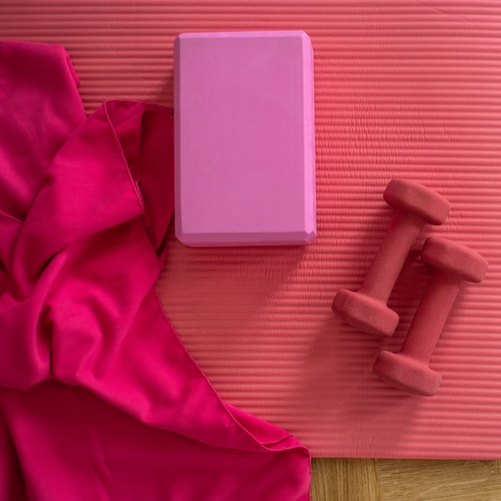
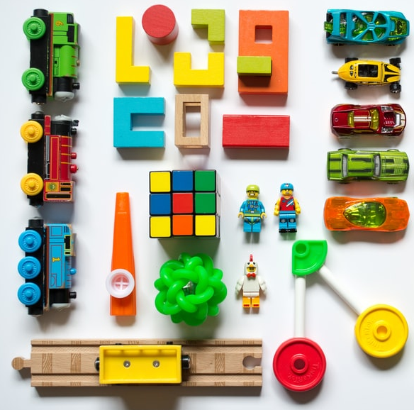
ORDERLY
1. Landing Page
Register
Login
Let’s get organized, together.

Slide 2
ORDERLY
2. Login Page
Email
Password
Not a member? Click to register

Slide 3
ORDERLY
3. Registration Page
First name
Last name
Email
Password
Confirm Password
Already a member? Click to login

Slide 4
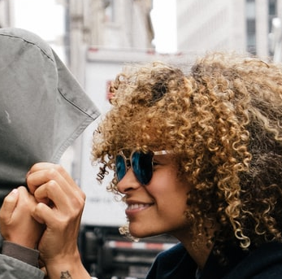
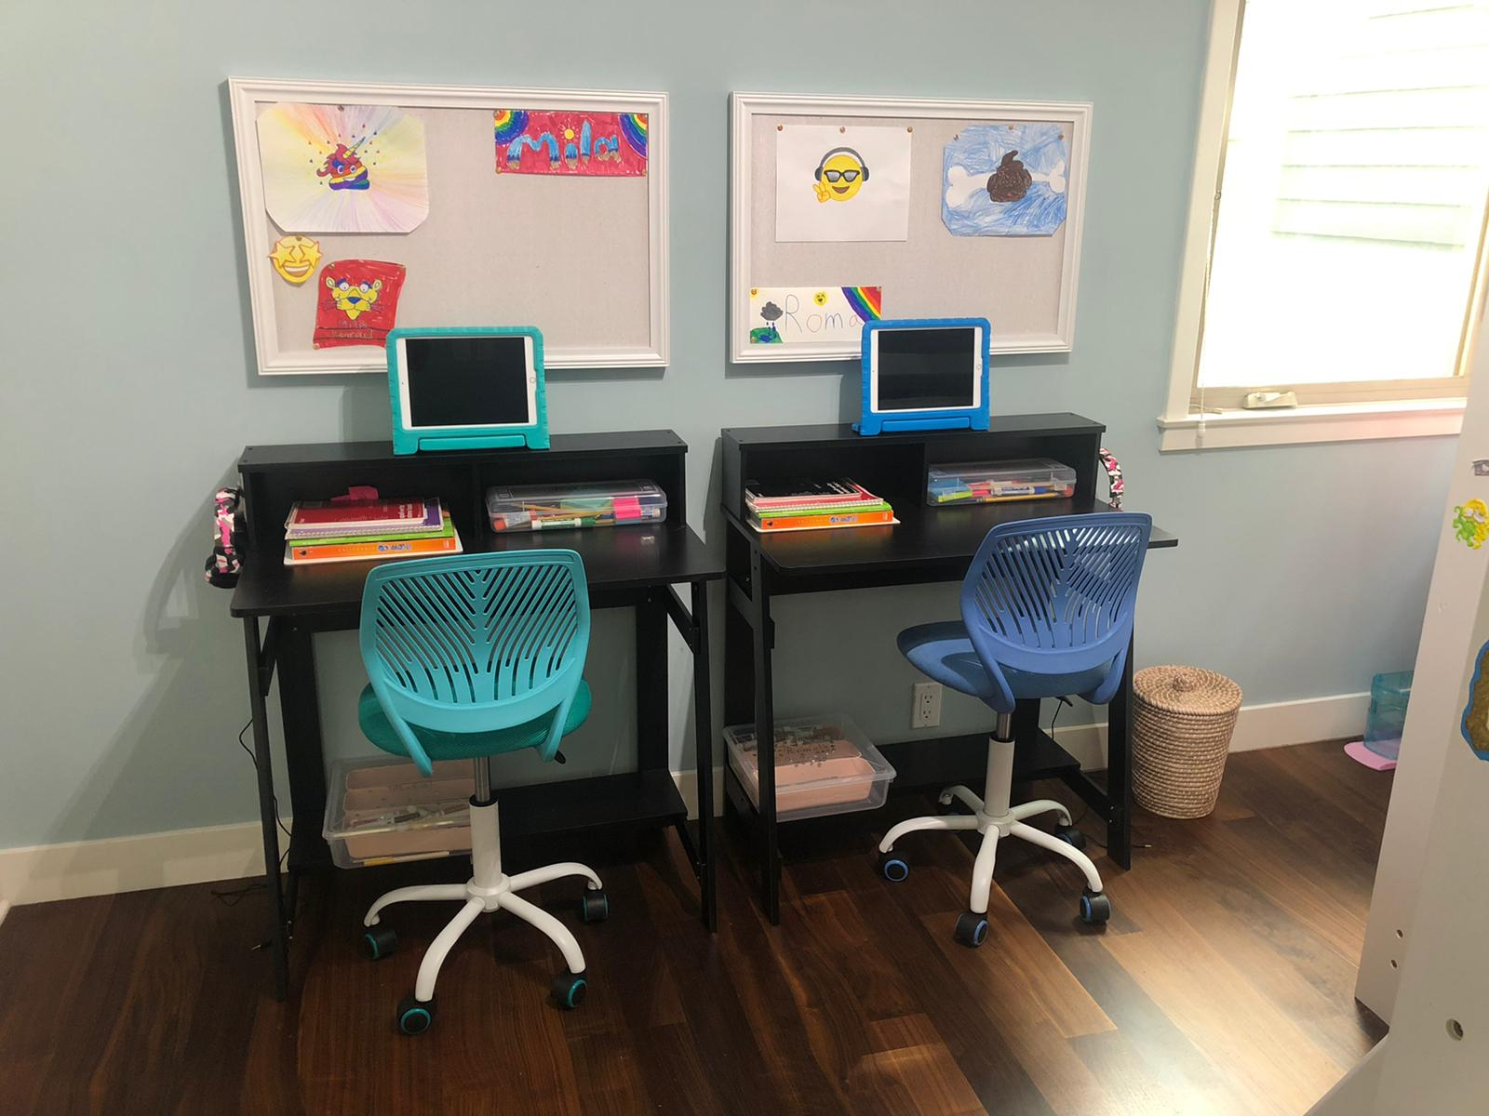

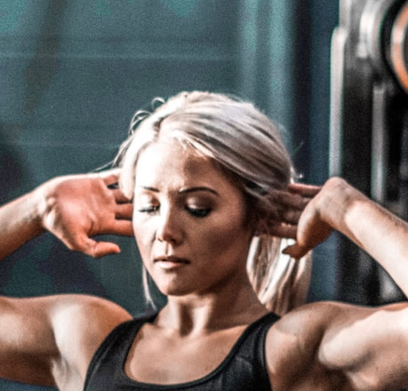
ORDERLY
4. Main Page
Welcome Meghan!
Add post
distancelearning_momma
Filter by category
Kitchen
Office
Kids
Closet
Garage
Gym
Managed to fit two desks in my kids’ tiny room! Any ideas
for floating book shelfs on a budget?
Multi-use
Save to wall
Reply
twinning
Love these desks for my twins! Where did you get them? I’ve used some affordable IKEA shelfs on the wall and they work well.
Reply
home_trainer
Help! I need to start training my clients at home and have no room for a gym.
Has anyone managed to make a garage workout space look professional?
Save to wall
Reply

