Slide 1

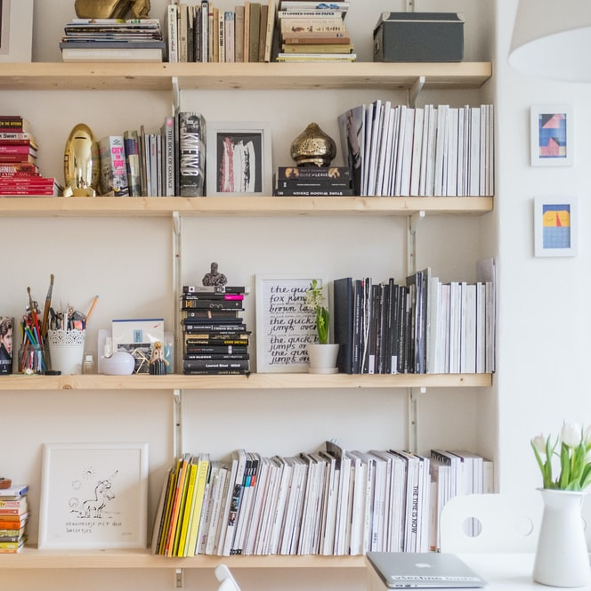
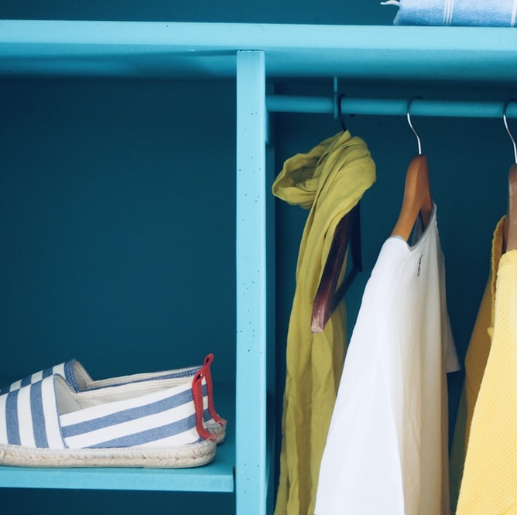
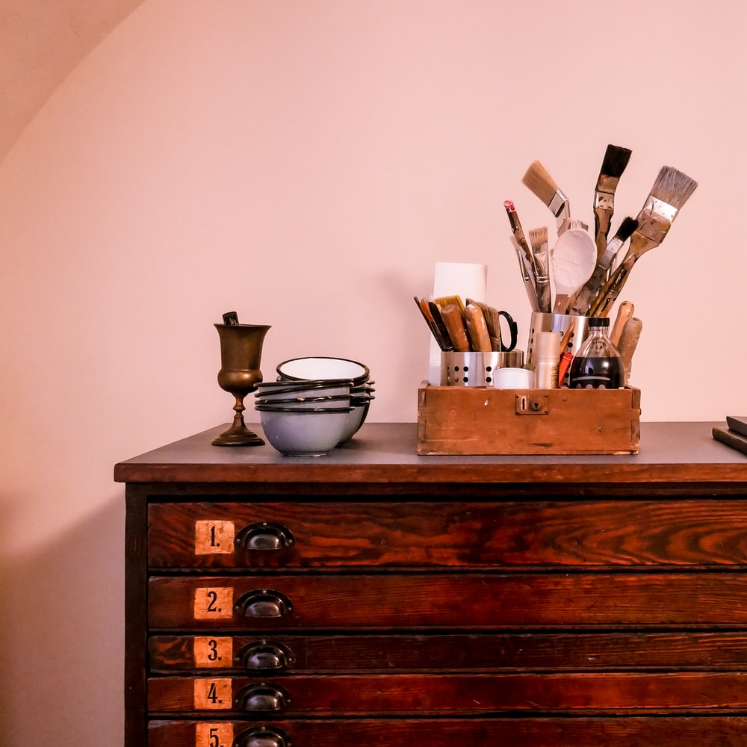
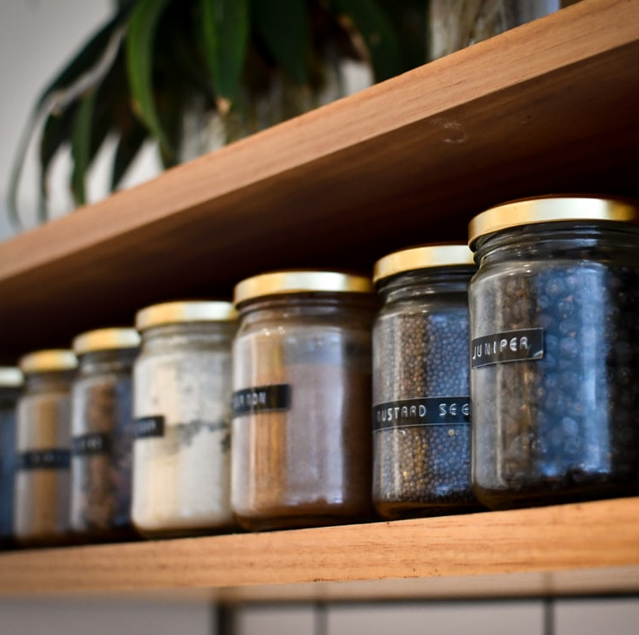
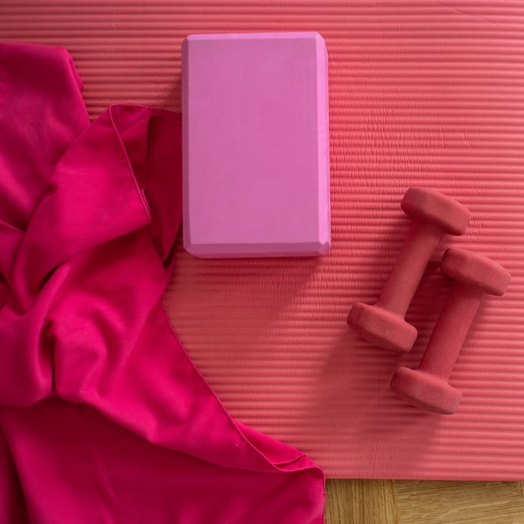

ORDERLY
1. Landing Page
Register
Login
Let’s get organized, together.

Slide 2
ORDERLY
2. Login Page
Email
Password
Not a member? Click to register

Slide 3
ORDERLY
3. Registration Page
First name
Last name
Email
Password
Confirm Password
Already a member? Click to login

Slide 4
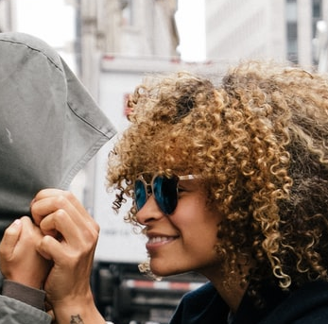
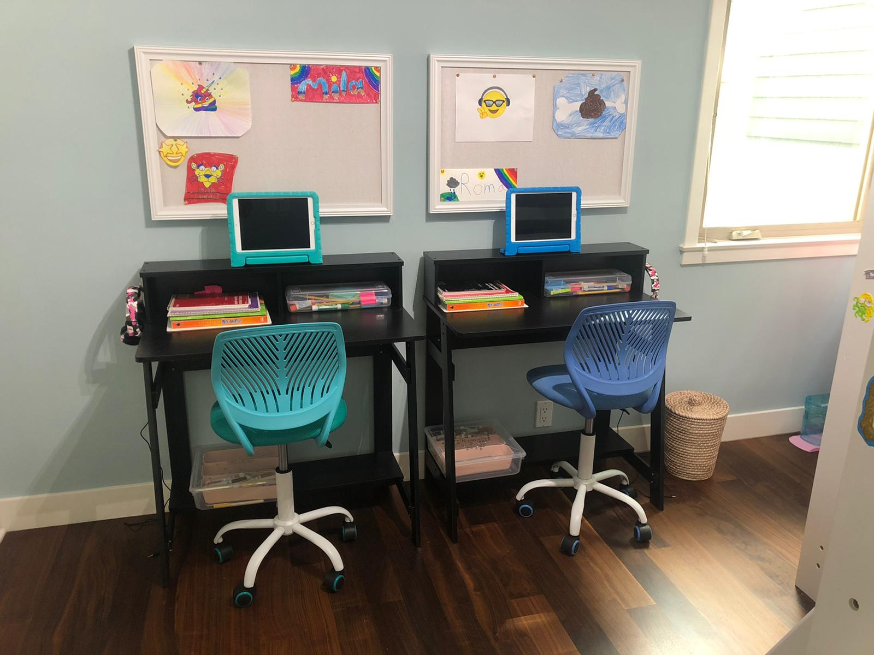
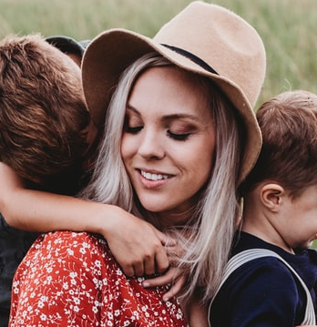
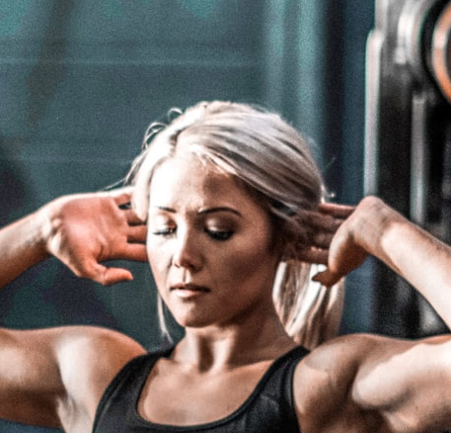
ORDERLY
4. Main Page
Welcome Meghan!
Add post
distancelearning_momma 3:34pm
Filter by category
Kitchen
Office
Kids
Closet
Garage
Gym
Managed to fit two desks in my kids’ tiny room! Any ideas for floating book shelfs on a budget?
Multi-use
2
Save to wall
Reply
twinning 5:12pm
Love these desks for my twins! Where did you get them? I’ve used some affordable IKEA shelfs on the wall and they work well.
Reply
home_trainer 12/01/20
Help! I need to start training my clients at home and have no room for a gym.
Has anyone managed to make a garage workout space look professional?
Save to wall

Slide 5

ORDERLY
5. Create Post
Upload a picture
Add caption
Select category
Kitchen
Kids
Garage
Multi-use
Office
Closet
Gym
Other
Post

Slide 6
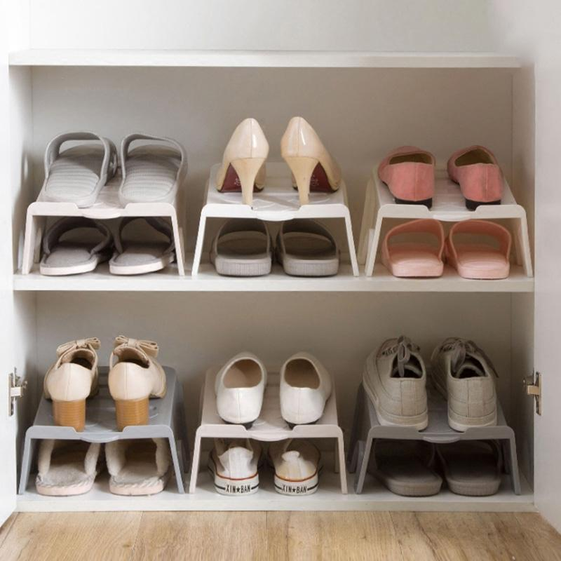
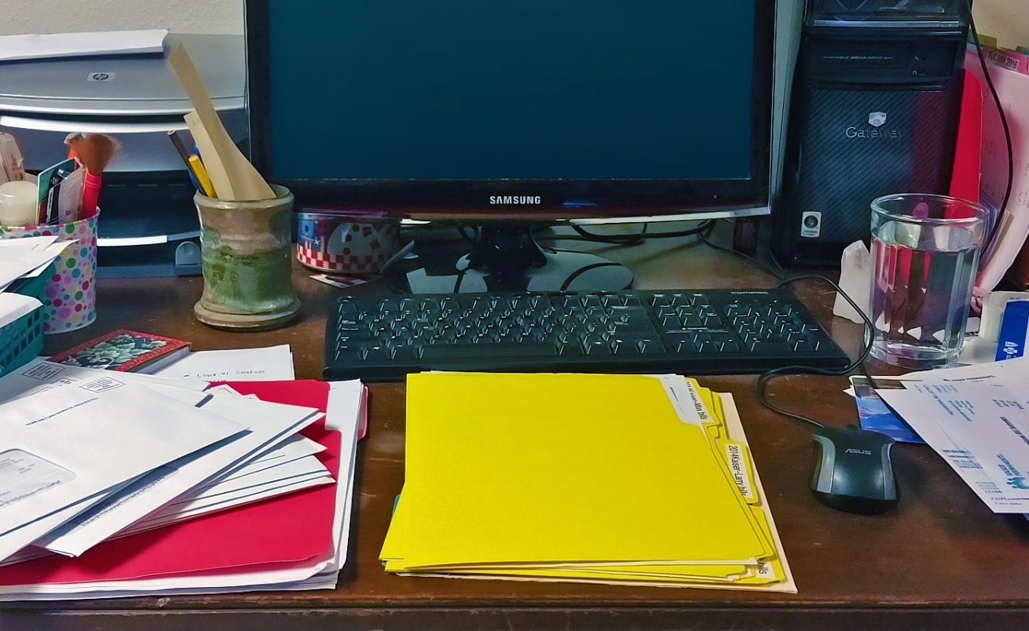
ORDERLY
6. Personal Wall
Meghan’s Posts
Add post
11/29/20
Loving this shoe organizer for my tiny closet. Can
store twice the shoes!
Pop up window asks for confirmation to delete post
Delete only available if you are the poster
4
Read Comments
Delete Post
11/15/20
Any suggestions for a messy desk??
Loving this shoe organizer for my tiny closet. Can
store twice the shoes!
4
Read Comments

Slide 7
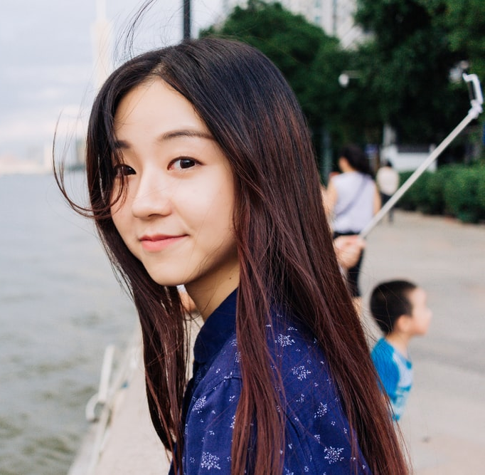
ORDERLY
7a. Profile Page: Can be seen by other users
Hi! I’m Meghan. I’m a graduate student living in DC trying to manage life and work in my tiny apartment.
Followers
order_love_79
headtubes
at_home_lawyer
Following
home_trainer
distance_learning_momma
Name
Username
City
Occupation
Meghan Lee
shoe_lover
Washington DC
Graduate student
Edit Profile
If user is looking at their own profile

Slide 8
ORDERLY
7b. Profile Page: User Edit
Hi! I’m Meghan. I’m a graduate student living in DC trying to manage life and work in my tiny apartment.
Followers
order_love_79
headtubes
at_home_lawyer
Following
home_trainer
distance_learning_momma
Edit profile picture
Name
Username
Email
City
Occupation
Meghan Lee
shoe_lover
MeghanLee@email.com
Washington DC
Graduate student
Save Changes

