Slide 1

Doggy Delights exists to enhance the bond between pets and their owners by delivering innovative, unforgettable treat experiences for all.

Slide 2
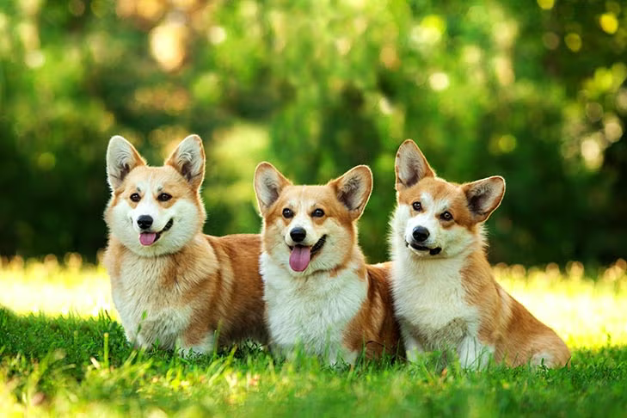
Languages & Environment
Python
MySQL
Google Colab
Jupyter Notebook
MySQLWorkbench
GitHub

Slide 3
Data
American Kennel Club (AKC) dataset
breed, temperament, popularity, min_height, max_height, min_weight, max_weight, min_expectancy, max_expectancy, group, energy_level_value, energy_level_category, trainability_value, trainability_category, demeanor_value, demeanor_cateogory
Pet shelter dataset
name, dob, sex, color, age, type, outcome_type, outcome_subtype, outcome_datetime
Random generated content
Customer surveys

Slide 4
Data
Quality checks – how and at what stage?
Data cleaning
Rules?
When?
Before or after extraction?
Data usage
Access is restricted to authorized employees only to comply with best practice privacy regulations

Slide 5
EER Diagram/Database Schema

Slide 6
Tables
Dimension
dog_breed
pet
pet_outcome
product_catalog
region
Fact
treat_consumption
survey_response

Slide 7
Database Storage
MySQL running on a web server
Not meant for public use and restricted to key employees
Backup and data recovery plan in place to help minimize the potential for a loss of data for the company

Slide 8
What dog breeds are most energetic & likely to consume the most treats?

Slide 9
Which breeds have the longest life expectancy and could be consumers for a longer amount of time?

Slide 11
Conclusion
Our data aids Doggy Delights in making critical business decisions
How best to spend marketing budget to new and existing customers
A/B testing on website
Streamline enterprise costs
Efficient coding and data storage to save on cloud/hosting costs

