Slide 1
Speech Recognition based on Tensorflow Speech Commands Datasets
ECE 271B – Statistical Learning Ⅱ
Pengluo Wang; Zhipeng Yao;
Yue Yang; Yuyi Tan;

Slide 2
Abstract
Background
Sequence to sequence learning has been successful in many tasks such as machine translation, speech recognition amongst others.
The prevalent approach to sequence to sequence learning maps an input sequence to a variable length output sequence via recurrent neural networks (RNN).
What we did
In this project, we use an architecture based entirely on convolutional neural networks (CNN). Compared to RNN, computations of CNN over all elements can be fully parallelized during training to better exploit the GPU hardware. CNN approach builds a hierarchical representation of the input words that makes it easier to capture long-range dependencies, similar in spirit to the tree-structured analysis of linguistic grammar formalisms.
We also testify that the use of gated linear units (GLU) will lead to better performance on our project.

Slide 3
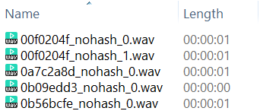
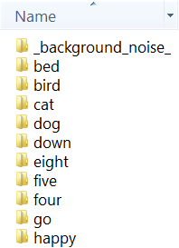
Dataset
Tensorflow Speech Commands Datasets
examples of people speaking a single English word commands
one-second .wav audio files
inconsistent with the length of the audio
Files are uniquely named with the label folders.
Only The Training Files Were Used
enough to train the model (both loss and error can converge)
GPU has limited memory for each pod.
Train, validation, and test
1/5 are used as test set, 4/5 are used as train set.
1/5 of train set are used as validation set (using cross-validation).

Slide 4
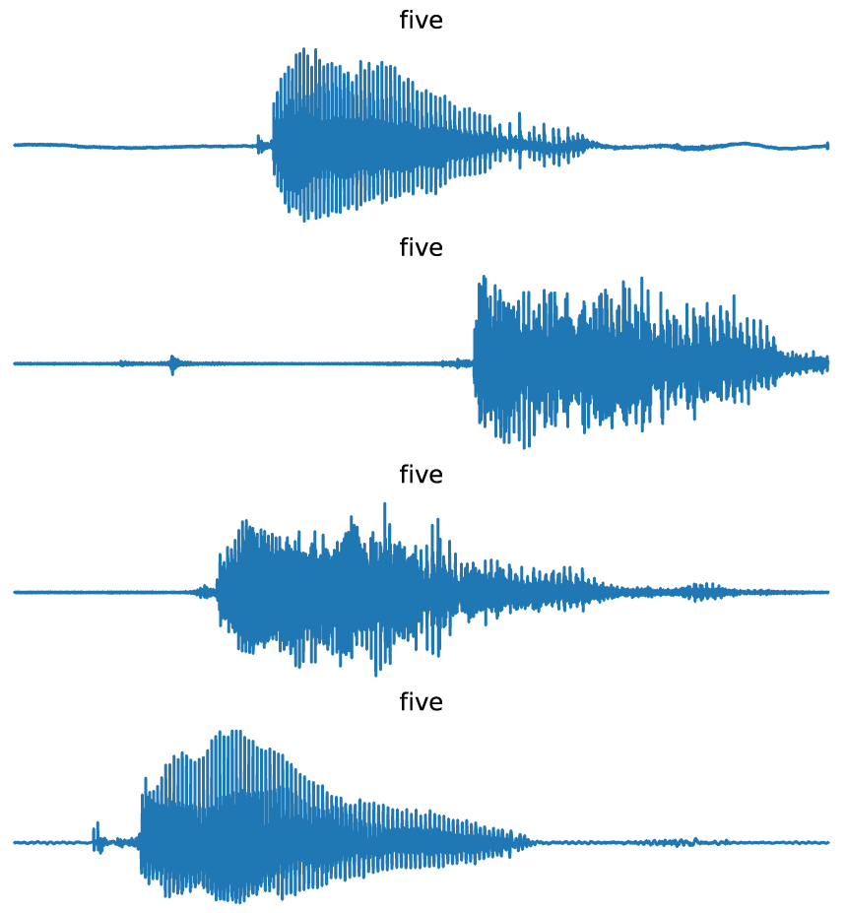
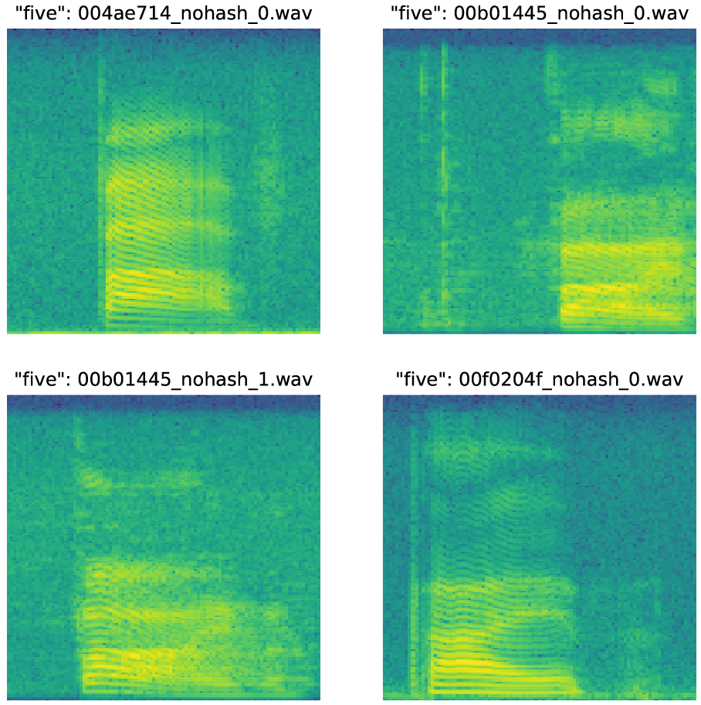
Data Pre-processing
Log spectrograms
Convert .wav data from time domain into frequency domain.
Import SciPy signal package, and use function spectrogram.
Image reshape
padding 0 for short audio files
intercepting for long audio files
image size (1×99×161), grayscale images

Slide 5
CNN Structure
Notes:
Talk about where these come from?

Slide 6
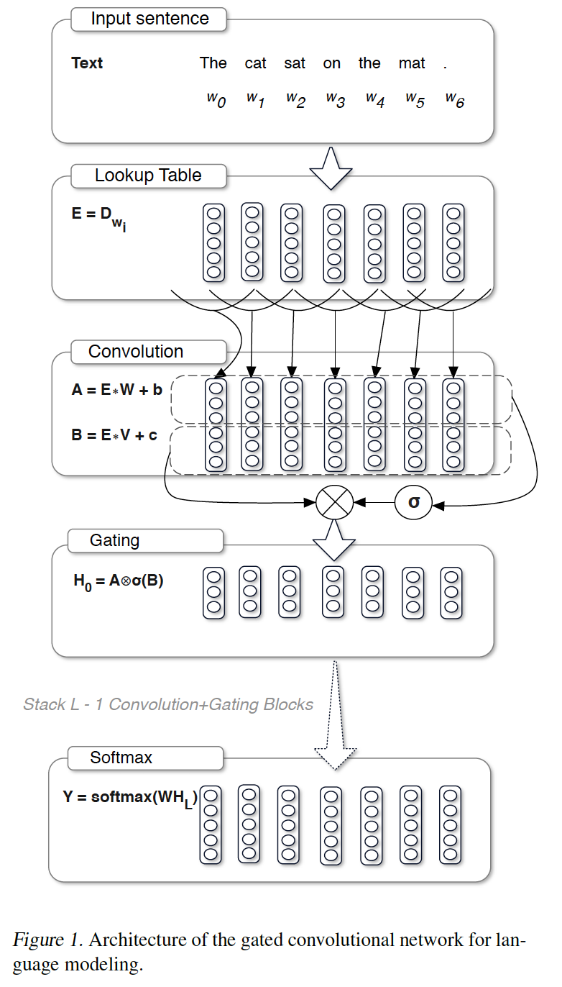
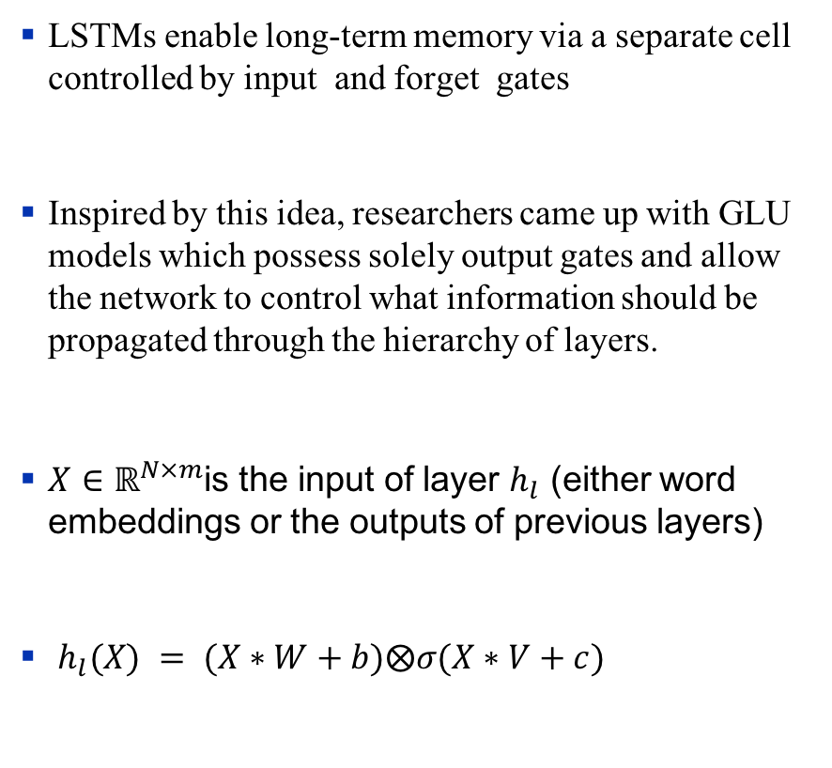
GLU
LSTMs enable long-term memory via a separate cell controlled by input and forget gates
Inspired by this idea, researchers came up with GLU models which possess solely output gates and allow the network to control what information should be propagated through the hierarchy of layers.
$X∈ℝ^{N×m}$is the input of layer $h_{l}$ (either word embeddings or the outputs of previous layers)
$h_{l}(X) = (X∗W+b)⨂σ(X∗V+c)$

Slide 7
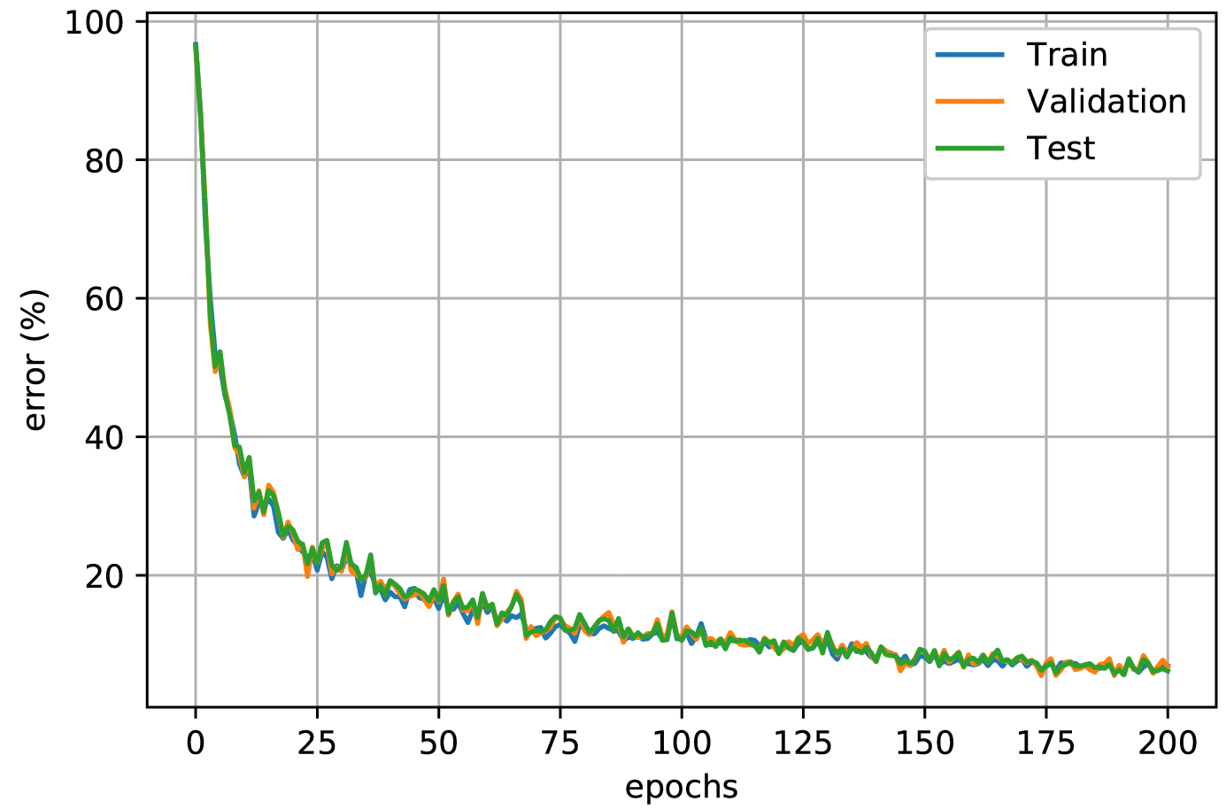
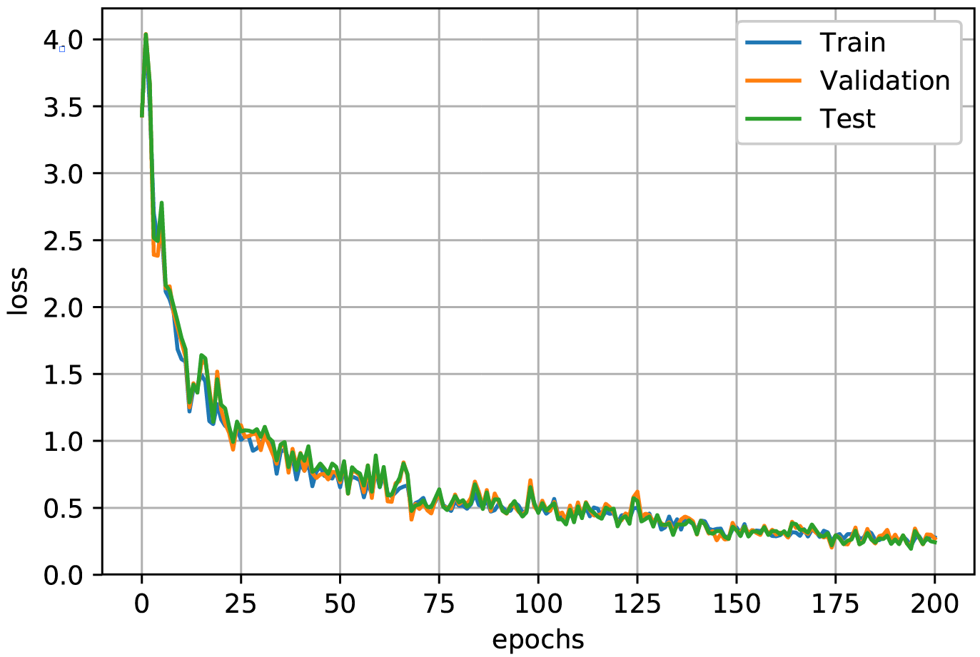
Results – Error & Loss
Training Parameters
SGD optimizer, Batch size = 16, Learning Rate = 1e-2
Probability of Error
Loss

Slide 8
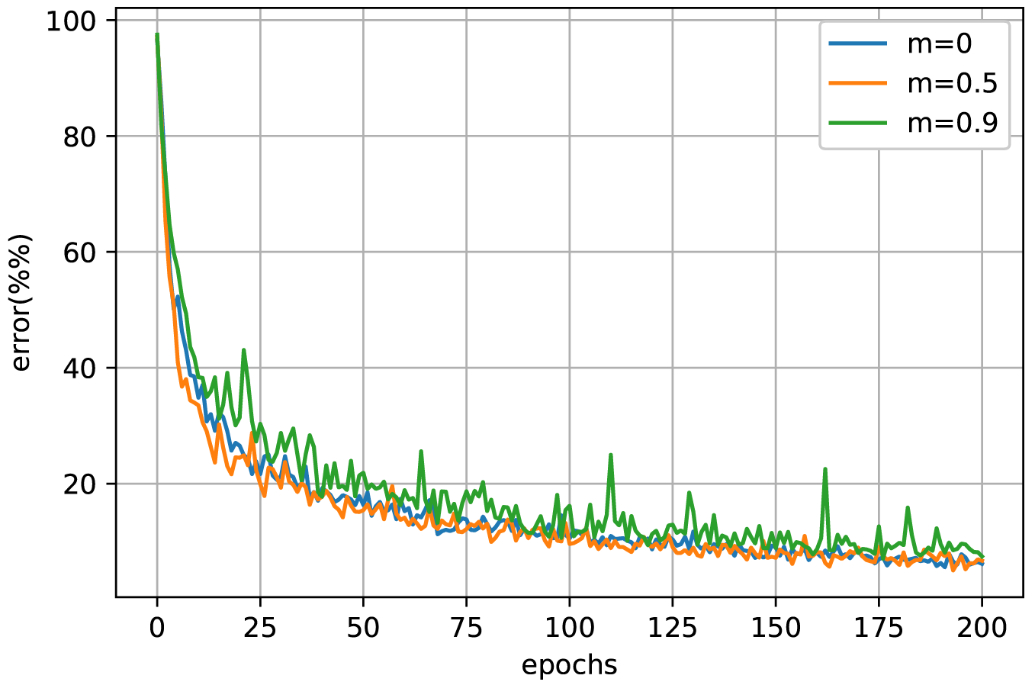
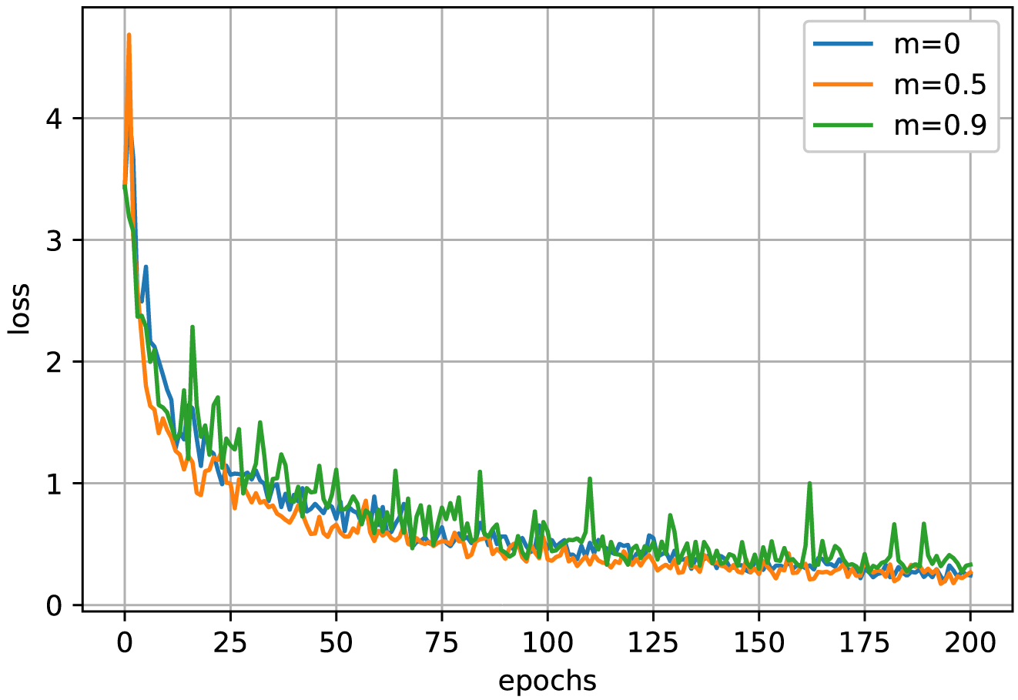
Results – Different Optimizers
Optimizer | Loss | Error
Adam | 0.21 | 6.55%
SGD, m = 0 | 0.24 | 6.18%
SGD, m = 0.5 | 0.27 | 6.71%
SGD, m = 0.9 | 0.33 | 7.46%
RMSprop, m = 0 | 0.36 | 6.82%
RMSprop, m = 0.5 | 0.46 | 7.23%
RMSprop, m = 0.9 | 0.49 | 12.05%
SGD
SGD

Slide 9
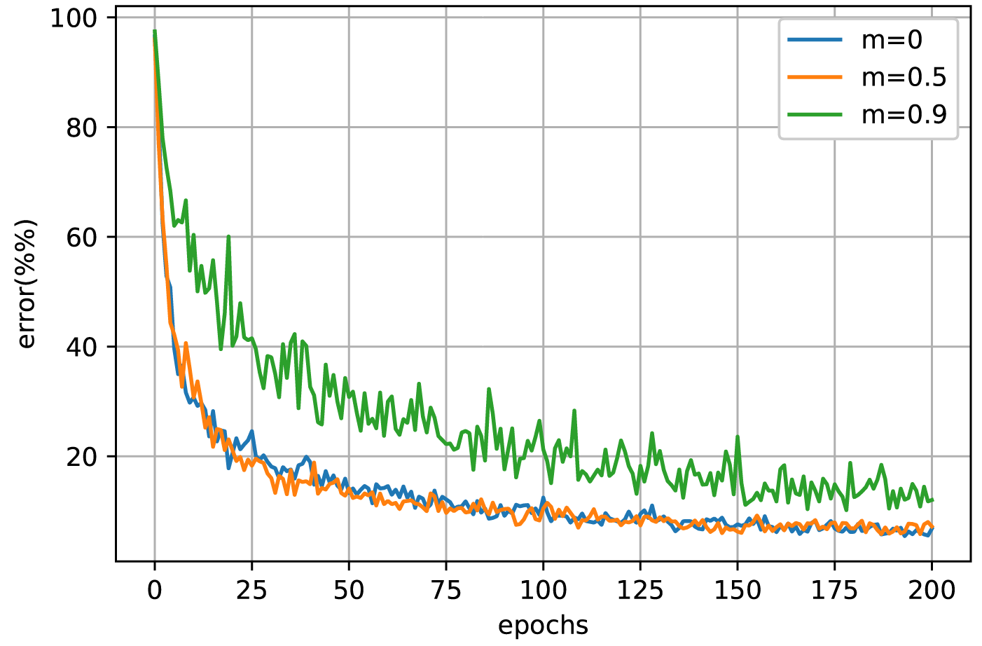
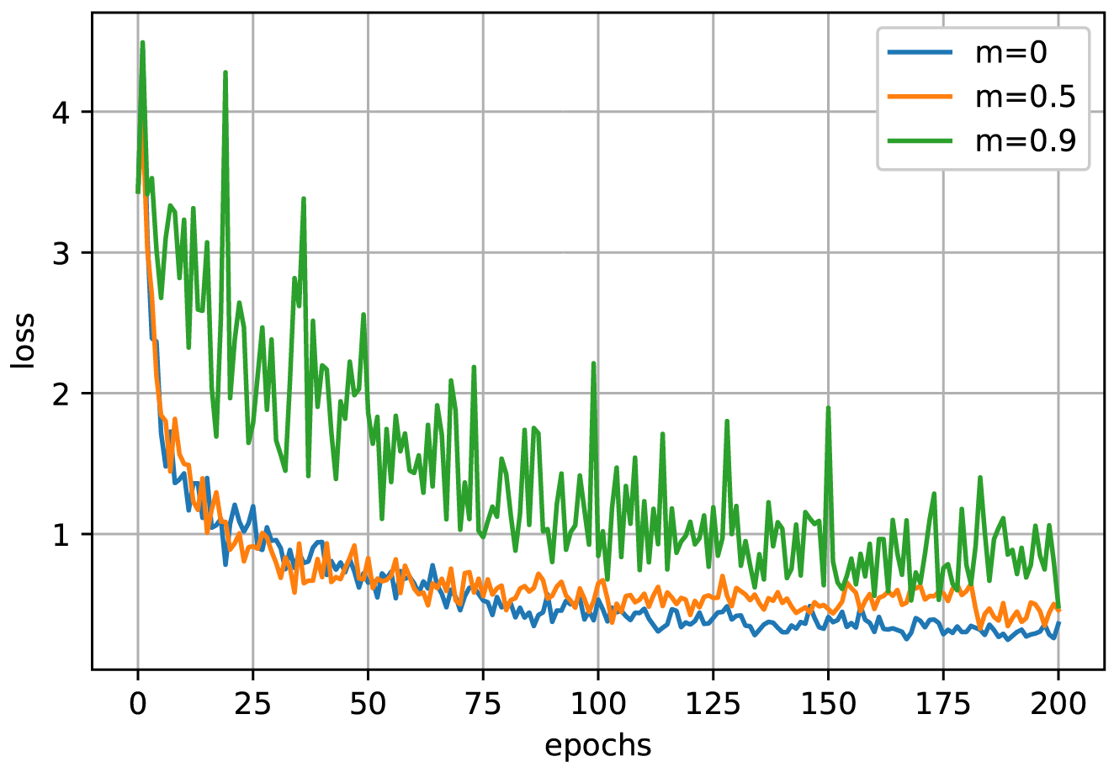
Results – Different Optimizers
Optimizer | Loss | Error
Adam | 0.21 | 6.55%
SGD, m = 0 | 0.24 | 6.18%
SGD, m = 0.5 | 0.27 | 6.71%
SGD, m = 0.9 | 0.33 | 7.46%
RMSprop, m = 0 | 0.36 | 6.82%
RMSprop, m = 0.5 | 0.46 | 7.23%
RMSprop, m = 0.9 | 0.49 | 12.05%
RMSprop
Bigger momentum value may lead to poorer performance.
RMSprop

Slide 10
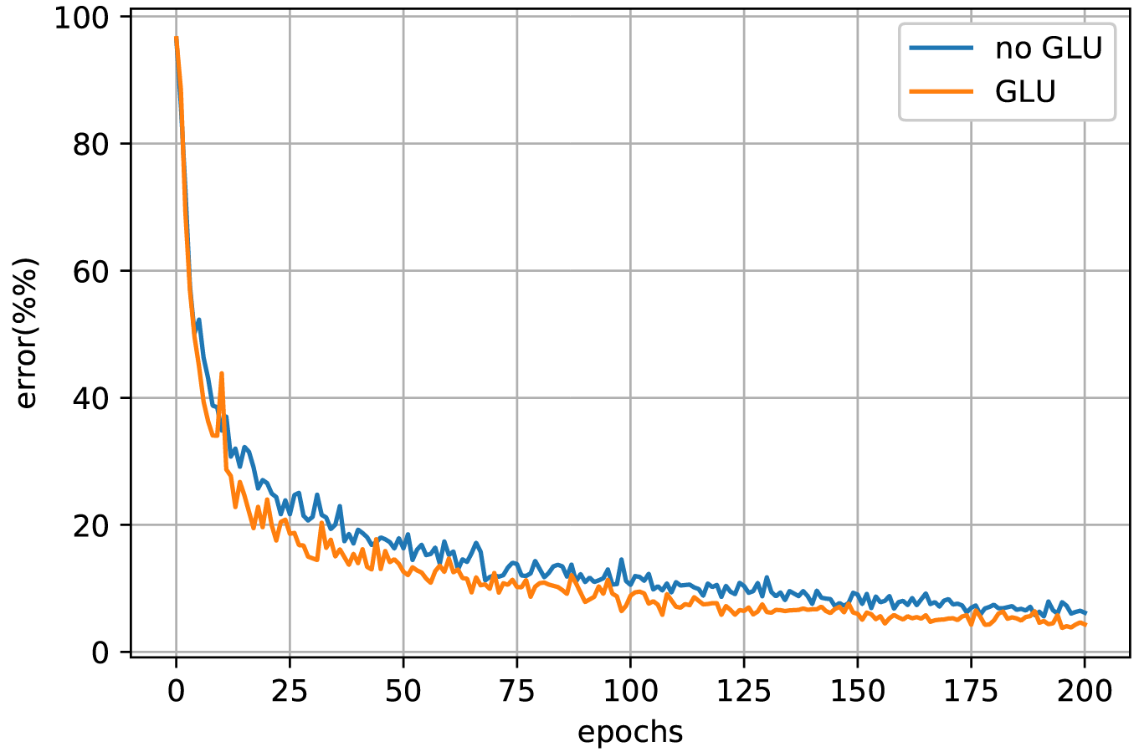
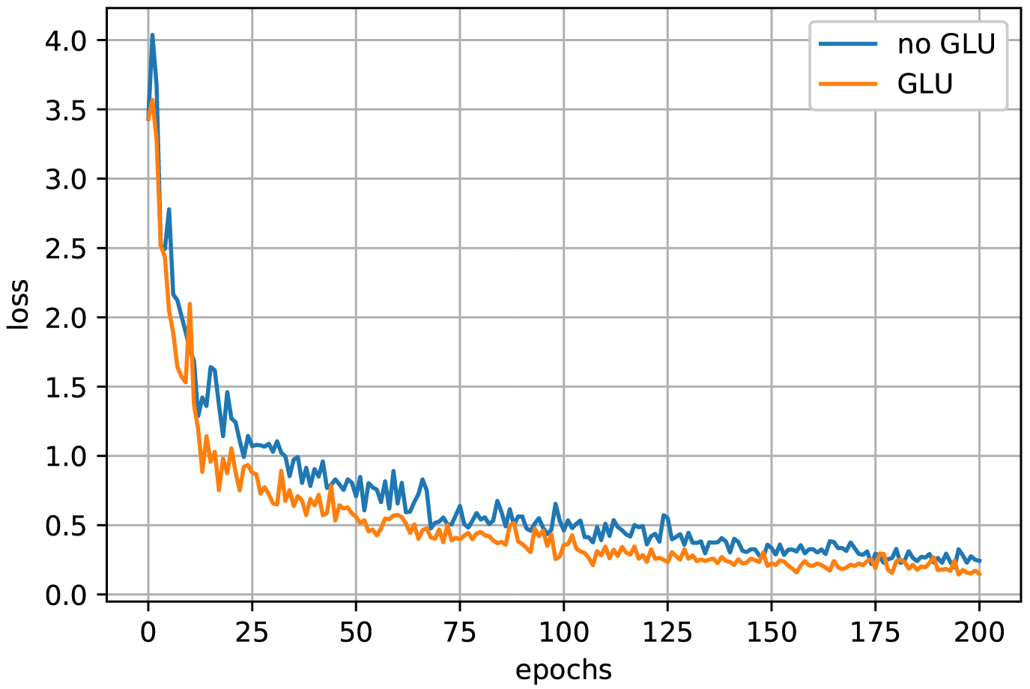
Results – GLU Activation
Probability of Error
Loss

Slide 11
Conclusion
We successfully implemented fully convolutional model for simple speech recognition task based on Tensorflow Speech Commands Datasets which proves that using convolutional model for sequence learning is indeed feasible.
We modified the original model by adding GLU (gated linear units) and achieved higher accuracy.
The best errorrate we achieve is 6.23% which is really close to the champion for Kaggle Competition Champion.

Slide 12
Prospect
Remaining efforts: Try to include separate attention module to achieve higher accuracy and acquire the ability to tackle with larger scale problems.
Remaining efforts: Extend to different tasks such as translation, video data generation.
Remaining efforts: One of the coolest thing that we can do with convolutional neural networks is neural style transfer. The former work is mainly with image files while the neural style transfer with video seems to be much more difficult. The success of implementing CNN to solve speech recognition problem proposes a promising method for neural style transfer with video files.

Slide 13
Reference
Language Modeling with Gated Convolutional Networks, Yann N. Dauphin, Angela Fan and etc., arXiv:1612.08083v3 [cs.CL] 8 Sep 2017
Convolutional Sequence to Sequence Learning, Jonas Gehring, Michael Auli and etc., arXiv:1705.03122v3 [cs.CL] 25 Jul 2017

