Slide 1
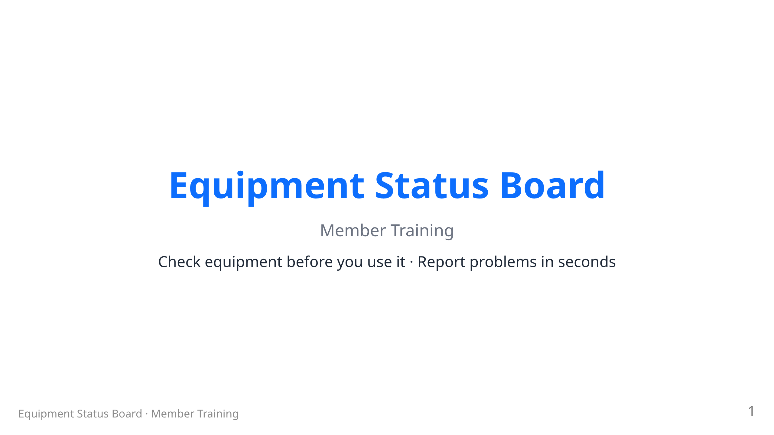
Notes:
RENDER: npx @marp-team/marp-cli docs/training/members.md --html --allow-local-files -o members.pdf (swap -o members.html or members.pptx for other formats) Images live in ../images relative to this file. PRESENTER: fill in the ESB web address posted in your space (the bracketed blanks on the dashboard slide). Presenter: 10–15 min. Audience = any member, no account needed. Emphasize: ESB tells you if a tool works BEFORE you walk over, and reporting a problem takes 30 seconds.

Slide 2
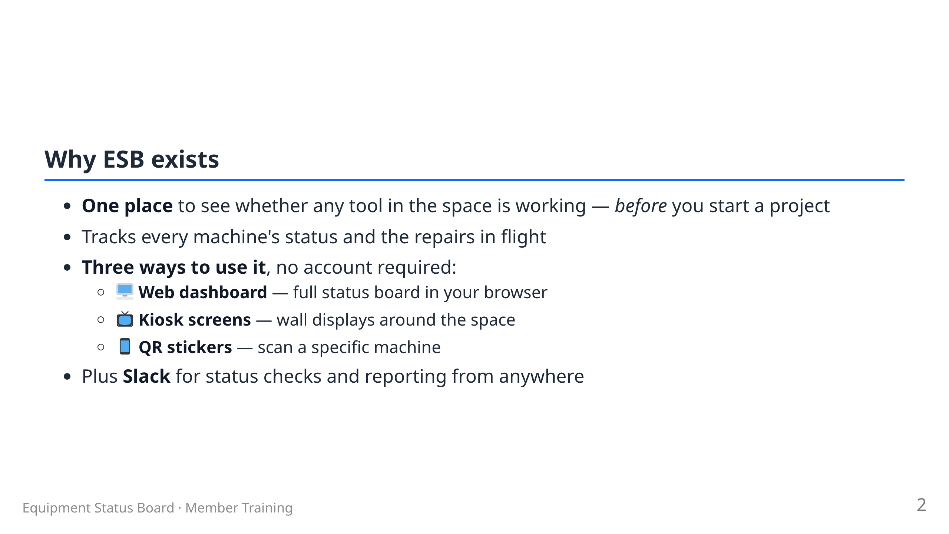
Notes:
Members never log in. The whole member experience is read + report.

Slide 3
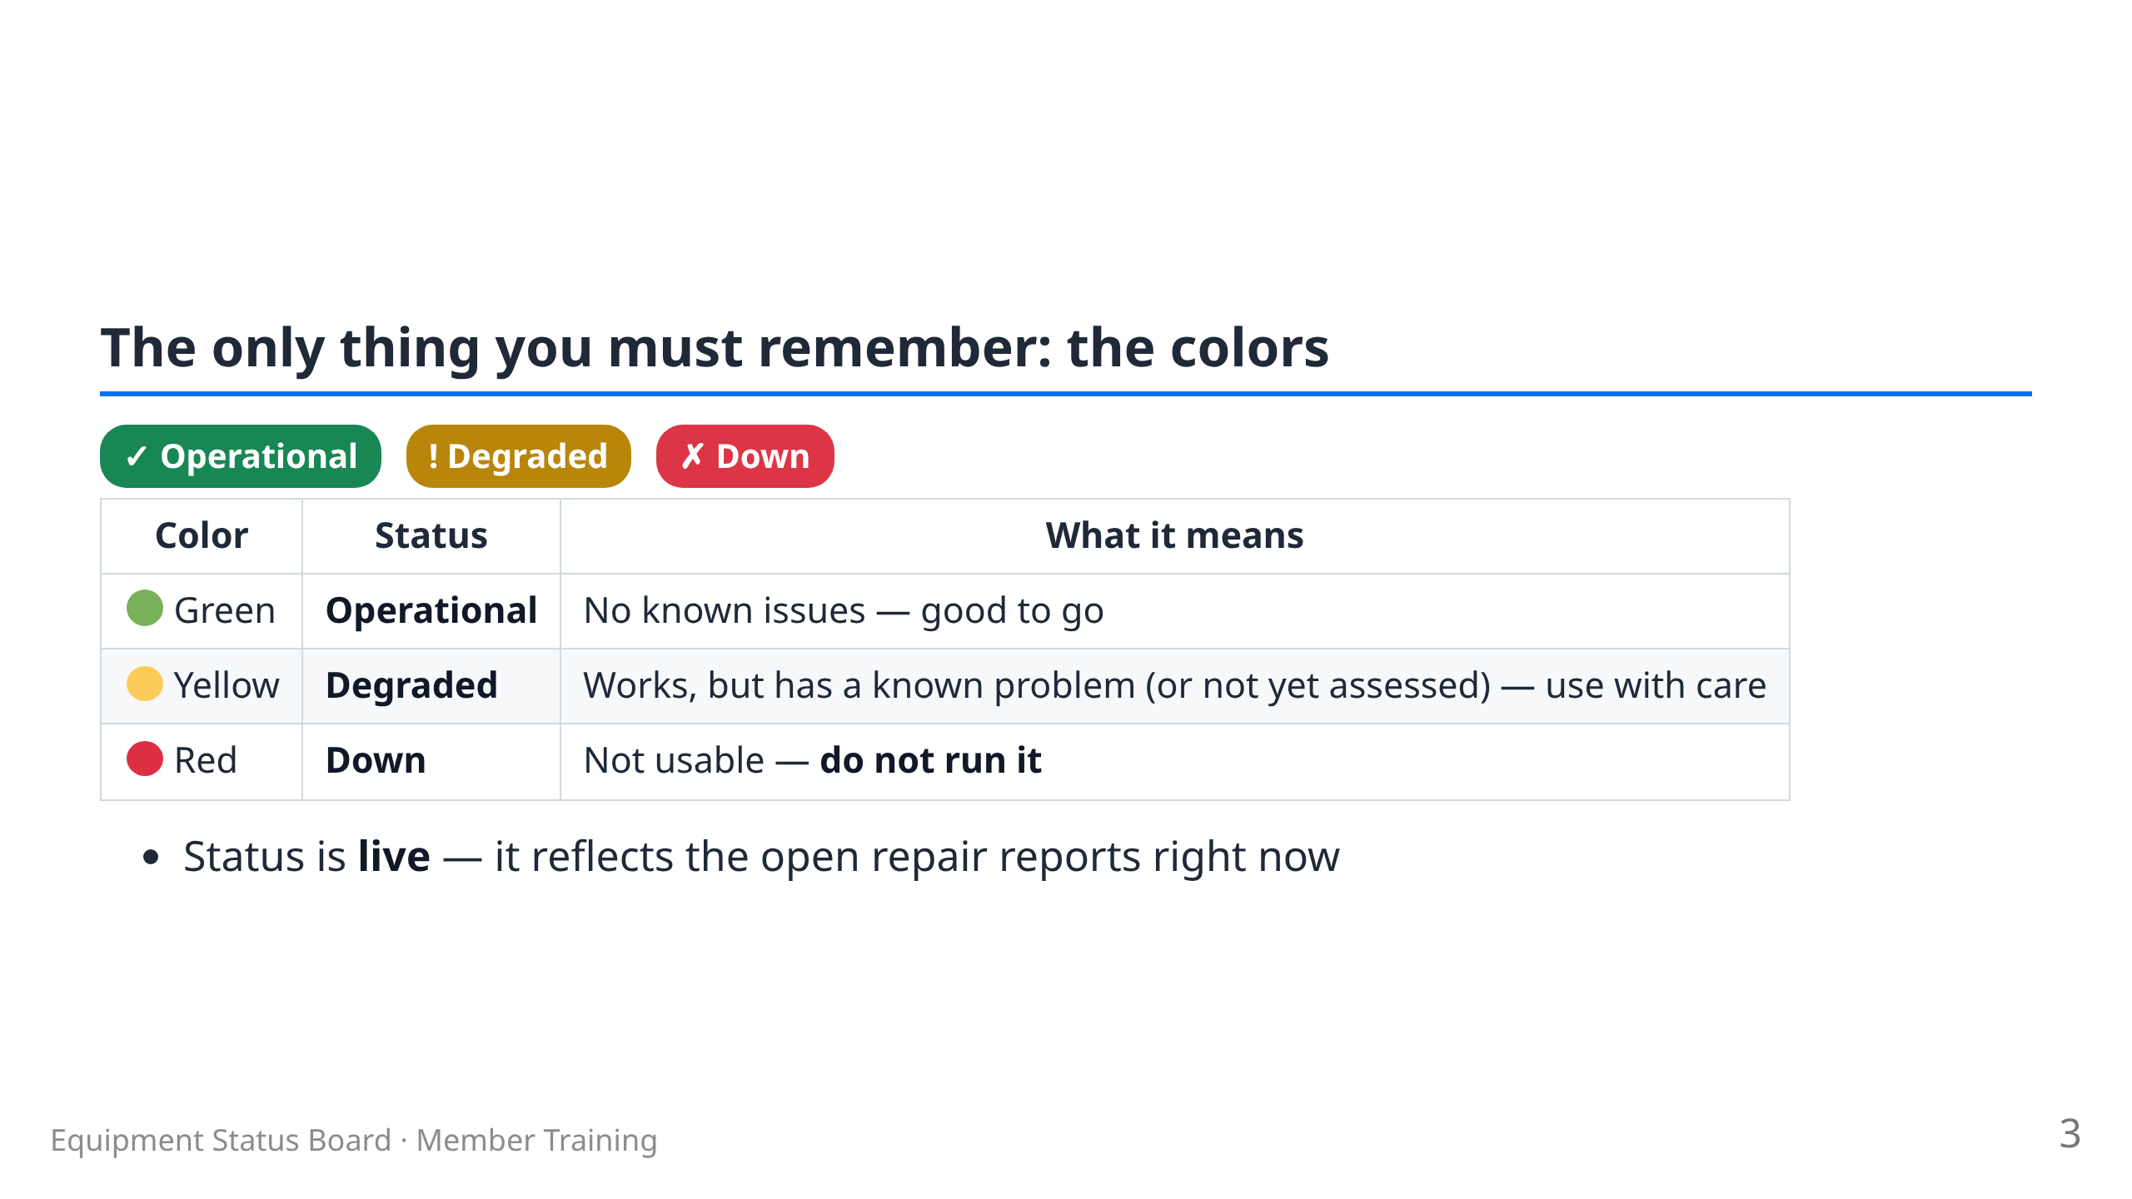

Slide 4
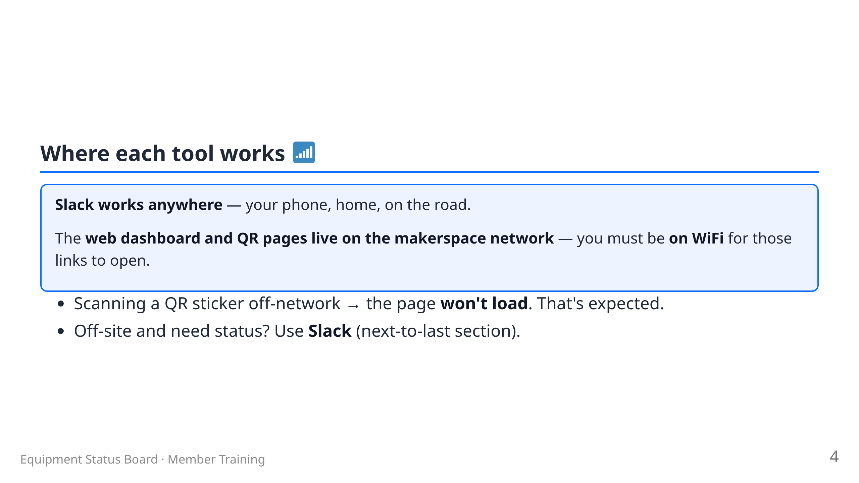
Notes:
Presenter: members do NOT get VPN — that's technicians only.

Slide 5
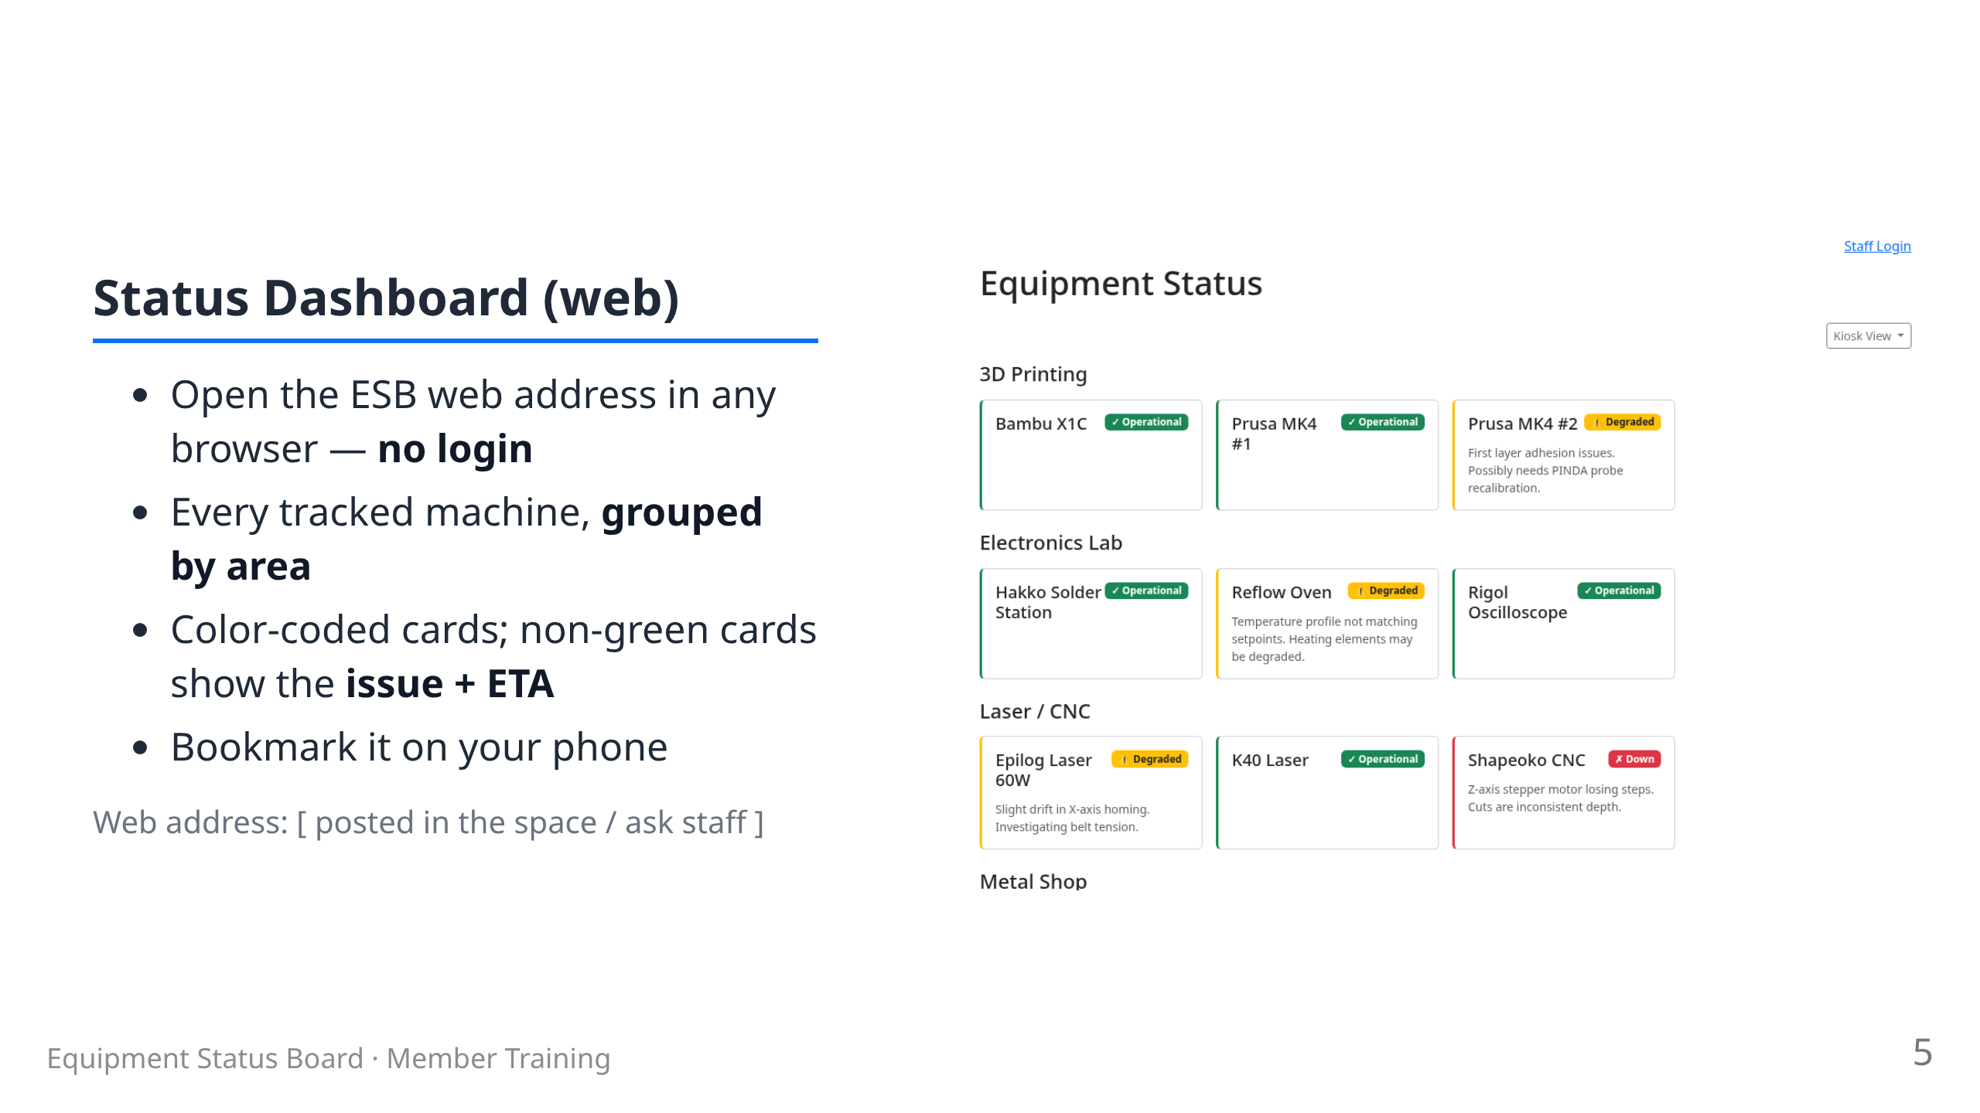

Slide 6
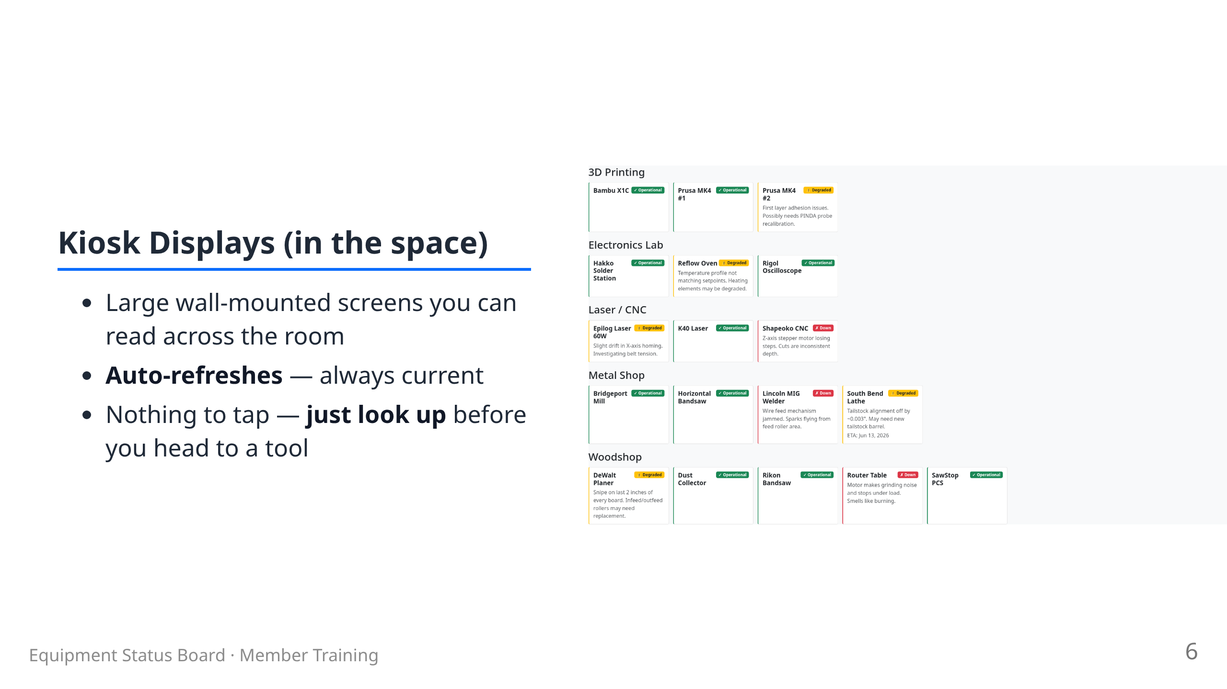

Slide 7
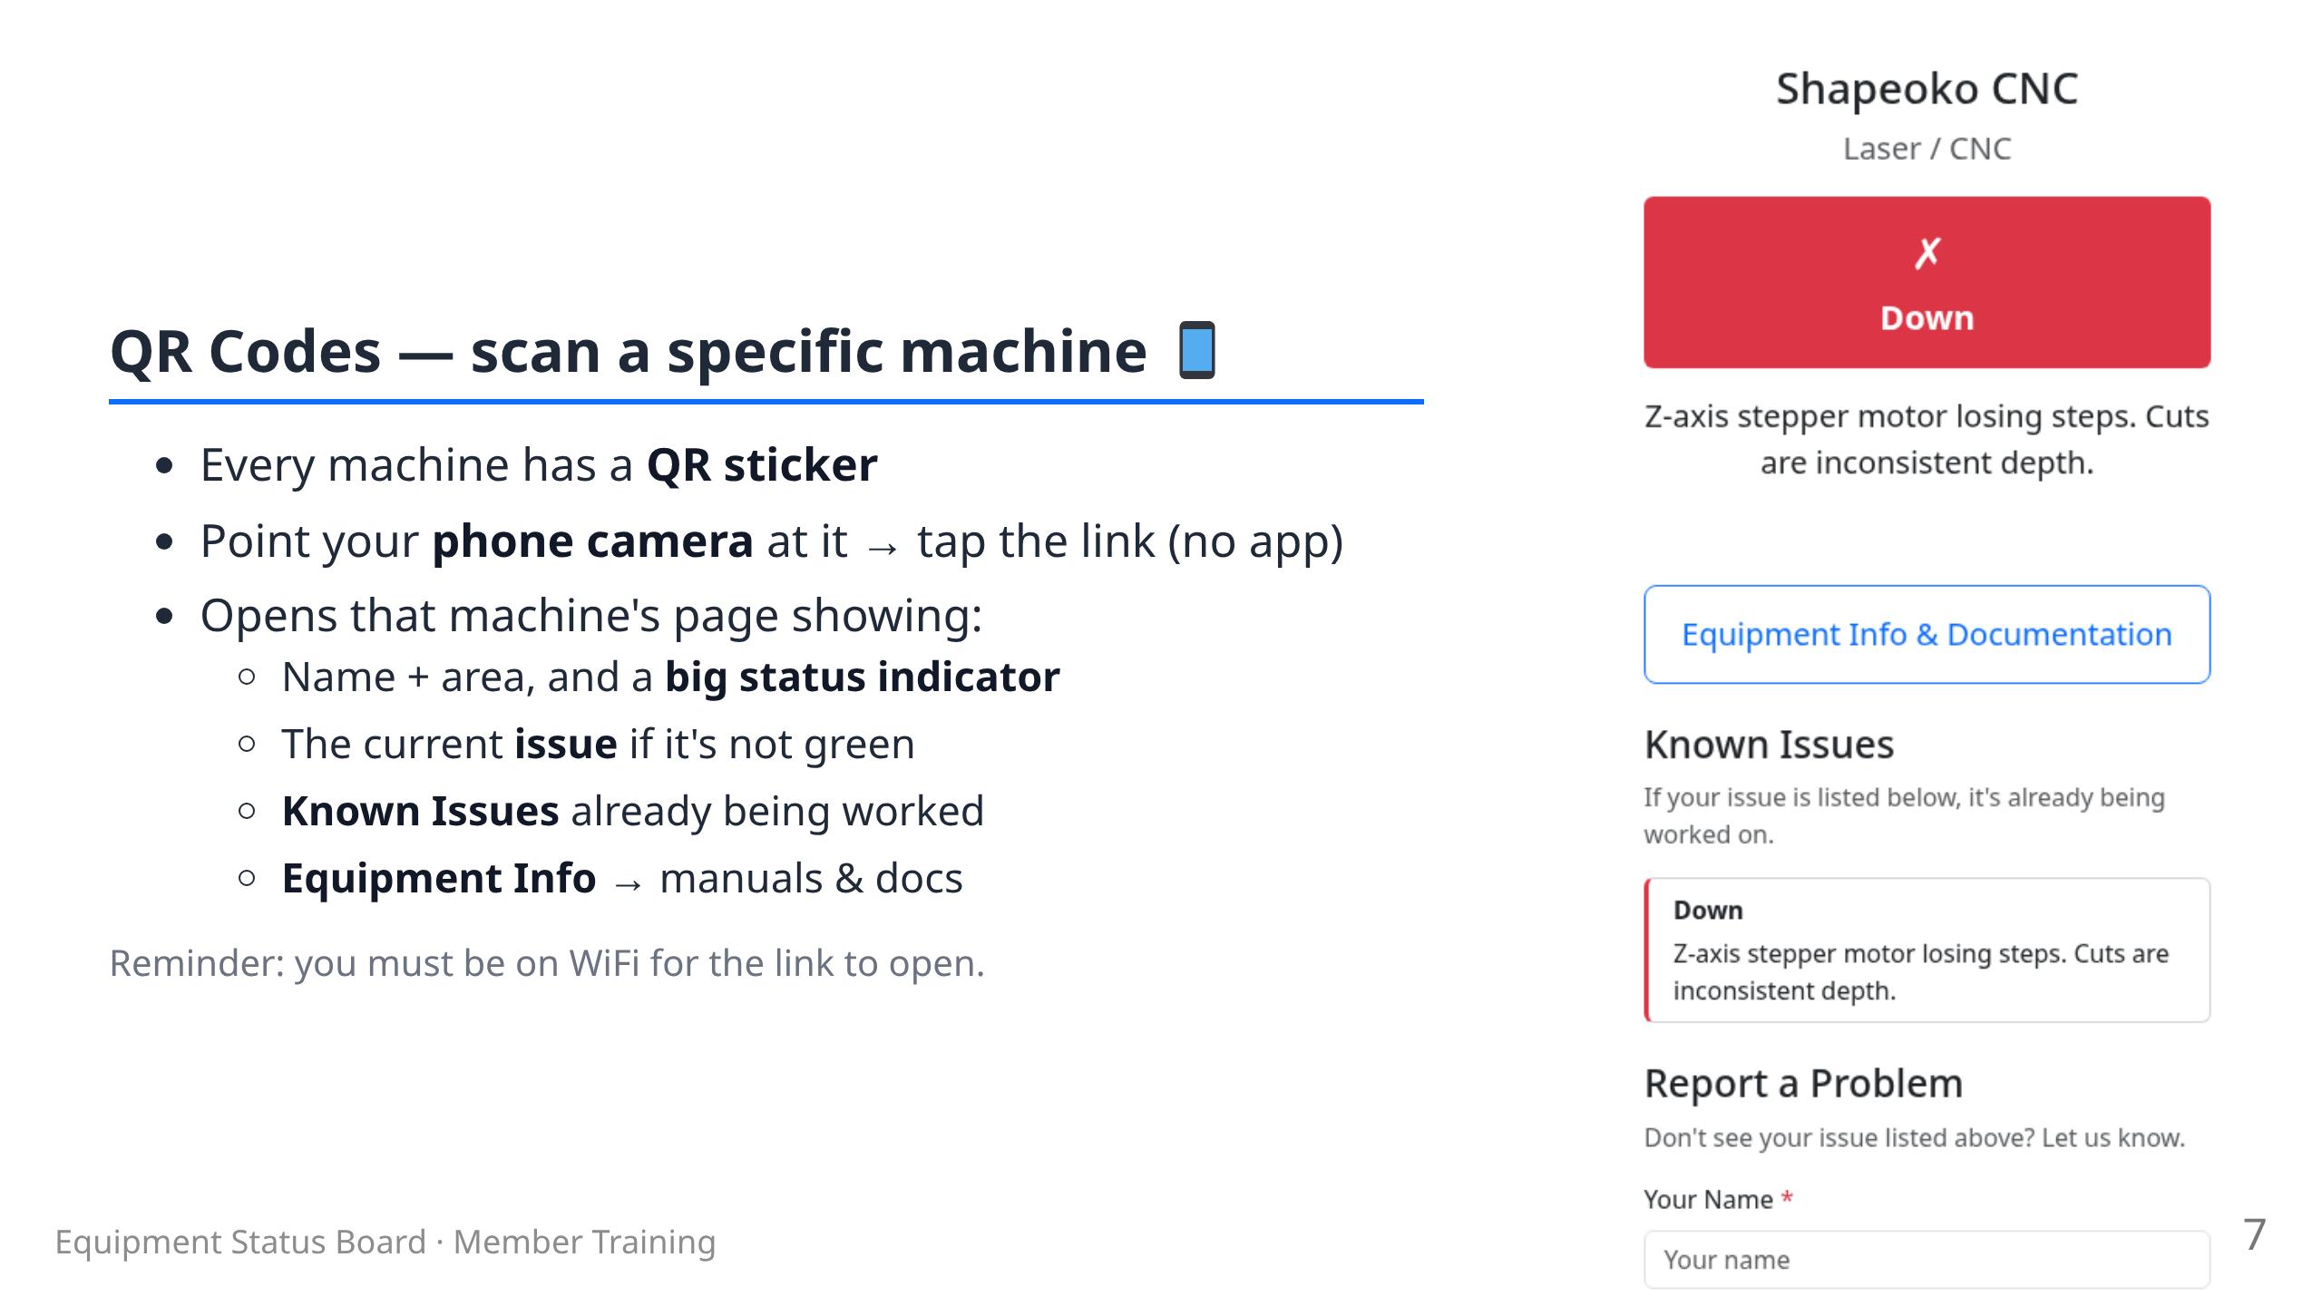

Slide 8
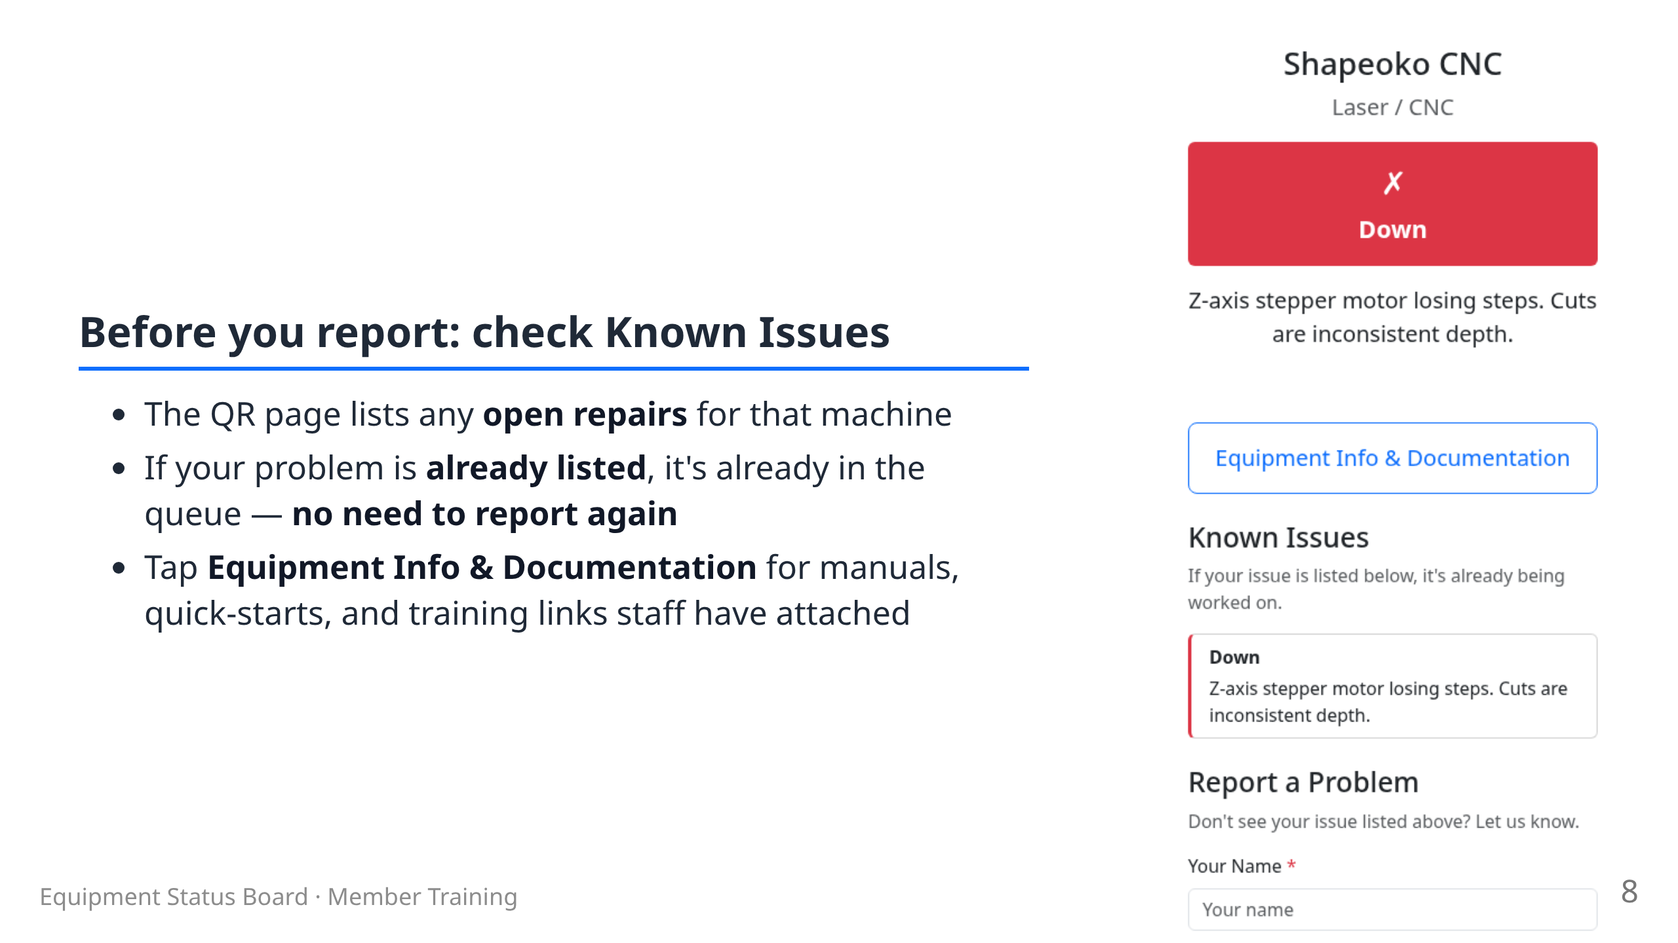

Slide 9
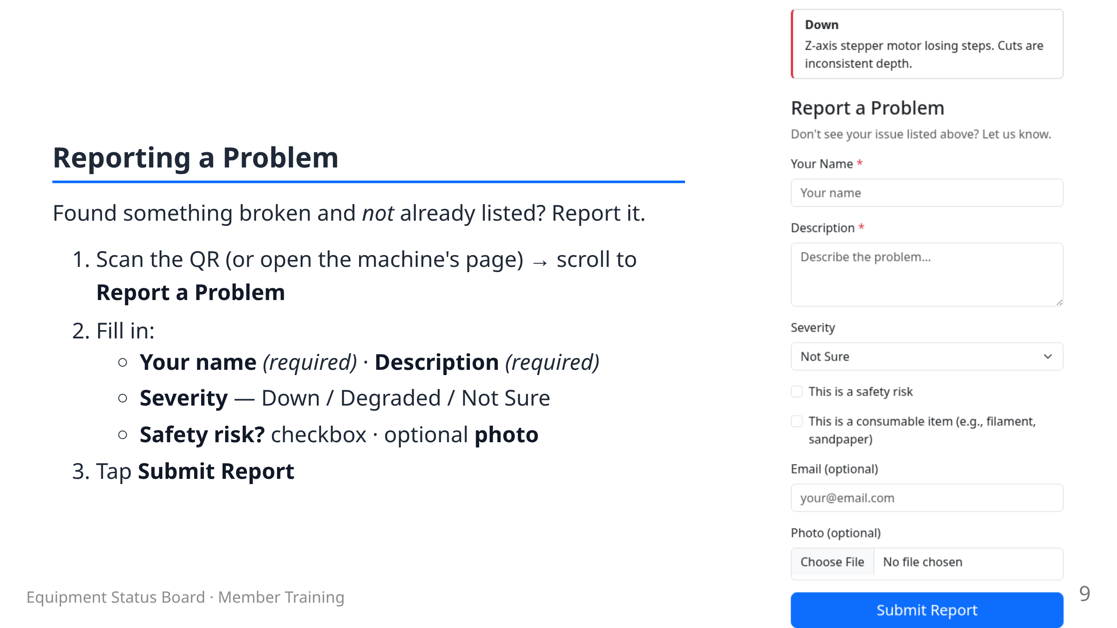

Slide 10
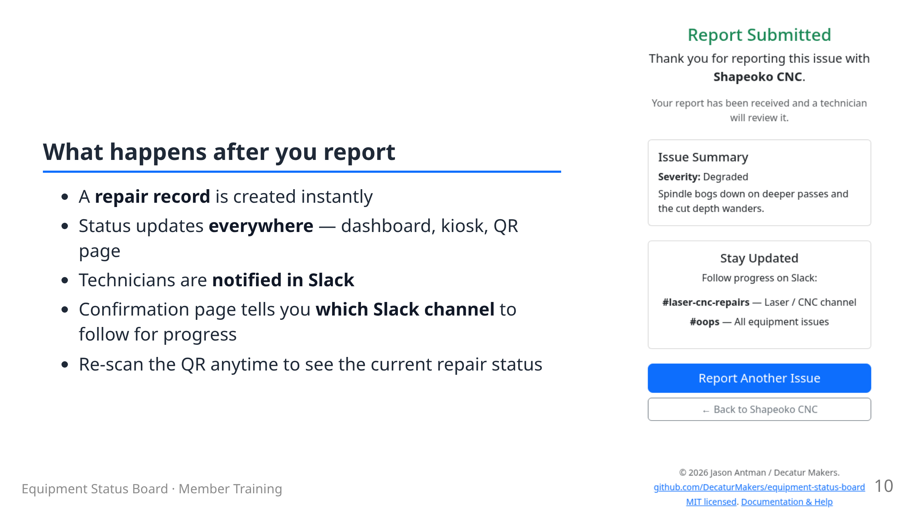

Slide 11
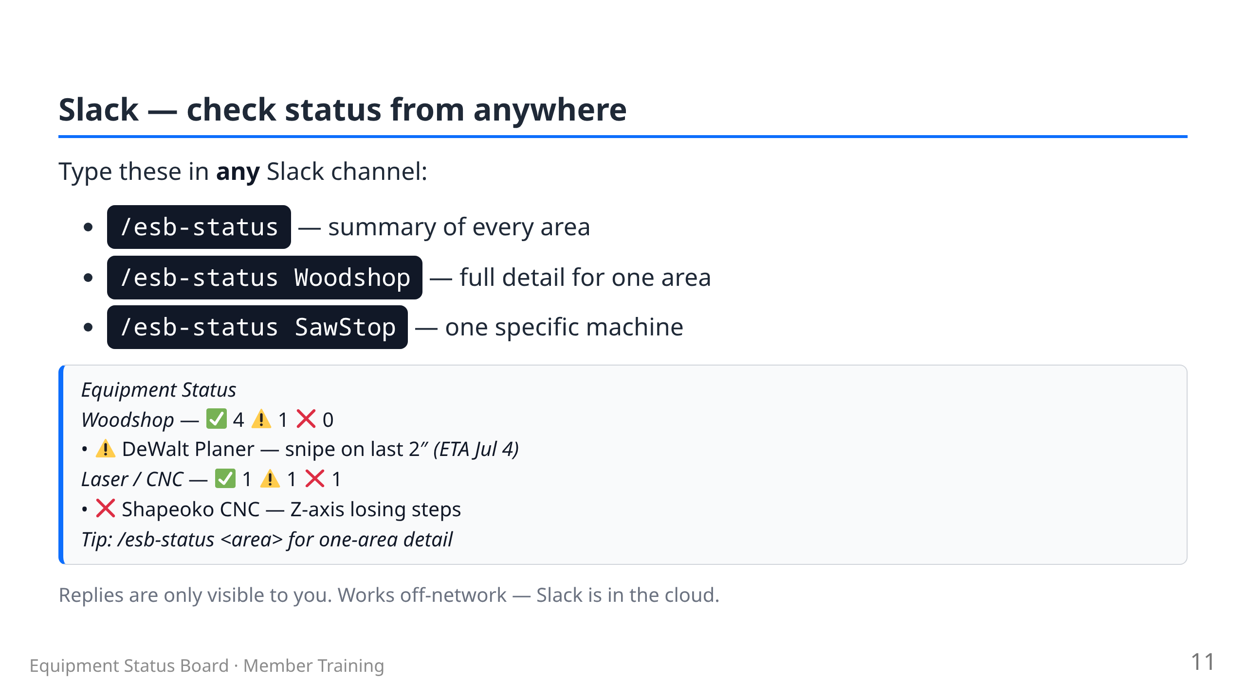

Slide 12
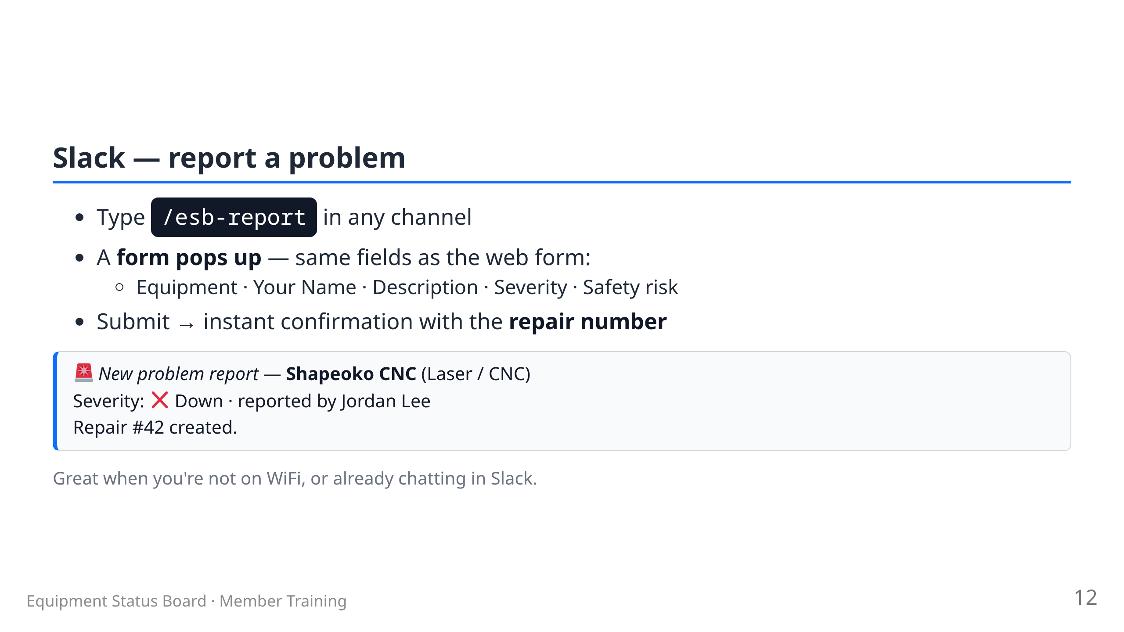

Slide 13
