Slide 1
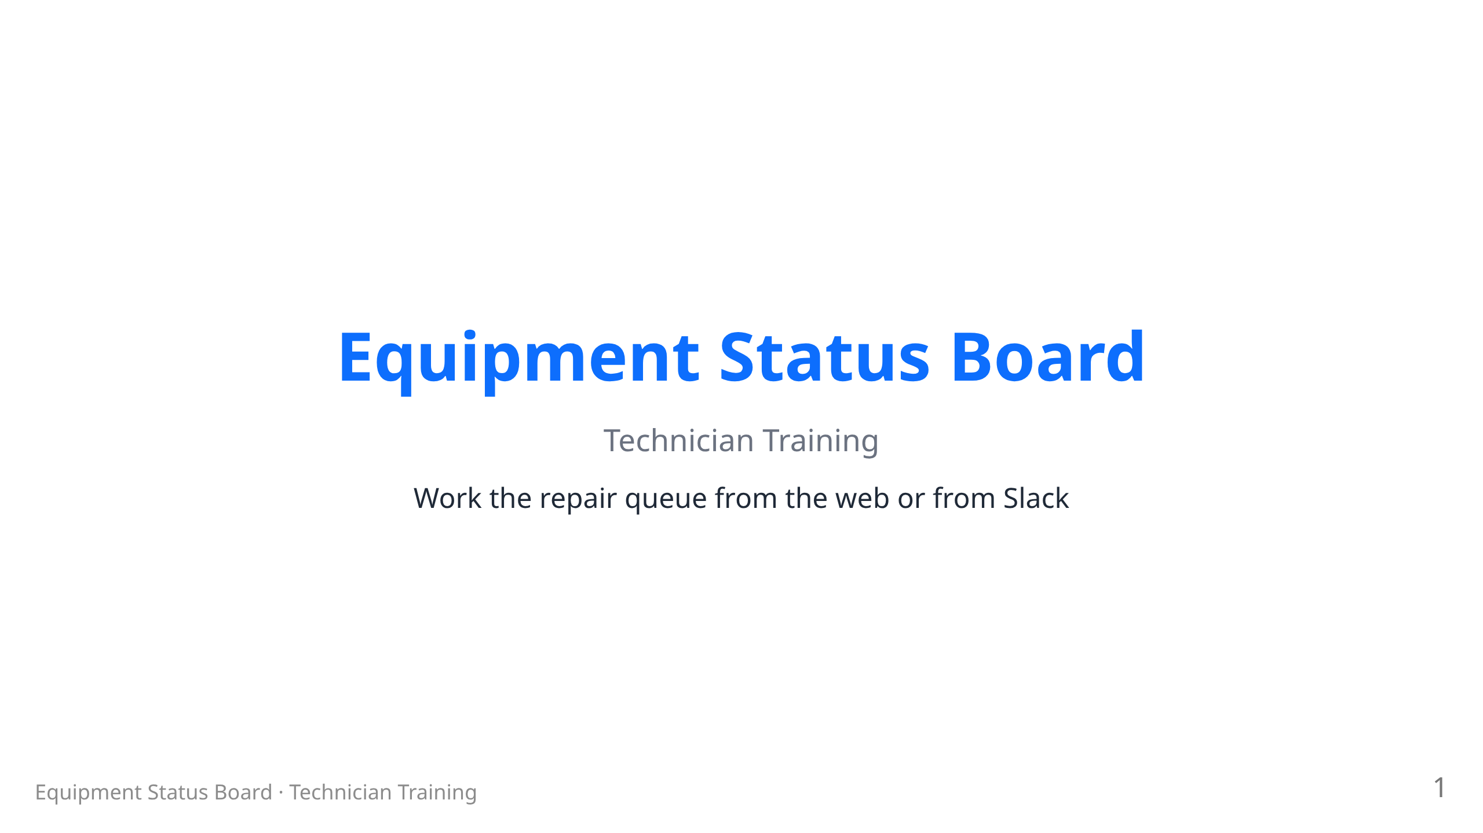
Notes:
RENDER: npx @marp-team/marp-cli docs/training/technicians.md --html --allow-local-files -o technicians.pdf (swap -o technicians.html or technicians.pptx for other formats) Images live in ../images relative to this file. PRESENTER: fill in the ESB web address posted in your space. Presenter: 25–30 min. Audience = volunteer repair techs with accounts. They already know the member-facing basics; this deck is the repair workflow + tech Slack commands.

Slide 2
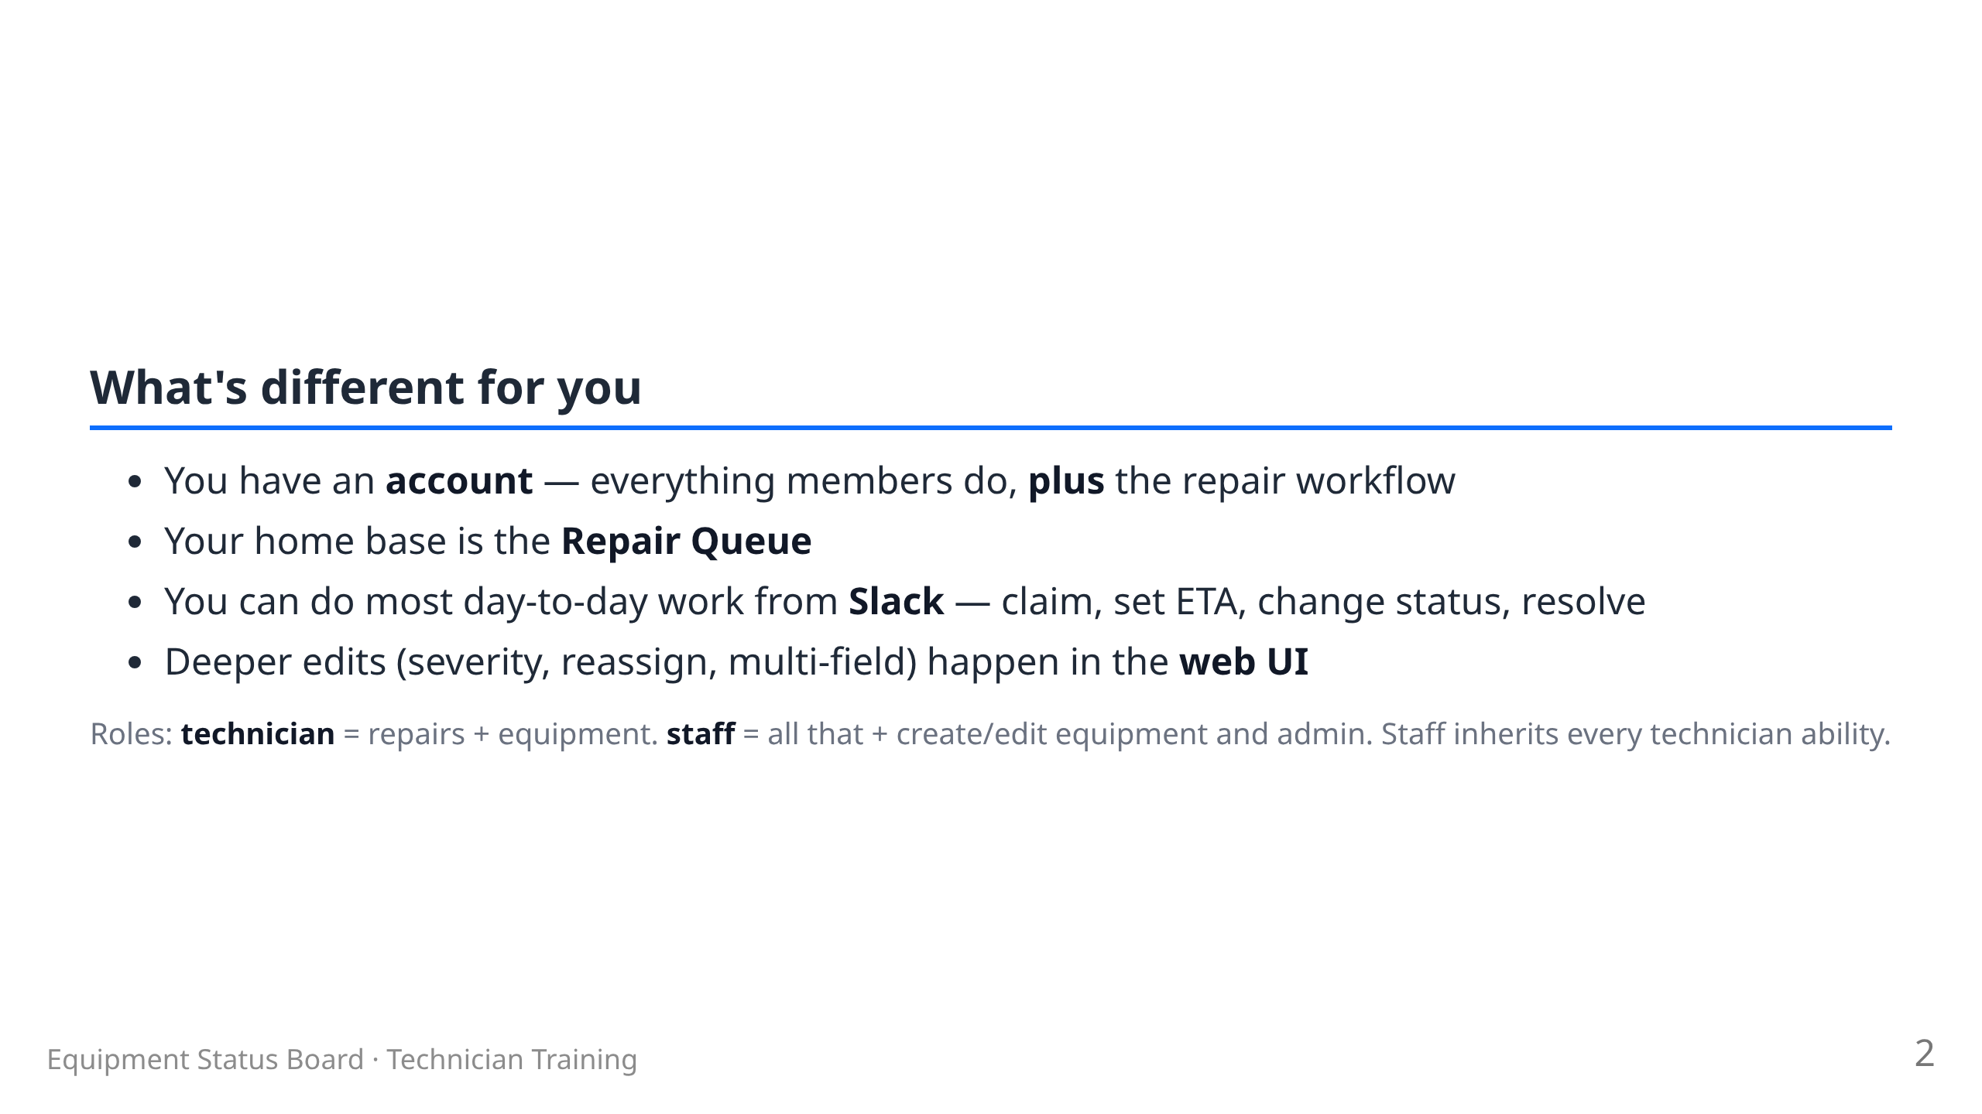

Slide 3
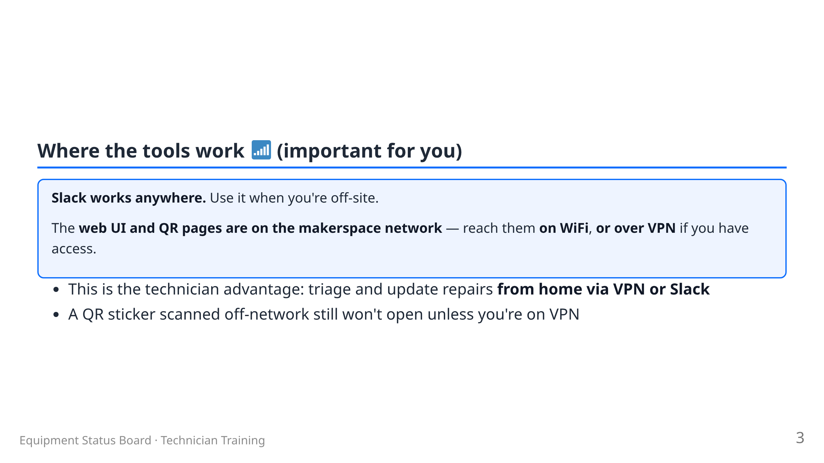
Notes:
Presenter: members do NOT get VPN — that access is technicians only.

Slide 4
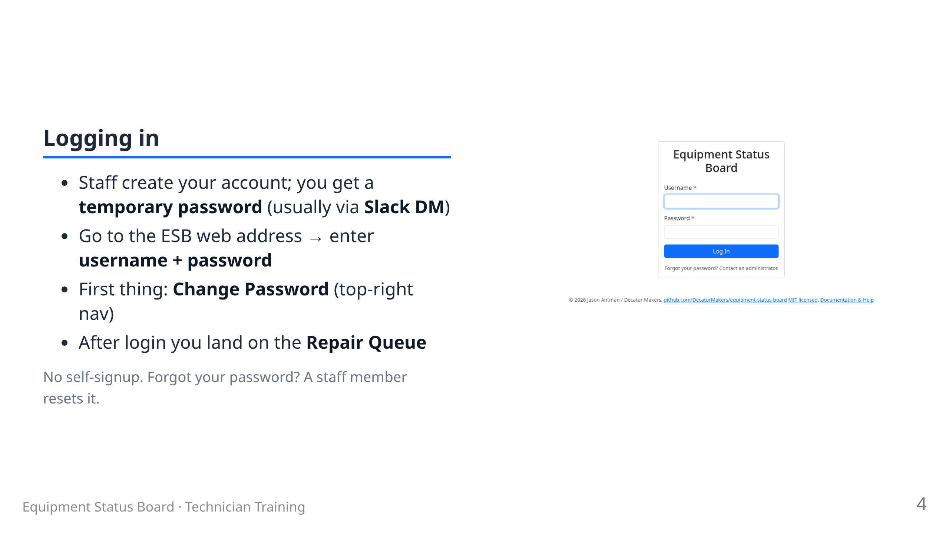

Slide 5
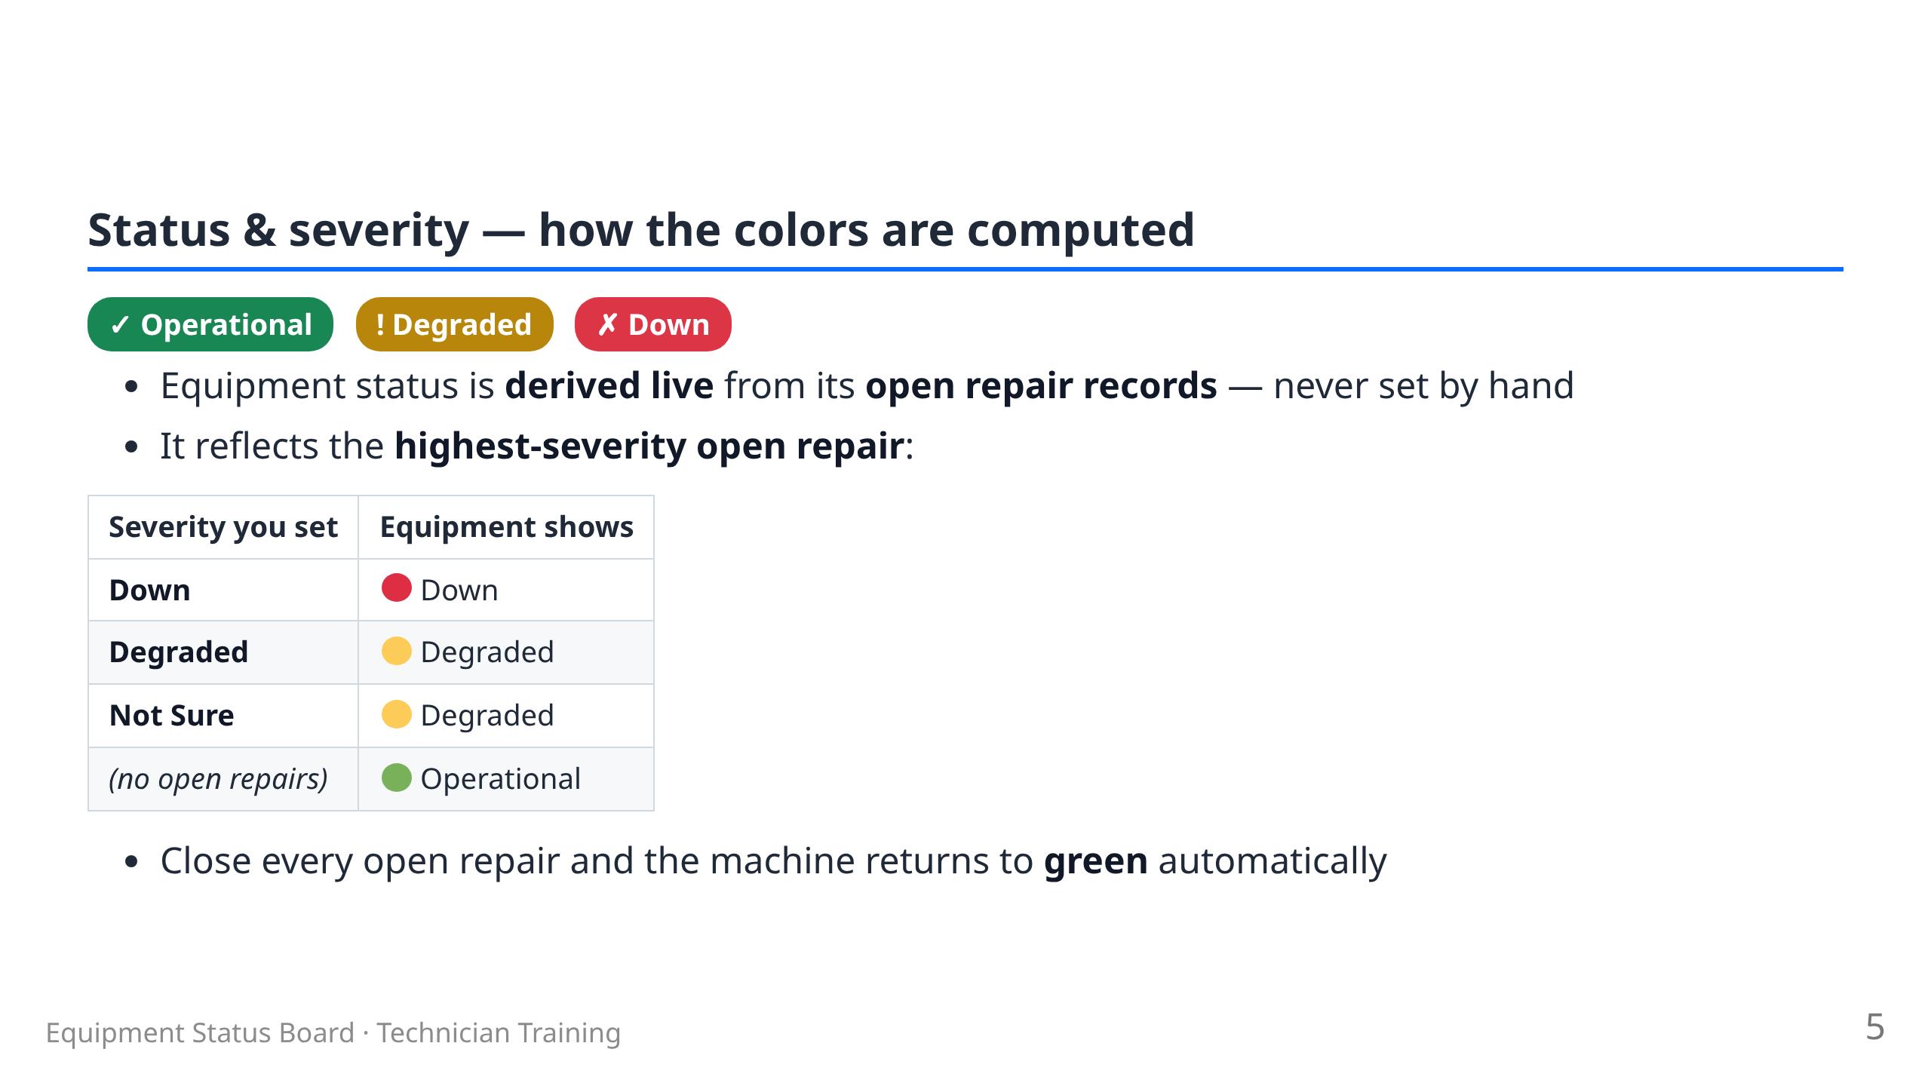

Slide 6
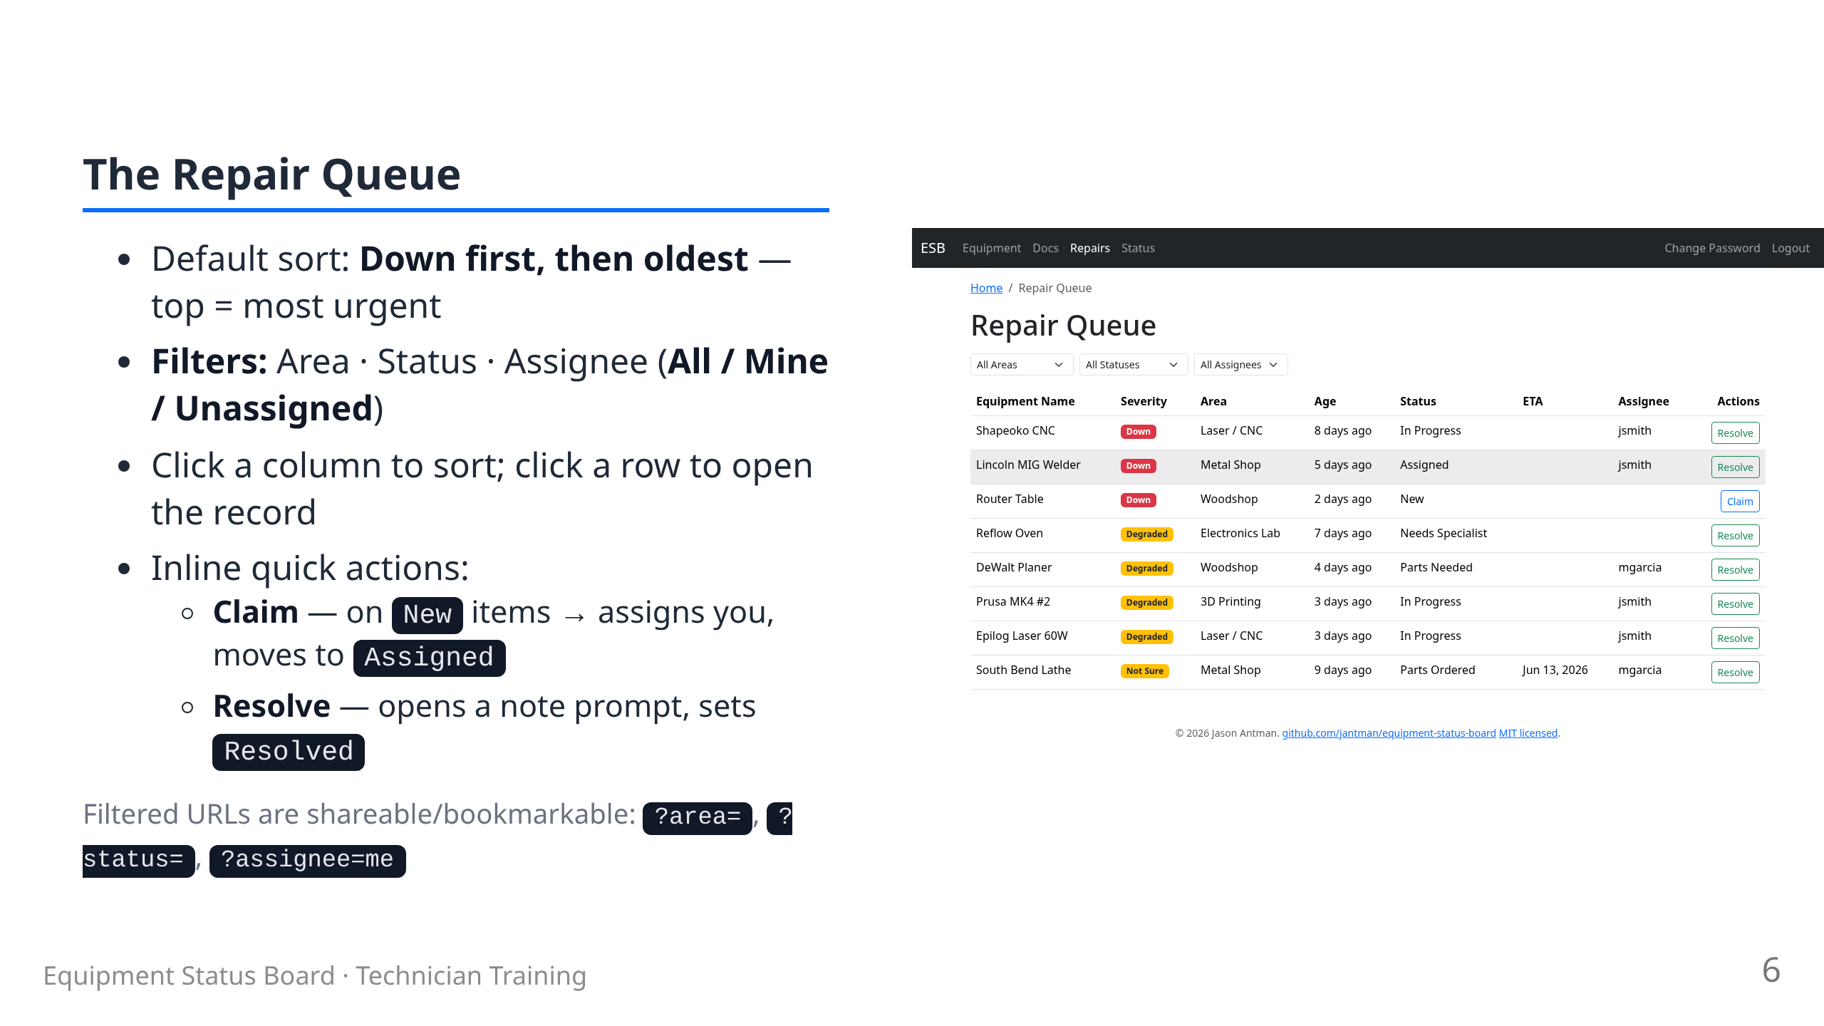

Slide 7
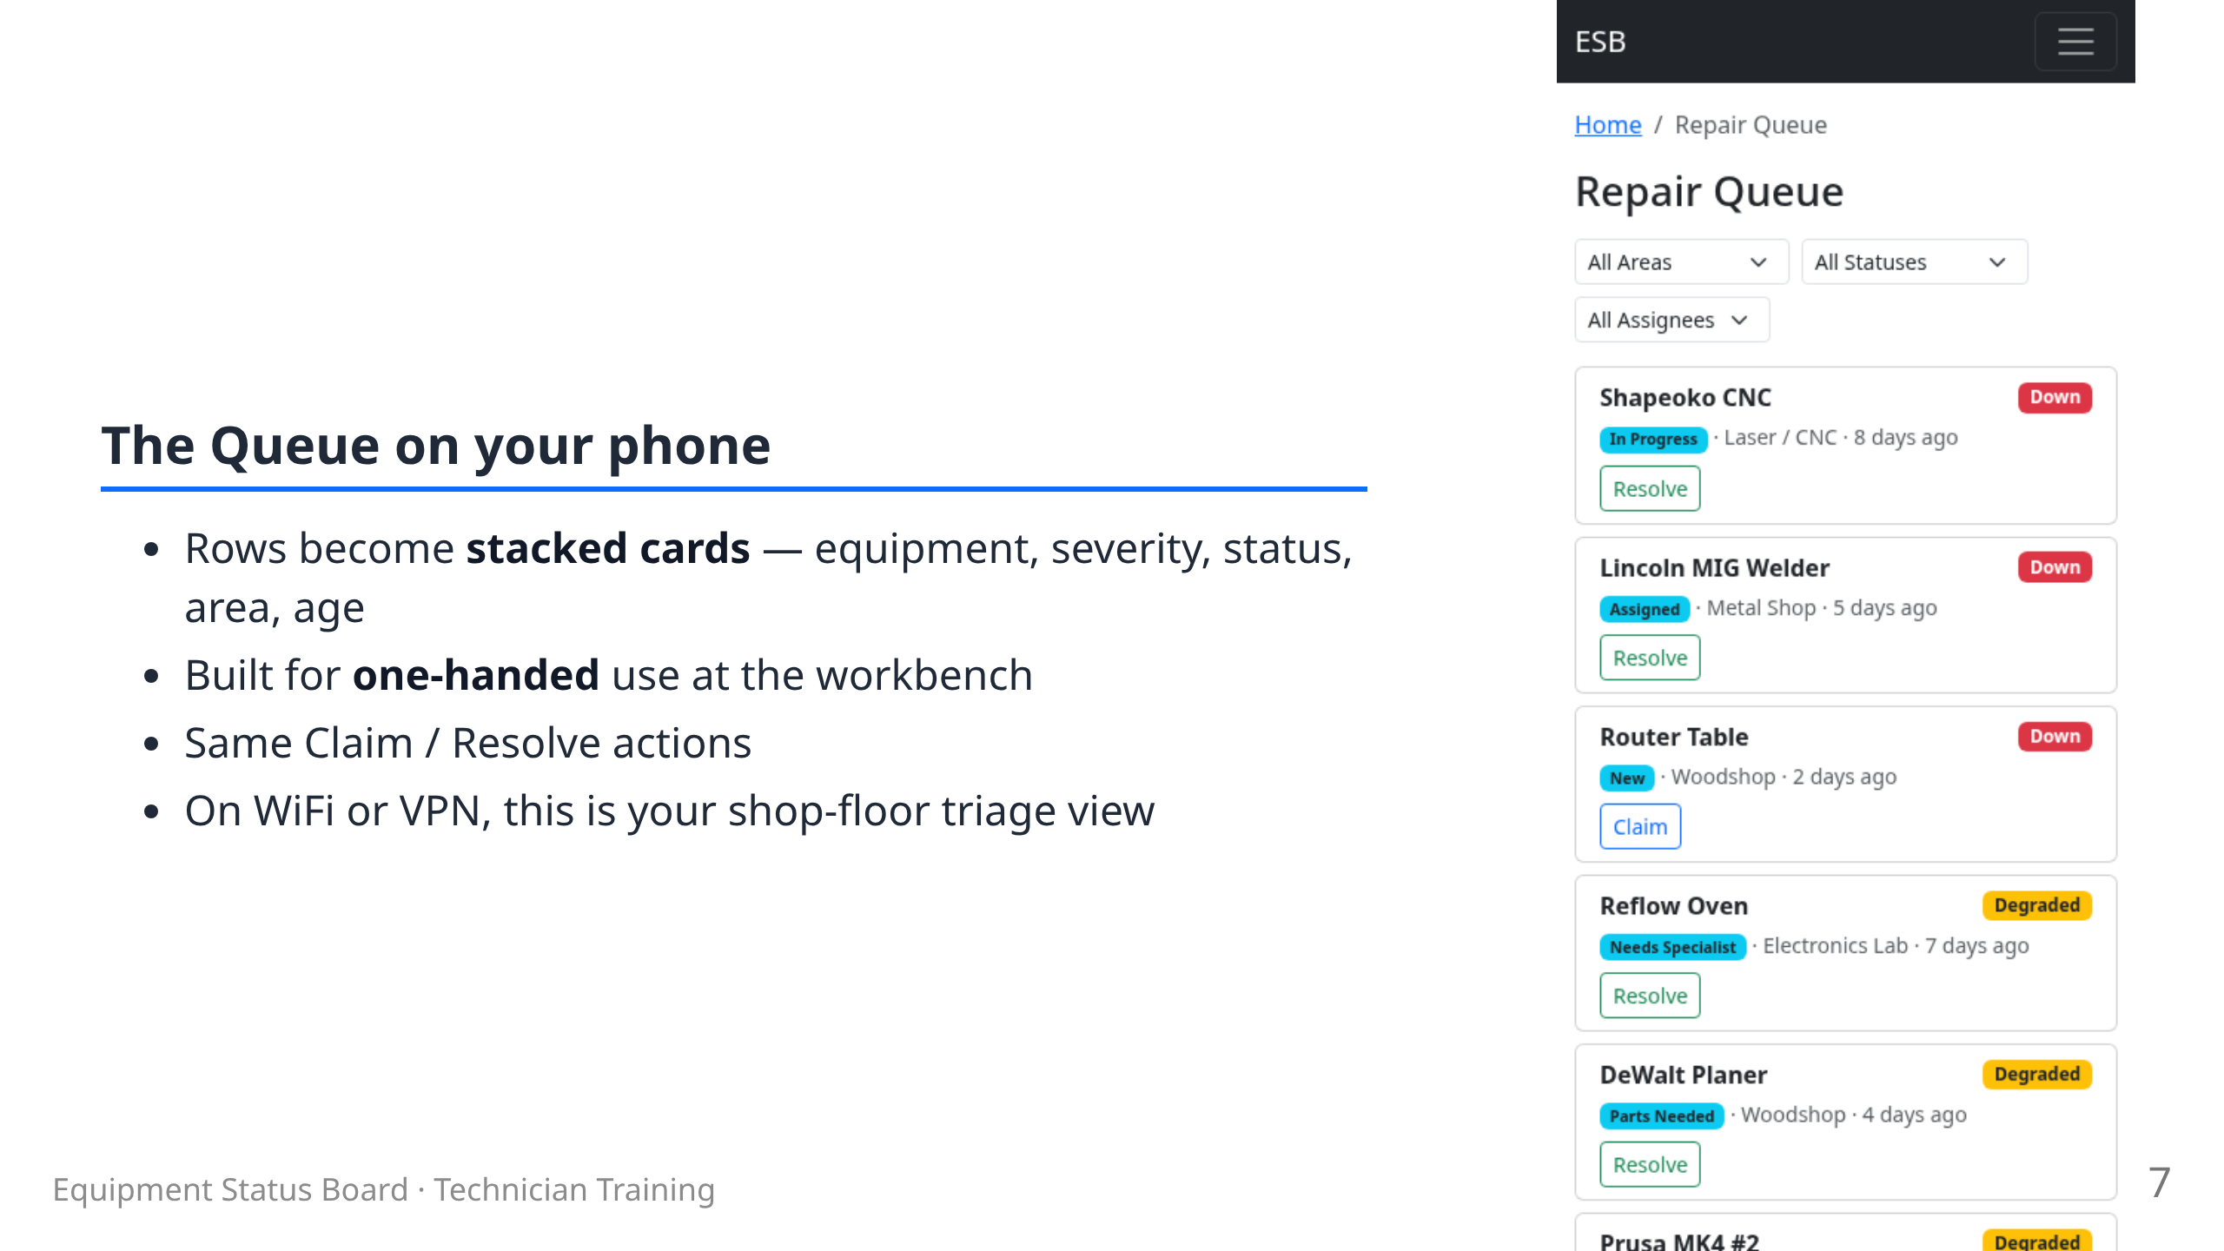

Slide 8
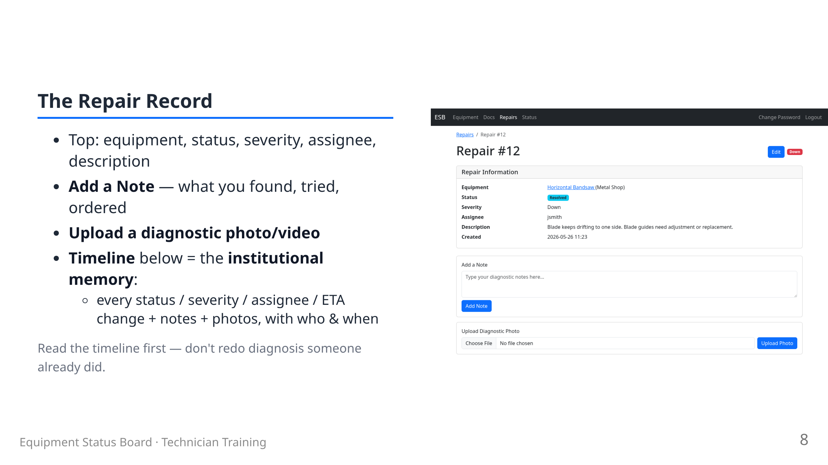

Slide 9
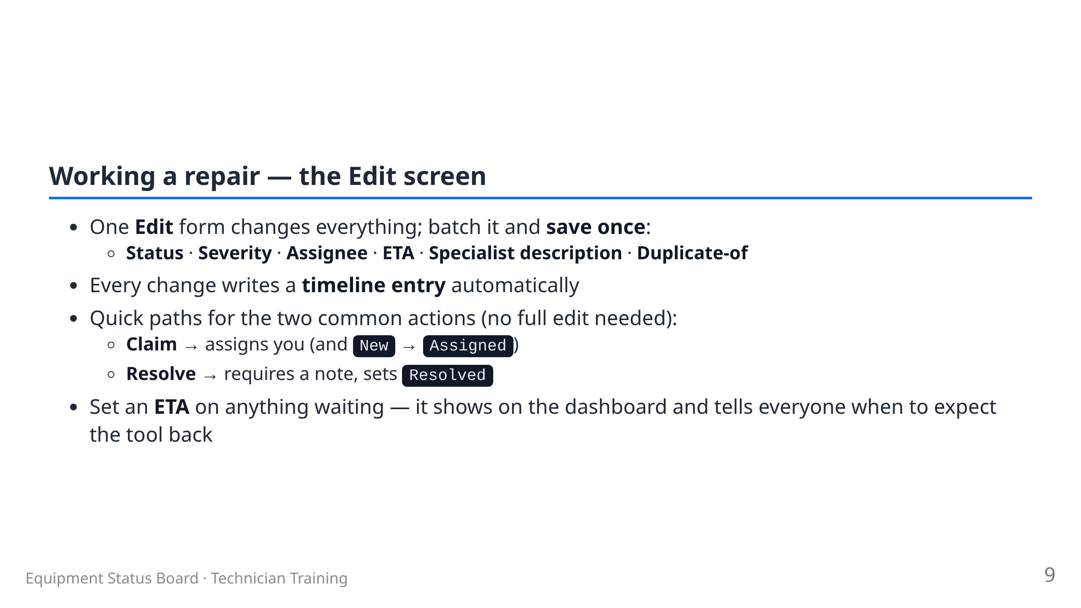

Slide 10
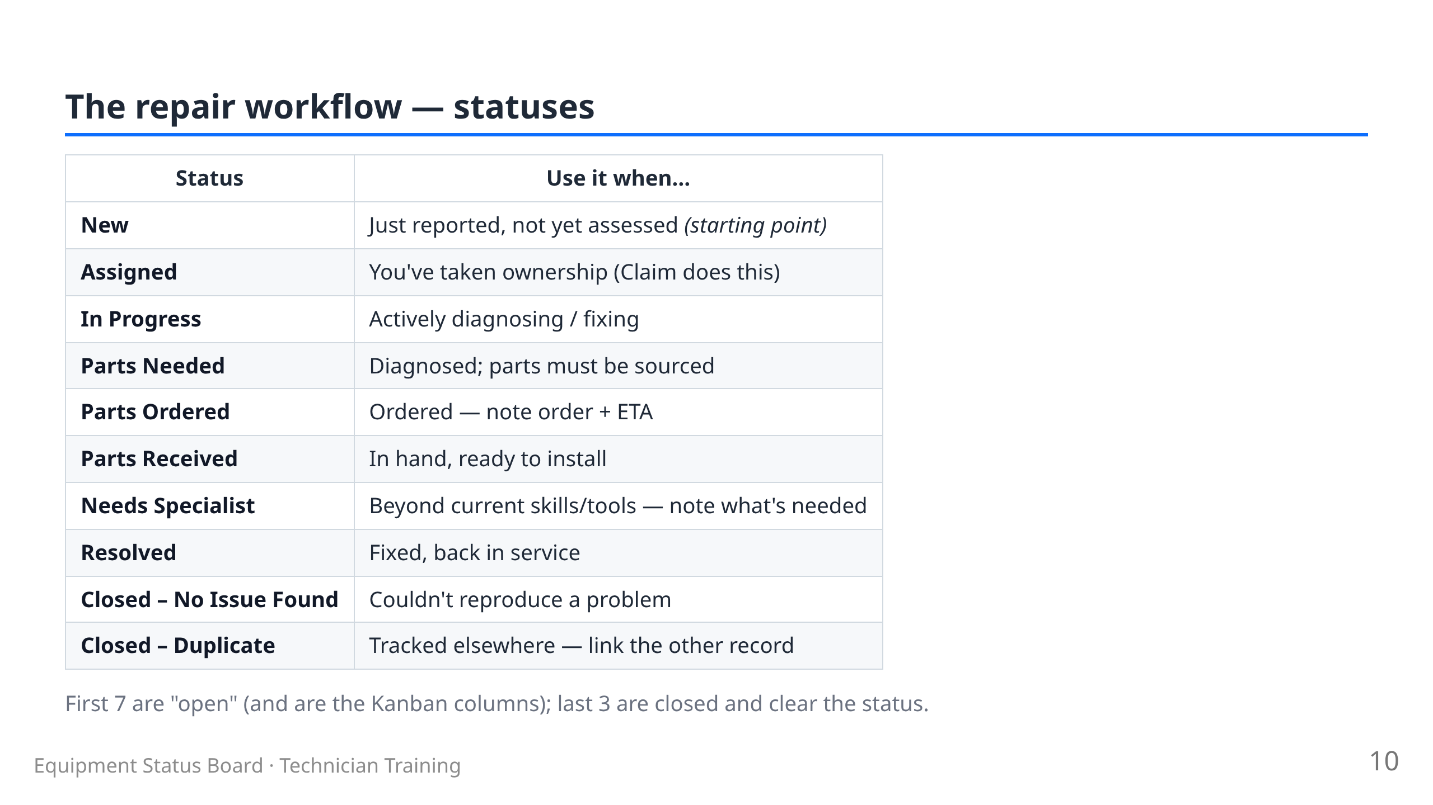

Slide 11
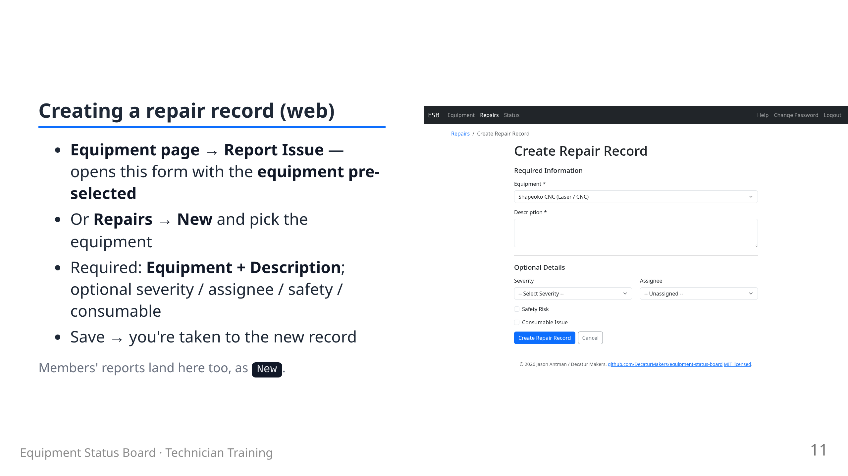

Slide 12
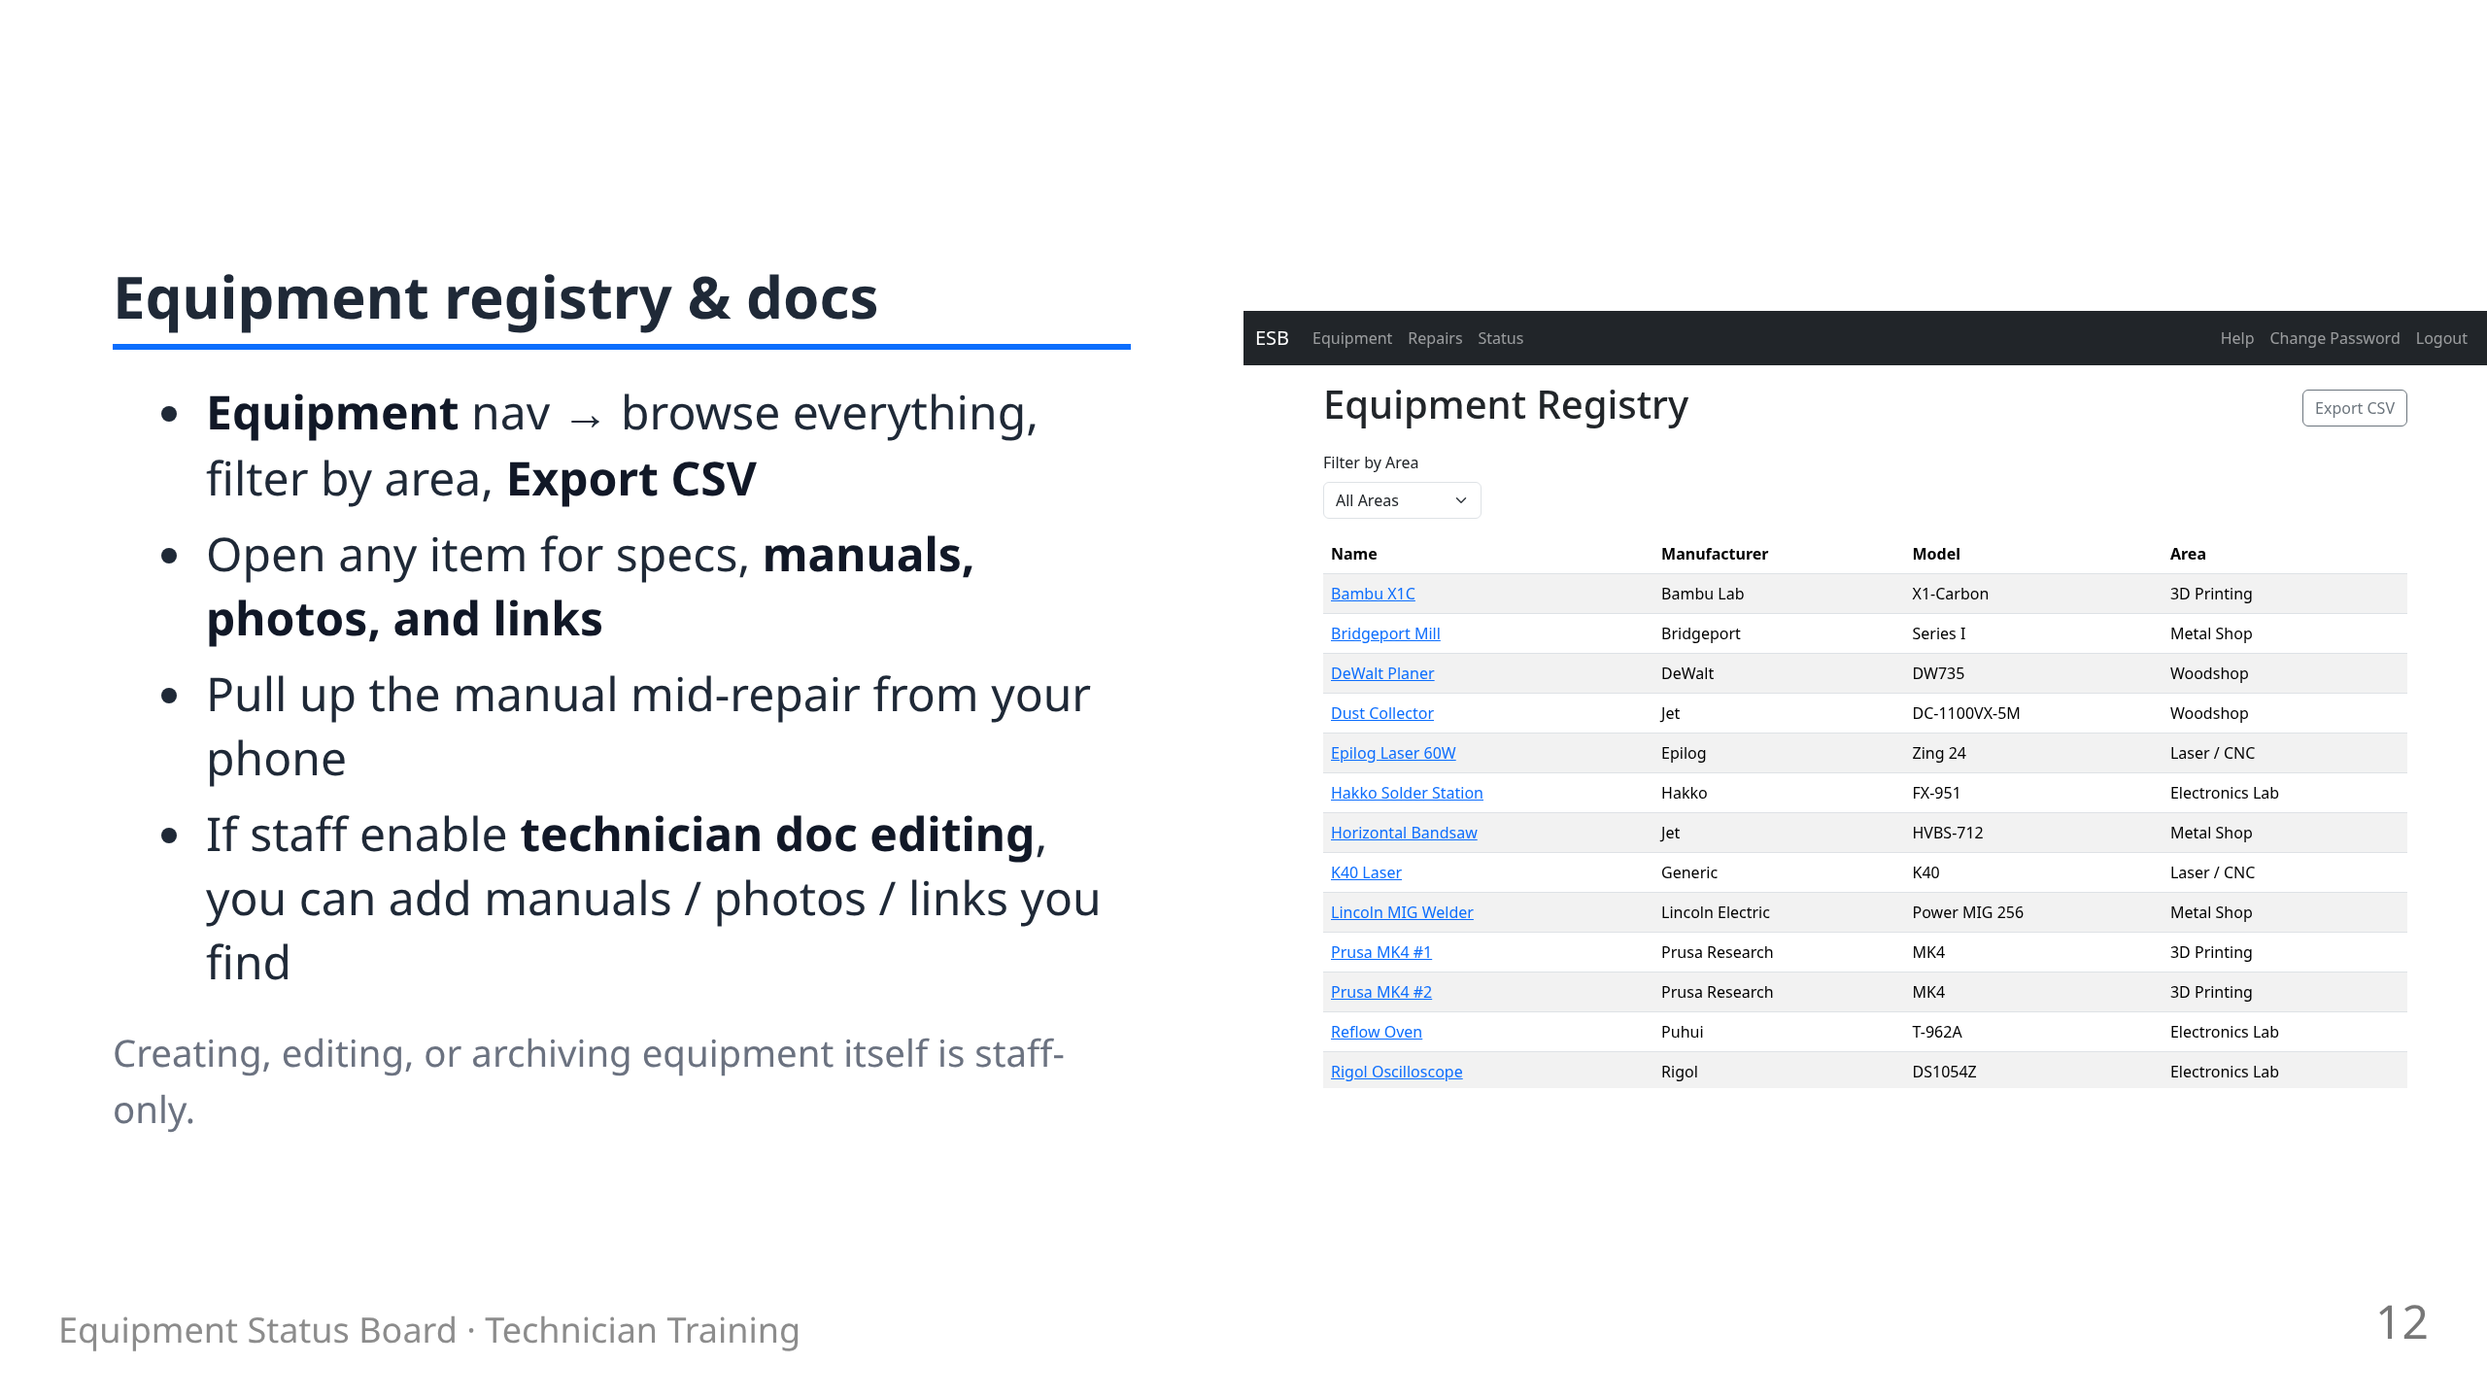

Slide 13
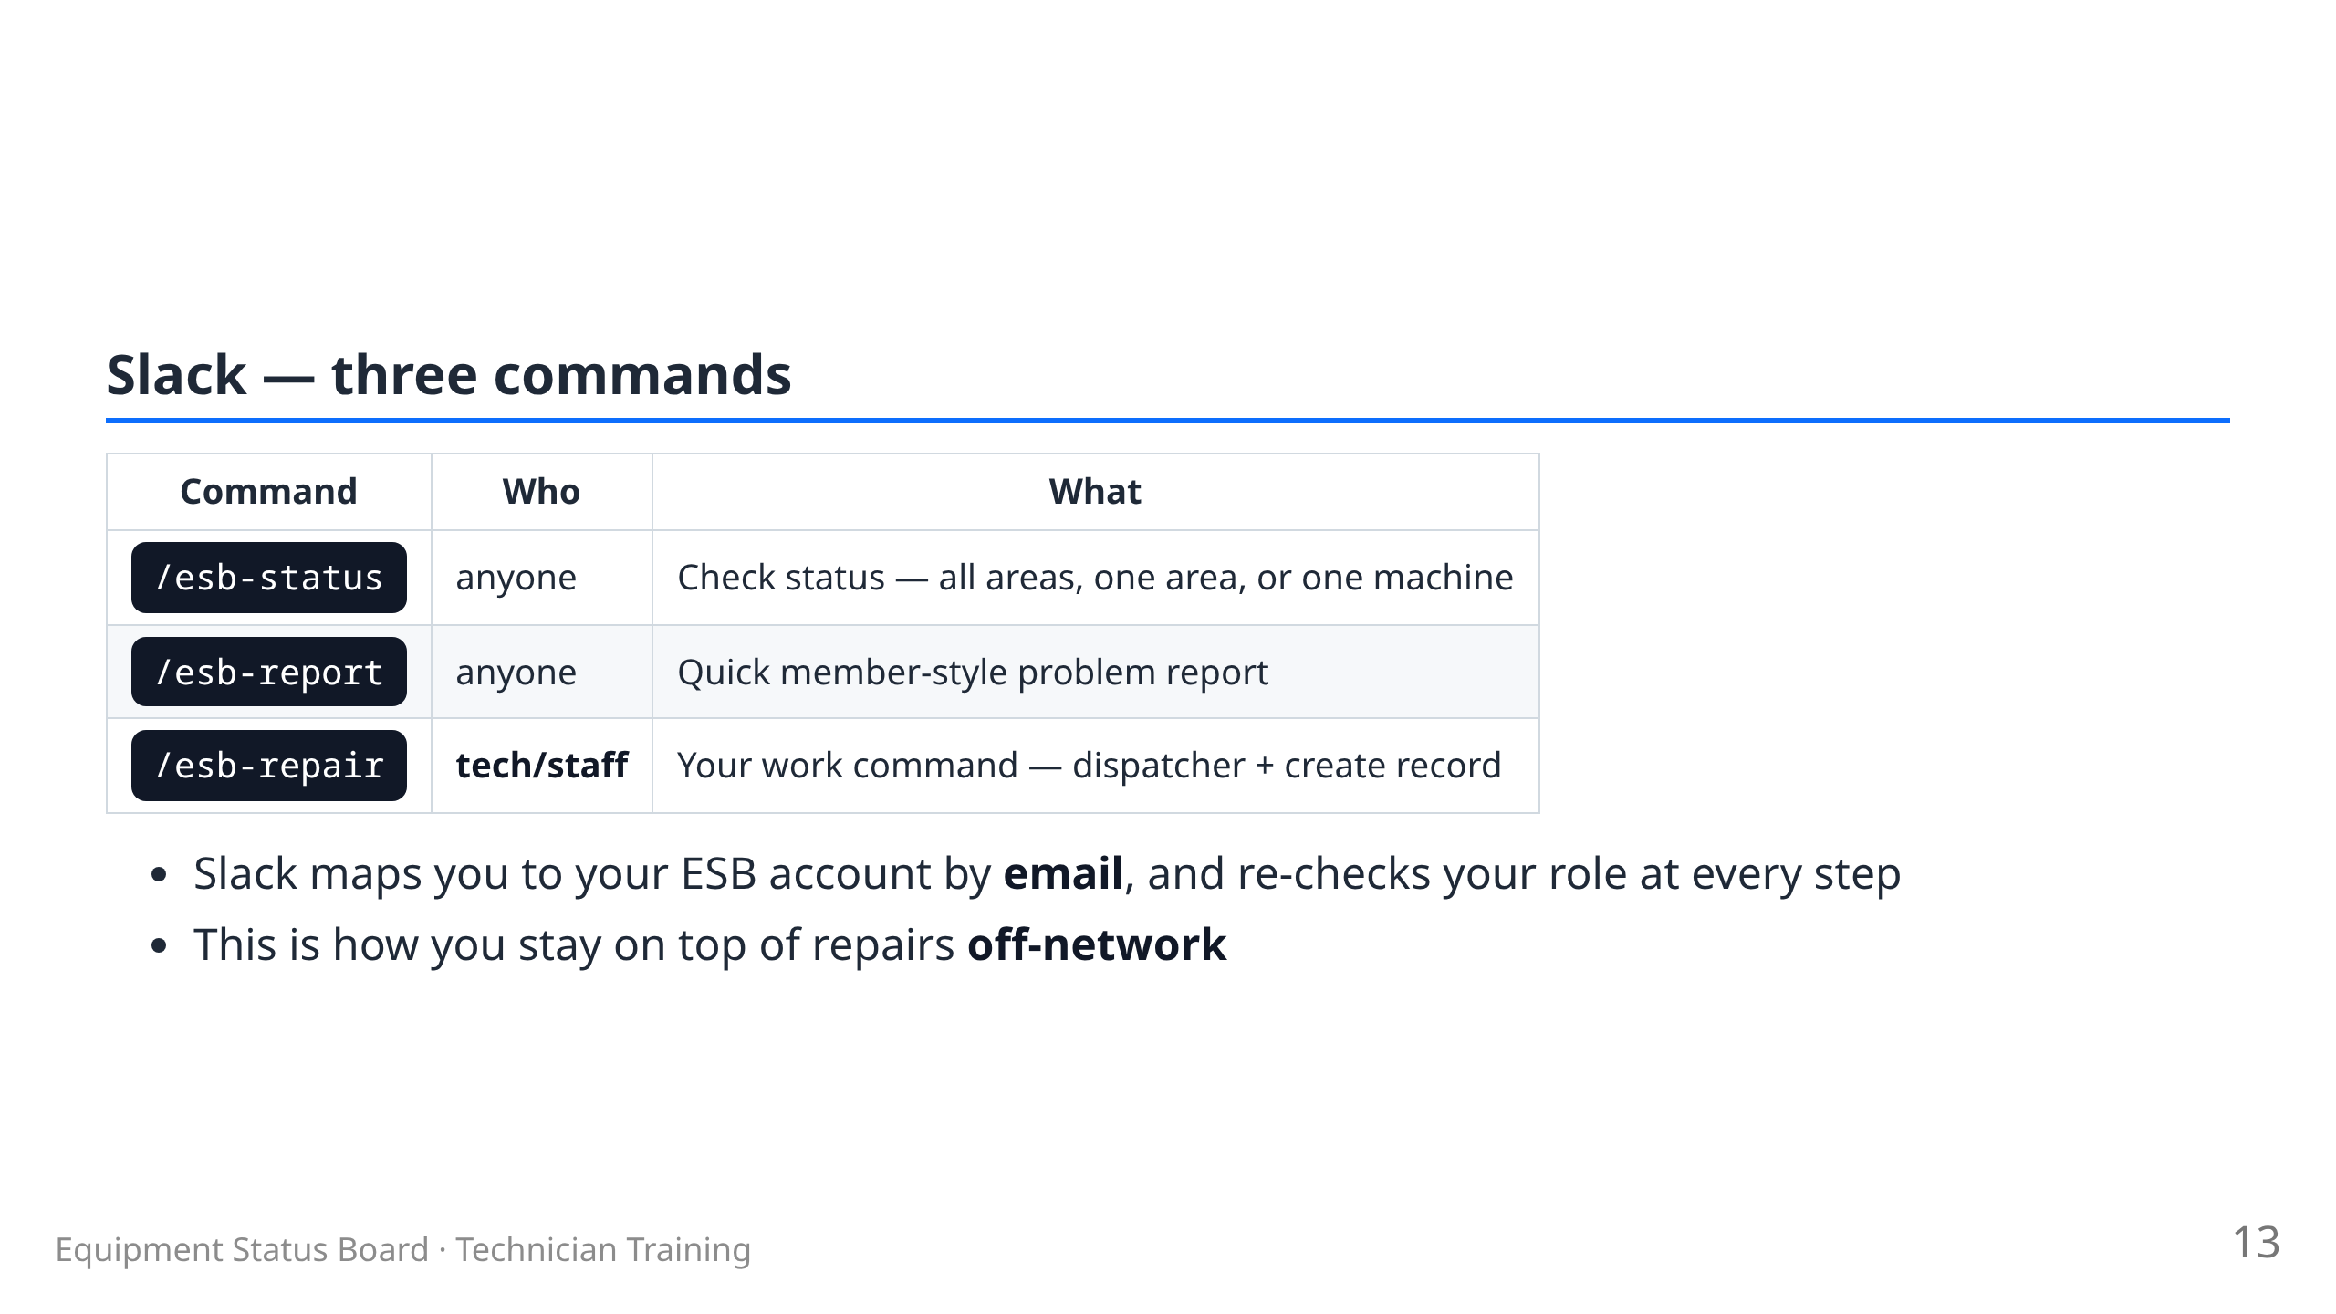

Slide 14
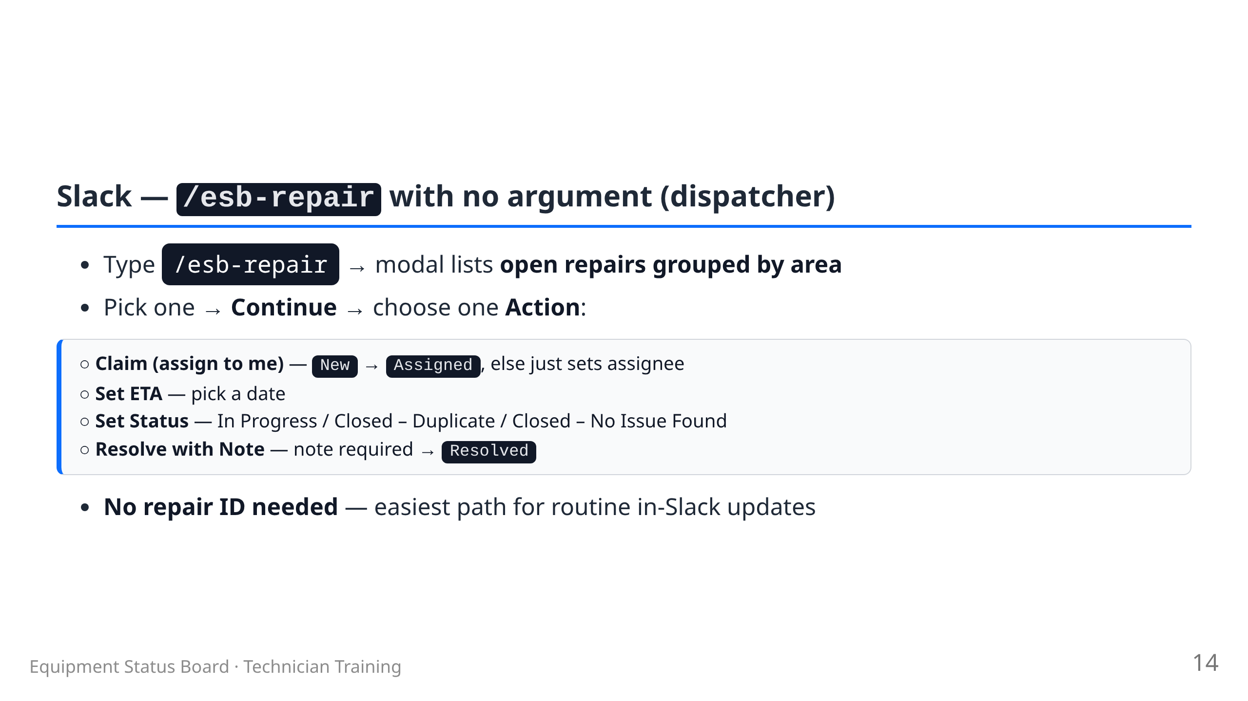

Slide 15
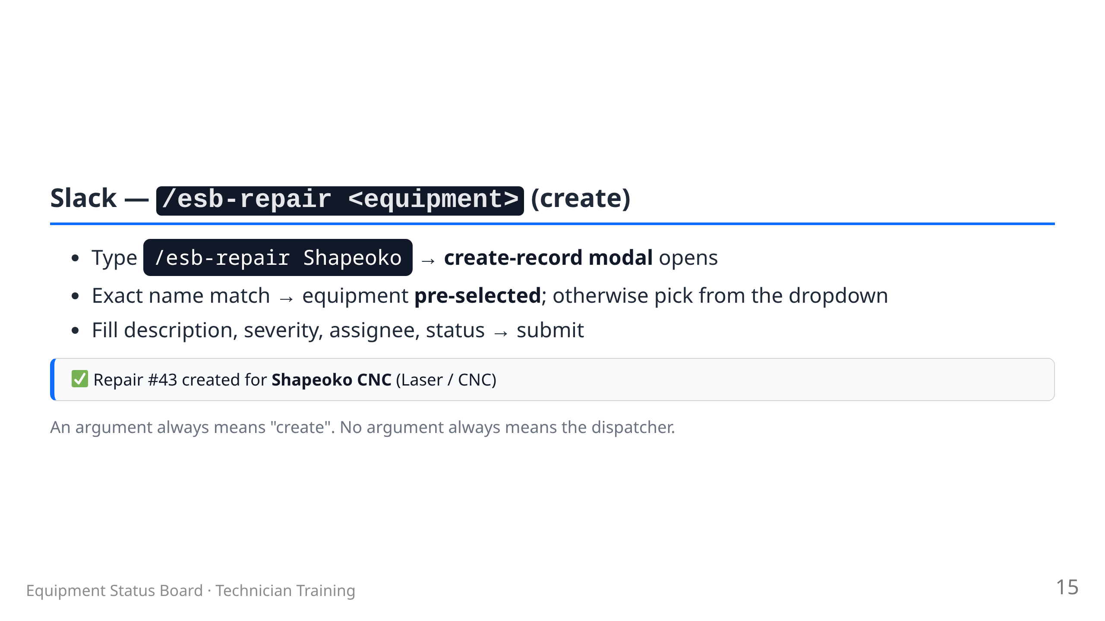

Slide 16
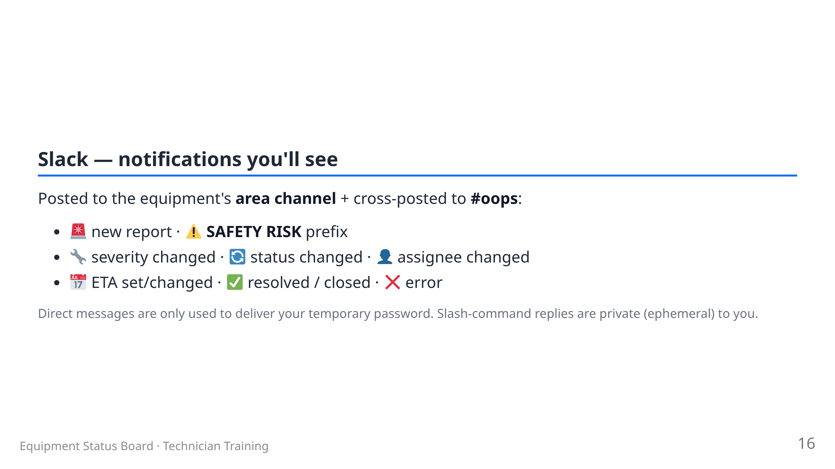

Slide 17
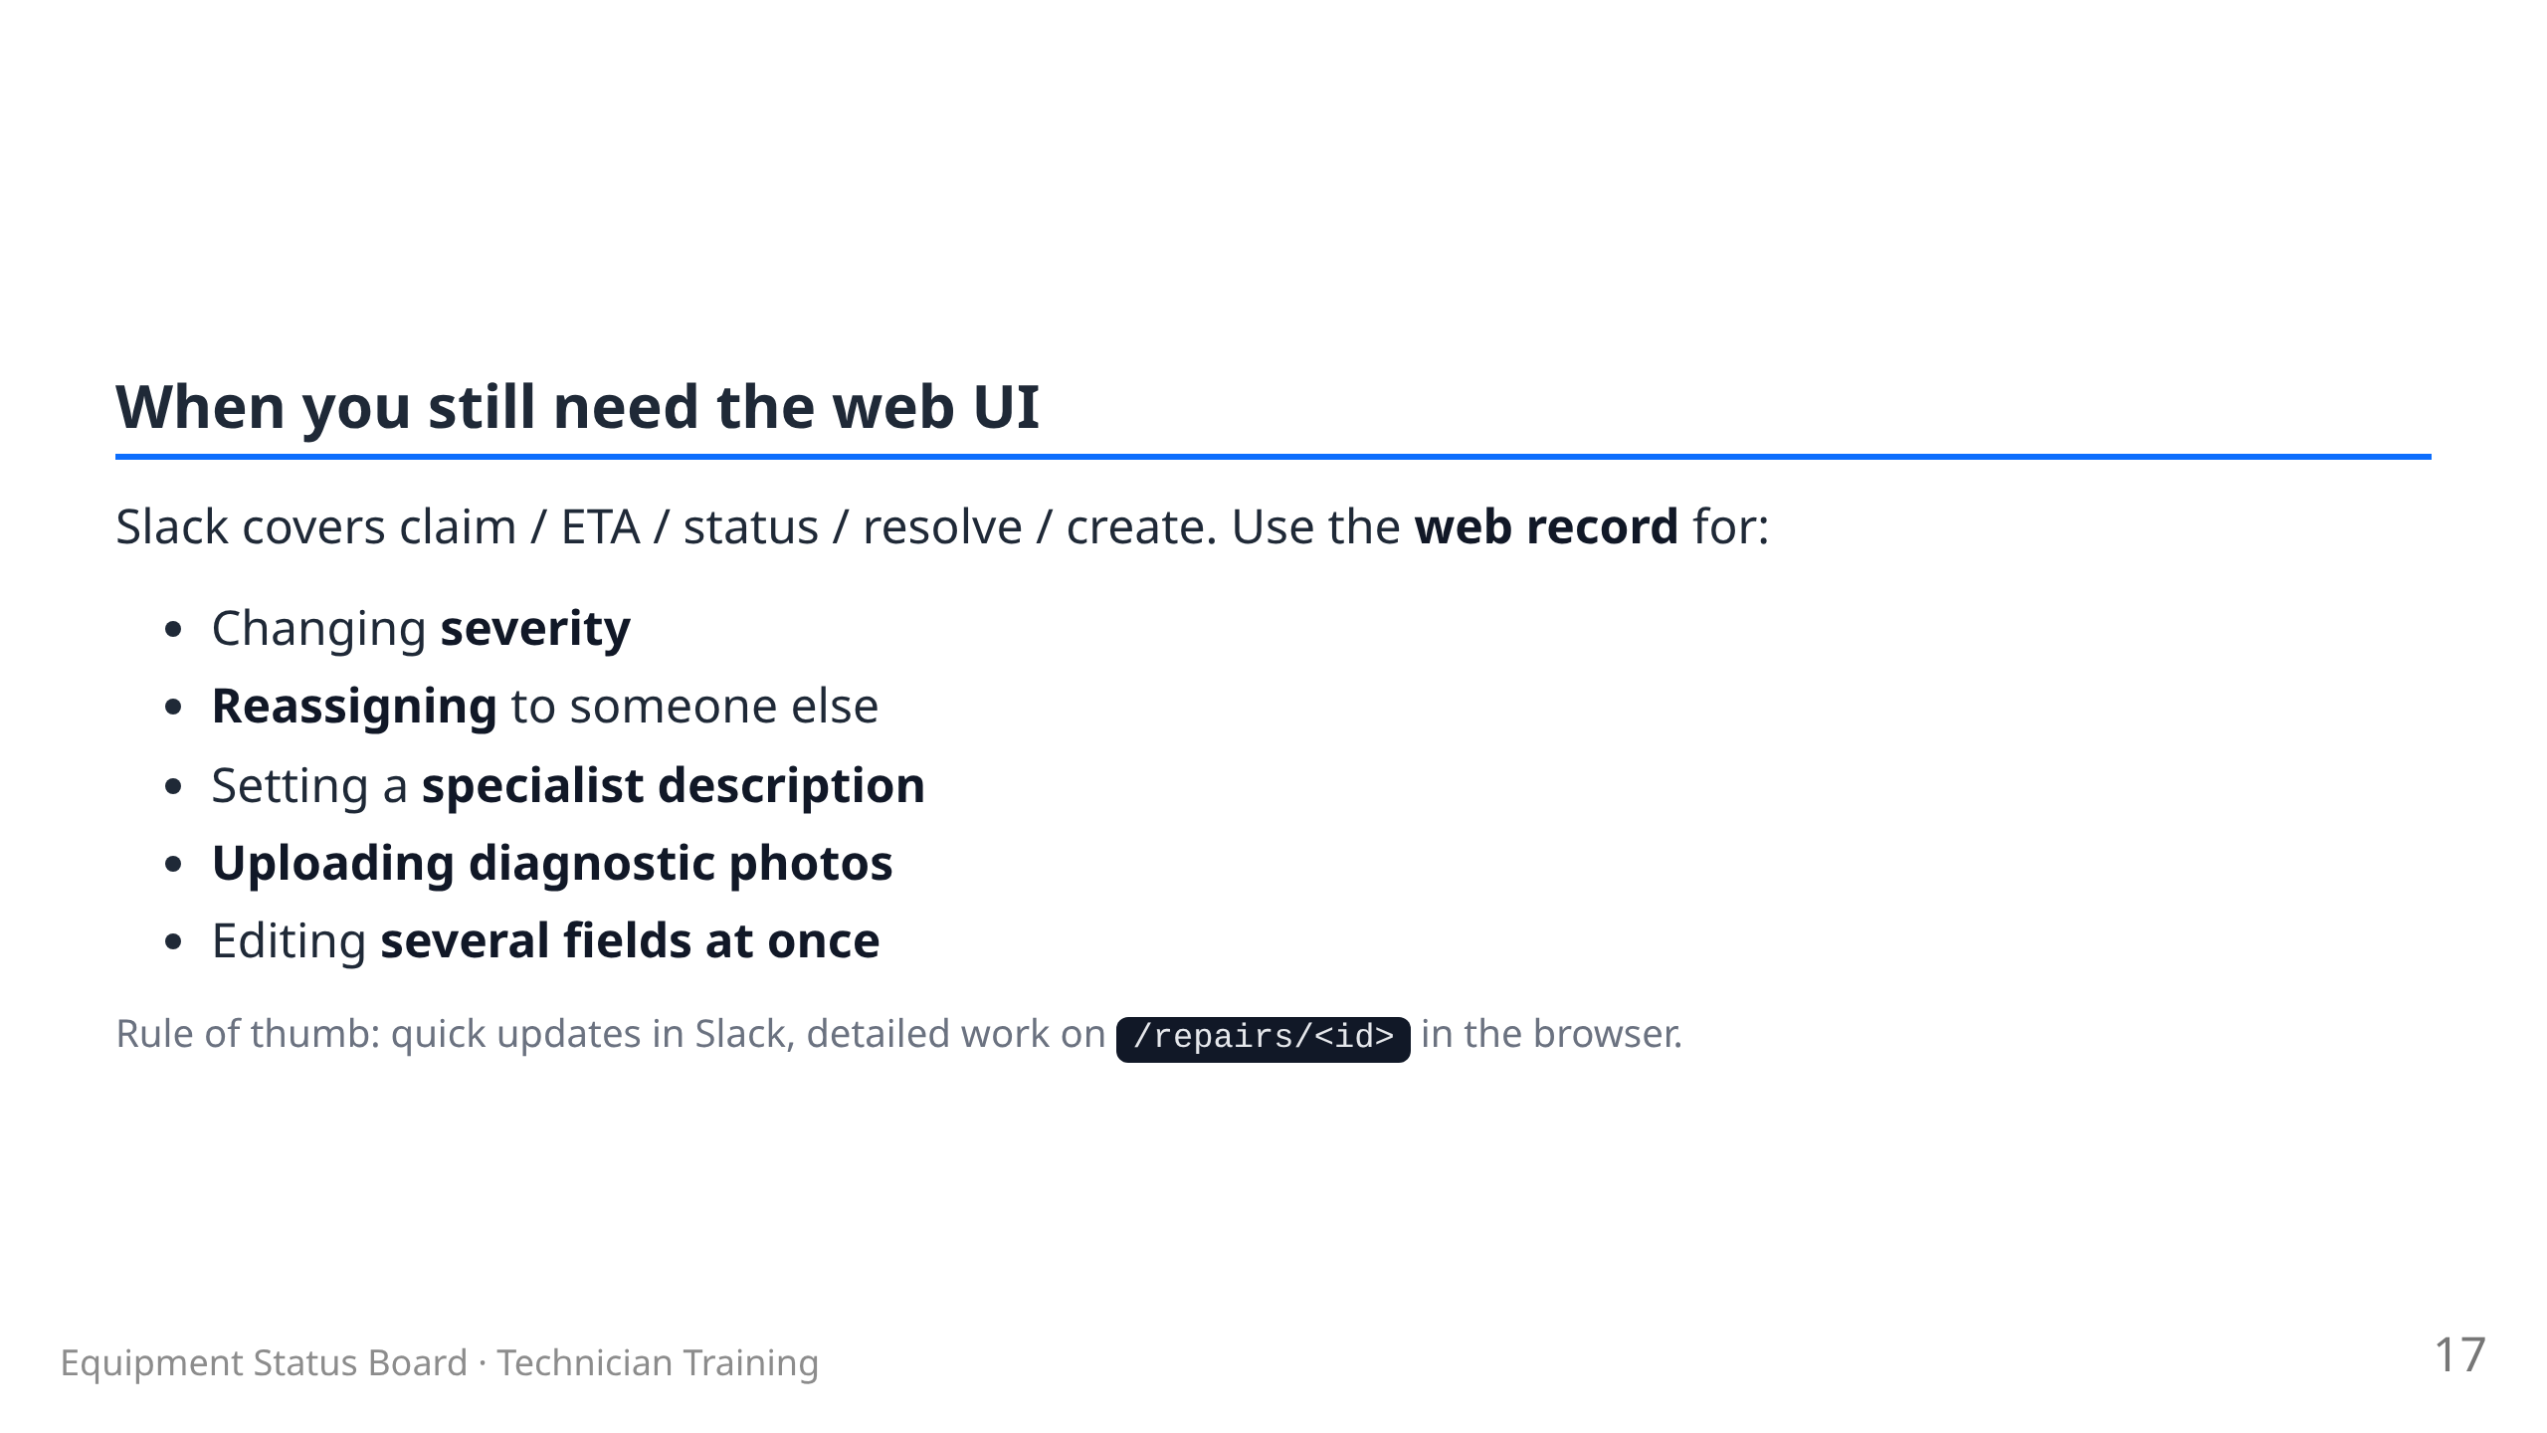

Slide 18
