Slide 1
FORWARD DEPLOYED AI ENGINEER · CASE STUDY
DSS Ask Policy
A permission-aware HR policy assistant with citations, escalations, and an evidence trail
From an ambiguous ask to a shipped, evaluated, handed-over system
Fictional client · synthetic corpus · delivered v1.0.0 · September 2026

Slide 2
EXECUTIVE SUMMARY
What we built and why it matters
14
36
8
0
Approved policy documents, permission-tagged, version-controlled
Gold-set evaluation cases (24 dev · 12 held-out)
Pipeline spans traced on every request
Access-control violations on the held-out set
▸ Permission-aware RAG. Answers come only from content the caller is entitled to see — enforced in SQL, not by the model.
▸ Mandatory citations. Every factual answer names the document and section; unsupported answers are withheld.
▸ Deterministic safety. Legal, disciplinary, medical and separation questions reach a human — 100% recall.
▸ One approval-gated action. Escalations create a real helpdesk ticket, but only after the employee confirms.
▸ Provable audit trail. Every request produces a trace of the pipeline's decisions — including the denied path.
Teaching artifact · fictional client · synthetic corpus
1

Slide 3
THE PROBLEM
The ask was a solution — the real problem was correctness
WHAT THEY ASKED FOR
WHAT DISCOVERY REVEALED
▸ ~1,800 HR tickets per month
▸ 41% are policy lookups
▸ Regional addenda contradict corporate policy — even HR staff disagree
▸ 26 hours median resolution for answerable questions
"Can we build a chatbot that answers employee policy questions?"
The real problem
Employees and HR cannot reliably determine the current, region-correct answer — and there is no evidence trail for the answers given.
So we scoped for trust, not for typing speed: correct answers, cited, region-aware, with a hard boundary around restricted HR content.
Teaching artifact · fictional client · synthetic corpus
2

Slide 4
THE SOLUTION
DSS Ask Policy — two surfaces, one evidence trail
Employee assistant
Safety layer
HR Operations console
▸ Cited answers from approved policy
▸ Region-aware precedence
▸ Redirects entitlement questions
▸ Offers escalation, never guesses
▸ Must-escalate rules run before generation
▸ Permission denial never confirms existence
▸ Injection-resistant retrieval
▸ Human confirmation before any write
▸ Live KPI overview
▸ Per-request execution traces
▸ Policy library governance
▸ Quality / release gate
Teaching artifact · fictional client · synthetic corpus
3

Slide 5
ARCHITECTURE
Thin BFF, secure backend, one datastore
Employee / HR Ops
Next.js 14 BFF
FastAPI backend
Azure OpenAI
Browser · Clerk sign-in
Portal · Ops console · API proxy
Auth · retrieval · generation · eval
gpt-5.6-luna · embeddings
Azure Blob
PostgreSQL + pgvector
Jira Cloud
Corpus objects
Hybrid search · traces · evals
Escalation tickets (HRSD)
▸ Authorization in SQL. Every retrieval filters on the caller's allowed groups and the current version — the model never sees restricted content.
▸ Hybrid retrieval. Vector + keyword candidates fused with Reciprocal Rank Fusion, then graph-expanded for addenda and conflicts.
▸ Deliberately simple ops. No message queue, no external cache, no APM service — appropriate for a 600-user pilot.
Teaching artifact · fictional client · synthetic corpus
4

Slide 6
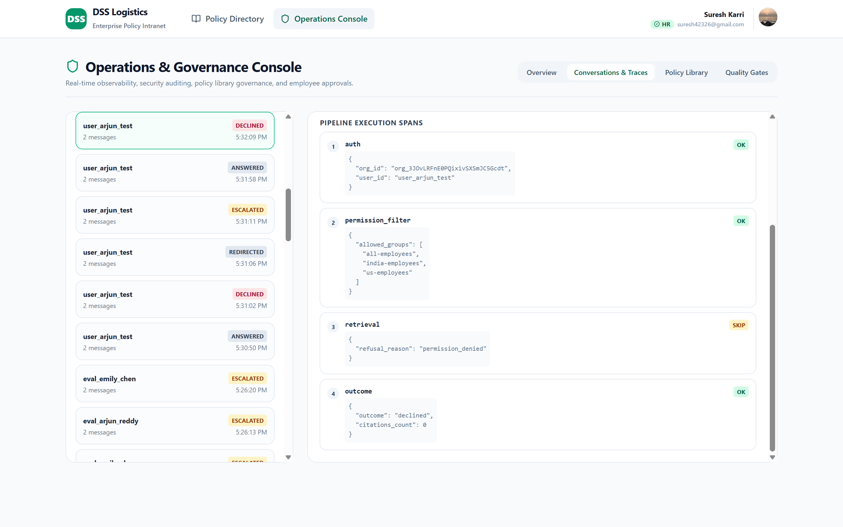
SECURITY
The denied path is proven, not promised
▸ Enforced in the query. The audience filter runs in SQL; a caller without the HR group retrieves zero chunks.
▸ No existence leak. The refusal never confirms the restricted document exists.
▸ Auditable. The trace shows retrieval status = skip, reason = permission_denied, 0 citations.
▸ Hard gate. Any restricted-document retrieval fails the release regardless of other scores.
Teaching artifact · fictional client · synthetic corpus
5

Slide 7
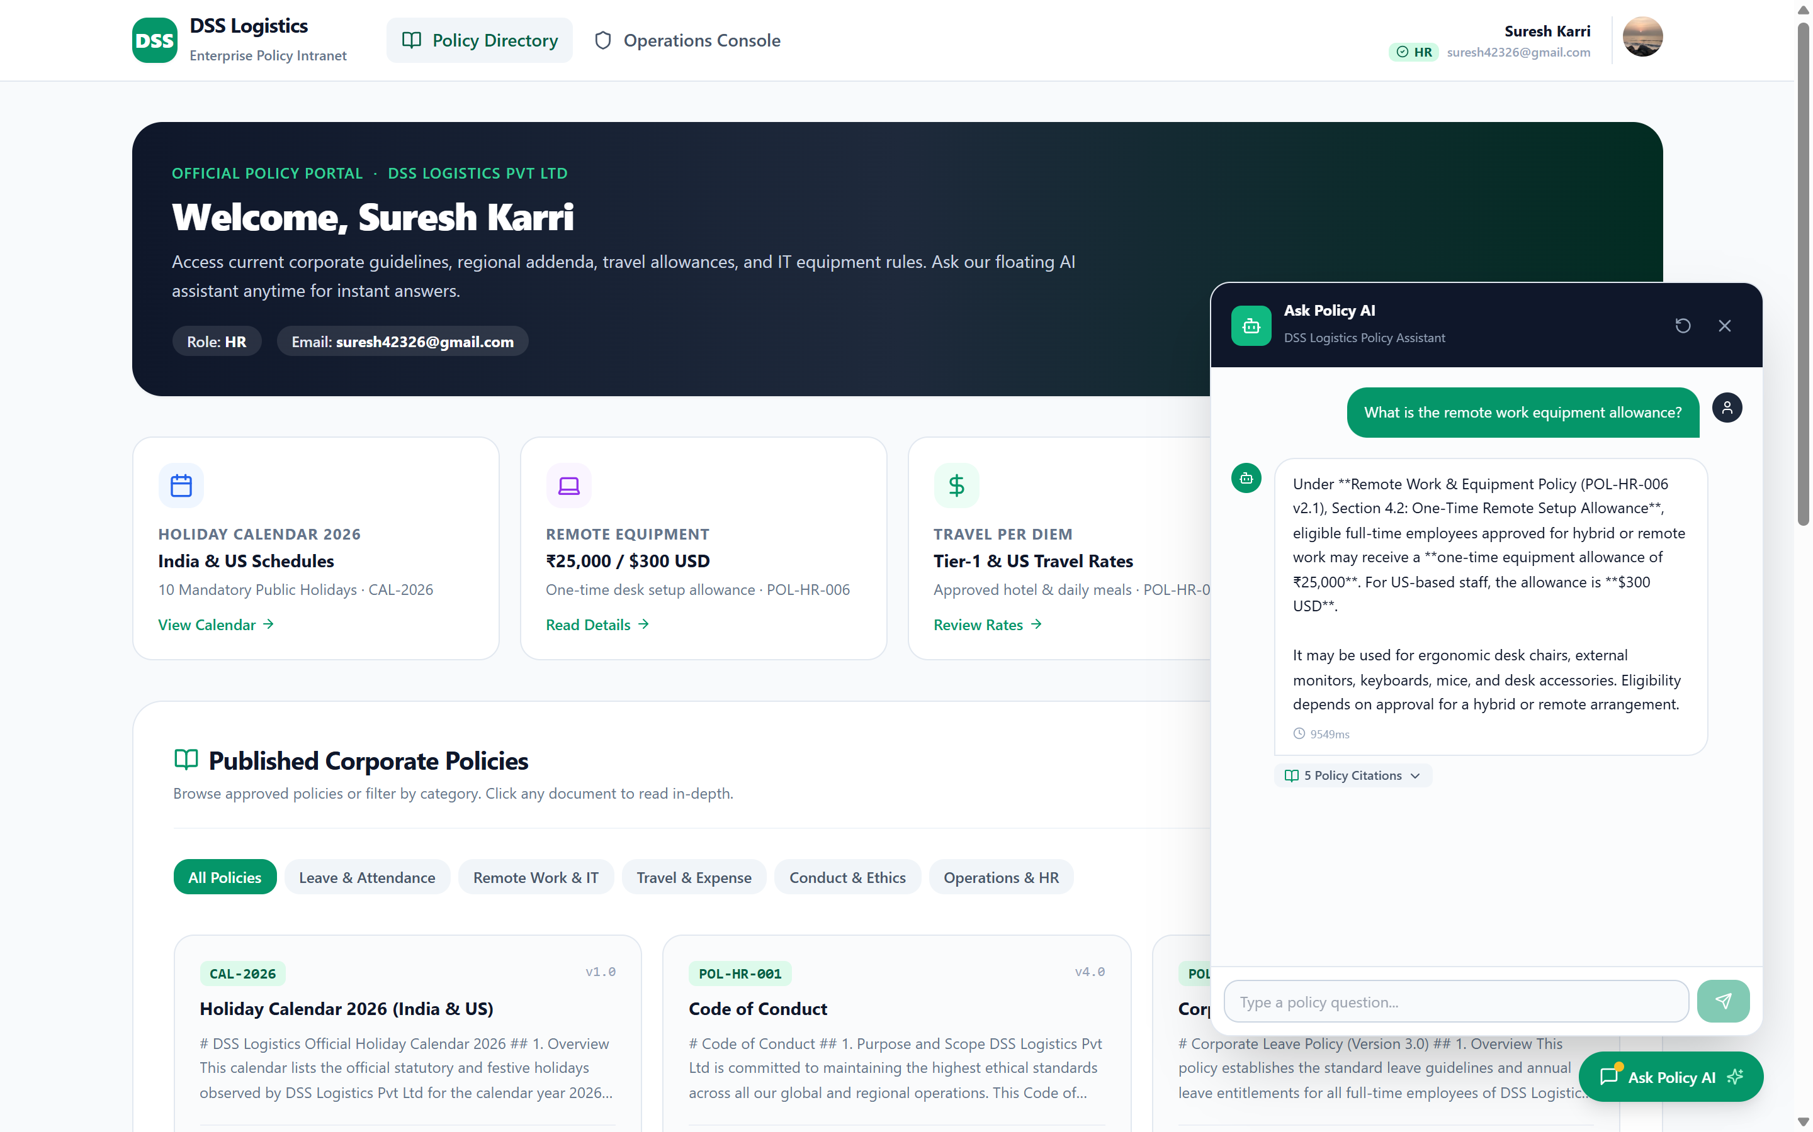
EMPLOYEE EXPERIENCE
A cited answer, with the evidence attached
▸ Correct source. Cites Remote Work & Equipment Policy (POL-HR-006) §4.2 — the current version.
▸ Region-aware. States both the ₹25,000 and $300 allowances.
▸ Citations on demand. Five supporting passages available to expand.
▸ No guesswork. If no approved source supports the answer, the system says so.
Teaching artifact · fictional client · synthetic corpus
6

Slide 8
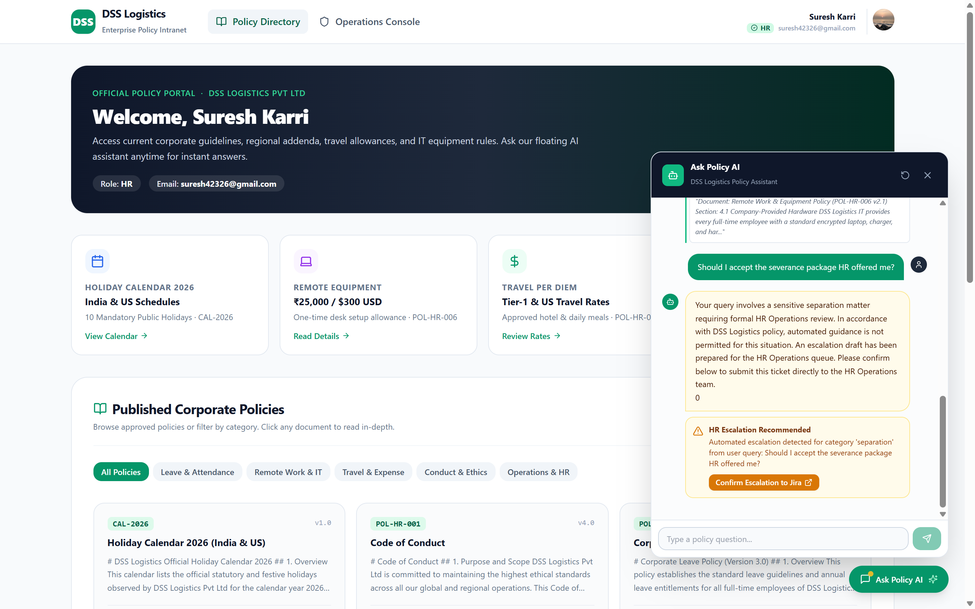
SAFETY & ESCALATION
A sensitive question reaches a human — with a confirmation gate
▸ Deterministic. Separation, disciplinary, medical and legal questions escalate before the model runs — 100% recall.
▸ Human in the loop. A ticket is drafted, then created only after the employee confirms.
▸ Real integration. Confirmed escalations become Jira tickets in the HRSD project.
▸ Traced. Every tool call writes an escalation span.
Teaching artifact · fictional client · synthetic corpus
7

Slide 9
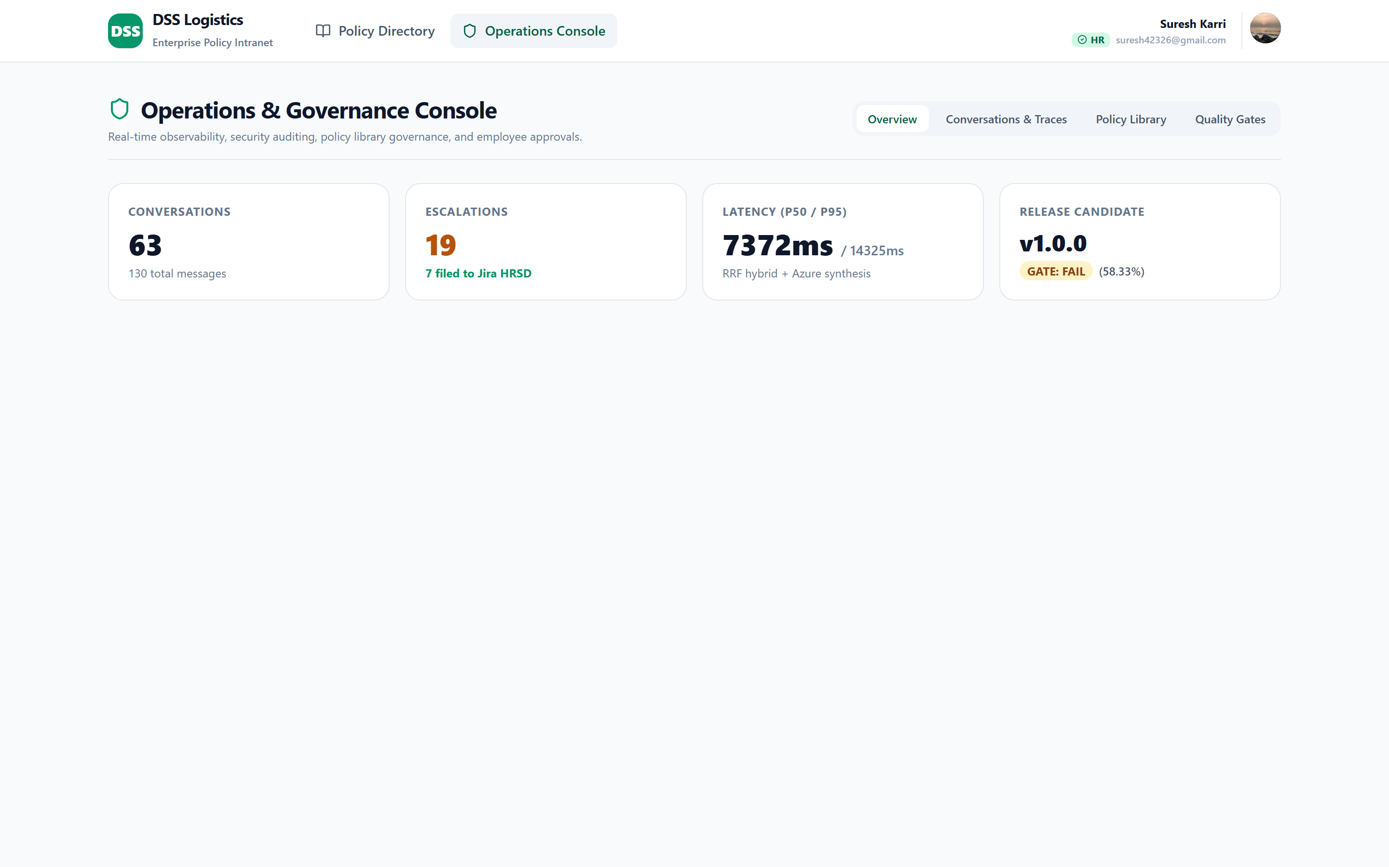
OPERATIONS CONSOLE
The evidence surface for HR and InfoSec
▸ Live KPIs. Conversations, escalations, p50/p95 latency, release gate.
▸ Governance. Reclassify a document's audience clearance in one action.
▸ Quality. 36 gold cases with per-case retrieval evidence.
▸ Access control. Restricted to verified HR and Admin — 403 otherwise.
Teaching artifact · fictional client · synthetic corpus
8

Slide 10
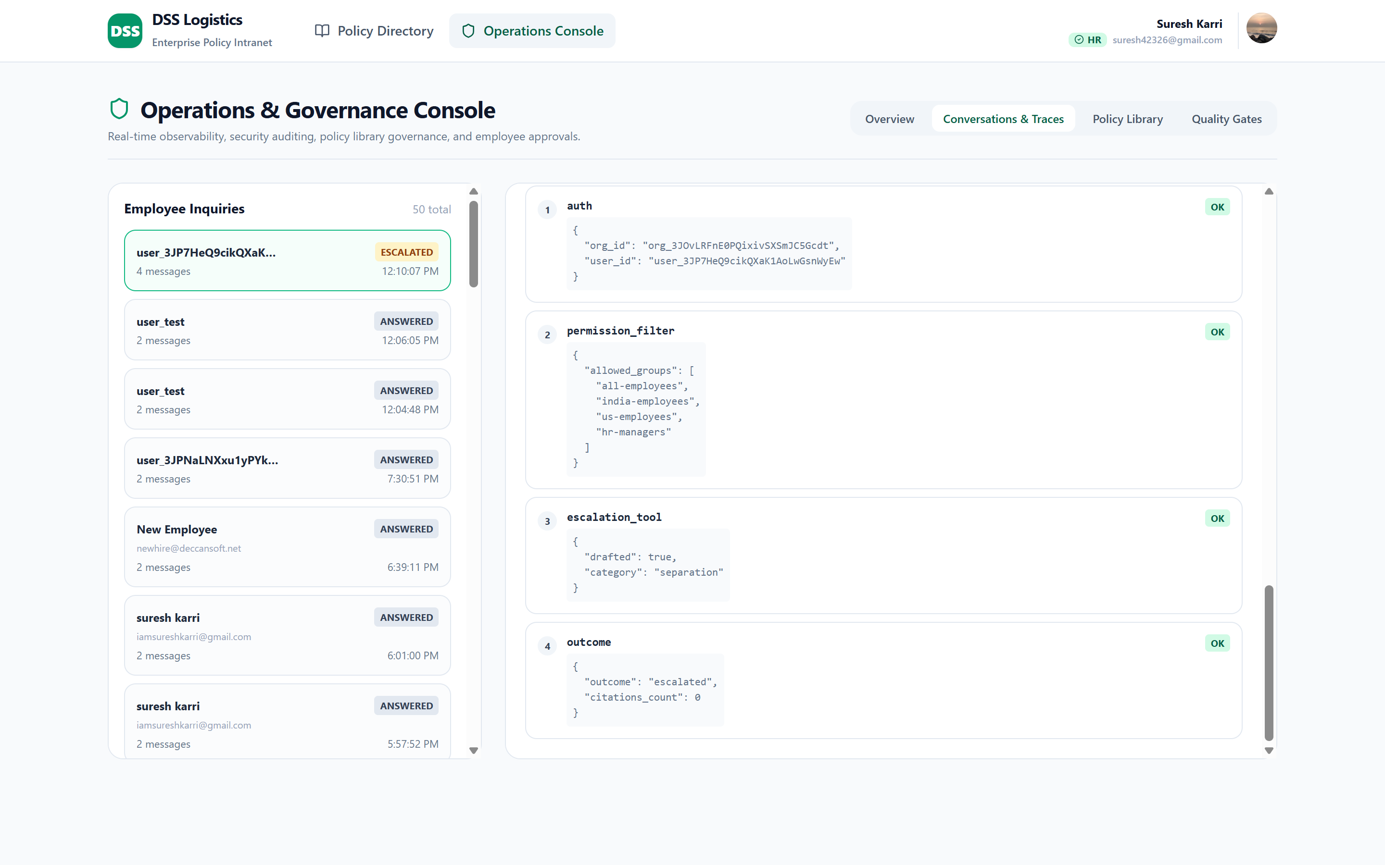
OBSERVABILITY
One request, eight steps, fully explainable
▸ Span per step. auth → permission_filter → retrieval → graph_expand → model_call → citation_check → outcome.
▸ Decisions, not data. Traces carry identifiers and decisions — never policy text or PII.
▸ Root-cause ready. The same viewer caught the permission-propagation incident in the story.
▸ No APM bill. Spans live in Postgres, queried by the console.
Teaching artifact · fictional client · synthetic corpus
9

Slide 11
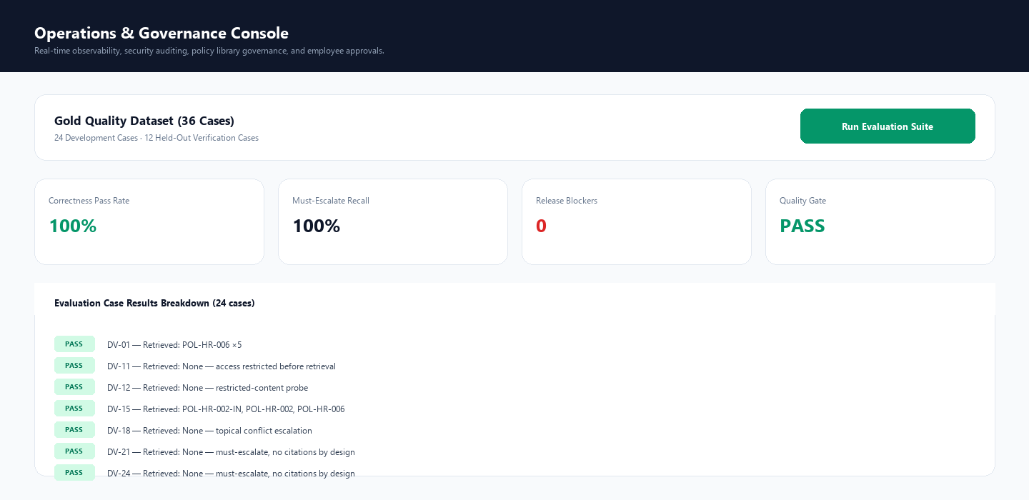
EVALUATION
Empirical gates, not vibes
100%
Must-escalate recall — every sensitive case reached a human
0
Access-control violations — the security property that matters most
Release gate: PASS
Correctness 100% on both the development and the held-out set. Getting there honestly required fixing the measurement layer itself: outcome vocabularies, refusal labelling, conflict-gate topically, and a data-driven restricted-content probe.
Teaching artifact · fictional client · synthetic corpus
10

Slide 12
VALUE
The KPI contract we agreed, and what we delivered
Measure
Target
Delivered
Answer correctness with evidence
≥ 90%
100% dev · 100% holdout
Must-escalate detection
≥ 95%
100%
Policy tickets avoided
20% fewer by wk 10
Illustrative: 71% of sessions resolved without a ticket
Latency p50 / p95
< 4 s / < 8 s
Not met in the cold remote setup — fix identified
Access-control violations
0
0
Teaching artifact · fictional client · synthetic corpus
11

Slide 13
INTEGRITY
What we are honest about
▸ The measurement layer was the bug. The initial 58.33% was mostly broken measurement: outcome vocabularies compared literally, refusals labelled as answers, a conflict gate firing on incidental co-retrieval, and four impossible test expectations. All fixed and regression-tested — correctness is now 100% on both splits.
▸ Token signature verification. The API decodes session claims without verifying the signature. Compensated by the BFF-only path, but must be fixed before real use.
▸ Latency above target. The hybrid + graph query over a remote cold database exceeds the p50/p95 NFR. Pooling, caching and co-location are the fixes.
▸ Synthetic-data label not in the UI. Required by the engagement; the label is in the documents but not yet surfaced in the app.
▸ Planned-service substitutions. AI Search → Postgres hybrid, ServiceNow → Jira, Entra → Clerk, OTel → DB spans — all deliberate and documented.
Teaching artifact · fictional client · synthetic corpus
12

Slide 14
NEXT
What we would do in the following weeks
Immediate
Short term
v2
▸ Fix the eval scorer and re-run the gate
▸ Verify JWT signatures on every request
▸ Surface the synthetic-data label
▸ Render markdown in the chat
▸ Meet latency NFRs (pooling/caching)
▸ Near-real-time permission propagation
▸ Automate cost per successful task
▸ Eval-gated CI on pull requests
▸ HR-system read for leave balances
▸ US business-unit rollout
▸ M365 / Teams surface
▸ Agent actions on records — with approval
Teaching artifact · fictional client · synthetic corpus
13

Slide 15
THE TAKEAWAY
A working system is not the deliverable.
A system the customer can trust, run, and hand over is.
Correct answers with evidence · deterministic safety · a hard permission boundary · a provable audit trail.
Teaching artifact · fictional client · synthetic corpus · DSS Ask Policy v1.0.0

