Slide 1
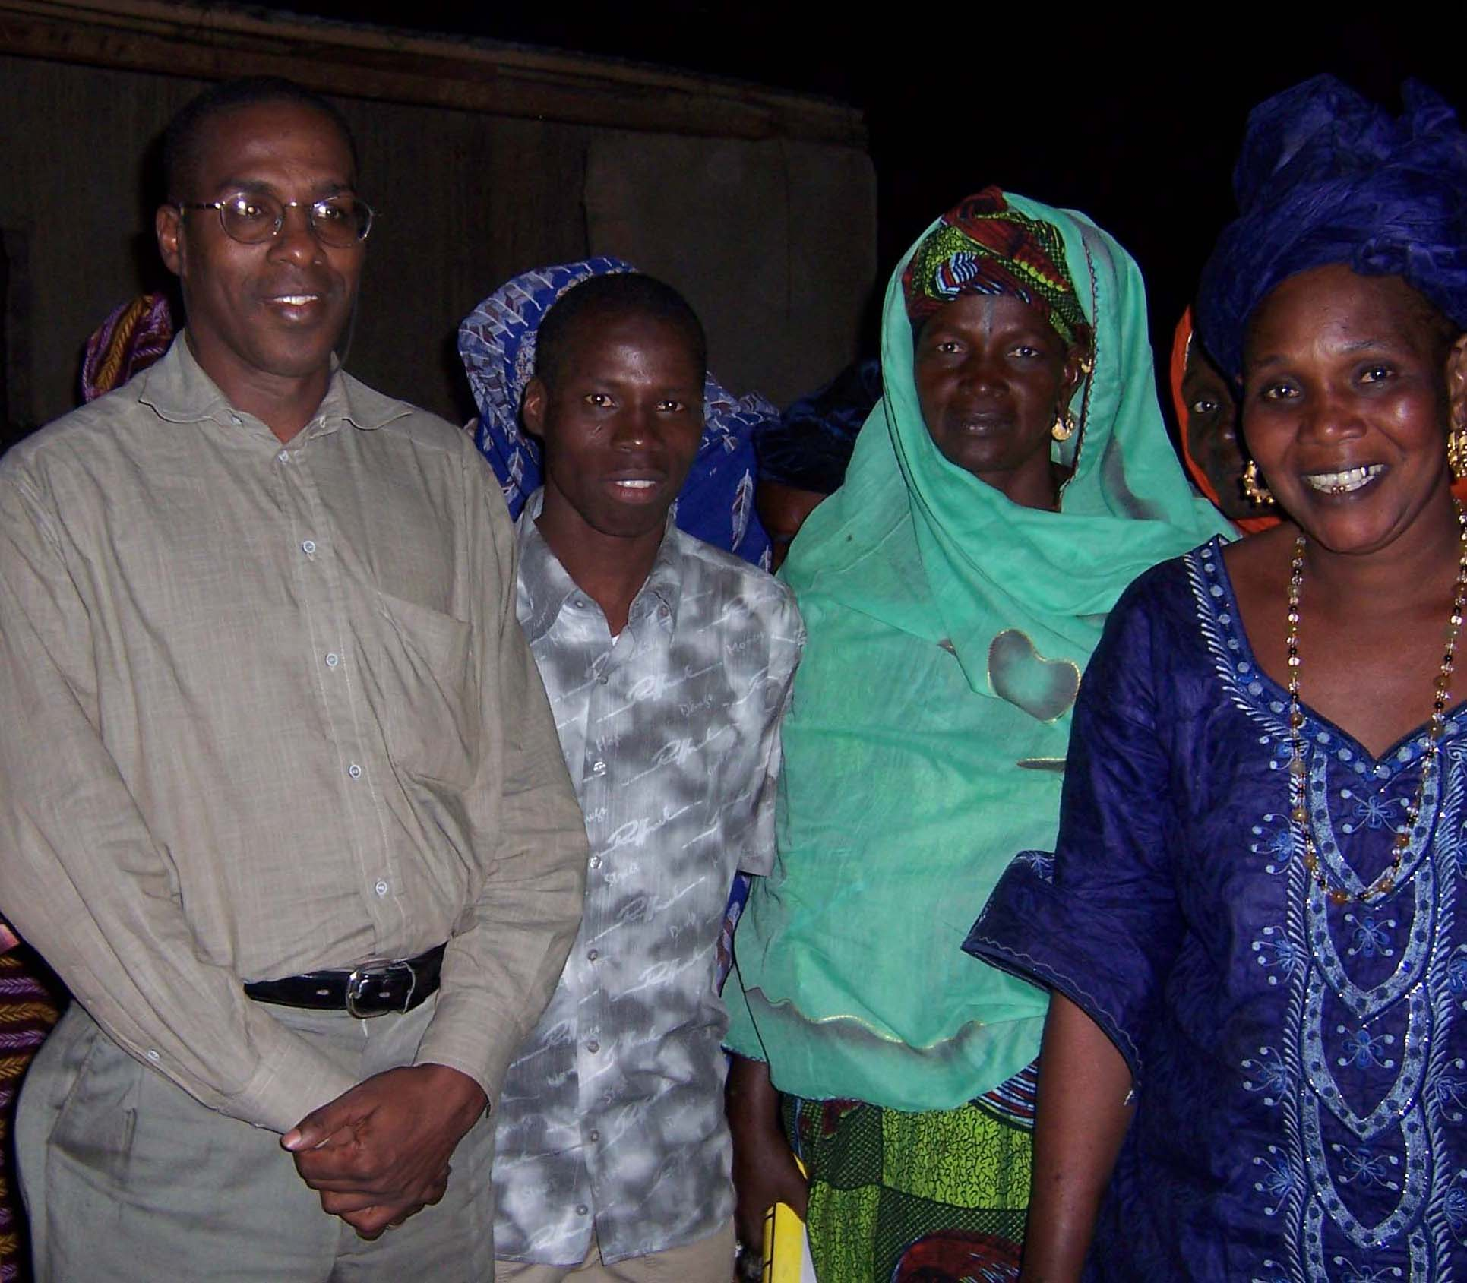
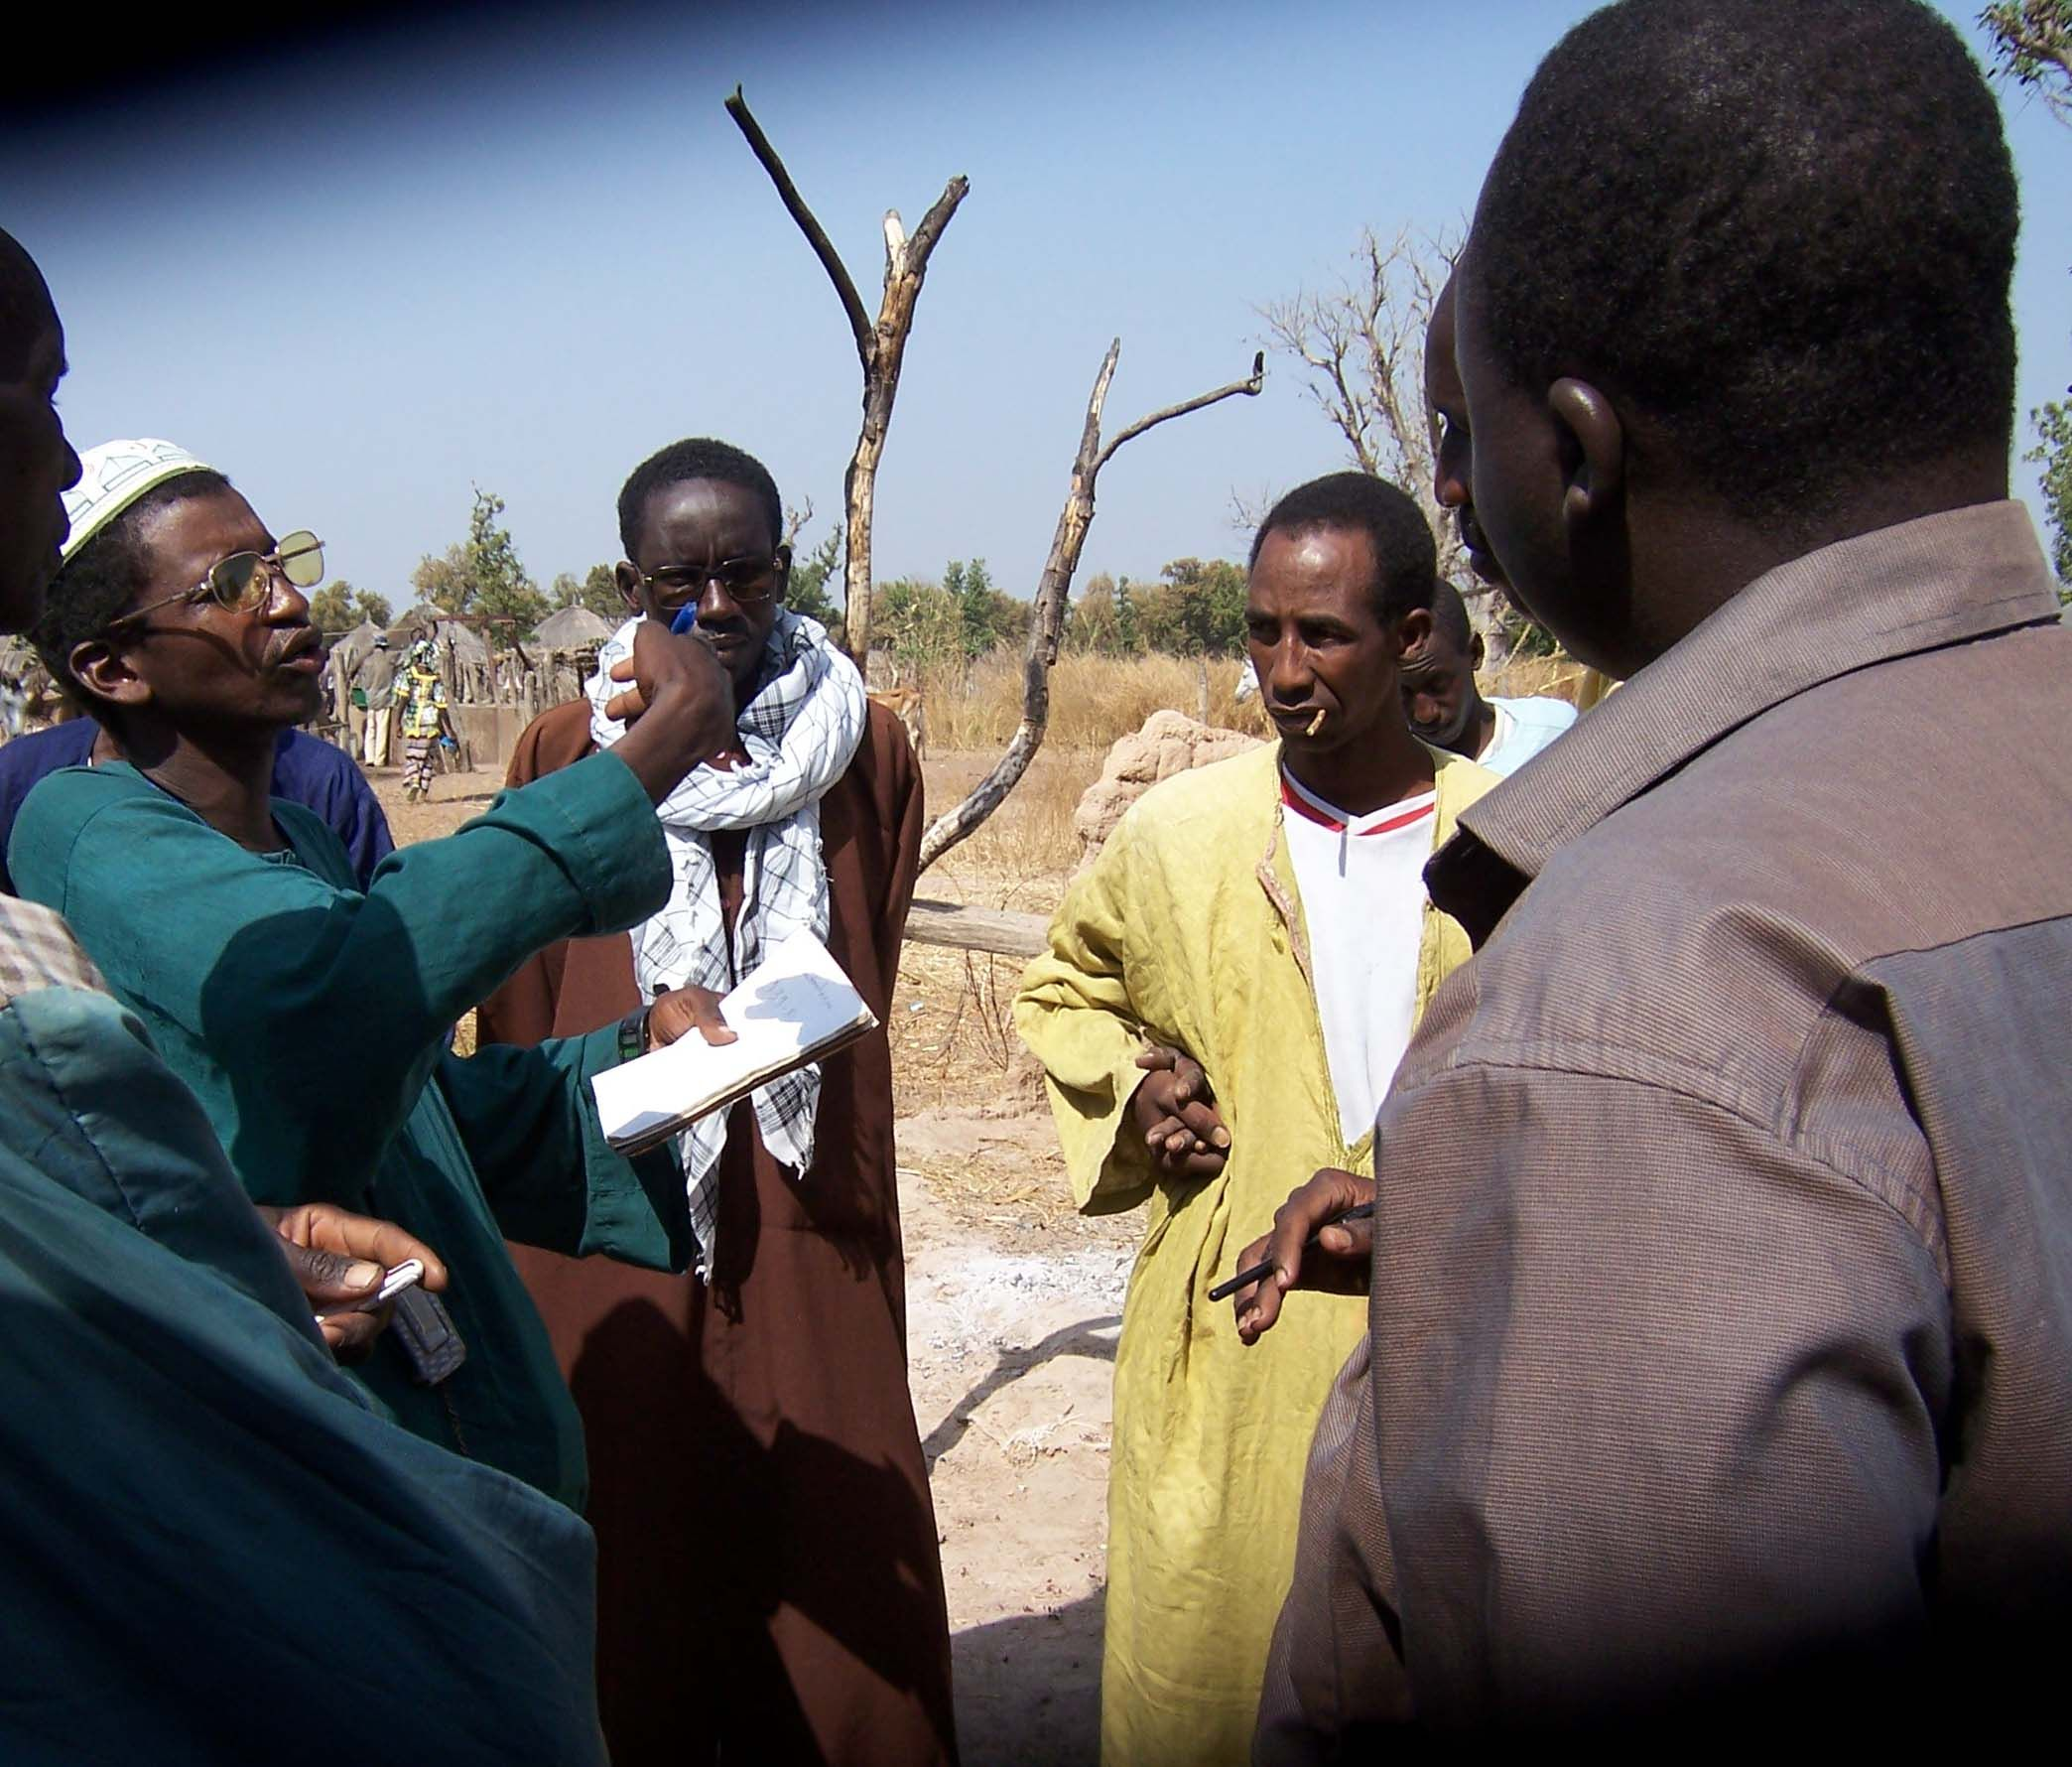
Evaluation of Wula
Conclusions and Recommendations
Weidemann Associates: John Pielemeier – team leader, Jeff Dorsey, Ousseynou Diop
January, 2007
National Coordinator with processing group leaders
Villagers discussing surveillance issues

Slide 2
Background and Methodology
Project ends January 2008
Non-traditional evaluation focused on key questions in TOR (see handout)
Evaluation also of interest to USAID/W regarding broader use of NWP paradigm
Methodology included intensive field visits and interviews with independent interlocateurs

Slide 3
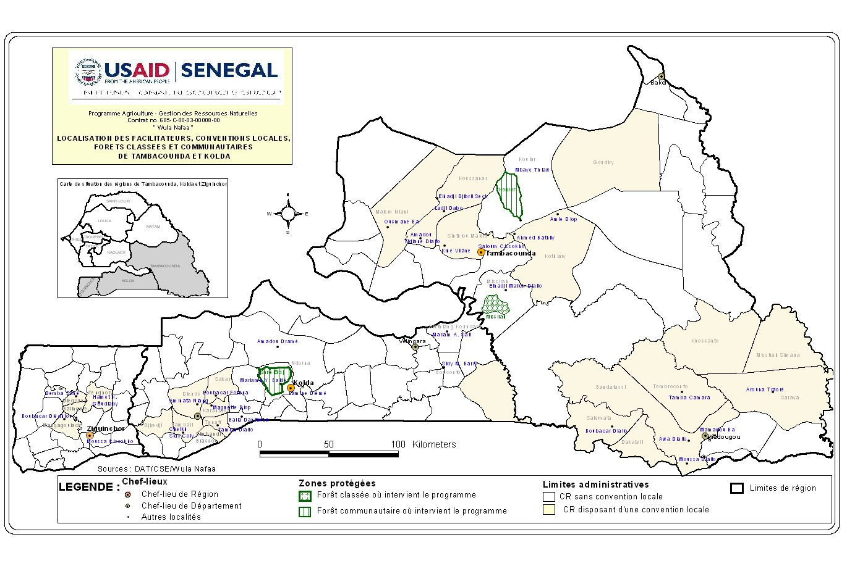

Slide 4
Overall Conclusions(1)
Wula Nafaa well appropriated by MinEnv and regional governments. Community-level response to project activities generally very positive. Concept is spreading.
Excellent progress with economic component which has led to desired changes in NRM by communities.
Good progress with development of local conventions and village level institutions (“g”). Attention now turning to ”G” issues with Rural Councils.

Slide 5
Overall Conclusions (2)
Progress on community and classified forest management planning is slow, but accelerating. Final year’s work is crucial to demonstrating success.
Good choice of policy issues. Approaches to policy reform appropriate to setting. Timeframe for resolution may be lengthy. Chances for successful reform uncertain.
Initial project management/project acceptance issues have been resolved with limited impact.

Slide 6
Overall Conclusions (3): Challenges for the future
Policy reform is uncertain
Local institutions are not financially secure
Implementation of local conventions and forest management plans is untested
Local institutions are not ready to function without outside support

Slide 7
Wealth: Increasing Revenues of Enterprises & Local Governments
Overall Impact of Wula Nafaa is highly positive
Direct benefits accrue to producers and processors due to better quality, higher prices & more volume
Indirect benefits are realized more broadly as higher prices negotiated by WN producers are then adopted by nearly all area producers
Technologies and organization introduced benefit WN producers directly and are adopted by other producers

Slide 8
Wealth: Poverty Reduction
Communities report major injections of cash into the local economy from sale of non-wood forest products, often during “periode de soudure”.
Impact of WN project favors low income segments: women, youth, & elderly.
Higher percentage of final price captured by community
Long-term relationships developed with buyers so benefits should continue to expand after project ends

Slide 9
Nature: Improving Natural Resource Management
Prior to project, local population largely unaware of their rights under Forestry Code and decentralization laws
Establishment of Local Codes, with penalties and surveillance, is widespread and popular
There is strong anecdotal evidence of use of new harvesting rules, improved harvesting practices and reduction in bush fires

Slide 10
Nature: Effects on biodiversity conservation
Too early to identify major physical changes in forest size or health, but villagers report improved productivity, forest regeneration and return of some fauna and insects
Major issue is village management of surveillance/penalty system or dependence on under-resourced Forest Service personnel

Slide 11
Power: Increased capacity and involvement of local institutions
Governance institutions: Needs and objectives not clearly defined at project start, thus it has been difficult to measure impact. Most project focus has been on village-level institutions with good results.
A) Village level: Widespread participation in design of 24 Local Conventions and willingness to execute LC rules is strong evidence of village level success.

Slide 12
Power:
B) Rural Council level: Good participation in preparation of Local Conventions; no un-earmarked funding yet allocated for environment; RC willingness/ability to resolve NRM problems is untested
C) Economic institutions: Good progress for young institutions. Technical and management training well focused and timed.

Slide 13
Power: Has local government revenue increased?
Very little revenue has been generated as yet. However significant funds may be generated from charcoal sales
Project made no clear estimates on how much $ is needed for new NRM institutions to function; nor how much revenue is likely to be generated from new regulations established by Local Conventions and Forest Codes. Thus, difficult to determine whether funds will be adequate.

Slide 14
Sustainability of WN activities –Economic component
Producer organizations capable of managing their businesses with gradual reduction of WN involvement
Credit is Available: Producers & Processors Linked with Banks and Microfinance Institutions
Producer Organizations Able to Respond to Changes/ New Opportunities

Slide 15
Sustainability of WN activities –Natural Resources Mgt.
Proper application and reform of key elements in the Forestry Code
Forest Service activities focus more on supporting CBNRM (and less on policing product sales)
Rural Councils organized to: a) resolve NRM problems in timely fashion; b) plan and finance investments to support community NRM efforts; c) manage resources effectively
Communities aware of their rights and responsibilities under decentralization and see link between economic benefits and NRM.

Slide 16
Sustainability of WN activities - Improved decentralized governance
Local Conventions being implemented (and modified) as appropriate in transparent fashion.
Village Committees and Rural Councils function without facilitators (or consultants)
Village and Rural Council NRM institutions have adequate financial resources to functioning

Slide 17
Responses to macro questions in TOR
Does NWP work? Yes, NWP is working in Senegal. The W&N nexus is providing economic benefits to poor communities who, in turn, realize the value of protecting their resource base. Good initial progress with “g” but key issue is ability to make LCs (“G”) work. Further progress on policy and finance issues essential to long-term success.

Slide 18
Why is the NWP approach working?
NWP is working because: a) the Senegalese entrepreneural spirit is alive and well even in remote communities, b) sufficient market demand exists for products, c) decentralization code exists (even with weaknesses in application), d) there is improved collaboration between the Forest Service, Wula Nafaa and local institutions.

Slide 19
Responses to macro questions in TOR
Are all 3 elements needed? Yes, all 3 elements appear to be necessary in Senegal context to ensure: increased income, protection of natural resources and management of local institutions that support both of the above.

Slide 20
Responses to broader questions in TOR
How can MinEnv scale up use of model?
NWP is broader than MinEnv mandate: Consider Forest Service link to a Senegalese Rural Development organization for a pilot effort to replicate NWP
Disseminate NWP model to interested donor projects and GOS institutions
Use Associations of Rural Council Presidents to disseminate successful project models and finance visits by Rural Council presidents and others to project sites

Slide 21
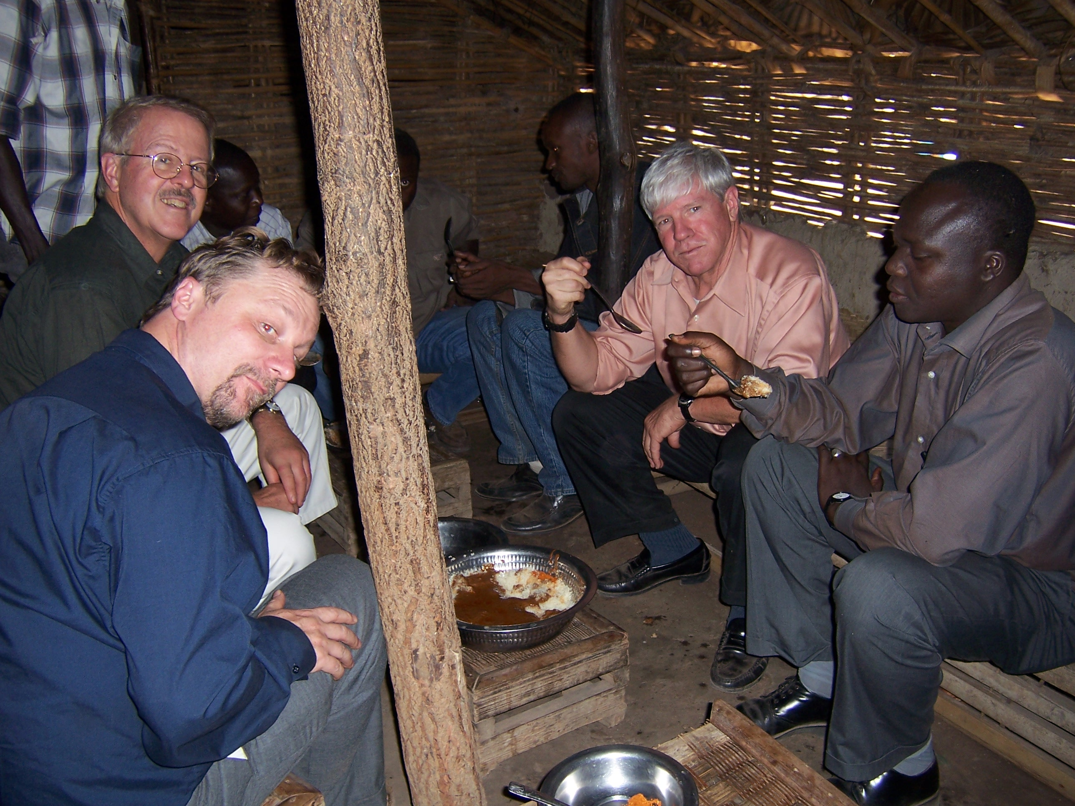
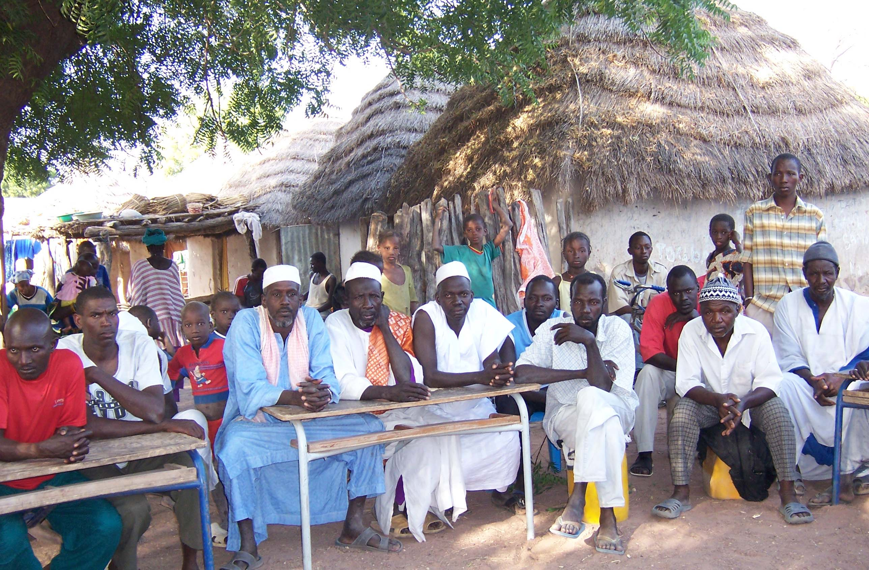
THANK YOU FOR YOUR ATTENTION
Producer Group - Wourohama
Evaluation team tasting fonio at village restaurant

