Slide 1
Natural Resource Management, Poverty Reduction and Knowledge Management
March 3, 2005

Slide 2
OUTLINE
  “KM in a nutshell”
  Key aspects of KM
  Types of KM tools
  Illustrative tools involving poverty and NRM
  Lessons learned, words to the wise

Slide 3
Nature, Wealth and Power & Knowledge Management
Recommendation One: Improve information and knowledge management systems
  Knowledge is critical for sound natural resource management. All phases of NRM—planning, implementation, monitoring, and decision making—are knowledge intensive.
  In many cases, knowledge, more than financial resources, is key to getting rural development going.
  There are new methods and tools for knowledge management that can increase the effectiveness and efficiency of NRM.

Slide 4
Key Elements of “KM”
  “Tacit” and well as “explicit” knowledge
  The importance of communities (“communities of practice”)
  Knowledge can be defined as the potential for solving problems:
    Importance of tools and capabilities to make use of knowledge.
    Premium on peer review, shared standards, skills transfer and some form of quality assurance and control
    Document distribution and broad-brush search engines by themselves can be self-defeating

Slide 5
Some Simple Examples of Communities
The BP oil rig
US Army Company commanders

Slide 6
Types of KM “Tools”
Libraries, archives
Content mgt. tools
Passive websites
Analytic frameworks
(NWP, PRSPs, etc.)
Chat rooms
Content
Newsletters
Communities
Peer review systems
Email lists
Workshops
Expertise/
“knowledge”
Experts systems
“E-Conferences”
Communities of practice
Advisory panels
“Yellow pages”;
expertise finders

Slide 7
Communities – Not So Easy to Make Work
  For some topics, finding common ground is difficult
  Communities can be self-selecting; if you want to foster a range of perspectives, this can be a flaw
  Communities are not always self-perpetuating

Slide 8
Communities – Not So Easy to Make Work cont’d
  People don’t all want to chat - sometimes they stay as lurkers or book buyers
  You need to be focused, but not directive; results oriented but not controlling
  The best communities are those within organizations, funded by one group, or sharing a strong set of attributes and needs

Slide 9
What Can Go Wrong
  KM4Dev
    Incestuous community
    Little memory
  SASUSG
    The narrowing of focus around parks and protected areas

Slide 10
Communities and Websites -
Some Examples

Slide 11
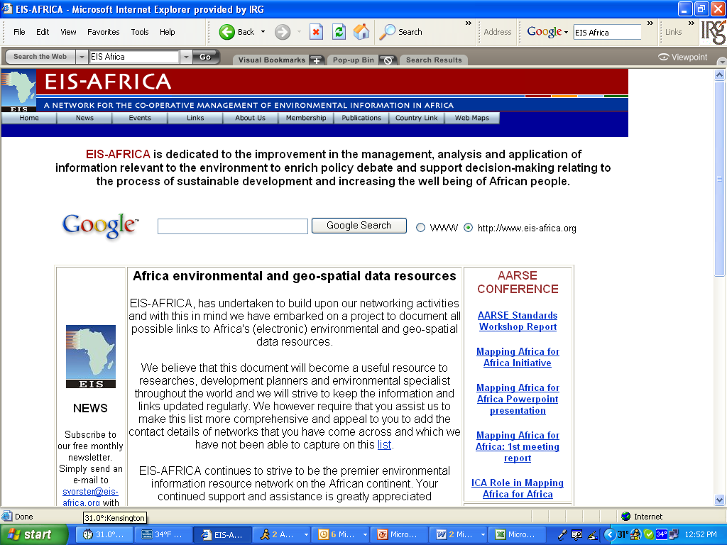

Slide 12
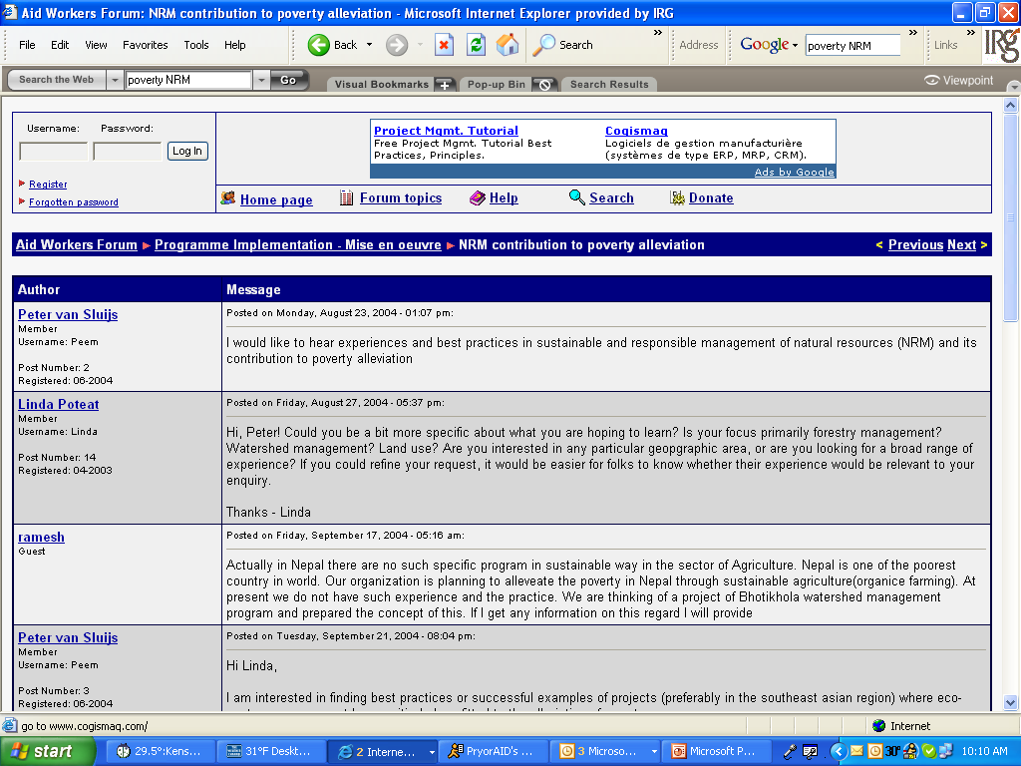

Slide 13
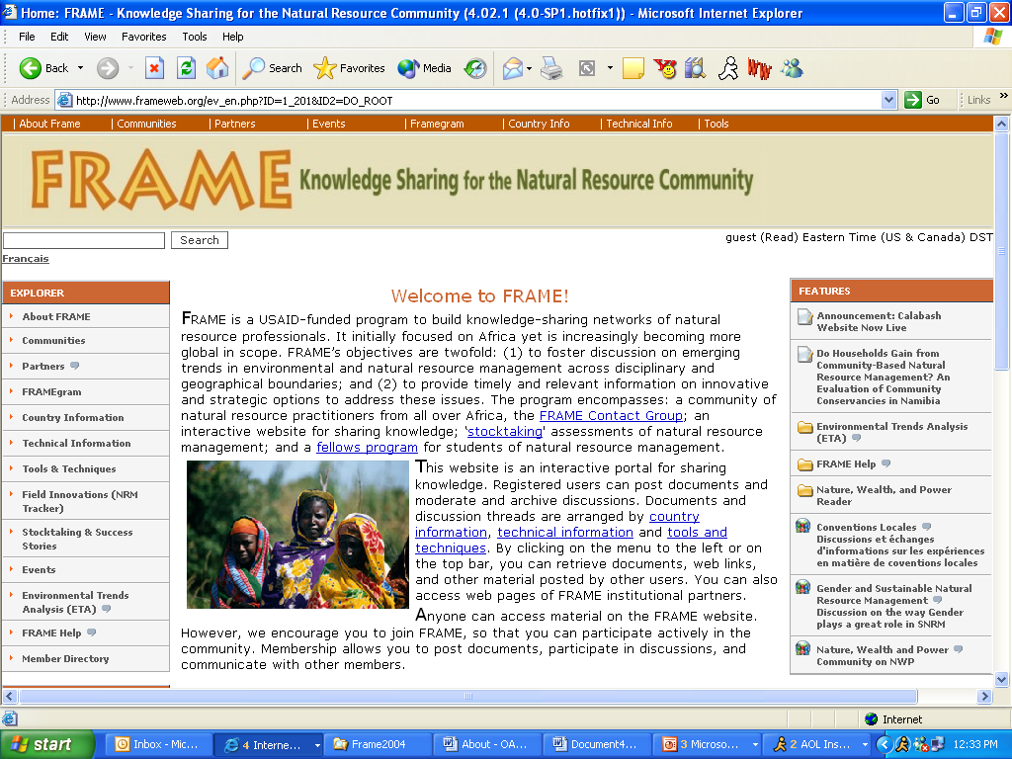

Slide 14
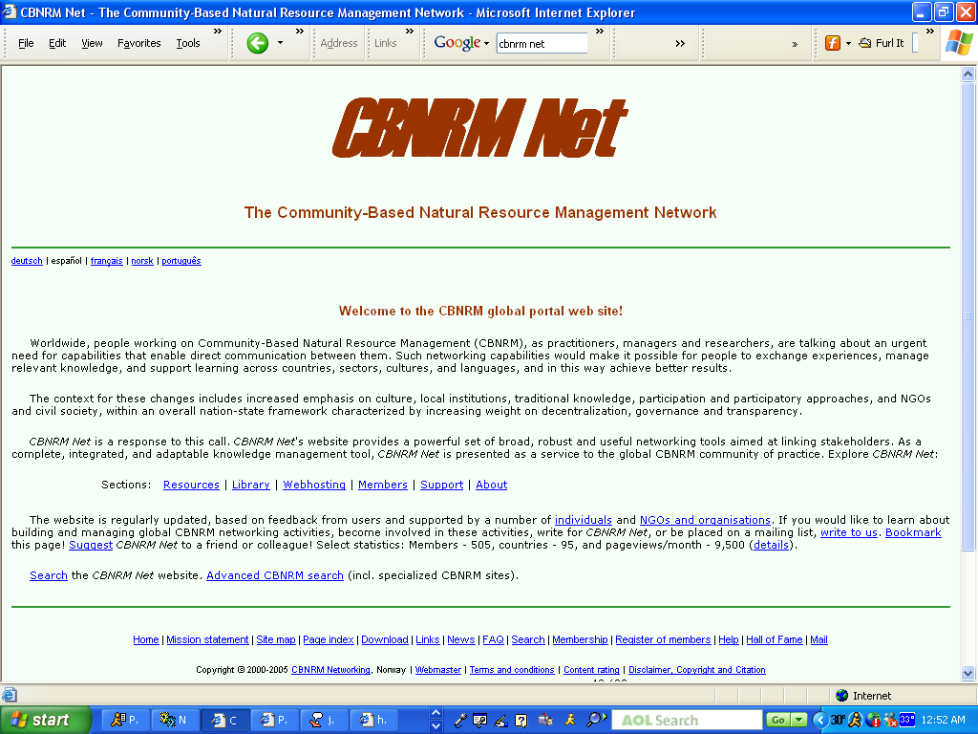

Slide 15
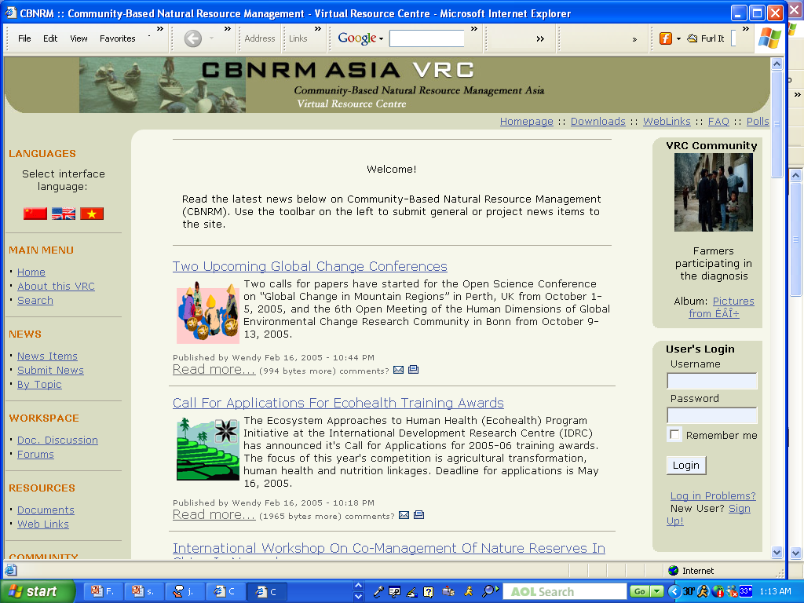

Slide 16
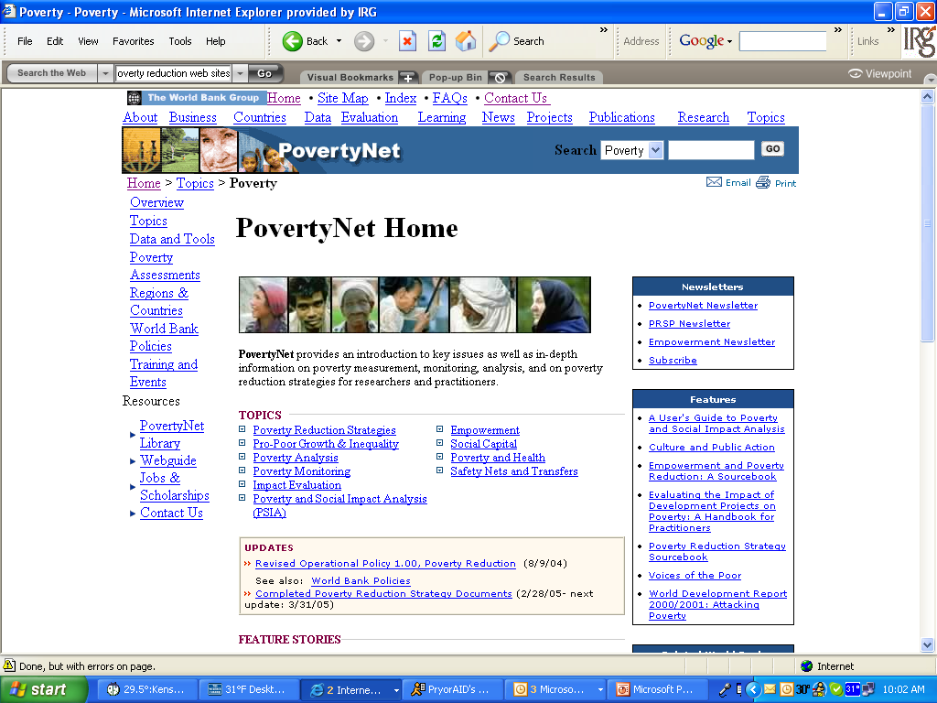

Slide 17
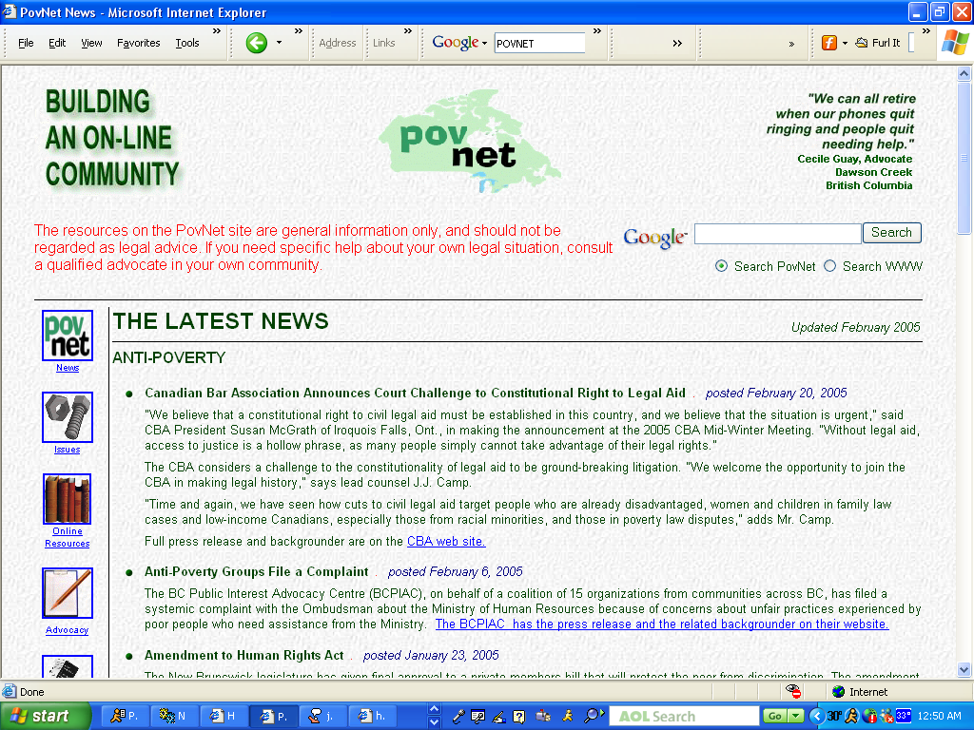

Slide 18
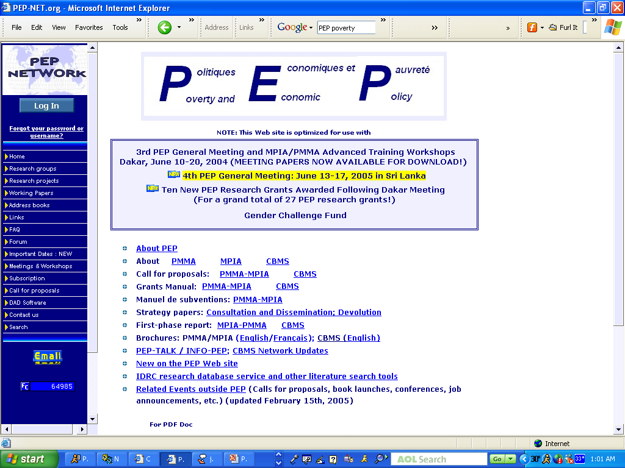

Slide 19
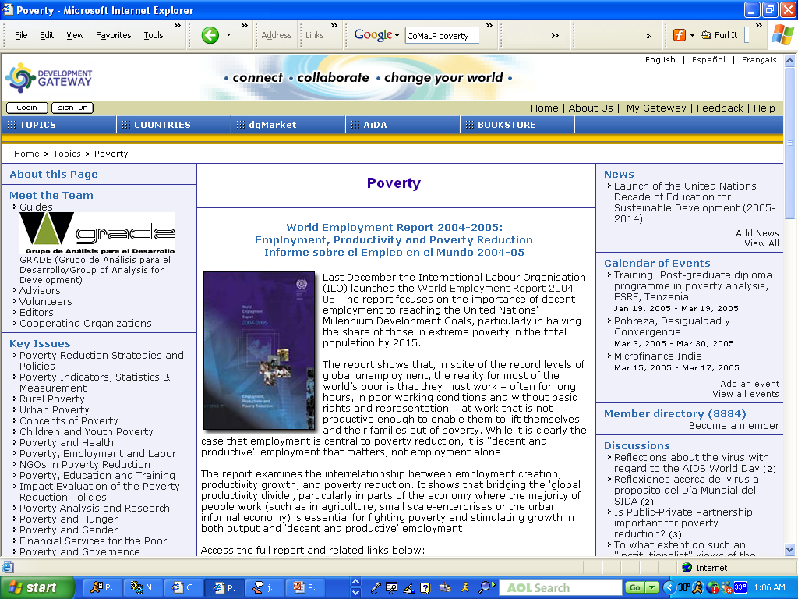

Slide 20
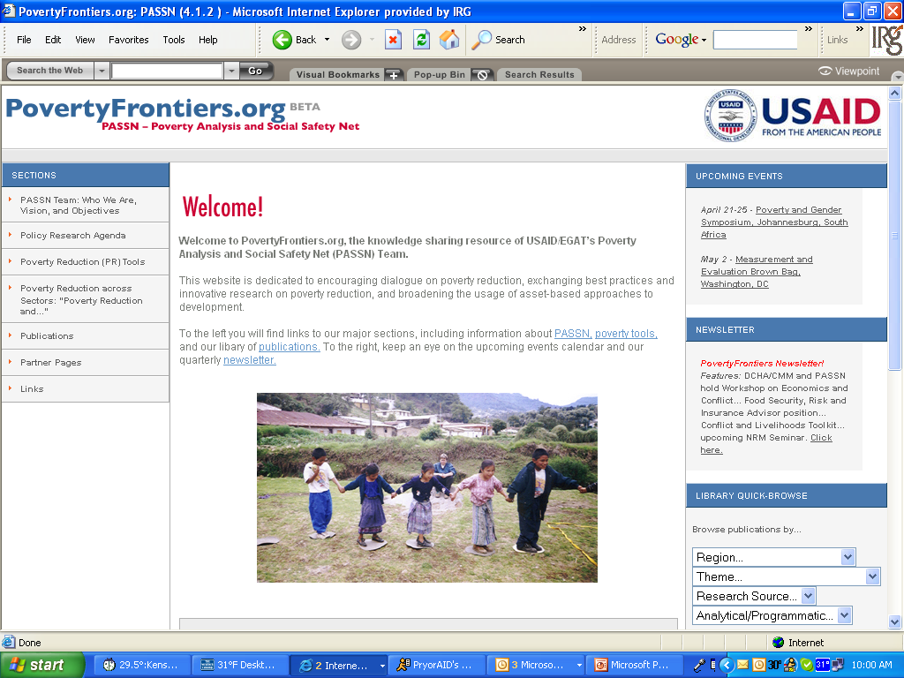

Slide 21
Some Final Observations
Communities can lead to confused messages on issues with multiple answers
IT choice is the least important consideration, and the least expensive
NRM and poverty are so inherently open to multiple perspectives that KM approaches can meander unless issues are well-defined

Slide 22
Some Final Observations
Web-based systems can be inherently biased towards those in the First World,
and towards those who are talkative
“Lurkers” matter, but are hard to track
Don’t forget “old fashioned” approaches – email lists, email-based newsletters, telephone and physical meetings
Human dynamics are most important

Slide 23
Questions?

Slide 24
Website addresses
EIS-Africa: www.eis-africa.org
Development workers -
FRAME - http://www.frameweb.org/ev_en.php
CBNRM Net: http://www.cbnrm.net/
CBNRM Asia VRC: http://www.cbnrmasia.org
PovertyNet http://web.worldbank.org/WBSITE/EXTERNAL/TOPICS/EXTPOVERTY
POVNet http://www.povnet.org/
PEP: http://132.203.59.36/PEP
Development Gateway: http://home.developmentgateway.org/
PovertyFrontiers (Not Open)
MicroLinkshttp://microlinks.org/: http://microlinks.org/

