Slide 1
Improving Law Enforcement and Governance for Better Forest Outcomes
Nalin Kishor
FLEG Coordinator, The World Bank

Slide 2
Some Examples of Losses
Brazil: More than 70% of concession management plans violated the law
Canada: Logging violations were detected in 55% of areas designated as protection areas
Malaysia: In the early 90s, forest product exports to Japan were under-declared by 40%
Indonesia: The government loses $600 million each year due to evasion of royalties, reforestation funds, and export tax payments

Slide 3
Illegal Logging in Selected Countries
Sources: Indufor 2004, SCA &WRI 2004
Country | Estimated Percentage of Production (%)
Indonesia | 60
Malaysia | 5
West and Central Africa | 30-70
Brazil | 15-20
Russia | 27 (North-West) 50 (Far East)

Slide 4
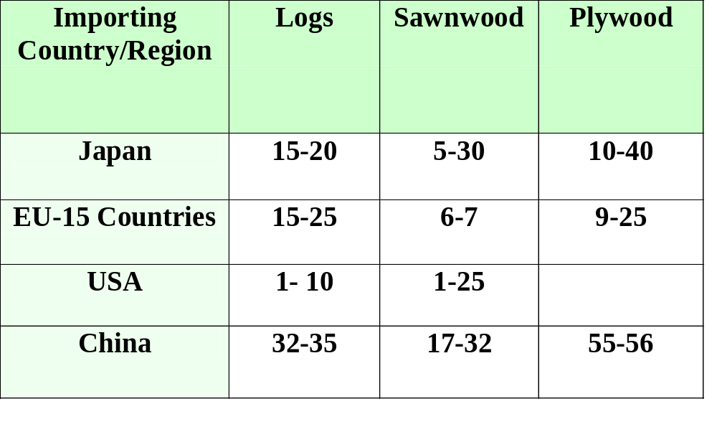
“Illegality” of Total Import Supply
Source: SCA & WRI 2004.

Slide 5
Value-Added Chain in the Illegal Trade of Ramin
Logger (Tanjung Putin Nat.Park): $2.2/m3
Broker (buying illegally in Idn.): $20/m3
Broker (selling in Malaysia): $160/m3
Buyer (of ramin sawntimber): $710/m3
Exporter (of sawn ramin in Sgp.): $800/m3
Buyer (of moulded ramin in US): $1000/m3
(Source: Timber Trafficking, EIA and Telapak, Sept. 2001)

Slide 6
Forests are Central to the Poverty Reduction Mission of the Bank
1.6 billion rural people are dependent upon forests to some extent.
1 billion out of 1.2 billion extreme poor depend on forest resources for part of their livelihoods
350 million people are highly dependent on forests.
60 million indigenous people are almost wholly dependent on forests.
Source: World Bank Forests Strategy and Policy, 2002.
“What we are doing to the forests of the world is a mirror reflection of what we are doing to ourselves
and to one another”
Mahatma Gandhi (cit. WDR 2003)
Examples of Forest-Dependent Populations
Country
Forest-Dependent Population (% of pop.)
India
275 million (27)
Indonesia
40-70 million (19-34)
Myanmar
25 million (52)
Vietnam
20 million (25)
Turkey
8 million (12)

Slide 7
Why Is Control of lllegal Logging Important?
Legal producers face unfair competition
Governments lose tax income (globally USD 5-10b per annum)
Trade unions concerned about violation of labor laws
Livelihoods of local communities are threatened
Threat to the protection of natural parks and critical habitats

Slide 8
Multiplicity of Factors Influencing Forest Outcomes
Good Forest Governance & Forest Law Enforcement
Forest Policy
SUSTAINABLE FOREST MGMT.
Scientific Forest Mgmt.
Cross-sectoral Impacts (inc. Overall Governance)

Slide 9
What is Good Governance?
Good governance is epitomized by predictable, open, and enlightened policymaking (that is, transparent processes); a bureaucracy imbued with a professional ethos; an executive arm of government accountable for its actions; and a strong civil society participating in public affairs; and all behaving under the rule of law.
(World Bank 2000, fn1).

Slide 10
Overall Governance and Forest Sector Governance
  Efforts to improve the overall governance environment may have positive impacts for the forest sector, via a “trickle-down effect”. They may also be important in galvanizing political will for sustaining the governance reform process.
  But specific efforts to improve governance within the forest sector are necessary, if the process is to be sustainable.

Slide 11
Overall Governance and Forest Sector Governance
Actions to promote better overall governance in the economy
Actions to promote sustainable forestry via forest policy and scientific forest management
Specific anticorruption efforts in the forestry sector

Slide 12
Cross-Sectoral Impacts: Actions to Improve Overall Governance
Institutional Reforms/building
Political Accountability
Competitive Private Sector
Public Sector Reform (including judiciary and police)
Civil Society Participation

Slide 13
Forest Policy Reforms to Improve Forest Outcomes
Establish Clear Property Rights
Establish well-defined Permanent Forest Estates
Reduce distortions to trade in forest products
Set the “right” level of forest taxation and rent capture
Simplify forestry legislation and strengthen implementation

Slide 14
Scientific Forest Management to Improve Forest Outcomes
Technical working plans for concession management should be written and enforced
Yields or coupes should be confined to prescribed limits
The residual stands should be adequate for reseeding
Remote sensing, GIS, RIL, and certification should be promoted

Slide 15
Actions to Reduce Corruption in the Forest Sector
Develop (and enforce) codes of conduct for forest industry
Create channels for reporting corruption; and develop processes to adequately deal with it
Strengthen the forest law enforcement system
Increase penalties for forest crimes to deterrent levels

Slide 16
Innovative Initiatives: National
Philippines: Multisectoral Forest Protection Committees
Cambodia: Forest Crime Monitoring Unit
Brazil: Geo-referenced licensing system and identification of illegal logging from land-use monitoring via satellite imagery
India: Village Forest Protection Committee (Joint Forest Management)
Bolivia: Legislative reforms conferring greater responsibility to individuals and local communities
Ecuador: Independent certifiers and outsourcing of supervisory functions of the forest department
Ghana: Timber Utilization Contracts

Slide 17
Promising Initiatives: Regional and International
Bilateral timber trade agreements: Indonesia and UK, China and Indonesia, etc.
Certification and chain-of-custody
Socially and environmentally responsible timber procurement: IKEA, Home Depot, B&Q, British government procurement, etc.
International Agreements: AML, CITES, BPCB, Equator Principles, etc.
Regional Co-operation: Forest Law Enforcement and Governance (FLEG); EU FLEGT Action Plan; G-8 Program on Forests; US Presidential Initiative for the Congo

Slide 18
Characteristic features of a FLEG Process
Explicit and frank discussion of forest crimes, illegal trade, corruption and forest law enforcement.
Collaborative dialog between national and international NGOs, and other stakeholder groups.
A spirit of collaboration between consumer (particularly G-8) and producer countries.
Regional declaration of political commitment and call for action at the highest levels.

Slide 19
Collaboration Between Consumer and Producer Countries
  “Recognizing that all countries, exporting and importing, have a role and responsibility in combating forest crime, in particular the elimination of illegal logging and associated illegal trade”.

Slide 20
Collaborative Dialogue Between ENGOs and Other Stakeholders
Discussions among national and international NGOs, governments, private sector in a positive and non-confrontational manner.
“Invite the representatives from among NGOs, industry, civil society……. to consider forming an advisory group to the regional task force.

Slide 21
“What we are doing to the forests of the world is a mirror reflection of what we are doing to ourselves
and to one another”
Mahatma Gandhi (cit. WDR 2003)

Slide 22
Rule of Law: Country Classification
40 | 21 | 29
Congo, DR Kenya Sierra Leone Nicaragua Russia Venezuela Zambia Malawi Cote d Ivoire | PNG Brazil Zimbabwe Philippines China Ghana India Tanzania Thailand | Botswana Costa Rica Malaysia S. Korea Chile US Japan Germany Canada

Slide 23
What Should the International Community Do?
Promote adherence to regulations in forestry related treaties/conventions
Promote adherence to anticorruption treaties
Zero tolerance for corruption and unethical practices in projects
Raise awareness and initiate action

