Slide 1
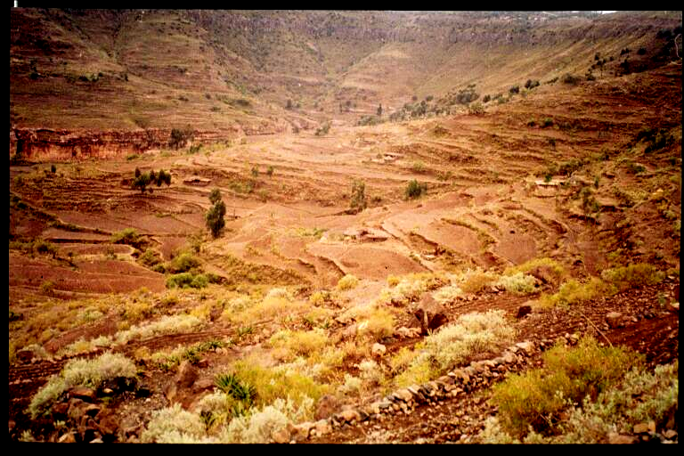
Impacts of Investments and Livelihood Strategies in Less Favored Areas: Evidence from Asia, East Africa and Central America
John Pender, IFPRI
USAID Seminar on Marginal Areas, Feb. 3, 2005

Slide 2
Outline
Background and rationale
  What are less-favored areas (LFA’s)?
  Why be concerned about them (or not)?
Returns to investment in LFAs
  India
  China
  Uganda
Impacts of investments and livelihoods on production, income, land degradation in LFAs
  Ethiopia
  Uganda
  Honduras
Conclusions and implications

Slide 3
What are “less-favored areas”?
Less-favored areas are less favored by nature or by man, including areas with
  low agricultural potential, due to limited rainfall, poor soils, steep slopes, etc. (biophysical constraints); or
  limited access to infrastructure (e.g., roads and irrigation) and markets (socioeconomic constraints)

Slide 4
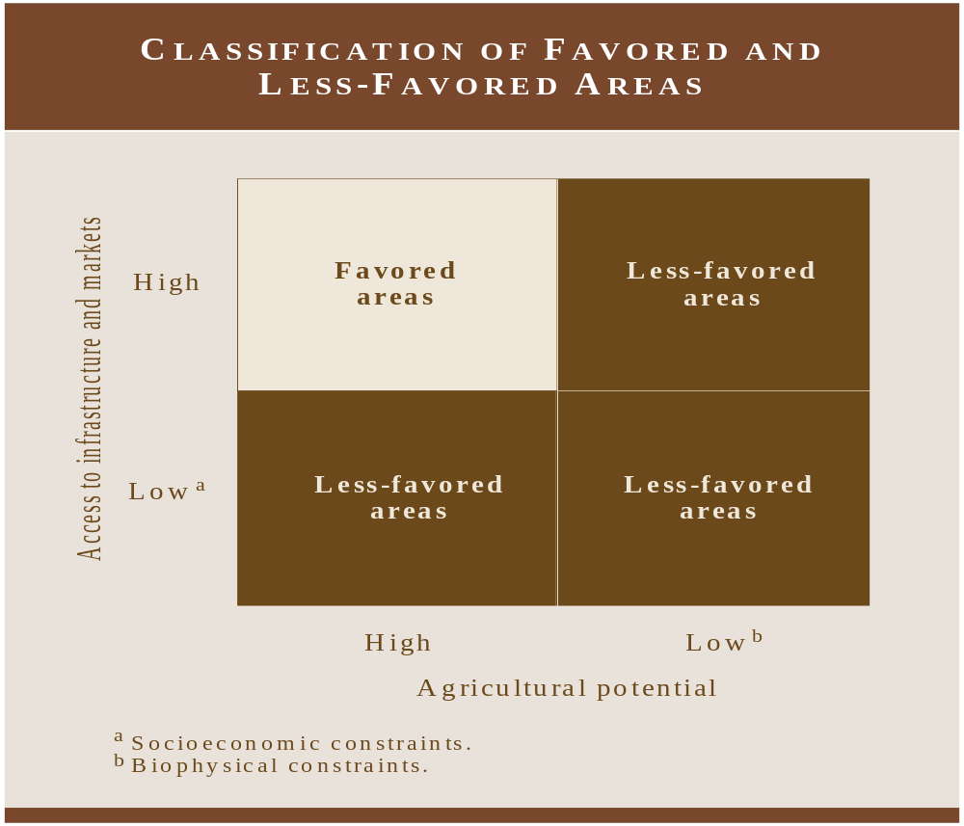

Slide 5
Less-favored areas include most of
  semi-arid and arid tropics of Asia and Africa
  mountain areas of Asia, Latin America and Africa
  hillside areas in Central America and Asia
  forest margins of humid and sub-humid tropics of Africa, Latin America and Asia

Slide 6
Why be concerned about less-favored areas?
Over 1 billion people live in such areas
These areas were largely bypassed by the Green Revolution
Problems of low agricultural productivity, poverty, and natural resource degradation severe and worsening in many such areas
Problems in these areas give rise to conflict, emigration to other areas, negative environmental consequences

Slide 7
The Conventional Wisdom
Emphasize public investments in agricultural R&D, infrastructure, etc. in favored areas where returns are higher
Benefits of increased food production, income and foreign exchange from favored areas will spread through lower food prices and migration to favored areas
Resources improve due to reduced pressure on fragile resources in less-favored areas

Slide 8
Challenges to the Conventional Wisdom
Rapid population growth continues in less-favored areas
Problems of poverty and resource degradation getting worse in many cases
Evidence of diminishing returns to investment and increasing environmental problems in favored areas
Evidence of higher or comparable returns to investments in less favored areas in some countries, and greater impact on poverty (“win-win” strategies)
Some evidence suggests possibility of “win-win-win” strategies benefiting the environment alongside economic growth and poverty reduction

Slide 9
Returns to investments in LFA’s
Evidence from three countries (Fan and colleagues)
India
China
Uganda

Slide 10
Returns to Investments in India – Impacts on Agricultural Production (Fan and Hazell 1999)
Investment | Units | Irrigated areas | High potential rainfed areas | Low potential rainfed areas
HYV’s | Rps/ha | 63 | 243 | 688
Roads | Rps/km | 100,598 | 6,451 | 136,173
Canal irrigation | Rps/ha | 938 | 3,310 | 1,434
Private irrigation | Rps/ha | 1,000 | -2,213 | 4,559
Electrification | Rps/ha | -546 | 96 | 1,274
Education | Rps/ha | -360 | 571 | 902

Slide 11
Returns to Investments in India – Impacts on Poverty Reduction (Fan and Hazell 1999)
Investment | Units | Irrigated areas | High potential rainfed areas | Low potential rainfed areas
HYV’s | Persons/ha | 0.00 | 0.02 | 0.05
Roads | Persons/km | 1.57 | 3.50 | 9.51
Canal irrigation | Persons/ha | 0.01 | 0.23 | 0.09
Private irrigation | Persons/ha | 0.01 | -0.15 | 0.30
Electrification | Persons/ha | 0.01 | 0.07 | 0.10
Education | Persons/ha | 0.01 | 0.23 | 0.01

Slide 12
Returns to Investments in China – Impacts on Rural GDP (Fan, et al. 2004a) (yuan/yuan inv.)
Investment | Coastal | Central | Western
R&D | 5.54 | 6.63 | 10.19
Irrigation | 1.62 | 1.11 | 2.13
Roads | 8.34 | 6.90 | 3.39
Education | 11.98 | 8.72 | 4.76
Electricity | 3.78 | 2.82 | 1.63
Telephone | 4.09 | 4.60 | 3.81

Slide 13
Returns to Investments in China – Impacts on Poverty Reduction (persons/10,000 yuan inv.)
Investment | Coastal | Central | Western
R&D | 3.72 | 12.96 | 24.03
Irrigation | 1.08 | 2.16 | 5.02
Roads | 2.68 | 8.38 | 10.03
Education | 5.03 | 13.90 | 18.93
Electricity | 2.04 | 5.71 | 7.78
Telephone | 1.99 | 8.10 | 13.94

Slide 14
Returns to Investments in Uganda – Impacts on Agricultural Production (Fan, et al. 2004b)
(Ush/Us invested)
Investment | Central | East | West | North
Ag. R&D | 12.49 | 10.77 | 14.74 | 11.77
Education | 2.05 | 3.51 | 3.80 | 2.10
Feeder roads | 6.03 | 8.74 | 9.19 | 4.88
Murram roads | n.s. | n.s. | n.s. | n.s.
Tarmac roads | n.s. | n.s. | n.s. | n.s.
Health | 1.37 | 0.92 | 0.96 | 0.37

Slide 15
Returns to Investments in Uganda – Impacts on Poverty Reduction (persons/million USh inv.)
Investment | Central | East | West | North
Ag. R&D | 21.75 | 66.31 | 48.91 | 175.52
Education | 3.57 | 21.60 | 12.62 | 31.38
Feeder roads | 10.51 | 53.85 | 30.49 | 72.82
Murram roads | 4.08 | 11.88 | 9.77 | 14.80
Tarmac roads | 2.58 | 13.12 | 9.39 | 62.92
Health | 2.60 | 6.15 | 3.46 | 5.95

Slide 16
Impacts of Investments and Livelihoods on Production, Income, and Land Degradation in LFA’s
Evidence from three countries (Pender and colleagues)
Ethiopia – highlands of Tigray and Amhara
  Surveys of 934 households in 198 highland villages
Uganda
  451 households in 107 villages
Honduras hillsides
  385 households in 95 villages in 19 municipalities

Slide 17
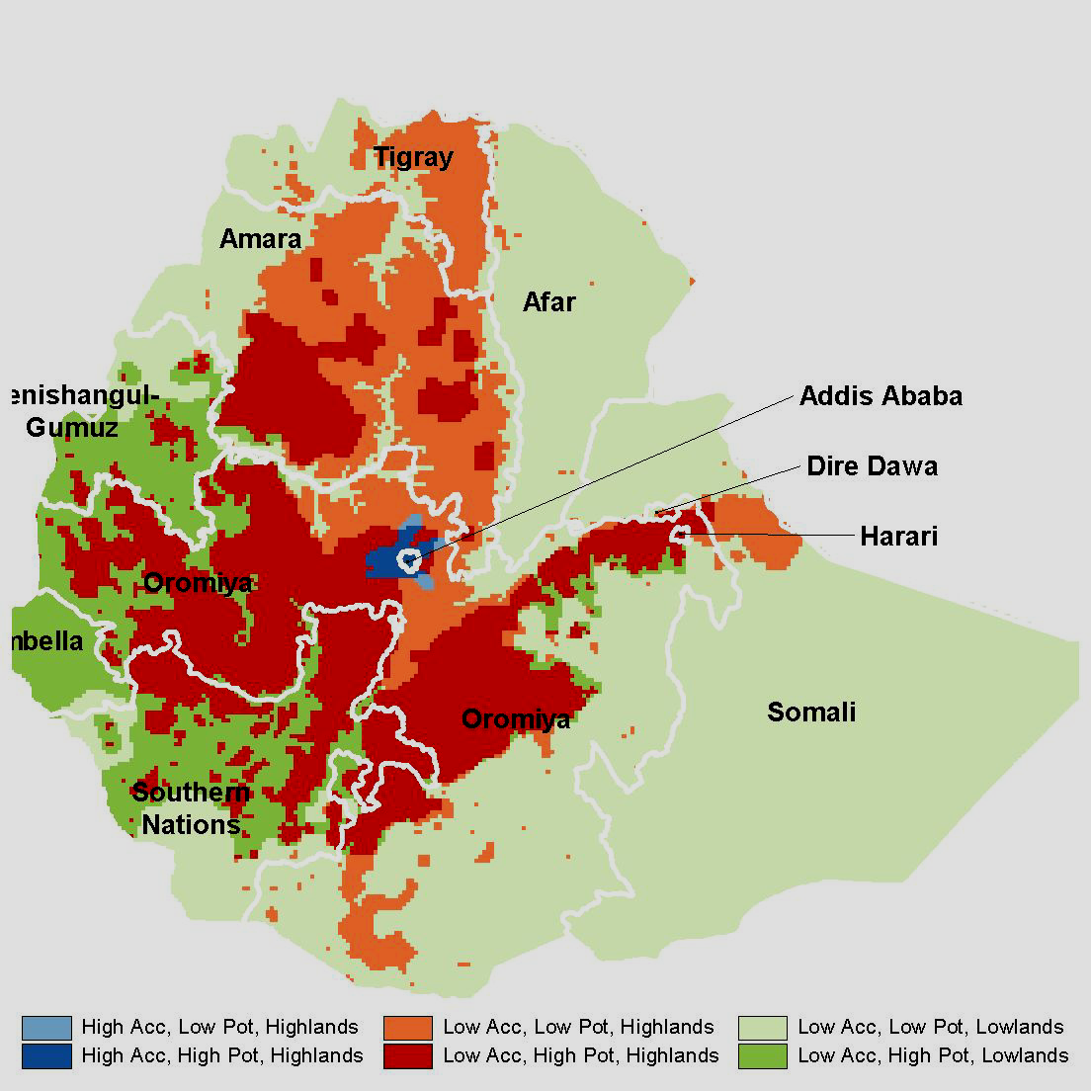
Ethiopia – Tigray and Amhara Study Regions

Slide 18
Selected Determinants of Crop Production, Income and Erosion in Tigray Highlands
(Pender and Gebremedhin (2004))
Variable | Crop Production | Income per capita | Soil erosion
Stone terrace | + | 0 | -
Number of cattle (other than oxen) | + | + | 0
Walking time to town | - | - | 0
Education | + | 0 | 0
Contact with extension | - | 0 | -
Use of formal credit | 0 | 0 | 0
Participation in marketing cooperative | + | + | 0

Slide 19
Variable | Crop Production | Per capita income | Soil erosion
Secondary income source. (cf. none) - Cereals Perennials - Cattle - Other livestock/beekeeping - Food for work/farm work Salary employment - Trading - Food/other assistance - Other nonfarm | 0 + - 0 0 0 0 + 0 | + 0 + + + + + + + | 0 - 0 0 0 - + 0 0

Slide 20
Impacts of Selected Investments in Tigray Highlands – Simulation Results
Variable | Scenario | Value of Crop Prod. | Per Capita Income | Erosion
Stone terraces | All plots terraced | +13.8% | +14.5% | -41.9%
Cattle | 1 additional cow | +6.2% | +3.3% | +1.4%
Education | 3 years minimum | +17.6 | 23.4% | -10.1%
Agricultural extension | Universal participation | -14.0% | +7.6% | -28.8%
Road access | 1 hour closer | -1.2% | +2.9% | -4.3%
Market access | 1 hour closer | +6.8% | +5.6% | -0.4%
Marketing cooperative | Universal participation | +45.5% | +48.7% | -4.7%

Slide 21
Rates of return to selected household investments in highlands of Tigray
Stone terraces
  34% (Pender and Gebremedhin 2004)
  50% (Gebremedhin, et al. 1998)
Tree planting
  20% to over 100% (Jagger and Pender 2003)
Fertilizer
  -14% (Pender and Gebremedhin 2004)
Livestock (Pender, et al. 2002)
  Cattle: 36%
  Poultry: 32%
  Beekeeping: 44%

Slide 22
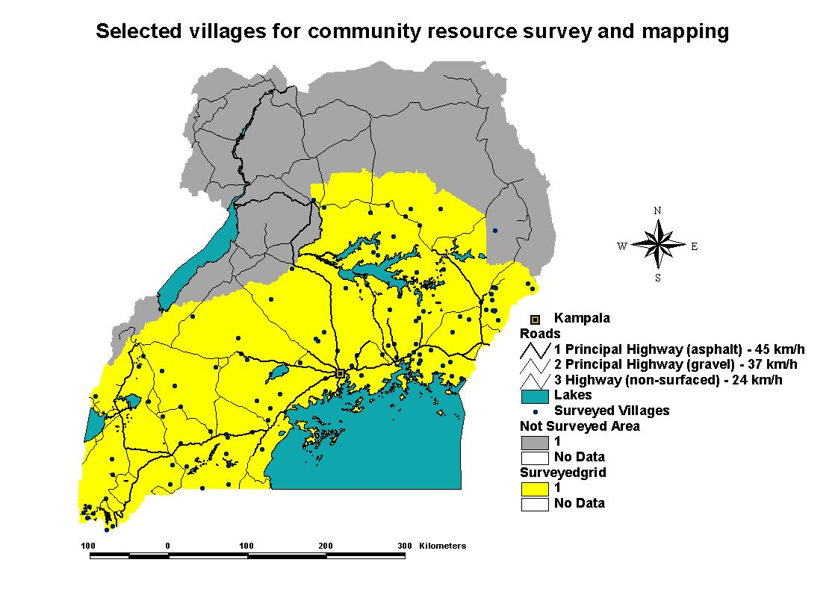
Uganda – Study Region
Source: Ruecker, 2002

Slide 23
Selected Determinants of Crop Production, Erosion and Income in Uganda
(Nkonya, et al. 2004)
Variable | Crop Production | Erosion | Income
Value of Livestock | + | 0 | 0
Education of Household Head (cf. none)
Primary | 0 | 0 | +
Secondary | 0 | + | 0
- Higher | 0 | + | +
Participation in Technical Assistance
- Ag. Training | + | 0 | 0
Ag. Extension | + | + | +
- Ag/env. Organizations | 0 | - | 0
Notes:
- We present selected results; insignificant vars and biophysical vars not reported
- As expected, plot area and labor increase production (note dependent variable is total production, not yield)
Bananas more profitable than other crops
Irrigation increases value of production (though not significant in OLS)
Interesting that crop rotation reduces value of production. May be a tradeoff between near term production and longer term sustainability/production.
Other land investments and land management practices (trenches, grass strips, lives barriers, tree planting, fertilizer, manure, mulch, etc., not found to have a significant impact)

Slide 24
Variable | Crop Production | Erosion | Income
Income Strategy (primary income source)
- Wages/salary | 0 | 0 | 0
- Nonfarm activities | + | 0 | 0
- Livestock | + | 0 | +
- Cereals | + | 0 | 0
- Legumes | + | 0 | 0
- Horticulture | + | 0 | 0
- Bananas | 0 | 0 | 0
- Coffee/export crops | + | 0 | 0
Notes:
Ag/environment oriented NGOs are important in helping to reduce soil erosion (through emphasis on soil conservation measures)
Extension programs may contribute to erosion by promoting more intensive or mechanized farming without sufficient emphasis on conservation (though this significant only in IV regression)
Income strategies have no significant impacts on erosion. This consistent with the fact that we found few significant impacts of income strategies on land management practices.

Slide 25
Impacts of Selected Investments in Uganda – Simulation results
Scenario | Crop Production | Erosion | Income
Universal Primary Education | -7.7% | +8.2% | 24.5%
Higher education for people with secondary ed. | -0.7% | +0.3% | 14.2%
Agricultural training for all households | +12.2% | +2.5% | -1.5%
Agricultural extension for all households | +13.7% | +11.5% | +61.2%
All households participate in ag./environment NGOs | -8.7% | -23.1% | -27.2%

Slide 26
Honduras: Study Sites

Slide 27
Selected Determinants of Crop Production and Income in Hillsides of Honduras – Preliminary Results (Jansen, et al. 2005)
Variable | Annual Crop Production/ha | Perennial Crop Prod./ha | Income/capita
Soil fertility | 0 | + | +
Machinery/equipment | 0 | + | +
Education | 0 | + | 0
Agricultural training | 0 | - | +
Livelihood strategy (cf., basic grains producer)
- Livestock producer | 0 | 0 | +
- Coffee producer | - | - | 0
- Basic grains/farmworker | - | 0 | +
Basic grains/livestock/ farmworker | 0 | 0 | 0
Notes:
- We present selected results; insignificant vars and biophysical vars not reported
- As expected, plot area and labor increase production (note dependent variable is total production, not yield)
Bananas more profitable than other crops
Irrigation increases value of production (though not significant in OLS)
Interesting that crop rotation reduces value of production. May be a tradeoff between near term production and longer term sustainability/production.
Other land investments and land management practices (trenches, grass strips, lives barriers, tree planting, fertilizer, manure, mulch, etc., not found to have a significant impact)

Slide 28
Impacts of Selected Land Management Technologies on Crop Productivity
Technology | Ethiopia |  |  | Uganda | Honduras - Annuals
 | Tigray | Amhara-Low Pot. | Amhara-High Pot.
Stone terrace | +17% | +20% | I | NA | NA
Trees planted | +41% | NA | NA | I | I
Manure/compost | +15% | I | I | I | +58%
No burning | +48% | NA | NA | I | I
Reduced tillage | +57% | I | I | NA | I
Contour plowing | +25% | I | I | NA | NA
Incorporate crop res. | NA | -27% | I | I | I
Crop rotation | NA | I | I | -18% | NA
Inorganic fertilizer | +13% | I | +70% | I | +32%

Slide 29
Conclusions/Implications
High returns to many public investments in LFA’s and greater impact on poverty in India, China, and Uganda
There are investments/livelihoods that can increase crop production, income, and/or reduce land degradation in less-favored areas; e.g.
  Tigray: stone terraces, reduced tillage and burning, manure, alternative livelihoods, market development
  Uganda: livestock production, other livelihood strategies
  Honduras: manure, fertilizer, machinery/equipment, livestock production
But trade-offs are often apparent; e.g.
  Effects of technical assistance in Uganda and Honduras
  Effects of education in Uganda
  Effect of farm work in Honduras

Slide 30
Conclusions/Implications (2)
Impacts of interventions/investments are context dependent, linked to local comparative advantages:
  Low returns to cereals in Tigray and low potential Amhara → low returns to fertilizer, extension, credit
  Higher returns to livestock, beekeeping, tree planting, nonfarm activities in Tigray
  High returns to cereals and fertilizer in high potential Amhara
  Higher returns to bananas, livestock in highlands of Uganda
Development strategies for less-favored areas should take local comparative advantages and disadvantages into account

