Slide 1

Mapping Ecosystem Services and Poverty in Kenya:
Preview of Work in Progress
Norbert Henninger, Dan Tunstall, and Janet Nackoney
USAID Poverty Reduction & Natural Resources
Management Seminar Series
3 March 2005

Slide 2
A Joint Project Relying on Data and Expertise from:
Central Bureau of Statistics (CBS)
Department of Resource Surveys and Remote Sensing (DRSRS)
Ministry of Agriculture and Livestock Development
Ministry of Water Resources and Development
National Environment Management Authority (NEMA)
Poverty Analysis and Research Unit (Ministry of Planning and National Development)
Kenya Wildlife Service (KWS)
African Centre for Technology Studies (ACTS)
Ecotourism Society of Kenya (ESOK)
Energy for Sustainable Development Africa
Kenya Association of Tour Operators (KATO)
University of Nairobi
Africover – Food and Agriculture Organization of the United Nations
FEWS NET
International Food Policy Research Institute (IFPRI)
International Livestock Research Institute (ILRI)
International Water Management Institute (IWMI)
World Agroforestry Centre (ICRAF)
World Resources Institute (WRI)
Notes:
The following presentation is very much a preview of our work on mapping poverty and natural resource use in Kenya. We are working with individuals from a broad cross section of national and international organizations that provide data and expertise to this project.

Slide 3
With Our Partners We Seek To:
Break down sectoral parochialism and influence national poverty reduction efforts
Arm civil society groups to push for poverty reduction efforts that take ecosystem and governance issues into considerations
Raise the status of environmental management authorities to improve environmental reporting and make them a stronger player
Transform the thinking in ministries of planning, finance, or development so that they perceive ecosystem stewardship as an important foundation of national development
Notes:
We expect that this work and the future efforts of our partners will break down sectoral parochialism and change how national poverty reduction strategies are implemented. We want to arm civil society groups with better information to push for poverty reduction efforts that take ecosystem and governance issues into considerations. We seek to raise the status of environmental management authorities to improve environmental reporting and make them a stronger player in national priority setting. And we want to transform the thinking in ministries of planning, finance, or development so that they perceive ecosystem stewardship as an important foundation of national development.

Slide 4
Ecosystems
Institutions & Governance
Poverty & Equity
Inputs
Private
Jobs
Purchasing
Provisioning
Taxes
Subsidies
Regulating
Ecosystem Services
Supporting
Inputs
Public
Expenditure
Cultural
Direct Use
Poor
Institutions
Local
National
International
Policies
Policies
Notes:
One of the toughest problems a policymaker is facing, probably anywhere in the world, is how to design policies that find the right balance between creating economic opportunities, protecting the environment, and improving governance. This challenge is even greater for policymakers in developing countries with their urgent needs for poverty reduction, high pressures on ecosystems, and more limited institutional and governance capacities.
As this chart shows, people’s livelihoods and a country’s economic development depend on a sustainable supply of ecosystem services. To ensure that the benefits derived from ecosystems (which are currently greatly skewed) contribute to human wellbeing and poverty reduction, will require a major transformation of institutions and governance (at multiple scales).

Slide 5
How do We Make the Linkages
between Poverty, Ecosystems, and Accountability?
Notes:
How can we help decision-makers to make these structural changes in all areas of economic, social, and political life?

Slide 6
One Way Would be to Answer the Following Questions:
Where are the poor?
Which areas provide which amount of ecosystem services?
How does the location of poverty compare to the distribution of ecosystem services?
Who has access to resources, who benefits, who bears the costs, and what are policymakers doing to improve the situation?
Notes:
One way is to develop tools that expose the linkages between poverty, ecosystems, and governance. Such a tool would try to answer the following questions: Where are the poor? Which areas provide which amount of ecosystem services? How does the location of poverty compare to the distribution of ecosystem services? Who has access to resources, who benefits, who bears the costs, and what are policymakers doing to improve the situation.
In the following slides, I share how mapping ecosystem services and poverty can assist in understanding and changing perceptions on poverty-ecosystem linkages. We have found indicator maps to be a powerful tool for stimulating and advancing policy dialogue. This is very much work in progress for Kenya. We expect to finalize a report by the end of 2005.

Slide 7
Where Are the Poor ?
Notes:
To answer the question on where are the poor, we have been supporting, with our international collaborators, the production of high-resolution poverty maps.

Slide 8
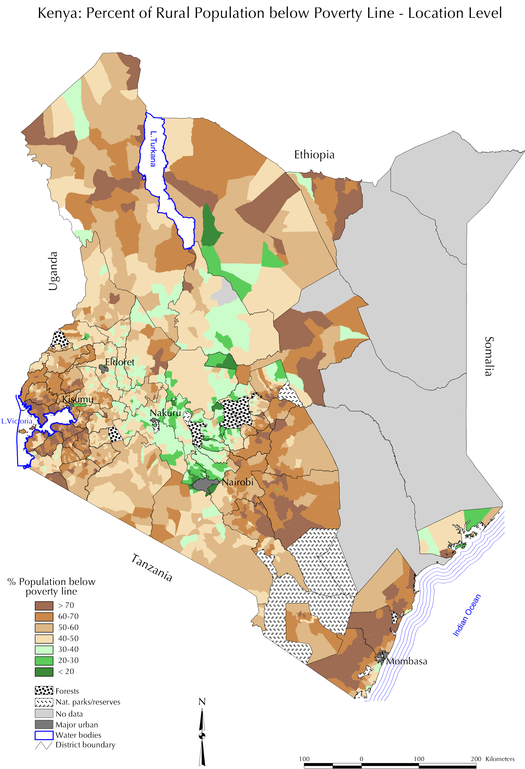
Percent of Rural Population below the Poverty Line
By Location
Source: Central Bureau of Statistics, Ministry of Planning and National Development, Kenya, 2003
Notes:
In October 2003, the Government of Kenya released for the first time reliable poverty data for 2,070 rural Locations and 496 urban Sub-Locations. Past poverty data covered only Kenya’s 63 Districts.
This map shows the percentage of the population falling below Kenya’s rural poverty line (about 59 US cents a day). Highest rates can be found in the arid north, along the coast and in western Kenya.

Slide 9
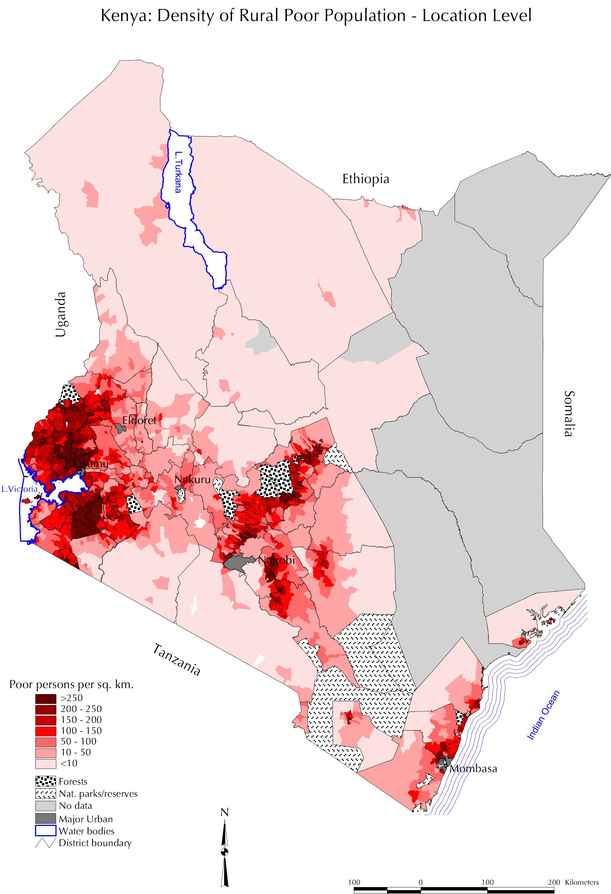
Number of Poor Persons per Square Kilometer
by Location
Source: Central Bureau of Statistics, Ministry of Planning and National Development, Kenya, 2003
Notes:
The second map shows the density of the poor. Many of the most densely populated areas in the highlands, western Kenya, and along the coast also have a high density of the poor. The more arid areas of Kenya, which in the previous map showed some of the highest poverty rates, usually have low poverty densities. Western Kenya has the greatest number of administrative areas where high poverty rates and high poverty density coincide.

Slide 10
Which Areas Provide
which Amount of Ecosystem Services?
Notes:
To identify important supply areas of ecosystems

Slide 11
Ecosystem Services:
The Benefits People Derive from Ecosystems
Provisioning
Products
obtained from ecosystems
• Food
• Fresh water
• Fuelwood
• Fiber
• Biochemicals
• Genetic resources
Regulating
Benefits obtained from regulation of ecosystem processes
• Climate regulation
• Disease regulation
• Water regulation
• Water purification
Cultural
Nonmaterial benefits obtained from ecosystems
• Spiritual and religious
• Recreation and ecotourism
• Aesthetic
• Inspirational
• Educational
• Sense of place
• Cultural heritage
Supporting
Services necessary for the production of all other services
• Soil formation
• Nutrient cycling
• Primary production
Source: Millennium Ecosystem Assessment, 2003
Notes:
we rely on the definitions of ecosystem services developed by the Millennium Ecosystem Assessment. They differentiate between different categories of ecosystem services: provisioning (which includes food, water, fuel, genetic resources), regulating (which includes climate and water regulation), cultural (which includes recreation and tourism), and supporting (which includes soil formation and nutrient cycling).

Slide 12
Approach: Map Major Ecosystem Services
Food from crops, livestock, fish, and wildlife
Water (quantity, quality, flood control)
Biodiversity
Tourism and recreation
Fuel and energy
Timber and housing material
Notes:
We will select a subset of ecosystem services to communicate the concept and main ideas, pretty much what you would learn in your first geography lesson. The main difference, however, is that we’ll use a consistent ecosystem services framework.

Slide 13
Provisioning Services:
Food from Crops, Livestock,
and Wildlife
Notes:
I will now show a few examples how supply areas of ecosystem services could be mapped. The first two slides show different sources of food.

Slide 14
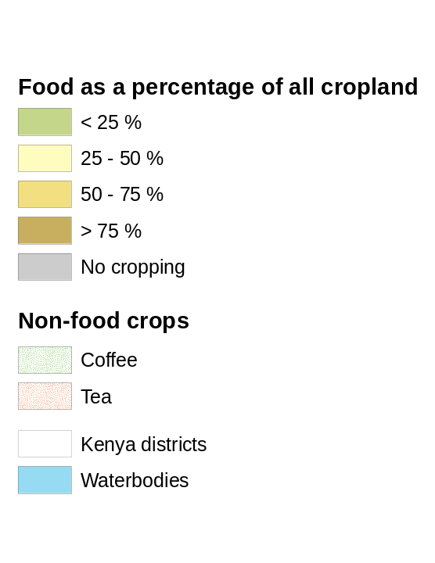
Food and Non-food Crops in Kenya’s Highlands
Sources: Africover – Food and Agriculture Organization of the United Nations (FAO) and Kenya Department of Resource Surveys and Remote Sensing (DRSRS).
Notes:
With the help of existing aerial photos and land cover maps, we can identify food and non-food crops for the highlands in Kenya where the majority of agriculture and population is concentrated. Most cropland is small-scale and dedicated to produce food. When food crops are less dominant, farmers grow other crops, for example coffee and tea.

Slide 15
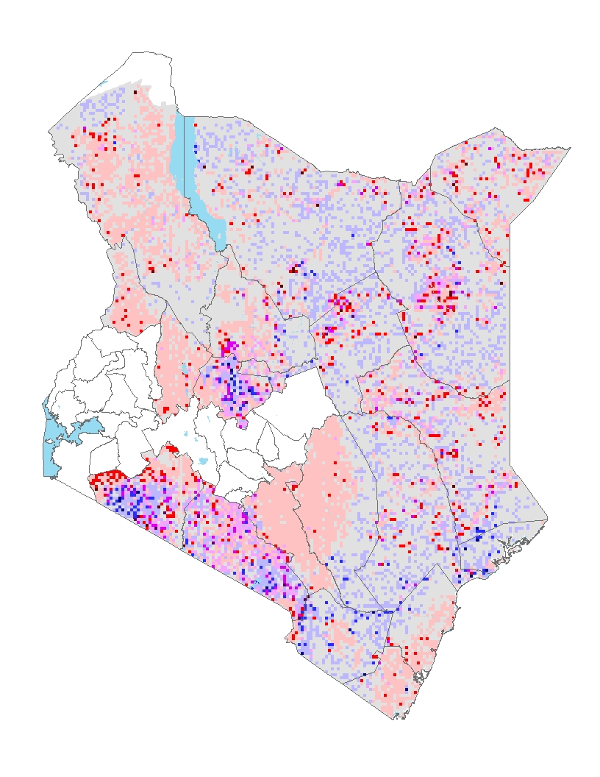
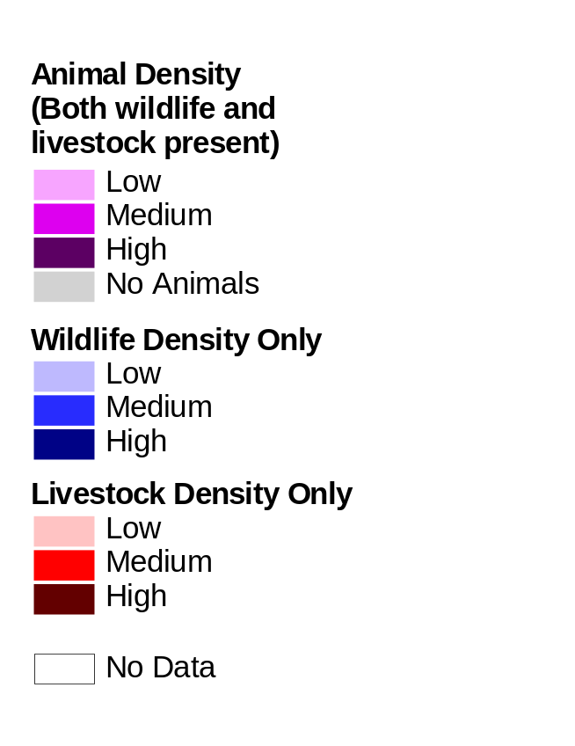
Supply of Livestock and Wildlife Products
Source: Kenya Department of Resource Surveys and Remote Sensing (DRSRS).
Supply of Livestock and Wildlife Products
Supply of Livestock and Wildlife Products
Sources: Africover – Food and Agriculture Organization of the United Nations (FAO), Kenya National Environment Management Authority
(NEMA), Kenya Department of Resource Surveys and Remote Sensing (DRSRS), and International Livestock Research Institute (ILRI).
Sources: Africover – Food and Agriculture Organization of the United Nations (FAO), Kenya National Environment Management Authority
(NEMA), Kenya Department of Resource Surveys and Remote Sensing (DRSRS), and International Livestock Research Institute (ILRI).
Notes:
Livestock and wildlife provide protein and other products (the latter illegal) to people. This map summarizes data from a regular aerial census of large mammals and livestock and can be used to identify major supply areas in Kenya's rangelands. Highest wildlife density can be found in Narok and Kajiado Districts along the Tanzanian border. Similar high densities can be found north of Mount Kenya in Laikipia District. Livestock are in the wetter parts of the rangelands and closer to human-made water sources.

Slide 16
Provisioning and Cultural Services:
Genetic Resources and Tourism
Notes:
The next slide applies some of the same data to draw attention to important provisioning and cultural services.

Slide 17
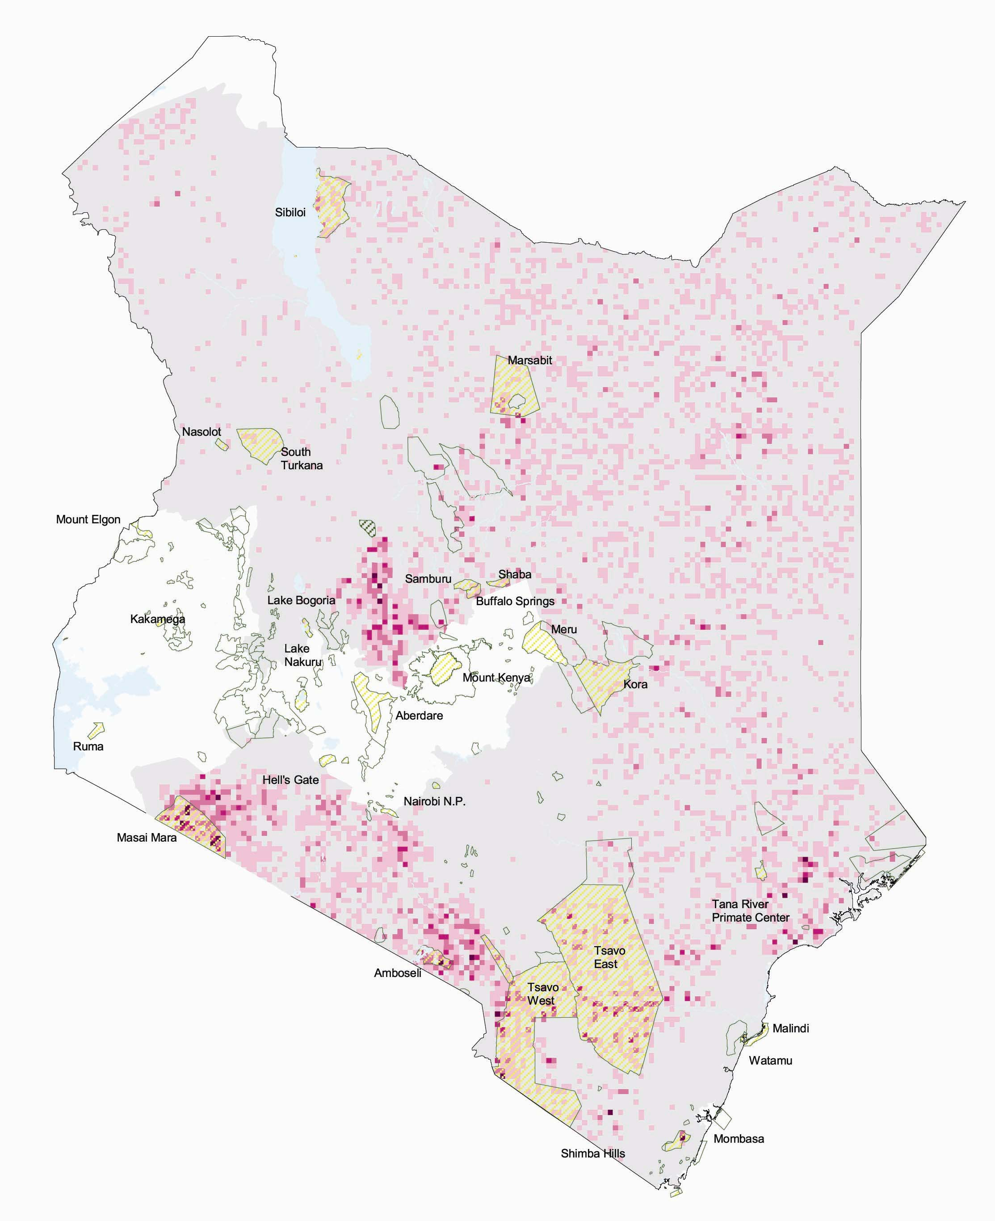
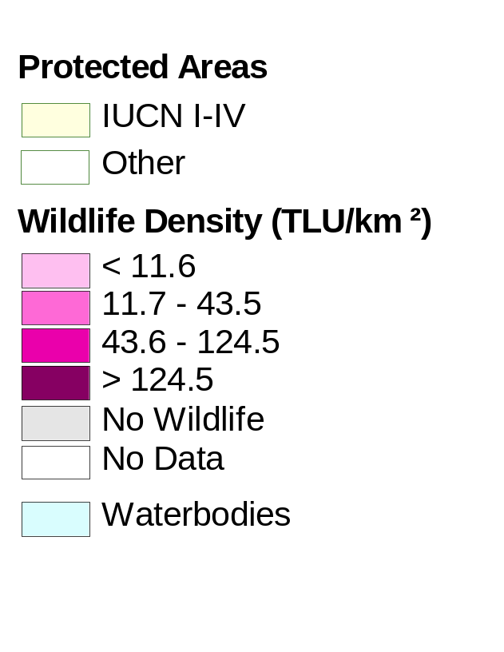
Mammal Density and Protected Areas
Sources: Kenya Department of Resource Surveys and Remote Sensing (DRSRS), International Livestock Research Institute (ILRI), and World Conservation Monitoring Centre.
Notes:
Kenya’s wildlife and landscapes have significant global and local biodiversity values. They are a chief attraction for Kenya’s tourism sector. Protected areas are an important tool for conservation, but they also represent, with appropriate investments in infrastructure, attractive destinations for tourists. As in the previous map, wildlife is concentrated in the Districts along the Tanzanian border, close to the protected areas of Masai Mara and Amboseli, and in Laikipia District. More importantly, the map highlights the great importance of land outside protected areas to support these grazing mammals.

Slide 18
Competing Demands for
Ecosystem Services:
Mount Kenya and Upper Tana River
Notes:
To demonstrate how overlays of these maps can help to expose the competing ecosystem demands, I will zoom in on the area around Mount Kenya and the Upper Tana River.

Slide 19
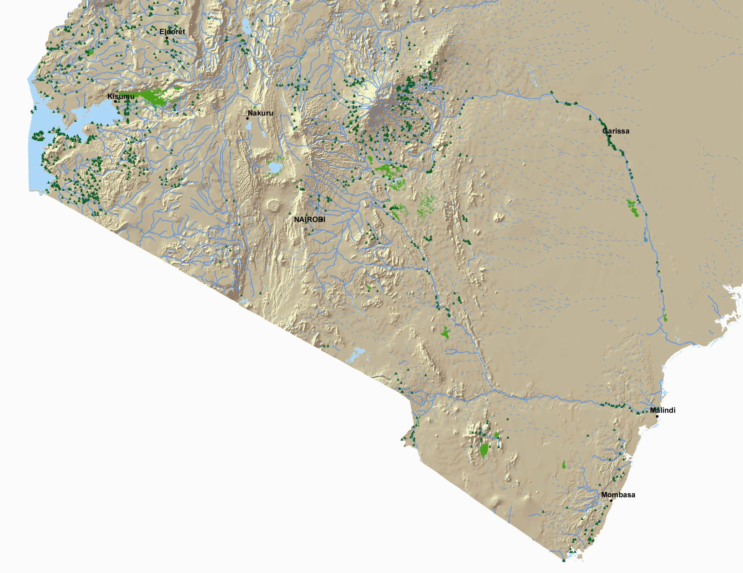
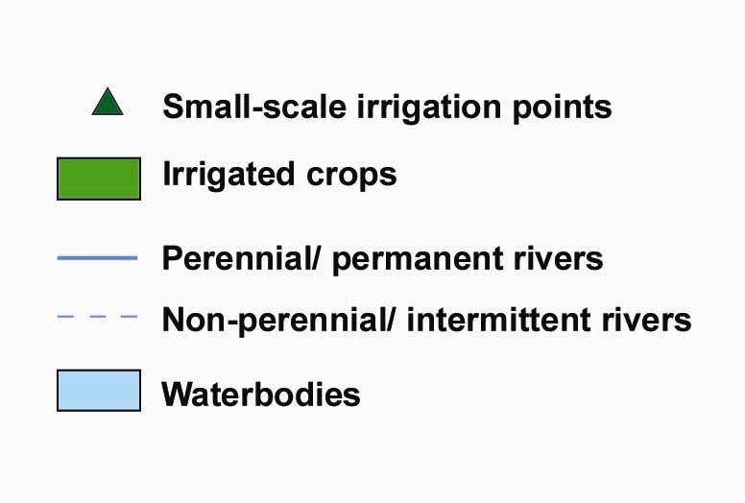
Tana River
Sources: International Water Management Institute, Africover – Food and Agriculture Organization of the United Nations, Kenya National Environment Management Authority, and Environmental Systems Research Institute.
Notes:
The Tana River is Kenya’s longest river.

Slide 20
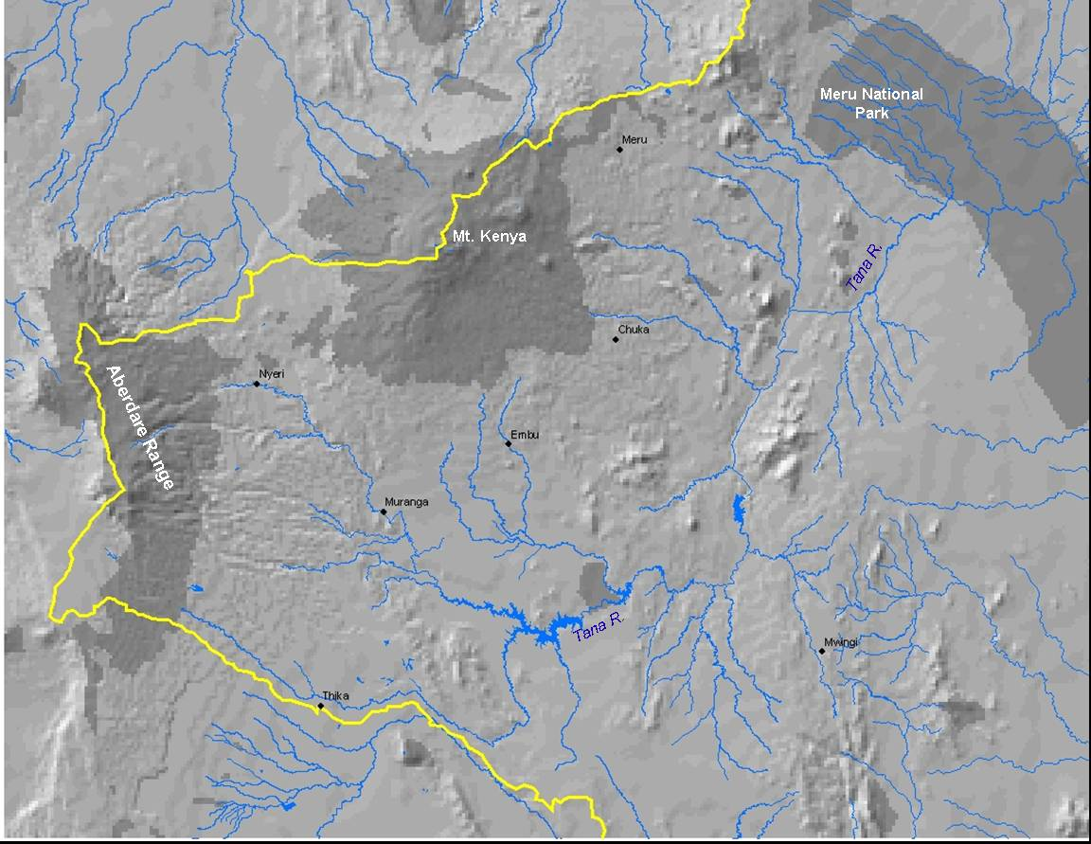
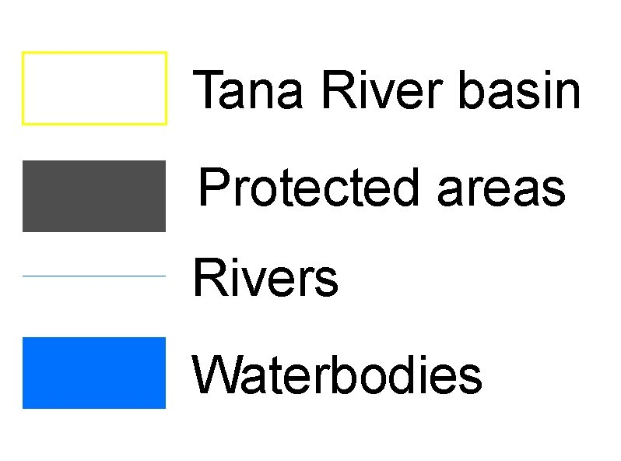
The Upper Tana River Basin
Sources: Kenya Central Bureau of Statistics, International Water Management Institute, Africover – Food and Agriculture Organization of the United Nations, Kenya National Environment Management Authority, and World Conservation Monitoring Centre.
Notes:
It drains the slopes of Mount Kenya and the Aberdare Range. The upper reaches of Mount Kenya and the Aberdare Range are designated as protected areas, safeguarding some of Kenya’s last tracts of forests. Meru National Park is a large protected area further downstream.

Slide 21
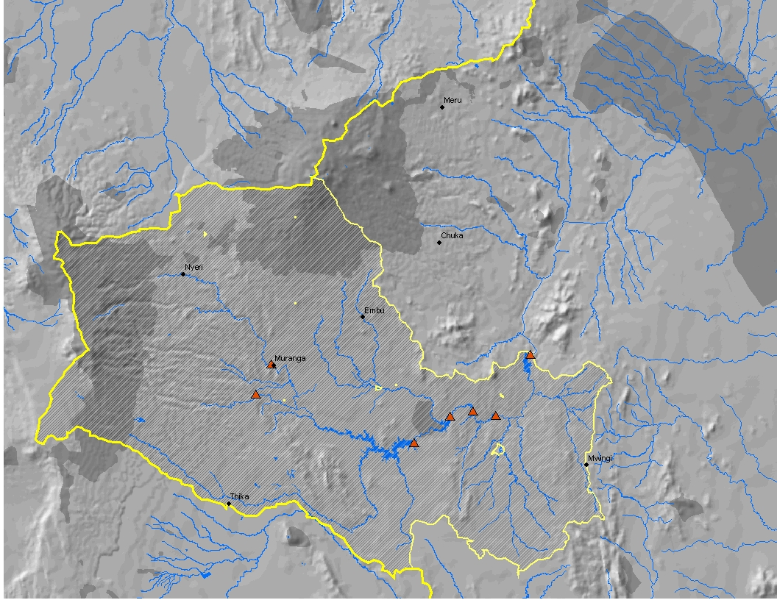
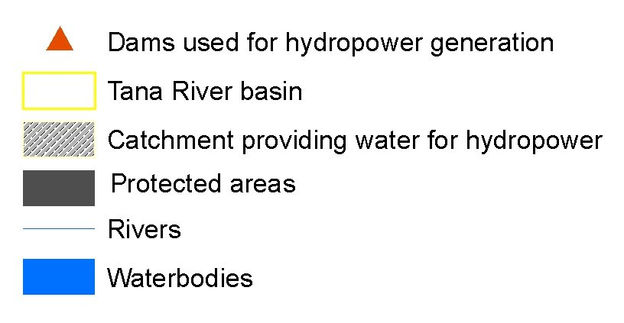
Water for Hydropower in the Upper Tana River Basin
Meru National
Park
Mt. Kenya
Tana R.
Aberdare Range
Tana R.
Sources: Kenya Central Bureau of Statistics, International Water Management Institute, Africover – Food and Agriculture Organization of the United Nations, Kenya National Environment Management Authority, and World Conservation Monitoring Centre.
Notes:
Two-thirds of Kenya’s electricity, mostly used by urban dwellers, comes from the catchment outlined in yellow, which feeds five power stations and reservoirs. Most of the drinking water supply for Nairobi comes from the headwaters in the Aberdare Range.

Slide 22
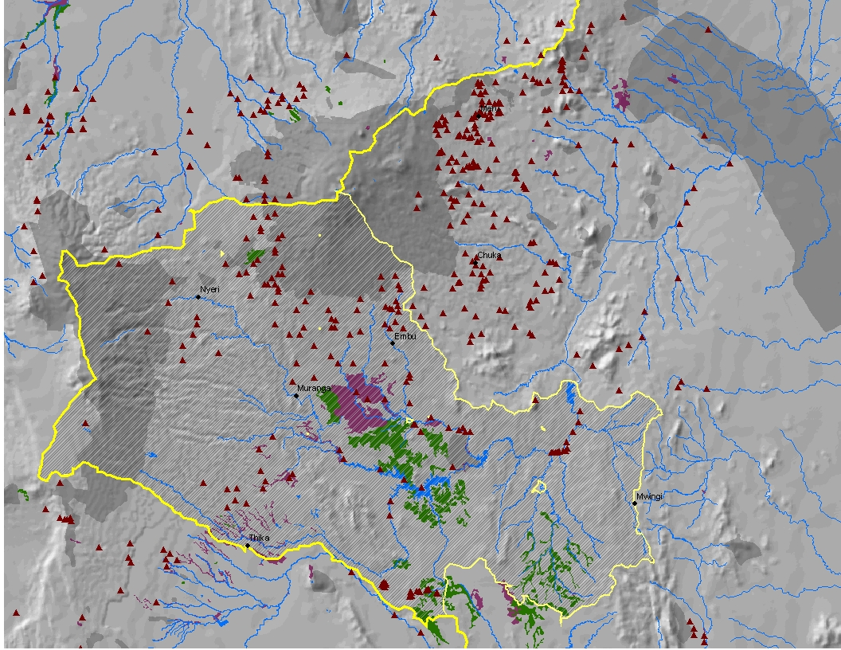
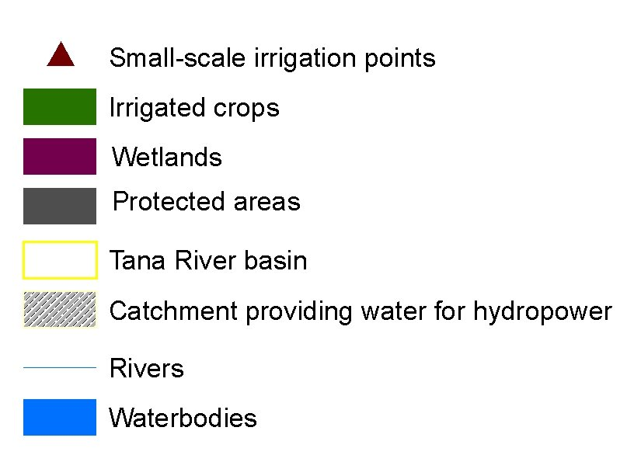
Ecosystem Services in the Upper Tana River Basin
Meru National
Park
Mt. Kenya
Tana R.
Aberdare Range
Tana R.
Sources: Kenya Central Bureau of Statistics, International Water Management Institute, Africover – Food and Agriculture Organization of the United Nations, Kenya National Environment Management Authority, and World Conservation Monitoring Centre.
Notes:
Policymakers have to balance multiple water demands, starting with minimum flow requirements to maintain Mount Kenya’s upland ecosystems which are ringed by clusters of small-scale irrigation efforts, followed by demands from concentrated large irrigated fields close to the main reservoirs, and ending with demands from households as well as from wildlife in Meru National Park further downstream.
Other competing demands put pressure on the few large remaining natural wetlands. They could be converted to produce irrigated crops or remain in their natural state, filtering runoff from Mount Kenya’s intensively cropped slopes and providing habitat for wetland species.

Slide 23
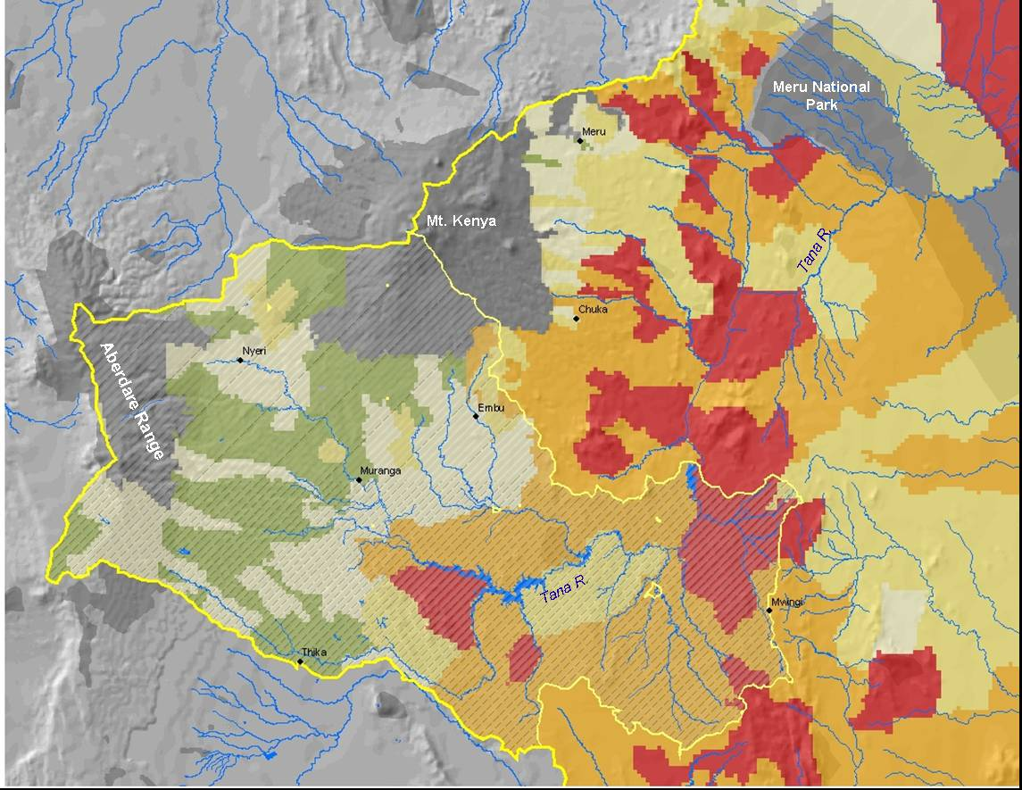
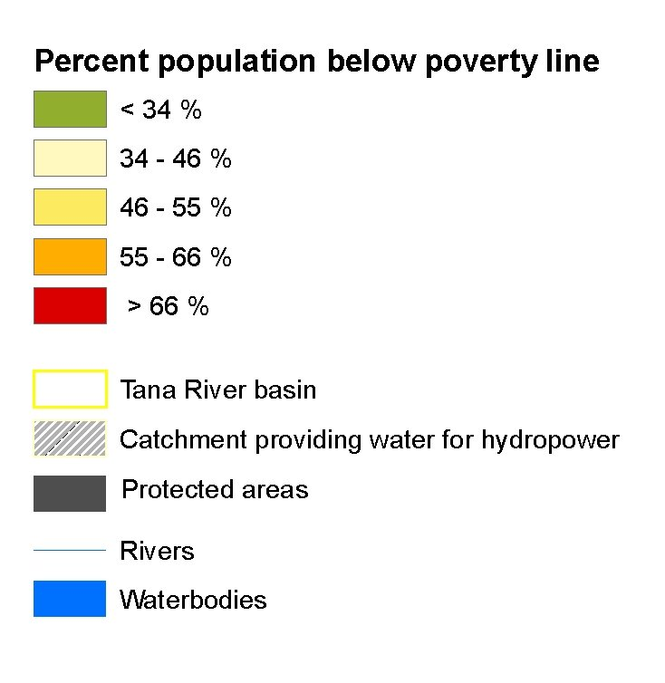
Poverty in the Upper Tana River Basin
Sources: Kenya Central Bureau of Statistics, International Water Management Institute, Africover – Food and Agriculture Organization of the United Nations, Kenya National Environment Management Authority, and World Conservation Monitoring Centre.
Notes:
Poverty rates are the lowest in the high-rainfall areas of the central highlands located between the large protected areas of Mount Kenya and the Aberdare Range. Following the Tana downstream, we see increasing poverty rates with some of the country’s highest rates in the lower-rainfall areas.

Slide 24
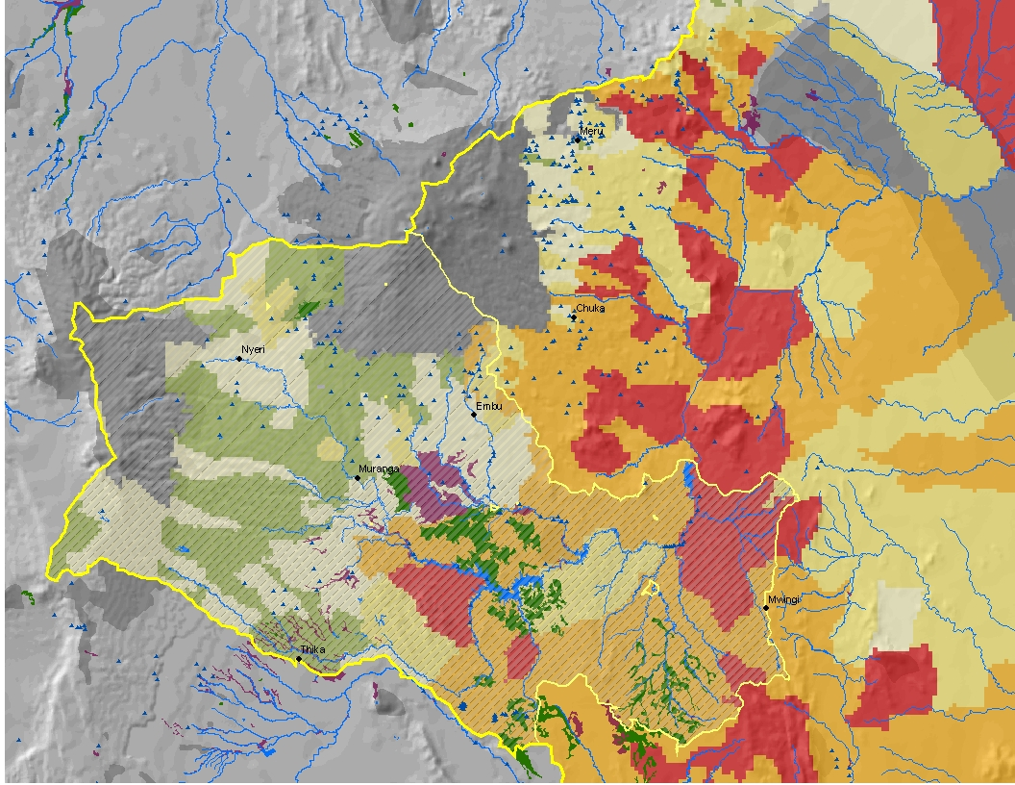
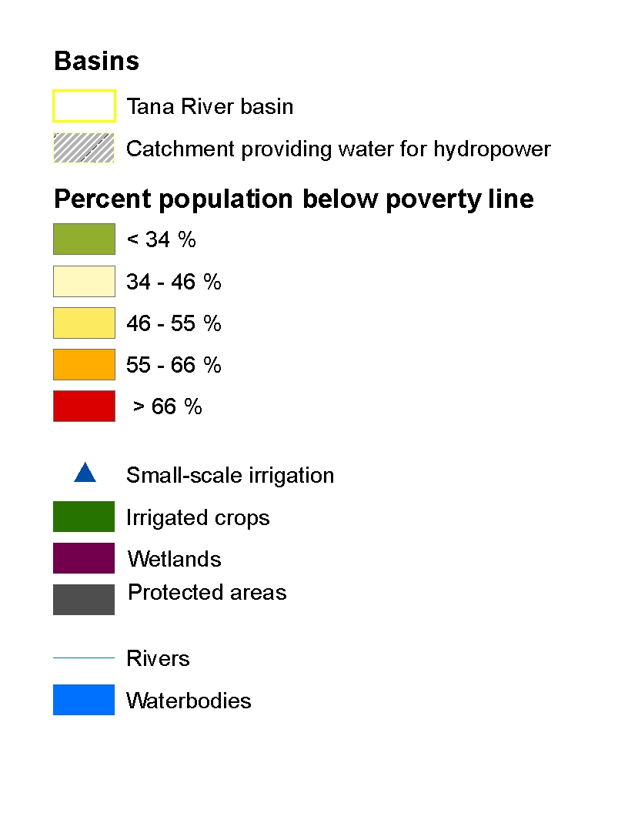
Combining all Layers: Poverty and Competing Demands for Ecosystem Services in the Upper Tana River Basin
Meru National
Park
Mt. Kenya
Tana R.
Aberdare Range
Tana R.
Sources: Kenya Central Bureau of Statistics, International Water Management Institute, Africover – Food and Agriculture Organization of the United Nations, Kenya National Environment Management Authority, and World Conservation Monitoring Centre.
Notes:
What does this spatial analysis tell policymakers, which by the way did not include other indicators of ecosystem services for example delineation of areas of with high agrobiodiversity, wildlife migration corridors, or important supply areas of timber and woodfuels.
The maps show that any intervention to create economic opportunities in the poorest and drier lowland areas, for example growing of vegetables for exports, better make sure that a clean supply of water is consistently available. The maps also show that downstream users do not have the financial means to pay for certain land use practices that would improve the quantity and timing of hydrological flows. The maps begin to indicate that future ecosystem changes, for examples changes in land use or new hydropower stations, can result in significant tradeoffs. In most cases Kenyan society has to make some very tough choices that should involve more than one sector or one major constituency.

Slide 25
Ecosystem Disservices
Notes:
Ecosystem services are in the eyes of the beholder. What may be a service for one group could create significant costs for other groups in society. For example, elephants have been used to promote Kenya’s tourism industry. Tourists have indicated in surveys that they would change their travel plans if elephant populations were grossly reduced or exterminated. Elephants, however, can be quite destructive and sometimes deadly to people living and farming close to their range.

Slide 26

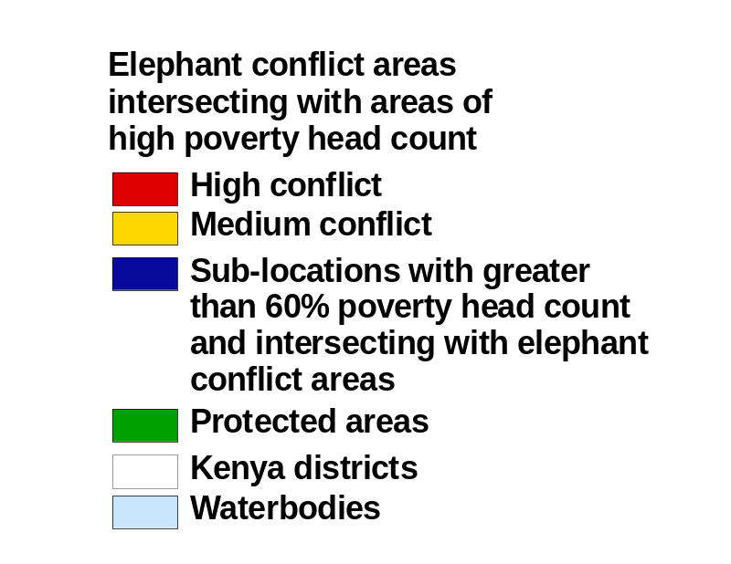
86 Administrative Districts with High Poverty Rates
Intersect with Elephant
Conflict Areas
Source: World Conservation Union (IUCN), World Conservation Monitoring Centre, and FAO Africover.
Notes:
This map shows areas with a high potential for people-elephant conflicts. These are areas where the current elephant range overlaps with croplands (often marginal maize cultivation). It also highlights in dark blue all administrative areas with poverty rates greater than 60 percent. The majority of “Locations” that are bordering potential conflict areas have high poverty rates.

Slide 27
Next Steps
Produce joint publication (2005)
Work with individuals in government and civil society to inject findings in selected policy processes
Raise funds to do similar work in Uganda (2006)
Explore options to replicate method and experiences in other countries
Notes:
We plan to produce a joint publication in 2005. We have done the initial team building to work with individuals in government and civil society to inject findings in selected policy processes. We would like to raise funds to do similar work in Uganda, perhaps in 2006. We are actively exploring options to replicate the method and experiences in other countries.

