Slide 1
Power and the Social Dimensions of Poverty and Natural Resource Management
Ruth Meinzen-Dick
Margaret Sarles
Victoria Rames
Julie Kunen

Slide 2
PURPOSE OF SESSION:
To explore basic concepts of social organization and power that have a profound affect on development work, and affect ANY program that seeks to redistribute assets within the political and social system.
Notes:
The purpose of this session is to explore some basic concepts of social organization and power that we believe will have a profound affect on your development work, and particularly will affect ANY program that seeks to redistribute assets within the political and social system.

Slide 3
GOALS
Understand the importance of factors relating to power and social organization to the success or failure of our development endeavor.
Understand the concepts of power, patronage, clientelism, and social capital, which underlie and influence choices and outcomes—both the definitions and why the concepts are important for NRM and poverty reduction.
Acquire a “technical skill” for efficiently understanding power relationships and factor them in to development work to maximize possibilities of improving the welfare of poor and marginalized groups.
Notes:
We have set out some goals for you we hope that together we can reach. By the end of this session, these are our goals:
A. That all of us understand the importance of factors relating to power and social organization to the success or failure of our development endeavor. Or, we can look at this in a more nuanced manner: During program design, and, even more, during implementation, officers will find that the particular choices they make are both influenced by and have an impact on power relationships.
B. That you understand the concepts of power, patronage, clientelism, and social capital, which underlie and influence choices and outcomes—both the definitions and why the concepts are important for NRM programs and poverty reduction.
C. That you acquire a “technical skill” that allows you to efficiently understand power relationships and factor them in to your work to maximize possibilities of success.

Slide 4
SESSION OVERVIEW
Definitions of key concepts and their importance
Introduction and work first as individuals, then as a group on developing a stakeholder matrix
In small groups, applying the matrix to the Namibia case study
Plenary presentations of group work
Wrap up to review whether the goals have been met
Notes:
The process of getting there—here’s how we’ll proceed during this session
A. Getting the definitions of the concepts down and the importance of them
B. Introduction and work first as individuals, then as a group on developing a stakeholder matrix
C. In small groups, applying the matrix to the Namibia case study. You will find there is a lot of room for judgment, so…
D. Meeting again in plenary, and presenting the small group work, with a wrap up to review whether the goals have been met.

Slide 5
POWER
`Power is a pervasive aspect of all human relationships. …how much power an individual or group is able to achieve governs how far they are able to put their wishes into practice at the expense of those of others.’ (Anthony Giddens)
  Can be through legal or illegal means
  Derives from multiple sources

Slide 6
CLIENTELISM
A network of one-to-one relationships based on unequal power; reciprocity of benefits
Based on historic patterns of land ownership and peonage
Adapted to local government (urban and rural) and resilient
Often found within layers of elected government, or bureaucracies
Elements of clientelism are found in all societies

Slide 7
PATRONAGE
Traditional:
  Within communities, elites offering certain assistance, esp. in times of hardship, in return for services/support
  In government, public sector jobs offered by politicians to their clients and allies, based on their private power relationship
Modern:
  Offering a broad array of state benefits, beyond jobs: non-competitive contracts, monopolies, subsidies, media control, differential regulation, etc. Still based on strengthening private power relationships
Patrimonial state: All state resources benefit particular groups, rather than society in general

Slide 8
WHY LOOK AT THESE PHENOMENA?
They help explain why NRM and poverty reduction programs falter.
USAID as a donor is inevitably a player in the patronage game; need to understand what linkages are strengthened/weakened
50-60% of DG Assessments single out patronage and clientelism as key development obstacles…
Patronage incentives are amenable to change
Notes:
A. P/C help explain why development efforts fail. (use Easterly as oral example, rather than slide; eliminate slide); We need knowledge of the traditional elite and the mechanisms that keep it in power.
B. USAID is a “player” as a donor in the p/c game: we reward some, provide certain resources that are used as patronage. Need to understand what linkages are being strengthened/weakened by our work; not always intuitive or obvious.
C. USAID missions often conclude that patronage and patron/client linkages in the political system are one of the most serious obstacles to the success of their own programs. You may know that many missions commission analyses of democracy and governance as they develop new strategies. USAID has carried out more than 60 such analyses, that look for the underlying issue that seems to be impeding good governance and better democracy. In more than half of these, patronage has been identified as a major factor. (A,B,C should be on one slide)
Paraguay – Decision of the whole mission in every area, including NRM to have a “patronage” focus.

Slide 9
DEVELOPMENT EFFORTS THAT IMPEDE AND DIMINISH PATRONAGE
Promote transparency in all state actions
Increase political competition (local v nat’l govt; new parties and oversight)
Scope of state: reduce it (absolute and %)—but consider who power is transferred TO
Encourage “horizontal linkages” (of equals, e.g. unions, mass membership organizations, mobilized social groups [churches, youth groups] to replace “vertical” ones) Robert Putnam

Slide 10
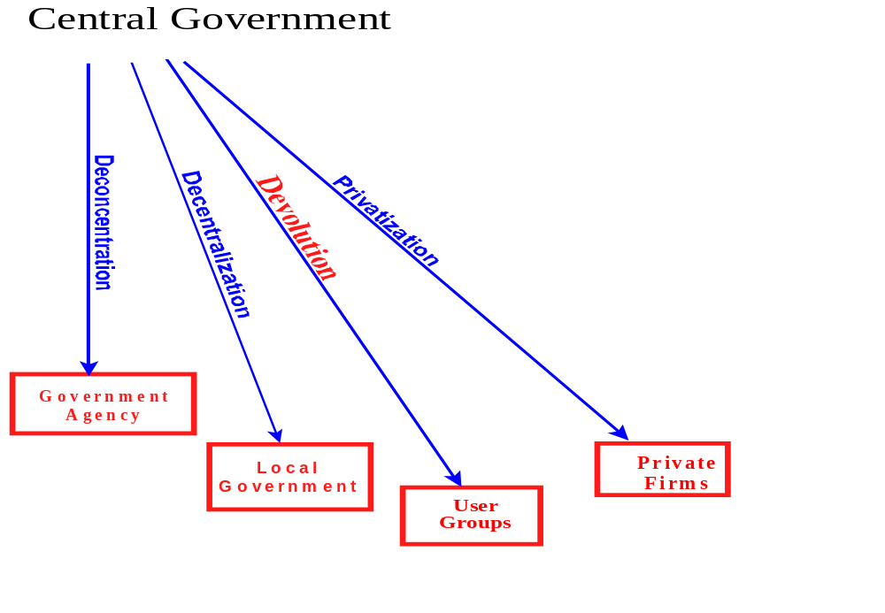
DEVOLUTION, DECENTRALIZATION AND OTHER INSTITUTIONAL REFORMS
Notes:
Point here is that not all efforts to diminish the role of the (central) state are the same; they transfer authority to different types of organizations, that have different types of accountability, and there are also different power structures within each.
NRM is often devolution.
Comanagement is often a blend of government and user groups, like in the Namibia case we will be studying

Slide 11
SOCIAL CAPITAL
Collective: Features of social organization - such as networks and values, including tolerance, inclusion, reciprocity, participation and trust - that facilitate coordination and cooperation for mutual benefit. Social capital inheres in the relations between and among actors. (UNDP 1997).
Individual: The social resources (networks, membership of groups, relationship of trust, access to wider institutions of society) upon which people draw in pursuit of livelihoods (Carney 1998:7).
Not only positive—those in power or blocking reforms also have social capital

Slide 12
TYPES OF SOCIAL CAPITAL
Bonding social capital: Horizontal ties that give communities a sense of identity and common purpose (World Bank 2002)
Bridging social capital : Ties that transcend various social divides (e.g. religion, ethnicity, socio-economic status) (World Bank 2002)
  With like people who are physically distant
  Linking (vertical ties)

Slide 13
STAKEHOLDERS
Anyone with a (substantial) interest
  Those who can damage/weaken authority,
  block changes
  Those who can strengthen, benefit the program
  Those who can influence direction or mix of an organization’s activities
Stakeholder analysis focuses on groups’
  Interest in a particular issue
  Types of resources they have to affect outcomes
Notes:
Note: original definition of stakeholder was the neutral person who held the stakes of contending bettors

Slide 14
STAKEHOLDER ANALYSIS IN NRM and POVERTY REDUCTION
Identify multiple users of resource, interest groups
  By occupation
  Elites/nonelites
  By gender
  By generation within the household
  Leaders and others in NRM groups
  Local and non-local
  Look for marginalized groups
  Government agencies
  Traders, others with livelihood stakes
  NGOs, environmental interest groups

Slide 15
ACTION ARENA
Action
Resources
Rules,
Strategies
Actors
Social Bargaining
Action and Outcomes
Notes:
From initial (static) conditions in our framework we move to look at the dynamics of the action arena. This encompasses
the ACTORS
ACTION RESOURCES ( resource at the disposal of actors) that they draw upon
DECISION-MAKING ARRANGEMENTS AND STRATEGIES of actors
ACTION: leads to OUTCOMES: action can corroborate existing conditions and institutions or change in material conditions as well as institutions themselves.

Slide 16
INCLUSION AND EXCLUSION
Are all stakeholders actors (are they all included)?
  Possible forms of exclusion:
    Being overlooked in formation of MSP
    Formal rules (e.g. only land owners, head of household)
    Other barriers: Ability to attend meetings, make contributions (look at time, location, cash requirements)
    Ability to speak and be heard
    (is it worthwhile to attend?)

Slide 17
ACTION RESOURCES
Tangible and intangible assets that give actors possibility of agency (to change things)
  Tangible:
    Rights to land, water, other natural resources
    Physical assets, including access to infrastructure (roads, information technology)
    Financial resources
  Intangible: social capital
    Political or social connections
    Internal connections (“bonding social capital”)
    External connections (“bridging social capital”)

Slide 18
ACTION RESOURCES:
INTANGIBLE ASSETS—HUMAN CAPITAL
Human capital is the knowledge and skills that individuals bring to the solution of a problem (Ostrom 1994)
  Information and ability to process it
  Cognitive schemata to make sense of the world
  Social standing, habitus
  Time
    To participate in activities
    Time horizon, discount rate

Slide 19
RULES, STRATEGIES
Some kinds of organizational structures give more importance to certain resources
  Formal meetings vs. informal communication
  Formal training vs. local knowledge
  Time, travel requirements for local people vs. government agents

Slide 20
ACTION AREA:
SOCIAL BARGAINING
What is the subject of the bargain?
Who has positional and sanctioning power?
Who has the ability to affect payoffs of strategic interactions
How can the poor increase their ability to bargain (e.g. through collective action ?)
How can external institutions affect the bargaining position of the poor?
Notes:
Social bargaining determines the value of action resources and affects payoffs of strategies. Some question that might be important to consider to understand the process:
What is the subject of the bargain? – affects value of action resources in the specific situation
Who has positional and sanctioning power? – and more generally
Who has the ability to affect payoffs of strategic interactions (and thus affect strategies themselves)
The poor (have few resources especially power resources: so one question is how can THE POOR THEMSELVES improve their bargaining position: CA is one way, although it is not always an easy way to go (excluded from CA and constraint in participating?)
Another question is how can external institution support the poor in social bargaining? (increase their action resources, support CA capabilities of the marginalized, through securing PR – to increase action resources (tangible and intangible) and give more legitimacy to their needs.

Slide 21
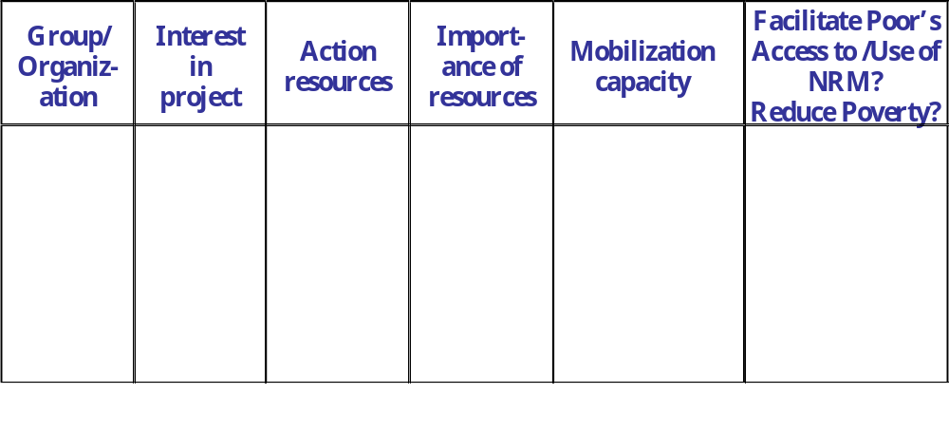
STAKEHOLDER ANALYSIS FRAMEWORK

Slide 22
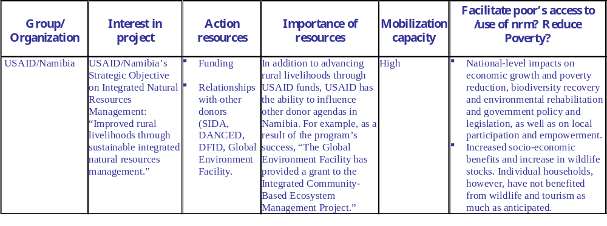
STRUCTURAL FACTORS
Please list several micro, meso or macro level structural factors/constraints that are pertinent to the stakeholder analysis and that would likely effect the success of the case study project in Namibia.
1. ___________________________________________________________________________
2. ___________________________________________________________________________
3. _____________________________________________________________________________
STAKEHOLDER ANALYSIS FRAMEWORK

Slide 23
APPLYING THESE PRINCIPLES
Break into small groups
Review Namibia case study
Group fills in Stakeholder Analysis Table
Discuss implications of power relations for outcomes of community conservancies

