Slide 1
Implementing Sustainable Tourism in the USAID Context
Arusha, Tanzania
February 2006

Slide 2

MODULE 1:
INTRODUCTION TO TOURISM

Slide 3
Objectives
By the end of the session, participants will be able to:
Describe the workings of the tourist industry
Identify international trends in tourism
Know the principles of sustainable tourism
Identify the opportunities and pitfalls of tourism as a development tool

Slide 4

Why Tourism?
It is global in extent
It is important to the economy of many developing countries
It can be utilized to help achieve several Agency pillar objectives
It can be used in an economic diversification strategy

Slide 5
What is Tourism?
Tourism comprises the activities of persons traveling to and staying in places outside their usual environment for not more than one consecutive year for the purpose of leisure, business, and other purposes.
What are the different categories of tourism?
Leisure
Cultural
Nature-based
Scientific/Educational
Business Traveler
Service

Slide 6
What is the Contribution of Tourism to the World Economy?
In 2004, travel & tourism directly accounted for 1.54 trillion USD in Gross Domestic Product (GDP) and 74 million jobs.
Indirectly, travel & tourism accounted for 4.22 trillion USD (10%) of the world’s GDP and 215 million jobs (8%) of the world’s employment.
Source- WTTC 2004

Slide 7
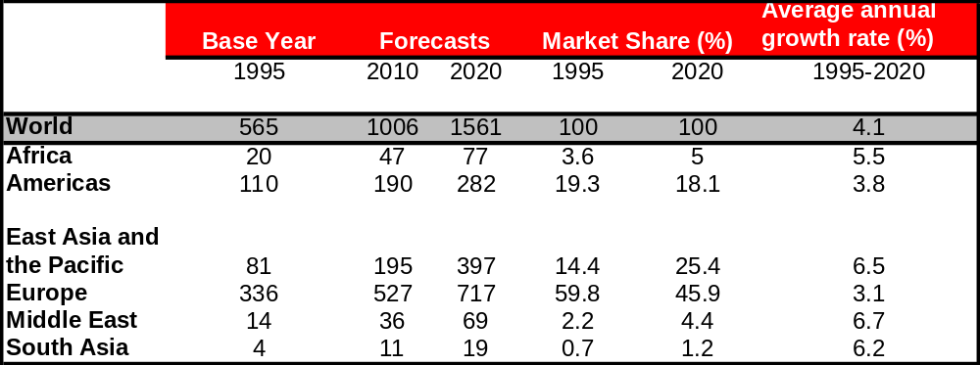
International Tourist Arrival Projections (millions) – 2010 and 2020
Source: WTO (2005) Projections based on reported data.

Slide 8
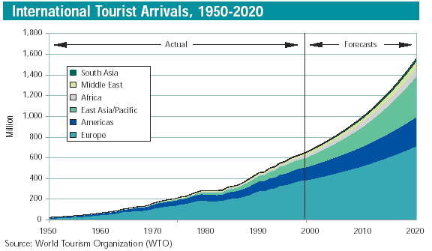

Slide 9
Tourism and the Developing World Economy
80% of the world’s poor live in 12 countries, of which 11 have a significant and growing tourism industry
In 2000, tourism was the second highest combined source of foreign exchange earnings in 46 of the 49 Least Developed Countries, and ranks behind only petroleum in Angola, Equatorial Guinea and Yemen
Tourism is a major export for 83% of all developing countries, and the primary export for one third of them
Source: WTO (2002)

Slide 10
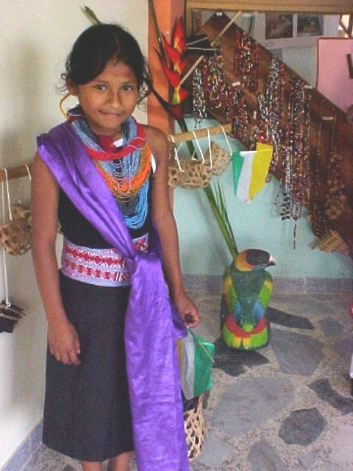
Tourism in Your Country: Exercise 1-1
Based on your research, how important is tourism in your country?
0 ——— 1 ——— 2 ——— 3
What types of tourism are important for our purposes?...
  Leisure
  Cultural/historical/archaeological/
  architectural
  Nature-based
  Adventure
  Scientific/educational
  Family

Slide 11
From Tourism to Sustainable Tourism
Agenda 21 (Rio de Janeiro, 1992)
UN Commission on Sustainable Development (CSD7, 1999)
Canary Islands Declaration (2001)
U.N. Millennium Development Goals (MDG, 2000)
World Summit on Sustainable Development
(Rio +10, 2002)
Declaration on Tourism and MDG (2005)

Slide 12
Sustainable tourism development meets the need of present tourists and host regions while protecting and enhancing opportunities for the future. It is envisaged as leading to management of all resources in such a way that economic, social, and aesthetic needs can be fulfilled while maintaining cultural integrity, essential ecological processes and services, and biological diversity.
Source: World Tourism Organization
What is Sustainable Tourism?

Slide 13
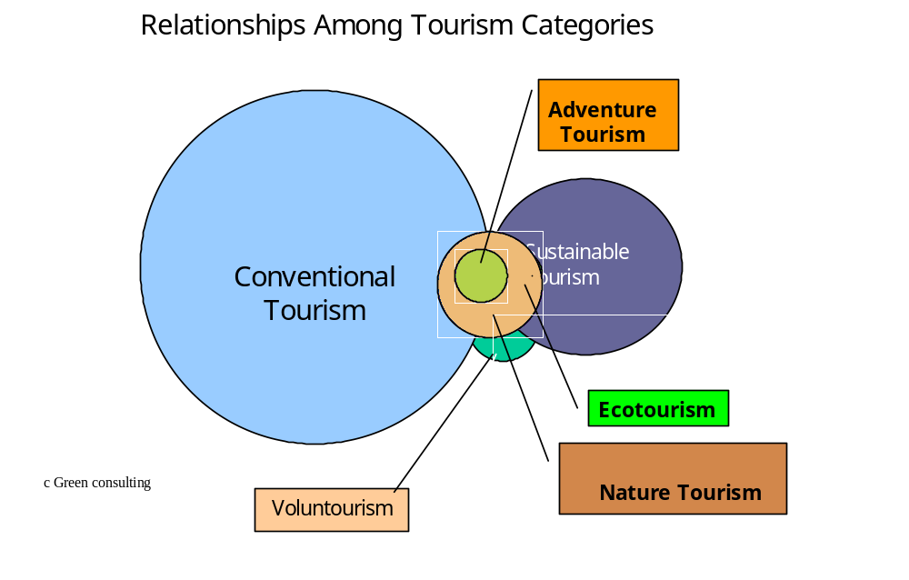

Slide 14
Based upon the Millennium development goals, additional emphasis has been placed on the economic as well as environmental benefits of Sustainable Tourism. Sustainable Tourism should:
Make optimal use of environmental resources that constitute a key element in tourism development, maintaining essential ecological processes, and helping to conserve natural heritage and biodiversity.
Respect the socio-cultural authenticity of host communities, conserve their built and living cultural heritage and traditional values, and contribute to inter-cultural understanding and tolerance.
Ensure viable, long-term economic operations, providing socioeconomic benefits to all stakeholders that are fairly distributed, including stable employment and income-earning opportunities and social services to host communities, and contributing to poverty alleviation.
World Tourism Organization, 2004

Slide 15
Environmentally Sustainable Development and Tourism
What is Ecotourism?
Responsible travel to natural areas that conserves the environment and improves the well being of local people.
The International Ecotourism Society

Slide 16
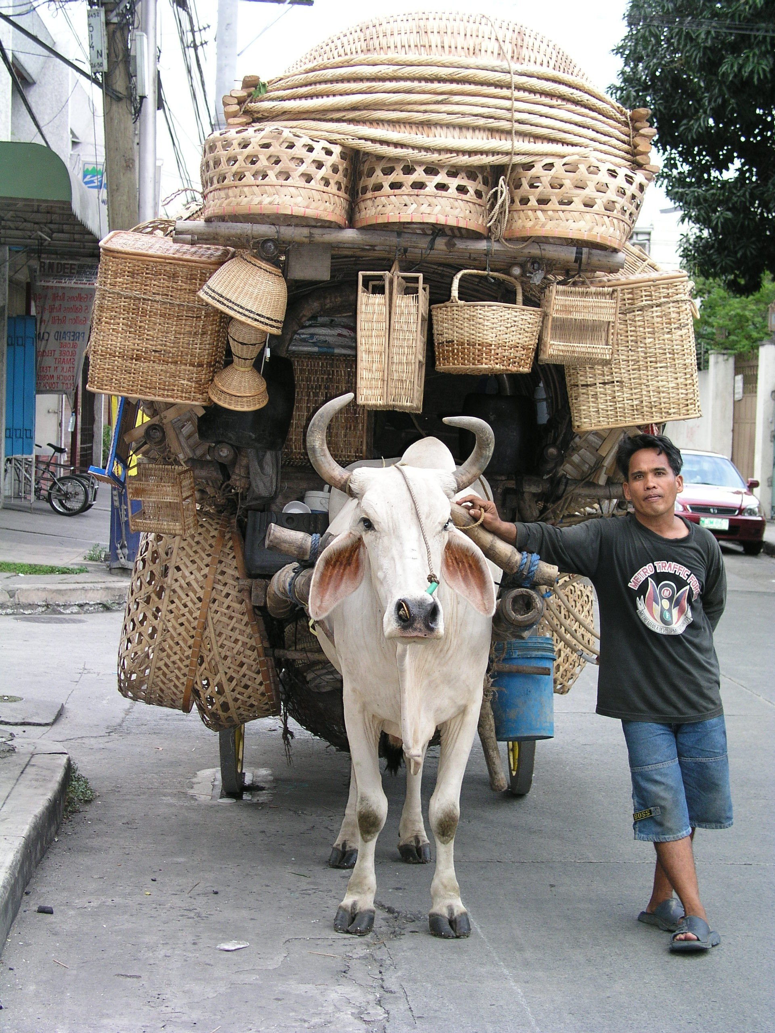

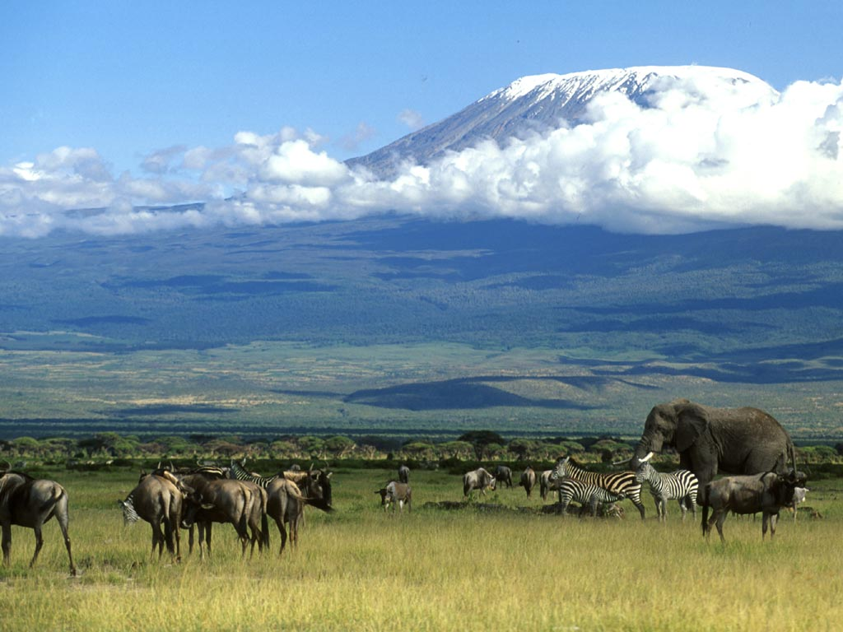
Relationship of Ecotourism to Sustainable Tourism

Slide 17
Tourism Industry Stakeholders: Exercise 1-2
What is involved in a tourism experience?
  Mr. and Mrs. Jones from the U.K. want a one-week safari experience in Southern Africa.
  What is the sequence of steps that Mr. and Mrs. Jones would probably take?
  Who are the players (or service providers) involved with each step?
  What is the role of each player?

Slide 18
International Tourism Industry First Order (Direct) Service Providers
ORIGIN
TRAVEL
DESTINATION
Travel Agencies
Cruise Lines
Inbound Operators
Outbound Operators
Airlines
Tour Buses
Information Services
Rail
Bus
Boat
Hotels/Motels/Lodges
Operators of
Attractions
Tour Guides
Information Services
Arts & Crafts
Restaurants/Food services
Nightlife/Entertainment

Slide 19
Tourism Value Chain: Exercise 1-3
What other suppliers help support these key
tourism service providers?

Slide 20
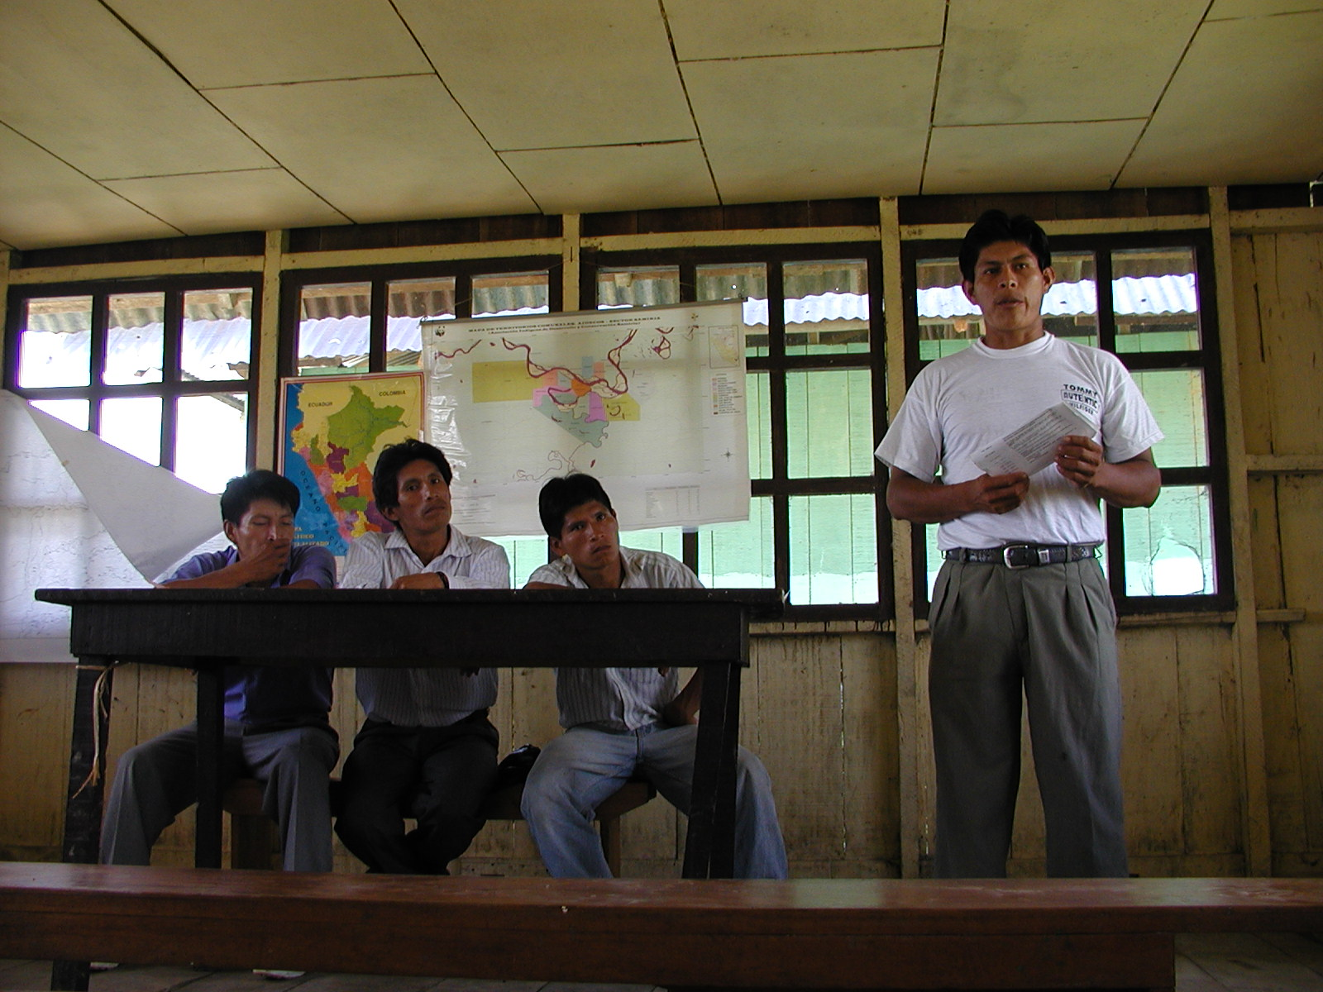
Tourism Support: Exercise 1-4
Who supports tourism in other ways?
• The Community
• The Government
• Public/Private Partner-
ships
• NGOs and Educational
Institutions
• Donors

Slide 21
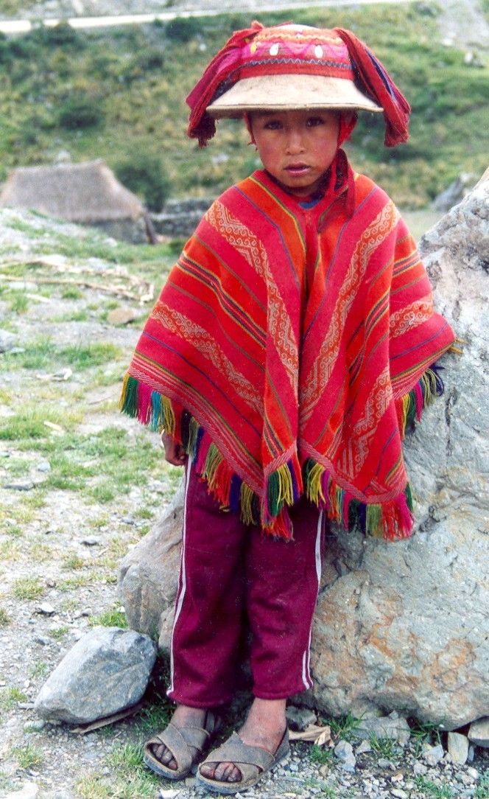
Tourism as a Development Tool
1970s – Infrastructure Development
1980s – Departure from Tourism
(left to private sector)
1990s – Emphasis on Environment
2000s – Increased emphasis on
Local Communities and Economic
Growth

Slide 22
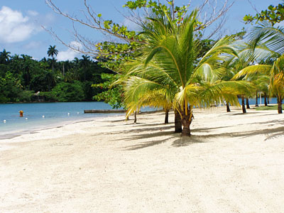
Benefits of Tourism: Exercise 1-5
  What are the potential benefits of tourism
  for a developing country?

Slide 23
Benefits of Tourism: Exercise 1-5
  What are the potential benefits of tourism for a developing country?
  Utilizes natural capital advantages to provide an internationally competitive industry for developing countries that can be more sustainable than extractive industries
  Provides opportunities to diversify a local economy
  Supports the formation of small and micro enterprises
  Is labor intensive and offers jobs with different levels of skills
  Provides employment opportunities for women and youths
  Promotes rural development
  Promotes local governance
  Introduces technology and basic infrastructure

Slide 24
•
Benefits of Tourism: Exercise 1-5, continued…
  What are the potential benefits of tourism for a developing country?
  Promotes health and general welfare
  Generates revenue for natural resources management and protection
  Provides incentive for local people to protect their natural environmental assets and maintain their cultural diversity – provides value (is important both financially and socially)
  Reduces the severity of conflicts between people and wildlife
  Supports cultural heritage
  Strengthens linkages with the outside world

Slide 25
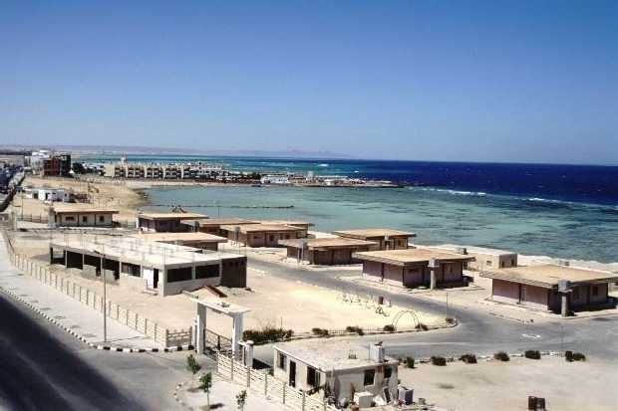
Pitfalls of Tourism: Exercise 1-6
  What are the potential pitfalls of tourism?
•

Slide 26
Pitfalls of Tourism: Exercise 1-6
  What are some potential pitfalls of tourism?
  Encourages cultural alienation and crime
  Corrupts and displaces societal norms and traditions
  Encourages prostitution and human trafficking
  Facilitates the spread of diseases
  Overburdens infrastructure systems
  Destroys fragile terrestrial and marine habitats
  Damages cultural and archeological sites
  Provides low paid, seasonal employment, poor living conditions for workers, and indentured servitude
  Is sensitive to world economic downturns and other events
  Habituation
  Increased cost of living
  Disproportionate benefits to some and not others
•

Slide 27

RECAP
How the tourism industry works
Recent international growth trends
Principles of sustainable tourism
Benefits and pitfalls of tourism

