Slide 1
Implementing Sustainable Tourism in the USAID Context
Arusha, Tanzania
February 2006

Slide 2

MODULE 6:
NEXUS – LINKAGES BETWEEN ECONOMIC & ENVIRONMENTAL INTERVENTIONS

Slide 3
Objectives
By the end of the session participants will be able to:
Understand and apply environmental best practices to sustainable tourism businesses
Understand and apply sound business practices to ecotourism operations

Slide 4
Revisiting the definitions of sustainable tourism and ecotourism
Sustainable tourism development meets the need of present tourists and host regions while protecting and enhancing opportunities for the future. It is envisaged as leading to management of all resources in such a way that economic, social, and aesthetic needs can be fulfilled while maintaining cultural integrity, essential ecological processes and services, and biological diversity.
Ecotourism is responsible travel to natural areas that conserves the environment and improves the well being of local people.

Slide 5
Environmentally Sustainable Tourism
Conservation and efficient use of natural resources
Management of wastes and chemical products
Environmental education and best practice training
Reduce impact of tourism operations on ecosystems
Extend programs to nearby communities, suppliers, vendors, and contractors

Slide 6
Program for Environmental Performance Improvement
Environmental management assessment
Environmental Management System (EMS)
Environmental management best practices
Environmental certification

Slide 7

Environmental Management Assessments
Environmental Walkthrough Assessment
Best Practice Assessment
Detailed Environmental Management Assessment

Slide 8
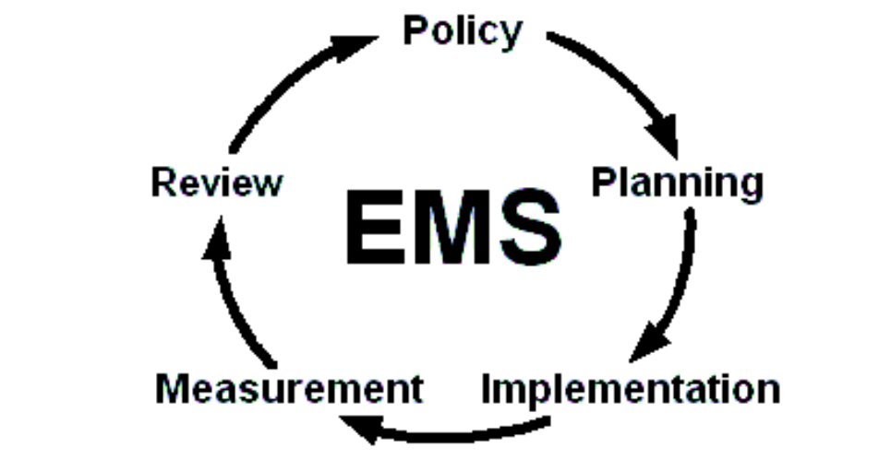
Environmental Management Systems
Source: Environmental Management Systems for Caribbean Hotels and Resorts: A Case Study of Five Properties in Jamaica, PA Consulting Group, 2001.

Slide 9
Elements of an Environmental Management System
Environmental policy statement
Objectives, targets and action plan
Organizational structure
Standard operating procedures
Environmental purchasing
Emergency preparedness
Monitoring and reporting

Slide 10
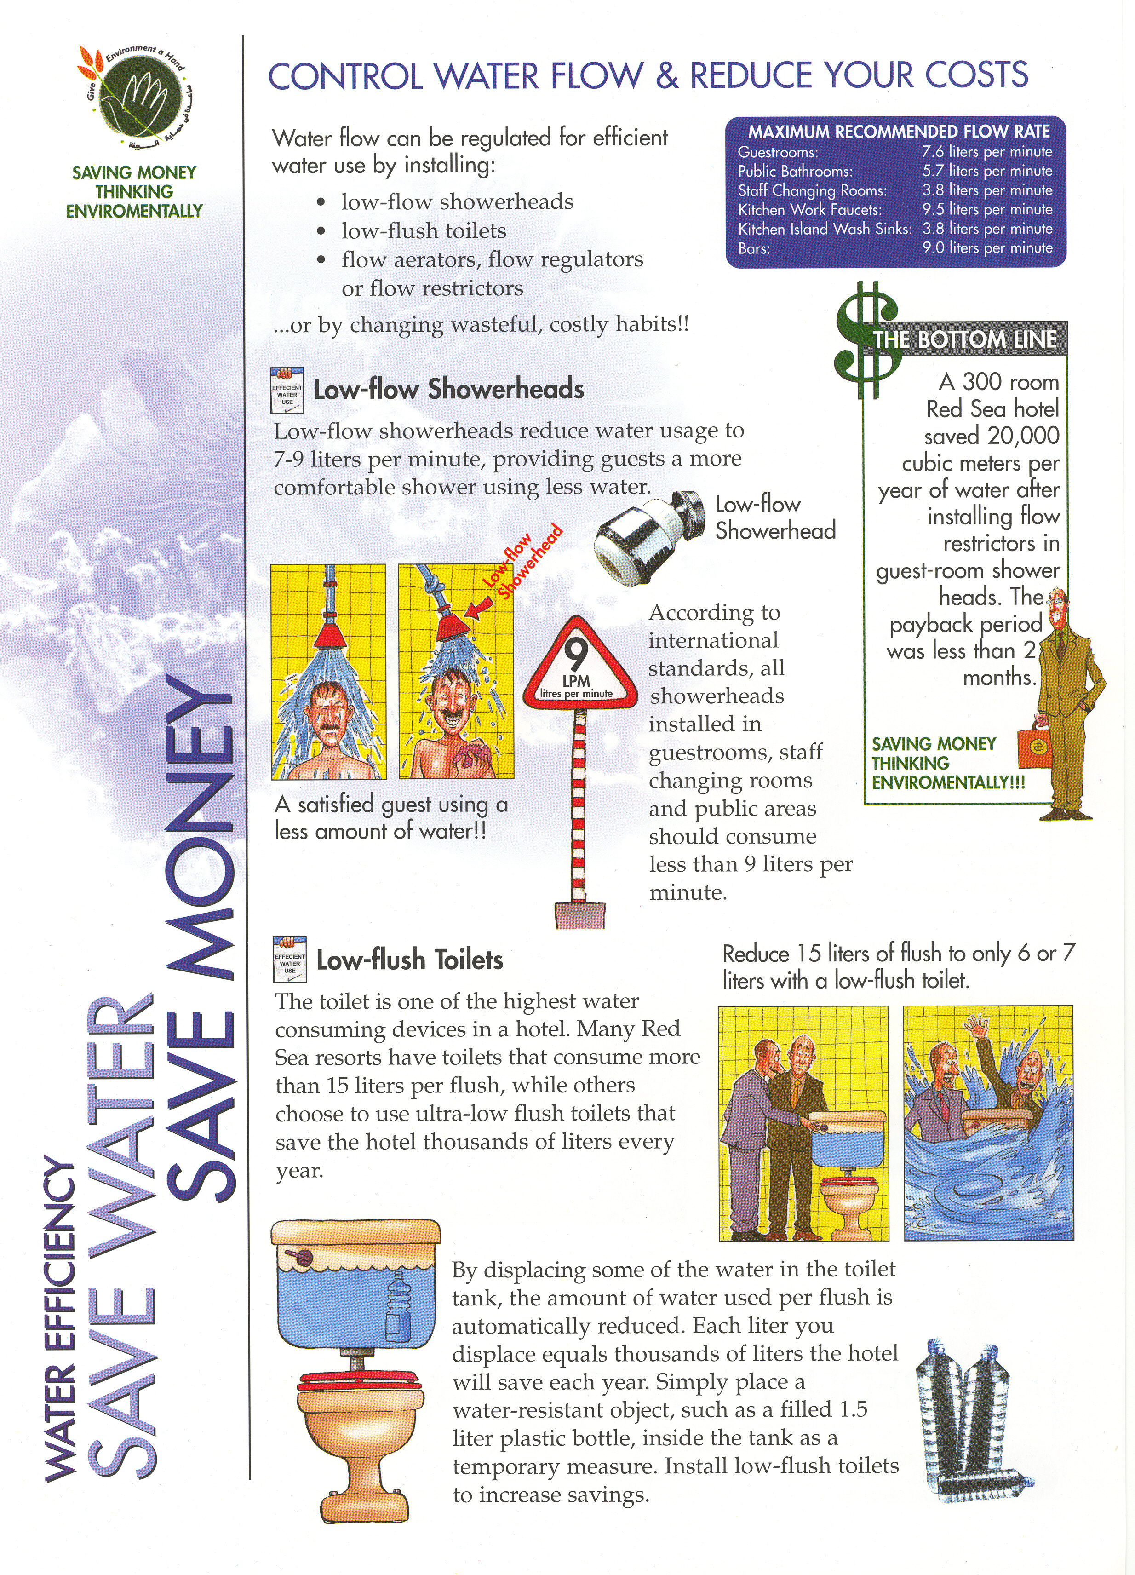
Environmental management best practices:
Energy
Water
Waste

Slide 11
Impact of Best Practices on Energy & Water Consumption
The most efficient hotel consumed ~1/12th as much electricity and water per guest-night than the least efficient hotel.
Hotel star rating and type of guest amenities affect consumption.
Efficient design, equipment and operations, and effective maintenance and staff participation have by far the greatest impact on performance.

Slide 12

Ecolabels and Sustainable Tourism Certification
A sample of labels in Europe alone:
Source: The VISIT Initiative

Slide 13
Lessons Learned in Introducing Environmentally Sustainable Tourism Businesses
Site and design to minimize impacts
Environmental management assessments to identify areas of improvement and cost savings
Environmental Managements Systems to establish a process for continuous improvement
Sustainable tourism certification to recognize accomplishments
Procurement that “greens the supply chain”
Actively engage in community and biodiversity conservation to ensure long term viability

Slide 14
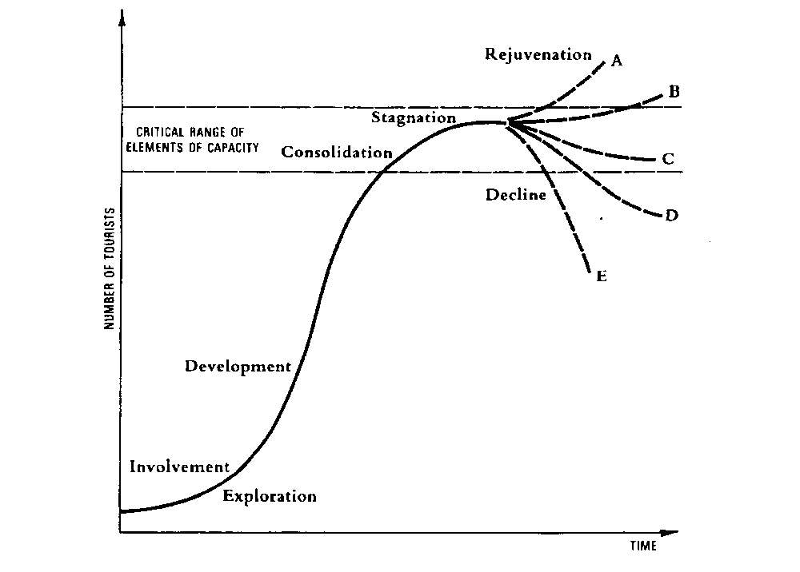
The Need for Sustainable Tourism Approaches at the Destination Level
Butler's well-known Hypothetical Evolution of a Tourist Area diagram (Butler, R.W. 1980, "The Concept of a Tourism Area Life Cycle of Evolution: Implications for Management of Resources." The Canadian Geographer 24(1), p. 8.

Slide 15
Destination Planning and Management
Multi-stakeholder governance
Positioning in the marketplace
Organizational development
Upgrade planning and monitoring capabilities of local communities
Linkages of tourism circuits

Slide 16
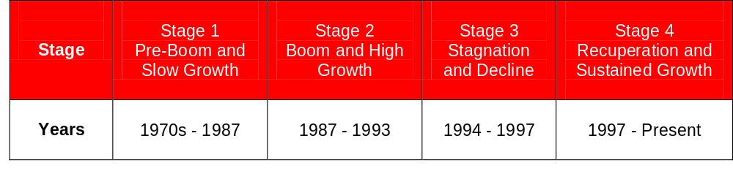
Market Positioning as an Eco-Destination: The Costa Rica Example
Stages of Tourism Development in Costa Rica

Slide 17
Destination Design: Exercise 6-1
3 Groups to illustrate a sustainable tourism destination.
Read about your destination and then:
Draw the natural and cultural attractions (coastline, mountains, villages, wetlands, species, forest, ruins, etc.)
Draw the critical infrastructure (roads, ports, airports, water supply, energy, hotels (?), etc.)
Identify their target market segments (domestic or international, adventure, history, nature, birdwatcher, family, retiree, etc.)
Identify vulnerabilities (places where tourism may impact community or nature, potential threats to tourism, etc.)

Slide 18
Ensuring the Economic Viability of Ecotourism Enterprises
Understanding business considerations
Role of conservation managers in the business of ecotourism
Creating a business partnership with tour operators
Preparing a feasibility analysis
Preparing a business plan
Financing for ecotourism business
Source: Ecotourism Development – A Manual for Conservation Planners and Managers, The Nature Conservancy, 2005.

Slide 19
Overview of Business Considerations
Protected area management and business planning
Financial and environmental quality
Business planning
Roles of NGOs in ecotourism business development
Risk factor in ecotourism business development
Source: Ecotourism Development – A Manual for Conservation Planners and Managers, The Nature Conservancy, 2005.

Slide 20
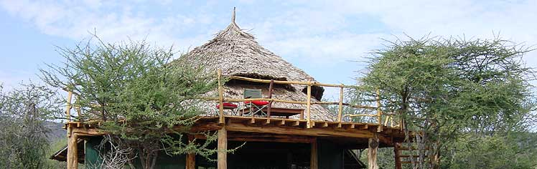
Ecotourism Enterprise Structures
Selecting an ecotourism enterprise structure
Assessing potential partners
Defining partnership expectations
Source: Ecotourism Development – A Manual for Conservation Planners and Managers, The Nature Conservancy, 2005.

Slide 21
Creating a Business Partnership with Tour Operators
The tour operators’ perspective
Marketing advantages of responsible tourism
Community expectations
Partner relationship
Source: Ecotourism Development – A Manual for Conservation Planners and Managers, The Nature Conservancy, 2005.

Slide 22
Preparing a Feasibility Analysis (10 steps)
Preliminary questions
Information gathering
Definition of goals
Resource inventory
Market analysis
Competitive analysis
Business description and operation
Sales forecast
Financial analysis
Viability assessment
Source: Ecotourism Development – A Manual for Conservation Planners and Managers, The Nature Conservancy, 2005.

Slide 23
Basic Rules for Creating a Viable Ecotourism Business
Business ideas must be market-driven
A business must make a profit
All costs must be taken into account
Judgement is required where information is lacking
Source: Ecotourism Development – A Manual for Conservation Planners and Managers, The Nature Conservancy, 2005.

Slide 24
Preparing a Business Plan
Address the target audience (funding providers)
Work with business owners
Consider social and environmental factors
Avoid common business plan mistakes
Source: Ecotourism Development – A Manual for Conservation Planners and Managers, The Nature Conservancy, 2005.

Slide 25

Financing an Ecotourism Business
Types of financing
Equity
Debt
Sources of financing
Self-financing
Commercial banks
Grants and donor agencies
Micro-finance institutions
Biodiversity enterprise funds
Non-financial support
Source: Ecotourism Development – A Manual for Conservation Planners and Managers, The Nature Conservancy, 2005.

Slide 26
  Ecotourism Enterprises: Exercise 6-2
  Same groups as earlier exercise to illustrate 2 or more ecotourism enterprises based on a handout.
  Also, answer…
  What are the enterprises? Who is/are the owner(s)?
  How are they linked to the target market?
  Who is the target market?
  What are the environmental best practices?
  What are the business best practices?
  What are the values of the destination we are representing?

Slide 27

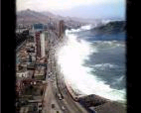

Extreme Events and Tourism
Natural disasters (e.g., hurricanes, floods, earthquakes, landslides)
Epidemics (e.g., SARS, AIDS, malaria)
Instability in fragile states (e.g., war, terrorism, political oppression)

Slide 28
Project Example: Jamaica – EAST
SO: Improved quality of key natural resources in selected areas that are both environmentally and economically significant
Program: Environmental Audits for Sustainable Tourism (EAST)
Intervention Areas: Expansion of sound environmental management practices in tourism, Environmental management services capacity building
Tools/Mechanisms Used: Environmental audits, Training in EMS, Environmental certification, destination management, financing, hurricane recovery
Partners/Collaborators: Jamaica Hotel and Tourist Association, Ministry of Tourism and Industry Tourism, National Environment Planning Agency

Slide 29
Project Example: Ghana – CBEP
SO: Economic Growth
Program:Community-Based Ecotourism Program (CBET)
Intervention Area:
Development of ecotourism destinations, improvement of resource protection and community awareness
Tools/Mechanisms Used:Construction of interpretive centers, ranger stations, huts and trails; performance of Biological Assessment; promotion of attractions; exchange program; training
Partners/Collaborators:
Ghana Tourist Board, Government of Ghana, Forestry Research Institute of Ghana, Nature Conservation Research Center

Slide 30
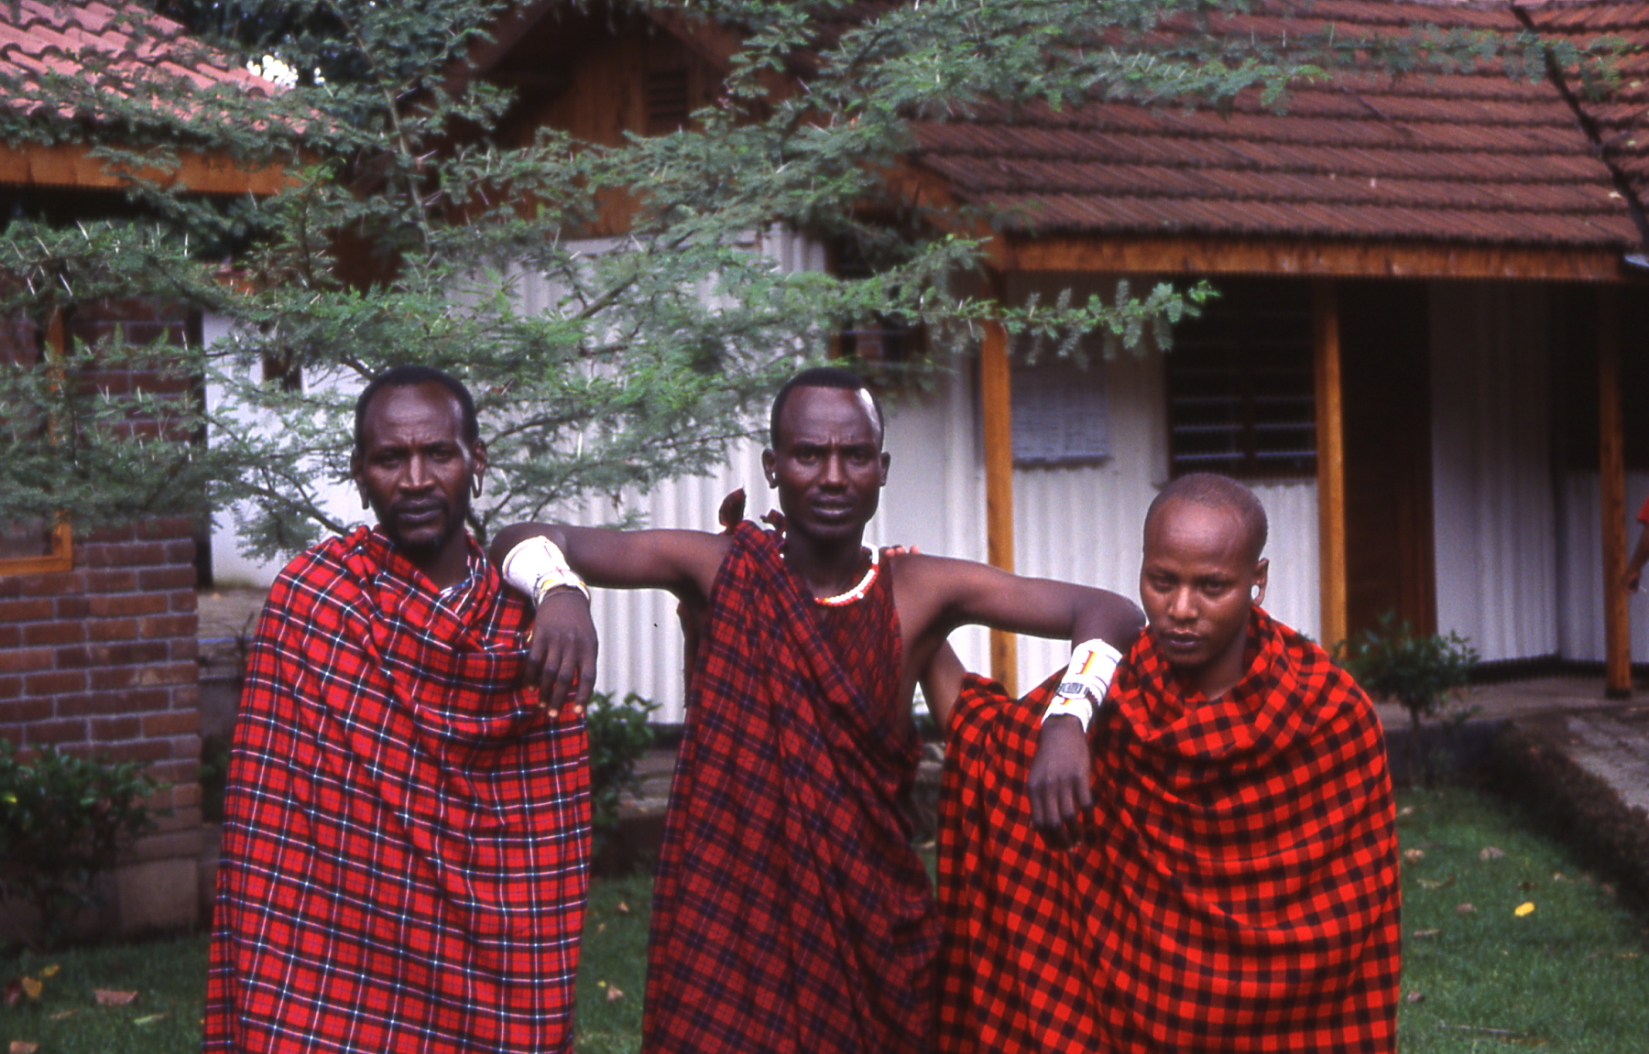
Categories of Sustainable Tourism Performance Indicators
Sustainable Tourism Businesses
Community Well-being
Visitor Well-being

Slide 31
Sample ST Performance Indicators:
1) Sustainable tourism businesses:
# of sustainable tourism businesses
# of businesses certified for eco-friendliness
% of all tourism businesses certified
# and % of staff trained in eco-standards
# of visitors to eco-destinations
Amount of financial support to NGOs
# of private-public partnerships with local community

Slide 32
Sample ST Performance Indicators:
2) Community well-being:
% of tourism staff with first-aid training
% of local tourism workers receiving health care
% of tourism operators who provide transport for women returning from night shifts
Women/men as a % of all tourism employment
Average income for women/men working in tourism
# of harassment incidents reported
Amount of tourism’s contribution to training and education
Amount of tourism’s contribution to ICT infrastructure

Slide 33
Sample ST Performance Indicators:
3) Visitor well-being:
# of visits by tourist to local doctors
# of reports of food poisoning
# of incidents of crime/violence per month, per year, per type
# of tourists harmed per month, per year
# of crime incidents reported to the international press
Level of expenditure on security (regional, national, enterprise)
# of police per tourist

Slide 34
Nexus Intervention: Exercise 6-3
Small groups; choose and develop an ecotourism development activity from one of your countries:
  What are the issues?
  What interventions could be used?
  What performance indicators could be
  measured?

Slide 35

RECAP
Environmentally sustainable tourism presents a win-win approach to enterprises and destinations
Ecotourism enterprises must operate like a business, but with special considerations
Extreme events can have a devastating impact on tourism

