Slide 1
Implementing Sustainable Tourism in the USAID Context
Arusha, Tanzania
February 2006

Slide 2

MODULE 7:
BRINGING IT ALL TOGETHER – ASSEMBLING A TOURISM PROJECT

Slide 3
Objectives
By the end of the session, participants will be able to:
Design a holistic, integrated approach for a new tourism project
Estimate the budget and period necessary for a chosen tourism intervention
Select illustrative performance indicators to measure whether interventions will achieve program goal(s)

Slide 4
From Concept to RFP/RFA
Goal
Background (issues)
Components, Interventions [and Activities]
Performance Indicators
Period of Performance
Budget
Staffing
Environmental Considerations
Funding Mechanism

Slide 5
USAID Jordan, 2004 - 2009
Strategic Objective: SO10
Improved Economic Opportunities for Jordanians
Intermediate Results:
More transparent, efficient and responsive public sector
More effective legal and regulatory reform
Increased depth of private sector growth involvement

Slide 6
Jordan Tourism Project
Program Goal:
To promote Jordan’s competitiveness as an international tourism destination by establishing the proper institutional and regulatory framework that enables a private sector-driven approach that spurs tourism growth while at the same time preserving the nation’s historic and natural treasures.

Slide 7
Jordan Tourism Project
Program Background:
Major challenges facing Jordan
Jordan’s economy and tourism’s contribution
Tourism in Jordan compared to neighboring countries
Constraints to Jordan’s tourism sector development
Past USAID involvement in tourism and other sectors
Past local and international partners in USAID projects
Jordan’s tourism institutions

Slide 8
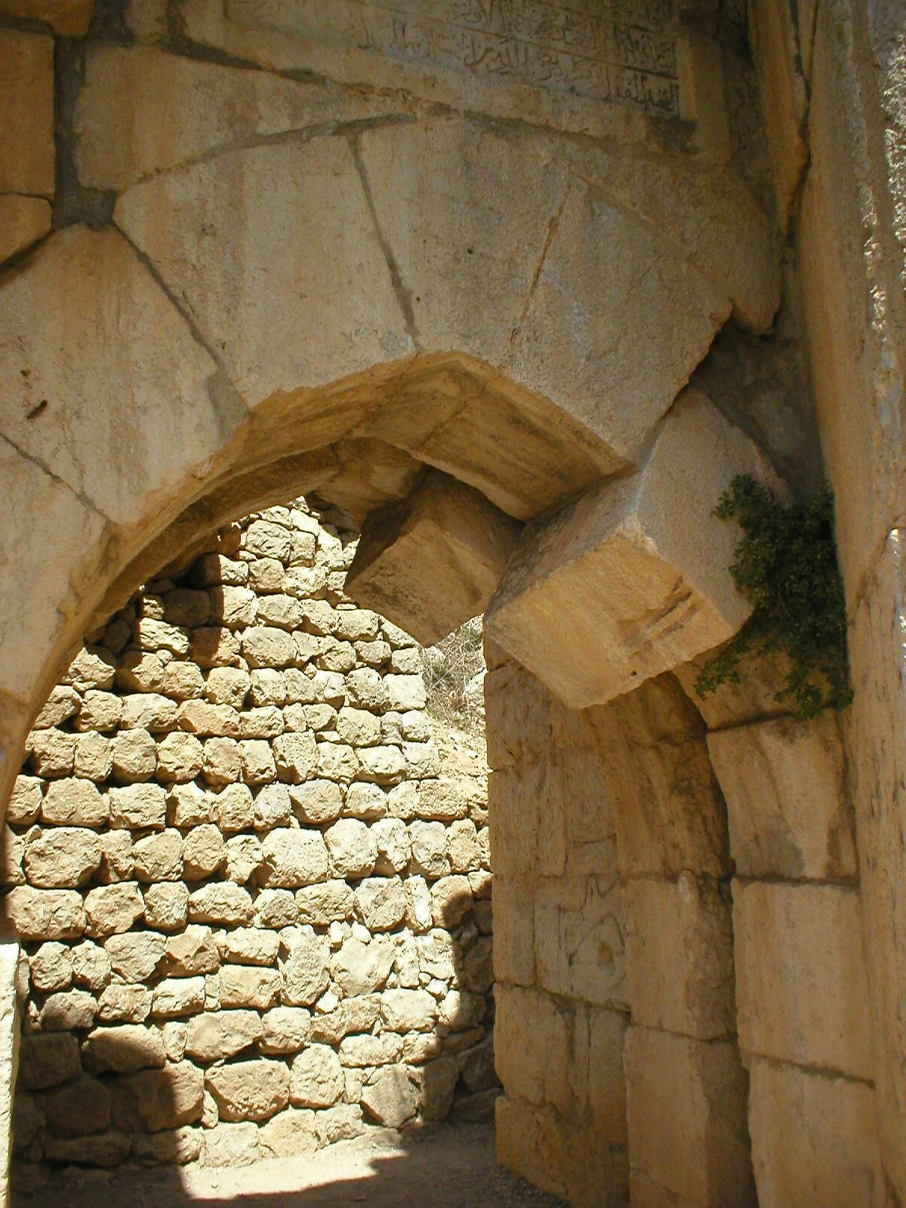
Jordan Tourism Project
Project Components:
1. Creating an Enabling Environment for Tourism Growth
2. Building a Responsive and Dynamic Tourism Sector and Local Development Opportunities
3. Cross-over Public-Private Activities

Slide 9
Jordan Tourism Project
Components:
Intervention areas:
Creating an Enabling Environment for Tourism Growth
Legal and Regulatory Reform
Institutional Reform
Building a Responsive and Dynamic Tourism Sector and Local Development Opportunities
Product and Site Development
Association & Enterprise Development
Awareness among Jordanians about the importance of tourism
Cross-over Public-Private Activities
Human Resources and Quality Assurance
Research Capacity
Financial Services Integration
Grants

Slide 10
Jordan Tourism Project
Components:
Intervention areas:
Creating an Enabling Environment for Tourism Growth
Legal and Regulatory Reform
Institutional Reform
Building a Responsive and Dynamic Tourism Sector and Local Development Opportunities
Product and Site Development
Association & Enterprise Development
Awareness among Jordanians about the importance of tourism
Cross-over Public-Private Activities
Human Resources and Quality Assurance
Research Capacity
Financial Services Integration
Grants

Slide 11
Jordan Tourism Project
Sample illustrative activities:
Work with the Executive Privatization Commission to create management contracts attractive to private investors;
Use community participation approaches and appropriate survey techniques to determine the target community’s development priorities;
Involve rural development authorities in local and regional tourism planning;
Provide support to various stakeholders for the development of product categories, i.e., cultural tourism, culinary tourism, eco-tourism, adventure tourism, religious tourism, architectural tourism, historical tourism, etc.;
Develop cross-sectoral linkages for rural tourism projects.

Slide 12
Jordan Tourism Project
Sample Proposed Performance Indicators:
Growth in number of tourists each year
Amount of private investment into tourism sector
Number of new tourism companies registered
Amount of tax revenue generated from tourism
Global Competitiveness Index ranking

Slide 13
Period of Performance
Depends upon whether it is a tourism only project, or if tourism is embedded in a larger project
Can be implemented in phases to allow for adaptive programming
Duration depends upon capacity of partners and counterparts
What’s your experience?

Slide 14
Period of Performance, cont.
Intervention
Typical Duration (not sequential)
Tourism Strategy
6-12 months
Tourism Master Plan
12-18 months
Tourism Cluster
18-24 months
Tourism Product Development
12-24 months
Industry Demonstration Program
18-24 months
Standards and Certification Program
24-36 months
Training Program
6-18 months
Destination Management Program
12-36 months
Community Based Tourism Program
12-24 months
Protected Area Tourism Program
12-24 months

Slide 15
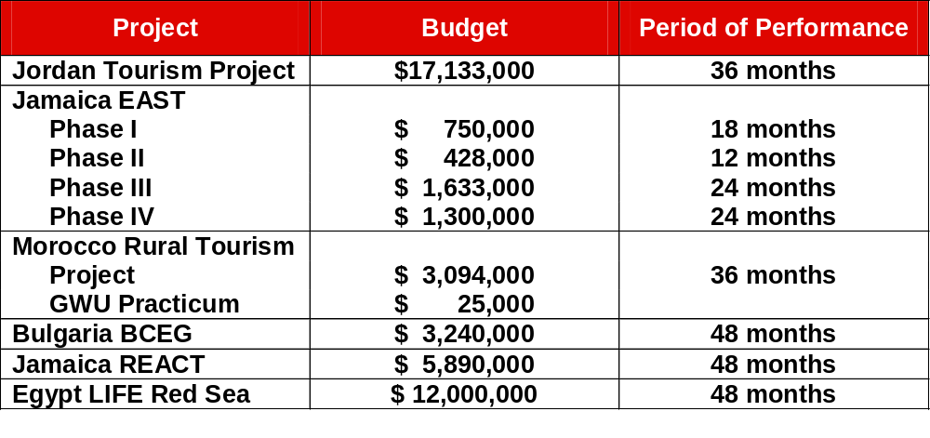
Budget – several examples

Slide 16
Jordan Tourism Project
Staffing proposed:
Tourism Law and Open Skies Agreements Specialist
Tourism Investment Promotion Specialist
Tourism Site Development Specialist
Tourism Reform Specialist
Transportation Specialist
Tourism Governance and Sector Analyst
Community-Based Tourism Development Specialist
National Parks Interpretation Specialist
World Heritage Site Specialist
Hospitality Quality Assurance Specialist
Public-Private Partnership Specialist
Institutional Reform Specialist

Slide 17
Environmental considerations – Reg 216
It is USAID policy to:
Ensure that the environmental consequences of AID financed activities are identified and considered by AID and the host country prior to a final decision to proceed and that appropriate environmental safeguards are adopted;
Assist developing countries to strengthen their capabilities to appreciate and effectively evaluate the potential environmental effects of proposed development strategies and projects, and to select, implement and manage effective environmental programs
Identify impacts resulting from AID’s actions upon the environment, including those aspects of the biosphere which are the common and cultural heritage of all mankind
Define environmental limiting factors that constrain development and identify and carry out activities that assist in restoring the renewable resource base on which sustained development depends.

Slide 18
General Procedures - Reg 216
Preparation of the Initial Environmental Examination (IEE)
Threshold Decision
Negative Declaration
Scope of Environmental Assessment or Impact Statement
Preparation of Environmental Assessments and Environmental Impact Statement
Processing and Review within USAID
Environmental Review after Authorization of Financing
Monitoring
Revisions
Other Approval Documents

Slide 19
Goal and Background: Exercise 7-1
Small group exercise. For a tourism project in your mission:
• Write a brief Goal (just a statement is ok), and
• Write a brief Background (bulleted list is ok) and
• Define 1-3 components of a tourism project
• Outline interventions and some illustrative activities
• List some performance indicators
• Determine a period of performance for the project
• Determine an estimated budget for the project

Slide 20
Evaluation Criteria
Appropriateness of interventions to address issues
Realism of budget, period of performance, staffing
Fulfills sustainable tourism objectives (economic, environmental, social)

Slide 21
RECAP
The Tourism Assessment Process from Module 3 helps set the stage for assembling a tourism project.
The implementation perspective provides valuable insights and lessons learned in designing tourism interventions.
Staffing, budget and period of performance needs vary depending on the project, location, previous tourism projects and other factors.
Performance indicators must be clearly defined, easy to understand, comparable, objective and realistic to measure.
A Reg 216 Initial Environmental Examination is required for all projects that are not categorically excluded or exempt.

Slide 22

Core Delivery Team
Peter Hetz – phetz@ardinc.com
Bill Meade – bill.meade@paconsulting.com
Andy Drumm – adrumm@tnc.org
Neil Inamdar – ninamdar@conservation.org

