Slide 1
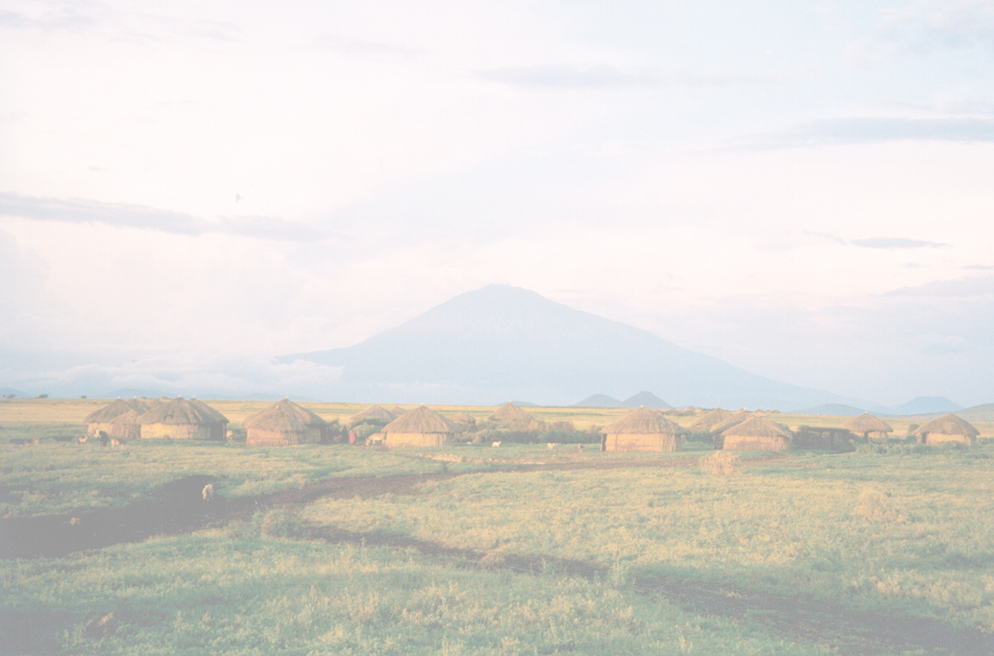
Implementing Sustainable Tourism in the USAID Context
Arusha, Tanzania
February 2006

Slide 2
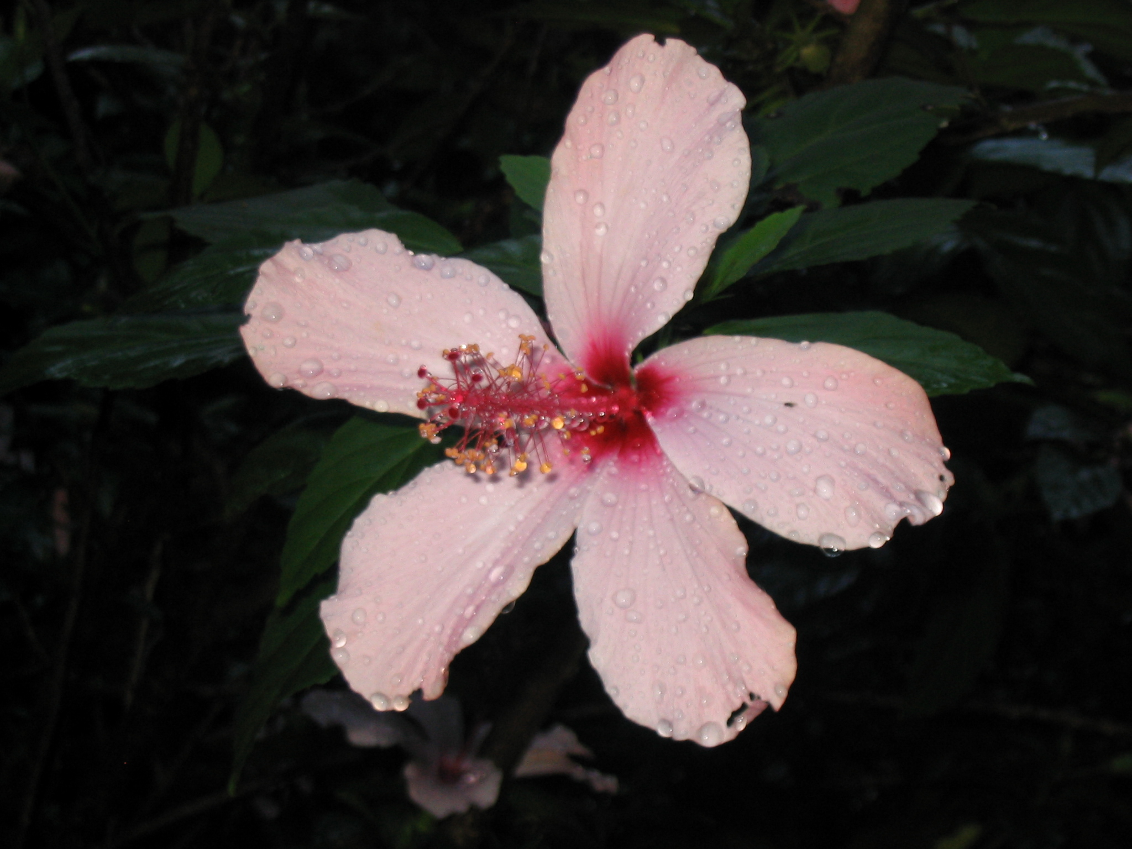
Workshop Objectives
increase understanding of the basic principles of sustainable tourism
develop capability to analyze whether tourism would be a good tool
explain how to approach tourism project design and implementation
illustrate realistic expectations, with examples of indicators
Notes:
This session will provide a background on the language and principles of tourism and sustainable tourism, review international trends, and begin to describe how tourism can be used as a tool for development.

Slide 3
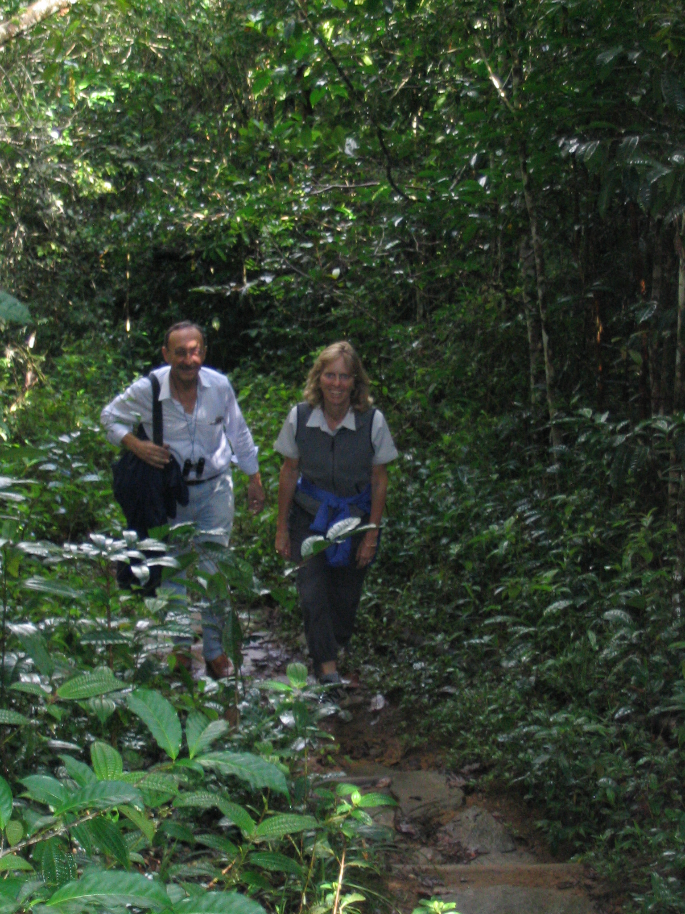
Contents
Tourism as an industry
Assessing tourism SWOTs
USAID and Tourism
Tourism for Economic Growth and Poverty Alleviation
Tourism for Natural Resources, Biodiversity, and Cultural Conservation
Economic and environmental approaches
Assembling a tourism program
Notes:
Discussion, Record on flip chart:
How important is tourism in your country?
begin to get an idea of how important tourism is in the participants’ own countries re: job creation, economic growth, improved livelihoods, etc.
draw the continuum from the slide on a flipchart; ask the group to supply answers from their research; mark a representative number of indicators on the continuum
draw conclusions of the level of importance of tourism.
What types of tourism are important?
List group ideas on flip chart. For example:
Leisure
Cultural/historical/archaeological/architectural
Nature-based
Adventure
Scientific/Educational
Family
Consider the types and relative importance of rural vs. urban tourism
Recap Points: We now have a good idea of what the current tourism situation is in some countries.

