Slide 1



EnterpriseWorks Worldwide (Phils.), Inc.
CBFM PO Assessments
for REGION 2
GLOBAL CONSERVATION PROGRAM
United States Agency for International Development
EnterpriseWorks Worldwide (Phils.), Inc.
Tuguegarao Field Office

Slide 2
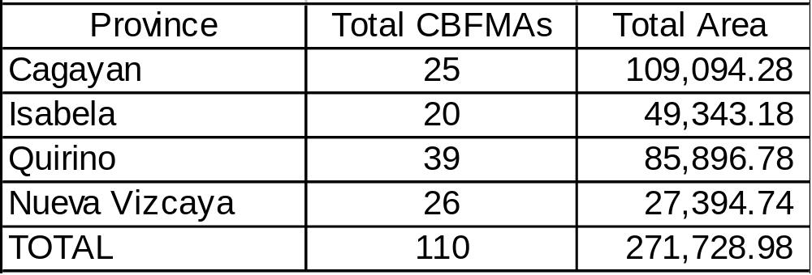
Summary of POs per Province

Slide 3

Background
Conducted a baseline study from 2002-’03
Objectives: assess the condition of PO’s and determine project intervention
68 % sampled
Conducted a reassessment in 2006-’07
73% of POs included in the study or a total of 79 POs
Objectives: determine impact of project interventions after 3 years, and recommend activities at the phase out stage

Slide 4
A. Organizational Set-up
2001-2003
38 POs hold at least a Regular Election within the past 2 years
43 POs are holding meetings (general assemblies, emergency, BOD)
2004-2006
44 POs hold at least a Regular Election within the past 2 years
48 POs are holding meetings (general assemblies, emergency, BOD)

Slide 5
C. Financial Condition
Total Assets = P 14.7 million
Total Liabilities = P 2 million
Asset Compositions
Buildings-store, warehouse, office
Equipment-truck, thresher
Cash on Hand/in bank
Animals-goat, cow, pig

Slide 6
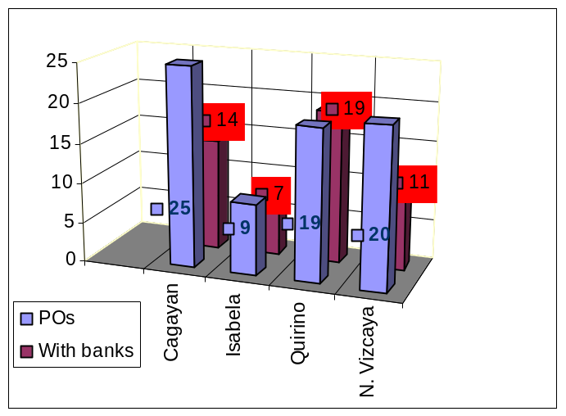
D. Financial Systems
28 POs have internals audits and 17 POs have external audits during the past 3 years
46 POs have existing bank accounts (Landbank, Coop Bank, PNB, Rural Bank)
Total money in the bank = not less than 1 million pesos

Slide 7
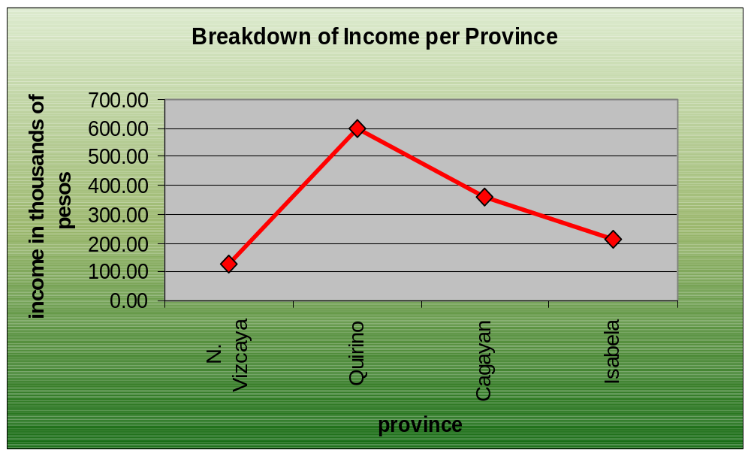
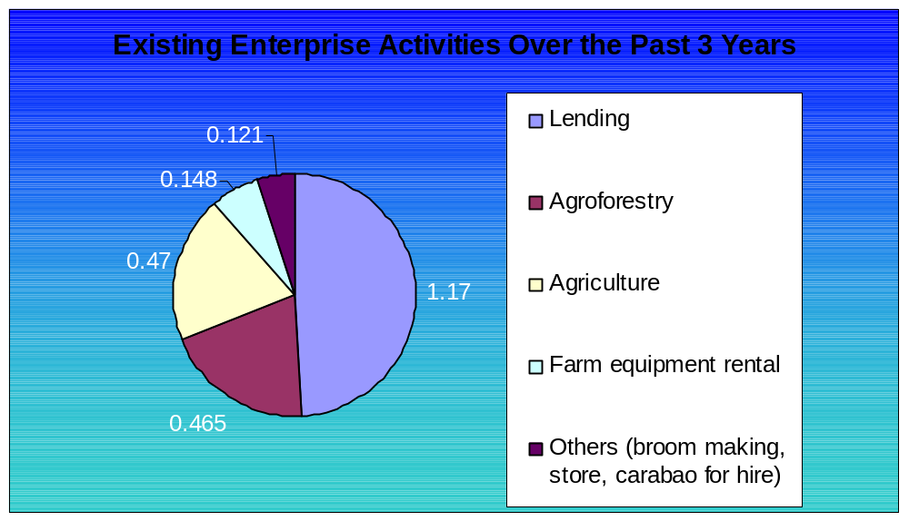
E. IGPs/Businesses
1.3 million reported income from enterprises
7,025 economic participants
26 active enterprises with a total of 2.3 million capitalization

Slide 8
F. Resources within CBFM Areas
Resources | Baseline |  | Re-assessment
 | For Sale | Household Use | Household Use
Timber | 37 | 42 | 46
Rattan | 15 | 20 | 25
Vines | 7 | 23 | 19
Banban/Darumaka | 12 | 21 | 19
Pandan | 9 | 16 | 11
Nito | 10 | 25 | 16
Bamboo | 27 | 44 | 42
Honey | 9 | 26 | 13
Water | 6 | 16 | 17

Slide 9
G. Resource Use Conflicts
Boundary Conflicts (members and non-members)
Individual Conflicts
Encroachment
Timber Poaching
Quarry
Mining

Slide 10
H. Eco-tourism Areas
Falls
Caves
Craters
Rice Terraces

Slide 11
I. Forest Protection
163 Active SDENROs or foot patrols
34 checkpoints established
5,200 board feet confiscated

Slide 12
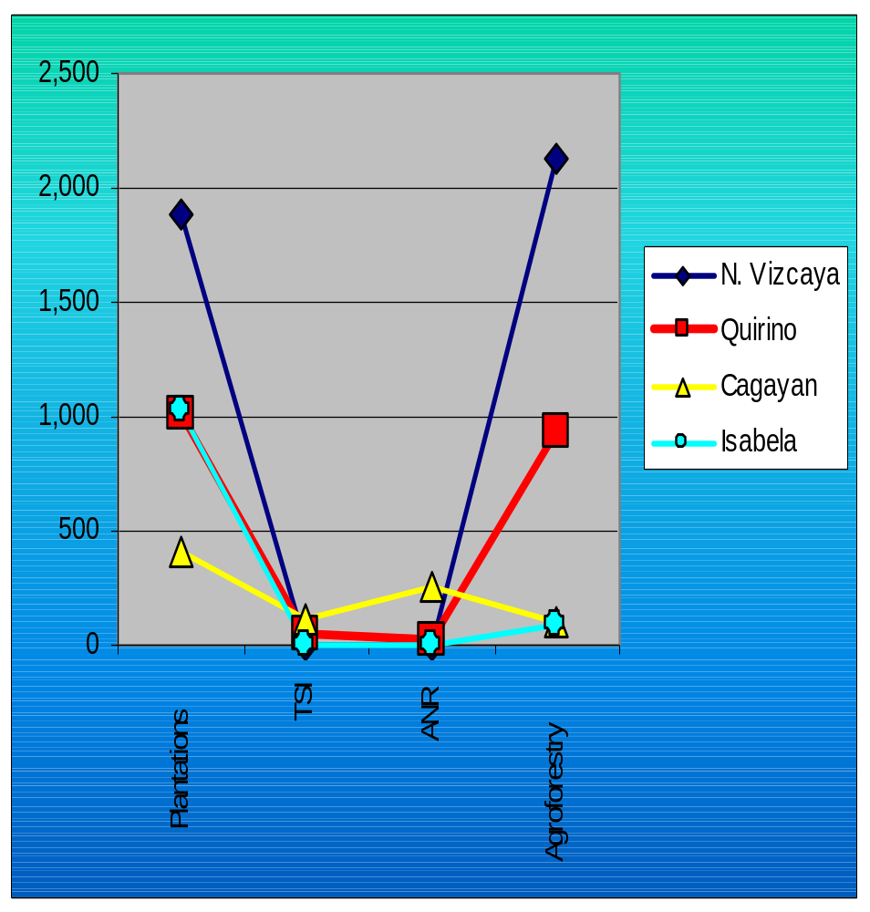
J. Forest Development
4, 338 hectares of newly established tree plantations
Conducted Timber Stand Improvement to 164 hectares of forest
275 hectares Assisted Natural Regeneration
Established 3, 250.34 hectares agro-forestry

Slide 13
K. Threats to Biodiversity
Timber poaching
Forest fires
Flash floods

Slide 14
L. Linkaging
Province | Agencies/ Organizations | Type of Assistance
N. Vizcaya | DENR; LGU;; DA, DTI, DOST, DOLE, PCAO, NGO DAR, EWW, | Technical, financial, organizational
Quirino | DENR, DA, TESDA, CFPQ, LGU, DFNSIP, QUEDANCOR, PCAO; UNDP, ECOGOV, UPLB | Technical, Financial, organizational
Cagayan | DENR, DA, DTI, DILG, LGU, FPE, DSWD, DAR, PROCESS, EWW CAVAPPED, DOLE, CDA, PENTECOST, UNDP, VSO | Technical, Financial, Organizational
Isabela | DENR, LGU, NGO | Technical, infra

Slide 15
M. Training Needs
Financial Mgt.
PO strengthening
Cooperative trainings
Leadership training
Livelihood trainings
Proposal Making
Business planning
Record management
Agriculture technologies

Slide 16
N. Issues and Problems

Slide 17
O. Lessons Learned

