Slide 1
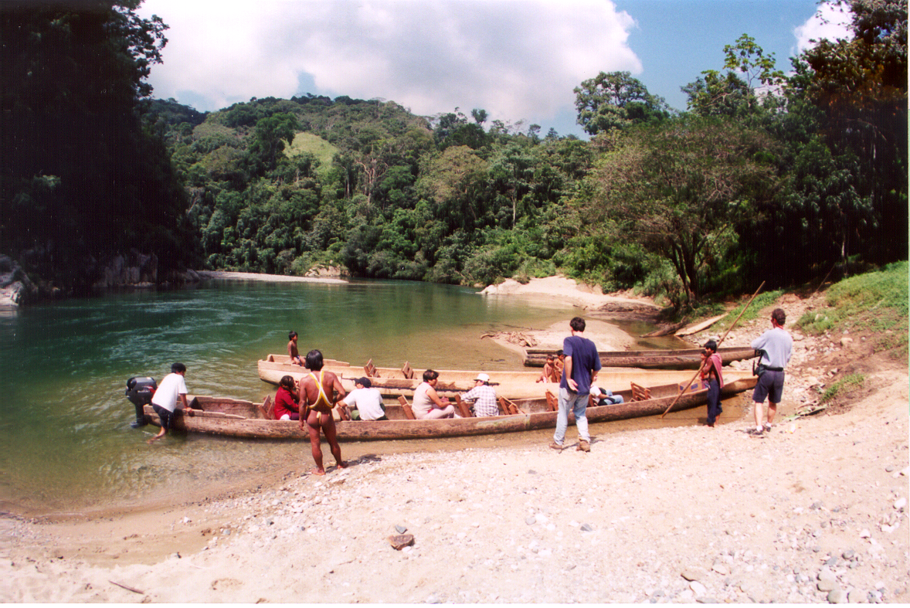
Ecotourism and Recreation in the Panama Canal Watershed:
Preliminary Assessment and Recommendations

Slide 2
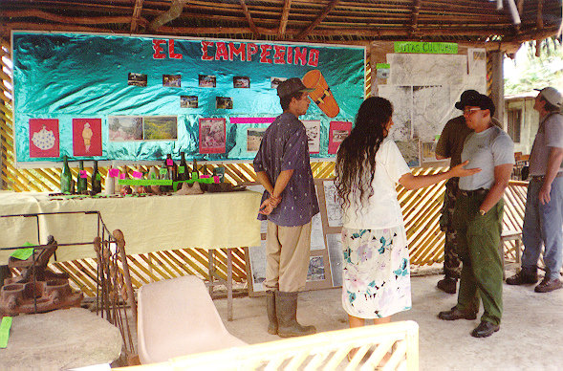
Finding 1:
Tourism is a growth industry and an important strategic issue for USAID/
Panama

Slide 3
Finding 1: Tourism is a growth industry and an important strategic issue for USAID/Panama
Develop a tourism strategy, information, and expertise to maximize benefits and minimize the costs and impacts
Identify partners and find niche in the broad field of tourism
Be proactive and champion forest-based “ecotourism”

Slide 4
Finding 1: Tourism is a growth industry and an important strategic issue for USAID/Panama
Understand the recreation/tourism industry and become an active player
Establish close working relationships with IPAT and the tourism private sector
Support ecotourism technical assistance, training, and case studies

Slide 5
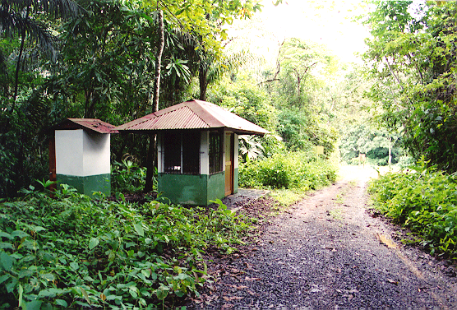
Finding 2:
Outdoor recreation and international tourism in national parks, if done correctly, is one of the best ways to develop support for these protected areas and the resources they contain

Slide 6
Finding 2: Outdoor recreation and international tourism in national parks is one of the best ways to develop support for these protected areas and the resources they contain
Develop public appreciation and support through environmental education, interpretation, and outdoor recreation
Use recreation and tourism programs as management tools to achieve conservation and economic objectives

Slide 7
Finding 2: Outdoor recreation and international tourism in national parks is one of the best ways to develop support for these protected areas and the resources they contain
Support the development of environmentally sustainable accommodations within the Panama Canal Watershed by organizing a conference on eco-huts, lodges and resorts
Explore linkages between national parks and forest eco-lodges and hotels in Panama City

Slide 8
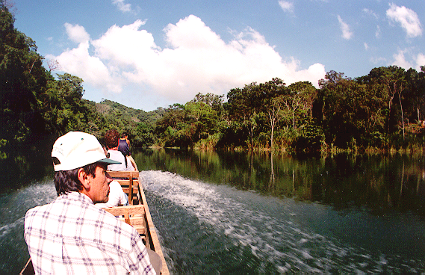
Finding 3:
The TCR Alliance of Tourism, Conservation and Research provides an excellent strategic framework for collaboration within the Panama
Canal watershed

Slide 9
Finding 3: The TCR Alliance of Tourism, Conservation and Research provides an excellent strategic framework for collaboration
Use the TCR Strategic alliance to help implement national park master plans
Emphasize projects that contribute to the development of a trans-isthmus heritage route as a priority project

Slide 10
Finding 3: The TCR Alliance of Tourism, Conservation and Research provides an excellent strategic framework for collaboration
Consider a Heritage Area or Corridor approach for organizing the stakeholders, resources, and activities within a trans-isthmus heritage route
Determine priority projects in consultation with Panama’s public agencies

Slide 11
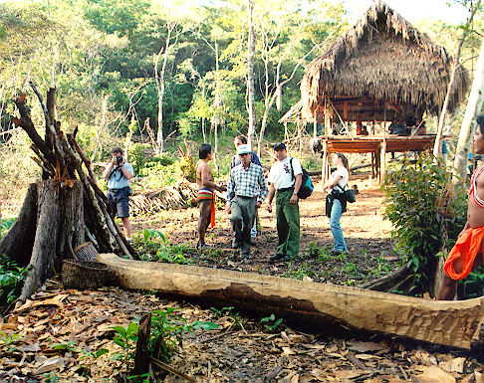
Checklist of Potential Programs and Projects for USDA Forest Service Support
Tourism and Recreation in the Panama Canal Watershed

Slide 12
Projects in Support of National Park Master Plans
Ocean-to-Ocean Heritage Area/Corridor
  Camino de Cruces Trail projects
  Scenic Byways
  Flatwater Kayaking
  Gamboa Marina
Eco-Lodges Workshop
Embera Villages Ecotourism Assistance
Ecotourism Case Studies

Slide 13
General Assistance to ANAM-Capacity Building and Working Tools
Environmental Education
  especially geared for school children
Improved Image and Visibility
  press kit, earned media, FAM tours, and special events
Visitor Information Services
  Maps, brochures, signs, and publications

Slide 14
General Assistance to ANAM-Capacity Building and Working Tools
Interpretive Associations
  To help develop and deliver visitor information
Business Tools
  Commercial permits, recreation fees, and concessions
Ecotourism
  Training and toolkit (handbook tailored to local needs)

Slide 15
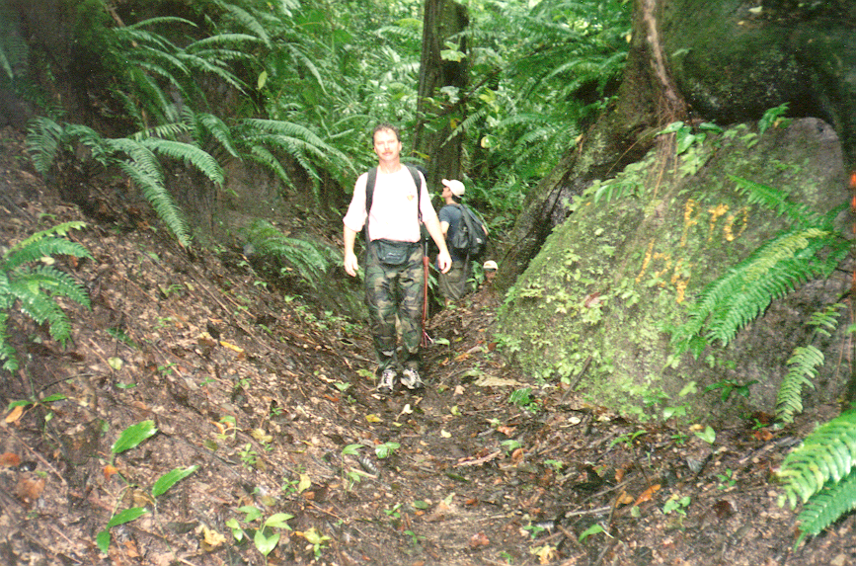
What is Ecotourism?
It is an ecological perspective … understanding the inter-relationships between tourism and the environment

Slide 16
Ecotourism
A Philosophy
Respect for the land and people
A Strategy
Tourism as a tool for conservation and economic development
An Activity
Tours based on natural and cultural resources

Slide 17
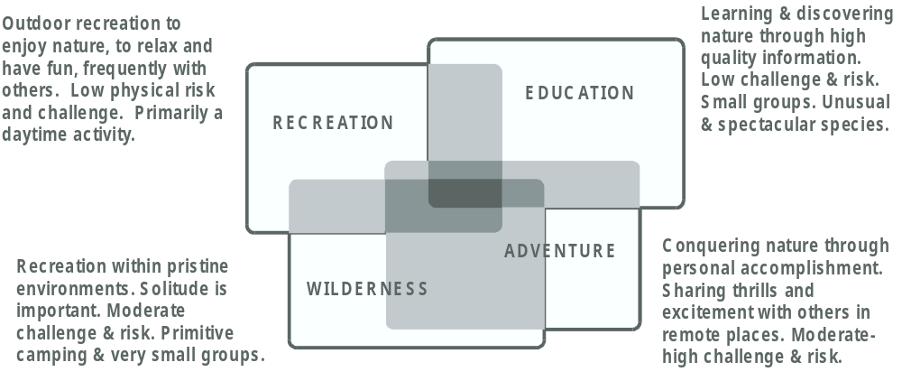
Resource-Based Tourism Niches

