Slide 1
HIV/AIDS and the Environment
Indigenous Medicine, HIV/AIDS,
and Medicinal Plant Resources
in sub-Saharan Africa
Marc Barany
Research Associate
College of Natural Resources, Virginia Tech
Notes:
80 % of the population relies on indigenous medicine systems to meet their primary healthcare needs. Very, very, few have access to the treatments that are drastically improve and prolong the life of people living with AIDS in the developed nations. As a result indigenous medicine systems have, and continue, to carry the burden of the HIV/AIDS epidemic. Realistically this will remain true in the future.
At the same time, the forests, bush, and grasslands that provide the medicinal plants that are the cornerstone of these healthcare systems are disappearing. Africa has the highest rate of deforestation of any region in the world. Worse, AIDS is rapidly killing professionals and community leaders that shoulder the responsibility of manageing and conserving this cornerstone of healthcare, and budgets for conservation and management are being diverted to
In this presentation I will discuss
the ways in which indigenous medicine systems are responding to the epidemic,
the role of medicinal plants and natural resources in these responses,
and demonstrate
That just as governments and international agenices are recognizing that indigenous medicine systems are a necessary component of HIV/AIDS programs, conservation and management of medicinal plants used in effective, affordable, and accessible AIDS treatment and care, are also a necessary component in HIV/AIDS programs

Slide 2
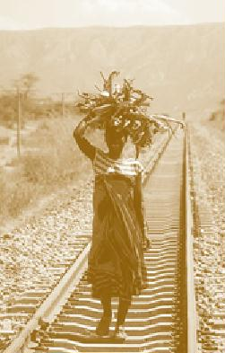
Indigenous Medicine (IM) in HIV/AIDS Programs
World Health Organization (1990)
National MoH
NGOs
UNAIDS
C.M. Good
Notes:
Given the scale of the AIDS crisis in Africa, and the fact that such a large number of people relied on indigenous medicine, efforts have been made to bring together those in indigenous medicine with those in biomedicine.
Traditionally, there has been little cooperation between the two health systems.
This was originally done in order to inform indigenous medicine practitioners about the disease, and to improve standardization and regulatory mechanisms for indigenous health care
The World Health Organization held a meeting in (1990) that recognized the contributions that IM had been and could make in addressing AIDS, and advocated its role in national AIDS programs
Soon thereafter both national health ministries and NGOs began efforts to bring indigenous medicine practitioners and biomedical health practitioners together to combat HIV/AIDS
More, recently the United Nations program on HIV/AIDS has identified such collaborations as best practices that are, in the words of the UN, imperative and practice in the response to HIV/AIDS

Slide 3
IM in the Response to HIV/AIDS
IM
PREVENTION
MITIGATION
TREATMENT
-Education
-Condom distribution
-Counseling
-Stigma reduction
-Herbal remedies
-Patient referral
-Drug management
Notes:
This slide illustrates the specific ways that indigenous medicine practitioners fit into HIV/AIDS programs
First, indigenous medicine practitioners Because of the strong ties with communities, and high social status of practitioners make good partners in the efforts to prevent the disease from spreading, such as education and condom distribution
Education also plays a role in mitigating the impacts of the disease by reducing the stigmas associated with the disease. For example, educating people that HIV/AIDS can not be transmitted through handshakes, and other such social norms, reduces social and economic alienation that many infected people face.
And indigenous medicine also has a role to play through the treatment of HIV/AIDS related illnesses. This is through the form of herbal remedies. And we may see that they play a role in the management of drug treatments as they become affordable. Healers are typically the point of contact when someone initially falls ill, and can refer patients that may be infected with the virus to clinics for diagnosis.

Slide 4
IM in the Response to HIV/AIDS
IM
TREATMENT
-Herbal remedies
-Patient referral
-Drug management
Notes:
For the purpose of this presentation, we are concerend specifically with the role that IM plays in the treament of HIV/AIDS with herbal remdies.

Slide 5
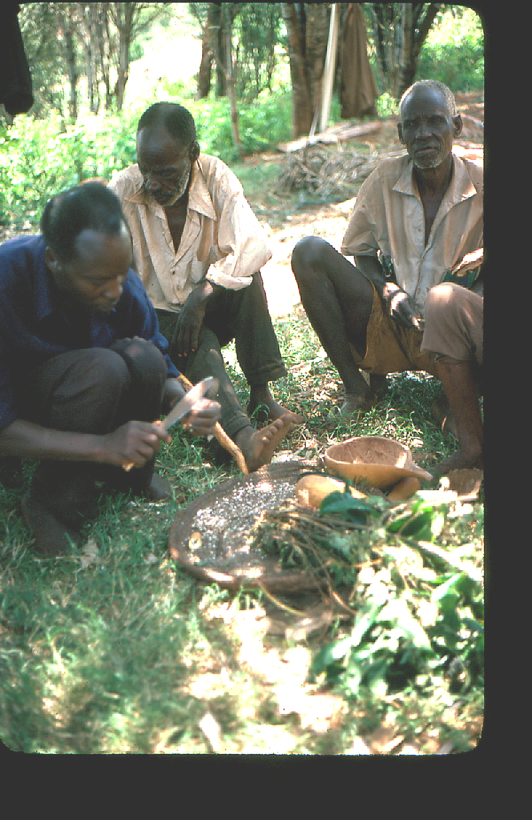
Herbal Remedies in the Treatment of PLWHA
- Opportunistic infections
- AIDS-related conditions
+ Immunostimulants
+ Anti-parasites
C.M. Good
Notes:
These improve the quality of life, and can slow the progression of the disease (increasing appetite, treating oral thrush can increase food intake, and thus improve nutrition – crucial element for the immune system). Evidence that parasites inhibit immune system. And boost immune systems
Opportunistic infections
herpes zoster, oral thrush, fungal infections
Aids related conditions
appetite loss, diarrhea
Immunostimulation
Increase CD-4 counts
Anti-parasitics – deworming reduces viral load slowing the progression of the disease. Treatment is associated with decreased HIV viral load
Anti viral agents

Slide 6
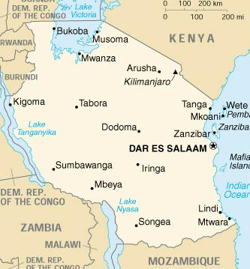
The Tanga AIDS Working Group (TAWG)
Initiated in 1990 as a referral system
Treats patients with medicinal plants in the hospital or at home
Provides care for 400 patients
Notes:
History and organization
An example of IM and Biomedicine collaboration is the TAWG
IM & biomedical collaboration
Tanga Regional Hospital, Tanga, Tanzania
Initiated in 1990 as a referral system
Treats patients with medicinal plants in the hospital or at home
Provides care for 400 patients
Do not lead in from UNAIDS
Based in northeast Tanzania, at the regional hospital
After realizing that many patients visit both IM practitioners and the hospital, physicians at Bombo hospital they attempted to set up a referral network and contacted the healers. After some meetings between healers and biomedical personnel, an elder healer asked to treat HIV/AIDS patients with three plants. The healer was allowed to treat several confirmed HIV= patients, their conditions improved, and the plant remedies became the hospitals standard HIV/AIDS treatment for patients preferring herbal medicine
Eventually developed a home care service to deliver the plant remedies to HIV/AIDS patients and there families
In addition to running seminars with healers, and education and HIV/AIDS prevention program

Slide 7
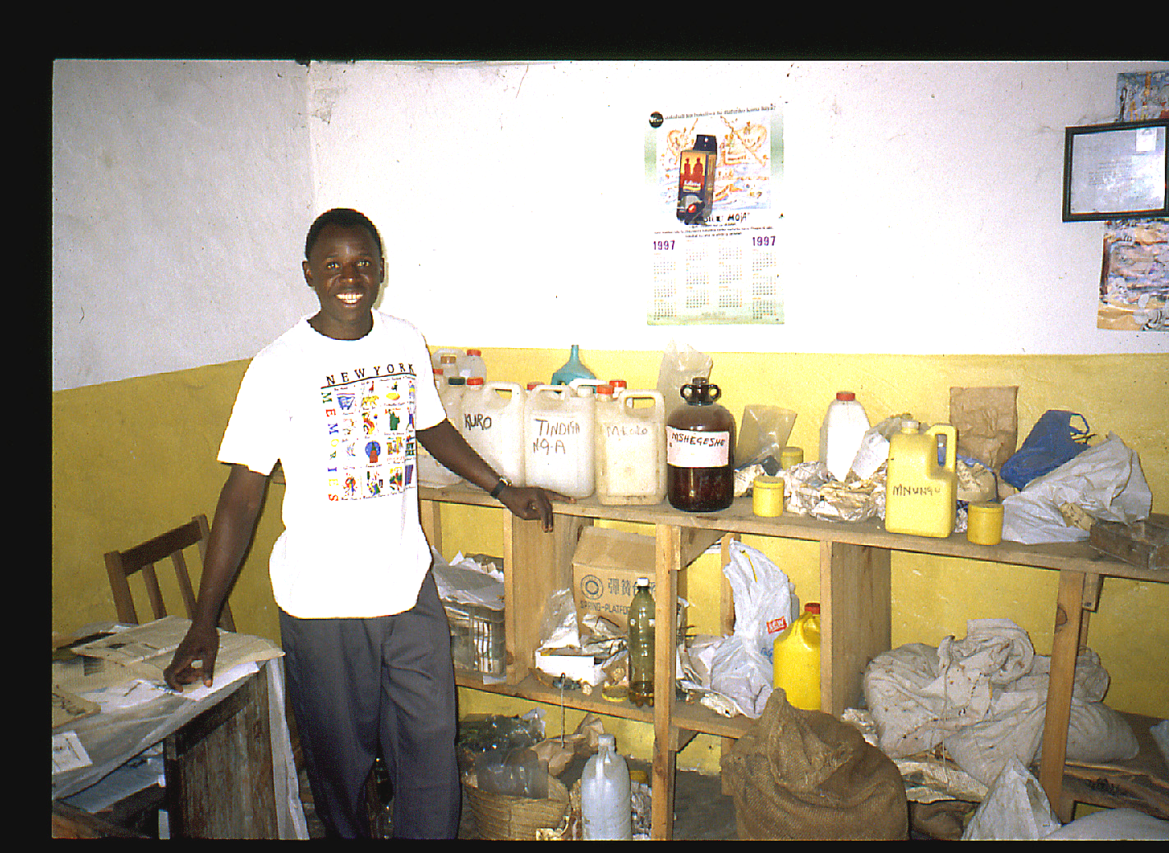
The Tanga AIDS Working Group (TAWG)
Notes:
If we trace supply chain back
We see that the impacts on health, originate here, in the forest
In tanga, as in most places for most species, medicinal plants are collected from the wild

Slide 8
TAWG: Health Impact
Improves quality of life, prolongs life
  Oral thrush + Appetite
  Herpes zoster + Body weight
  Diarrhea
  Fever
Effective, particularly if treatment given in the early stages
Some expressed preference over biomedicines (reduced side effects)

Slide 9
Indigenous Medicine
HIV/AIDS
Notes:
UNAIDS has designated TAWGS collaborative arrangement between indigenous and biomedical health sectors as a best practice, which means that advocate its scaling up and replication in other parts of Tanzania and Africa as an effective and sustainable response to the crisis.
However there is a major limiting factor to the effectiveness and sustainability of TAWGs response to HIV/AIDS,

Slide 10
Indigenous Medicine
HIV/AIDS
Treatment
Herbal remedies
Medicinal Plant Resources
Notes:
And that is, the resources from which the herbal remedies are supplied

Slide 11
Medicinal Plant Collection
Habitat
Town/Market
Optimal Collecting Area
Notes:
Typically collected from wild
Obviously, this is going to occur in areas that are closest to settlements

Slide 12
Factors Reducing Access to Medicinal Plant Resources
Loss of habitat
Over-harvesting
Poor harvesting methods
C.M. Good
Notes:
In Tanga, like the rest of SSA
These natural supplies are increasingly coming under pressure
There are those factors that are occurring from pressures outside of the medicinal plant resources; and, those occurring within the collection sites
Macroscale Affects the quantity of natural resources, micro level affactes and the quality

Slide 13
Medicinal Plant Collection
Habitat
Town/Market
Optimal Collecting Area
Notes:
Typically collected from wild
Obviously, this is going to occur in areas that are closest to settlements

Slide 14
Habitat/Specie Decline
Town/Market
Notes:
When habitat and species populations decline in the optimal collecting area, the practitioner is forced to collect further from the community, and may even subcontract collection to others.
This means an increased labor input or in the case of a subcontractor, extra transaction cost
Preliminary results indicate that this is occurring in Tanga with species used in the treatment of PLWHAs
Bodeker, in Nairobi conference, the African potatoe, used as an immunostimulant, according to herbalsist is diinishing in the wild and the price is increasing.
What does this mean in terms of the accessibility of HIV/AIDS treatment

Slide 15
Expansion
Stabilization
Decline
Price
Volume Wild Harvest
Source: Schippman et al. 2002
Notes:
In the beginning stage of a products life cycle, price increase in relation to demand. As the demand for this product levels off, the price follows. However, where this sustained demand exceeds production, or the resource is reduced in size, the population declines, and
Well, we can draw on the simple economics of supply shortages
Price increase can be significant – become more expensive than pharmaceuticals
- it can even become economical to trade over large distances, and across national borders
Not only does the price increase, but substituion occur. If we look at the graph, the price is highest for species which are most difficult to find. The high price can encourage the use of substitute materials that are not even effective.
So the effectiveness and affordability of indigenous medicine and the replicability and sustianability of collaborative arrangements between the indigenous medicine system and HIV/AIDS, ultimately depend on the resources from which medicinal plants used in treating HIV/AIDS are harvested.

Slide 16
Conservation & Management
Cultivation
Improve harvesting methods
Management of wild resources
Notes:
Biggest lesson, is to realize the contribution that natural resource-based iM is making at the ocmmuinyt level in terms of coping with the epidemic. Second, the pressures on the resource are very real, and without efforts to conserve and manage resources, the sustainability of this coping mechanism is threatened, which could mean poorer health
third, this will require manpower, on the part of the natural resource sector, which is falling victim to loss of staff and loss of budgets.
IM is important component of HIV/AIDS treatment and care in SSA, and source of livelihood
The effectiveness, affordability, and sustainability of IM as an appropriate response to AIDS is a function of local natural resources
Preliminary research suggests that demand for specific medicinal plants used in treating HIV/AIDS exceeds ecological regeneration capacities
The conservation and management of these plants needs to be a priority in efforts supporting IM
Local rights retained and re-inforced

Slide 17
Expansion
Stabilization
Decline
Price
Volume Wild Harvest
Source: Schippman et al. 2002
Notes:
In the beginning stage of a products life cycle, price increase in relation to demand. As the demand for this product levels off, the price follows. However, where this sustained demand exceeds production, or the resource is reduced in size, the population declines, and
Well, we can draw on the simple economics of supply shortages
Price increase can be significant – become more expensive than pharmaceuticals
- it can even become economical to trade over large distances, and across national borders
Not only does the price increase, but substituion occur. If we look at the graph, the price is highest for species which are most difficult to find. The high price can encourage the use of substitute materials that are not even effective.
So the effectiveness and affordability of indigenous medicine and the replicability and sustianability of collaborative arrangements between the indigenous medicine system and HIV/AIDS, ultimately depend on the resources from which medicinal plants used in treating HIV/AIDS are harvested.

Slide 18
Expansion
Stabilization
Decline
Conservation/Management
Price
Volume Cultivated
Volume Wild Harvest
Source: Schippman et al. 2002
Notes:
In order to change this, efforts are needed to increase and maintain the supply
Cultivation is the answer, but not easy Need to pint out that cultivation is not so easy
Call for conservation in Nairobi meeting?
Taske force calls for (bodeker)
Numerous NGOs supporting
Bodeker in Nairobi – this clearly highlights the need for cultivation of priority species used for management of HIV-related illness
Permits
Local user rights
Point out that when dececntralized expanding markets can be incentive for conservation bc value returns to people at resource – in other words don’t ban users, but give them exclusive rights
trade controls, tax imports would mean that local values not supressed and encourages local production

Slide 19
Conclusion
IM is necessary in HIV/AIDS treatment and care in SSA
Demand for certain medicinal plants used in treating HIV/AIDS exceeds ecological regeneration capacities
Medicinal plant scarcity leads to + price and – quality of healthcare
Sustainability of HIV/AIDS treatment is dependent on NRMC
Notes:
Biggest lesson, is to realize the contribution that natural resource-based iM is making at the ocmmuinyt level in terms of coping with the epidemic. Second, the pressures on the resource are very real, and without efforts to conserve and manage resources, the sustainability of this coping mechanism is threatened, which could mean poorer health
third, this will require manpower, on the part of the natural resource sector, which is falling victim to loss of staff and loss of budgets.
IM is important component of HIV/AIDS treatment and care in SSA, and source of livelihood
The effectiveness, affordability, and sustainability of IM as an appropriate response to AIDS is a function of local natural resources
Preliminary research suggests that demand for specific medicinal plants used in treating HIV/AIDS exceeds ecological regeneration capacities
The conservation and management of these plants needs to be a priority in efforts supporting IM
Local rights retained and re-inforced

Slide 20
Recommendations
Identify efficacious species used locally in treating HIV/AIDS-related conditions
Measure and monitor indicators of scarcity
Assess opportunities and constraints in the cultivation and management of vulnerable species
Notes:
In order for IM to remain an effectice and sustainable response to HIV/AIDS(as it is currently defined by the United Nations) specific steps need to be taken. Work with traditional healers to
(see mander on econommics of cultivation)
2) Price
Substitution
Collection time
Commercialization
3) What parts of plant are used (roots, or tree bark difficult to cultivate)
Are there substitues
Current policies governing use of resources
For this to occur, there needs to be an increased recognition by the health sector on the importance of local medicinal resources in the treatment and care of people living with HIV/AIDS.

Slide 21
Recommendations
Integrate medicinal plant conservation
and management into collaborative
HIV/AIDS programs
Notes:
In order for IM to remain an effectice and sustainable response to HIV/AIDS(as it is currently defined by the United Nations) specific steps need to be taken. Work with traditional healers to
(see mander on econommics of cultivation)
2) Price
Substitution
Collection time
Commercialization
3) What parts of plant are used (roots, or tree bark difficult to cultivate)
Are there substitues
Current policies governing use of resources
For this to occur, there needs to be an increased recognition by the health sector on the importance of local medicinal resources in the treatment and care of people living with HIV/AIDS.

Slide 22
Acknowledgments
Africa Biodiversity Collaborative Group
Tanga AIDS Working Group
US Forest Service, South Research Station
Notes:
And finally, I would like to thank those for whom this presentation would not have been possible,
Biggest lesson, is to realize the contribution that natural resource-based iM is making at the ocmmuinyt level in terms of coping with the epidemic. Second, the pressures on the resource are very real, and without efforts to conserve and manage resources, the sustainability of this coping mechanism is threatened, which could mean poorer health
third, this will require manpower, on the part of the natural resource sector, which is falling victim to loss of staff and loss of budgets.

Slide 23


Questions/Comments
Marc Barany
(540)-239-2788
mbarany@vt.edu
College of Natural Resources, Virginia Tech
Blacksburg, VA 24061-0323
Notes:
Biggest lesson, is to realize the contribution that natural resource-based iM is making at the ocmmuinyt level in terms of coping with the epidemic. Second, the pressures on the resource are very real, and without efforts to conserve and manage resources, the sustainability of this coping mechanism is threatened, which could mean poorer health
third, this will require manpower, on the part of the natural resource sector, which is falling victim to loss of staff and loss of budgets.
IM is important component of HIV/AIDS treatment and care in SSA, and source of livelihood
The effectiveness, affordability, and sustainability of IM as an appropriate response to AIDS is a function of local natural resources
Preliminary research suggests that demand for specific medicinal plants used in treating HIV/AIDS exceeds ecological regeneration capacities
The conservation and management of these plants needs to be a priority in efforts supporting IM
Local rights retained and re-inforced

