Slide 1
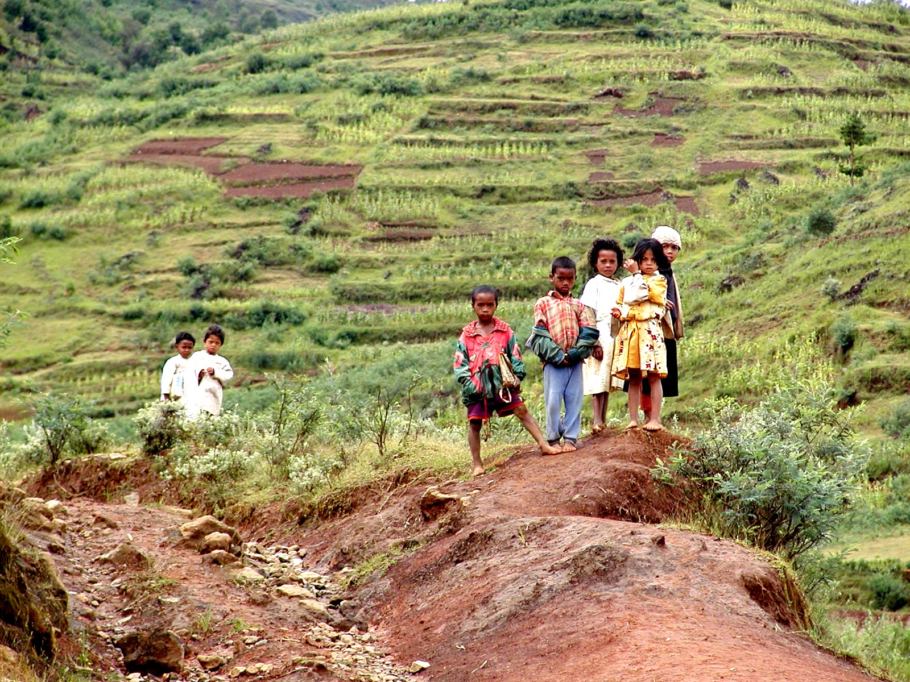
Assets, Poverty Traps and Rights
USAID Seminar Series:
Natural Resource Management
and Poverty Reduction
Chris Barrett
Cornell University
December 9, 2004
Washington, DC

Slide 2
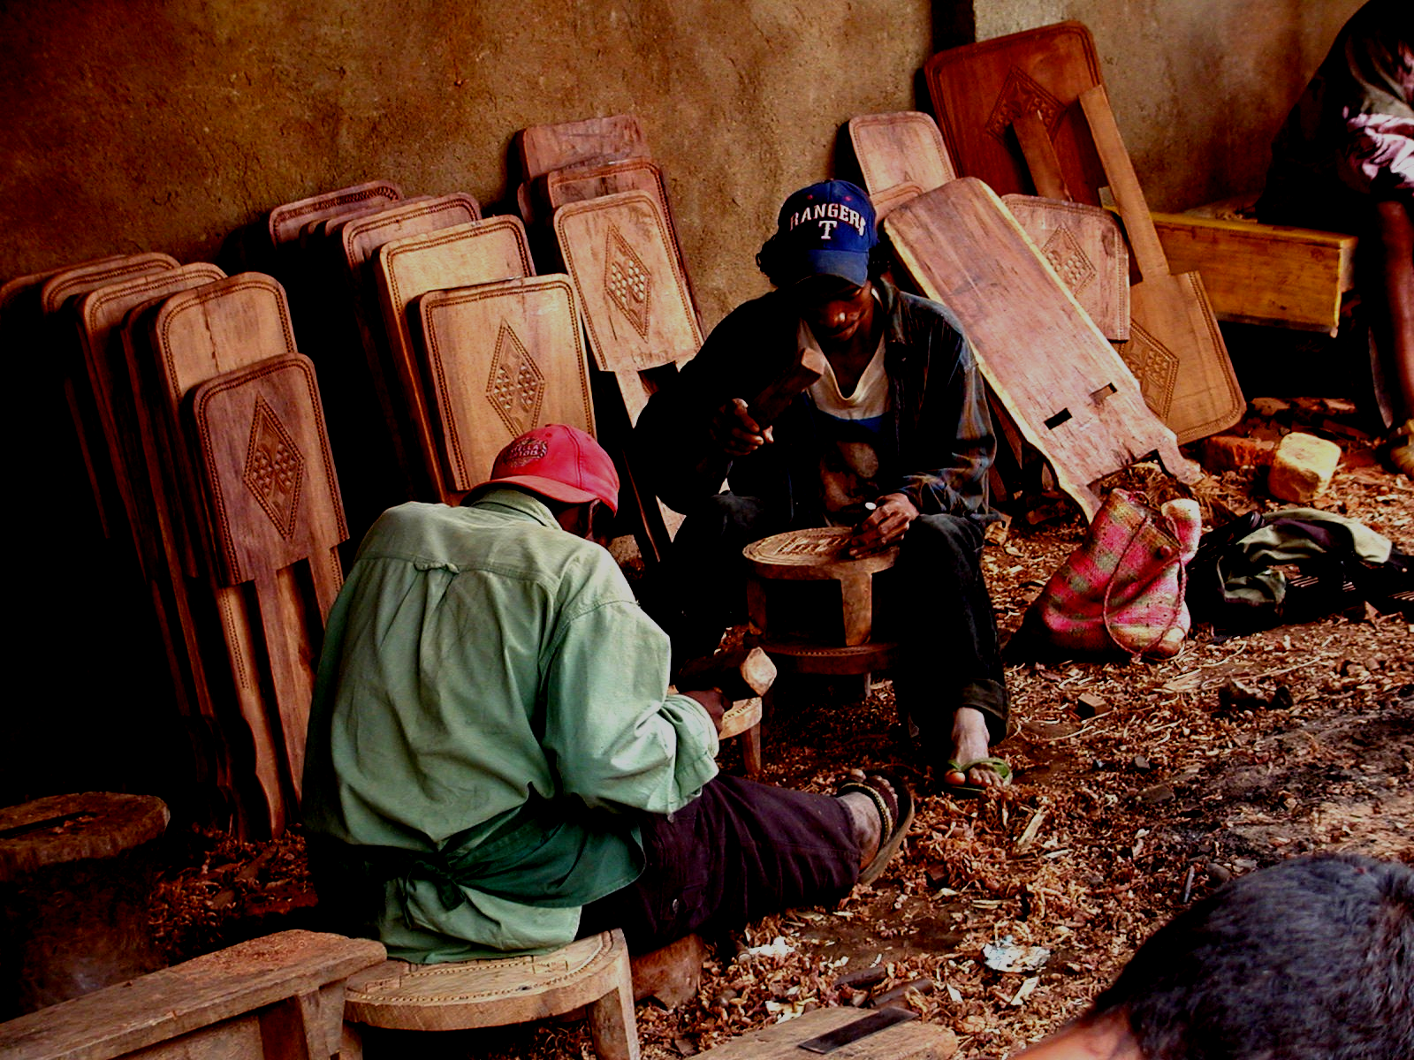
Asset-Based Poverty
Assets underpin the generation of income and self-insurance against adverse shocks
… the foundation of livelihoods
Five main types, 0/w three key for the poor:
  Financial
  Human
  Natural
  Physical
  Social

Slide 3
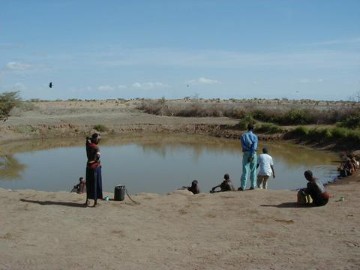
Evolving Views of Poverty
Successive generations of poverty analysis
1st: static income/expenditure analysis (headcount, poverty gap, FGT measures)
2nd: dynamic income/expenditure analysis (chronic/transitory poverty distinction)
3rd: static asset poverty analysis
(structural/stochastic poverty distinction)

Slide 4
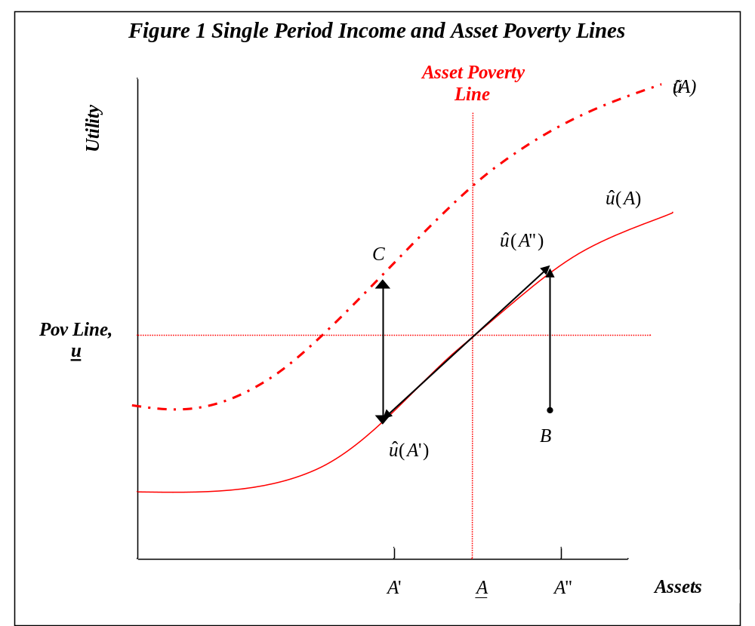
Asset-Based View of Poverty
Transitions Stochastic churning (B to u(A’’))
from Poverty: Structural via accumulation (A’ to A”)
Structural via higher returns (u(A’) to C)

Slide 5
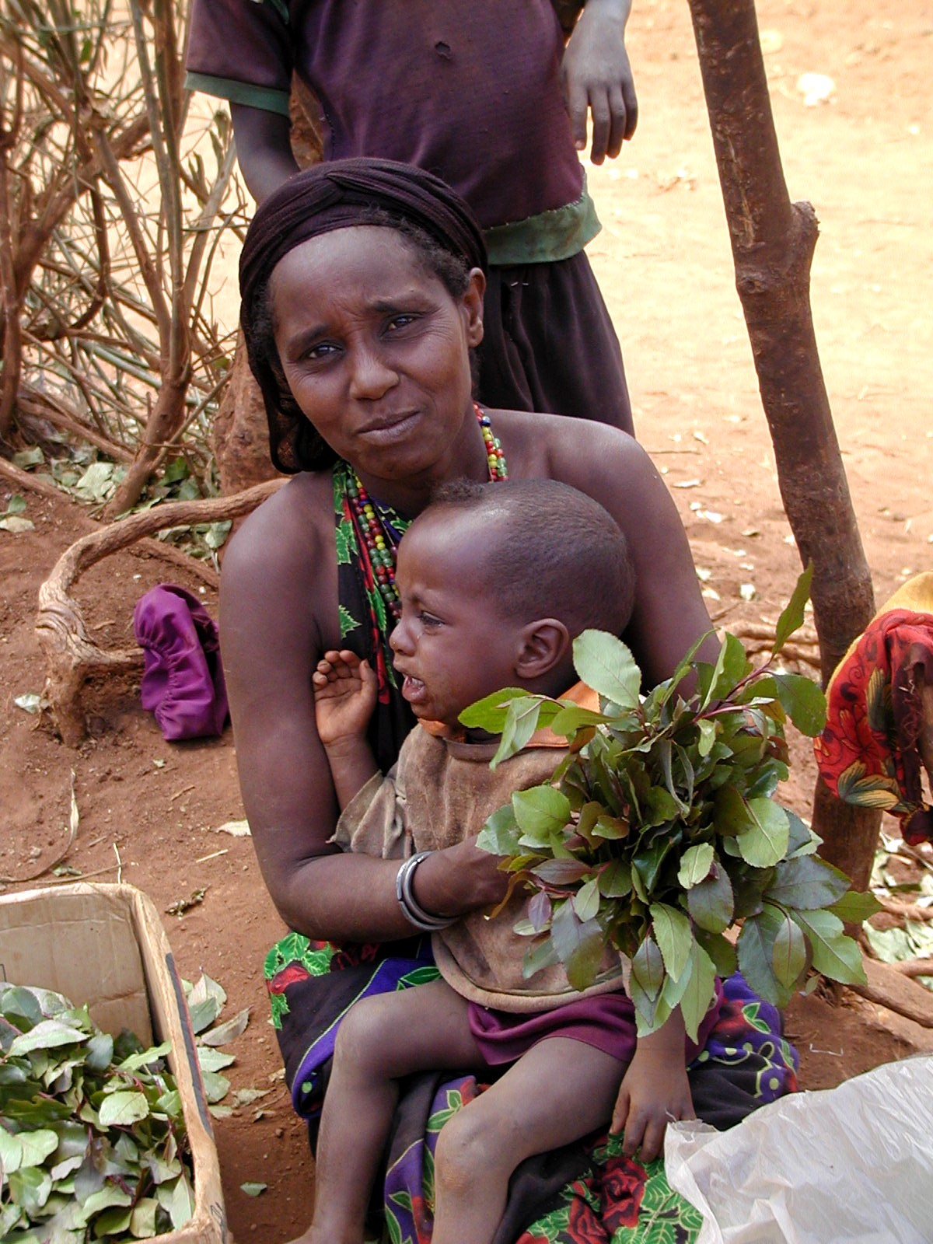
An Emerging 4th Generation View
Stable, dynamic equilibrium (SDE) below asset poverty line … a “poverty trap”
Commonly, multiple SDE with locally increasing returns and nonlinear asset dynamics … investment, natural dynamics and shocks matter a great deal
Fractal patterns – can exist
at multiple scales

Slide 6
The Possibility of Poverty Traps
Utility
Figure 3: The Dynamic Asset Poverty Line
L2
U*_{H}
Income Poverty Line
Dynamic Asset Poverty Line
L1
U*_{L}
Static Asset Poverty Line
The Poverty Trap
Initial Assets
A*_{L}
A*
A_{L}
A
A*_{H}
The Critical Dynamic Asset Poverty Threshold
From Carter and Barrett (2004)
Next Period’s Assets
A_{t}=A₀ (dynamic equilibrium)

Slide 7
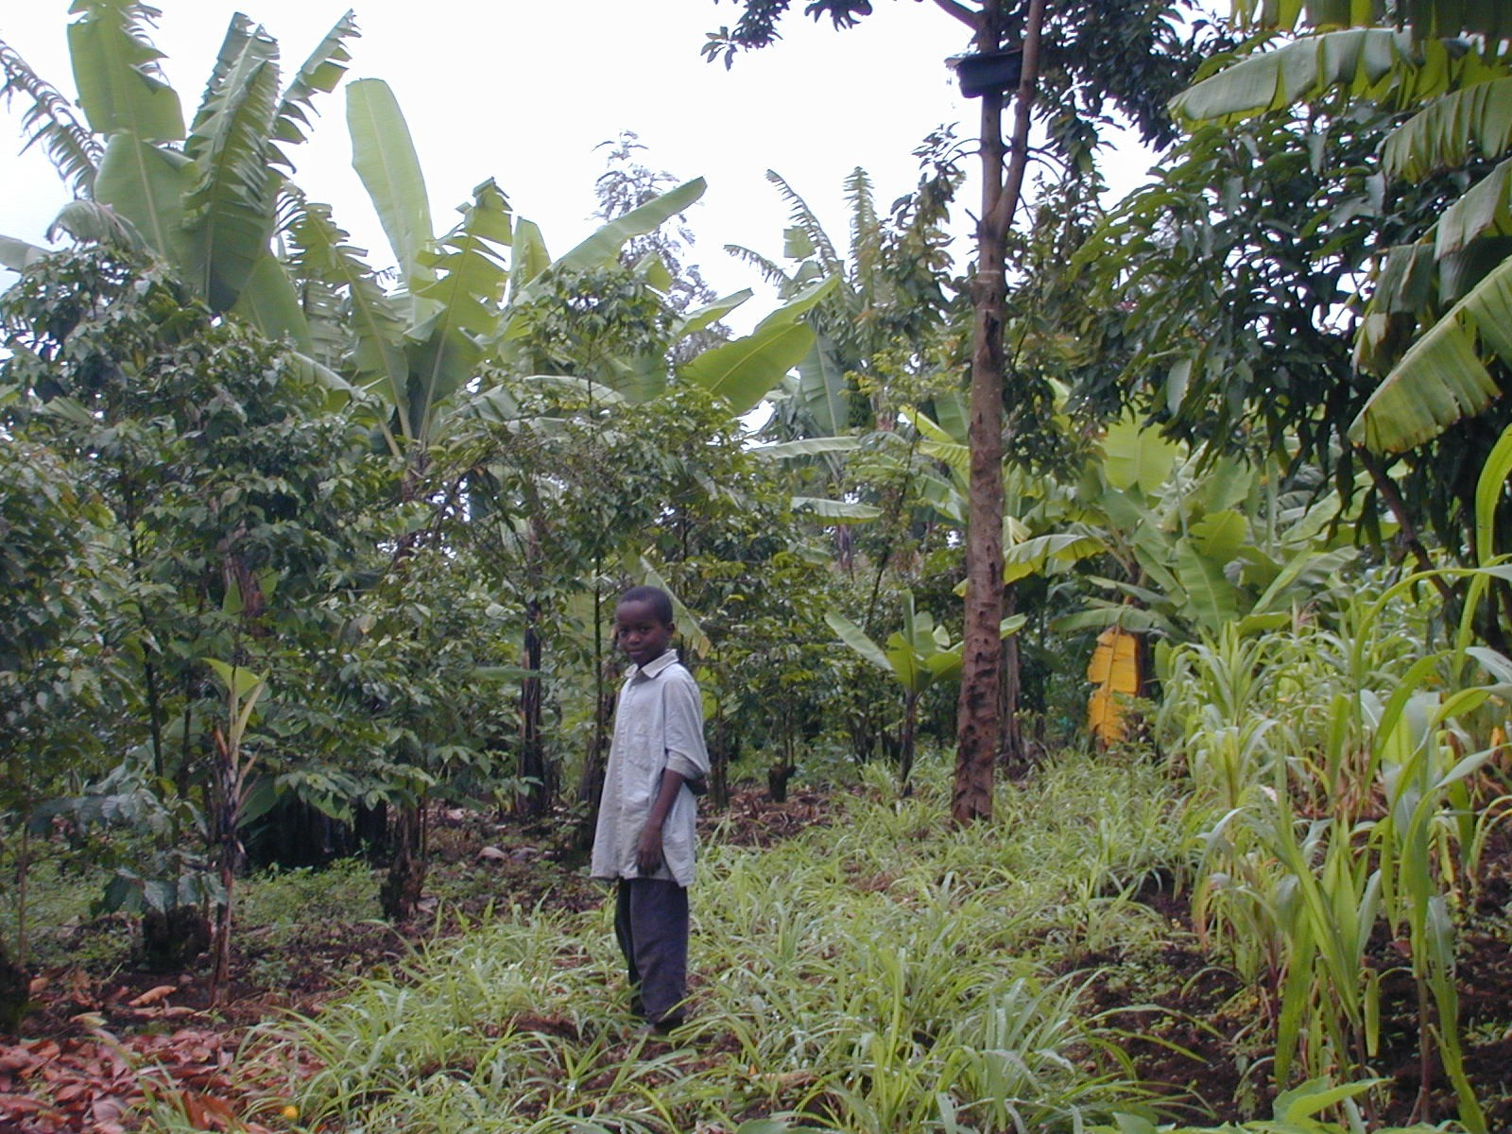
Relevance to NRM
S-shaped natural asset dynamics standard:
- biological recruitment (livestock, wildlife, forests)
- soil nutrient depletion/repletion
(shifting cultivation, transhumance)
Agriculture embodies asset portfolio rebalancing: NRM practices, harvests, etc. exchange natural – human – financial – social capital constantly.
Multiple equilibria in managing commons:
meso-scale (geographic) poverty traps due to coordination problems (land, water, forest, wildlife, pests)

Slide 8
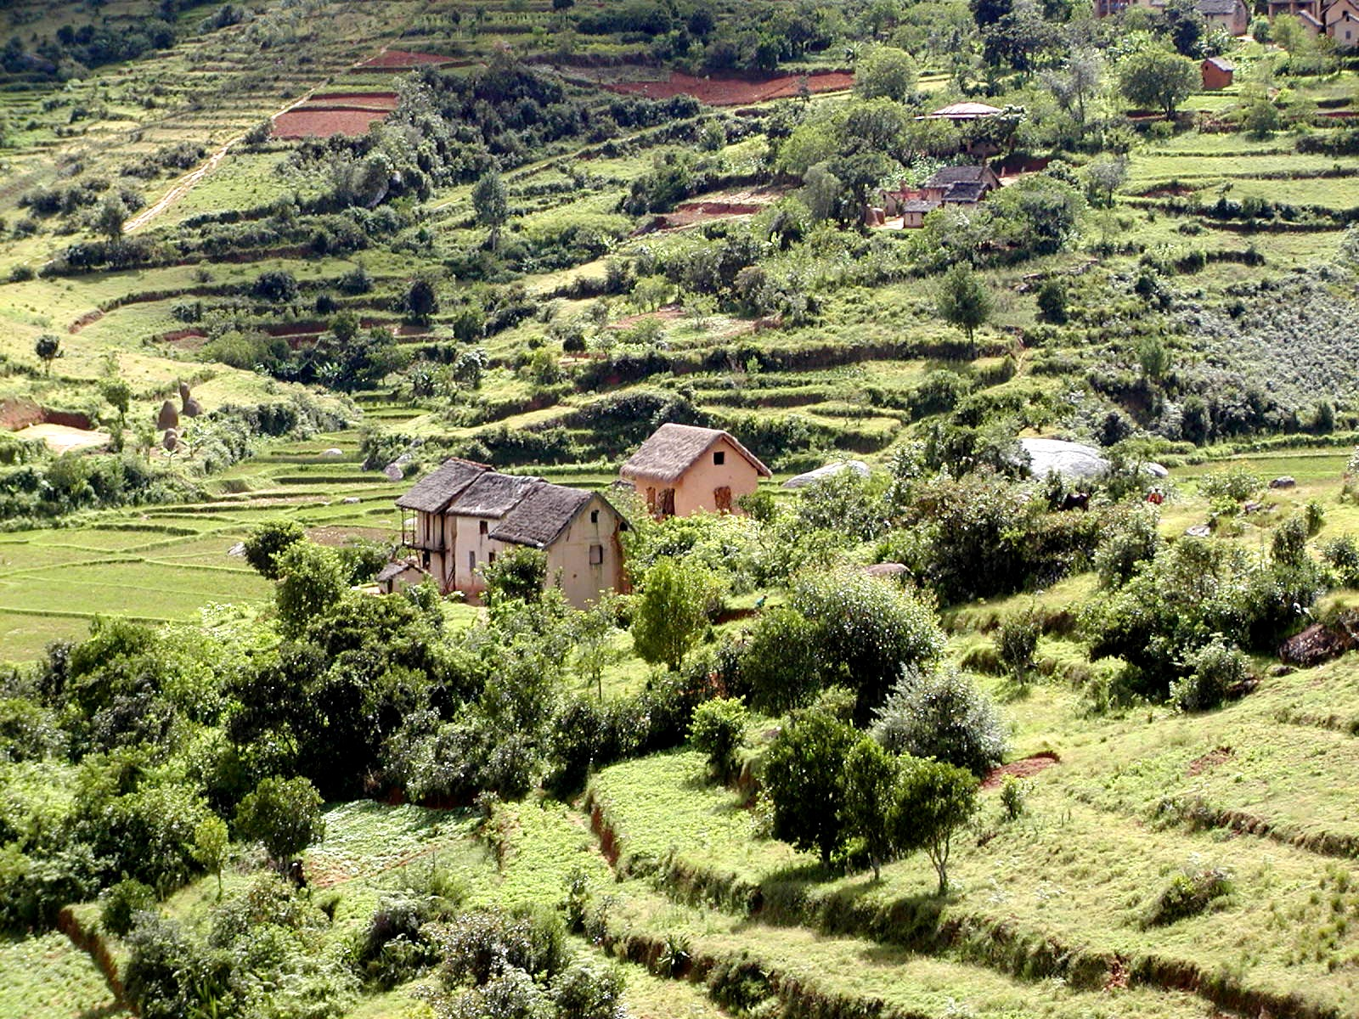
Relevance to NRM
NRM is an investment choice – crucial to reducing rural poverty as well as to conservation
- Five “ins”: Investment depends on incentives, institutions, information and infrastructure
(Barrett, Place and Aboud 2002)
Inherent complementarity of different types of assets and among the “ins”

Slide 9
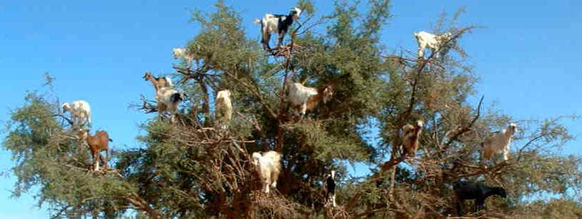
Relevance to NRM
Cautionary tale of market-based conservation and development in Morocco’s argan forest

Slide 10
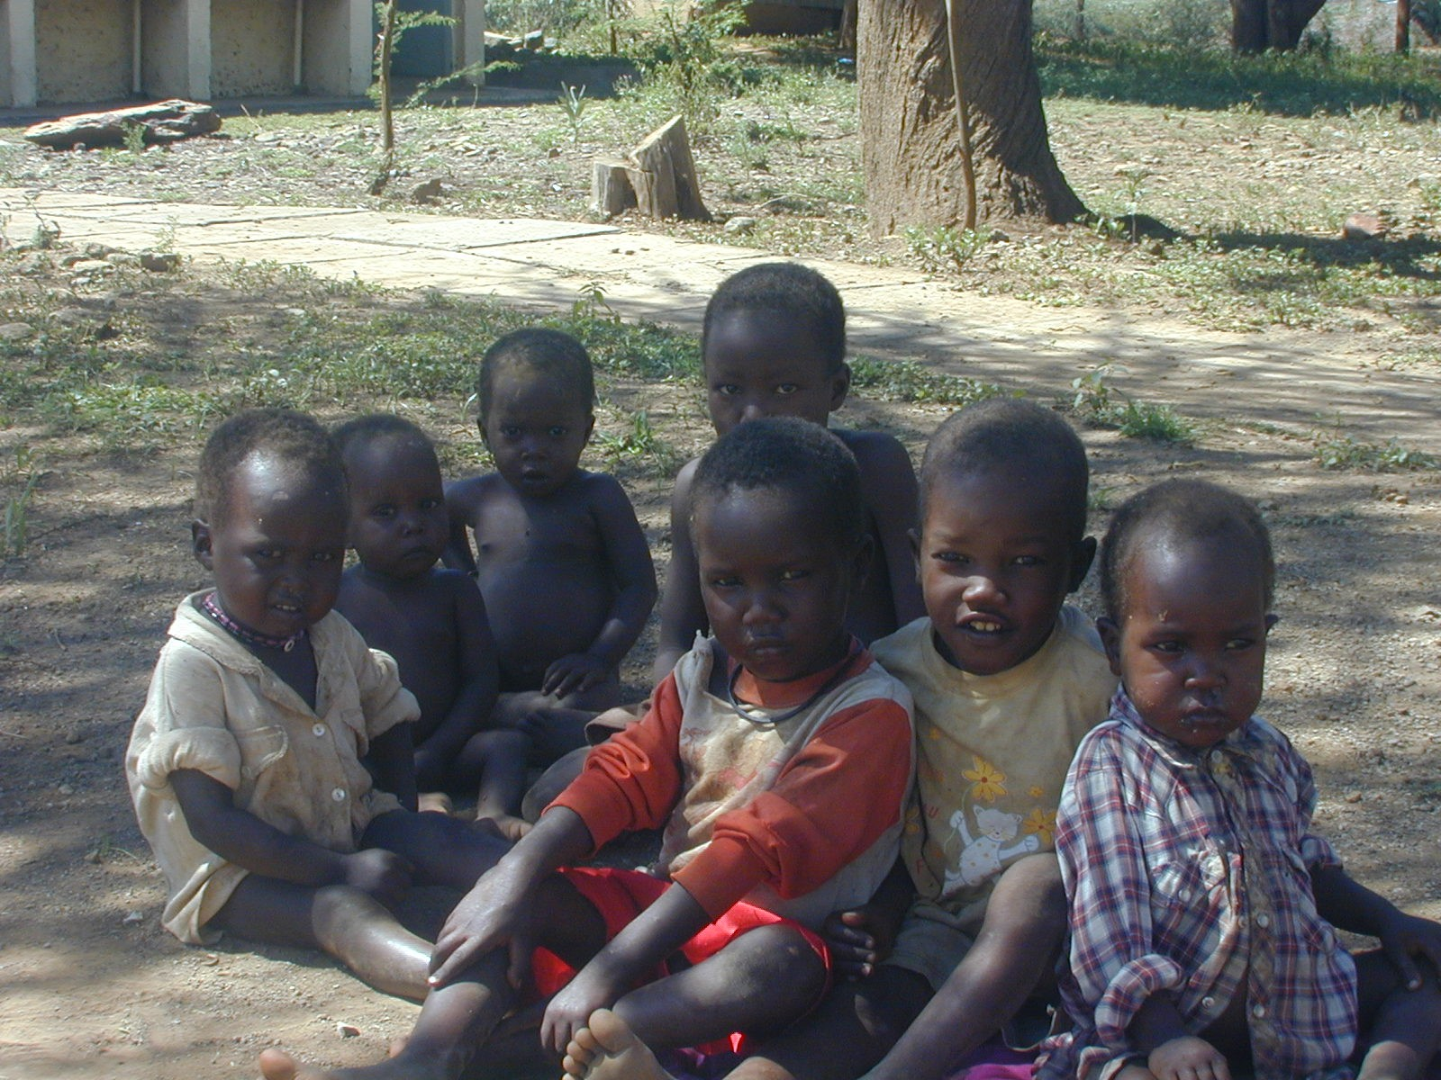
Rights and Poverty Dynamics
Rights matter to:
-Access to and control over natural assets
Ability to defend against asset loss (asset stripping, raiding)
Incentive to invest in natural asset growth (tree planting, SWC structures, fallowing)
… shifts the dynamic asset poverty line
Propensity to mis-/over-use of resources
Enforcing rules: 2nd order public good

Slide 11
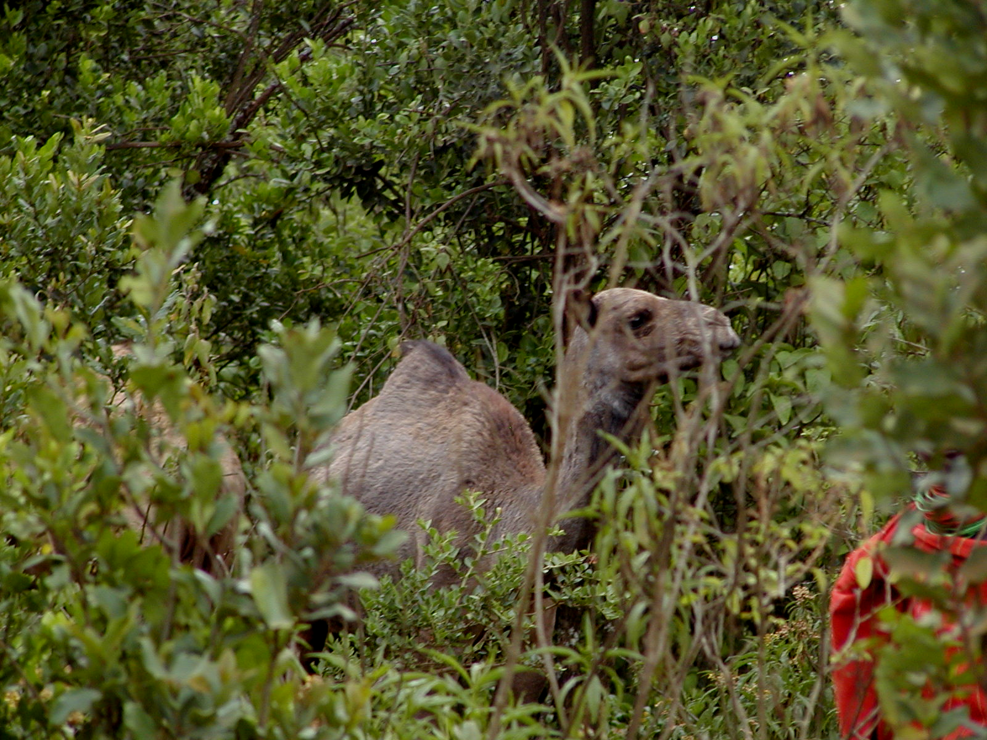
Natural Resources and The Poverty Reduction Challenge
Context-specific, multi-dimensional asset thresholds that separate growth / decline … natural assets are especially crucial for rural poor
Climbing out of poverty traps and keeping the non-poor out of poverty traps requires:
- Increase productivity of assets (markets/technologies)
- Facilitate asset building and protection (cargo/safety nets)
- Remove exclusionary mechanisms (finance/social networks/rights systems)

Slide 12
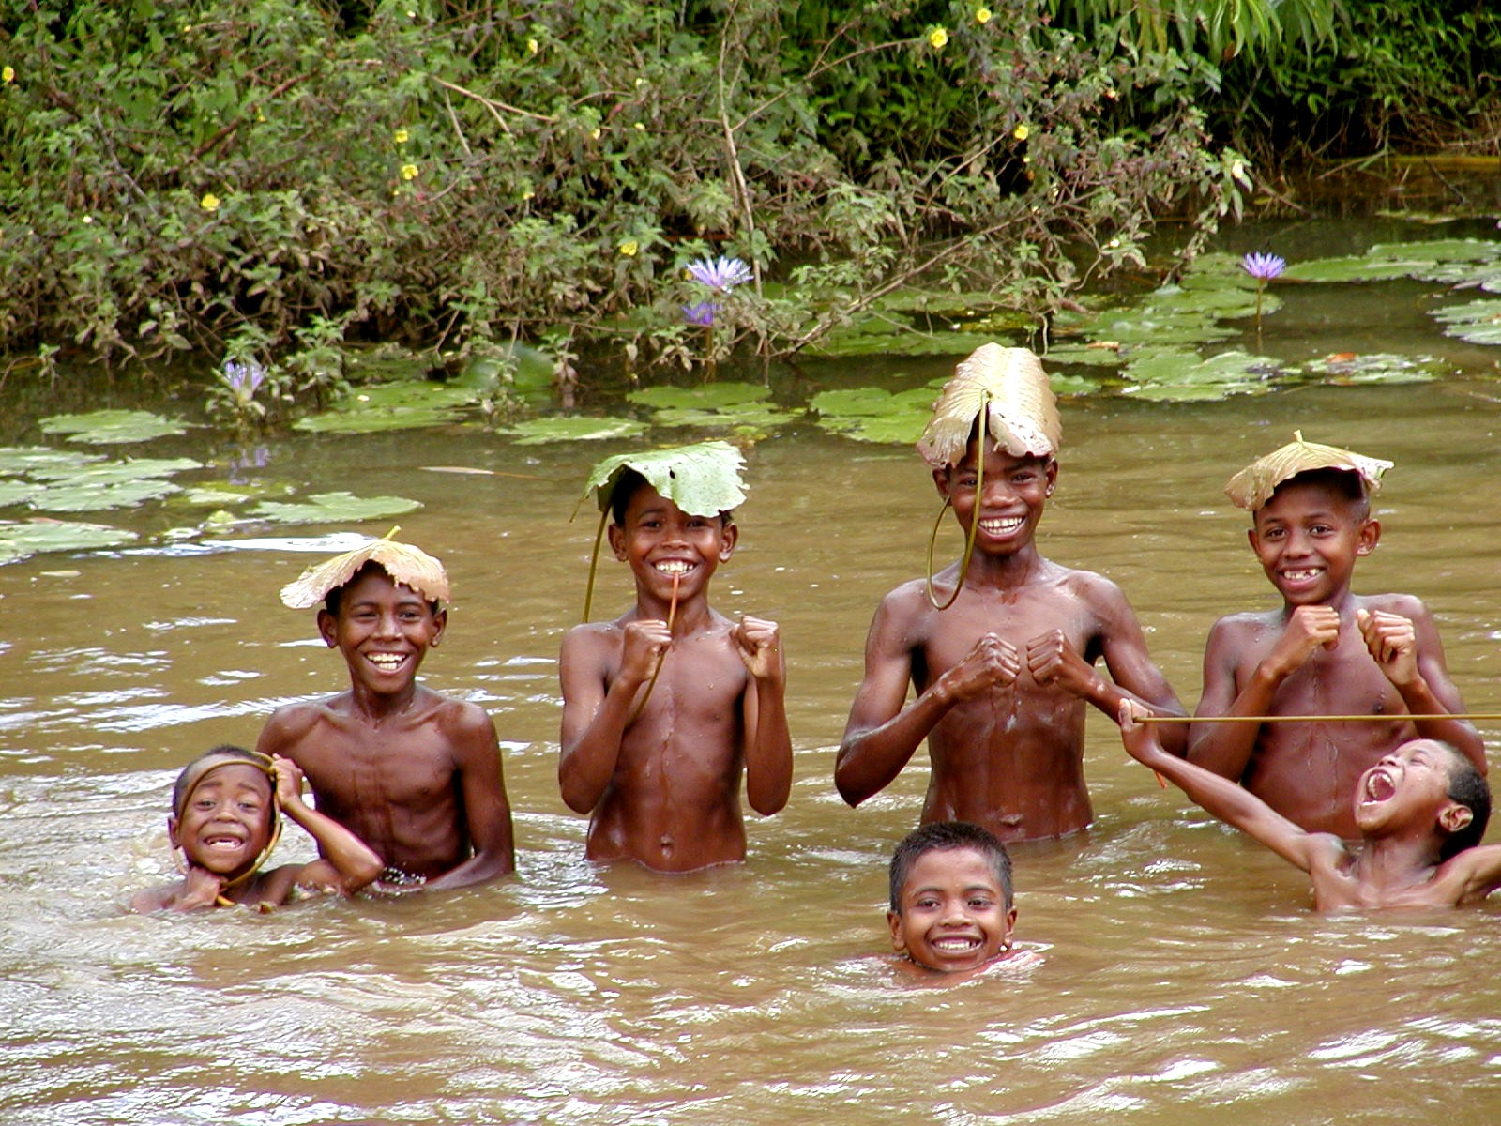
Thank you!

