Slide 1

State of the Art
Food Security Assessment
Gary Eilerts, Program Manager USAID FEWS NET

Slide 2
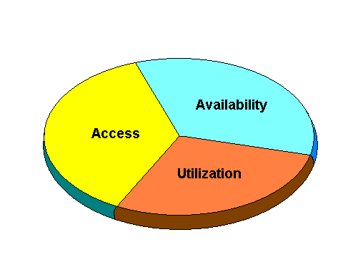
Concept
Food Security is Achieved...
When All People at All Times Have:

Slide 3
Concept
Measuring What?...
Individual: Prevalent diseases, malnutrition, care of infants, feeding and food preparation practices, presence of health & sanitation facilities, water supply characteristics, etc...
An area: Crop planting date, vegetation or crop condition, amount & timing of rain, drought, market availability of food, food prices, imports, exports, public stocks, household stocks, wild food availability, etc...
Household/community: Local household food crop & animal production, household sales of goods & services, conditions of other income sources, labor wage rates, food aid, assets, etc...

Slide 4
Concept
Assessing the Concept
Units:
Sub-national resolution, esp. households
Produce, buy, receive food
Risk
Tools:
Secondary datasets
Surveys, primary datasets
Analysis/exchange/ partnership

Slide 5
Concept
What Do We Do Again?...
Food Aid Targeting
Needs Assessment
Nutritional Status
Food Security
Early Warning?
Vulnerability?
Food Security Assessment
Early Warning
Vulnerability
Poverty?

Slide 6
Operations
Doing EW, FS, V +
Hazard early warning
Food security assessment
Vulnerability assessment
Contingency and response plan inputs

Slide 7
Operations
Methodological Issues…
Old vs. New Early Warning
Livelihoods vs. Indicators
Adding it all up

Slide 8
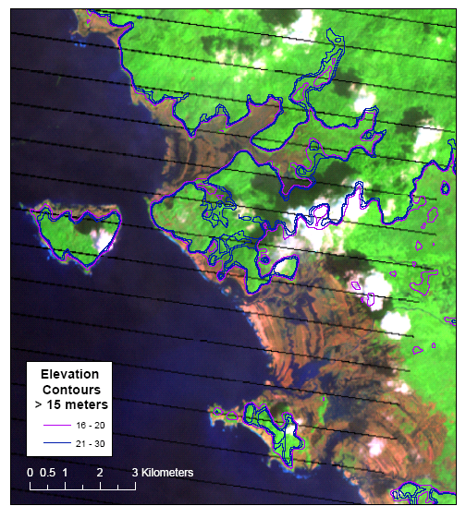
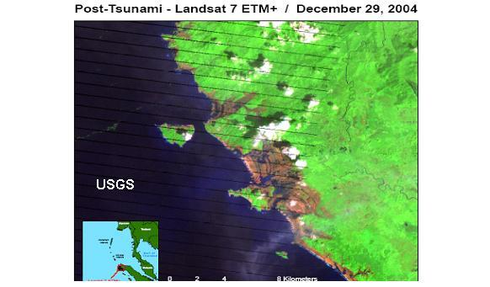
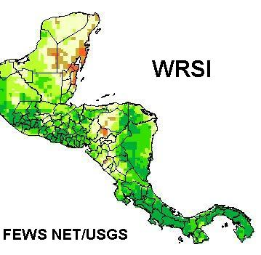
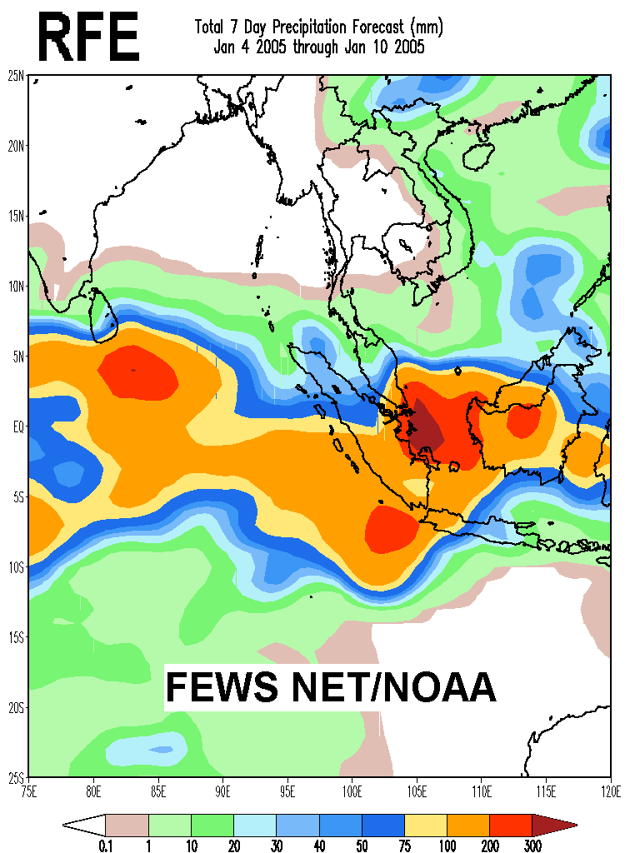
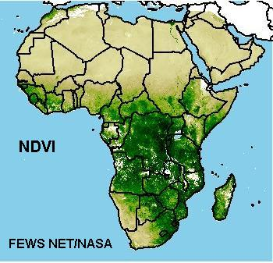
Operations

Slide 9
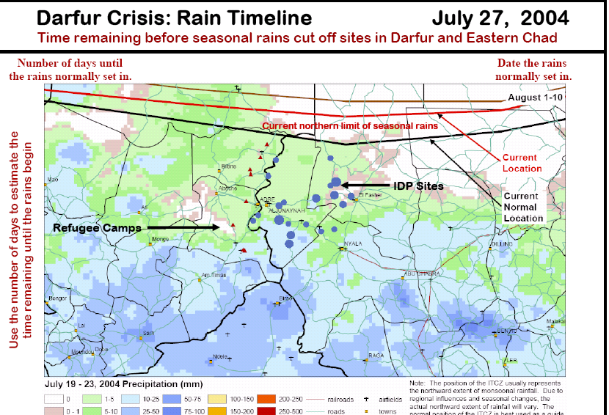

Operations
How Operational…?

Slide 10
Operations
Why ‘Why’?
If:
Availability
No food in market, sufficient purchasing power
Plenty of food in market, no purchasing power
Access
Food & purchasing power available, but, bad water, disease, poor care practices
Utilization
Insufficient food security
Different causes, different responses

Slide 11
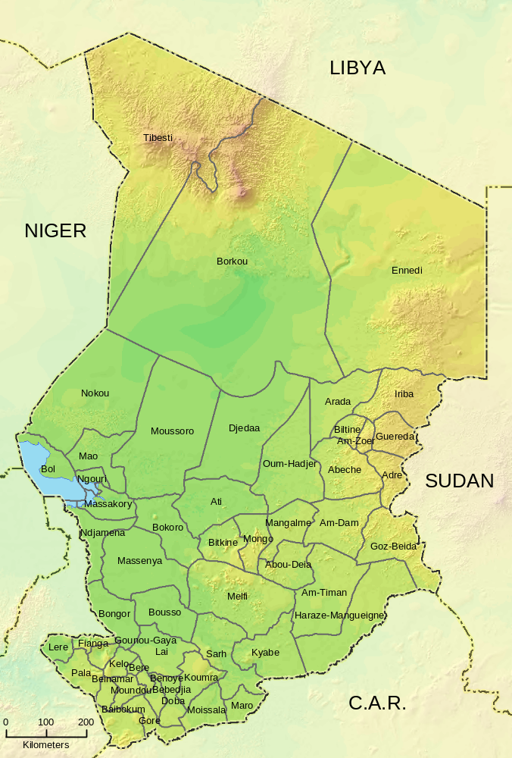
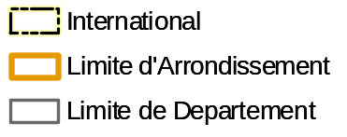
Operations
Chad: Administrative boundaries and relief…

Slide 12
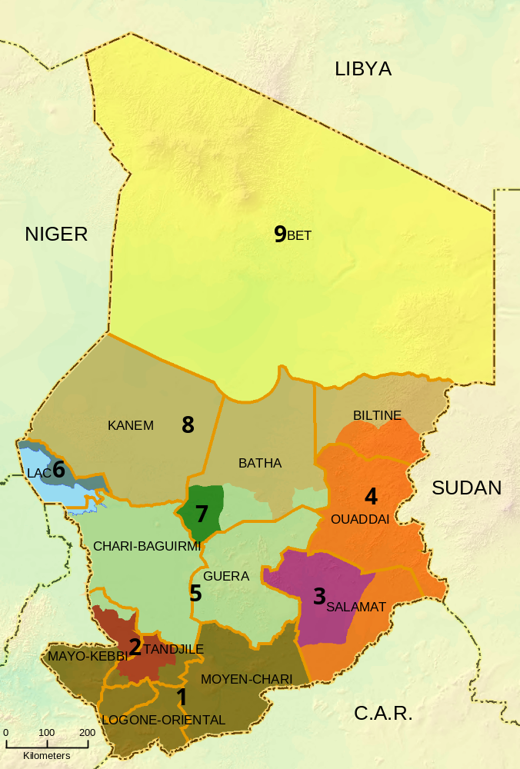
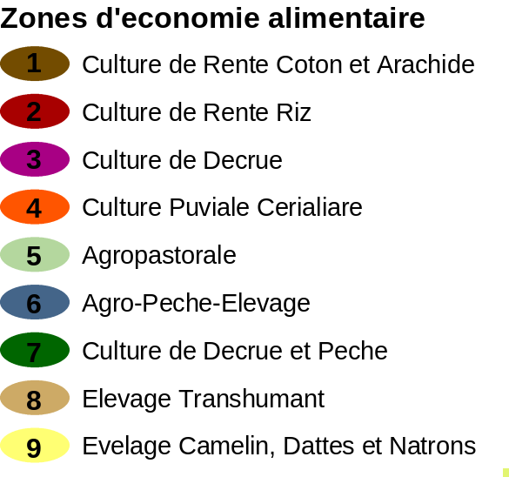


Operations
Chad: Household Economy Zones

Slide 13
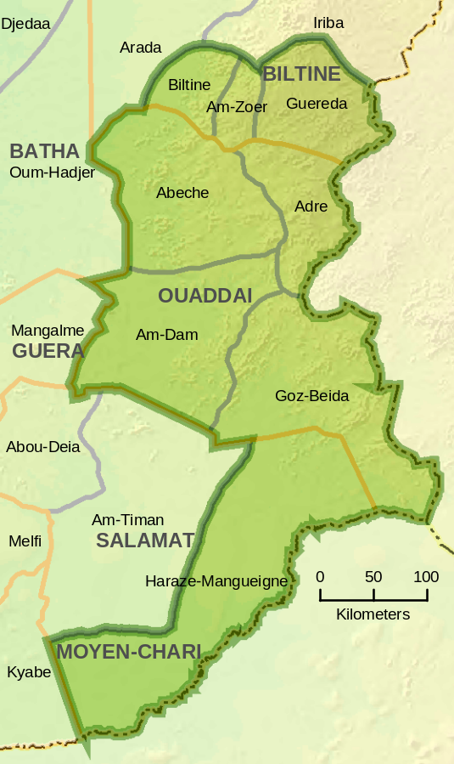


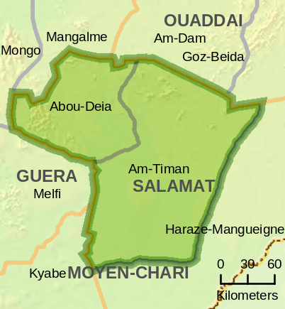

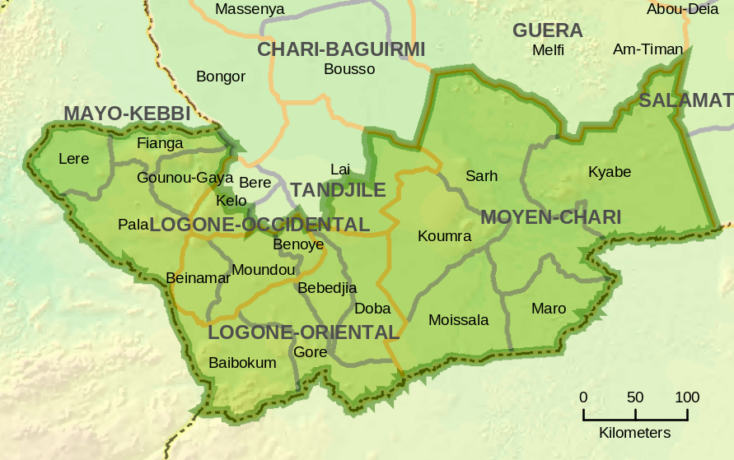

Chad: Household Economy Zones
4
Culture Puviale Cerealiere
Operations

Slide 14
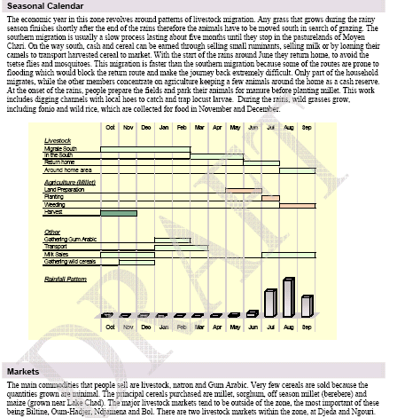
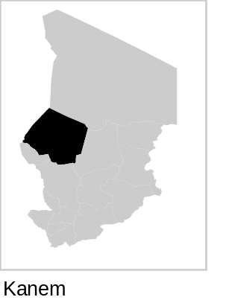
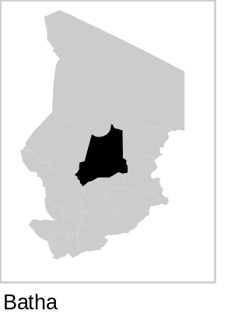
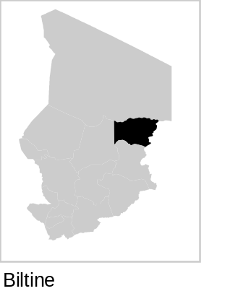
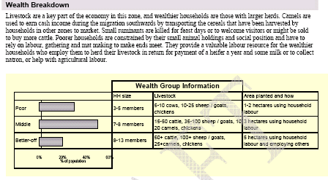
Chad: Extract of Zone Profile of the Transhumance Zone
Operations

Slide 15
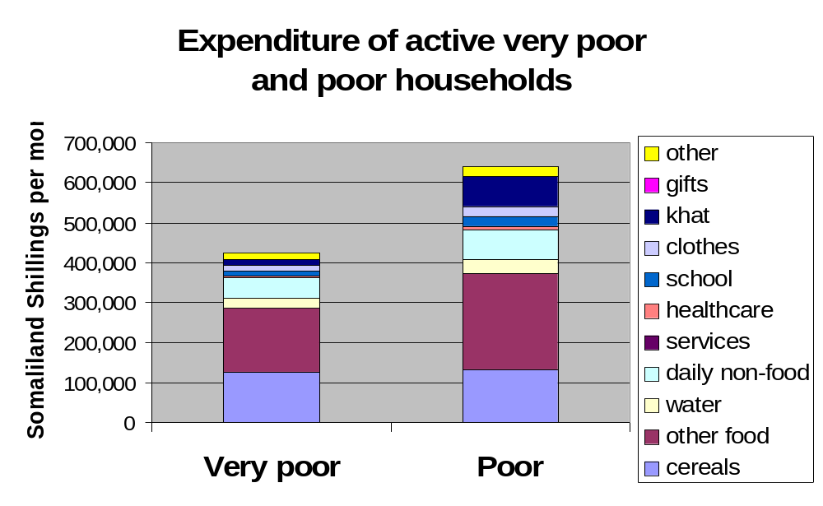
Operations
Important Differences for Food Security & Poverty

Slide 16














Operations
Partners: The Double-Edged Sword
Vulnerability Assessment Committee (VAC)

Slide 17

WWW.FEWS.NET
AFRICA: Senegal, Mauritania, Mali, Burkina, Niger, Chad, So. Sudan, Eritrea, Ethiopia, Djibouti, Somalia, Kenya, Uganda, Rwanda, Tanzania, Zambia, Mozambique, Zimbabwe, Botswana, South Africa, Lesotho, Swaziland
CENTRAL AMERICA: Guatemala, Honduras, El Salvador, Nicaragua
CARIBBEAN: Haiti
CENTRAL ASIA: Afghanistan

