Slide 1
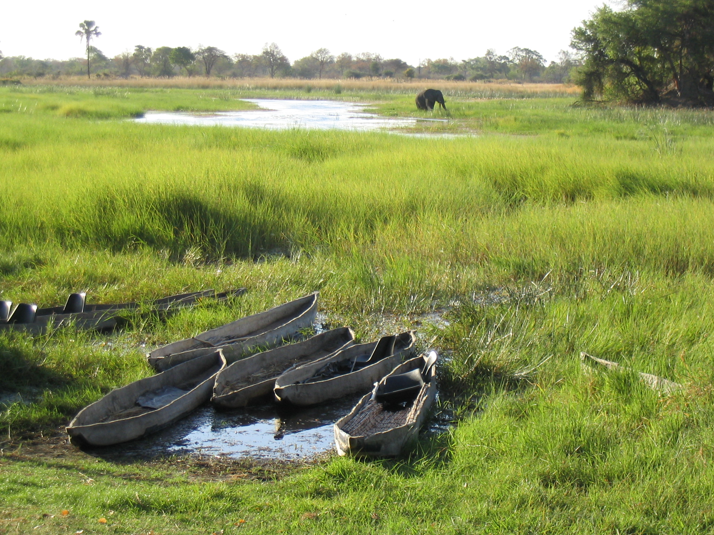
Environment, Conflict, and Cooperation:
From Threat to Opportunity
Geoff Dabelko
Environmental Change and Security Project
Woodrow Wilson International Center for Scholars
Notes:
Get a better image from http://earthobservatory.nasa.gov/NaturalHazards/

Slide 2

Woodrow Wilson International
Center for Scholars
Environmental Change and Security Project
Nonpartisan, non-advocacy
Facilitating dialogue between research and policy communities
Lee H. Hamilton: Wilson Center President

Slide 3
Presentation Outline
Environment and Conflict: A Range of Links
Scarcity and Conflict
Abundance and Conflict
Environmental Pathways to Peace
Key Challenges and Questions

Slide 4
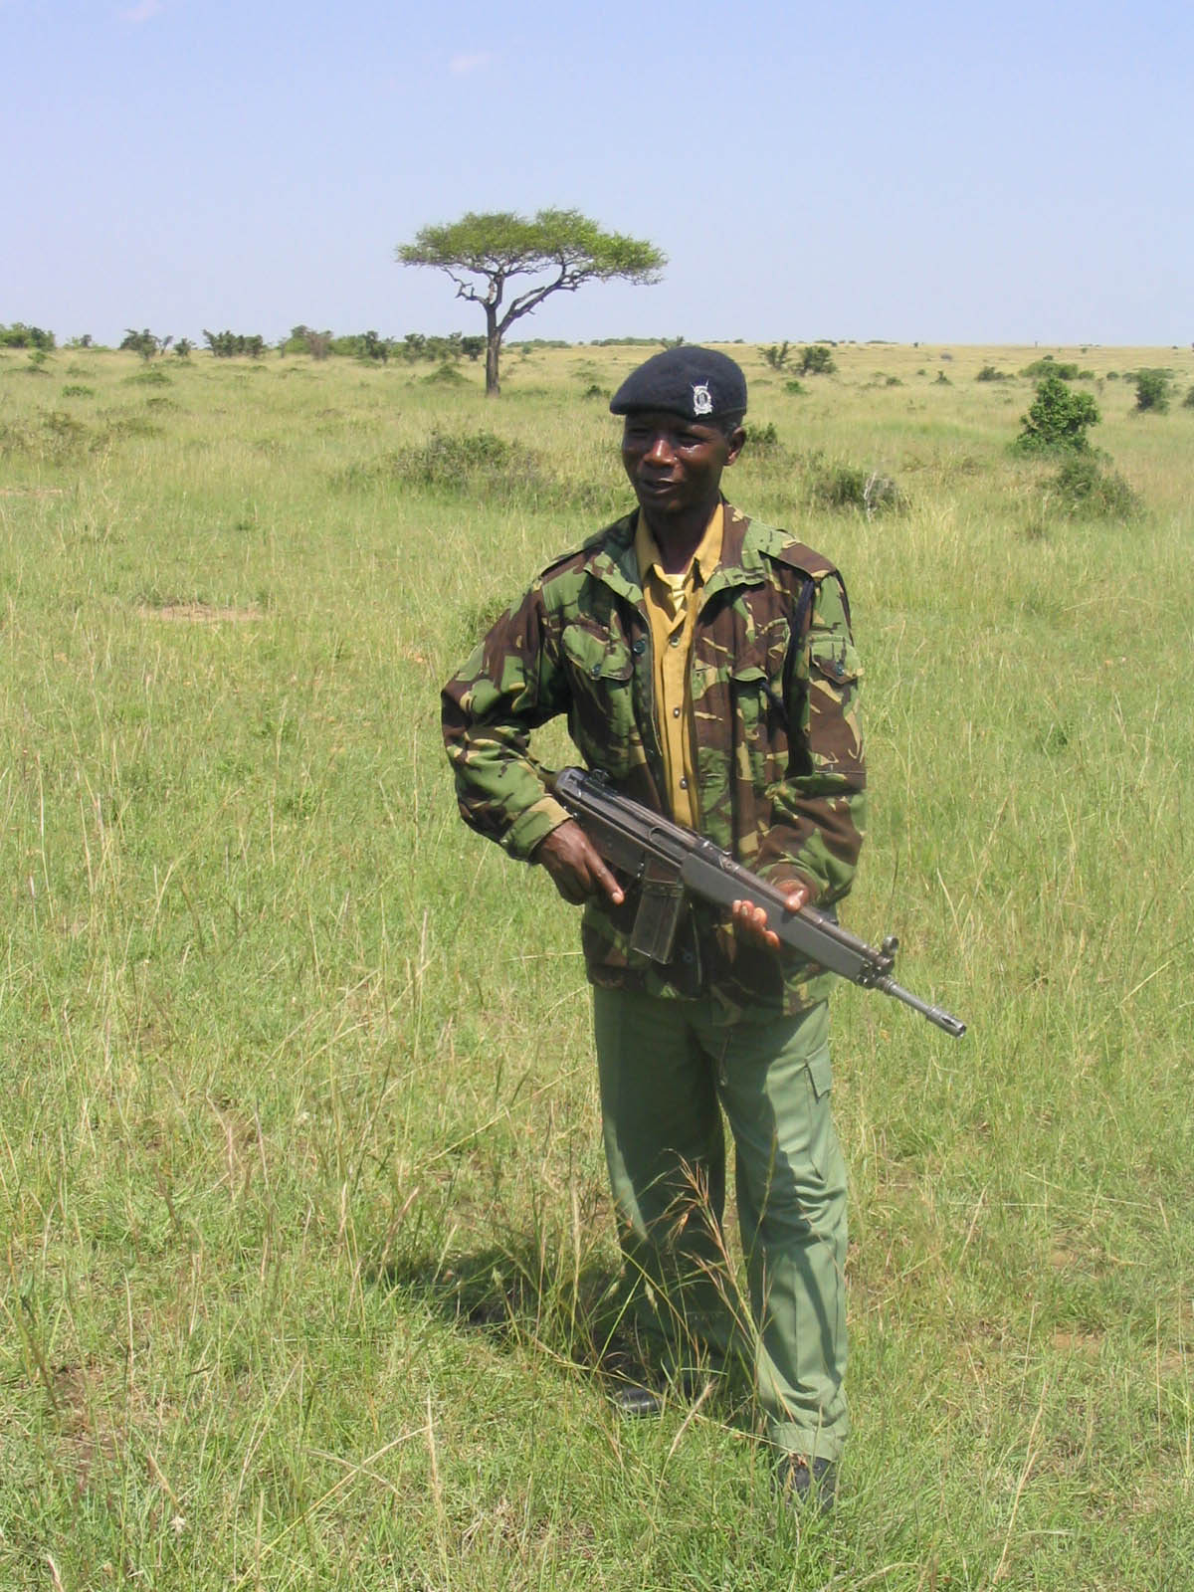
Environment and Conflict: A Range of Links
Environmental damage from warfare
Environment as tool of war
Forests as base for combatants
Combat zone as conservation zone

Slide 5
Natural Resources and Conflict:
The Scarcity Thesis
Environmental degradation/depletion and violent conflict
  Almost exclusive focus on developing countries
  Focus on renewable resources and VIOLENT conflict
  Lots of “small c” conflict: not well-integrated into analysis

Slide 6
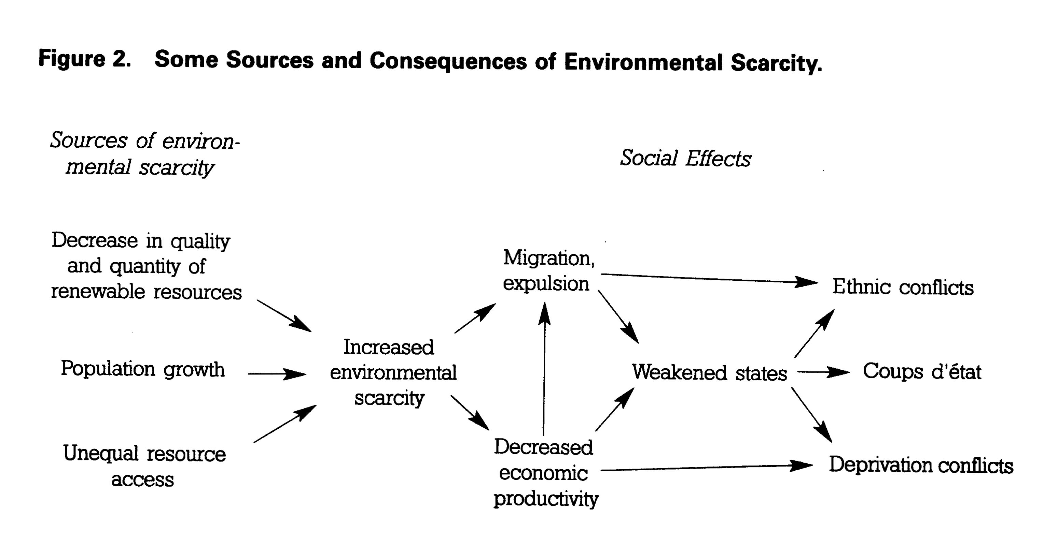
Environmental Scarcity and Conflict from Thomas F. Homer-Dixon (1999)

Slide 7
The Environment and Conflict Thesis: Case Study Conclusions
The environment is neither a necessary nor sufficient cause of violent conflict
“Underlying, subnational, and diffuse” environmental contributions to violent conflict
Indirect role in intrastate, rather than interstate, violent conflict
Fisheries, arable land, water, and deforestation are the most salient renewable resources

Slide 8
Environment and Conflict Conclusions (cont.)
Environmental scarcity contributes to:
  Migration (marginal lands, urban areas)
  Undercutting economic activity
  Resource capture by elites
  Weakening of states
If adaptation is not sufficient, these social effects in turn can exacerbate existing ethnic and/or income divisions, which are more proximate causes of conflict

Slide 9
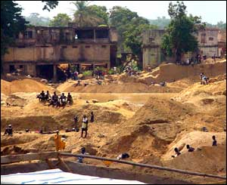
Abundance Rather Than Scarcity
Forests, diamonds, gold, coltan
Fungible, portable, and lucrative
Worth fighting over
  DRC
  Liberia
Funding the fighting
  Cambodia
  Liberia

Slide 10

Shortcomings of Environment and Conflict Work
Scarcity vs. abundance: a false dichotomy
Looking to levels beyond the state: small “c” livelihood conflict
Putting poverty and development back in: the Southern perspective
Intervening variables as key for barking dogs: governance
Not just local affairs: consumption and international footprints
Data limitations for large N
Cooperation, not just conflict
Environment, Development, and Sustainable Peace Workshop, Costa Rica, 2002

Slide 11
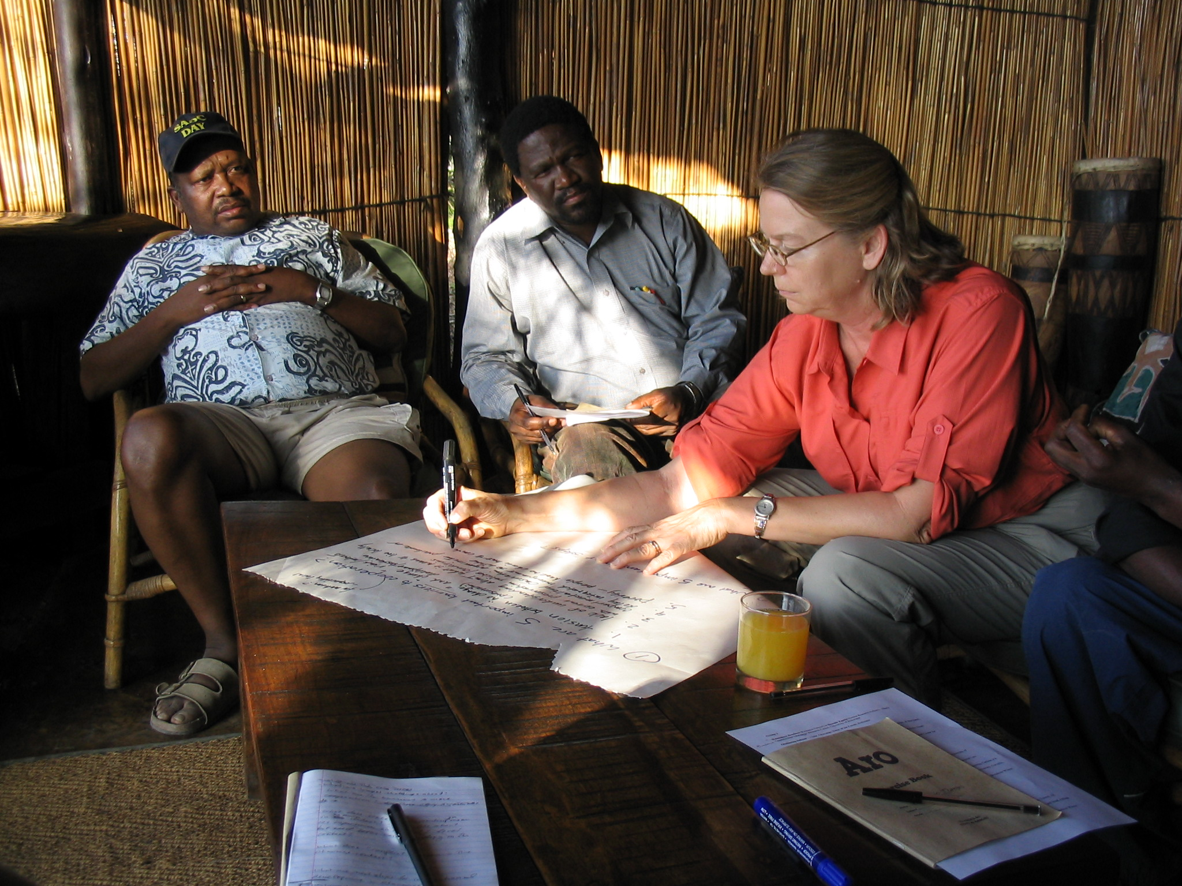
Turning the Environment and Conflict Thesis on its Head
Propose proactively exploiting environmental problems strategically as part of broader peacemaking efforts
Environment, Conflict, and Cooperation Workshop
Okavango Delta, 2003

Slide 12
Environmental Pathways to Peace
Utilize the logic of environmental interdependence and the need for ongoing interactions to talk across lines of tension
  State-to-state
  Civil society-to-civil society
Use cooperative efforts and dialogue to manage natural resources as a way to transform insecurities and create more peaceful relations between parties in dispute

Slide 13
Exploring Environmental Pathways to Peace
Along a Conflict Continuum
CONFLICT
PREVENTION
CONFLICT
POST-
CONFLICT

Slide 14
CONFLICT
POST-
CONFLICT
CONFLICT
PREVENTION

Slide 15
Environmental Cooperation and Natural Resources Management as Conflict Prevention

Slide 16
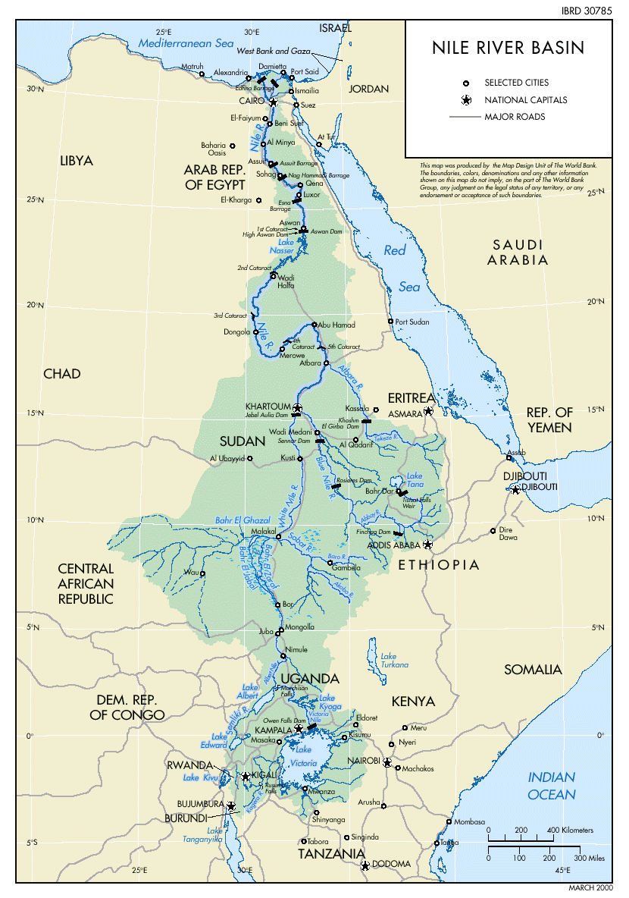

Slide 17
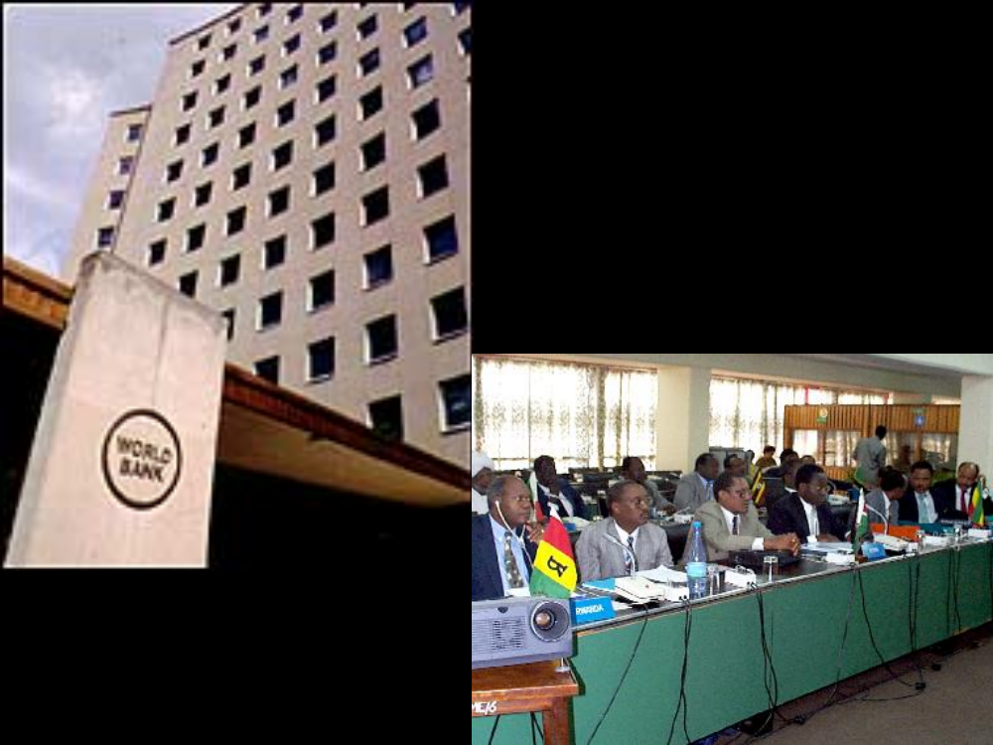
Nile Basin Initiative

Slide 18
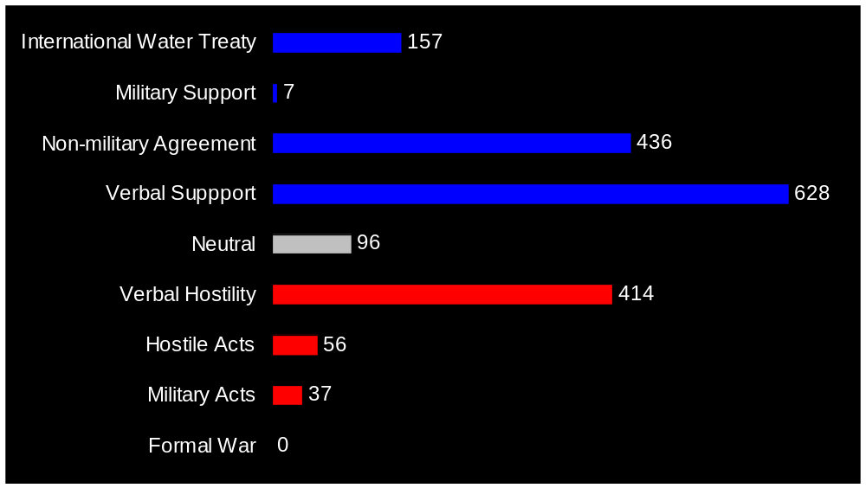
1,700 State-to-State Water Interactions in Transboundary Basins, 1946-1999
Source: Adapted from Wolf et al. 2003 in Water Policy

Slide 19
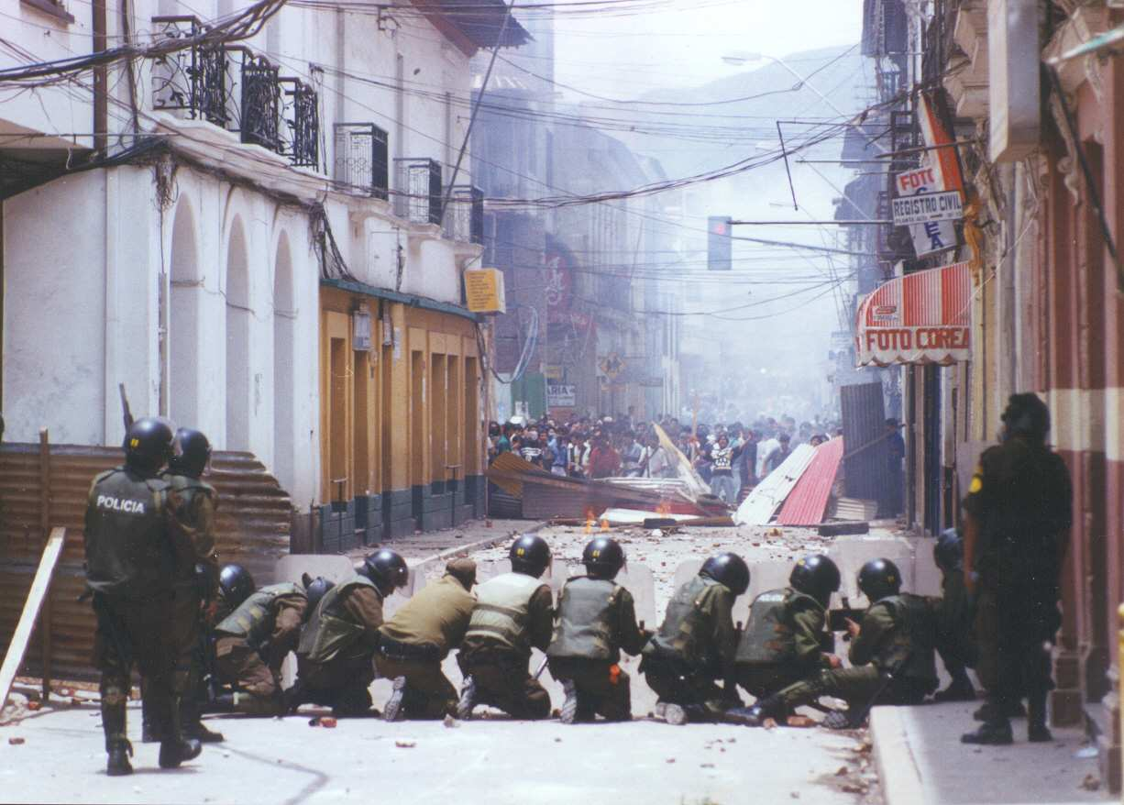
Notes:
www.xs4all.nl/~ac/nieuws/ watering.htm

Slide 20
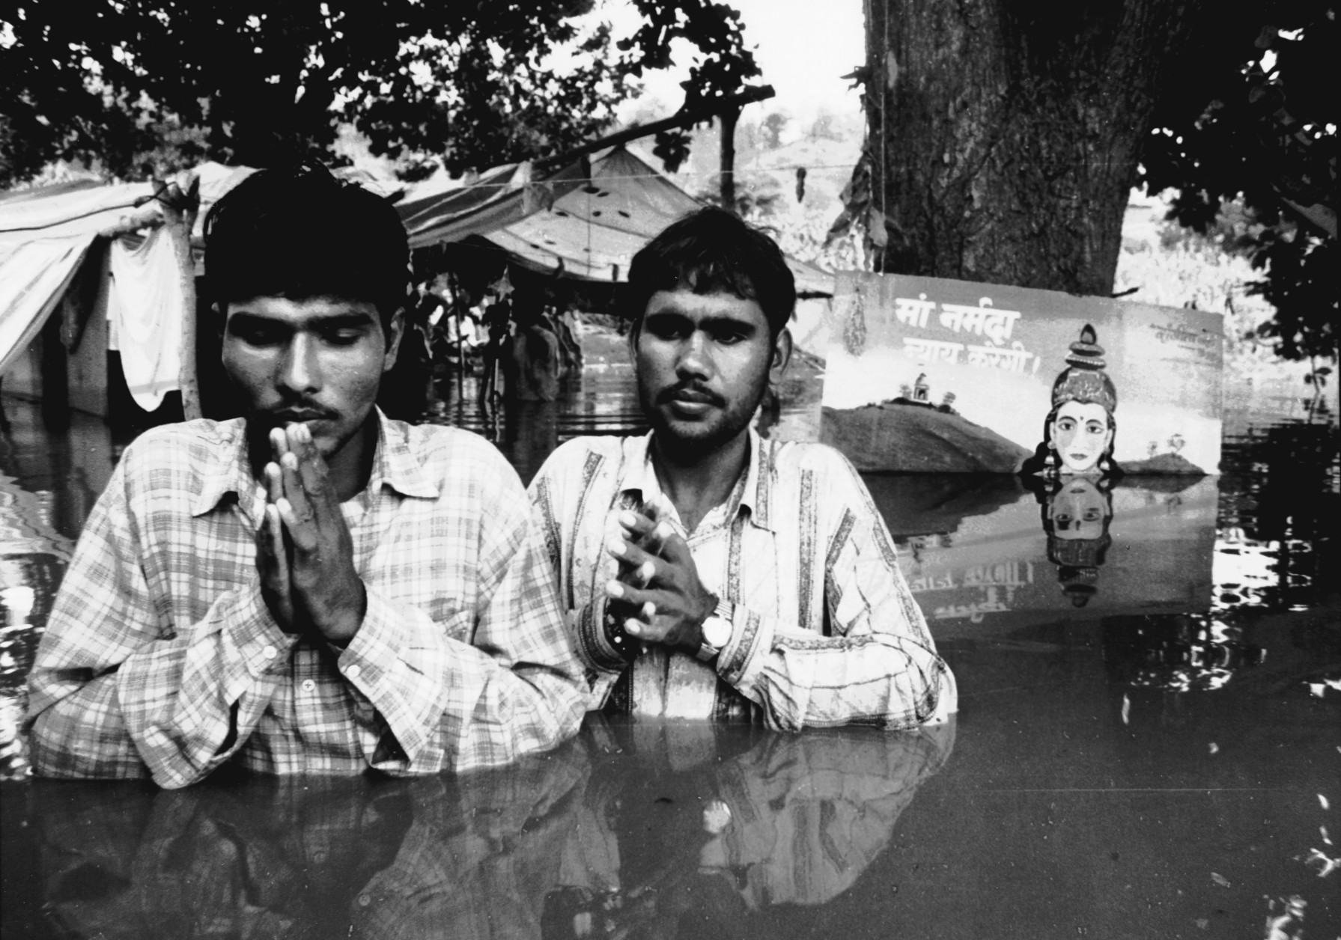

Slide 21
Environment as Lifeline in Times of Conflict

Slide 22
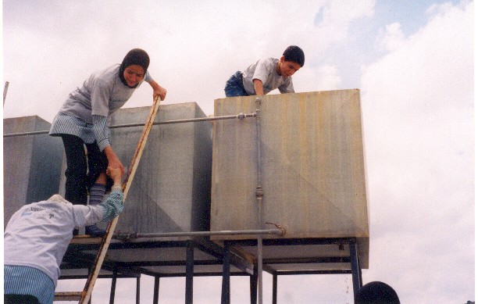
Environmental Dialogue as Lifeline in Times of Conflict and Tension
“Picnic Table” talks
Good Water Makes Good Neighbors
U.S-Norway-Russia in Russian Northwest (AMEC)
Indus Water Treaty

Slide 23
Environment as Essential Ingredient to Achieving Peace

Slide 24
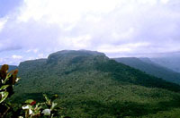
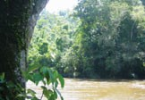
Peru – Ecuador
border
Cordillera del Condor Transboundary Protected Area

Slide 25
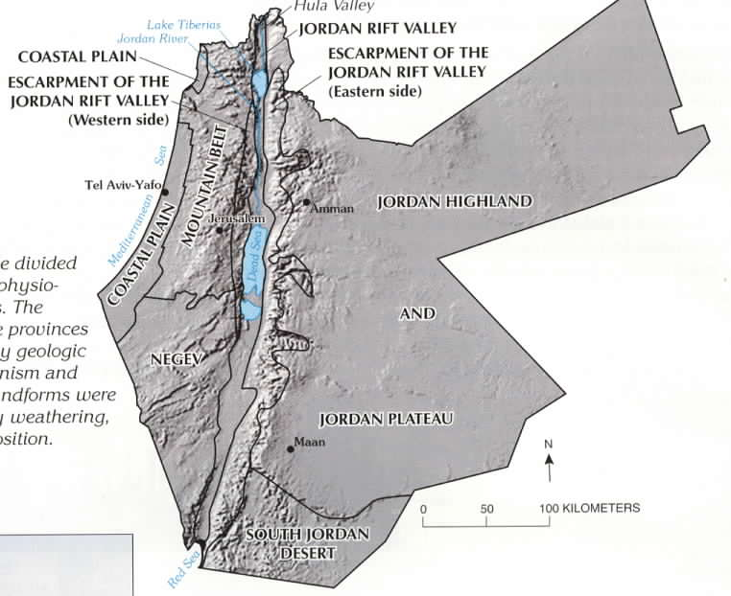
Water didn’t get you into this mess, but…
Palestine-Israel
India-Pakistan

Slide 26
Environment as Post-Conflict Confidence Builder

Slide 27
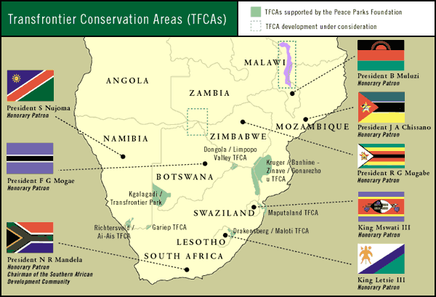
Peace Parks or TFCAs

Slide 28
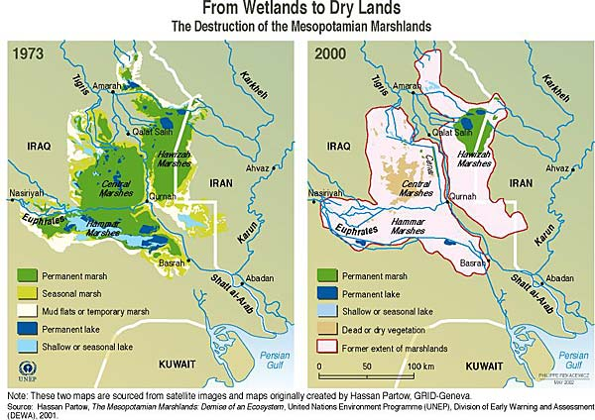
UNEP Post-Conflict Assessment Unit

Slide 29
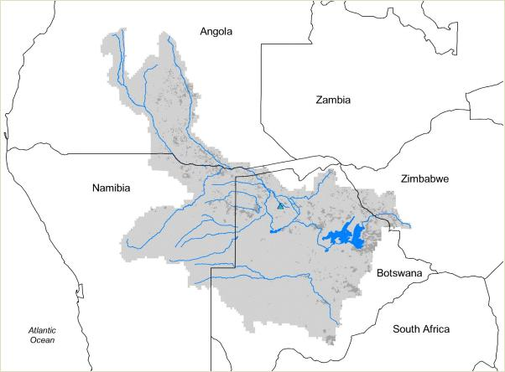

Slide 30
Key Challenges and Questions
Transparency and participation: finding the right mix and the right time – what is the best mix of state and civil society?
Doing environmental peacemaking without calling it environmental peacemaking or environmental security
Variable chances of success along conflict continuum: are some times better than others for NRM’s peacemaking qualities?
Variable peacemaking potential among resources: is water better than land or forests better than minerals?

Slide 31
Key Challenges and Questions
Overcoming barriers to cooperation – playing well together across institutional and topical lines
  UN, regional orgs, US, USAID, NGOs, academics
  NRM, development, conflict, governance
Shortage of diverse skill sets
Improving donor coordination and duration of commitment
Staying behind the scenes: U.S. can’t always be out front
How to demonstrate/measure success if success is something that didn’t happen (null case)

